Slide 1

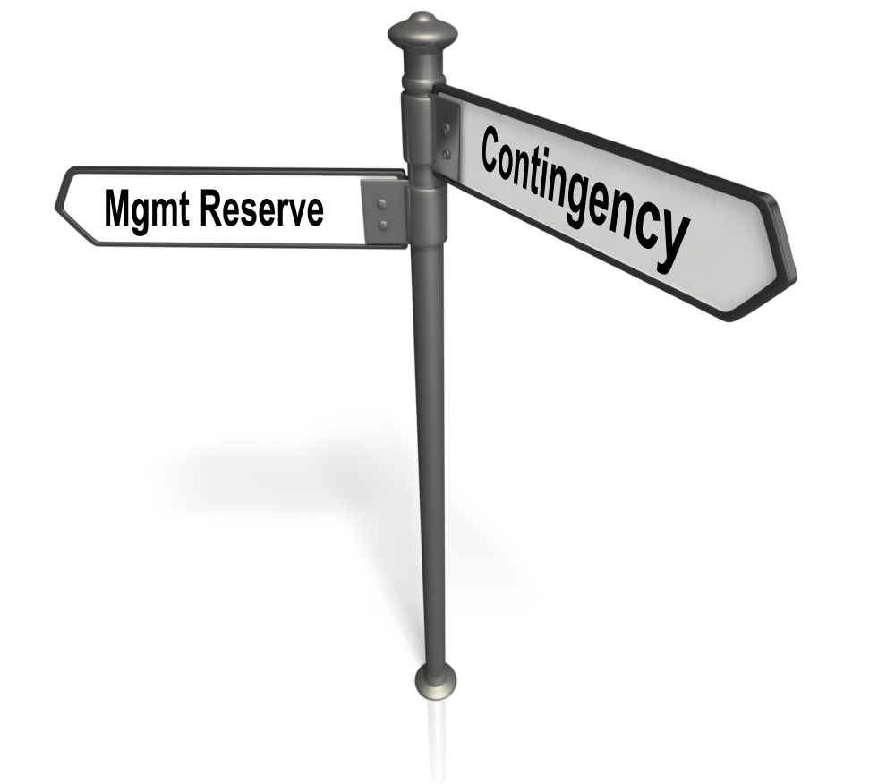
Snippet 6-3B:
Management Reserve vs. Contingency Scenarios
U.S. Department of Energy
Office of Project Management (PM)
Notes:
This EVMS Training Snippet, sponsored by the Department of Energy’s Office of Project Management is the second of two Snippets regarding Management Reserve or MR versus Contingency. The purpose is to provide a common understanding within DOE and among DOE contractors, and to provide consistency.
Snippet 6-3A is a discussion of Management Reserve and Contingency concepts, purposes, and uses. Snippet 6-3B is a discussion of different Management Reserve and Contingency detailed scenarios.

Slide 2
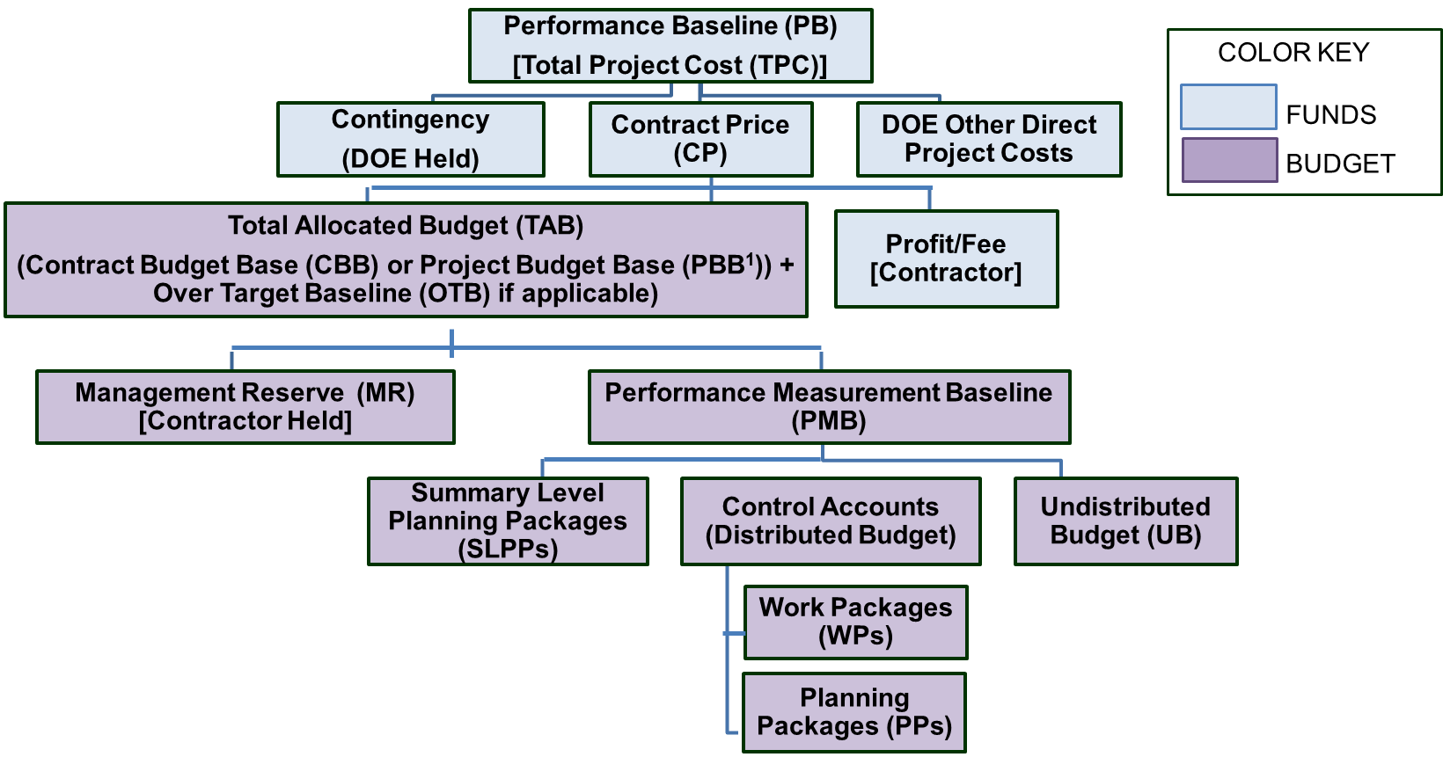
Introduction to Time Phased Scenarios
¹ Refer to Snippet 1-11 Varying Project and Contract Structures or the DOE EVMS Gold Card for information relative to the relation of the Contract Budget Base (CBB) and Project Budget Base (PBB)
Notes:
This snippet provides detailed scenarios of how normal project changes impact the performance measurement baseline, management reserve, projected variances at completion, and DOE contingency. A project hierarchy is shown to refresh viewers of a project hierarchy. Note to refer to Snippet 1-11 Varying Project and Contract Structures or the DOE EVMS Gold Card for information relative to the relation of the Contract Budget Base (CBB) and Project Budget Base (PBB).

Slide 3
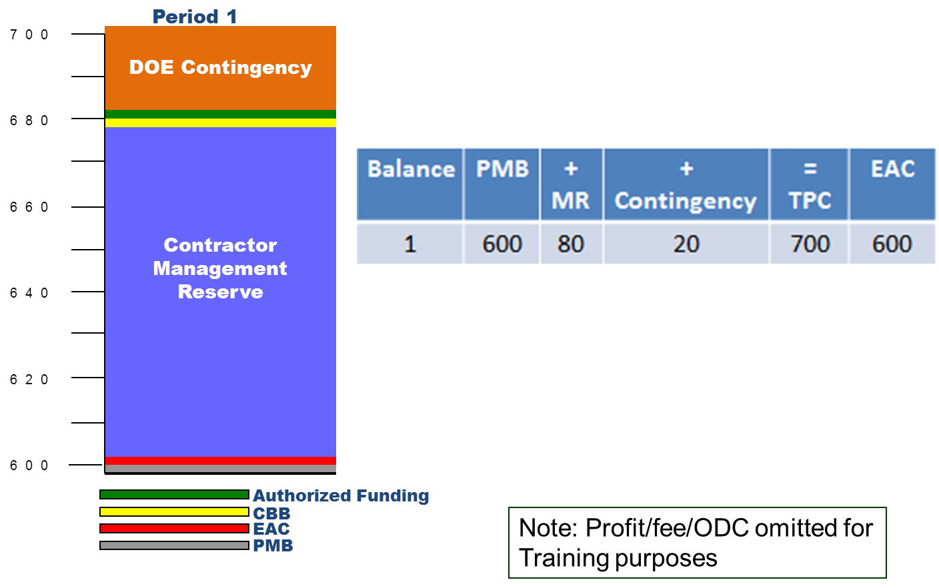
  Scenario Period 1 Bar Chart
Page 3
or PBB
Notes:
We are going to walk through several scenarios to demonstrate how changes in the project impact different elements. To simplify our examples, we are not including profit, fee, or Other Direct Costs (ODC). For all of the scenarios, the information will be presented in a table, a bar chart, and in an “S” Curve.
For the first scenario, we have an example of an active project. Note the legend at the bottom of the bar chart. The grey line represents the amount of the PMB, $600M. The Red line represents the Estimate at Completion, which is currently $600M. The Blue area represents the amount of Management Reserve the contractor has available for those scope changes that are within the contractual project statement of work but not yet allocated to any control account. The scale to the left of the bar shows that the MR is $80M. The yellow line represents the CBB or PBB. Since it is the sum of the MR and the PMB, it is $680M on the scale. The green line represents the Authorized Funding (less profit/fee/ and ODC). At this point, the authorized funding from the DOE to the contractor is $680M. The DOE customer’s Contingency is not part of the CBB or PBB, therefore it is above that point and is shown in orange. You can see by the scale the Contingency is $20M.
The sum of the PMB plus the MR plus the contingency equals the Total Project Cost or TPC; therefore, the TPC is $700M. The current Estimate at Completion is $600M, which indicates that no total project variance at completion is expected for the scope of work represented by the PMB.

Slide 4
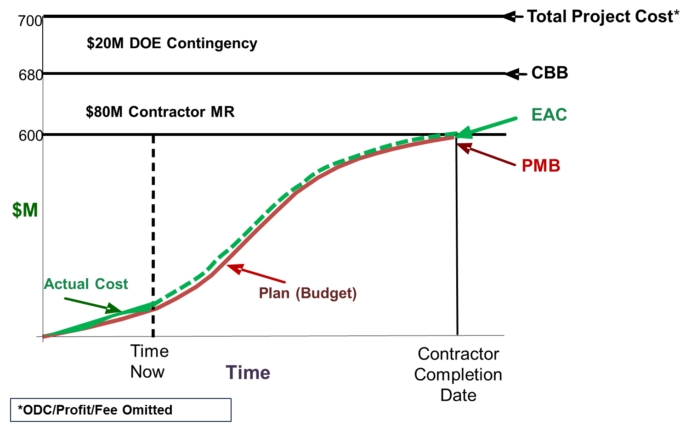
  Period 1 “S” Curve
or PBB
Notes:
This is an S curve which shows the same information as previously shown in the table and the bar chart associated with this scenario. We are showing each scenario in all three forms to reinforce the teaching points presented in each scenario. As the scenarios progress, you will see changes to each of these three visual representations - the table showing the current period changes, the bar chart, and the S curve.

Slide 5
  Period 2
Page 5
Contractor applied MR due to the realization that waste treatment testing would need to be done
This effort is required to meet the project statement of work, but was not planned within an existing control account
Balance | PMB | + MR | + Contingency | = TPC | EAC
Prior Period | 600 | 80 | 20 | 700 | 600
Period 2 | 20 | (20) |  |  | 20
Balance | 620 | 60 | 20 | 700 | 620
Notes:
In Period 2, the contractor transferred management reserve to the performance measurement baseline because of the realization that waste treatment testing would need to be done. This effort was required to meet the project statement of work, but was not planned within an existing control account. Therefore, 20 million dollars of MR was authorized to a control account for this scope.
Because of the internal application of budget for the waste treatment testing, the performance measurement baseline as well as the Estimate at Completion increased by 20 million dollars. No contingency was used because the scope was not new to the project requirements, and there was no additional funding impact for the customer.

Slide 6
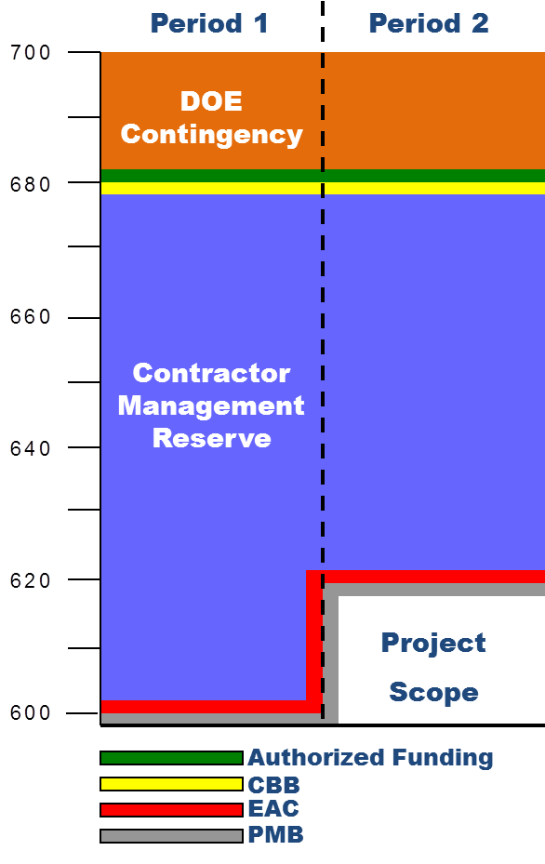
Period 2 Bar Chart
or PBB
Notes:
Because 20 million dollars’ worth of Management reserve was transferred to the performance measurement baseline to conduct the waste treatment testing scope that was not previously included in any control account, the PMB (grey line) and EAC (red line) is now at 620 million dollars while the MR is reduced from 80 million dollars to 60 million dollars. Note that the CBB or PBB remains at 680 million dollars since the sum of the PMB, now 620 million dollars, plus the MR, now 60 million dollars, equals 680 million dollars.
Because this was an internal application of budget from MR, the Contract Budget Base (yellow line), Authorized Funding (green line), and Contingency (orange area) did not change.

Slide 7
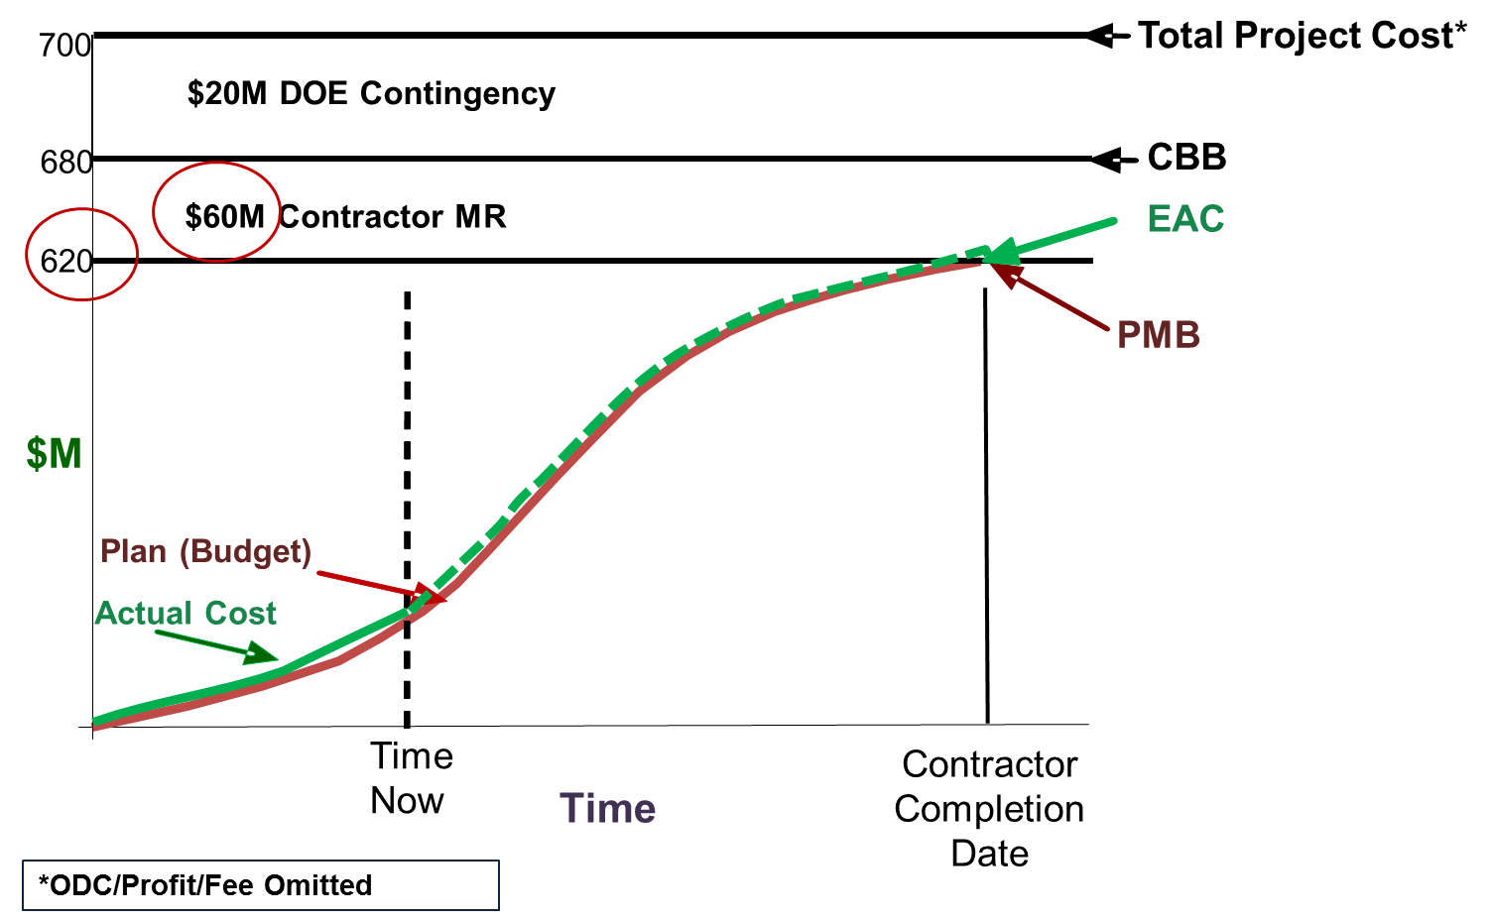
Scenario 2 “S” Curve
or PBB
Notes:
The only changes to the S curves were that the PMB and EAC increased by 20 million dollars and the MR was reduced by 20 million dollars.

Slide 8
Period 3
Page 8
The DOE customer modifies the contract to add two additional holding tanks, a new scope of work estimated at $10M
This out-of-scope change is an increase not only in the contractor PMB and EAC for this effort, but also the CBB or PBB
This change decreases the available government contingency by $10M
Balance | PMB | + MR | + Contingency | = TPC | EAC
Prior Period | 620 | 60 | 20 | 700 | 620
Period 3 | 10 |  | (10) |  | 10
Balance | 630 | 60 | 10 | 700 | 630
Notes:
In Period 3, the DOE customer modified the contract to add two additional holding tanks, a new scope of work estimated at 10 million dollars. This contract modification was an increase not only to the contractor’s performance measurement baseline and contract budget base, but it also increased the estimate at completion for that effort. MR was not affected, but the change decreased the available government Contingency by 10 million dollars and increased the total contract value.
Why wasn’t management reserve used? The reason is because the two additional holding tanks were not part of the original contract scope of work. Thus a contract modification with additional budget was required.

Slide 9
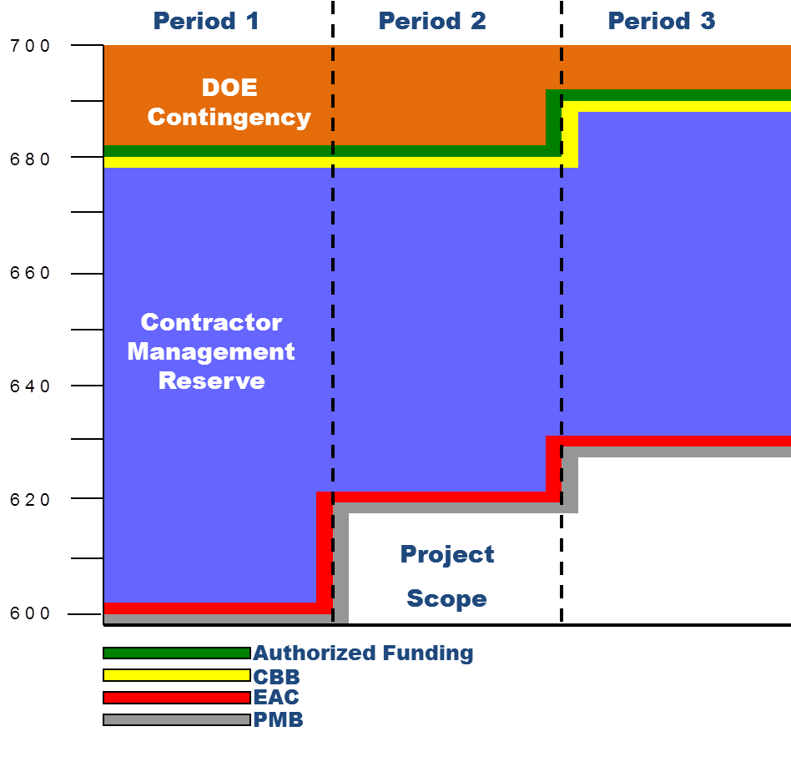
Period 3 Bar Chart
Page 9
or PBB
Notes:
On the bar chart, you can see how the application of contingency impacted the budget and funding profile.
The performance measurement baseline (grey line), estimate at completion (red line), contract budget base (yellow line), and the authorized funding (green line) all increased by 10 million dollars. The contingency (orange area) was reduced by 10 million dollars.

Slide 10
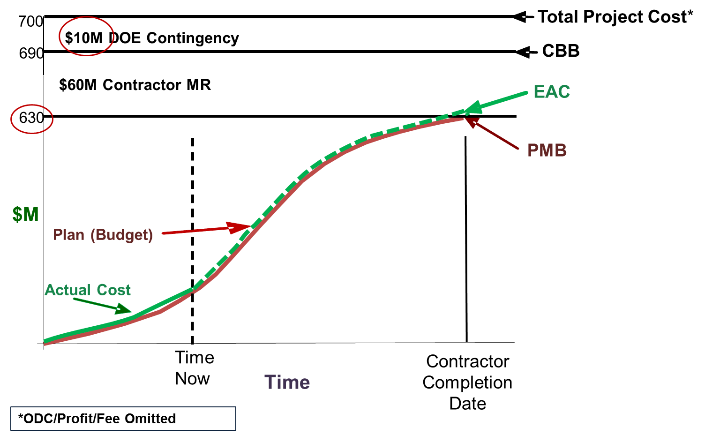
Period 3 “S” Curve
or PBB
Notes:
Since new scope was added by contract modification, the CBB or PBB increased to 690 million dollars and both the performance measurement baseline and estimate at completion increased to 630 million dollars. The MR did not change but the DOE Contingency was reduced to 10 million dollars.

Slide 11
Period 4
A project wide comprehensive EAC exercise has resulted in a $40M forecasted overrun to the current PMB
Balance | PMB | + MR | + Contingency | = TPC | EAC
Prior Period | 630 | 60 | 10 | 700 | 630
Period 4 |  |  |  |  | 40
Balance | 630 | 60 | 10 | 700 | 670
Notes:
In period 4, the contractor conducted its annual project Comprehensive Estimate at Completion. Once all the new estimates were reviewed and summarized, they realized they were forecasting an overrun of 40 million dollars against the performance measurement baseline.
Note that the PMB did not change with the incorporation of the EAC. The EAC simply was the best estimate at the time of what the responsible managers thought would be the ultimate cost of the work when it is completed. Because the contractor had 60 million dollars of management reserve, the government did not have to increase funding as the contract budget base was not impacted. However, the government is on alert now that further overruns or use of MR could impact funding.

Slide 12
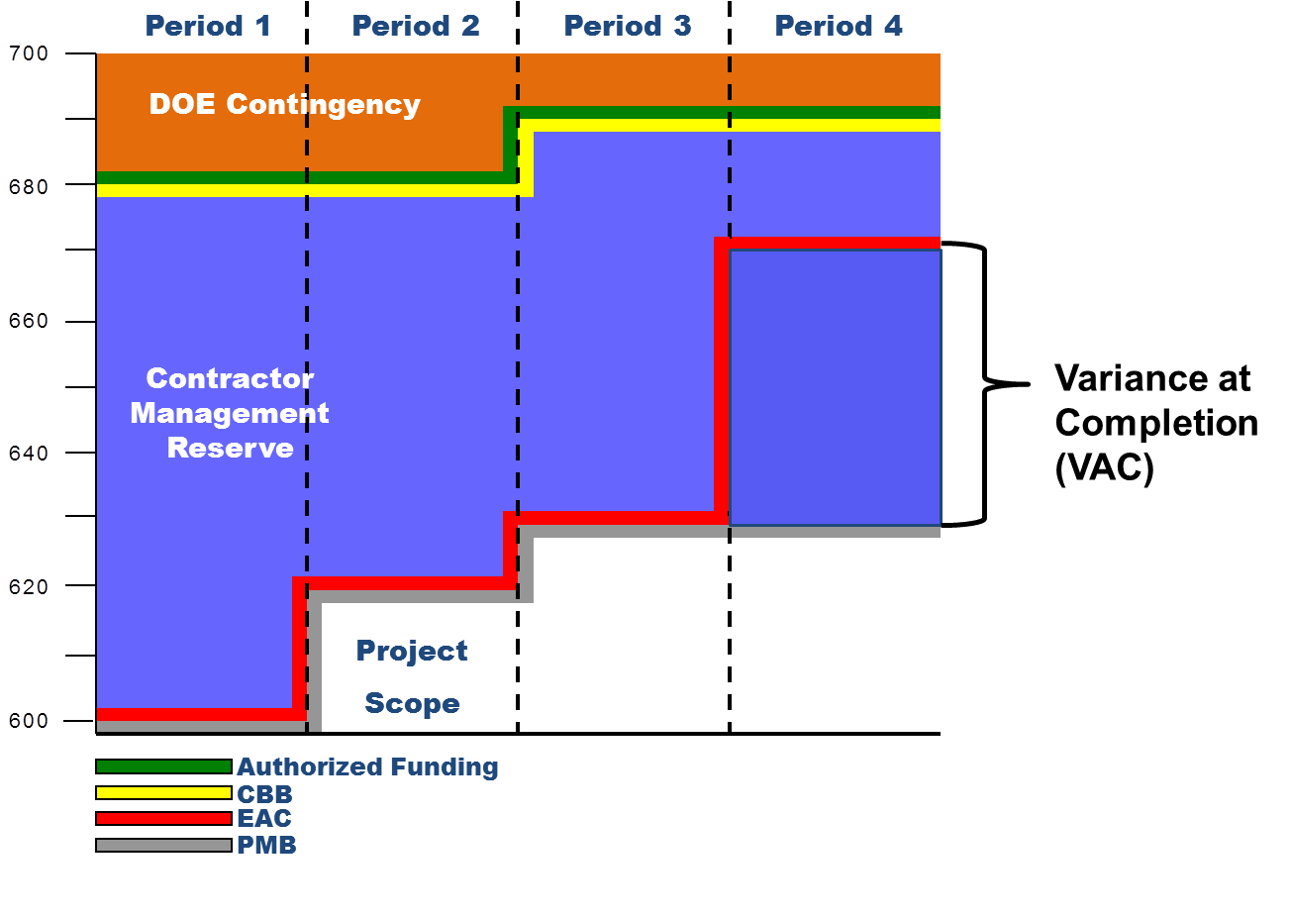
Period 4 Bar Chart
or PBB
Notes:
The bar chart shows how the estimate at completion (red line) increased by 40 because of the project comprehensive EAC. The difference between the PMB and the EAC is called the Variance at Completion. In this scenario, the contractor still has 60 million dollars of MR; so at this point, there is no need for the government to increase the authorized funding (green line) because the projected EAC is within the boundaries of the CBB or PBB.
Said another way, if the contractor completed the project at this point with an actual overrun of 40 million dollars and did not use any of the existing MR, the authorized funding would be sufficient.
However, the concern is that the project is not complete, and the government needs to track this very closely as any significant use of the 60 million dollars of MR could cause an immediate need to increase the authorized funding on this project.

Slide 13
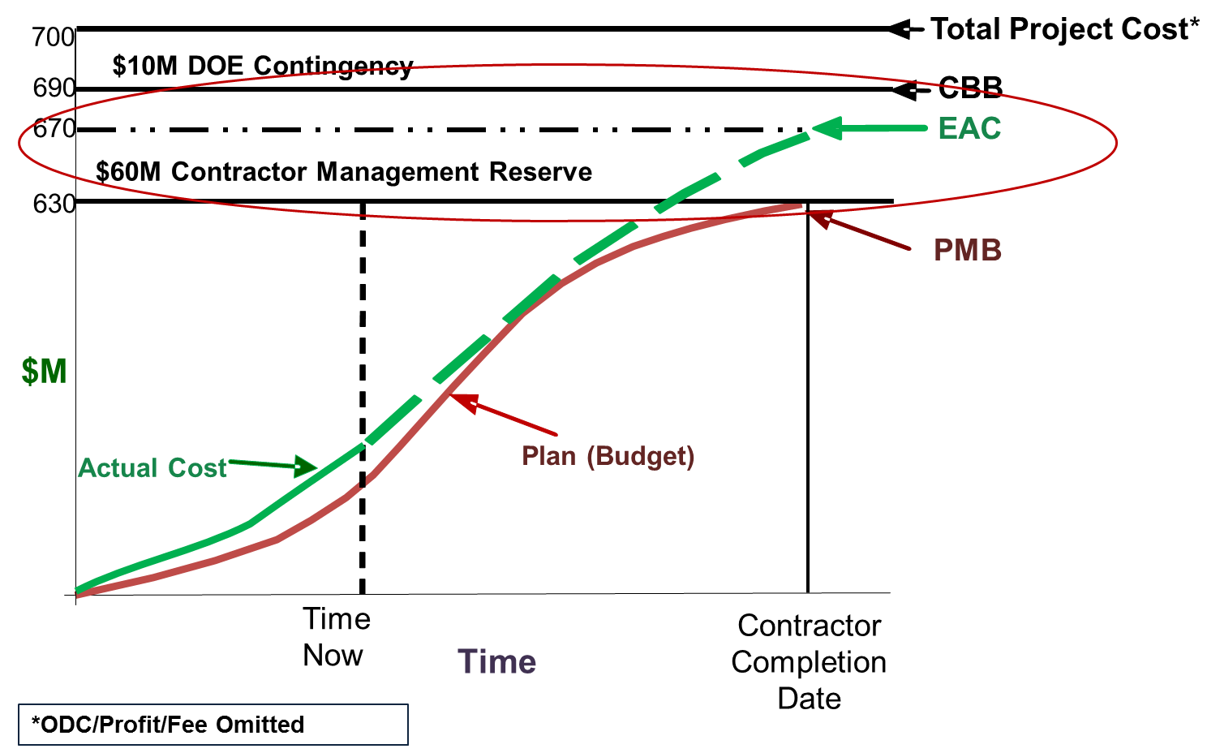
Period 4 “S” Curve
or PBB
Notes:
The S curve shows the 40 million dollars increase in the EAC. Again, the MR available for the contractor to use is still 60 million dollars, but if MR greater than 20 million dollars is used and the estimate at completion is accurate, the contractor will overrun the current funding level.

Slide 14
Period 5
Page 14
Two tanks scrapped due to welding issues
Overrun associated with two new tanks is $20M
Balance | PMB | + MR | + Contingency | = TPC | EAC
Prior Period | 630 | 60 | 10 | 700 | 670
Period 5 |  |  |  |  | 20
Balance | 630 | 60 | 10 | 700 | 690
Notes:
In Period 5, the weld process for the stainless steel containers proved more difficult than originally planned. Two tanks had to be scrapped and rebuilt. This caused an estimated 20 million dollars increase in the Estimate at Completion.
The overrun eliminated any possibility that there might be enough unused MR budget to offset any additional overruns. The DOE still holds 10 million dollars of Contingency.

Slide 15
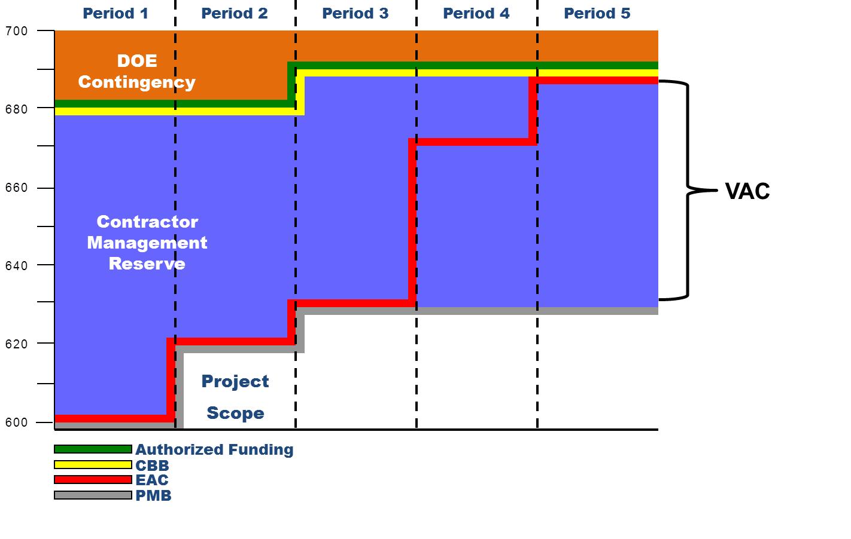
Period 5 Bar Chart
or PBB
Notes:
The bar chart shows how the increase in the estimate at completion for the scope of work in the performance measurement baseline is now equal to the contract budget base. Note that the 60 million dollars of management reserve is still available for the contractor’s use for future work. Should the contractor transfer any MR to the PMB, it will cause the projected EAC to increase, thus requiring additional funding.

Slide 16
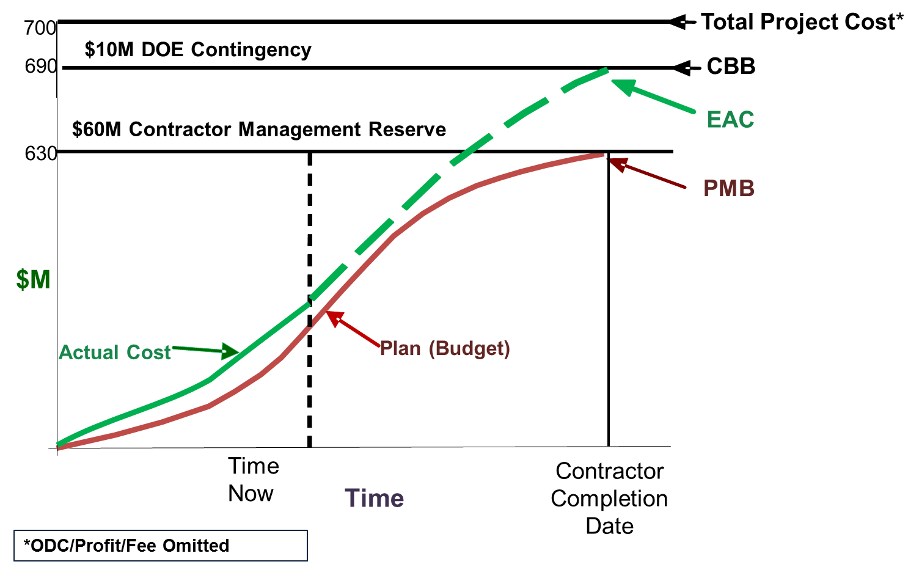
Page 16
Period 5 “S” Curve
or PBB
Notes:
The EAC curve increased to the CBB or PBB line and the contractor still has 60 million dollars of MR; however, any use of it could set off an immediate need for additional funding. The DOE Federal Project Director (FPD) needs to watch this very carefully. The 10 million dollars of contingency must be set aside or obligated to fund the projected overrun.

Slide 17
Period 6, Scenario 1
The impact from the welding issues is $10M more than originally projected as the contractor struggles continue
Since the EAC exceeds the CBB or PBB, additional funding is needed to pay for the costs of the overrun
*The $10M of contingency must be obligated to fund the projected overrun
Balance | PMB | + MR | + Contingency | = TPC | EAC
Prior Period | 630 | 60 | 10 | 700 | 690
Period 6.1 |  |  |  |  | 10
Balance | 630 | 60 | 10* | 700 | 700
Notes:
Period 6 will be approached with two different scenarios. The first scenario shows that the impact from the welding issues was 10 million dollars more than originally projected as the contractor’s struggles continue. This does not change the contract budget base since it is only an EAC and funding increase, but it does require the customer to change the funding authorization to accommodate the increase in the estimate at completion. The Contingency is gone as is any flexibility for the DOE customer to make additional project adjustments.

Slide 18
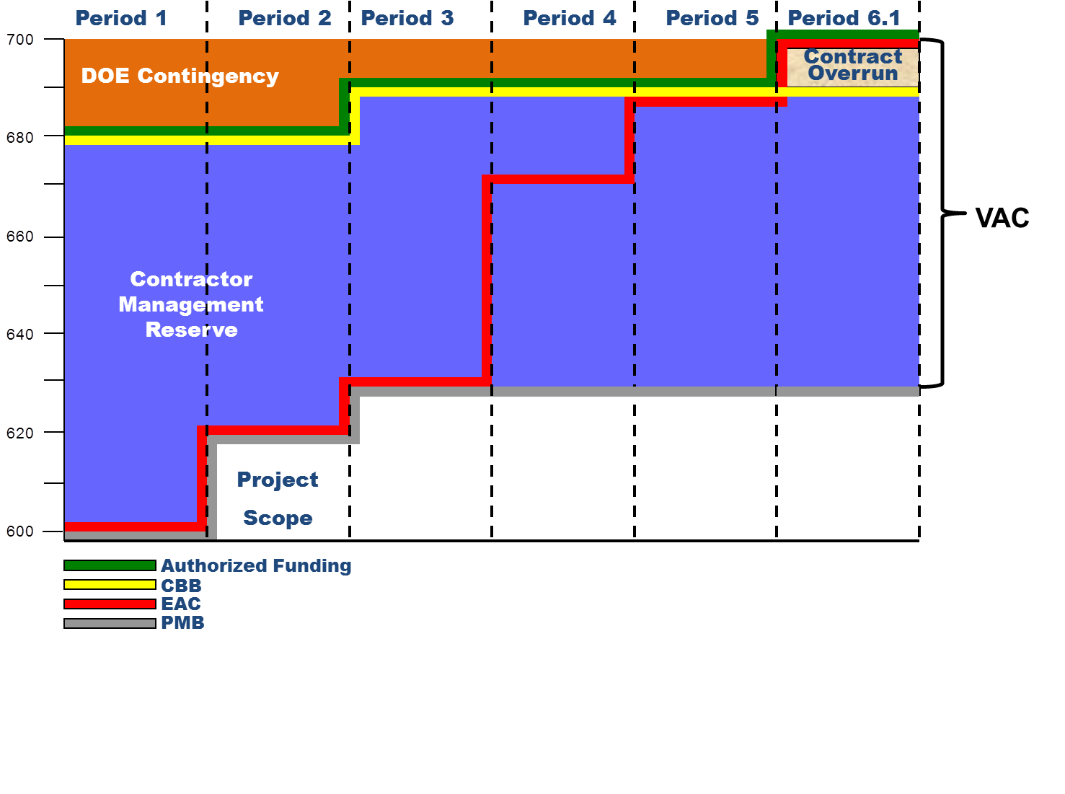
Period 6, Scenario 1 Bar Chart
or PBB
Notes:
The bar chart shows that because of the increase in the estimate at completion, the government had to apply contingency, this time as funding for current scope as opposed to using the contingency for future scope changes. The Contingency is now gone as is any flexibility for the DOE customer to make additional project adjustments. If this project is not close to completion, the DOE Project Manager would need to pursue additional funding in case of further overruns.
Note that only the red EAC line and the green Authorized Funding lines increased but the yellow contract budget base line did not. Why is that? The answer is that the amount of budget provided to the contractor has not changed. This scenario helps to visualize how the DOE Contingency is not only used for funding additional scope, but in this example, it is being used to fund the overrun.

Slide 19
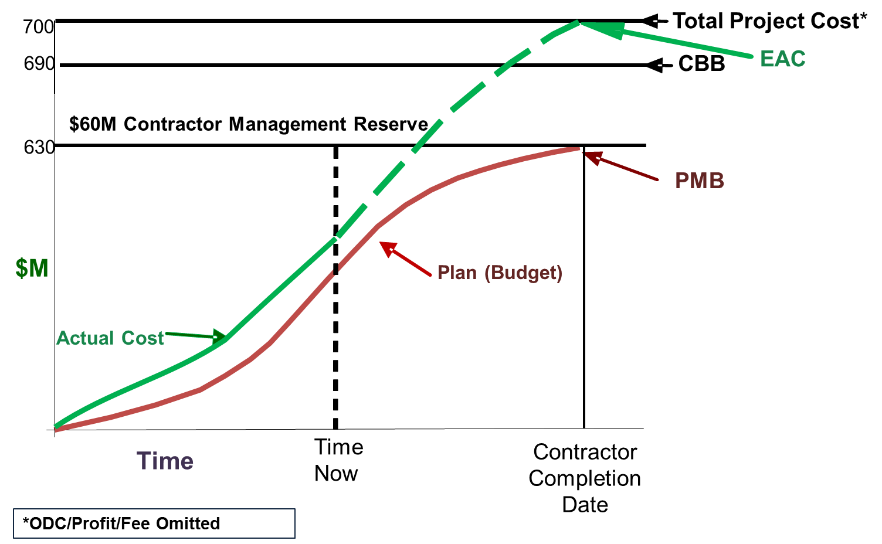
  Period 6, Scenario 1 “S” Curve
or PBB
Notes:
Once the EAC reached the Total Project Cost line, no Contingency remained. Contingency could only be applied via contract modification for increased scope if the EAC projection improved.

Slide 20
Period 6, Scenario 2
The contractor applied $10M MR to the PMB due to the realization that additional unanticipated ground water testing would need to be done as part of their risk mitigation program
*The $10M of contingency must be obligated to fund the projected overrun caused by the application of MR to the PMB which caused an increase to the EAC
Balance | PMB | + MR | + Contingency | = TPC | EAC
Prior Period | 630 | 60 | 10 | 700 | 690
Period 6.2 | 10 | (10) |  |  | 10
Balance | 640 | 50 | 10* | 700 | 700
Notes:
Let’s look at Period 6 with a different twist applied. The contractor applied 10 million dollars of MR to the PMB due to the realization that additional unanticipated ground water testing would need to be accomplished. This was identified in its risk mitigation plan.
The additional MR caused the PMB to increase, the EAC to increase, and forced the need for additional funding. DOE must change the funding authorization to match the increase in the EAC. The Contingency is gone as is any flexibility for the DOE to make additional project adjustments.

Slide 21
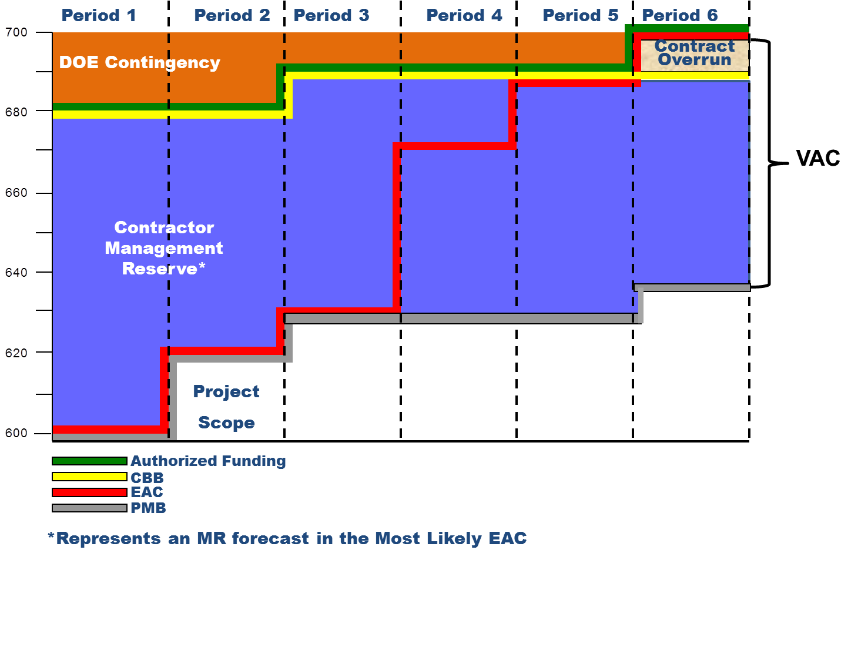
Period 6, Scenario 2 Bar Chart
or PBB
Notes:
The only difference between the first scenario for Period 6 and this 2nd scenario is that the grey Performance Measurement Baseline line increased to show the transfer of budget from MR to the PMB for an internal scope change. The PMB increased to 640 million dollars and MR was reduced to 50 million dollars.
Although MR was available, the 10 million dollars of contingency must be obligated to fund the projected overrun caused by the application of MR to the PMB, which also caused an increase to the EAC.
Again, the 10 million dollars above the CBB or PBB is labeled here as “contract overrun” since it exceeds the CBB or PBB. The Variance at Completion or VAC, estimated at 60 million dollars less the 10 million dollars contract overrun, is considered estimated PMB overrun. What this means to the DOE is that if the contractor were to use any MR in the future, an increase to the authorized funding would be likely. DOE may need to take action to execute a Baseline Change Proposal (referred to as a BCP) to increase the TPC, thereby making additional contingency available based on current projections, and ensuring sufficient funding authorization is in place to complete the project.

Slide 22
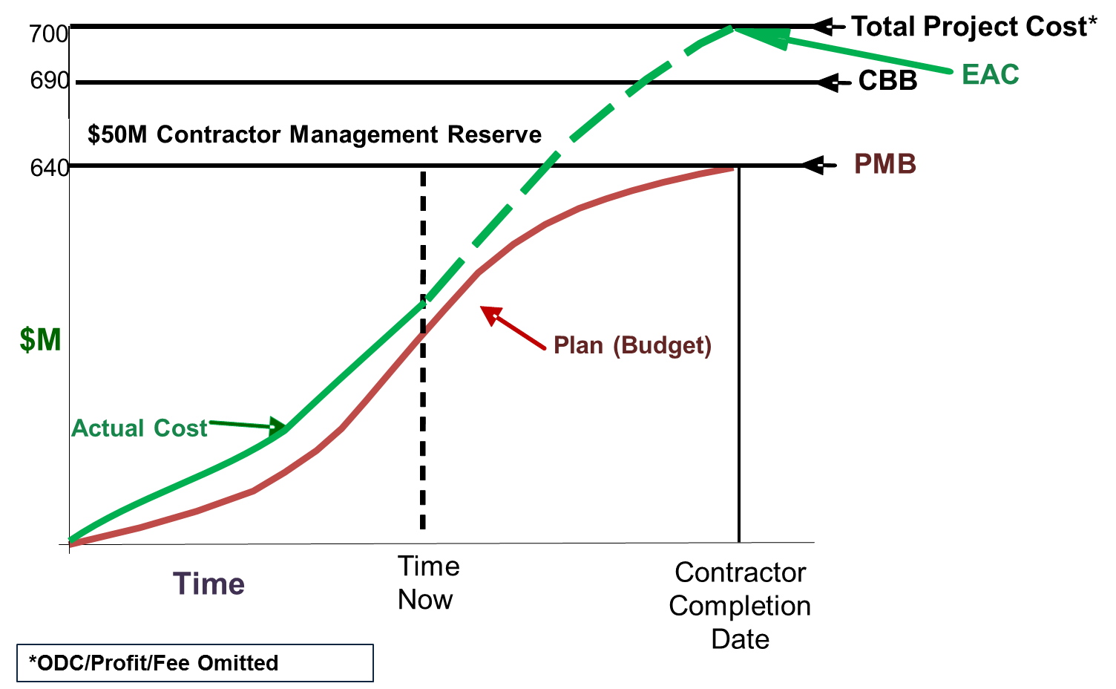
Period 6, Scenario 2 “S” Curve
or PBB
Notes:
In this scenario the EAC reached the Total Project Cost line because of the use of MR which also caused an increase to the EAC. Again there is no Contingency remaining.
The point of these two scenarios for Period 6 is to demonstrate that in either case, the contingency is depleted.

Slide 23
  Period 7 Over Target Baseline
The contractor has requested and received authorization from DOE to report to an Over Target Baseline (OTB)
Before OTB
Total Allocated Budget (TAB)
Contract Budget Base (CBB) or Project Budget Base (PBB)
Performance Measurement Baseline (PMB) | MR
After OTB
Total Allocated Budget (TAB)
Contract Budget Base (CBB) or Project Budget Base (PBB) | Over Target Budget (OTB)
Performance Measurement Baseline (PMB) |  | MR
Notes:
In Period 7, the contractor received authorization to implement and report an Over Target Baseline (OTB). Recall that an OTB is a baseline that exceeds the Contract Budget Base, which becomes a new Performance Measurement Baseline for management purposes. The CBB or PBB is not adjusted as a result of an OTB.
In EVM terminology, before an OTB, the sum of the budgets distributed to control accounts and summary level planning packages, plus undistributed budget (UB) and management reserve (MR) equals the CBB or PBB which also equals the TAB. After the OTB, the TAB exceeds the CBB or PBB. The difference between the new TAB and the CBB or PBB is the amount of the new Performance Measurement Baseline, which resulted from the overrun and revised EAC, as well as the reduced amount of Management Reserve. Establishment of an OTB entails adding budget for the work remaining to be performed and possibly adjusting variances (cost, schedule or both). For more detailed information on an Over Target Baseline, please refer to Snippets 1-5A and 5B.

Slide 24
  Period 7 OTB
Between Period 6 and Period 7, the contractor and DOE agreed to an OTB, thus allowing the contractor to provide a formal replan of its PMB and MR to reflect a realistic baseline to complete the project
DOE also received Project Management Executive approval for additional project funding; TPC (less profit/fees and ODC) is now $760M
Authorized Funding to the contractor is $710M as designated by the green line, and the Contingency is $30M
Balance | PMB | + MR | + Contingency | = TPC | EAC
Prior Period | 640 | 50 | 10 | 700 | 700
Period 7 | 70 | (30) | 20 | 60 | 10
Balance | 710 | 20 | 30 | 760 | 710
Notes:
Let’s take a look at how the OTB looks on our Bar Chart. In our scenario, the contractor was obviously showing signs of trouble as the EAC overran the contract budget base in period 6. Between Period 6 and Period 7, the contractor and DOE agreed to an Over Target Baseline, thus allowing the contractor to provide a formal replan of its PMB and MR to reflect a realistic baseline to complete the project.
The government also received approval from the Chief Executive for Project Management for additional project funding. The TPC (less profit/fees and ODC) is now 760 million dollars. Authorized Funding to the contractor is 730 million dollars, reflected as budget of 710 million dollars in the PMB and 20 million dollars in MR. The DOE Contingency is 30 million dollars. The EAC is currently 710 million dollars.

Slide 25

Period 7 OTB Bar Chart
Period 1
Period 2
Period 3
Period 4
Period 5
Period 6
Period 7
760
740
Total Allocated Budget (TAB) = CBB or PBB + OTB = $730M
720
OTB = (PMB + MR) – CBB or PBB = $40M
OTB
Contract Overrun
DOE Contingency
Contractor Management Reserve
Project
Scope
Authorized Funding
or PBB
CBB
EAC
PMB
Notes:
Let’s take a look at how the OTB looks on our Bar Chart. The post OTB Management Reserve (blue area) is 20 million dollars. The post OTB Performance Measurement Baseline (grey line) increased from 640 million dollars to 710 million dollars.
The Contract Budget Base as shown by the yellow line remains at 690 million dollars since this is an OTB, not a change in scope. The authorized funding is 730 million dollars as shown by the green line. The EAC (red line) increased by 10 million dollars since Period 6.
By definition, the OTB is the PMB, 710 million dollars, plus the MR of 20 million dollars, minus the CBB or PBB of 690 which equals 40 million dollars. The sum of the OTB, 40 million dollars, plus the CBB or PBB, 690 million dollars, equals the TAB at 730 million dollars.

Slide 26
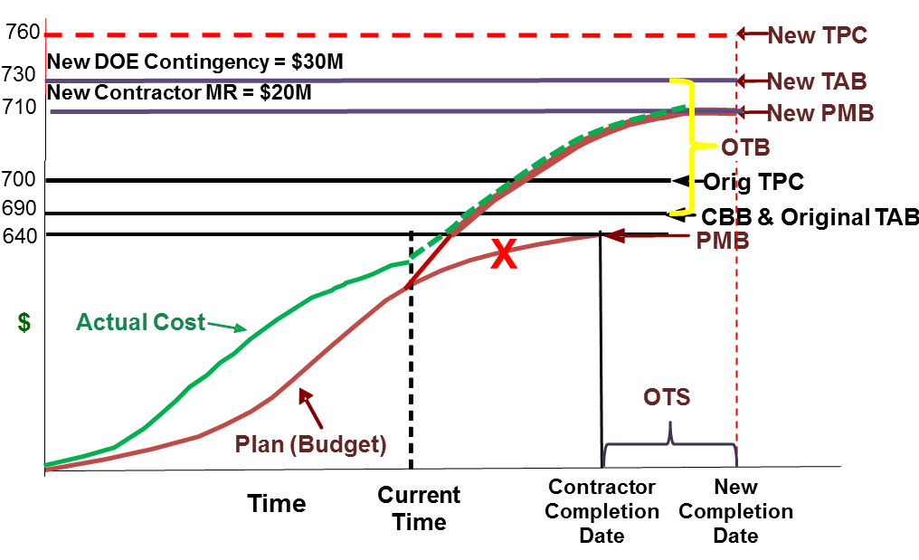
Period 7 OTB “S” Curve
or PBB & Original TAB
Notes:
The New TPC, TAB, PMB along with the OTB and Over Target Schedule (OTS) are shown on this S curve chart.

Slide 27
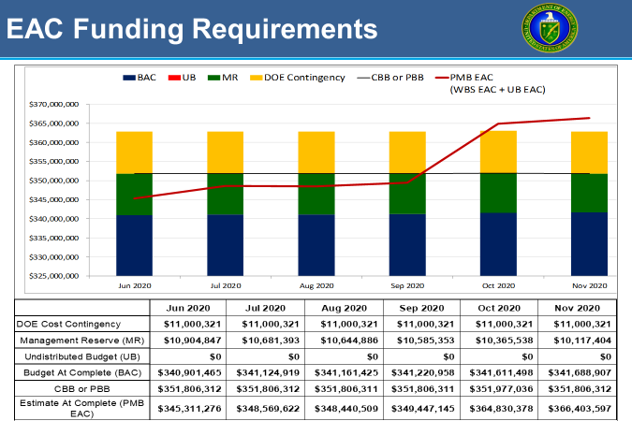
  PARS EAC Funding Requirements
EAC Funding Requirements Report Location:
  PARS Project Reports
    Project Summary Excel Workbook
    Tab ‘EAC Funding Requirements’
Notes:
From the examples that we have shown throughout this training module, the need for funding status is apparent. The DOE FPD can use the PARS EAC Funding Requirements report to track whether sufficient funding is available to complete the project. An example of the Report in PARZ is shown. Major components of Total Project Cost (TPC) are plotted in a stacked column. This allows the analyst to identify the current balances of each major TPC component, mainly DOE Contingency and CBB or PBB. Further analysis should look at how the contractor’s reported forecast (EAC) is plotted against the TPC and if additional funding may be required to complete the project. Extreme increases in the EAC may indicate that an Over Target Baseline should be considered.
Focus areas for analysis include:
A comparison of the contractor’s reported forecast (EAC) against the Total Project Cost to determine if additional funding may be required to complete the project.
Verification that all components of Total Project Cost are being accurately reported, the height of each column for each period is the same or very close, and any indications that the risk reserves and contractor baseline have not been reported accurately or are being used improperly.
The indicators include: Fluctuations in the CBB or PBB line without corresponding reverse changes in the DOE Contingency, a significant change in Contingency balance that is not reflected in the CBB or PBB line, and a decrease in Contingency with an associated increase in MR without any change to the Budget at Completion.
The EAC Funding Requirements report is located in PARS, Select Project Reports, then select the Project Summary Excel Workbook, and click on the EAC Funding Requirements Tab.

Slide 28
SUMMARY
Choosing MR or DOE Contingency depends on the situation.
The impact of selecting the correct source is crucial to project management and oversight.
EAC Funding Requirements: Provides a visualization of each of the PB components and fluctuations indicating concerns with remaining risk reserves and project cost variances that may signal insufficient funds to complete the project
Notes:
In summary, choosing MR (the Contractor’s Budget) or DOE Contingency depends upon each situation.
As we learned while working though the scenarios in this snippet, the impact of selecting the correct source is crucial to project management and oversight as the choice may cause funding concerns.
The EAC Funding Requirements report provides a visualization of each of the PB components and fluctuations indicating concerns with remaining risk reserves and project cost variances that may signal insufficient funds to complete the project.

Slide 29

For additional information, please browse our library at the following Project Management Earned Value Management websites.
External:
https://www.energy.gov/projectmanagement/services-0/earned-value-management
Internal:
https://community.max.gov/display/DOEExternal/PM+EVM+Guidance
46
Notes:
Please refer to Snippet 6-3A for information relative to MR and Contingency concepts, purpose, and uses.
For additional information relative to EVMS procedures, templates, helpful references, more Snippets, and training materials, please refer to DOE PM’s external EVM Home page or the internal Max.Gov PM Library. Check back periodically for updated or new information.
Thank You for using the Snippet Library.

