Slide 1
Snippet 6-2: Authorized Unpriced Work (AUW) vs Not to Exceed (NTE)
U.S. Department of Energy
Office of Project Management (PM)
Notes:
This EVMS Training Snippet, sponsored by the U.S. Department of Energy’s Office of Project Management (PM) covers Authorized Unpriced Work, or AUW, and how it is implemented, particularly when there is a contractual Not to Exceed, or NTE, cost limit. The purpose is to provide a common understanding within DOE and among DOE contractors, and to provide consistency.

Slide 2
Definition of Authorized Unpriced Work
AUW is the estimated cost (less fee/profit) for directed changes not yet negotiated
Associated Terminology:
Undefinitized Change Order allows contractor to proceed with work, pending negotiations
Not-To-Exceed (NTE) is funding language
Undefinitized Contractual Action
Notes:
Authorized Unpriced Work is the estimated budget (excluding fee or profit) for contract changes that have been approved by the government contracting officer but have not yet been fully negotiated. This allows the contractor to start the work while a proposal and contract modification are being negotiated. Some common terminology associated with AUW includes: Undefinitized Change orders which allow the contractor to proceed with scope not yet negotiated; Not-To-Exceed which relates to ceiling funding language within a change order; and Definitization which is the conversion of a change order to a bilateral modification.

Slide 3
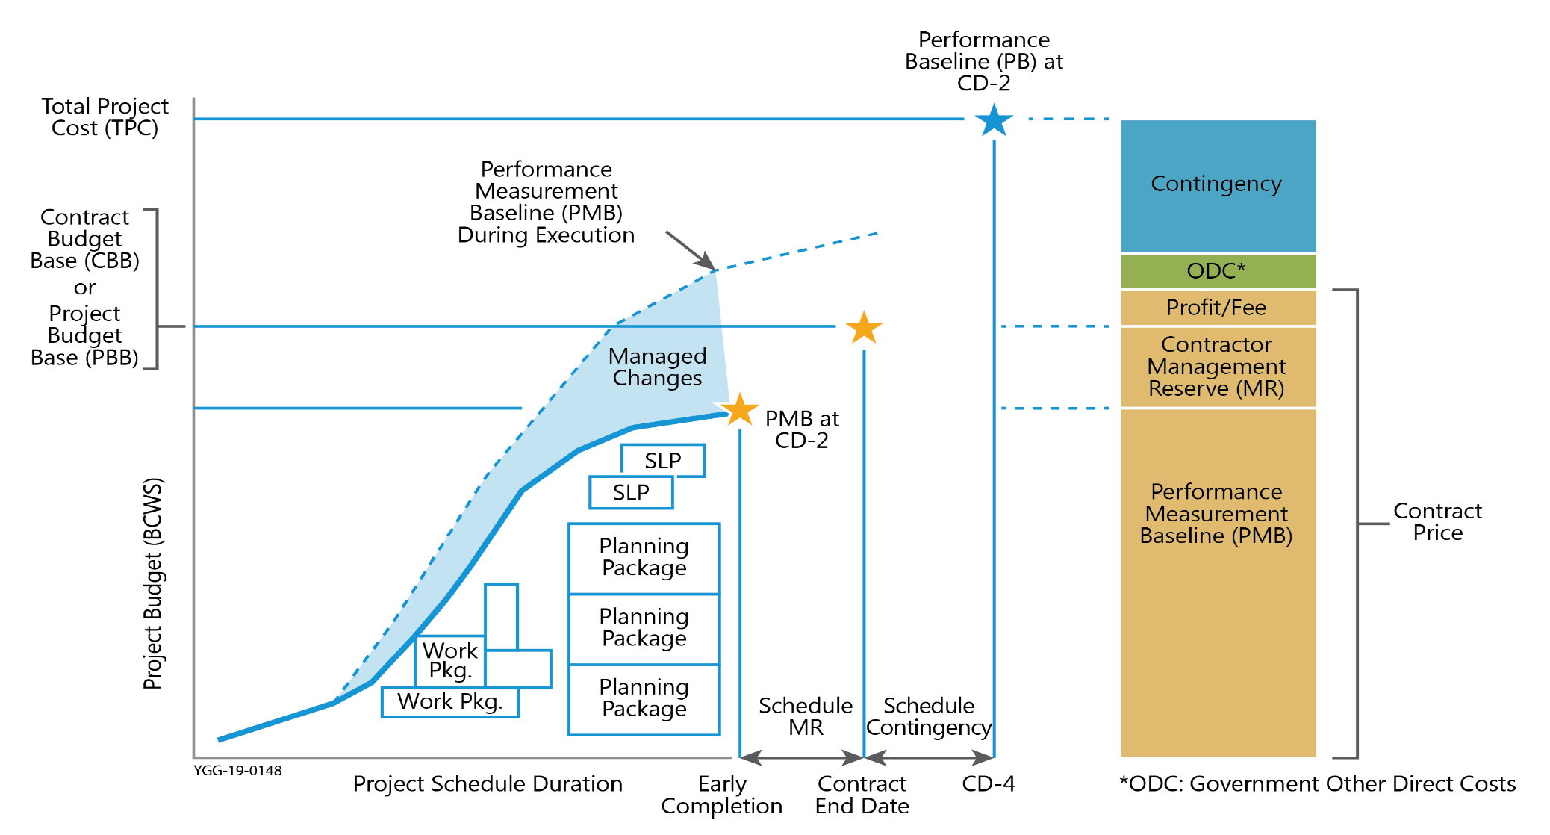
AUW Causes Misalignment with Contract Until Negotiations Complete
Estimated CBB/PBB
Notes:
This illustrates the concept of AUW, a part of the Contract Budget Base (CBB) or Project Budget Base (PBB). Throughout the life of the contract, modifications may be issued by the contracting officer to add or delete work within the scope of the contract. The type of authorization does not change the approach to updating the PMB. The negotiated cost plus AUW must always equal the cumulative authorization (CBB or PBB).
Applying AUW to the project will temporarily cause the new estimated CBB or PBB, shown in red, to be out of alignment with the contract until negotiations are complete. In order to remain compliant with the DOE Acquisition Guide Chapter 43.3, the Contracting Officer must definitize the unilateral modification after negotiations in order to realign the contract and the CBB or PBB.
If you are unfamiliar with the term Project Budget Base (PBB), please refer to Snippet 1-11 Varying Project and Contract Structures or the DOE EVMS Gold Card.

Slide 4
AUW and the Not-to-Exceed (NTE)
Budget vs. Funds
Budget represents entire scope of proposal; applied without constraint of funding
Funding is typically incrementally applied until negotiations are completed or as annual budgets approved by Congress
AUW is authorized yet unpriced new scope expressed as a budget.
NTEs are funding limits.
BUDGET and FUNDS are two separate things.
Notes:
To understand why the CBB or PBB may be out of alignment temporarily with the contract, one needs to understand the concept of budget versus funds in the EVMS vernacular. To do so, please view Snippet 3-1: Budget vs Funding and the PMB. The PMB component of the CBB or PBB represents the budget for all project scope.
Earned Value Management budgets are goals or metrics for work performance. The budgets must be sufficient to represent a realistic plan to capture all scope on the contract. Budgets are applied without the constraint of funding or not-to-exceed (NTE) limitations. Just as incrementally funded contracts should establish a baseline for the entire scope of work, incorporation of AUW into the contract or project baseline should represent all authorized scope (a portion of which will be in undistributed budget until negotiations are completed).
Putting the entire estimated budget for the full scope of the undefinitized effort into Undistributed Budget is an essential component for project management purposes. The contractor must track the accrued actual cost of work performed of the AUW scope against the NTE spending limit as the not yet negotiated work is underway.

Slide 5
AUW and the Not-to-Exceed (NTE)
Contracting Officer authorizes the contractor to proceed with new work, pending final negotiations
Contractor’s rough-order-magnitude or proposal amount serves as the estimated budget for the full scope of this new effort.
Contractor is limited in incurring actual costs in performing the scope up to the NTE funding limit
Notes:
When the Contracting Officer (CO) formally authorizes the contractor to proceed with not yet negotiated work by issuing a change order, the CO will identify the scope changes and AUW budget in the authorization. It may reference a contractor provided rough-order-magnitude or certified pricing. The CO should also identify a not-to-exceed or NTE funding limit. The amount of the NTE usually represents enough funding to last until the change order is definitized.
The contractor enters the full AUW budget as specified by the CO or if not mentioned, the contractor’s rough-order-magnitude or proposal amount into Undistributed Budget, not the NTE funding limit. A portion of that budget is then distributed to control account managers to begin work on the near term effort. This amount of distributed budget is usually equal to or no greater than the NTE. The remainder of the budget is left in Undistributed Budget.

Slide 6
AUW and the Not-to-Exceed (NTE)
Contractor must notify the Contracting Officer for direction if negotiations are incomplete and funding limit is approaching. Options by Contracting Officer include:
Increase NTE or Issue Stop Work
Notes:
If negotiations are delayed and the contractor is reaching the NTE, the contractor must notify the CO for direction. The CO may either authorize an increase to the NTE or issue a stop work order pending results of the negotiations.

Slide 7
AUW and Undistributed Budget (UB) Relationship Prior to Final Negotiations
Contract Price
Target Profit/Fee
Performance Measurement Baseline
Management Reserve
Contract Authorized
Target Unpriced
Cost Work
Contract Budget Base /
Project Budget Base
Undistributed Budget
Distributed Budget
Proposal Amount less fee
Near Term up to NTE
Proposal less fee and NTE
Proposal budget less fee is in AUW and is flowed down to either Distributed or Undistributed Budget.
Distributed budget is for the near-term scope of work up to the NTE.
The remainder of the AUW is held in the Undistributed Budget pending negotiation.
Notes:
The full estimate associated with the authorized but not yet negotiated work is reflected as AUW. Near term effort should be planned with detailed scope and cost reflected in control account(s). Far term effort that cannot be reasonably planned in the near term may be placed in summary level planning packages or maintained in Undistributed Budget until negotiations are complete and the contract modification is issued. When this additional work is authorized the EIA 748 Standard requires the budget to be updated as well as the EAC.

Slide 8
AUW and Undistributed Budget (UB) Relationship After Final Negotiations
Contract Price, Target Profit, and Contract Target Cost Increase
Contract Price
Target Profit/Fee
Performance Measurement Baseline
Management Reserve
Contract Authorized
Target Unpriced
Cost Work
Contract Budget Base /
Project Budget Base
Undistributed Budget
Distributed Budget
AUW becomes zero
Remaining Change Notice Scope should be distributed within next two accounting periods
Notes:
Once negotiations have been completed and the definitized modification is issued, the Contract Price increases, fee it added to the Target Profit/Fee, and the Contractor adjusts the previously AUW budget estimate to the negotiated budget. The AUW becomes zero. The contractor may place a portion of the budget in management reserve, and any remaining additional budget remaining in the UB. The UB should be distributed within two accounting periods.
If the final negotiation is less than the AUW proposal estimate, the difference is deducted from the UB.

Slide 9
CBB or PBB Log
Date | Description | Contract Target Cost | Authorized Unpriced Work (AUW) | CBB or PBB | MR | PMB | UB | Distri-buted Budget
1/4 | ABC Contract | 120 | - | 120 | - | 120 | 120 | -
1/31 | January Summary | 120 | - | 120 | 10 | 110 | 10 | 100
2/5 | Contract Change No. 001 | - | 45 | 45 | - | 45 | 10 | 35
2/23 | SWO Generator XX7 | - | - | - | - | - | 30 | (30)
2/28 | February Summary | 120 | 45 | 165 | 10 | 155 | 50 | 105
Notes:
This is an example CBB slash PBB Log to illustrate the process of logging and tracking the AUW.
Refer to the row highlighted in red. On February 5th, the contractor received Contract Change Number 001 allowing for Authorized Unpriced Work. As shown on the CBB or PBB Log, this change was for 45 million dollars and was allocated to three places: AUW, CBB or PBB and the PMB. The contractor distributed 35 million dollars, for approximately six-to-seven months of work and left 10 million dollars in the Undistributed Budget.
At the end of the month, the Contract Budget Base is 165 million dollars; the PMB, 155 million dollars; a total of 50 million dollars in the UB; and 105 million dollars distributed to the control accounts. The Contract Target Price which remains at 120 million dollars will be adjusted when the AUW change is definitized.
Refer to the column highlighted in red. Of the 50 million dollars in UB, 10 million dollars from the initial contract award, 10 million dollars is for the February 5th Contract Change No. 1, and 30 million dollars for a Stop Work Order received from the customer on February 23rd for the SWO Generator.

Slide 10
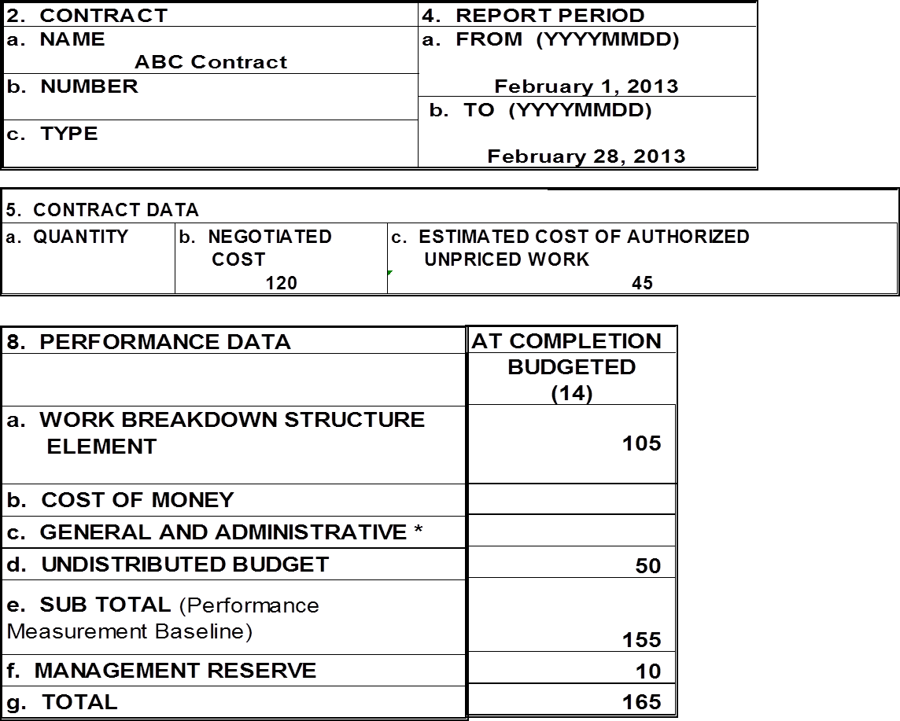
IPMR Format 1 With AUW
Note: This is a partial view of the IPMR Format 1.
Only Blocks 2, 4, 5, and 8 are shown.
Notes:
This is an example of the Format 1 of the Integrated Program Management Report, IPMR. Please see Snippets 1-9, 1-10,.and 1-11 for more information on the IPMR reporting formats.
To illustrate the AUW and associated data we just looked at in the CBB Log, this example Format 1 -- with authorized unpriced work -- contains only that data related to the AUW, PMB, and CBB in the CBB Log. This clearly illustrates the reporting of authorized unpriced work. Subsequent transactions will be reported and traceable to the CBB Log in the same manner.
The contract name and date for the February report are in the upper Blocks 2 and 4. The negotiated Contract Target Cost of 120 million dollars at February month-end is in Block 5.b, with the 45 million dollars of AUW in Block 5.c.
A summary of the distributed budget values for the WBS elements, including Cost of Money and the G&A, totaling 105 million dollars is in Block 8, Column 14. The UB of 50 million dollars is in Block 8.d; the PMB total (which includes UB) of 155 million dollars is in Block 8.e, Column 14; and finally, the CBB of 165 million dollars (which includes MR) is in Block 8.g, Column 14.

Slide 11
IPMR Format 3 With AUW (Partial View)
Notes:
This is the IPMR Format 3 for the ABC Contract for the same report period as the Format 1. This illustrates the project with authorized unpriced work in the Baseline Format.
The Field 5 Blocks 5.a through 5.g display the contract level data contained in the contractor’s CBB Log. Starting with Block 5.a, the original negotiated cost, 120 million dollars, with no negotiated changes (yet), and the resultant current negotiated cost is in Block 5.c.
The 45 million dollars AUW is in Block 5.d, with the CBB of 165 million dollars in Block 5.e. The Total Allocated Budget, or TAB, is also 165 million dollars, so there is no difference. Only when there is an Over Target Baseline would the TAB be greater than the CBB.

Slide 12
IPMR Format 3 With AUW (Partial View)
Notes:
Now we come to the baseline block of the Format 3, Block 6. Again to illustrate only those terms and concepts involved with AUW, the format contains only specific, related data. In short, it is not fully populated.
At the beginning of the period, Block 6.a, the PMB, comprised 100 million dollars of incremental data and when the 10 million dollars of UB was added, resulted in a 110 million dollars Project BAC.

Slide 13
IPMR Format 3 With AUW (Partial View)
Notes:
As we just saw in the CBB Log, on February 5th a not yet negotiated contract change was authorized. Of the 45 million dollars of AUW, 35 million dollars was distributed to the CAMs and baselined, and 10 million dollars remained in the Undistributed Budget. During the same reporting period, the 30 million dollars Stop Work Order was received, which resulted in removal of work and associated budget from the PMB. This was logged in the UB.

Slide 14
IPMR Format 3 With AUW (Partial View)
Notes:
The end of the period’s PMB is now comprised of 105 million dollars and the new UB total of 50 million dollars for a Project BAC of 155 million dollars. The 10 million dollars of MR brings the CBB total to 165 million dollars with all the data traceable to the CBB Log.
And, now on to what happened in the next month, March.

Slide 15
Contract Budget Base (CBB) Log
Date | Description | Contract Target Cost (CTC) | Authorized Unpriced Work | CBB | MR | PMB | UB | Distributed Budget
1/4 | ABC Contract | 120 | - | 120 | - | 120 | 120 | -
1/31 | January Summary | 120 | - | 120 | 10 | 110 | 10 | 100
2/5 | Contract Change No. 001 | - | 45 | 45 | - | 45 | 10 | 35
2/23 | SWO Generator XX7 | - | - | - | - | - | 30 | (30)
2/28 | February Summary | 120 | 45 | 165 | 10 | 155 | 50 | 105
3/4 | Negotiated Change No.001 | 44 | - | (1) | - | (1) | (1) | -
3/28 | Baseline Change 001 & Program | - | - | - | - | - | (19) | 19
3/31 | March Summary | 164 | - | 164 | 10 | 154 | 30 | 124
Notes:
The CBB Log indicates that two important developments occurred during the month.
Contract Change 001, which was received on February 5th resulting in 45 million dollars of AUW, was negotiated on March 4th for 44 million dollars. Accordingly, the Contract Target Cost increased by 44 million dollars and the 1 million dollars negotiation loss was noted in the three respective columns -- CBB, PMB and UB.
On March 28th, two transactions took place. The initial project’s remaining UB of 10 million dollars was distributed as well as the 9 million dollars UB balance following negotiations of the Contract Change 001. The log shows the total 19 million dollars debit to the UB and the 19 million dollars credit to the distributed budget.
The March Summary, which we will soon see in the IPMR Formats 1 and 3, shows the results of the monthly transactions. The CTC is now 164 million dollars, which equals the CBB, consisting of 10 million dollars of MR and the PMB of 154 million dollars. Thirty million dollars is still in Undistributed Budget, the result of last month’s Stop Work Order. The new Distributed Budget is now 124 million dollars.
Now let’s look at the Project IPMR Formats 1 and 3 after the AUW was negotiated.

Slide 16
IPMR Format 1 (Partial View) After AUW Negotiated
Notes:
The March Format 1 shows the updated 124 million dollars Budget at Completion in the WBS elements. There is the 30 million dollars of UB for the Stop Work Order, bringing the PMB total to 154 million dollars in block 8.e.
The 10 million dollars of MR is in Block 8.f, Column 14; and the revised 164 million dollars Contract Budget Base is in Block 8.g, Column 14.

Slide 17
IPMR Format 3 After AUW Negotiated (Partial View)
Notes:
The March IPMR Format 3 is again updated in the contract data blocks, reflecting the negotiation of the 45 million dollars of AUW for 44 million dollars, bringing the current negotiated cost, or CTC, up to 164 million dollars. The Contract Budget Base and the Total Allocated Budget are both now 164 million dollars.

Slide 18
IPMR Format 3 After AUW Negotiated (Partial View)
Notes:
The PMB at the beginning of the period was comprised of 105 million dollars with 50 million dollars in UB for a beginning period BAC of 155 million dollars.

Slide 19
IPMR Format 3After AUW Negotiated (Partial View)
Notes:
The two actions that we just saw in the CBB Log are noted in Block 6.b. This shows the distribution of the negotiated CCN 01 balance of 9 million dollars into the baseline, the 10 million dollars UB debit, and the 1 million dollars loss in negotiations in the project’s BAC.
The UB resulting from the initial project award baselining was distributed and debited from the UB accordingly.

Slide 20
IPMR Format 3After AUW Negotiated (Partial View)
Notes:
The end of the month PMB is now comprised of 124 million dollars with the 30 million dollars for the Stop Work Order still in the UB.
The new BAC of 154 million dollars, 10 million dollars of MR, and the new CBB of 164 million dollars are in Block 6.g, Column 14, as well as up in Block 5.e.

Slide 21
IPMR Format 5 Requirements Regarding AUW
The DOE IPMR Instructions requires:
Identify the components of the UB in current report
Discuss UB and PMB changes
Explain significant shifts in PMB time phasing
Explain significant changes in PMB total
Explain content of Authorized Unpriced Work
Notes:
Format 5 requirements involving authorized unpriced work are essentially the same for both the Contract Performance Report and the IPMR. Authorized unpriced work involves Undistributed Budget. Consequently, the UB components should be specifically identified. The requirement to document changes in the statement of work and its associated budget is a good reason to correctly maintain the UB Log, which experienced contractors attach to the Format 5 as backup for the explanations.
Any UB and PMB changes associated with AUW should be discussed.
Often AUW and the resultant distribution of budget results in PMB shifts. Again, these shifts and changes require explanations in Format 5.
And finally, even though the recipient of the IPMR Format 5 is the DOE Federal Project Director and the DOE Contracting Officer who authorized the unpriced work, the Format 5 should still explain the AUW’s contents.
Why, you ask? Two reasons: Better understanding for people responsible for project oversight; and clear traceability during multiple, simultaneous contract modifications. Occasionally, there are two to three authorized unpriced work orders in process simultaneously on today’s risky projects. Since these involve limited funds., greater transparency is necessary for all involved.

Slide 22
Summary
Authorized Unpriced Work and Associated Distributed/Undistributed Budgets should be logged, distributed, reported, and diligently monitored
After negotiations, remaining UB should be distributed within approximately two-months
AUW is not normally fully funded - contractor should carefully observe ACWP while observing the NTE value
Notes:
We sum up this snippet on Authorized Unpriced Work with these three points: AUW and its associated logging, reporting, and tracking, in conjunction with the other project elements -- UB, CBB, Distributed, and post-negotiation Contract Target Cost, requires diligent monitoring.
Following negotiations of the AUW, the remaining UB should not linger in the UB Log lest it be improperly used to budget something unrelated to its scope.
It is the contractor’s responsibility to monitor the burn rate of the additional work while the AUW is in process. The NTE involves only the funding limit. The AUW should be incrementally baselined. The BCWS should be planned well in advance of Time Now for measurement of the work performed (BCWP), and accrual of the actuals (ACWP), while observing the not-to-exceed funding limit.

Slide 23
For additional information, please browse our library at the following Project Management Earned Value Management websites.
External:
https://www.energy.gov/projectmanagement/services-0/earned-value-management
Internal:
https://community.max.gov/display/DOEExternal/PM+EVM+Guidance
Notes:
For additional information relative to EVMS procedures, templates, helpful references, more Snippets, and training materials, please refer to DOE PM’s external EVM Home page or the internal Max.Gov PM Library. Check back periodically for updated or new information.
Thank You for using the Snippet Library.

