Slide 1
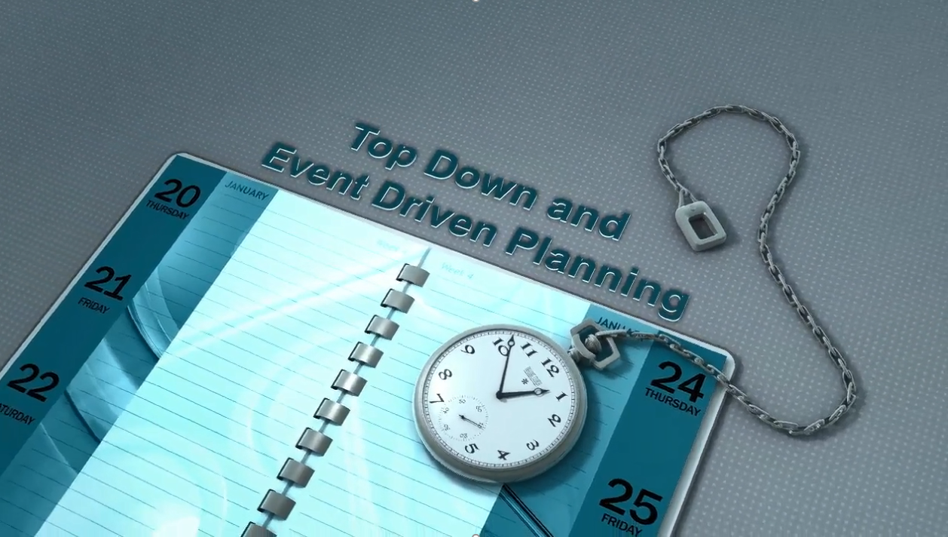
Snippet 3-3:
Top Down and Event Driven Planning
U.S. Department of Energy
Office of Project Management (PM)
Notes:
This EVMS Training Snippet, sponsored by the U.S. Department of Energy’s Office of Project Management discusses the process and results associated with Top Down and Event Driven Planning. The purpose is to provide a common understanding within DOE and among DOE contractors, and to provide consistency.

Slide 2
Top Down and
Event driven planning
Top Down Planning is a success-driven approach with the goal to ensure that critical project requirements are planned for and executable
Project Planning & Resource Allocation
  Statement of Work (SOW)
  Project Execution Plan (PEP)
  Work Breakdown Structure (WBS)
  Integrated Master Plan (IMP)
  Integrated Master Schedule (IMS)
Notes:
The most critical activity to help ensure a project’s success is an early and thorough planning process. The first part of this is developing what success looks like on a project, and in government contracting success is often linked to the execution of critical project requirements. These requirements are often captured in the contract. The Top Down Planning process is a success driven approach with the goal of ensuring that these critical requirements are planned and executable.
The top down planning process begins with the development of the Integrated Master Plan or IMP. The IMP provides project traceability by expanding and complying with the project's Statement of Work or SOW, the Project Execution Plan or PEP, and the Work Breakdown Structure or WBS. The IMP is an event‐based plan consisting of a hierarchy of project events with each event being supported by specific accomplishments, and each accomplishment associated with specific criteria to be satisfied for its completion. The IMP is included in the DOE-H-2024 Clause and is thus contractually binding. The IMS ties to the IMP by applying duration and resources.

Slide 3
Integrated Master
Plan
The IMP is developed to depict the overall structure of the Project including Critical Milestones and Events.
Defines the major Events of the Project and Establishes the Significant Accomplishments and Entrance/Exit Criteria for those Events.
The IMP is not “Date Driven” rather it is “Event Driven”.
Serves as foundation for the Integrated Master Schedule
The IMP is the “What” of the Project
Notes:
The IMP is developed to depict the overall structure of the project, including critical milestones and events. If further defines the accomplishments and criteria for the successful completion of each critical milestone or event listed. Each of the major events of the project are defined, and the significant accomplishments, including the entrance and exit criteria for these accomplishments, are established. These comprise the three major components of the IMP: Project Events, Significant Accomplishments, and Success Criteria.
For those of you familiar with project scheduling, you will notice a lot of similarity. And while this is true, there is one significant difference. The IMP is not date driven; but rather event driven. These Events, Accomplishments and Criteria serve as the foundation for the content of the Integrated Master Schedule.
In other words, the IMP is the “what” of the project.

Slide 4
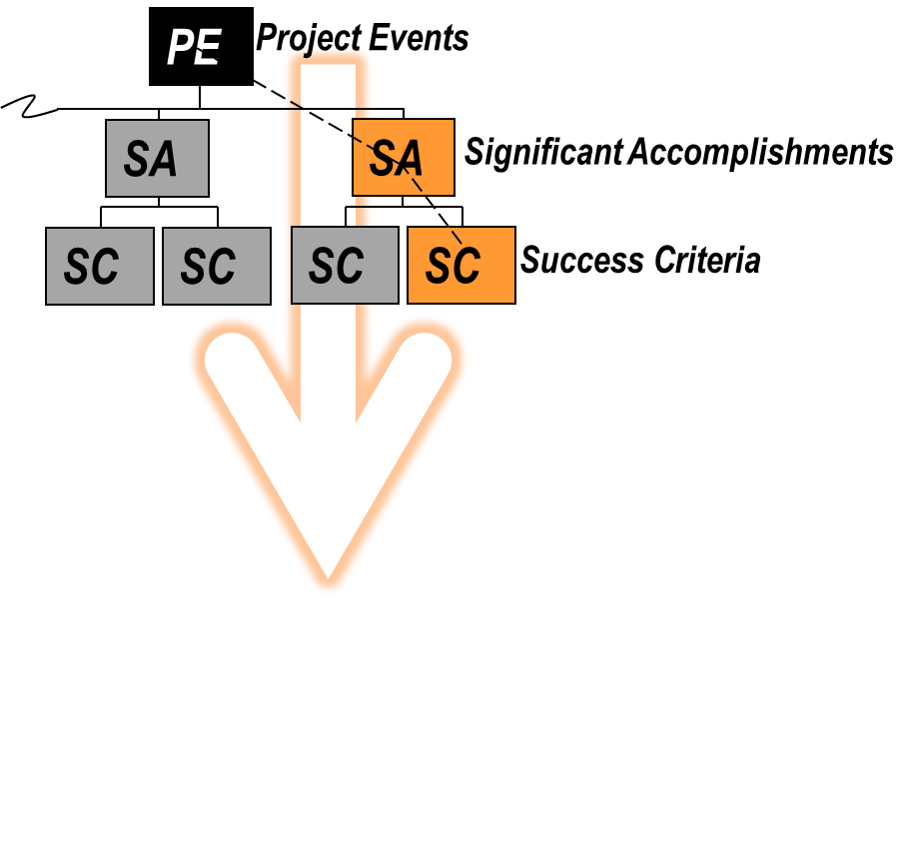
Integrated Master Plan Levels
TOP DOWN PLANNING
Notes:
These three components of the IMP form three different levels, and each of these levels will be discussed in greater detail in subsequent slides. Top down planning begins with the identification of Project Events, which can be thought of as major project assessment points found in the Master Schedule. For each of these events are Significant Accomplishments which are the desired results defining the completion of an Event. And finally, each event has identified Success Criteria which is supporting evidence that the goals of the Significant Accomplishments have been achieved.

Slide 5

Identify
Project
Events
The IMP is an Event-Driven plan for executing the project
Major Progress Assessment Points
Project Events selected jointly by Contractor and Government team.
Events are often Gates required prior to entering the next Phase of the Project
Events may include:
  Major Critical Decisions (CD-1, CD-2, etc.)
  Key Deliveries or Product Completions
  Completion of Critical Reviews
Notes:
As was said earlier, the IMP is an event driven plan for executing the project. Therefore, the first step in planning is identifying the Major Project Events. These should be the major assessment points which correspond to the primary goals of the project. These steps are selected and developed jointly by the Contractor and Government team.
The DOE’s policy Four Thirteen dot three B, Program and Project Management for the Acquisition of Capital Assets, identifies multiple Critical Decision points for each project. These critical decision points, often called CDs, begin with CD zero, the Initiation phase, and end with CD four, the start of operations or project completion. The transition from one CD phase to the next CD phase is contingent on achieving a set of criteria identified in Four Thirteen dot three B. This set of criteria can be thought of as gates which a project must go through on the road from one phase to the next, and these gates constitute major critical decisions. In addition to CD points, additional Events may include the delivery of key products or services, and completion of critical reviews.

Slide 6

Identify Significant Accomplishments
The Desired Result(s) prior to or at completion of an Event that indicates a level of the Project’s progress.
Accomplishments requirements and activities specifically identified in the RFP or contract.
Completion of a Significant Accomplishment substantially contribute to the success of the related event.
Significant Accomplishments may include:
  Review of Final Design
  Certification of the EVMS
  Perform an External Independent Review
Notes:
After major events have been identified, the team must select the significant accomplishment associated with those events. These are the desired results which are completed prior to or at completion of each event, and indicate the level of the project’s progress. These accomplishments should include, at a minimum, any requirements and activities that are identified in the request for proposal, or RFP, or the contract.
These accomplishments should be selected so that completion of them substantially contributes to success in a related event. For example, if the event is approval to begin construction, then successfully accomplishing the review of the final design would be critical to that event. For those capital asset projects greater than 100 million dollars, compliance with the earned value guidelines identified in EIA seven forty-eight, is a requirement associated with CD-3 which is approval to start construction or execution. In this case, certification of the Earned Value Management System or EVMS would be a good example of a significant accomplishment in support of that event.
Conducting an External Independent Review, or EIR, is also an example of a significant accomplishment required prior to the CD-2 event, or approval of the performance baseline.

Slide 7

Identify
Success
Criteria
Answers the question: “How do you know when an accomplishment has been completed”?
Success Criteria is often “entry” or “exit” criteria supporting Accomplishments.
Criteria can be Quantitative or Qualitative and must be Measurable.
Success Criteria may include:
  Approval of Design
  Submittal and Approval of EVM System Description
  Approval of Project Requirements Document
Notes:
The final level of the Integrated Master Plan is the identification of success criteria. Each significant accomplishment will have one or more success criteria which answers the question “How do you know when an accomplishment has been completed” or “what does ‘done’ look like”? These can be thought of as entry or exit criteria associated with the accomplishments they support. Each of these criteria can be quantitative or qualitative, but must be measurable or objective.
Examples of success criteria might be Design Approval as an exit criteria for final design. Having an approved EVM System Description may be an entrance criteria for the certification of the EVM System. And for some projects, having an approved project requirements document may be an entrance requirement for the design phase of a project.

Slide 8
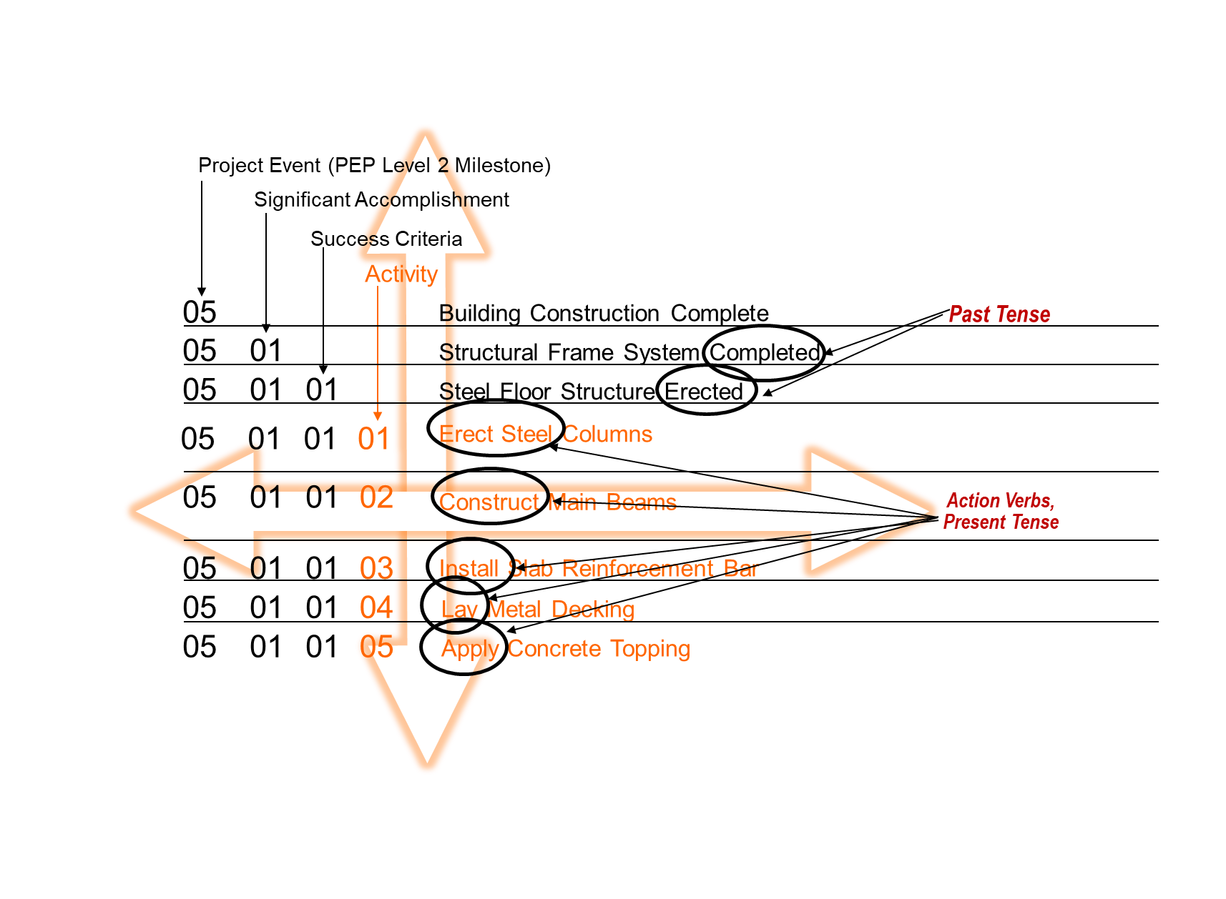
IMP (Vertical) and IMS (Horizonal) Integration
IMP Elements are Tracked in the IMS
Notes:
Next we will discuss how the IMP’s vertical project events, significant accomplishments, and success criteria are horizontally integrated in the IMS.

Slide 9
Integrated
Master
Schedule
Integrated, resource loaded, time-based plan containing the logical network of activities required to accomplish the project scope
Includes the entire required scope of effort, including the effort necessary from all government, contractor, and other key parties
Provides Project Management a comprehensive status of Authorized Work Scope and facilitates the timely tracking and communication of Project performance
Provides the dates by which each of the IMP Events, Accomplishments and Criteria are planned to occur by providing the timing of the detailed actual work required to meet them
The IMS is the “When” of the Project
Notes:
The Events, Accomplishments and Criteria identified in the Integrated Master Plan serve as the foundation for the content of the Integrated Master Schedule. The IMS is an integrated, resource loaded, time-based plan containing the logical network of activities required to accomplish the project’s scope. Using earlier language, the project’s scope can be considered the “what” of the project, and in the IMP, this is displayed as the events, accomplishments and criteria.
The IMS includes the entire required scope of effort, including the effort necessary from all government, contractor, and other key parties. Hence, it’s first name: “Integrated”.
The IMS provides project management, both contractor and government, a comprehensive status of all authorized work scope and facilitates tracking and communication of project performance.
And, using coding from the IMP, the IMS provides the dates by which the elements of the IMP are planned to occur. This is accomplished by providing the timing of the detailed actual work required to meet those elements.
In summary, the IMS provides the “When” to the IMP’s “What”.

Slide 10
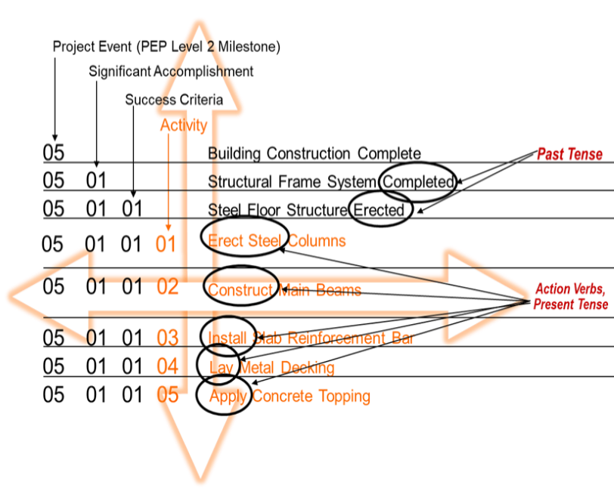
IMP AND IMS ILLUSTRATED
Notes:
It is important that an integrated coding system, combined with a disciplined approach to labeling planning elements, is used to provide a structure which can serve as an effective management tool. The elements of the IMP are coded using a logical structure, in this case the top-level Project Event is coded as Zero-Five. These events are often associated with Level two milestones in the Project Execution Plan, or PEP.
Underneath this event at least one Significant Accomplishment has been identified, Structural Frame System Completed, which has been coded as Zero Five, Zero One. In addition, the third level of the IMP, Success Criteria, has Steel Floor Structure Erected, identified as evidence that the Structural Frame System has been Completed. This Success Criteria is coded as Zero Five, Zero One, Zero One.
Notice that the titles of the IMP elements are phrased in the past tense. This is because success for Accomplishments and Criteria is based on completion, and in the IMS these elements will be represented as milestones, with the lower level activities representing the work required to accomplish the milestone. In a resource loaded schedule, all the resources associated with the Steel Floor Structure Erected Success Criteria will be loaded into the five activities identified below it in orange. Because the activities represent actual work, they are phrased as action verbs and in the present tense.
Because the coding structure is fully integrated between the IMP and IMS, the planning and status for any IMP element is simply the rolled-up planning and status of the elements beneath it, down to the individual activities in the IMS. All IMP elements are tracked in the IMS.

Slide 11
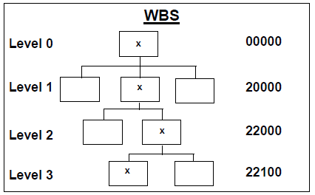
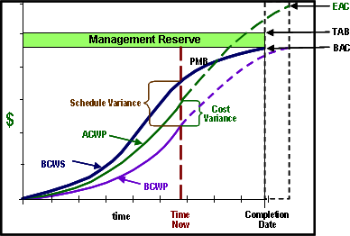
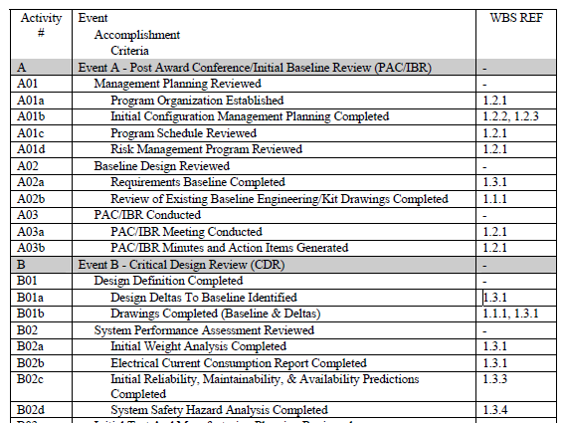

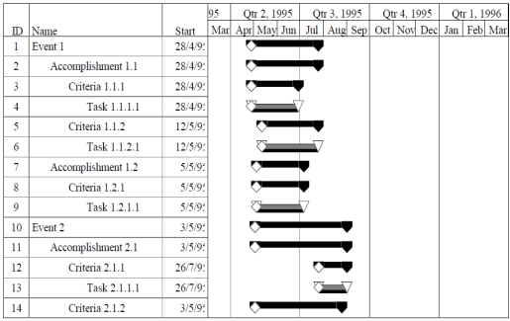
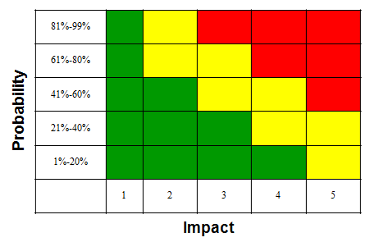
IMP / IMS Linkages To Project Activities
WBS
EVMS
SOW
IMP
IBR
PEP
IMS
Risk Mgt
Notes:
This picture depicts the linkages of the IMP and IMS to other project activities. We discussed in this Snippet how the IMP connects to the WBS, SOW, and PEP. The IMS links to the Integrated Baseline Review or IBR. We can also see how the IMP and the IMS tie to the EVMS as it relates to processes within the EIA-748, such as Organizing, Planning and Scheduling, Budgeting and Work Authorization, Material Management, Subcontractor Management, Analysis and Managerial Reporting, Change Control, and Risk Management.

Slide 12
Summary
IMP and IMS are linked yet serve two different purposes:
  IMP is Event-Based with Significant Accomplishments and Success Criteria
    A top-down planning tool of all project requirements
  IMS is a Time-Based plan, with activities which support successful execution of the Project Scope
    A bottom-up tool for execution of Project Plans
The IMP is the “What” for Project Execution
Integration with the IMS provides the “When”
Notes:
In Summary, both the IMP and the IMS are critical tools for the management of DOE projects, and while integrated they serve two distinctly different purposes.
The IMP is an event-driven plan which identifies significant accomplishments and success criteria associated with key project events. The IMP is a top-down planning tool for all project requirements.
The IMS is a time-based plan with activities supporting the successful execution of the project’s scope. The IMS is a bottom-up tool for execution of the project plans.
The combination of these two critical management tools provides sufficient definition to allow for tracking the completion of the required accomplishments supporting each key project event, and the project in total.
In short, the Integrated Master Plan is the “what” for Project Execution, and the Integrated Master Schedule provides the “when” for the project.

Slide 13

For additional information, please browse our library at the following Project Management Earned Value Management websites.
External:
https://www.energy.gov/projectmanagement/services-0/earned-value-management
Internal:
https://community.max.gov/display/DOEExternal/PM+EVM+Guidance
Notes:
For additional information relative to EVMS procedures, templates, helpful references, more Snippets, and training materials, please refer to DOE PM’s external EVM Home page or the internal Max.Gov PM Library. Check back periodically for updated or new information.
Thank You for using the Snippet Library.

