Slide 1
EVMS Training Snippet 3-10: Undistributed Budget
UB
UB
UB
UB
UB
U. S. Department of Energy
Office of Project Management (PM)
UB
Notes:
This EVMS Training Snippet, sponsored by the U.S. Department of Energy’s Office of Project Management covers an Earned Value Management System budgeting concept of Undistributed Budget or UB and how it must be managed. The purpose is to provide a common understanding within DOE and among DOE contractors, and to provide consistency when the baseline no longer deemed executable.

Slide 2
What is Undistributed Budget (UB)?
UB
UB
UB
UB
Temporary holding place for budget for assigned scope not yet authorized to a responsible manager
UB budget has scope associated with it and can only be used for that purpose
Example: A Contract Change for the Foundation scope cannot be used to add budget to the Rafters scope.
Notes:
Undistributed Budget is a temporary holding account for contract scope and associated budget that is not yet authorized to control accounts, Summary Level Planning Packages or SLPP’s, or MR. UB always has scope associated with it and the budget can only be used for that purpose. By that we mean if a contract change was awarded for a foundation change, that budget cannot be used to build the rafters.

Slide 3
Hierarchy and Terms
BUDGET; NO SCOPE
)¹
SCOPE, SCHEDULE, BUDGET
BUDGET FOR
1) SCOPE and 2) MR
¹Refer to Snippet 1-11 Varying Project and Contract Structures or the DOE EVMS Gold Card for information relative to the
relation of the Contract Budget Base (CBB) and Project Budget Base (PBB)
Notes:
This slide illustrates the various contract and project level terms to better understand the concept of Undistributed Budget. Starting at the Contract Budget Base or Project Budget Base, the Management Reserve is budget with no scope or schedule. The Performance Measurement Baseline is comprised of two types of budget and work scope: Distributed and Undistributed. The Distributed Budget includes scope, schedule, and budget. The Undistributed Budget includes budget for scope, yet the contractor’s project manager may set aside a portion for MR budget for management control purposes to be used at contractor’s discretion. Sometimes Distributed Budget and Undistributed Budget are functionally referred to as time-phased distributed budget versus non-time phased undistributed budget because UB is missing the schedule aspect of the scope/schedule/budget integration.
Refer to Snippet 1-11 Varying Project and Contract Structures or the DOE EVMS Gold Card for information relative to the relation of the Contract Budget Base (CBB) and Project Budget Base (PBB)

Slide 4
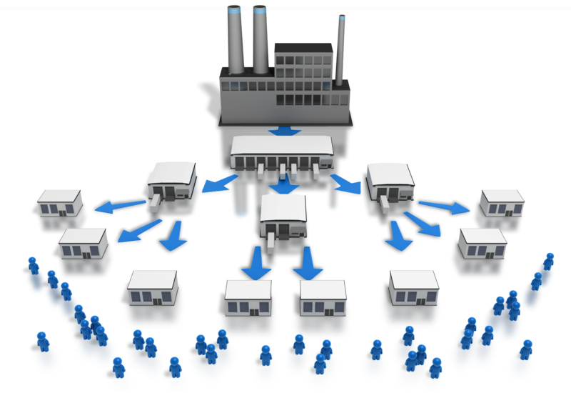
UB Distribution to Control Accounts
)
UB Warehouse
CA
SLPP
WP
CA
WP
PP
WP
WP
Notes:
Imagine the Undistributed Budget as boxes with specific Scope and Budget in each one. The illustration to the right shows a UB Warehouse. When a particular box of UB is ready to be detail planned, the box is then transported and distributed to the component of Distributed Budget as required, such as a Control Account or a Summary Level Planning Package. As the Control Account Manager receives the budget and scope, the CAM then proceeds with detail planning the Control Account by distributing and scheduling the scope and budget into Work Packages and/or Planning Packages.

Slide 5
CBB/PBB Log
Date | Description | Contract Target Cost (CTC) | Authorized Unpriced Work (AUW) | CBB | Mgmt Reserve (MR) | PMB | UB | Distri-buted Budget
1/4 | ABC Contract | 120 | - | 120 | - | 120 | 120 | -
1/27 | CAs 001, 002, 003, and MR established |  |  |  | 10 | (10) | (110) | 110
1/31 | January Summary | 120 | - | 120 | 10 | 110 | 10 | 110
Notes:
Each project initial award and change must be tracked within UB until totally allocated to the time phased PMB and MR.
On January 4th, a new contract award shows the entire Contract Budget Base value of 120 Million Dollars is placed in UB.
On January 27, the program manager distributed $110Million of the UB to establish control accounts 001, 002, and 003; $10M transferred to establish the MR, and $10 remains in UB.

Slide 6
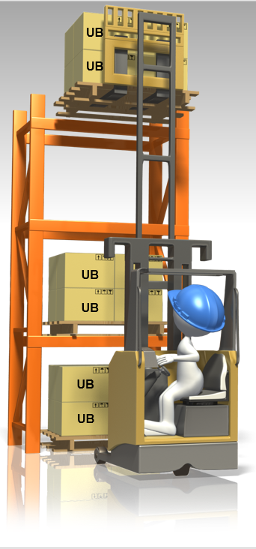
Undistributed Budget Parameters
Must be logged to show the scope and budget movement in and out of the time-phased portion of the PMB.
Should typically be distributed within two accounting periods after negotiations are complete
Serves as a temporary holding place for scope that is either being added, deleted, or moved
UB already has scope associated with it so must be used for that specific scope regardless of whether that scope is being added or removed
Contracting Officer must ensure clear contractual direction regarding adding, deleting, or changing scope
Notes:
Each distribution in or out of UB must be logged. The purpose is to keep the identification of specific work scope and budget together; thus preventing misuse of budget tied to one purpose for another purpose. This is strictly prohibited in EVMS.
The next parameter involves the time limit for allowing scope and budget to reside in the UB before being distributed. The reason for allocating budgets after contractual award or a contractual change typically within two accounting periods is to limit the period for which a time phased PMB does not exist. Therefore it is in everyone’s best interests to see get the work scope and budget out of UB and into time-phased portion of the PMB. There may be exceptions to the general practice of two accounting periods subject to discussions between the Contractor’s Project Manager and the Federal Project Director. An example may include a massive restructuring effort. In such cases documentation should be maintained and provided to explain the circumstances for compliance purposes.
Previously we showed an example of budget and scope being added to UB and then distributed to control accounts and MR. Sometimes previously distributed scope, budget, and schedule is awaiting a contract modification for deletion. Until a contractual change is issued, the scope and budget is moved from the control account to UB. It cannot be used for other purposes without contractual direction. The contractor must have clear direction from the Contracting Officer to support the basis for UB transactions.

Slide 7
Undistributed Budget Parameters
Reported to DOE via the IPMR/CPR
Credits and debits should be distinctly and clearly identified
Used in conjunction with stop work orders
Is a portion of the contract budget for authorized scope set aside until contract definitized
Notes:
The UB Log is very important not only for tracking the UB receipts and allocations, but for traceability to and within the CPR or IPMR Format reports. The amount of Undistributed Budget is reported in the monthly CPR or IPMR in Formats 1, 2, and 3; with receipts, allocations and scope for existing UB balances discussed in Format 5.
More detailed discussion of UB transactions in relation to a Stop Work Order (SWO) or Authorized Unpriced Work (AUW) is provided in later slides.

Slide 8
Sample UB Log
Notes:
This is an example of an Undistributed Budget Log detailing various transactions when maintained outside the CBB or PBB log. Capturing these multiple monthly transactions in the UB Log provides the contractor with detailed traceability to the CBB Log’s monthly updates, as well as back-ups for the IPMR or CPR Formats 1, 2, 3 and 5 requirements.

Slide 9
UB in Conjunction with AUW
Contracting Officer may authorize the contractor to proceed with new work, pending definitization
The contractor’s proposal amount serves as the estimated budget and is added to UB
Near term effort (based on NTE) is detail planned into control accounts
Remaining effort remains in UB until proposal definitization (should be within 2 months)
Contractor must notify the Contracting Officer as work progresses, negotiations are incomplete, and funding limit is approaching for direction, e.g. stop work or NTE increase
Upon definitization, scope and budget distributed from UB
For more information, refer to Snippet 6-2 Authorized Unpriced Work
Notes:
Another reason for UB is to accommodate Authorized Unpriced Work or AUW, which is the estimated cost (excluding fee or profit) for contract changes that have been approved by the government contracting officer but have not yet been fully negotiated. A portion of the budget associated with the not yet negotiated work is distributed to control account managers to begin work on the near term effort. The remainder of the contractor’s proposed budget is put in Undistributed Budget. This is necessary to ensure the full scope of the proposal is identified in the PMB. Recall the PMB represents all authorized project scope, even if not yet definitized.
As discussed in Snippet 6-2, Authorized Unpriced Work, the term NTE is used. From a funding perspective, the Contracting Officer will identify a not to exceed or NTE funding limit associated with the proposal, generally set at 50% of the scope. While the PMB reflects the contractor’s proposal, the funding is limited to a portion of that amount until negotiations have been completed. At that point, the contractor will make any adjustments to the PMB, originally based on its proposal, to reflect what was ultimately negotiated. Therefore, the contractor typically detail plans budget up to the funding limit, leaving the rest of its proposed amount in UB to simplify the final negotiation adjustment process.
As budget is needed to detail plan near term effort while negotiations are underway, the contractor will transfer budget from UB and distribute it to the proper control accounts. Should the contractor reach a point where the NTE funding limit has been reached and negotiations are incomplete, the Contracting Officer must be notified to either provide additional funding, that is extend the not to exceed funding limit, or advise the contractor to stop work pending completion of negotiations.
The preferred practice is for Undistributed Budget to be distributed to the applicable Summary Level Planning Packages (SLPPs) or control accounts by the end of the ensuing reporting period after contract definitization takes place.

Slide 10
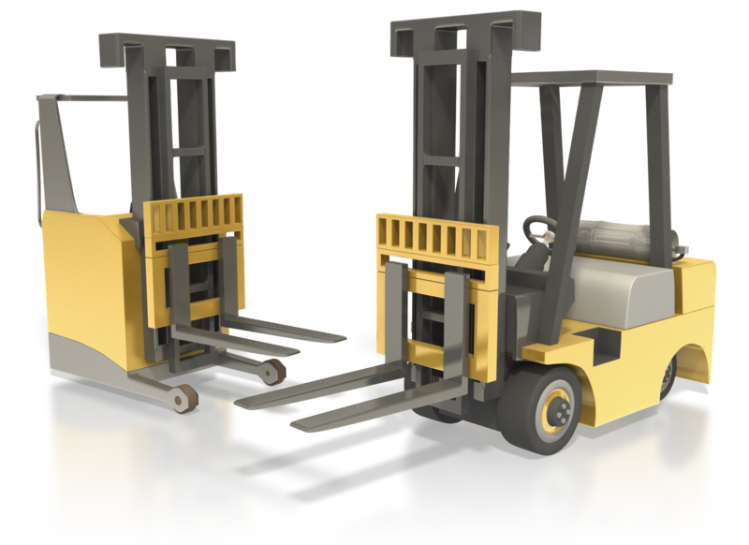
DOE-Directed Stop Work Orders (SWO)
If work is to be done later, remaining scope and associated budget are transferred to the UB Log
Transfer to applicable control account(s) upon receipt of customer direction
If the work scope is to be deleted
UB is reduced by the budget associated with that effort
CBB and Contract Target Cost are adjusted accordingly
Notes:
When the contractor receives a full or partial Stop Work Order or SWO, the subsequent process involves the UB and CBB slash PBB logs.
If the work is to be done later, then the contractor should transfer the applicable remaining scope and associated budget to the Undistributed Budget Log where it is maintained until DOE direction is received. The contractor continues to report the UB in the monthly or IPMR or CPR, with an applicable Stop Work Order discussion in Format 5.
Upon direction from the DOE Contracting Officer to resume the work, the contractor allocates the UB to the control accounts according to its internal procedures.
If the DOE Contracting Officer directs work to be deleted, the contractor should:
Delete the UB amount associated with the removed scope
Update the contract target cost by the amount negotiated with DOE
Update the contract budget base and the Contract Target Cost to reflect the amount negotiated with DOE; this amount may not be the same as the amount of the deleted work in Undistributed Budget if the Contract Target Cost included any profit or fee associated with the scope removed.
Again, these allocation and receipts transactions are noted in the CBB slash PBB and UB logs.

Slide 11
Contract Budget Base (CBB) Log
Date | Description | Contract Target Cost | Authorized Unpriced Work (AUW) | CBB | Mgmt Res (MR) | PMB | UB | Distri-buted Budget
1/4 | BC Contract | 120 | - | 120 | - | 120 | 120 | -
1/27 | CAs 001, 002, 003 established |  |  |  | 10 | (10) | (110) | 100
1/31 | January Summary | 120 | - | 120 | 10 | 110 | 10 | 100
2/5 | Contract Change No. 001 | - | 45 | 45 | - | 45 | 10 | 35
2/23 | SWO Generator XX7 | - | - | - | - | - | 30 | (30)
2/28 | February Summary | 120 | 45 | 165 | 10 | 155 | 50 | 105
Notes:
The CBB Log shows a Stop Work Order transaction on February 23rd for $30 Million. The Distributed Budget was debited and the UB credited accordingly. The contractor’s UB Log would provide more specifics.

Slide 12
Replanning Between Control Accounts
Example: Make or Buy
Step 1: Transfer scope, budget, schedule from current Control Account to UB
Step 2: Distribute changed budget, scope, schedule to new Control Account
Step 3: If the change in strategy causes an excess of budget in UB, the excess is transferred to MR
Notes:
When the contractor decides to replan effort between control accounts, UB is also involved in the process. For example, a contractor may determine that scope that was originally planned for an item to be made in house now needs to be purchased from a vendor. The first step would be to transfer the scope, schedule, and budget associated with that effort to UB. The second step would be to distribute the replanned scope, schedule, and budget to the new control account based on the schedule and budget needs associated with the purchase.
The last step is to determine if there is any excess budget remaining in UB because of the replan. If so, that budget would be transferred to MR since there no longer is any scope associated with it. An example of this would be if the contractor determines that it would be cheaper to purchase the item instead of making it.
Conversely, if additional budget is needed, the CAM may need to request MR allocation to the control account. The example in this case would be that it was cheaper to make it in house, however, it takes longer. Because an urgent need, the PM decides to buy the item in order to receive it sooner. The budget required would be greater than the budget in UB. MR could be applied as this is an authorized use for MR.

Slide 13
IPMR Format 1, Section 8
Notes:
This is an example of the IPMR Format 1. The project has 1 million dollars in Undistributed Budget, which is in Block 8.d, Column 14.

Slide 14
IPMR, Format 3, Sections 6 - 8
K
FREEZE PERIOD
Notes:
The IPMR Format 3 shows the same $1 Million of Undistributed Budget at the end of the period in Block 6.c, Column 15. At the beginning of the period, the UB amount in Block 6.a, Column 15 was $1.5 Million. During the period, half a million dollars was distributed for ECP 02, increasing the PMB in the periods June, July, August, September, and October/November. Note that the contractor honored the PMB Freeze Period change restrictions, assumed to be two months, with the distribution beginning in the third month from Time Now.

Slide 15
IPMR, Format 5
Notes:
The DOE IPMR Format 5, Explanations and Problem Analyses, is a narrative report prepared to amplify and explain data provided in the other IPMR formats. The DOE IPMR Instructions, available on both the internal and external websites listed on the last slide of this training module, stipulate other discussion requirements involving Undistributed Budget on the format 5.

Slide 16
CPR/IPMR Format 5 - UB Discussion Requirements
Identify components:
$1M remaining involves two Stop Work Orders for $250k and $300k, and AUW for $450k
Explain content by BCP or other basis
Explain any EAC differences in Formats 1 and 2
Notes:
The Contractor must identify the components of the UB. For example, the 1 million dollars of UB remaining as seen in Formats 1 and 3 involve two Stop Work Orders; one, 250 thousand dollars; another 300 thousand dollars; and 450 thousand dollars of Authorized Unpriced Work received during the reporting period.

Slide 17
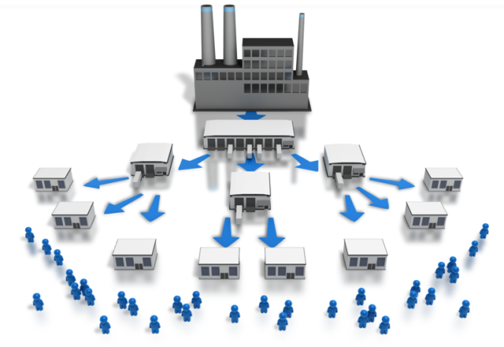
Undistributed Budget Summary
UB is a holding area
Each project change must be tracked within UB until totally allocated to the time-phased PMB or MR.
UB contains budget contractually tied to scope and must be used only for that purpose
Logs must be kept to identify all credits and debits
Notes:
In summary, UB is a holding area until such time as the scope and budget is either distributed to Control Accounts or Summary Level Planning Packages OR until contractually deleted or moved to the correct control account. Each project change must be tracked within UB until totally allocated to the time-phased PMB or MR.
UB contains budget contractually tied to scope and consequently must only be used for that particular scope.
Lastly, Logs must be maintained to identify all credits and debits throughout the project to the Contract Budget Base or Project Budget Base.

Slide 18
For additional information, please browse our library at the following Project Management EVMS websites:
External:
https://www.energy.gov/projectmanagement/services-0/earned-value-management
Internal:
https://community.max.gov/display/DOEExternal/PM+EVM+Guidance
Notes:
For additional information relative to EVMS procedures, templates, helpful references, more Snippets, and training materials, please refer to DOE PM’s external EVM Home page or the internal Max.Gov PM Library. Check back periodically for updated or new information. Thank You for using the Snippet Library.

