Slide 1
CLASSIFICATION OF
NUCLEAR WEAPONS-RELATED
INFORMATION
Restricted Data, Formerly Restricted Data, and Transclassified Foreign Nuclear Information
February 2019
Notes:
The Office of Classification’s Classification Training Institute’s Classification of Nuclear Weapons-Related Information; Restricted Data, Formerly Restricted Data, and Transclassified Foreign Nuclear Information, dated February 2019

Slide 2
Purpose
To meet the training requirements required for persons from other agencies (non-DOE) who have access to
  Restricted Data (RD)
  Formerly Restricted Data (FRD), and
  Transclassified Foreign Nuclear Information (TFNI)
under 10 CFR Part 1045, Nuclear Classification and Declassification
Notes:
This briefing is to familiarize individuals who may come in contact with Restricted Data (RD) or Formerly Restricted Data (FRD) with the procedures for identifying, marking, handling, and declassifying those types of information.
This training is required for persons who have access to RD, FRD, or TFNI by Title 10 Code of Federal Regulation (CFR) Part 1045, Nuclear Classification and Declassification.

Slide 3
Not the Purpose
This briefing does not authorize you to classify or declassify matter containing RD, FRD, or TFNI
Contact your Restricted Data Management Official (RDMO) or an Associate Restricted Data Management Official (ARDMO) if you need to classify or declassify matter containing RD or FRD.
Notes:
This briefing does not authorize you to classify or declassify matter containing RD, FRD, or TFNI
Contact your Restricted Data Management Official (RDMO) or an Associate Restricted Data Management Official (ARDMO) if you need to classify or declassify matter containing RD or FRD.

Slide 4
Why a separate briefing for RD, FRD, and TFNI?
RD, FRD, and TFNI are nuclear weapons-related categories of information classified under the Atomic Energy Act with special authorities and requirements, including:
  Only trained/authorized persons have authority to classify matter containing RD,
  FRD, or TFNI
  RD, FRD, and TFNI are never automatically declassified – even if the matter is erroneously marked with a declassification date or event, it can only be declassified after review by an authorized person
  Only authorized persons may declassify (or redact) RD, FRD, or TFNI from matter containing RD, FRD, or TFNI
They are not types of National Security Information and are not caveats or dissemination controls
Notes:
RD, FRD, and TFNI are nuclear weapons-related categories of information classified under the Atomic Energy Act with special authorities and requirements, including:
Only trained/authorized persons have authority to classify matter containing RD,
FRD, or TFNI
RD, FRD, and TFNI are never automatically declassified – even if the matter is erroneously marked with a declassification date or event, it can only be declassified after review by an authorized person
Only authorized persons may declassify (or redact) matter RD, FRD, or TFNI from matter containing RD, FRD, or TFNI
They are not types of National Security Information and are not caveats or dissemination controls

Slide 5
Classification Categories
There are four categories of classified information.
  Nuclear weapons-related categories, classified by the Atomic Energy Act
    Restricted Data (RD)
    Formerly Restricted Data (FRD)
    Transclassified Foreign Nuclear Information (TFNI)
  Information classified by Executive order
    National Security Information (NSI)
Notes:
There are four categories of classified information
Classified information governed by the Atomic Energy Act and Title 10 Code of Federal Regulations (CFR) Part 1045
RD
FRD
TFNI
Classified Information governed by Presidential Executive order (E.O.) 13526 and 32 CFR part 2001
National Security Information (NSI)

Slide 6
Restricted Data
Classified information related to the design, manufacture, or utilization of atomic weapons; the production of special nuclear material; or the use of special nuclear material in the production of energy
Examples
  Nuclear weapon design
  Nuclear material production
  Naval reactor information
Notes:
Restricted Data is Classified information related to the design, manufacture, or utilization of atomic weapons; the production of special nuclear material; or the use of special nuclear material in the production of energy
Examples Nuclear weapon design
Nuclear material production
Naval reactor information

Slide 7
Not RD…
RD does not include data declassified or removed from the Restricted Data category pursuant to section 142 of the Atomic Energy Act.
The process for moving information from the RD category into another category of classified information is called
“TRANSCLASSIFICATION”
“Removed from the RD category” does not mean declassified.
Transclassified information is STILL classified!
Notes:
What does Transclassification mean?
RD does not include data declassified or removed from the Restricted Data category pursuant to section 142 of the Atomic Energy Act.
The process of removing information from the RD category under Section 142 of the Atomic Energy Act is referred to as transclassification.

Slide 8
Overview of Transclassification
FRD
No automatic declassification
DOE and DoD jointly determine when declassified
Special marking
Treated as RD in foreign dissemination
Military
Utilization
DOE and DoD act under Section 142d of the Atomic Energy Act
  Transclassified to FRD
RD
TFNI
No automatic declassification
DOE determines when declassified
Special marking
Access same as NSI
Foreign transmission same as NSI
Foreign
Atomic Energy
Programs
DOE and DNI act under Section 142e of the Atomic Energy Act
  Transclassified to TFNI
Notes:
What classified information has been removed from the RD category?
RD concerning military utilization was transclassified under section 142d of the Atomic Energy into the category of FRD. FRD information is not automatically declassified, DOE and DoD jointly determine when FRD is declassified and there are special marking and handling requirements. For example, FRD is handled as RD in foreign transmission.
RD concerning certain foreign atomic energy programs was transclassified under section 142e of the Atomic Energy Act to TFNI. TFNI is not automatically declassified. DOE determines when TFNI is declassified. There are special marking requirements for TFNI. However, access and safeguarding is the same as NSI.

Slide 9
Formerly Restricted Data
Classified information that was once RD, but DOE and DoD jointly decided it should be FRD because it concerns military utilization
Examples
  Stockpile quantities
  Nuclear weapons safety and storage
  Nuclear weapon yields
  Locations of nuclear weapons (past and present)
Notes:
FRD is classified information that was once RD, but DOE and DoD jointly decided it should be FRD because it concerns military utilization
Examples Stockpile quantities
Nuclear weapons safety and storage
Nuclear weapon yields
Locations of nuclear weapons (past and present)

Slide 10
Transclassified Foreign Nuclear Information
Classified information that was once RD, but DOE and the Intelligence Community jointly decided it should be TFNI because it concerns foreign nuclear programs and is used for intelligence-related purposes
Examples
  Foreign nuclear weapon design
  Foreign nuclear material production
Notes:
TFNI is classified information that was once RD, but DOE and the IC jointly decided it should be TFNI because it concerns foreign nuclear programs and is used for intelligence-related purposes
Examples
Foreign nuclear weapon design
Foreign nuclear material production

Slide 11
Agency RD Program Implementation
Each agency has an RD Management Official (RDMO) who implements the requirements for RD, FRD, and TFNI
Agencies may also have Associate RDMOs (ARDMO) in organizations with access to RD, FRD, or TFNI
If you have questions about agency procedures for RD, FRD, or TFNI, contact your RDMO or ARDMO
If you do not know who your RDMO/ARDMO is, contact the DOE Classification Outreach Program at 301-903-7567 or outreach@hq.doe.gov
Notes:
Each agency has an RD Management Official (RDMO) who implements the requirements for RD, FRD, and TFNI
Agencies may also have Associate RDMOs (ARDMO) in organizations with access to RD, FRD, or TFNI
If you have questions about agency procedures for RD, FRD, or TFNI, contact your RDMO or ARDMO
If you do not know who your RDMO/ARDMO is, contact the DOE Classification Outreach Program at 301-903-7567 or outreach@hq.doe.gov

Slide 12
Your Responsibility
If matter has the potential to contain RD, FRD, or TFNI it must be reviewed by a person with the appropriate authority for classification or declassification
Notes:
If matter has the potential to contain RD or FRD, it must be reviewed by an RD Derivative Classifier
If matter has the potential to contain TFNI, it must be reviewed by someone who has been trained to classify matter containing TFNI
Matter includes email!

Slide 13
Classification Review Authority of matter not for Public Release
For matter that potentially contains RD or FRD, the review must be by a trained and designated RD Derivative Classifier
For matter that is potentially contains TFNI, the review must be by a person trained to classify TFNI
Notes:
If you believe matter contains information which may be RD or FRD it must be submitted for review. Matter in RD or FRD subject areas may contain RD or FRD, and therefore, should all be reviewed.
The review must be conducted by an RD Classifier with authority in the subject area of the matter being reviewed.

Slide 14
Classification Review Authority of Matter intended for Public Release
If matter potentially contains RD, FRD, or TFNI (e.g., in an RD or FRD subject area), the matter must be reviewed by
  DOE for RD and TFNI
  DOE or DoD for FRD
Contact your RDMO for procedures to transmit matter
for the appropriate review
Notes:
If matter is for public release
If matter is marked as or potentially contains RD, FRD, or TFNI (e.g., in an RD or FRD subject area), the matter must be reviewed by DOE for RD and TFNI; DOE or DoD for FRD

Slide 15
RD Derivative Classification Authority
RD Derivative Classification authority is required for ANY derivative classification determination that matter contains RD or FRD, including
  Use of portion-marked source documents to classify matter containing RD or FRD
  Determining an email contains RD or FRD
RD Derivative Classification authority is required to upgrade the LEVEL and CATEGORY of matter (CRD to SRD or SNSI to SRD)
RD Derivative Classification authority is required to downgrade the LEVEL of matter containing RD or FRD (SRD to CRD)
An RD Derivative Classifier is NOT authorized to downgrade the CATEGORY of matter containing RD or FRD (SRD to SNSI) or to declassify matter containing RD, FRD, or TFNI
Notes:
An RD derivative classifier is required any time matter is marked RD. This includes whenever a source portion-marked source document is used as the basis to classify matter containing RD or FRD.
RD Derivative Classification authority is required to upgrade the LEVEL and CATEGORY of matter (SNSI to SRD)
RD Derivative Classification authority is required to downgrade the LEVEL of matter containing RD or FRD (SRD to CRD)
An RD Derivative Classifier is NOT authorized to downgrade the CATEGORY of matter containing RD or FRD (SRD to SNSI) or to declassify matter containing RD, FRD, or TFNI

Slide 16
Declassification Review Authority for Matter Marked as or Potentially Containing RD, FRD, and TFNI
RD, FRD, and TFNI are not automatically declassified
Requires review by an authorized person
  RD and TFNI - only authorized persons within DOE
  FRD - only authorized persons within DOE or DoD
These authorities apply even if matter containing RD, FRD, or TFNI is erroneously marked with a declassification date or event.
No declassification date or event applies to RD, FRD, or TFNI
Notes:
How do you get matter containing RD, FRD or TFNI declassified?
If the matter is RD or TFNI, only a DOE designated declassifier can declassify the matter.
If it is FRD, a designated individual in DOE or an appropriate individual in DoD can declassify the matter.
Remember, RD, FRD and TFNI are NOT automatically declassified.

Slide 17

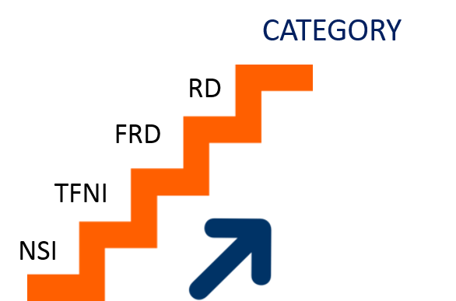
Precedence Rule
The overall classification of matter (or page of a document) is the highest level and most restrictive category of information in that matter (or on that page of a document).
For example: TSNSI + CRD = TSRD
Notes:
The overall classification of matter (or page of a document) is the highest level and most restrictive category of information in that matter (or on that page of a document).
Under the precedence rule, the precedence of categories from lowest to highest is NSI, TFNI, FRD, and RD.

Slide 18
Recognizing Matter Containing
RD or FRD
First page will always have an RD or FRD Admonishment
May have level only (SECRET) on first page
May have level and category (SECRET//RESTRICTED DATA) on all pages
Classification Authority Block will have no declassification instruction line or N/A to RD
(or FRD)
Notes:
You will able to tell if matter contains RD or FRD because the first page will always have Admonishment for RD or FRD
The first page may have either just the level in the overall/banner marking or may have level and category (SECRET//RESTRICTED DATA) on all pages
Classification Authority Block will have no declassification instruction line or N/A to RD
(or FRD)

Slide 19
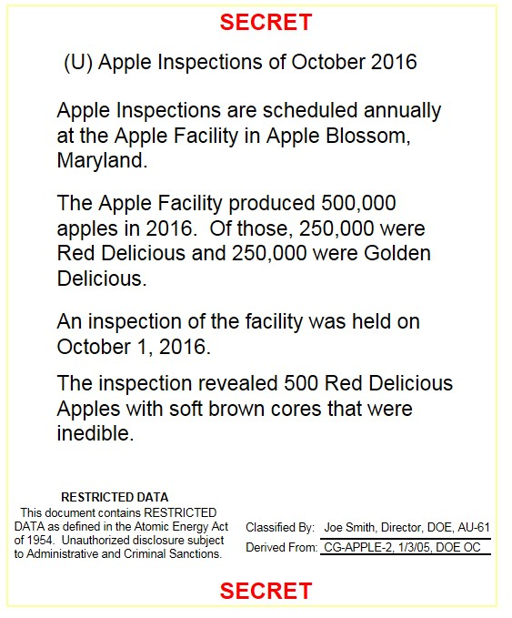
Recognizing Matter Containing RD or FRD - Example
Notes:
Note that since the matter does not contain NSI, there are no automatic declassification instructions.

Slide 20
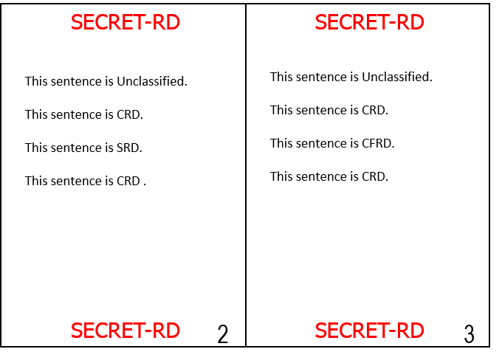
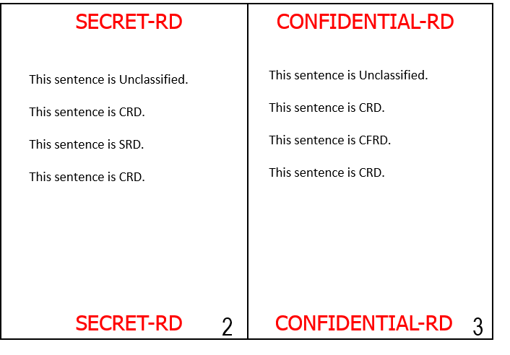
Recognizing Matter Containing RD and FRD - Interior Pages
Top and bottom marked with overall highest level and category of the matter or the highest level and category of the individual pages
Markings are for example purposes only
Notes:
Top and bottom marked with overall highest level and category of the matter or the highest level and category of the individual pages.
The examples show that the highest level and category of information in the document is Secret RD and the highest level and category of information on the page is Confidential FRD information.
In the example on the left every page is marked with the overall level (Secret) and overall category (RD) of the document. In the example on the right each interior page is marked with the highest level and category on the page.

Slide 21
Recognizing Matter Containing RD or FRD - Email
Banner will have level and category
Email will have Admonishment for RD or FRD
Classification Authority Block will have no declassification instruction line or N/A to RD (or FRD)
Notes:
You will be able to tell if an email contains RD or FRD because the level will be in the banner and the RD or FRD Admonishment will be in the email. Note that if the email does not contain NSI, there will be no automatic declassification instructions.

Slide 22
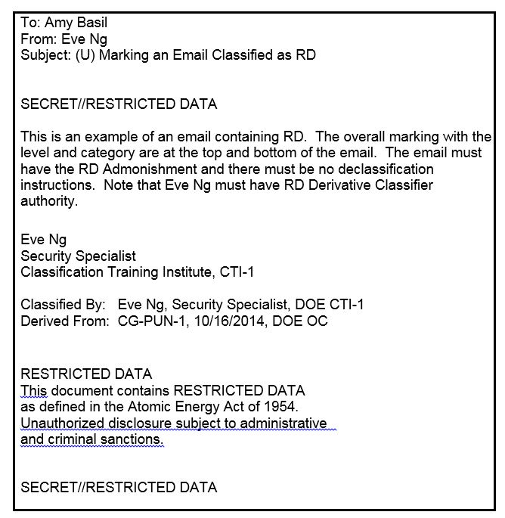
Example of email Containing RD
Markings are for example purposes only
Notes:
This is an example of an Email containing RD

Slide 23
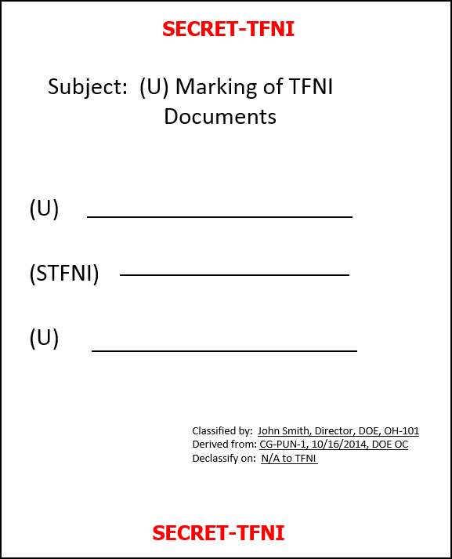
Recognizing Matter
Containing TFNI (with no RD or FRD)
Overall marking/banner contains TFNI
Matter containing TFNI or TFNI and NSI is portion marked
Classification Authority Block with no declassification instructions or N/A to TFNI
Notes:
Matter containing TFNI must have the TFNI identifier on all pages. The identifier must also be on the first page, because TFNI does not have an admonishment or warning statement. Matter containing TFNI must also be portion marked. Matter containing TFNI is never automatically declassified, so the “Declassify on:” line must read N/A to TFNI portions.

Slide 24
Portion Marking
Not required for matter containing RD or FRD
Agencies may require portion marking matter containing RD and FRD
Required for matter containing TFNI (and no RD or FRD)
When portion marked, the level and category are used to identify portions containing RD, FRD, or TFNI (e.g., CRD, SFRD, STFNI)
If matter containing RD or FRD is not portion-marked it CANNOT be used as a source document
Notes:
Not required for matter containing RD or FRD
Agencies may require portion marking matter containing RD and FRD
Required for matter containing TFNI (and no RD or FRD)
When portion marked, the level and category are used to identify portions containing RD, FRD, or TFNI (e.g., CRD, SFRD, STFNI)
If matter containing RD or FRD is not portion-marked it CANNOT be used as a source document

Slide 25
Classification Challenges
Any person with access to RD, FRD, or TFNI who believes that RD, FRD, or TFNI is improperly classified is encouraged and expected to challenge the classification.
Challenges are submitted in accordance with agency procedures, but may also be submitted directly to the DOE Director, Office of Classification, at any time.
Under no circumstances is the person subject to retribution.
Notes:
Any person with access to RD, FRD, or TFNI who believes that RD, FRD, or TFNI is improperly classified is encouraged and expected to challenge the classification.
Challenges are submitted in accordance with agency procedures, but may also be submitted directly to the DOE Director, Office of Classification, at any time.
The person must receive an initial response within 60 days
Under no circumstances is the person subject to retribution.

Slide 26
Access to RD, FRD, and TFNI
Must have a need to know and appropriate clearance
  Check with your supervisor or your agency security office if you have any doubt as to an individual’s “need-to-know.”
  Additional access authorization may apply
  (e.g., Sigma)
Notes:
You must ensure that access is only given to properly cleared individuals who have a need to know, the appropriate clearance and any additional access authorizations required.

Slide 27
Access Requirements
- non DoD agencies
Category Top Secret Secret Confidential
Restricted Data Q Q L
Formerly Restricted Data Same as NSI
Transclassified Foreign
Nuclear Information Same as NSI
Certain RD and FRD may require additional access authorizations
Notes:
These are the clearance requirements for all agencies except DoD. As you can see, in order to get access to RD you must have a DOE “Q” or “L” clearance depending on the level of the material.
The National Aeronautics and Space Administration (NASA) and the Nuclear Regulatory Commission (NRC) also have Q clearances. However, it is important to note that NASA Q clearances are accepted for NASA RD covering space reactors and power systems. If you have any questions, ask before you transmit the information.

Slide 28
RD Access Requirements
- DoD
Refer to DoD Instruction 5210.02 or
contact DASD(NM)
Notes:
For RD access requirements for DoD personnel, see DoD Instruction 5210.02 or contact DASD(NM)

Slide 29
Potential for Mismarked Matter
RD or FRD: There may be matter that contains RD or FRD information that is not marked RD or FRD
TFNI:
  Did not have special designation or unique marking prior to 2010
  Matter containing TFNI was previously (and may still be erroneously) marked as NSI with “25X2” or “50X2-WMD” declassification instructions
To ensure that all matter containing RD, FRD, and TFNI is reviewed by the appropriate authority, matter that MAY contain RD, FRD, or TFNI MUST be referred to DOE prior to public release (potential FRD may be referred to DoD)
Notes:
RD or FRD: There may be matter that contains RD or FRD information that is not marked RD or FRD
TFNI Did not have special designation or unique marking prior to 2010
Matter containing TFNI was previously (and may still be erroneously) marked as NSI with “25X2” or “50x2-WMD” declassification instructions
To ensure that all matter containing RD, FRD, and TFNI is reviewed by the appropriate authority, matter that MAY contain RD, FRD, or TFNI MUST be referred to DOE prior to public release (potential FRD may be referred to DoD)

Slide 30
Other Considerations
International exchange of RD/FRD
“No comment” policy
Sanctions
Notes:
Some other aspects you should be aware of when dealing with RD, FRD, or TFNI concern training requirements, international exchange, the “No Comment” policy and possible sanctions.

Slide 31
International Exchange Limitations
The Atomic Energy Act states there can be no exchange of RD or FRD except pursuant to an agreement for cooperation
FRD is treated as RD in foreign dissemination
Approval for exchange is a multi-step process
Contact the Joint Atomic Information Exchange Group (JAIEG) if you need to share RD or FRD with any foreign nation or regional defense organization; call either
JAIEG Deputy Chief (DoD) Dexter Simmons – (703) 681-0224
JAIEG Chief (DOE) Kevin Winston - (703) 681-0222
Notes:
RD and FRD cannot be exchanged internationally without an agreement for cooperation. If you need to exchange RD or FRD, you must contact the Joint Atomic Information Exchange Group (JAIEG).

Slide 32
“No Comment” Policy
Classified information may appear in the open literature (e.g., magazines, newspapers, webpages)
Appearance in the open literature does not make it unclassified
Must not comment on the accuracy, classification, or technical merit of the information
Notes:
Classified information may appear in the open literature (e.g., magazines, newspapers, webpages)
Appearance in the open literature does not make it unclassified
Must not comment on the accuracy, classification, or technical merit of the information

Slide 33
Sanctions
Any knowing, willful, or negligent action contrary to the requirements of 10 CFR 1045 that results in the misclassification and mishandling of information may result in sanctions
  Appropriate criminal, civil, and/or administrative penalties for violations
  Administrative sanctions possible for other violations of the policies and procedures of 10 CFR part 1045
Notes:
Failure to abide by the provision of 10 CFR part 1045 could result in sanctions.
For example, any knowing, willful, or negligent actions such as failing to get newly generated matter a person believes contains RD or FRD reviewed could be a serious incident if it results in a misclassification or mishandling of matter containing RD.
Possible punishments include criminal, civil, and administrative penalties, depending on the nature and severity of the action as determined by appropriate authority, in accordance with applicable laws. Other violations of 10 CFR part 1045 could result in administrative sanctions.

Slide 34
Suggestions or Comments
Suggestions or comments on RD, FRD, or TFNI classification or declassification policies or procedures can be made to an RDMO or directly to DOE
Suggestions/comments should include
  Description of the issue
  Suggestion or comment
  All applicable background information
  Address for the response
DOE address: Outreach Program, AU-61/ Germantown Building, 1000 Independence Avenue, SW., Washington, DC 20585-1290
Notes:
If you have any suggestions or comments on the DOE’s policies and procedures on classification and declassification covered by 10 CFR part 1045, the information covered by this briefing, contact the DOE Office of Classification Outreach Program.

Slide 35
Summary RD, FRD, and TFNI
 | RD | FRD | TFNI
Legal Basis | Atomic Energy Act | Atomic Energy Act | Atomic Energy Act
Authority to initially identify information | Only DOE | Joint DOE and DoD | Joint DOE and IC
Matter Classification (based on guide or source document) | RD Derivative Classifier | RD Derivative Classifier | Person trained to classify TFNI
Matter Declassification | Authorized persons in DOE only | Authorized persons in DOE or DoD | Authorized persons in DOE only
Automatic Declassification | Not subject to automatic declassification | Not subject to automatic declassification | Not subject to automatic declassification
Review for public release/FOIA and MDR requests | DOE only | DOE or DoD | DOE only

Slide 36
Who should you contact if you have questions?
Your RDMO or ARDMO
The DOE Office of Classification Outreach Program at (301) 903-7567 or outreach@hq.doe.gov
Notes:
If you have questions contact
Your RDMO or ARDMO
The DOE Office of Classification Outreach Program at (301) 903-7567 or outreach@hq.doe.gov

