Slide 1
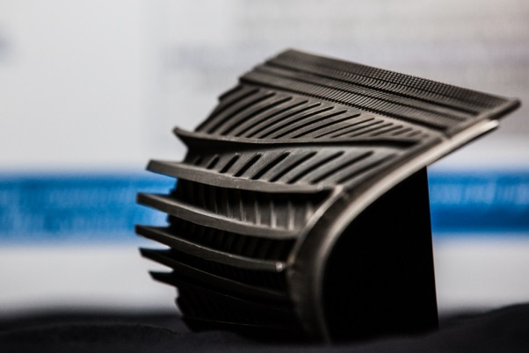
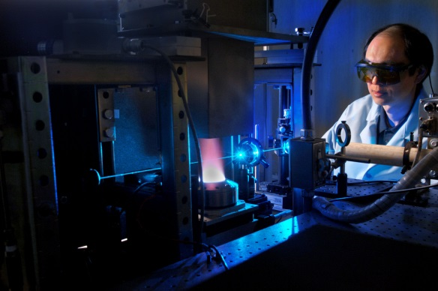
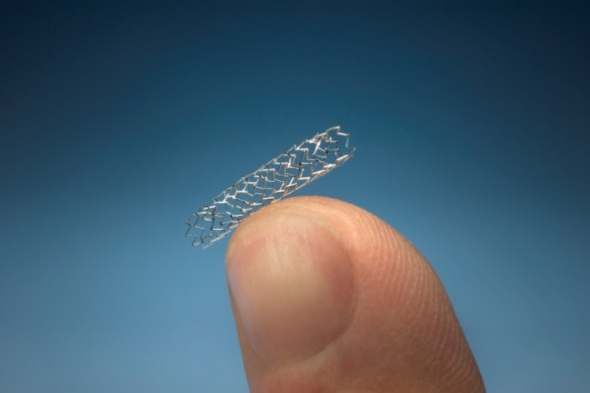
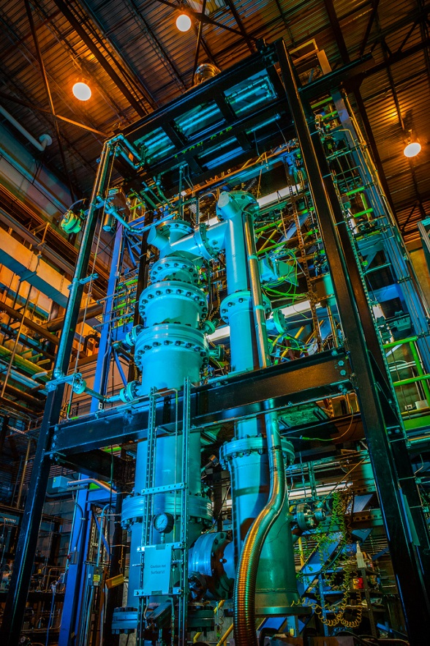
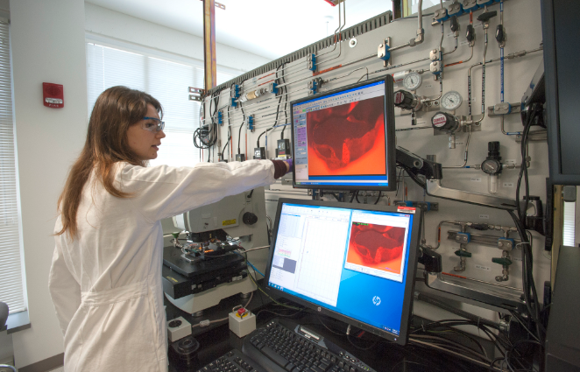
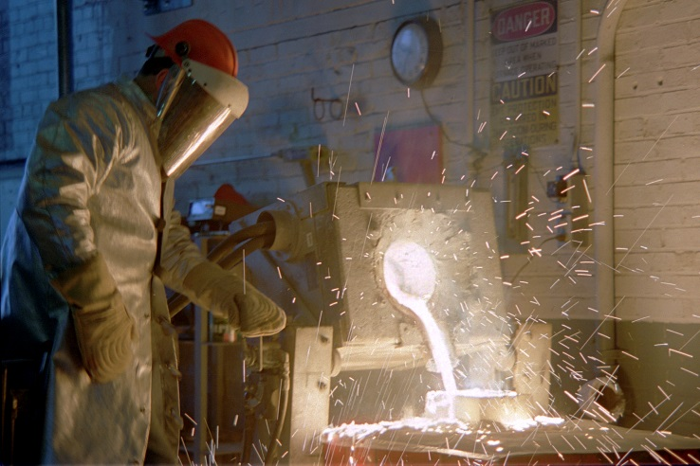

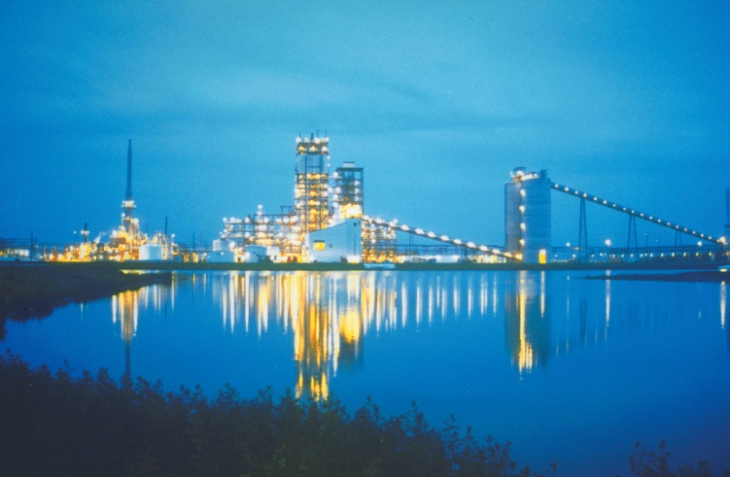
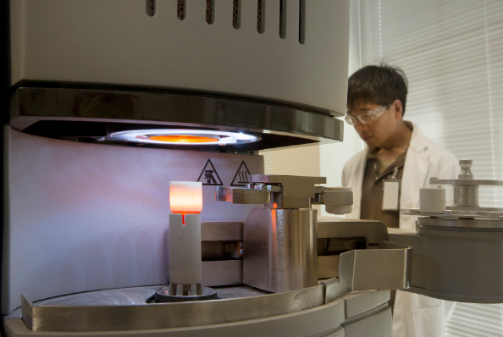
NETL RIC Natural Gas Hydrate FWP
Yongkoo Seol – FWP Lead
Jared Ciferno – Tech Mgr Oil and Gas
October 19, 2016

Slide 2
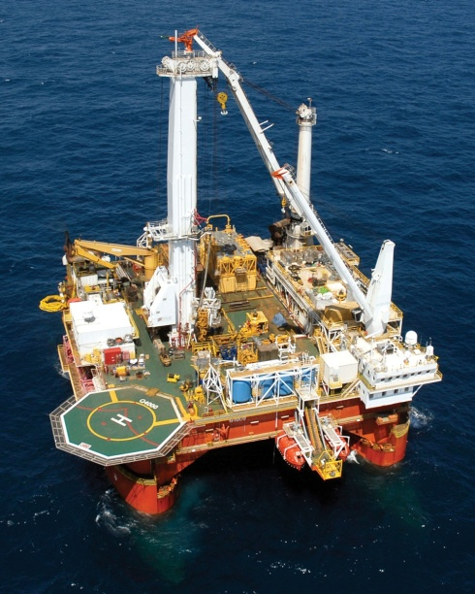
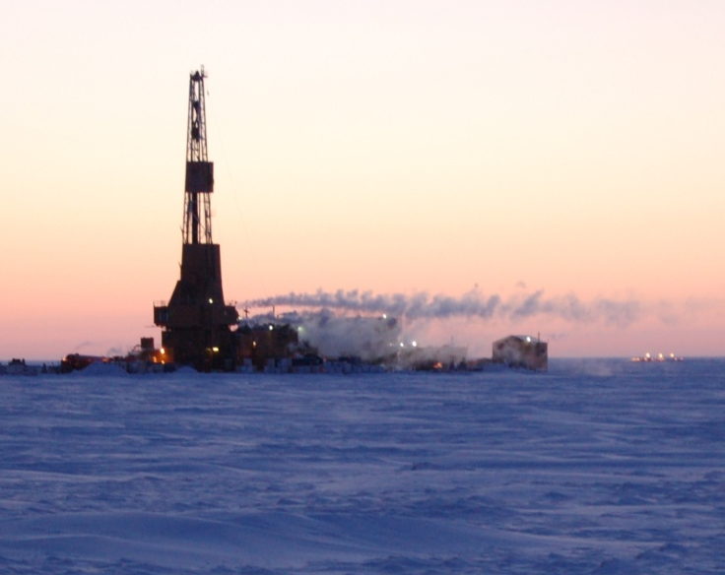
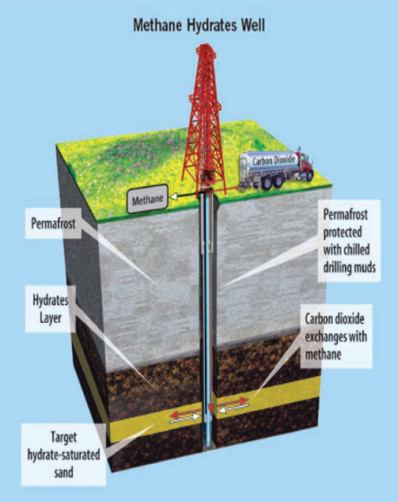
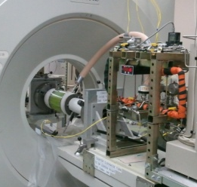
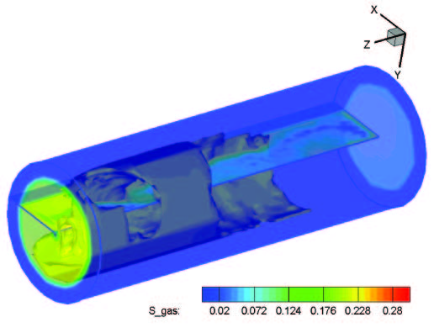
NETL RIC Gas Hydrate R&D
DOE National Program Mission
Determine the potential for methane hydrates as a energy source, the environmental impacts associated with production, and it’s role in the global climate cycle.
NETL RIC Supports the Program
Enabling the realization of the Nation’s methane hydrates resource potential, through:
Improved understanding of the fundamental behavior of hydrates, both in situ, and during man-made disturbances.
Development of predictive models that accurately describe gas production, responsive ground deformation, and environmental impacts.
Laboratory experiments that support numerical simulations by providing accurate input data.

Slide 3
Task 2: Numerical Simulations Supports
Importance
  Maintain and develop numerical modeling capability to support planning, executing, and analysis of field production tests and long-term prediction of reservoir performance and environmental impacts.
Scope
  Numerical modeling supports for long-term production tests in permafrost of Alaska North Slope.
  Reservoir simulations for gas productions from marine hydrate deposits (e.g. India NGHP-03, Japan Nankai Trough).
  New production technology (e.g. CO₂ injection, Brine injection, thermal disturbance).
  Core/pore scale simulations to complement laboratory studies on functional forms of relative permeability functions governing multiphase flow
  Basin and petroleum system modeling to understand gas hydrate accumulation in geological time scale at selected GOM mini-basin.

Slide 4
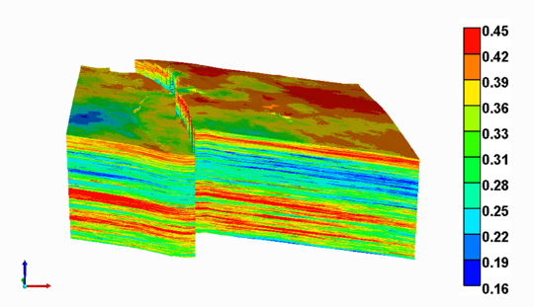
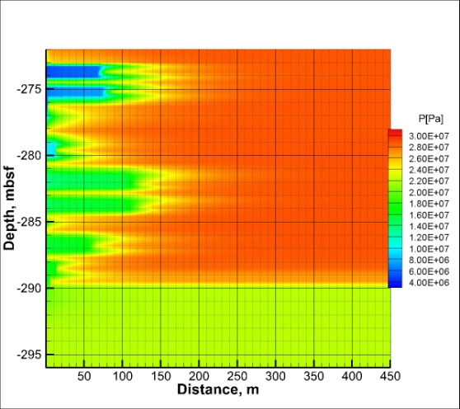
Task 2: Numerical Simulations Supports
Major FY16 Accomplishments:
  Development and application of 3D heterogeneous reservoir model for gas production potential on the Alaska North Slope
  Reservoir model development (thin interbedded layers) for NGHP-03 gas production test in India and sensitivity analysis
  Numerical estimation of gas production through new production technology: CO₂ injection into the base of methane hydrate reservoir
Expected Accomplishments:
  FY17: Continued efforts of numerical simulations support for gas production from hydrate reservoirs (interbedded layer system at NGHP-03, GOM 3D heterogeneous model), new production technology, and PetroMod basin model setup for GOM mini-basin
  Beyond: Comprehensive modeling supports on hydrate production, environmental impacts, and development, and resource assessment.

Slide 5
Task 3: Thermal-Hydro-Chemo-Mechanical Simulator
Importance
  High quality prediction of the hydrate-bearing sediment behavior under natural conditions and gas production scenarios, concerning (1) all possible hydrate dissociation mechanisms (e.g. depressurization, thermal stimulation, brine injection, CO₂/N₂ injection etc.) and (2) incorporated fully coupled flow-geomechanical formulations computing stress induced impacts on flow and porous media, solid phase (sand) migration.
Scope
  Incorporate in-code coupled flow-geomechanical formulation to compute
  stress-induced impact on the flow properties and porous media to reliably predict production potential and manage risk associated with changes in structural integrity during hydrate decomposition in host sediment
  Provide in-code capability to account for solid phase (sand) migration into producing stream
  Include thermodynamic basis to treat carbon dioxide in supercritical state
  (important for new production technique development benefiting from prior carbon sequestration)

Slide 6
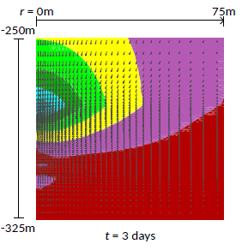
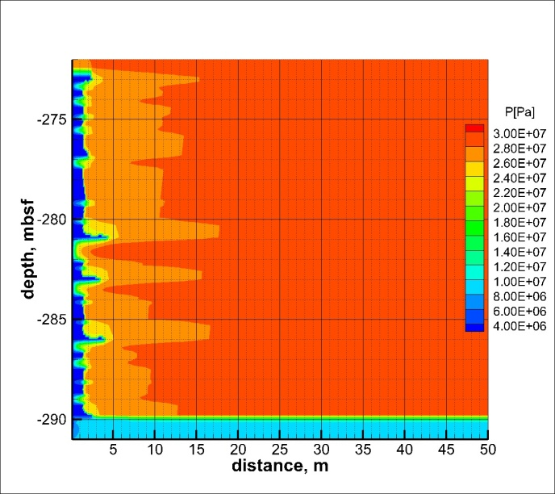
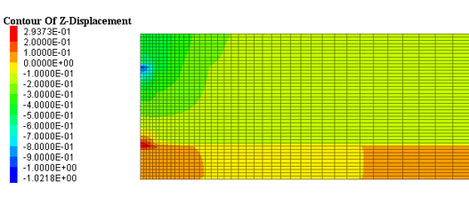
Task 3: Thermal-Hydro-Chemo-Mechanical Simulator
FY16 Accomplishments
  Developed new constitutive relations for geomechanical modeling of hydrate-bearing sediments based on NETL R&IC experimental measurements
  Developed thermal-hydrological-geomechanical analytical formulations of sand production
Expected Accomplishments
  FY17: Initiate fully coupled THM model for gas production, reservoir deformation, and solid production.
  Beyond: NETL owned, open-sourced fully coupled THM simulator (Mix3HydraResSim, M3HRS), validated for reservoir simulations of gas production potential and reservoir behavior

Slide 7
Task 4: Fundamental Property Characterizations
Importance
  Hydrate relevant physical properties (hydrological, thermal, and geomechanical) are critical for accurate predictions of hydrate bearing sediment behavior and flow migrations.
  Deficiency in properties including relative permeability and geomechanical strength should be improved for high quality prediction based on numerical reservoir simulations.
Scope
  To complete measuring mechanical properties of HBS before/during hydrate dissociation under various overburden stresses and hydrate saturations, to develop a data set for constitutive models
  To complete measuring gas-liquid relative permeability in HBS involving dissociated CH₄ and in-situ brine as an input for numerical simulation of hydrate productions
  To conduct microfluidic relative permeability experiments to obtain the values of key parameters of relative permeability in hydrate-bearing sediment
  To characterize seismic characteristics of hydrate bearing sediments (i.e., velocity, amplitude and attenuation, characteristic frequency, etc.) during hydrate dissociation
  To visualize hydrate pore-scale habits impacted by water and fines contents

Slide 8
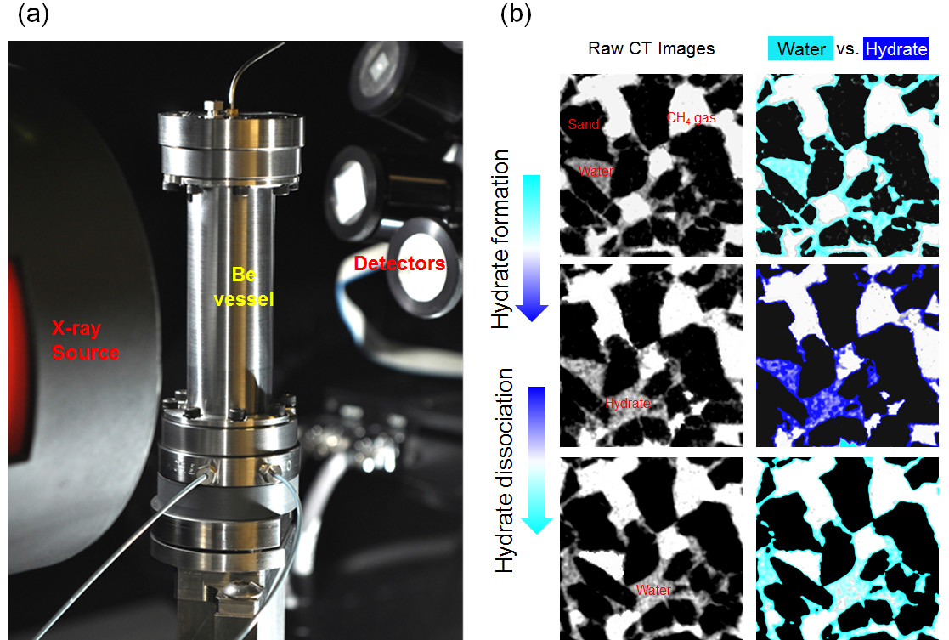
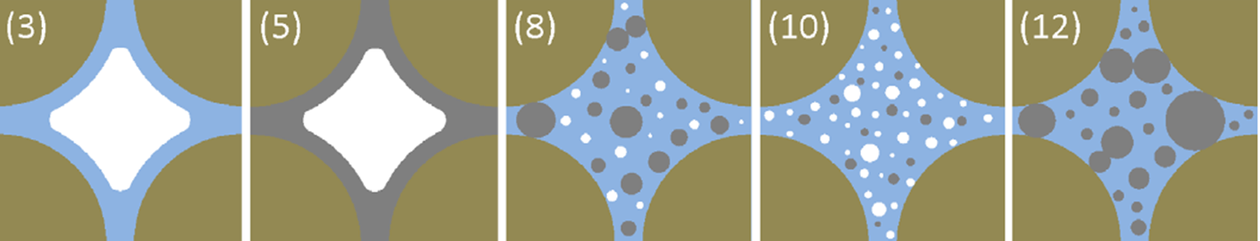
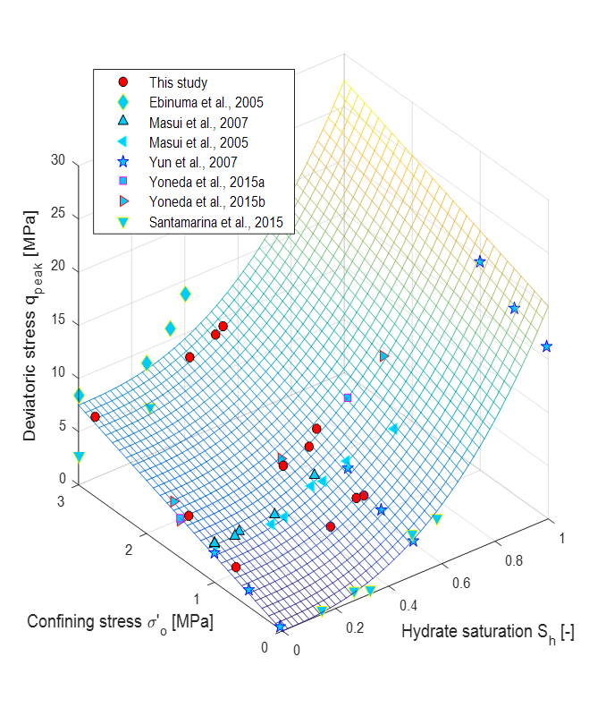
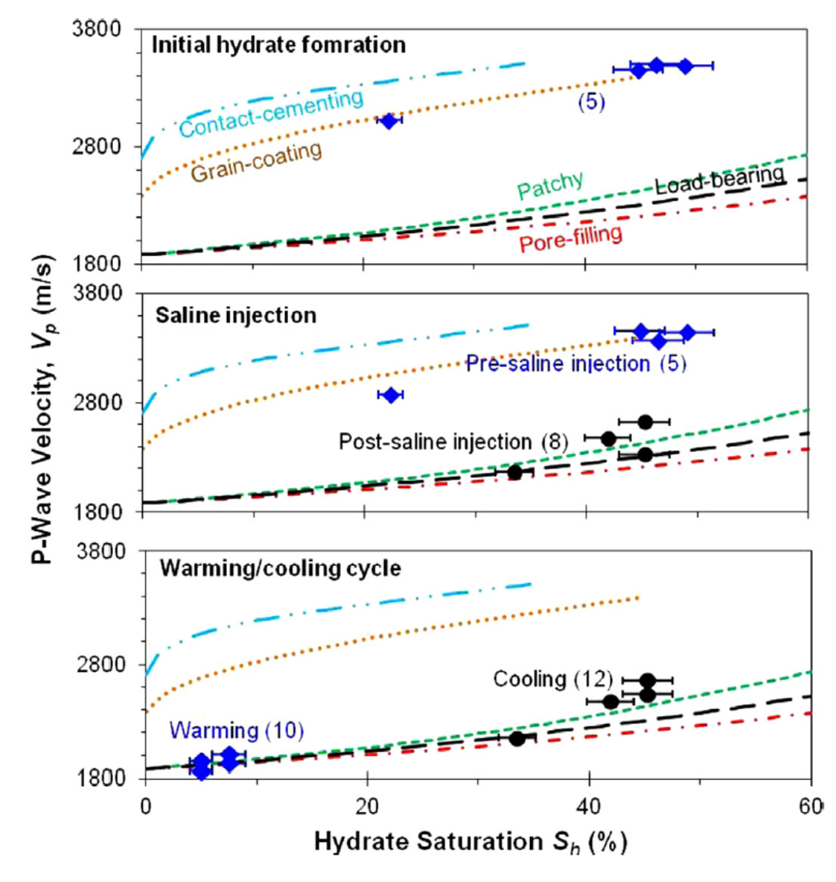
Task 4: Fundamental Property Characterizations
Major FY16 Accomplishments
  Noble laboratory synthesis method of non-cementing hydrate bearing sediment
  Completed measurements of geomechanical strength with varied hydrate contents, thermal conductivity under dissociation, pore-scale estimation of relative permeability with microfluidic system
Expected Accomplishments
  FY17: Comprehensive property database (geomechanical strength, relative permeability) for hydrate bearing sediments under natural condition and production scenarios.
  Beyond: Completed integration of physical properties of hydrate-bearing sediments into numerical simulators.

Slide 9
Task 5: Field Supports and External Collaborations
Importance
  Tools to characterize pressure cores retrieved from natural condition without any PT disturbance and to visualize hydrate accumulation habits in pore scale are critical for success of hydrate developments
  International collaborations is critical for success of methane hydrate developments
Scope
  To develop and maintain a new suite of state-of-the-art pressure core characterization and testing chambers to support international and domestic pressure coring activities
  To provide technical expertise and tools in the area of analysis and characterization of pressure- and conventional- cores from international and domestic gas hydrate field activities
  To promote and participate communications and collaborations among international and domestic hydrate research parties

Slide 10
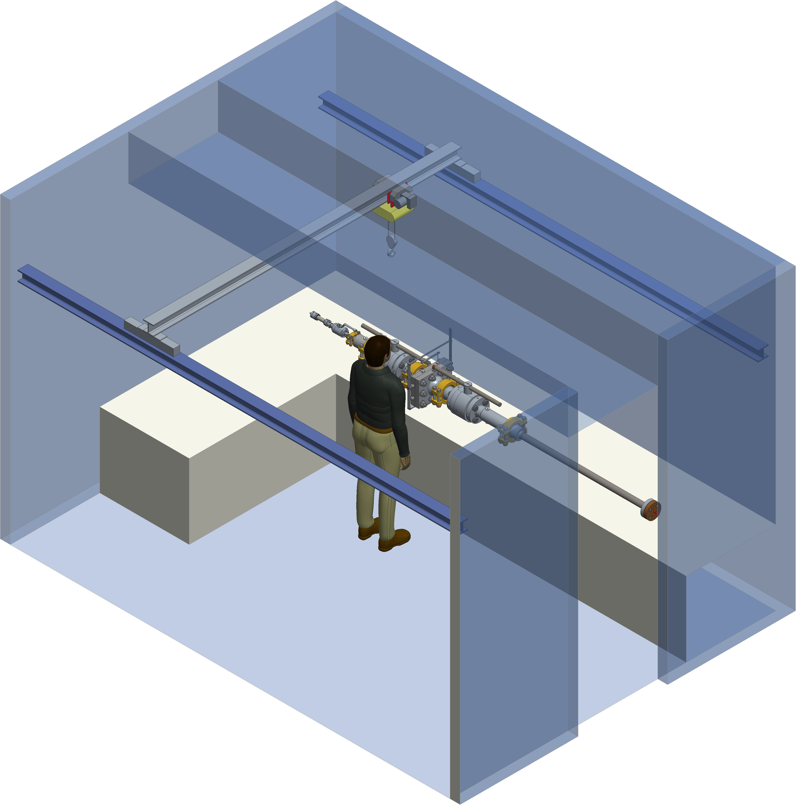
Task 5: Field Supports and External Collaborations
Major FY16 Accomplishments
  Completed detailed designs of high-pressure sub-corer for micro-CT studies, cutter, manipulator, and effective stress chambers
  Coordinating international meetings (US-Korea collaboration) and workshops on (1) code comparison studies, and (2) geomechanical property
  Supports on NGHP-03 Planning through production potential simulations
Expected Accomplishments
  FY17: Completed design and fabrication of pressure core characterization tools and applications for high resolution imaging of hydrate in pores and physical properties measurements
  Beyond: (1) Complete sets of tools handling and characterizing pressure- and conventional cores of hydrate bearing sediments, (2) Maintaining leading role at international hydrate research community

Slide 11
Task 6: Systems Engineering and Analysis
Importance
  Systems Engineering and Analysis (SEA) efforts provide critical analysis on energy systems and markets as well as the components of these systems and markets
  Methane Hydrates present a significant potential resource, yet utilization of this resource may present challenges with respect to climate change. SEA can provide an analysis of the market opportunity for methane hydrates as well as an understanding on the climate challenge impacts on markets associated with its use.
Scope
  Assess depletion of Natural Gas reserves and resulting decline in Natural Gas production in the 2040 time frame and potential for Methane Hydrates to provide methane gas to the market.
  Literature/scoping study on current studies/research and impact of methane hydrate release on climate change either by dissolution or production.
Expected Accomplishments
  (1) Evaluation of potential for methane hydrate production to replace declining production on conventional and unconventional natural gas production to meet market demand in the 2040 time frame. (2) Literature review/scoping report on analysis/research on climate impacts

