Slide 1

Base Load Measures
WEATHERIZATION ENERGY AUDITOR SINGLE FAMILY
WEATHERIZATION ASSISTANCE PROGRAM STANDARDIZED CURRICULUM – December 2012

Slide 2
Learning Objectives
Base Load Measures
By attending this session participants will be able to:
Define base load measures.
Recognize base load measures allowable in the WAP based on Appendix A.
Discuss how to use utility bill analysis to determine base load usage.
Identify tools useful for calculating energy and money savings associated with common base load measures.
Notes:
By attending this session, participants will be able to:
Define base load measures.
Recognize base load measures allowable in the WAP based on Appendix A.
Discuss how to use utility bill analysis to determine base load usage.
Identify tools useful for calculating energy and money savings associated with common base load measures.

Slide 3
Base Load Defined
Base Load Measures
Base Load:
The energy used by electric or gas appliances in a home that is not used for space conditioning, thus it is not a seasonal load.
Typical measures include:
Lighting retrofits.
Refrigerator replacement.
Water heater modification.
Low-flow fixtures.
Notes:
Base load: The energy used by electric or gas appliances in a home that is not used for space conditioning, and therefore is not a seasonal load.
Typical measures include:
Lighting retrofits–Replacing incandescent or halogen bulbs with compact fluorescent lamps (CFLs).
Refrigerator replacement.
Water heater modification.
Installation of low-flow fixtures, such as low-flow showerheads and faucet aerators.

Slide 4
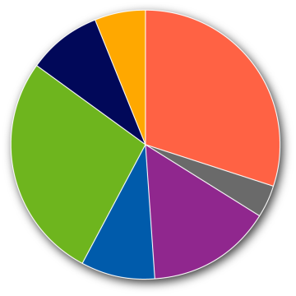
Why Target Electric Base Loads?
Base Load Measures
Percent of Total Energy Costs by End Use
in Income Eligible Households
Lighting 6%
Refrigerator 9%
30% Space Heating
Appliances 27%
(other) ….
4% Cooking
15% Water Heating
Space Cooling 9%
Source: Energy Information Administration, U.S. Department of Energy
Notes:
This graph shows the percent of total energy costs by end use of income eligible households.
Space heating and cooling make up 39% of the energy use in weatherization-eligible homes. That means 61% of the total energy use is base load and can be reduced by modifying or replacing existing appliances to increase efficiency.

Slide 5
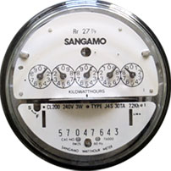
Why Target Electric Base Loads?
Base Load Measures
About half of the electricity used by households with electric heat is for base loads.
Many homes heated with fossil fuel have higher
annual electric bills than gas
or oil bills.
Photo courtesy of PG&E
Notes:
These are two reasons to target electric base loads:
About half of the electricity used by households with electric heat is for base loads.
Many houses heated with fossil fuel have higher annual electric bills than gas or oil bills.

Slide 6
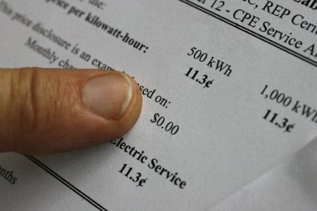
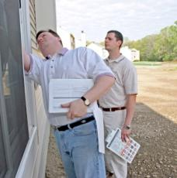
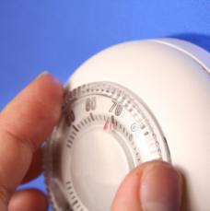
Consumption Analysis
Base Load Measures
1. Analyze Bill
2. Survey Site
3. Reconcile
the Two
#1 Photo courtesy of National Energy Deregulation Information
#2 Photo courtesy of National Home inspection Services of New England
#3 Photo courtesy of Life123 Inc.
Notes:
Consumption analysis includes three steps:
Analyze bill – How much energy is going to base load uses?
Survey site – What are the main base loads?
Reconciliation of the two – Do the utility bills make sense in light of the site survey?

Slide 7
Simple Bill Analysis Method
Base Load Measures
Bill Analysis
Review previous 12 months.
Average three lowest months.
Multiply by 12 to estimate
annual base load usage.
Photo courtesy of National Energy Deregulation Information
Notes:
Review the previous 12 months of the client’s energy bills. This reveals seasonal loads associated with heating and cooling.
Average the three lowest months, which are those with little-to-no heating or cooling costs. These months provide a picture of the total base load of the home. Averaging the three months together helps to account for vacations when the home was empty or high-use weeks that are out of the ordinary.
Multiply by 12 to estimate annual base load usage.

Slide 8
Site Survey Analysis
Base Load Measures
Site Survey Analysis
Account for typical consumption.
  Where does all the juice go?
Build a consumption table based on:
  Client interviews.
  Known and guesstimated wattages.
Hint – Identify the 5 biggest users.
Photo courtesy of National Home inspection Services of New England
Notes:
Account for typical consumption.
Where does all the juice go?
Build a consumption table based on client interviews and known and guesstimated wattages.
Hint – Identify the five biggest users.
Ask students what they think are typically the five biggest users.
They are lighting, water heaters, refrigerators, clothes dryers, and various electronics (especially flat-screen TVs).

Slide 9
Post-Survey Analysis
Base Load Measures
Post-Survey Analysis
Are there existing loads whose consumption can be reduced by:
  Repair?
  Installation or replacement?
  Client education?
Is it cost effective?
Is it listed in Appendix A?
Photo courtesy of Life123 Inc.
Notes:
After analyzing consumption, the question becomes whether the WAP can lower base load energy use for this home.
Are there existing loads whose consumption can be reduced by:
Repair?
Installation or replacement?
Client education?
Is it cost-effective? Except for health and safety measures, all measures installed with WAP money must be cost-effective.
Is it listed in Appendix A of the 10 CFR 440 Weatherization rule? Appendix A lists materials and equipment that DOE WAP funds can be spent on in various categories. States may ask for special additions within its state plans, and if approved by DOE those are also acceptable. If the equipment you’re interested in replacing or repairing isn’t listed in Appendix A, check with state staff to see if you have, or might want to get, an allowance to work on that equipment statewide.

Slide 10
Bill Analysis Examples
Base Load Measures
Month | Bill kWh | Ave. Base Load | Heat? | Cool?
Jan
Feb
Mar
Apr
May
June
July
Aug
Sept
Oct
Nov
Dec
Total
% Base Load Use
Record:
Lowest Reading
2nd Lowest
3rd Lowest
Average Monthly Base Load
Notes:
The auditor can use a simple table like this to arrange utility bills by month, separate base load, and guesstimate heating and cooling loads.

Slide 11
Bill Analysis Example #1
Base Load Measures
Date | # of Days | Reading | kWh
5/7/99 | 29 | 06248 | 1031
4/8/99 | 30 | 05217 | 1968
3/9/99 | 29 | 03249 | 3143
2/8/99 | 31 | 00106 | 3356
1/8/99 | 32 | 96750 | 3648
12/7/98 | 33 | 93102 | 2206
11/4/98 | 29 | 90896 | 1327
10/6/98 | 32 | 86569 | 576
9/4/98 | 29 | 88993 | 442
8/6/98 | 29 | 88551 | 874
7/8/98 | 30 | 87667 | 522
6/8/98 | 32 | 87155 | 538
5/7/98 | 30 | 86617 | 941
Notes:
This table is typical of the information utility companies will provide. For bill analysis, the critical facts are:
Month.
Amount of kWh used that month.
Q: Based on the information shown here, is this sample home in a heating-dominated or cooling-dominated climate?
A: Heating-dominated. The highest-use months are in the winter: January, February, and March, indicating electric heating in a cold climate.

Slide 12
Bill Analysis Example #1
Base Load Measures
Month | Bill kWh | Ave. Base Load | Heat? | Cool?
Jan | 3,356
Feb | 3,143
Mar | 1,968
Apr | 1,031
May | 538
June | 522
July | 874
Aug | 442
Sept | 576
Oct | 1,327
Nov | 2,206
Dec | 3,648
Total | 19,631
% Base Load Use
Lowest Reading
2nd Lowest
3rd Lowest
Average Monthly Base Load
442
522
538
1,502/3
= 501
Notes:
Here is that same information, inserted into the bill analysis table.
Q: Which are the three lowest months for energy use?
A: Click to reveal the three lowest readings, from August, June, and May, and the average monthly base load calculation.
In this example, approximately 501 kWh/month are used for base load.

Slide 13
Bill Analysis Example #1
Base Load Measures
Month | Bill kWh | Ave. Base Load | Heat? | Cool?
Jan | 3,356 | 501
Feb | 3,143 | 501
Mar | 1,968 | 501
Apr | 1,031 | 501
May | 538 | 501
June | 522 | 501
July | 874 | 501
Aug | 442 | 501
Sept | 576 | 501
Oct | 1,327 | 501
Nov | 2,206 | 501
Dec | 3,648 | 501
Total | 19,631 | 6,008
% Base Load Use |  | 31%
Lowest Reading | 442
2nd Lowest | 522
3rd Lowest | 538
Average Monthly Base Load | 501
Notes:
Click to highlight the annual percentage of the energy bill that is base load.
501 kWh makes up 31% of this home’s total energy bill.

Slide 14
Bill Analysis Example #1
Base Load Measures
Month | Bill kWh | Ave. Base Load | Heat? | Cool?
Jan | 3,356 | 501 | 2,855
Feb | 3,143 | 501 | 2,642
Mar | 1,968 | 501 | 1,467
Apr | 1,031 | 501
May | 538 | 501
June | 522 | 501 |  | 21
July | 874 | 501 |  | 373
Aug | 442 | 501 |  | -59
Sept | 576 | 501
Oct | 1,327 | 501
Nov | 2,206 | 501 | 1,705
Dec | 3,648 | 501 | 3,147
Total | 19,631 | 6,008
% Base Load Use |  | 31%
Lowest Reading | 442
2nd Lowest | 522
3rd Lowest | 538
Average Monthly Base Load | 501
Notes:
The remaining 69% can then be separated into suspected heating and cooling loads.

Slide 15
Bill Analysis Example #2
Base Load Measures
Date | # of Days | Reading | kWh
1/29/99 | 30 | 65389 | 344
12/30/98 | 35 | 65045 | 418
11/25/98 | 29 | 64627 | 347
10/27/98 | 29 | 64280 | 330
9/28/98 | 32 | 63950 | 422
8/27/98 | 28 | 63528 | 401
7/30/98 | 30 | 63127 | 416
6/30/98 | 32 | 62711 | 455
5/29/98 | 30 | 62256 | 390
4/29/98 | 30 | 61866 | 312
3/30/98 | 28 | 61554 | 262
3/2/98 | 32 | 61292 | 255
1/29/98 | 30 | 61037 | 312
Notes:
Another bill analysis example.
Q: Based on the information shown here, is this a heating- or cooling-dominated climate?
A: It’s difficult to say for sure, but it looks like either a very moderate climate, or the home uses alternative fuel for heating since there is very little fluctuation in seasonal energy usage.

Slide 16
Bill Analysis Example #2
Base Load Measures
Month | Bill kWh | Ave. Base Load | Heat? | Cool?
Jan | 344
Feb | 255
Mar | 262
Apr | 312
May | 390
June | 455
July | 416
Aug | 401
Sept | 422
Oct | 330
Nov | 347
Dec | 418
Total | 4,352
% Base Load Use
Lowest Reading
2nd Lowest
3rd Lowest
Average Monthly Base Load
255
262
312
829/3
= 276
Notes:
Q: Which are the three lowest months for energy use?
A: Click to reveal the three lowest readings, from February, March, and April, and the average monthly base load calculation.

Slide 17
Bill Analysis Example #2
Base Load Measures
Month | Bill kWh | Ave. Base Load | Heat? | Cool?
Jan | 344 | 276
Feb | 255 | 276
Mar | 262 | 276
Apr | 312 | 276
May | 390 | 276
June | 455 | 276
July | 416 | 276
Aug | 401 | 276
Sept | 422 | 276
Oct | 330 | 276
Nov | 347 | 276
Dec | 418 | 276
Total | 4,352 | 3,316
% Base Load Use |  | 76%
Lowest Reading | 255
2nd Lowest | 262
3rd Lowest | 312
Average Monthly Base Load | 276
Notes:
This home uses far less energy overall and only a little over half the energy the previous home used for base load, but this base load still makes up a whopping 76% of the annual energy bill.
Click to highlight the annual percentage of the energy bill that is base load.

Slide 18
Bill Analysis Example #3
Base Load Measures
Date | # of Days | Reading | kWh
2/24/00 | 29 | 10036 | 1904
1/26/00 | 30 | 08132 | 2097
12/27/99 | 40 | 06035 | 2341
11/17/99 | 30 | 03694 | 1382
10/18/99 | 31 | 02312 | 695
9/17/99 | 30 | 01617 | 1334
8/18/99 | 28 | 00283 | 1175
7/21/99 | 34 | 99108 | 1314
6/17/99 | 29 | 97794 | 888
5/19/99 | 28 | 96906 | 752
4/21/99 | 30 | 96154 | 1182
3/22/99 | 29 | 94972 | 1826
Notes:
Here’s one last bill analysis example.
Q: Based on the information shown here, is this a heating- or cooling-dominated climate?
A: Heating-dominated. The highest-use months are in the winter.

Slide 19
Bill Analysis Example #3
Base Load Measures
Month | Bill kWh | Ave. Base Load | Heat? | Cool?
Jan | 2,097
Feb | 1,904
Mar | 1,826
Apr | 1,182
May | 752
June | 888
July | 1,314
Aug | 1,175
Sept | 1,314
Oct | 695
Nov | 1,382
Dec | 2,341
Total | 16,870
% Base Load Use
Lowest Reading
2nd Lowest
3rd Lowest
Average Monthly Base Load
695
752
888
2,335/3
= 778
Notes:
Once again, averaging the three lowest readings provides us with the average monthly base load: 778 kWh.
Click to reveal the three lowest readings and calculations.

Slide 20
Bill Analysis Example #3
Base Load Measures
Month | Bill kWh | Ave. Base Load | Heat? | Cool?
Jan | 2,097 | 778
Feb | 1,904 | 778
Mar | 1,826 | 778
Apr | 1,182 | 778
May | 752 | 778
June | 888 | 778
July | 1,314 | 778
Aug | 1,175 | 778
Sept | 1,314 | 778
Oct | 695 | 778
Nov | 1,382 | 778
Dec | 2,341 | 778
Total | 16,870 | 9,340
% Base Load Use |  | 55%
Lowest Reading | 695
2nd Lowest | 752
3rd Lowest | 888
Average Monthly Base Load | 778
Notes:
At an average of 778 kWh/month, base load accounts for 55% of this home’s annual energy use.
Click to highlight the annual percentage of the energy bill that is base load.

Slide 21
Bill Analysis Example #3
Base Load Measures
Month | Bill kWh | Ave. Base Load | Heat? | Cool?
Jan | 2,097 | 778 | 1,319
Feb | 1,904 | 778 | 1,126
Mar | 1,826 | 778 | 1,048
Apr | 1,182 | 778
May | 752 | 778
June | 888 | 778 |  | 110
July | 1,314 | 778 |  | 536
Aug | 1,175 | 778 |  | 397
Sept | 1,314 | 778
Oct | 695 | 778
Nov | 1,382 | 778 | 604
Dec | 2,341 | 778 | 1,563
Total | 16,870 | 9,340
% Base Load Use |  | 55%
Lowest Reading | 695
2nd Lowest | 752
3rd Lowest | 888
Average Monthly Base Load | 778
Notes:
The remaining 45% can then be separated into suspected heating and cooling loads.

Slide 22
What is High Usage?
Base Load Measures
The greater the waste, the greater potential for savings.
Charts and table from experts, utilities, etc., seldom agree on exact kWh for average or high usage of various appliances.
Notes:
The greater the waste, the greater potential for savings.
Charts and table from experts, utilities, etc., seldom agree on the exact kWh for average or high usage of appliances.

Slide 23
Appliance Energy Use (Annual)
Base Load Measures
Appliance | Low kWh | Mid kWh | High kWh
Refrigerator | 400 | 900 | 1,500
Clothes Dryer | 500 | 900 | 1,200
Clothes Washer | 500 | 900 | 1,200
Indoor Lighting | 350 | 900 | 1,200
Air Conditioning | 300 | 500 | 750
Cooking | 300 | 500 | 750
Television | 200 | 350 | 600
Outdoor Lighting | 50 | 250 | 350
Space Heating Motors | 150 | 250 | 350
Stereo | 100 | 200 | 300
Hair Dryer | 25 | 100 | 200
Vacuum Cleaner | 25 | 50 | 75
Miscellaneous | 100 | 200 | 400
Notes:
This table shows the wide range of energy use within a single class of appliances.
Many factors affect the energy efficiency of appliances including:
Age – Most appliances decline in efficiency each year they operate.
Standards – Federal efficiency standards at the time of manufacture regulate the unit’s maximum energy use.
Size – Bigger may mean better to some, but it generally means more energy use.
Special features – Through-the-door ice and water service on refrigerators ups energy usage significantly. Moisture-sensors on clothes dryers reduce energy use.
User habits – Leaving lights on, standing in front of an open refrigerator deciding what to eat, and running air conditioners with the windows open are all examples of user habits that increase energy use.

Slide 24
(Very) General Rule of Thumb
Base Load Measures
There may be good potential for savings if a four-person household uses:
More than 600 kWh/month without an
electric water heater, or
More than 1,000 kWh/month with an
electric water heater.
Notes:
There may be good potential for savings if a four-person household uses:
More than 600 kWh/month without an electric water heater.
More than 1,000 kWh/month with an electric water heater.

Slide 25
Occupant Impacts
Base Load Measures
Base load use is affected by:
  Number of occupants.
  Size and efficiency of equipment.
  Habits of occupants.
Client education is key to effectively reducing base-load energy use.
Notes:
Base load use is affected by:
The number of occupants.
Size and efficiency of the equipment.
Habits of occupants.
In many cases, appliances may not qualify for replacement, but clients can still reduce their energy use by changing habits. Client education is key.

Slide 26
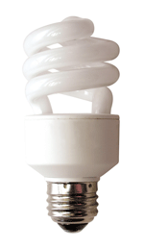
Lighting
Base Load Measures
Lighting accounts for up to 10% of total home energy use.
With Compact Fluorescent Lighting (CFL) retrofits, can cut that by 75%.
Overall energy reduction of
7.5% for the home.
Notes:
Lighting accounts for up to 10% of total home energy use.
CFL retrofits can cut lighting energy use by 75%, yielding an overall energy reduction of 7.5% for the home.

Slide 27
Lumen Table
Base Load Measures
  CFLs save energy by producing more light (output)
  per watt of energy used.
  The light output is measured in lumens.
Incandescent (watts) | Minimum Light Output (lumens) | Common ENERGY STAR Qualified Bulbs (watts)
40 | 450 | 9 to 13
60 | 800 | 13 to 15
75 | 1,100 | 18 to 25
100 | 1,600 | 23 to 30
150 | 2,600 | 30 to 52
Notes:
Table showing wattage of incandescent bulbs and CFLs with comparable lumen output
CFLs save energy by producing more light per watt of energy used.
The light output is measured in lumens.

Slide 28
Lighting Savings Table
Base Load Measures
CFLs save energy by producing more light output (measured in lumens) per watt of energy used.
Incandescent (watts) | Average Usage (Hrs/Day) | CFL Replacement (watts) | Annual Savings* ($/ bulb replaced)
40 | 4 | 9 - 13 | 4.98
60 | 4 | 13 - 15 | 7.55
75 | 4 | 18 - 25 | 9.15
100 | 4 | 23 - 30 | 12.37
150 | 4 | 30 - 52 | 19.27
* Annual Savings based on $0.11/kWh.
Notes:
This table shows annual savings per bulb for a range of CFL replacements.
The greater the use, the greater the potential savings.
These numbers are based on $0.11/kWh.
This table shows just one year of savings and does not account for the costs associated with replacing incandescent bulbs, which burn out about 10 times faster than CFLs.

Slide 29
Lighting & CFL Considerations
Base Load Measures
Dimmers
Photocells
Specialty bulbs (candelabra, reflectors, etc.)
Color Scale
  CRI: 0 – 100; most CFLs are between 80-90
  Kelvin Temperature
    2700 - 3000K: Warm white/soft white light (incandescent)
    3500 - 4100K: Cool or bright white light
    5000 - 6500K: Natural or daylight
Mercury
Notes:
Some people may be reluctant to have CFLs installed in their homes due to past experiences or sensationalized news stories about the mercury content. Specify these replacements to ensure that clients have positive experiences with their lighting retrofits:
Dimmers – General-use CFLs are not designed to work with dimmer switches. Special CFLs are available. Be sure to specify “dimmer compatible” CFLs when replacing incandescent bulbs in fixtures with dimmer switches.
Photocells – General-use CFLs are not designed to work with photocells. Dimmer-compatible bulbs do work in these fixtures.
Specialty bulbs (candelabra, reflectors, etc.) – Specify a replacement that fits the fixture properly, accepting whatever lampshade or other hardware is part of the fixture.
Color scale – One of the most common complaints about CFLs is that the light is unflattering. Avoid this problem by specifying bulbs according to the color scale.
Color rendering index (CRI): 0–100; most CFLs are between 80 and 90.
Kelvin temperature.
2700–3000K: Warm white/soft white light.
3500–4100K: Cool or bright white light.
5000–6500K: Natural or daylight.
Mercury – There is a small amount of mercury in each bulb. How small?
Ask students if they have heard concerns about mercury in CFLs.

Slide 30
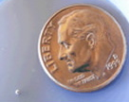
Mercury?
Base Load Measures
Most CFLs contain around 4 milligrams
of mercury.
Reduced electricity
use offsets the mercury in the bulb.
The amount of mercury contained within a typical CFL compared to a US dime.
Notes:
Most CFLs contain around 4 milligrams of mercury. The photo shows how small 4 milligrams is.
This mercury is of no danger to anyone unless the bulb breaks. If a bulb breaks, follow EPA’s clean-up guidelines:
Get people (especially children and pregnant women) and animals out of the room.
Open a window.
Do not vacuum, as this will disperse the mercury into the air.
Use cardboard to “sweep” fragments up. Use tape to pick up smaller pieces.
Wipe the area with a damp paper towel and dispose of all clean-up materials in a closeable jar.
As with other fluorescent lighting, CFLs should be disposed of properly to avoid contaminating water supplies.
Power plants release mercury when they produce electricity. Using CFLs to reduce electricity demand more than offsets the mercury in the bulb.

Slide 31
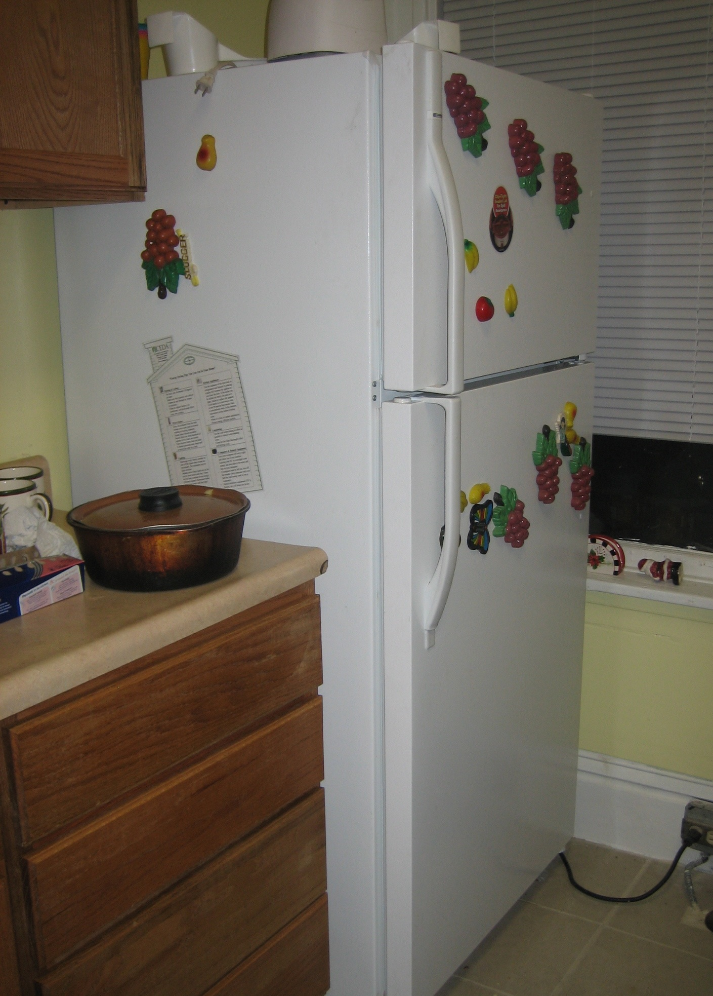
Refrigerator Replacement
Base Load Measures
Replacement includes removal and decommissioning of old unit; must be included
in cost for SIR calculations.
Only when cost-effective,
SIR ≥ 1.
Based on metering or recognized database
(AHAM, Home Energy, or Weatherization Refrigerator Guide).
Must meter at least 10% of units.
Photo courtesy of US Department of Energy
Notes:
Replacement includes removal and decommissioning of the old unit to ensure it will not be plugged in again. Decommissioning includes removal, proper storage of refrigerants, and ideally, recycling of the refrigerator. All these expenses must be included in the cost for SIR calculations.
Refrigerator replacement is allowed only when it is cost-effective, i.e., SIR ≥ 1.
Energy usage of the existing appliance is based on metering or data from a recognized database (Association of Home Appliance Manufacturers (AHAM), Home Energy, or WAP Refrigerator Guide) corrected for temperature and other factors.
You must meter at least 10% of units, even if all units can be found in the database.

Slide 32
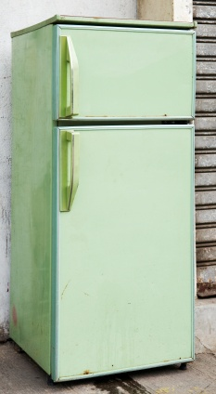
Refrigerator Replacement
Base Load Measures
Older models are typically energy hogs.
Worn gaskets make the unit run
more often.
Insulation can be guessed by pushing on door.
  Pushes in easily – likely fiberglass
  Does not push in easily – likely solid foam
If Coppertone brown, avocado green,
or harvest gold, replacements can be cost-effective.
Photo courtesy of US Department of Energy
Notes:
Older models are typically energy hogs.
Worn gaskets make the unit run more often.
You can guess the type of insulation by pushing on the door.
If it pushes in easily, it is likely fiberglass and less efficient.
If it does not push in easily, it is likely solid foam and more efficient.
If the unit is coppertone brown, avocado green, or harvest gold, replacements can be cost-effective. These colors were popular before current efficiency guidelines and typically indicate an older model.

Slide 33
Michael Blasnik’s Refrigerator Study
Base Load Measures
In NE, adding 11% to DOE rating is a fairly good predictor of actual use.
Other factors affect actual use:
  Occupants: add 5% per person to rated use
  Anti-sweat switch on: add 20% to rated use
  Through-the-door ice service: add 15% to rated use
  Visible gaps in door seal: add 15% to rated use
  Refrigerator bought used: add 20% to rated use
  Thermostat setting high: add 5% to rated use
  Thermostat setting really high: add 10% to rated use
No relationship between rated and actual use for refrigerators located in basements.
Notes:
Findings from this study have not yet been replicated in other regions or formally adopted into WAP procedures, but they can help auditors more accurately predict energy usage of refrigerators based on approved databases. If relying on a database for usage, applying these corrections presents a more accurate picture of how much energy is being consumed. These corrections may help qualify units that will provide positive energy savings but wouldn’t have qualified based solely on the less accurate database figures.
From June 2003 to May 2004, researchers monitored electricity usage and room temperature for two weeks of 160 existing units and 30 Energy Star qualified replacement units.
In the Northeast, adding 11% to the DOE rating is a fairly good predictor of actual use if the unit is located in the living space (i.e., not in the unconditioned basement).
Other factors affect actual use. The table in the PowerPoint slide summarizes the survey results.
¹Blasnik, Michael. Measurement and Verification of Residential Refrigerator Energy Use: Final Report: 2003-2004 Metering Study. 2004.

Slide 34
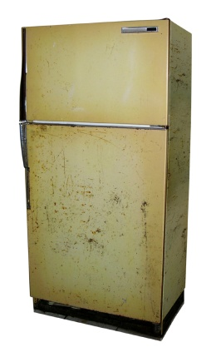
Metering
Base Load Measures
At least two hours
Disable defrost cycle
for duration
Adjust for temperature variation
Photo courtesy of US Department of Energy
Notes:
These are the formal rules for metering refrigerators:
Meter for at least two hours.
Disable the defrost cycle for the duration of the test.
Adjust for temperature variation.

Slide 35
Metering Duration ≥ 2 Hours
Base Load Measures
Debate over how long a refrigerator must be metered to accurately estimate annual energy use
1-hour tests accurate within ±10% only 18 times out of 100
3-hour tests increase ±10% accuracy to 90 times out of 100
Currently recommending at least 2 hours
Notes:
There is debate over how long a refrigerator must be metered to accurately estimate annual energy use.
One-hour tests are accurate within ±10% only 18 times out of 100.
Three-hour tests increase that accuracy to 90 times out of 100.
WAP currently recommends metering for at least 2 hours.

Slide 36
Defrost Cycles
Base Load Measures
Defrost cycles during metering can significantly affect accuracy of results.
Demand of 380 watts or more usually indicates the defrost heaters are on.
If no defrost cycle during metering, add 8% to metering results.
Notes:
Defrost cycles during metering can significantly affect the accuracy of results.
Demand of 380 watts or more usually indicates the defrost heaters are on.
If there is no defrost cycle during metering, add 8% to the metering results to account for the annual additional energy use due to the defrost cycle.

Slide 37
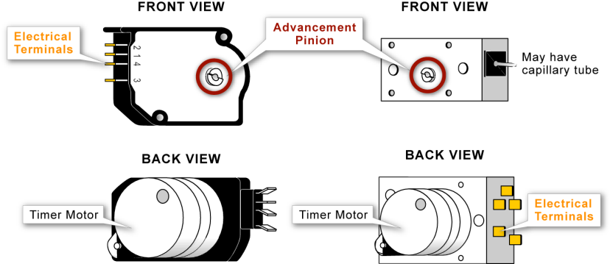
Defrost Timers
Base Load Measures
Typical Timers
Square / Rectangular Timers
Figure Source: Refrigerator Guide
Notes:
To prepare for metering the refrigerator, advance the defrost timer through the defrost cycle. Metering should begin at the start of a “fresh” cycle with no risk of the defrost kicking in during the metering period.
The Refrigerator Info Toolkit on www.waptac.org contains all of this information.

Slide 38
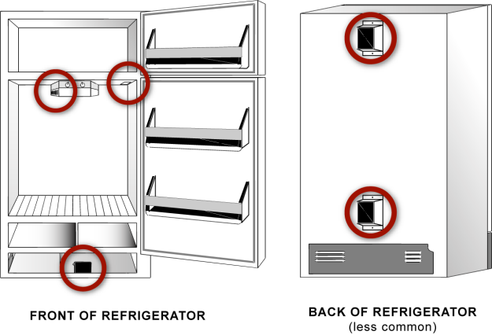
Defrost Timer Locations
Base Load Measures
Timer may be found in
virtually the same locations
in top- or bottom-freezer models or side-by-sides.
May be under a small panel in the roof of the food compartment
May be behind lighting panel
Timer may be located inside the FREEZER section of certain bottom-freezer models.
Usually inside of a removable mounting box
Most common place is somewhere behind the kickplate. (Shown removed
in this illustration.) You may need to lift or move a bundle of wires to see it.
Figure Source: Refrigerator Guide
Notes:
These are the common places to look for the defrost timer:
Behind the kickplate (most common).
Behind the lighting panel.
Inside the freezer of certain bottom-freezer models.
On the rear of the refrigerator in a removable mounting box (less common).
This is also included in the toolkit.

Slide 39
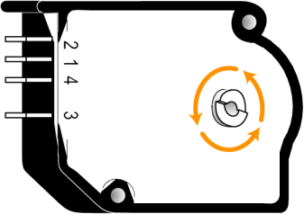
Advancing Defrost Timers
Base Load Measures
Use a broad-tipped screwdriver to advance past the defrost cycle for metering purposes.
Remember to add 8%
to metered results to account for regular defrost cycles.
Defrost Cycle
1st Loud Click
2nd Loud Click
Run Cycle
Some timers have a defrost cycle every 180 degrees; in others, it’s every 360 degrees.
Figure Source: Refrigerator Guide
Notes:
Use a broad-tipped screwdriver to advance past the defrost cycle for metering purposes.
Some timers have a defrost cycle every 180 degrees. In others, it’s every 360 degrees.
Remember to add 8% to metered results to account for regular defrost cycles.

Slide 40
Adjust for Temperature Variation
Base Load Measures
Delta T between inside the refrigerator and ambient
effects efficiency: 2.25% to 2.5% per °F.
To calculate correction factor, multiply the temperature difference by 2.5%.
If kitchen is cooler than normal during metering,
add the correction. If warmer, subtract.
For example, if the kitchen is normally 72°F,
but the temperature is 66°F during metering:
1+ (2.5% x (72°F - 66°F)) = 1+ (0.025 x 6) = 1.15
Notes:
After metering, the auditor must apply corrections to account for temperature variations. If the unit is metered on an uncommonly hot day, it appears to use much more energy annually than it actually does.
The Delta T between the inside of the refrigerator and the ambient air affects efficiency: 2.25% to 2.5% per °F.
To calculate the correction factor, multiply the temperature difference by 2.5%.
If the kitchen is cooler than normal during metering, add the correction. If warmer, subtract. For example, if the kitchen is normally 72°F, but the temperature is 66°F during metering:
1+ (2.5% x (72°F - 66°F)) = 1+ (0.025 x 6) = 1.15
Click to highlight the resulting correction factor: 1.15
Multiply the metered annual usage by 1.15 to get a more accurate picture of energy consumption, since the house is typically warmer than when metering occurred.

Slide 41
Refrigerator Calculation
Base Load Measures
If existing refrigerator is metered, assuming typical
ambient temperature during metering, kWh/year =
0.882 is a factor to adjust estimated energy usage
since the crew asks the client not to open and close
the refrigerator during metering.
Source: John Proctor
Metered usage (kWh)
Metering Duration (minutes)
x 60
minutes
hour
x 8,760
hours
year
0.882
Notes:
Here is the complete calculation converting meter reading to annual estimated usage. In this calculation, we assume that interior temperatures were typical during metering, so there is no temperature adjustment.
Walk through the calculation. Divide metered usage by the duration of metering, in minutes, and then multiply by 60 to get hourly usage. Multiply that by 8,760 hours a year to get annual usage. Divide this number by 0.882 because the crew asks the client to not open the refrigerator during metering, but normally the refrigerator would be opened and closed occasionally, resulting in higher energy use.²
²Correction factor thanks to John Proctor, PE, Proctor Engineering Group.

Slide 42
Can’t Always Meter
Base Load Measures
It is not always possible to meter the refrigerator.
  Cannot move fridge without damaging floor
  Difficult access due to cabinets, furniture, stove, etc.
  Receptacle suspect
When metering is not possible, use Association of Home Appliance Manufacturers (AHAM) database for energy use of existing refrigerators.
Notes:
It is not always possible to meter the refrigerator.
Sometimes you can’t move the fridge without damaging the floor.
It may be difficult to access the fridge due to cabinets, furniture, stove, etc.
The receptacle is suspect, i.e., it won’t plug into the metering device or appears unsafe.
When metering is not possible, use the AHAM database for energy use of existing refrigerators.
If the refrigerator cannot be found in the database, use the chart from Appendix B of the Refrigerator Info Toolkit to translate model and serial numbers to date of manufacture. Generally speaking, if the refrigerator was made in 2003 or later, it will not qualify for replacement.

Slide 43
Adjust for Age
Base Load Measures
Refrigerator efficiency degrades between 1% and 2%
per year of operation.
NEAT tool accounts for this in audit.
When using database instead of metering, correct
for age of appliance.
NEAT Adjustments to AHAM Appliance Energy Data for Refrigerator Age
Refrigerator Age | AHAM Energy Data is Inflated By:
Less than 5 years old | 0%
5 to 10 years old | 10%
10 to 15 years old | 20%
More than 15 years old | 30%
Notes:
When relying on the database, adjust for the decline in performance over time.
Refrigerator efficiency degrades between 1% and 2% per year of operation.
The approved computerized audit tools accounts for this in the audit.
When using the database instead of metering, correct for the age of the appliance.

Slide 44
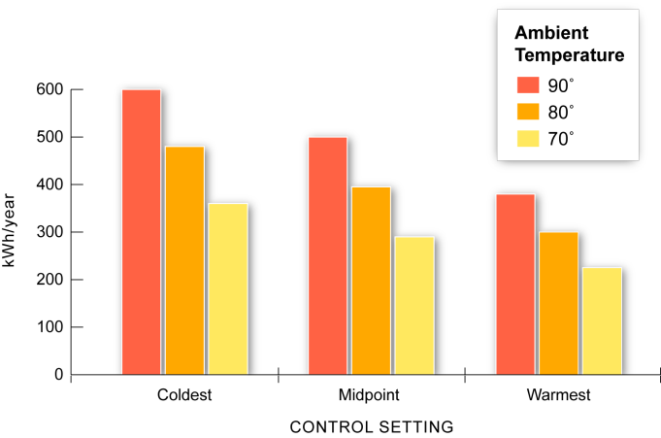
Control Settings Matter
Base Load Measures
Energy Use of a 15 ft³ Maytag
Source: Larry Kinney, E Source, Boulder, CO, 2001
Notes:
Chart: Energy use of a 15-cubic-foot Maytag refrigerator.³
Some refrigerators may not qualify for replacement under the WAP, but changing the settings can result in noticeable energy savings for the client.
In a hot climate with an ambient temperature of 90°F, changing the fresh food compartment setting from 36.4°F to 43.9°F (-9.1°F up to 12.4°F for the freezer) will save the client over 200 kWh/year.
³ Larry Kinney, E Source, Boulder, CO, 2001.

Slide 45
Other Refrigerators Issues
Base Load Measures
Replacement refrigerators must comply with UL 250.
Must properly dispose replaced units per Clean Air Act 1990, section 608, as amended by 40 CFR 82, 5/14/93.
Cost of disposal, if any, should be reflected in
SIR calculation.
Notes:
Replacement refrigerators must comply with UL 250. This label reflects compliance with federal regulations.
Dispose of old units according to the Clean Air Act of 1990, section 608, as amended by 40 CFR 82, 5/14/93.
The old unit may not remain at the client’s home or go to another home. The purpose of replacing inefficient refrigerators is to get them off the grid.
Decommissioning is necessary to ensure that the WAP doesn’t inadvertently create a black market in second-hand refrigerators.
The cost of disposal, if any, should be reflected in the SIR calculation.

Slide 46
Clean Refrigerator Coil
Base Load Measures
Even if replacement is not an option,
some savings are possible.
 | Average | High
Energy Savings | 36 kWh/yr | 200 kWh/yr
$ Savings* | $3.96/yr | $22.00/yr
Frequency of coil cleaning | Once/year, 3% savings | Never been cleaned
* Savings based on $0.11/kWh
Notes:
This table shows estimated energy savings from cleaning a refrigerator coil.
Even if replacement is not an option, some savings are possible.
The refrigerator will function more efficiently if the coil is clean and has a few inches of air space around it (i.e., it’s not pushed right up to the wall).
If the coil has never been cleaned, doing so could save up to 200 kWh/yr!
Clean coils with the long, flat attachment on a vacuum cleaner and/or a long brush, similar to a bottlebrush.
Turn the refrigerator off before cleaning the coils. If it is built-in, turn off the circuit at the breaker.

Slide 47
Water Heating
Base Load Measures
Assess condition of appliance.
Test draft of gas water heaters (more information in Combustion Appliances section).
Adjust set temperature.
Insulate tank and first 6 feet of pipes.
Replace.
Reduce hot water use.
Notes:
Assess the condition of the appliance.
Test the draft of gas water heaters. (For more detail, refer to the Combustion Appliance section of this curriculum)
Adjust the set temperature and insulate the tank and the first six feet of pipes if the tank is in good working order.
Replace the unit if needed.

Slide 48
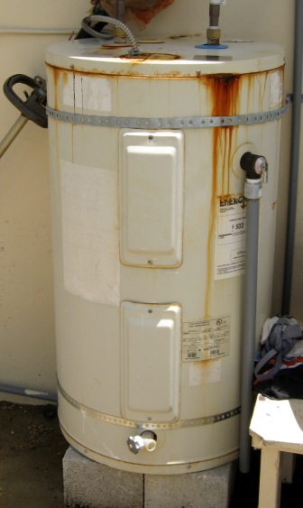
Assess Condition
Base Load Measures
Damaged?
Rusty or corroded?
Leaking?
This unsheltered water heater is less than
6 months old.
Photo courtesy of US Department of Energy
Notes:
Assess the condition of the water heater to determine if a replacement might be necessary as a health and safety measure. Is the tank:
Damaged?
Rusty or corroded?
Leaking?

Slide 49
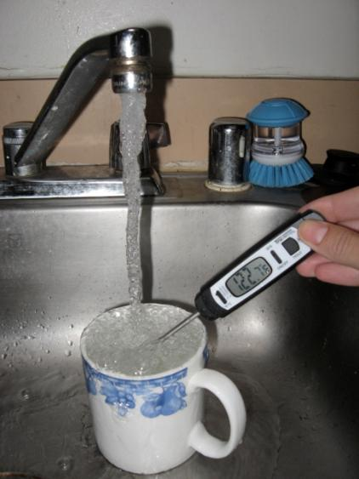
Adjust Set Temperature
Base Load Measures
Mark original position of dial.
Verify water temperature.
Set back to 120°F.
Adjust as needed.
Photo courtesy of US Department of Energy
Notes:
Many clients have the temperature set as high as 140°F, though 120°F is adequate for most homes. The lower temperature saves energy and prevents scalding.
Mark the original position of the dial. The labeling around the dial can be off, so it’s important to mark a reference point before changing anything.
Verify the water temperature. Run water from the hot tap closest to the water heater to measure.
Set back to 120°F.
Adjust as needed.

Slide 50
Reduce Setting from
140°F to 120°F
Base Load Measures
 | Average | High
Energy Savings | 343 kWh/yr | 974 kWh/yr
$ Savings* | $37.73/yr | $107.14/yr
Existing DHW Use | 4,500 kWh/yr | 6,500 kWh/yr
* Savings based on $0.11/kWh
Notes:
If the existing hot water heater is using 4,500 kWh/yr, setting the temperature back from 140°F to 120°F can save 343 kWh/yr, or almost $40 at $0.11/kWh.

Slide 51
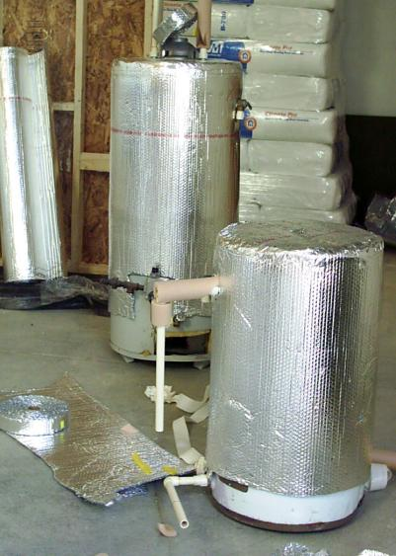
Insulate
Base Load Measures
Leave 3”- 6” exposed along bottom for leak detection.
Mark access panel.
Insulate first 6’ of pipe.
Gas - Don’t Insulate top, mind the flames.
Electric - Insulate top.
Photo courtesy of US Department of Energy
Notes:
To reduce standby losses, insulate the water heater and the first 6 feet of pipe.
Leave 3” to 6” exposed along the bottom for leak detection.
Mark the access panel.
Gas − Don’t insulate the top and mind the flames.
Electric − Insulate the top.

Slide 52
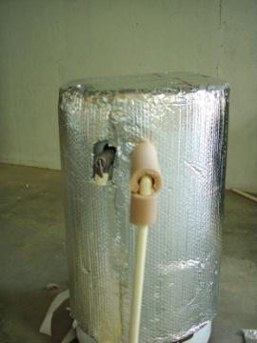
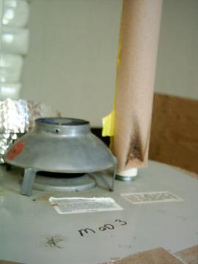
Insulate
Base Load Measures
Pipe is exposed at elbow
Insulation too close to flame
Photos courtesy of US Department of Energy
Cut pipe insulation at an angle to cover elbows.
Don’t insulate too close to the flame on gas water heaters.
Notes:
Specify that elbows should be insulated correctly, with insulating sleeves cut at a 45-degree angle to cover the joint.
On gas water heaters, pipe insulation can present a fire hazard if installed too close to the burner.

Slide 53


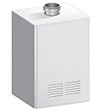
Replacement
Base Load Measures
Replacement can be based on:
Audit.
Water heater guide on WAPTAC.
Health and safety.
Existing water heater can be
replaced in eligible households with:
Standard tank water heaters.
Whole home tankless.
Heat pump water heaters.
Solar water heaters.
Images courtesy of www.energystar.gov
Notes:
Replacement can be based on:
Audit results.
Water Heater Info Toolkit on WAPTAC.
Health and safety concerns.
Replace an existing water heater in eligible households with:
Standard tank water heater.
Whole home tankless water heater.
Heat pump water heater.
Solar water heater.

Slide 54
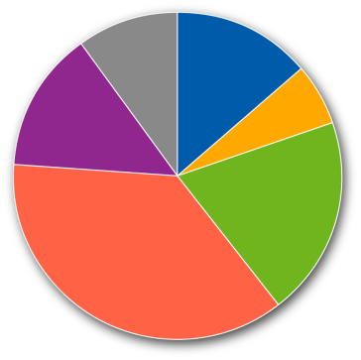
Hot Water Use
Base Load Measures
Cut down on hot water use by repairing leaks and installing low-flow fixtures.
Dishwasher 10%
14% Sink Filling
Clothes Washer 14%
6% Faucet Flow
20% Bath Filling
Showers 37%
Source: 2008 Buildings Energy Databook. US DOE
Notes:
This chart shows typical hot water use by end use in the home.
Cut down on hot water use by repairing leaks and installing low-flow fixtures.

Slide 55
Repair Leaky Hot Water Tap
Base Load Measures
 | Average | High
Energy Savings | 144 kWh/yr | 3,000 kWh/yr
$ Savings* | $15.84/yr | $330/yr
Leakage | 2 drips/min | 1 drip/sec
* Savings based on $0.11/kWh
Notes:
Repairing a hot water tap leaking 2 drops/minute can save almost $16/yr based on $0.11/kWh.
Repairing larger leaks save substantially more. Repairing a hot water leak dripping at the rate of 1 drop/second will save over $300/year based on the same energy prices.

Slide 56
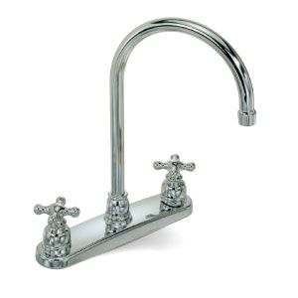
Low-Flow Fixtures
Base Load Measures
Reduce hot water consumption by addressing:
Showers.
Lavatory faucets.
Kitchen faucets.
Photo courtesy of Sanibel
Notes:
Here are a few ways to reduce hot water consumption:
Showers: Replace showerheads that have a flow ≥ 3 gpm with low-flow showerheads.
Lavatory faucets: Install faucet aerators if none exist.
Kitchen faucets: Install faucet aerators if none exist.

Slide 57
Other Base Load Intervention
Base Load Measures
Remove Dryer Vent Restriction
 | Average | High
Energy Savings | 227 kWh/yr | 455 kWh/yr
$ Savings* | $24.97/yr | $50.05/yr
% Savings on 364 Loads/Year | 25% | 50%
* Savings based on $0.11/kWh
Notes:
Remove dryer vent restrictions.
When dryers must force air through constricted spaces, they must work harder and it takes longer to dry a load of clothes.
Creating a smooth, open pathway for dryer exhaust can save up to $50/year through improved dryer performance.
Refer to the Dryer Vent section of the Installer Intermediate curriculum for more details on dryer exhaust protocols.

Slide 58
Summary
Base Load Measures
Base load refers to all non-seasonal energy use
within the home.
About half of home energy use is for base load requirements.
Utility bill assessment helps the auditor determine
base load usage and related savings potential.
Typical measures include lighting retrofits, refrigerator replacement, hot water heater modification or replacement, and reduction of hot water use.
Notes:
Base load refers to all non-seasonal energy use within the home.
About half of home energy use is for base load requirements.
A utility bill assessment helps the auditor determine base load usage and the related savings potential.
Typical measures include lighting retrofits, refrigerator replacement, hot water heater modification or replacement, and reduction of hot water use.
Present this slide as an interactive discussion, soliciting personal examples from the trainees. Add your own personal examples and knowledge to supplement.

