Slide 1

Attic Ventilation
WEATHERIZATION ENERGY AUDITOR SINGLE FAMILY
WEATHERIZATION ASSISTANCE PROGRAM STANDARDIZED CURRICULUM – December 2012

Slide 2
Learning Objectives
Attic Ventilation
By attending this session, participants will be able to:
Explain the purpose and principles of attic ventilation.
Summarize misconceptions about attic ventilation.
Determine ventilation needs by code and practical alternatives.
List ventilation options.
Propose specific attic ventilation.
Describe safeguards for ensuring that attic ventilation does not cause problems.
Notes:
By attending this session, participants will be able to:
Explain the purpose and principles of attic ventilation.
Summarize misconceptions about attic ventilation.
Determine ventilation needs by code and practical alternatives.
List ventilation options.
Propose specific attic ventilation.
Describe safeguards for ensuring that attic ventilation does not cause problems.

Slide 3
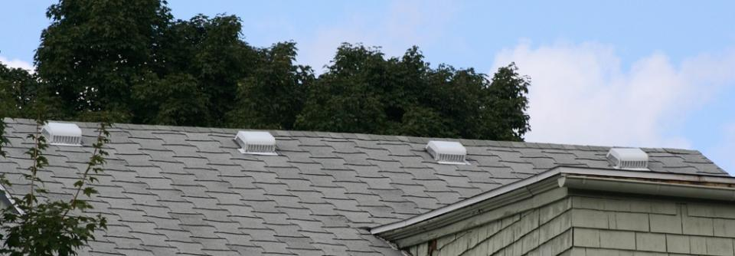
Purpose of Attic Ventilation
Attic Ventilation
Photo courtesy of US Department of Energy
Removes solar heat during hot weather
Removes moisture vapor during cold weather
Notes:
Attic ventilation:
Removes solar heat during hot weather.
Removes moisture vapor during cold weather.
Anecdotal wisdom from the field indicates that less than 10 percent of homes in certain areas of the country have any type of roof ventilation. Many homes with roof vents have far fewer than required by code.
Q: If the purpose of attic ventilation is to remove moisture and solar heat, then why haven’t the majority of unvented roof systems failed? And why do certain roof systems fail regardless of whether they are vented?
A: Some of the causes of failure are obvious and can be resolved with attic ventilation. Other problems are more complex and require a broader approach.
Attic ventilation is required and is therefore more closely related to code requirements than to building science.

Slide 4
Common Misconceptions
Attic Ventilation
Attic ventilation always removes moisture
vapor during cold weather.
Attic ventilation will cure an attic moisture problem.
The more attic ventilation, the better.
Attic ventilation is not necessary.
Notes:
Some common misconceptions of attic ventilation are:
Attic ventilation always removes moisture vapor during cold weather.
Attic ventilation will cure an attic moisture problem.
The more attic ventilation, the better.
Attic ventilation is not necessary.
Some building scientists question the need for attic venting, particularly in cold climates where there is mounting evidence that attic ventilation may only worsen an existing attic moisture problem. On the other hand, codes require a certain amount of attic ventilation.
Raise these issues with participants in preparation for the slides that follow. Ask participants for examples from the field.

Slide 5
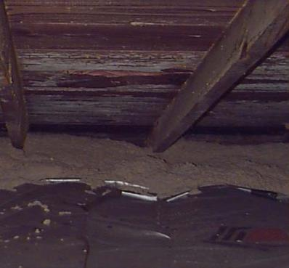
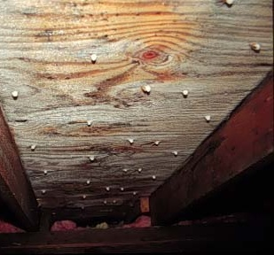
Post Wx Attic Moisture Problems
Attic Ventilation
Mold on Sheathing
Frost on Sheathing
Photo courtesy of US Department of Energy
Both conditions occurred after attics were
insulated and vented, not before.
Notes:
These photos show mold and frost on sheathing after attic insulation and roof vents were installed.
In an uninsulated or unsealed attic, the house sufficiently warms the air to cause ventilation.
Insulation prevents the air in the attic from warming, thereby reducing its buoyancy and ability to vent.
The combination of high interior moisture sources and poor attic air sealing is one of the primary causes of roof failure in heating climates.
Attic vents have the potential to worsen an attic moisture problem.
Venting provides openings that pull warm, moist air from the house through unsealed bypasses into the attic, where moisture can condense on cold surfaces.
On still, winter days, cold and dense air can sink into the attic space from the outside through the vents, cooling the attic surfaces even further.
Additional venting is not the solution when attic air sealing and moisture mitigation would control moisture.

Slide 6
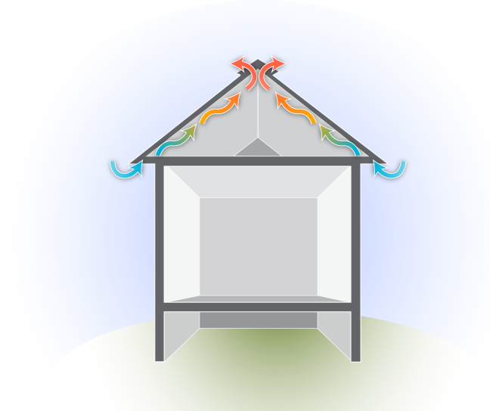
Passive Attic Venting: Convection
Attic Ventilation
Ridge vent
How does it work?
Outlet
(Heated Air)
Natural Convection
Hot air rises,
escapes high vents
Cooler air pulled through soffit vents
Heat rises,
escapes ridge vents
Inlet
(Cool Air)
Graphic developed for the US Department of Energy
Notes:
This graphic illustrates venting via natural convection.
Passive attic venting takes advantage of the natural buoyancy of air by providing inlets and outlets low and high on the roof. As air in the attic is warmed by solar radiation, it becomes lighter and rises, escaping through the higher vents. Cooler air is drawn in through eave vents as warmed air escapes. Venting is especially important in hot climates where attic temperatures can exceed 140°F for long periods of time. Passive attic ventilation can significantly reduce cooling loads.

Slide 7
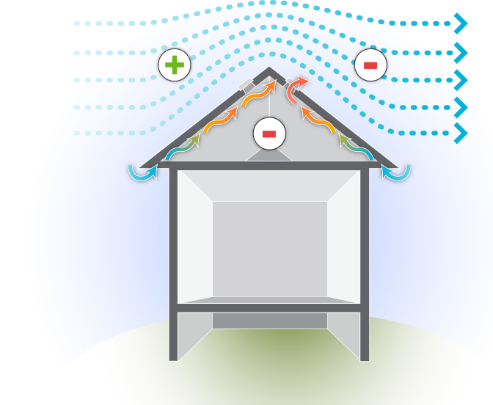
Passive Attic Venting: Wind
Attic Ventilation
WIND
How does it work?
Bernoulli Principle
Positive pressure on windward side
Negative pressure on leeward (protected) side
Air sucked out leeward vents
Graphic developed for the US Department of Energy
Notes:
This graphic illustrates venting via wind effect.
Wind can also aid venting by creating positive pressure on the windward side of the roof and negative pressure on the leeward side. Air is exhausted from the attic by a phenomenon known as the “Bernoulli Principle,” where a sufficient air stream across an opening will create enough of a pressure difference to draw a liquid or gas (air) out of a vessel (attic space).
Demonstrate the Bernoulli principle with an old perfume bottle if possible or by puffing smoke into a bottle, then gently blowing across the opening, causing smoke to lift from the bottle. Or use a chalkboard or other visual aid to illustrate the principle.

Slide 8
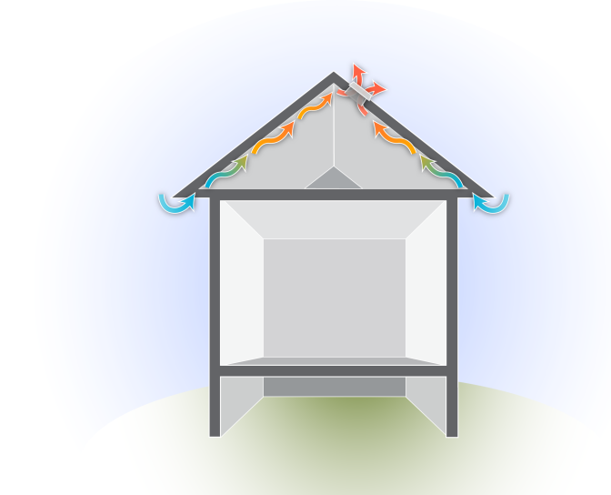
Power Venting
Attic Ventilation
Fan-powered roof vent
How does it work?
Attic fan mounted in central hallway used in non-air conditioned homes.
Roof vent (pictured) used
in air conditioned homes.
Neither is recommended
as weatherization measure.
Potential for moisture condensation is high.
Graphic developed for the US Department of Energy
Notes:
This graphic illustrates power venting.
Power ventilation is an active (mechanical) ventilation approach and can be accomplished in two ways.
In non-air-conditioned homes, temperatures may be controlled to some extent by the use of attic fans. An attic fan is usually mounted on the ceiling in a central hallway so that outside air is pulled through open windows and exhausted through the attic. The attic must have sufficient outlets to exhaust the air without creating high pressures against which the fan must operate.
Air-conditioned homes can use power attic ventilators with exhaust fans mounted through the roof or in the gable. The attic must have inlets for the ventilating air at opposite gable ends, or low-mounted roof vents if there is no roof overhang.
Power venting is generally not recommended as a weatherization measure because fans can draw warm, humid air into the house, which may condense on cool surfaces in basements or crawl spaces.
Sufficient attic insulation and passive (non-mechanical) ventilation is a better alternative in most cases.

Slide 9
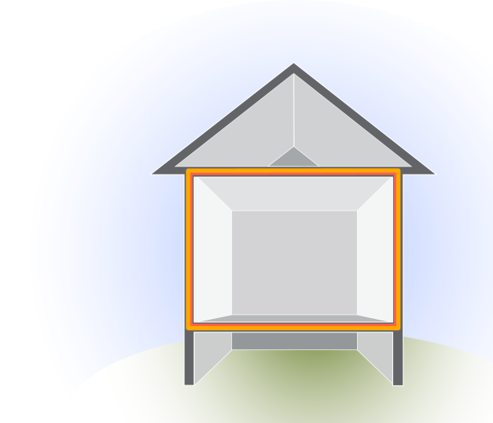
Code Issues
Attic Ventilation
Requirements are based on presence of ceiling vapor retarder, climate zone, and vent location.
Options:
1/150
  One square foot of net free vent area per 150 square feet of attic
1/300
  One square foot of net free vent area per 300 square feet of attic
Thermal boundary - Ceiling
Graphic developed for the US Department of Energy
Notes:
The amount of net free area (NFA) of vent required depends on the climate zone, presence of a vapor retarder, and location of vents.
The International Residential Code 2012 requirement for attic venting states:
Minimum net free ventilating area shall be 1/150 of the area of the vented space. Exception: The minimum net free ventilation area shall be 1/300 of the vented space provided one or more of the following conditions are met:
In climate zones 6, 7, and 8, a class I or II vapor retarder is installed on the warm-in-winter side of the ceiling.
At least 40% and not more than 50% of the required ventilating area is provided by ventilators located in the upper portion of the attic or rafter space.
When the ceiling is the thermal boundary, attic ventilation is required. Code requires using a 1/150 or 1/300 formula.
Most code officials recognize a painted ceiling as a vapor retarder. Therefore, the 1/300 rule will likely apply in most cases in climate zones 6–8.
NFA refers to the actual open area available to provide effective ventilation. For example, a 12” x 12” vent will provide somewhat less than 144 square inches of NFA because screens and louvers occupy some of the space.
Vents are rated by an R-value that relates to their NFA (not to be confused with insulation value). For example, an R-61 roof vent has an NFA of 61 square inches.

Slide 10
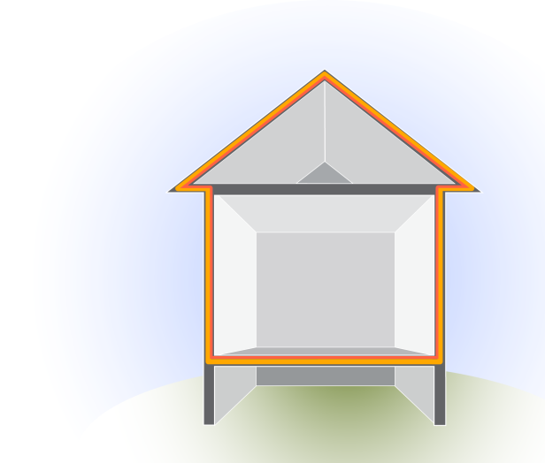
Code Issues
Attic Ventilation
Thermal boundary –
Roof deck
Attic ventilation not required
when the roof assembly is the thermal and pressure boundary.
Graphic developed for the US Department of Energy
Notes:
When the roof deck is the thermal and pressure boundary, attic ventilation is neither required nor recommended.
Finished attics or those containing HVAC equipment and duct systems are examples. The roof assembly in a finished attic should not be vented. Rather, it should be airtight and insulated with closed- or open-cell spray foam insulation.

Slide 11
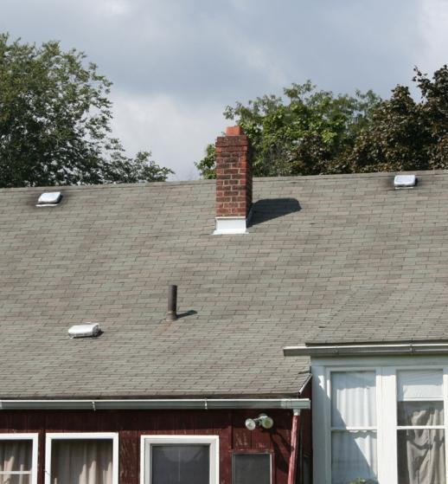
Applied Ventilation Formula
Attic Ventilation
How many roof vents does it take?
Calculate the number
of roof vents required.
Climate is Zone 7.
Ceiling is air sealed
and insulated.
Ceiling has vapor retarder.
Ceiling area is 60’ x 30’.
Each vent has a net free area of 60 square inches.
Photo courtesy of the US Department of Energy
Notes:
Show students how to solve the following:
Calculate the number of roof vents required for a ranch home with a gable roof and an insulated and air-sealed ceiling that measures 60 ft. x 30 ft. Each vent has a net free area of 60 sq. in.

Slide 12
Applied Ventilation Formula
Attic Ventilation
Ceiling = 60’ x 30’ = 1,800 square feet.
Formula for attic with vapor retarder = 1/300
1,800 ÷ 300 = 6 sq. ft. required NFA ventilation
Convert to inches:
6 sq. ft. x 144 sq. in./sq. ft. = 864 square inches
864 ÷ 60 square inches NFA/vent = 14.4
15 vents!
Notes:
Calculate number of sq. ft.: 1,800 sq. ft. ÷ 300 = 6 sq. ft.
Convert sq. ft. to sq. in.: 6 sq. ft. x 144 sq. in./sq. ft. = 864 sq. in.
Calculate number of vents: 864 ÷ 60 = 14.4 (15 roof vents).
Click to reveal answer.
That’s an awful lot of holes in the roof. In most cases, installing this number of vents in a roof system is neither practical nor cost effective.
The additional openings may even encourage air loss through the stack effect, which forces warm, moist air from the house into the attic, where it may condense on the roof assembly in cold weather.
Although attic ventilation is required and advisable, there are reasonable alternatives to adding 15 roof vents. Larger vents are an option.
A gable roof may have slate shingles, making it technically very difficult to install roof vents, but it would seem reasonable to install vents on each gable end to provide some attic ventilation.

Slide 13
Ground Rules and Specifications
Attic Ventilation
Vented attics should not communicate with the conditioned space.
The ceiling air barrier must be continuous with no leakage.
Specify appropriate attic sealing as part of the work scope.
Specify that vents be placed low and high on roof.
Specify eave chutes when soffit vents are present
and loose fill insulation is needed.
Specify that all mechanical ventilation ducts and
plumbing stacks are vented directly to the outside.
Notes:
Vented attics should not communicate with the conditioned space.
The ceiling air barrier must be continuous with no leakage.
Specify appropriate attic sealing as part of the work scope.
Specify that vents be placed low and high on the roof.
Specify eave chutes when soffit vents are present and loose fill insulation is needed.
Specify that all mechanical ventilation ducts and plumbing stacks be vented to the outside.
Air sealing specifications are an important part of attic retrofits but are listed here to underscore their importance for attic ventilation.

Slide 14
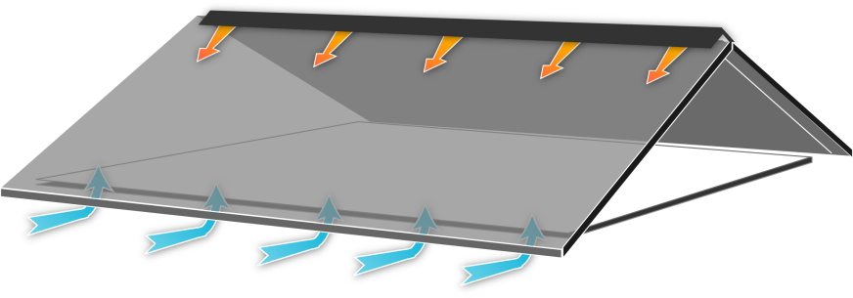
Venting Configurations
Attic Ventilation
In a perfect world...
Continuous ridge vent
Continuous eave vent (soffit vents)
Graphic developed for the US Department of Energy
Notes:
This graphic shows continuous soffit and ridge venting.
Continuous soffit and ridge venting is the best configuration because it allows for a good cross flow of ventilating air from low to high points in the roof assembly. However, this is best done during original construction. It would be impractical and costly to attempt to ventilate every roof this way.
Many vent types are available to accommodate different venting situations and roof configurations.

Slide 15
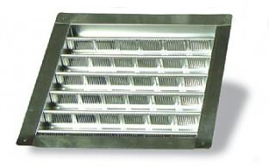
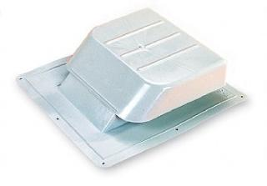
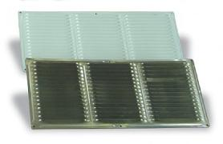
Vent Types
Attic Ventilation
Gable vent
Roof vent
Eave vent
Images courtesy of J&R Products Inc.
Notes:
These are photos of gable, roof, and eave vents.
There are several types of passive attic vents. Gable and roof vents are the most commonly used in weatherization.
Gable vents are available in many sizes, in aluminum or acrylonitrile butadiene styrene (ABS) plastic, and are designed to be installed on gable ends. When installed on opposite gable ends, they allow for good cross flow across the length of an attic.
Roof vents are designed to be installed on pitched roofs and are available in aluminum and ABS plastic. Roof vents are rated by their net free area; an R-61 vent has an NFA of 61 sq. in.
Eave vents are used when there is sufficient soffit area and cross flow is required. They are difficult to install, and it takes a lot of them to have much effect.

Slide 16
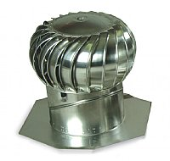
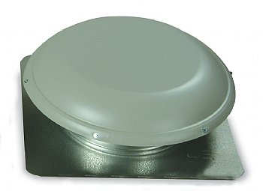
Vent Types
Attic Ventilation
Turbine vent
R-144 mushroom roof vent
Images courtesy of J&R Products Inc.
Notes:
These are photos of turbine and large mushroom roof vents.
Turbine vents are rated to vent 600 sq. ft. when used with 300 sq. in. NFA of eave vents. A turbine vent has a galvanized adjustable base to fit most roof slopes. Because they are subject to mechanical failure and contribute to air leakage, turbine vents are not recommended in weatherization.
The large R-144 mushroom vent has more than twice the NFA as two R-61 roof vents. The opening is also large enough for an average-sized person to fit through when attic access through the roof deck is the only option.

Slide 17
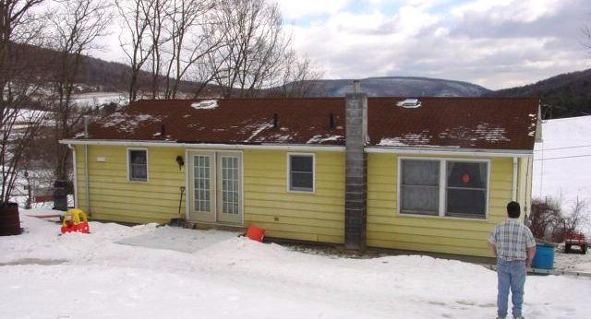
Vent Placement
Attic Ventilation
Roof vents placed high on roof
Continuous soffit vent
Photo courtesy of PA WTC
Notes:
This photo shows vents placed high on a roof.
Continuous soffit venting on both roof eaves provided the low vents, which allow for a good cross flow from low to high points within the attic space.
If no soffit venting is present, a combination of high and low roof vents is recommended.

Slide 18
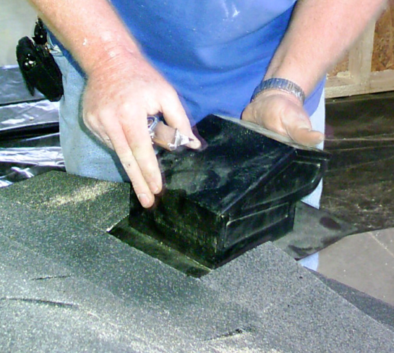
Vent Installation
Attic Ventilation
Cut hole to fit;
test fit vent.
Caulk edges of hole where flange will sit.
Slide vent into place under shingles.
Seal and nail.
Photo courtesy of the US Department of Energy
Notes:
Installers should follow these guidelines. Specify details as needed.
Cut the appropriate size hole and test-fit the vent. The flange is designed to slide under the roofing.
Once a proper fit is established, remove the vent and caulk a bead of roof cement under the shingles around the edges where the flange will sit.
Slide the vent into position, caulk with roof cement, and fasten through the roof deck with galvanized roofing nails.
Cover nail heads with roof cement. Nails should not be exposed.

Slide 19
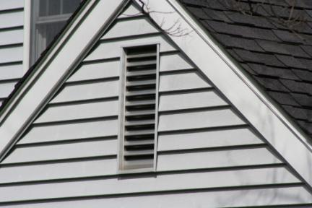
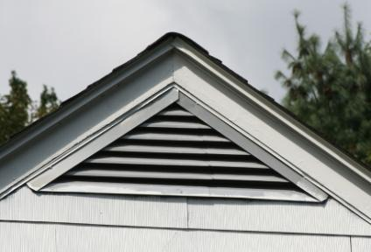
Vent Placement
Attic Ventilation
Gable vents are attached similarly to roof vents.
Photos courtesy of the U.S. Department of Energy
Notes:
This photo shows rectangular and triangular gable vents.
To install, cut an appropriately sized hole near the peak of each gable end. The vent is then caulked and fastened with galvanized nails or screws through the flange into the finished siding.

Slide 20
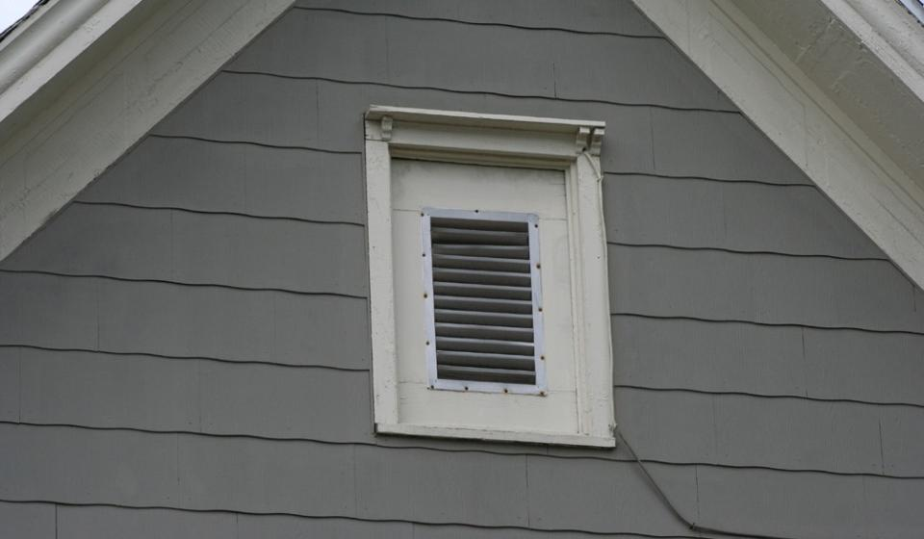
Attic Window Vent
Attic Ventilation
Photo courtesy of the US Department of Energy
Notes:
This photo shows the common practice of replacing an existing attic window with a plywood panel and standard rectangular gable vent.
Converting old attic windows to an attic vent saves the home from one more penetration.

Slide 21
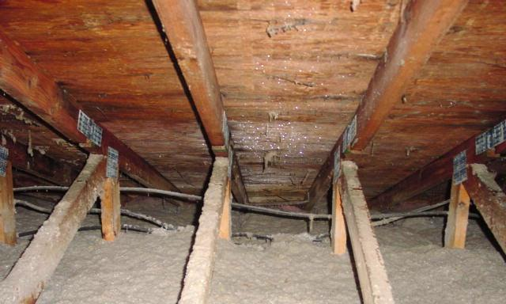
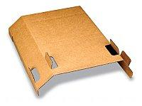
Eave Chutes
Attic Ventilation
Eave Chute
Photo courtesy of PA WTC; Product photo by J&R Products, Inc.
Notes:
This is a photo of installed eave chutes.
When soffit vents are part of the attic ventilation scheme, eave chutes should be installed before attic insulation is blown in.
Eave chutes maintain air space between the insulation blanket and the roof sheathing and prevent insulation from clogging soffit vents.
Without eave chutes, installers may be tempted to scrimp on blown-in insulation around the edges to prevent blocking soffit vents. Specify chutes to maintain attic ventilation and encourage fast, effective attic insulation work.

Slide 22
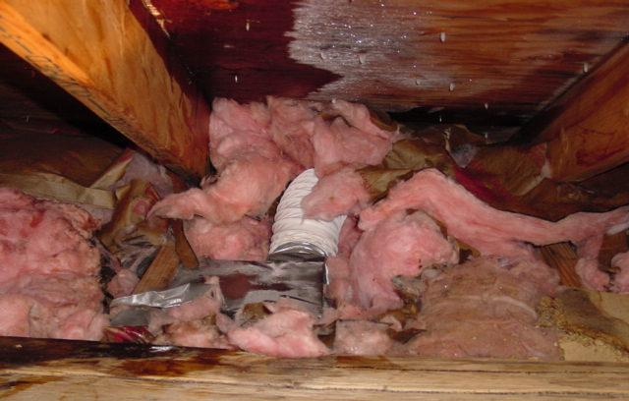
Mechanical Vent Terminations
Attic Ventilation
Photo courtesy of PA WTC
Notes:
This is a photo of a disconnected bathroom exhaust fan and resulting degradation of roof sheathing.
Specify that all mechanical vents be vented to the outside before attic vents or insulation is installed.
Vent terminations must prevent intrusion of moisture, materials, and animals into the vents.

Slide 23
Summary
Attic Ventilation
Vent attics where possible and practical.
Follow 1/150 and 1/300 code guidelines.
Don’t specify vents to solve an attic moisture problem.
Keep moisture out of the attic by air sealing.
Use the right vent for the job.
Place vents high and low.
Avoid turbine or power vents.
Notes:
Vent attics where possible and practical.
Follow 1/150 and 1/300 code guidelines.
Don’t specify vents to solve an attic moisture problem.
Keep moisture out of the attic by air sealing.
Use the right vent for the job.
Place vents high and low.
Avoid turbine and power vents.
Present this slide as an interactive discussion, soliciting personal examples from the trainees. Add your own personal examples and knowledge to supplement.

