Slide 1
Weatherization Assistance Program
Weatherization Energy Auditor
Single Family
Weatherization Assistance Program Standardized Training Curriculum
December 2012

Slide 2

Introduction to Weatherization
WEATHERIZATION ENERGY AUDITOR SINGLE FAMILY
WEATHERIZATION ASSISTANCE PROGRAM STANDARDIZED CURRICULUM – December 2012

Slide 3
Learning Objectives
Introduction to weatherization for auditors
By attending this session, participants will be able to:
Discuss the historical perspective of the Weatherization Assistance Program (WAP).
Name characteristics of the client base served by
the program.
Recognize that building science guides the selection of measures installed with program dollars.
Describe the principles of cost-effectiveness and the
savings-to-investment ratio (SIR).
Recognize modern weatherization measures.
Cite communication guidelines for working with clients.
Describe how energy audits guide weatherization work.
Notes:
By attending this session, participants will be able to:
Discuss the historical perspective of the Weatherization Assistance Program (WAP).
Name characteristics of the client base served by the program.
Recognize that building science guides the selection of measures installed with program dollars.
Describe the principles of cost-effectiveness and the savings-to-investment ratio (SIR).
Recognize modern weatherization measures.
Cite communication guidelines for working with clients.
Describe how energy audits guide weatherization work.

Slide 4
Mission
Introduction to weatherization for auditors
Mission of the
Weatherization Assistance Program
To reduce energy costs for low-income
families, particularly for the elderly, people
with disabilities, and children, while
ensuring their health and safety.
Notes:
The legislative mission of the program is:
To reduce energy costs for low-income families, particularly for the elderly, people with disabilities, and children, while ensuring their health and safety (H&S).
The purpose of the program was changed in the law to include health and safety in the enabling legislation of 1990.

Slide 5


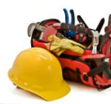
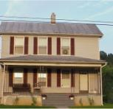
Organization
Introduction to weatherization for auditors
Organization: The Team Approach
U.S. Department of Energy Headquarters and the Project Management Centers
50 State Energy Offices, The District
of Columbia, Native American Tribal Organizations, and five U.S. Territories
Over 900
Local Agencies
Low-Income
Households.
Notes:
The graphics shown illustrate the flow of dollars through the program.
The Federal government distributes funds to the U.S. Department of Energy (DOE), where the program is managed by the Project Management Center (PMC).
Funds pass to each of the Grantees: the 50 State Offices, the District of Columbia, Native American Tribal Organizations, and the five U.S. Territories.
Grantees distribute funds to over 900 local agencies nationwide according to approved budgets.
The money is used to install cost-effective energy-saving measures in low-income households.
Lyndon Johnson’s “War on Poverty” laid the groundwork for the Weatherization Assistance Program (WAP) by creating the infrastructure of Community Action Programs (CAPs) that now exist in every state. These CAPs often act as subgrantees. The War on Poverty included Head Start, the Low-Income Home Energy Assistance Program (LIHEAP), and after-school programs for children so parents could be part of the work force.
CAPs have the right of first refusal to be a local weatherization agency. Only non-profits and local government agencies are also allowed to act as subgrantees.

Slide 6
Weatherization Process
INTRODUCTION TO WEATHERIZATION FOR AUDITORS
Wx Program Promotion and Client Recruitment
Wx Program Intake and Eligibility Determination
Applicant Selection and Preparation
Auditor Background Familiarization
Initial Site Visit – Auditor Conducts Energy Audit, H&S Testing, etc.
Work Scope Development
Work Scope Implementation/
Installation
Contractor/Crew Final Inspection
Agency Final Inspection
Client Follow-Up
Notes:
This flow chart provides an overview of how a client home progresses through the weatherization process.
WAP promotion and client recruitment – This can be done through radio or other advertisements, posting notices at community centers, churches, and senior centers, through LIHEAP referrals, and so on.
Intake and eligibility determination – This is usually done by designated administrative staff that verifies income eligibility and helps applicants fill in the necessary forms, as needed.
Applicant selection and preparation – Many agencies prioritize clients based on elderly, disabled, or children in the home, energy use/energy burden, or some combination of these factors. This is also often where the client learns what they can expect from the weatherization process.
Auditor background familiarization – When possible, the auditor can review utility data and other relevant information before actually visiting the home.
Initial site visit/audit – The auditor collects site-specific information to enter into a software audit program or determine the applicability of a relevant priority list. In some cases, the auditor determines the structure is unsound and defers services on the home.
Work scope development – Using the data collected on-site and local costs and savings related to various measures, the auditor develops a cost-effective list of measures to be installed in the home.
Work scope implementation/installation – Crew and contractors install measures listed in work order and notify the local agency of any new issues discovered during installation, sometimes adding energy savings or health and safety measures based on necessity.
Contractor/crew final inspection – Contractors and crews perform a final inspection on their work to ensure no measures were skipped and that measures were installed in accordance with local technical and quality guidelines.
Agency final inspection – The local agency is responsible for checking each home.
Client follow-up – If clients call with questions, thanks, or complaints, agency staff help tie up loose ends.

Slide 7
Low-Income Households
Introduction to weatherization for auditors
Characteristics of Low-Income Households
More than 90% of low-income households have annual incomes less than $15,000.
More than 13% of these low-income households have annual
incomes less than $2,000.
Seventeen percent of annual income in low-income households is spent on energy vs. 4% by other households.
The average energy expenditure in low-income households
is $1,871 annually.
The elderly occupy 34% of low-income homes.
Notes:
Facts¹ of low-income households include:
More than 90% of low-income households have annual incomes less than $15,000.
More than 13% of these low-income households have annual incomes less than $2,000.
According to DOE’s Energy Information Administration (EIA), low-income households spend 14.4% of their annual income on energy, while other households only spend 3.3%.
The average energy expenditure in low-income households is $1,800 a year.
The elderly occupy 34% of low-income homes.
These statistics highlight the importance of reducing the energy burden on our clients. Energy burden refers to the percentage of a household’s income that must be used for energy bills. The energy burden for low-income households is more than four times that of other households.
¹ This data, provided by Joel Eisenberg, Oak Ridge National Laboratory, and Meg Power, Economic Opportunity Studies, is based on raw data from the Residential Energy Consumption survey conducted by EIA. Source 1: ORNL/CON-493, ORNL/CON-484, EIA February 2008 Short-Term Energy Outlook Source 2: ORNL/TM-2010/66, EIA February 2010 Short Term Energy Outlook

Slide 8
History: 1976 to Early 1980s
Introduction to weatherization for auditors
First Generation
Started in Maine as “Winterization”
Originally administered by the Community Services Administration
Used volunteer labor
Installed low-cost measures
Little or no production or financial accountability
Notes:
The Weatherization Assistance Program was created in 1976, after the first oil embargo and before DOE was formed. Local programs with the same goals had been in operation, but this was the formal beginning of a national program.
Started in Maine as “Winterization” − Maine’s program was used as a model for the national program
Originally administered by the Community Services Administration.
Later managed by the Federal Energy Administration, a predecessor to DOE
Used volunteer labor, who stapled plastic over windows
Installed low-cost measures − there was very little insulation installation
Little or no production or financial accountability

Slide 9
History: Early 1980s to Late 1980s
Introduction to weatherization for auditors
Second Generation
Used volunteer labor under the Department of Labor’s Comprehensive Employment & Training Act
Often installed temporary measures
Little or no diagnostic technology
Project Retro-Tech was energy audit
Addressed the building envelope
“Blow and Go”
Notes:
The program grew in the early 1980s.
Used volunteer labor from the Comprehensive Employment and Training Act under Department of Labor
Often installed temporary measures
Little or no diagnostic technology
Project Retro-Tech − This paper energy audit allowed users to enter in the areas and difference in R-value in the home and do very basic heat transfer calculations.
Addressed the building envelope
“Blow and Go” − Workers blew insulation into attics. It was a “quick and dirty” program that completed houses quickly but with much less improvement to the home than is common today.

Slide 10
History: 1990s
Introduction to weatherization for auditors
Third Generation
Used paid professional labor
Addressed both building envelope and mechanical
heating systems
Some states used diagnostic tools
Computerization of various components of program
State and national evaluations
Structured training and technical assistance
Notes:
The program was evaluated in 1991 and it became clear that the cost-effectiveness of installed measures must be tracked. Measures expanded from shell work to heating and cooling systems.
The program was finally allowed to pay for labor. Groundbreaking states began using blower doors and created diagnostic techniques that have been refined over the years.
Structured Training and Technical Assistance (T&TA) addressed the program’s shortcomings. There is now a feedback loop and accountability. When an inspector notices work in the field that is not up to state standards, training at a recognized facility can be required, or technical assistance will be sent to the local agencies to provide on-the-job training.
Used paid professional labor
Addressed both building envelope and mechanical heating systems
Diagnostic tools used in some states
Various components of program computerized
State and national evaluations conducted
Structured training and technical assistance provided

Slide 11
History: 1990s to Present
Introduction to weatherization for auditors
Fourth Generation
Weatherization measures are permanent and cost-effective.
States have rental plans to ensure that weatherization benefits, i.e., savings on utility bills, accrue to tenants, not landlords.
States have health and safety plans that establish protocols for energy-related health and safety measures, like relining chimneys or replacing faulty furnaces.
There is increased use of advanced diagnostic tools and energy audits.
Several states leverage funds from other Federal programs and often through utilities to expand the reach of their WAP.
Through coordination with the U.S. Department of Housing and Urban Development’s (HUD) housing agencies, comprehensive rehabilitation and weatherization is possible.
Notes:
Testing and diagnostics are refined and effective, and installation is often conducted by highly trained crews.
Weatherization measures are permanent and cost-effective.
States have rental plans to ensure that weatherization benefits, i.e., savings on utility bills, accrue to tenants, not landlords.
States have health and safety plans that establish protocols for energy-related health and safety measures, like relining chimneys or replacing faulty furnaces.
There is increased use of advanced diagnostic tools and energy audits.
Several states leverage funds from other Federal programs and often through utilities to expand the reach of their WAP.
Through coordination with the U.S. Department of Housing and Urban Development’s (HUD) housing agencies, comprehensive rehabilitation and weatherization is possible.

Slide 12
“Old School” Weatherization Measures
Introduction to weatherization for auditors
“Old School” Weatherization Measures
Window replacement
Storm windows
Door replacement
Weather stripping
Some attic insulation
Caulk (by the case)
Notes:
Many weatherization programs without strong management turned into “doors and windows” programs that often included:
Replacing windows.
Adding storm windows.
Replacing doors.
Adding weather stripping.
Adding some attic insulation.
Caulking (by the case).
Doors and windows especially are highly visible and get much publicity, but typically they aren’t cost-effective. The measures that save the most energy—air sealing and adding insulation—are largely invisible.

Slide 13
Modern Weatherization Measures
Introduction to weatherization for auditors
Modern Weatherization Measures
Blower door-directed
air sealing
Attic insulation
Dense-pack
Sidewall insulation
Heating and cooling equipment repair and replacement
Duct sealing and modification
Electric base load measures
  CFLs
  Refrigerator replacement
  Water heater modification and replacement
Notes:
The program has improved dramatically over the years. Modern measures provide cost-effective savings based on computerized energy audits. These are more than just shell measures.
Blower door-directed air sealing
Attic insulation
Dense-pack sidewall insulation
Heating and cooling equipment repair and replacement
Duct sealing and modification
Duct modification includes adding returns to provide the air-handling unit (AHU) with enough air, or reconnecting ducts in attics. Occasionally, a duct system is redesigned to use a trunk line. Generally, modifications are done to make sure the returns are adequately sized, and to replace the floor grills if they’ve been smashed shut.
Electric base load measures
Installation of compact fluorescent lamps (CFLs)
Refrigerator replacement
Water heater modification
Modern weatherization methods mean looking at the whole house—including the building shell, the mechanicals, and the base load—as a system.

Slide 14
Results
Introduction to weatherization for auditors
More than 6.4 million homes have been weatherized to date with Federal and leveraged funds such as state and utility monies and fuel assistance program funds.
The average reduction in energy used for space heating is 35%.
Favorable benefit-cost ratio of 1.8:1.
The program supports tens of thousands of direct and indirect jobs nationwide; 52 direct jobs for every million dollars invested (before the Recovery Act). This number is changing dramatically with deployment of the American Recovery and Reinvestment Act (ARRA) funds.
Notes:
A comprehensive national evaluation found that compared to utility-sponsored and local weatherization programs, DOE’s program was the most effective. The evaluation determined the program to be beneficial on many levels, from energy reduction to jobs creation.
More than 6.4 million homes have been weatherized to date with Federal and leveraged funds such as state and utility monies and fuel-assistance program funds.
The average reduction in energy used for space heating is 35%.²
The favorable benefit-cost ratio is 1.8:1.³
The program supports tens of thousands of direct and indirect jobs nationwide; 52 direct jobs for every million dollars invested (before the Recovery Act). This number is changing dramatically with deployment of the American Recovery and Reinvestment Act (ARRA) funds.
² This average reduction is extrapolated from natural gas reductions attributed to space heating; batch fuels like propane and fuel oil are difficult to impossible to monitor.
³ National evaluation resulted in three benefit-cost ratios. The lowest one (1.8) measures materials and labor spent at the house (denominator), against the projected energy savings over the life of the measures (numerator). This doesn’t include administrative costs. Other ratios include societal benefits and other non-energy benefits: indirect jobs, pollution reduction, improved health and productivity of those served, etc. Including societal benefits increases the benefit-cost ratio.

Slide 15
Cost-Effectiveness
Introduction to weatherization for auditors
Cost-Effectiveness Requirements
Each individual weatherization material—and the package of weatherization materials installed—must be cost-effective.
Cost-effectiveness is measured by the savings-to-investment ratio, the amount of energy savings versus the cost to install a measure.
Notes:
The success of the program is due to the hard work and dedication of its workers.
Two key principles guide the installation of measures: cost-effectiveness and the availability of health and safety funds.
Each individual weatherization material—and the package of weatherization materials installed—must be cost-effective.
Cost-effectiveness is measured by the savings-to-investment ratio (SIR), the amount of energy savings versus the cost to install a measure.
An SIR of 1 or higher means the savings earned over the lifetime of a given measure are greater than the full cost of installing that measure.
The SIR of each individual measure and of the package as a whole must be greater than or equal to 1.
Energy-related health and safety work is not included in the SIR.
There is no federally mandated upper limit for H&S funds. Each state designates this in its state plan.
Historically, states have set their upper limit around 6-7%. With an increase in the amount of lead-safe weatherization (LSW) and furnace replacements, that number has gone up.
Higher requests for H&S can encourage increased scrutiny of the state plan.

Slide 16
Cost-Effectiveness
Introduction to weatherization for auditors
Cost-Effectiveness Requirements (cont.)
SIR > 1 means energy cost savings over the lifetime of the measure(s), discounted to present value, equal or exceed the cost of materials, installation, and on-site supervisory personnel.
States may include additional related costs.
Incidental repair costs must be included in overall SIR
of entire package of measures.
Notes:
SIR ≥ 1 means energy cost savings over the lifetime of the measure(s), discounted to present value, equal or exceed the cost of materials, installation, and onsite supervisory personnel.
For example, cost-effectiveness of a refrigerator replacement measures the present value of the energy savings over the lifetime of the appliance against the cost to purchase and install a new unit, as well as remove and decommission the old unit.
Present value accounts for the time value of money: $10 was worth more 15 years ago than it is today, and $10 spent today is probably worth more than $10 saved 15 years from now.
States may include overhead costs in their cost-effectiveness requirements, but this limits the weatherization measures that can be cost-effectively done to the house.
Incidental repair costs must be included in the overall SIR.
Incidental repairs are those repairs necessary for the effective performance or preservation of weatherization materials. They may include adding framing or making limited roof repairs so attic insulation doesn’t get wet. Costs do not cover roof replacement.
A cold water leak in a mobile home is considered an incidental repair, since it will keep the belly insulation dry, but repairing a toilet drain comes under H&S.
On a home needing significant repairs, the SIR for the entire package might be less than one, even though each measure has an SIR greater than one. For entire package calculations, the cost of incidental repairs enters the denominator. This puts a limit on the incidental repairs that can be done. H&S measures do not enter the cost-effectiveness equation.

Slide 17
Typical Savings & Payback
Introduction to weatherization for auditors
TYPICAL MEASURES INSTALLED | ENERGY SAVINGS | PAYBACK PERIOD
Virginia homes weatherized July 1988 to June 1989
• Caulking • Weather stripping • Replacement windows • Storm windows • Attic insulation | Single family – Gas heat………...10% Single family – Electric heat………5% Mobile homes…………………….10% | 30 years 21 years 53 years
Virginia homes weatherized July 1989 to June 1990
• Advanced air sealing • Attic insulation • High-density wall insulation • Heating safety and efficiency improvements | Single family – Site built…………24% Mobile homes…………………….17% | 10 years 17 years
Notes:
This study dispels the myths that windows and doors are the most cost-effective energy-savings measures. Air sealing and adding insulation save more energy and cost less, so have a much quicker payback than doors and windows.
Virginia savings have gone up even more since this study was done.

Slide 18
Why Do an Energy Audit?
Introduction to weatherization for auditors
Save energy and money for the client
Improve indoor air quality
Promote building durability
Increase comfort
Powerful tool for informed decisions
It’s a “Win-Win” (except for the energy vendors!)
Notes:
Weatherization done right delivers four basic benefits.
Saves energy and money for the client
Improves Indoor Air Quality (IAQ)
Promotes building durability by avoiding moisture problems
Increases comfort
The only group that does not benefit from weatherization is energy vendors.

Slide 19

Save Energy
Introduction to weatherization for auditors
Almost 40% of energy used in the U.S. goes to power commercial and residential buildings.
Half of that (20% U.S. energy) is for space heating and cooling.
Half of that (heating and cooling energy) is wasted.
21%
Buildings - Residential
28%
Transportation
Buildings – Commercial
18%
33%
Industry
Chart Courtesy of 2008 Buildings Energy Data Book.
A 5 Quad savings opportunity!
Notes:
Almost 40% of primary energy in the United States is used to light, heat, cool, and otherwise power residential and commercial buildings.
One-half of that, or 20%, of all primary energy in the United States is used for space heating and cooling those buildings.
Of that amount, one-half is wasted though air leaks, insufficient insulation, and inefficient heating and cooling equipment.
Simply improving the efficiency of heating and cooling systems could lead to five quads of energy savings per year.
One quad is one quadrillion BTUs; 10^15 BTUs.

Slide 20
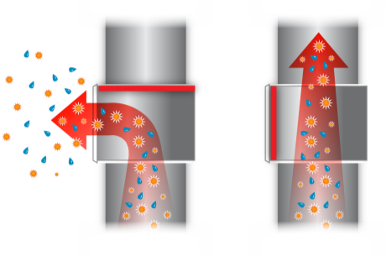
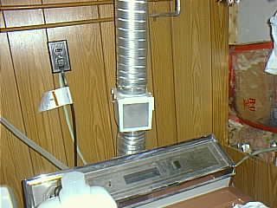
Improve Indoor Air Quality
Introduction to weatherization for auditors
Prevent mold/mildew.
Eliminate odors.
Reduce respiratory ailments.
The homeowner installed this device
to save energy.
Why is it a bad idea?
Photo courtesy of Tony Gill
Notes:
Through audit-guided weatherization work, we can improve the IAQ of the homes we serve.
Prevent mold and mildew
Eliminate odors
Reduce respiratory ailments
Q: This homeowner installed an energy-saving device on the clothes dryer. Why is this a bad idea?
A: The dryer vent energy reclaimer works with a damper.
Horizontal damper: warm moist air from dryer exhaust is guided into the home. Vertical damper: dryer exhausts outside.
The instructions tell users to start the dryer with the damper vertical and change it to horizontal toward the end of the cycle. Typically, people leave the damper in one position and ignore it.
If left in the “divert to interior” position, moisture will condense on cool interior surfaces causing mold. All the chemicals from the wash will be delivered to the living space for the occupants to inhale.
Moisture isn’t the only culprit in poor IAQ. Others include:
Stored toxic materials, like paints or fuel.
Radon.
Sewer gas.
Pets or new furnishings off-gassing.

Slide 21
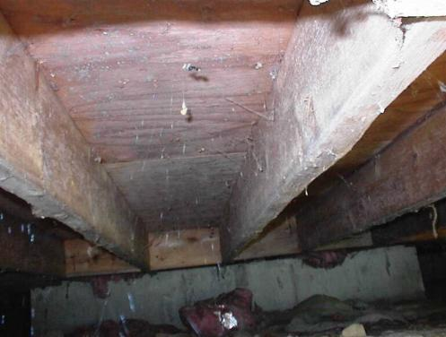
Extend Building Life
Introduction to weatherization for auditors
The same conditions that lower IAQ can reduce building durability.
What’s bad for the home occupants is usually bad for
the home.
Mold growing on floor stringers over a dirt-floored crawl space.
Photo courtesy of U.S. Dept. of Energy
Notes:
This is a photo of mold growing in floor stringers over a crawl space with a dirt floor.
Audit-guided weatherization work often identifies problems that can cause structural damage to the home. The same conditions that create poor indoor air quality, i.e., moisture condensing on interior surfaces, also reduce building durability.
What’s bad for the occupant is usually bad for the home.

Slide 22
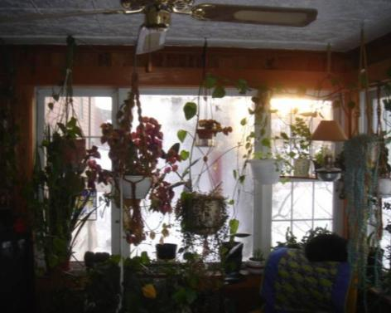
Increase Comfort
Introduction to weatherization for auditors
No drafts
No cold floors
No hot or cold rooms
No fogged windows
Photo courtesy of Tony Gill
Notes:
Tight, well-insulated houses not only save energy, they simply feel better!
No drafts – Air sealing prevents drafts.
No cold floors – Strategic air sealing and insulating keeps cold outdoor air out of floor cavities.
No hot or cold rooms – Pressure diagnostic-guided duct sealing balances delivery of conditioned air throughout the home.
No fogged windows – Proper ventilation and client education about moisture management prevents condensation on building materials, including windows.

Slide 23
Communicating with Clients
Introduction to weatherization for auditors
Basics of Communication
Respect
Boundaries
Understanding
Notes:
Auditors interact with the clients on a very personal level. Auditors spend a lot of time in client homes, sometimes for days in a row.
Auditors need to be diplomats as well as detectives. Auditors sometimes have questions that only the client can answer or have lessons to teach the client, like how to conduct regular maintenance. Below are some tips on communication that can make these interactions more pleasant for both the auditor and the client.
Basics of Communication – More is said than what is spoken.
Respect – Show respect for clients and their property.
Boundaries – Understand personal space.
Understanding – Communicate clearly and be aware of communication barriers.

Slide 24
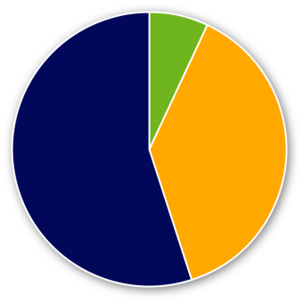
Communication 101
Introduction to weatherization for auditors
Communication of Feelings and Attitudes
Words (7%)
Body Language (55%)
Tone of Voice (38%)
Actions speak louder than words.
Notes:
Our tone of voice, facial expression, and body language express our feelings and attitudes much more than words.
Words – 7%
Tone – 38%
Body language – 55%
Actions speak louder than words.

Slide 25
Respect
Introduction to weatherization for auditors
We Are in Their Homes
Pride of Ownership
Privacy
Sensitivity
Ask yourself, “How would I feel if people behaved
this way around my children/mother/grandparents?”
Notes:
These are the clients’ homes. Be mindful of:
Pride of ownership – Show respect for the property. It may not be much, but it may be all they have. Do not speak or act in a way that robs people of their dignity.
Privacy – Save yourself and the client a potentially embarrassing situation and knock before entering a room with a closed door. Do not handle personal materials, even if they are lying out.
Sensitivity – Understand that world views, political views, and general standards of propriety vary widely among our client base. Do not discuss religion or politics. Do not use profanity.
Ask yourself, “How would I feel if people behaved this way around my children, siblings, mother, father, or grandparents?”

Slide 26
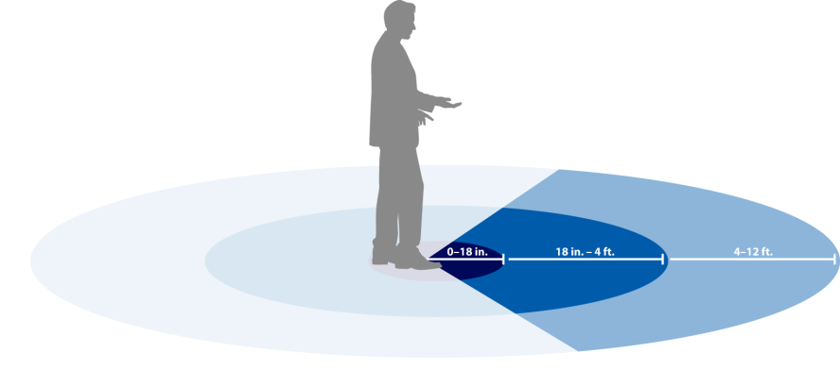
Boundaries
Introduction to weatherization for auditors
Personal Space
Acceptable distance differs widely by culture
Violating personal
space is threatening
Other Boundaries
Closed doors
Image created for U.S. Dept. of Energy
Notes:
When it comes to personal space there are distinct zones of comfort based on the type of relationship. Americans are remarkably uniform in their comfort zones.
0” to 18” – Reserved for intimate and deeply personal relationships.
18” to 4’ – Personal conversations with friends, family, or associates.
4’ to 12’ – Formal interactions, like interviews or official meetings.
Acceptable distance differs widely by culture. Pay attention to the clients. If they seem uncomfortable or continuously back away, give them some room.
Violating personal space is threatening. Imagine how it would feel if a stranger began poking around in your house. Invading personal space offends the same sense of personal boundaries.

Slide 27
Understanding
Introduction to weatherization for auditors
Understanding Each Other
Includes understanding and being understood.
Intention – What are you trying to communicate?
  Getting answers
  Client education
Know your Audience – Use terms they will understand.
Barriers – Are there barriers to effective communication?
  Language
  Culture
  Poor hearing or sight
Notes:
During the energy audit, you will need to ask the client a lot of questions. You will also need to educate the client on how to maintain the home. Clear communication is key.
Intention – What are you trying to communicate?
Getting accurate answers means asking questions the client can understand. Don’t use technical jargon. If there are a few different words for the same building component, make sure you are talking about the same thing. For example, “heater” could refer to the furnace, the water heater, or something else depending on the house and the client. Be as clear as possible.
Changing filters and cleaning equipment provide an opportunity for client education. People are more likely to remember the lesson if they know how it benefits them. Make it clear that cleaning and maintaining equipment keeps it running efficiently, reduces the likelihood of costly repairs, and helps get the most out of the energy-saving measures being installed. Be clear about how often regular maintenance should take place.
Barriers – Are there barriers to effective communication? Recognizing the barriers make it easier to overcome.
Language – Do you speak the same language? Can a relative or neighbor help translate?
Culture – Cultural norms may dictate which family members you should interact with or how family members treat you in the home. Be flexible.
Poor hearing or sight – Someone suffering from hearing loss may ask for a word or phrase to be repeated. Someone suffering from sight loss may not see what you are pointing at.

Slide 28
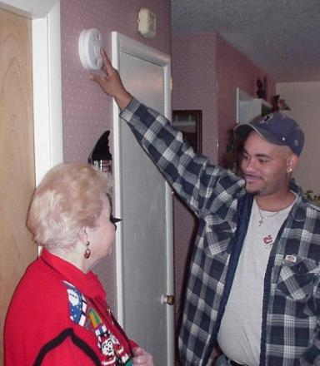
Client Interview #1
Introduction to weatherization for auditors
Assessment begins with meeting and interviewing the client.
Follow the ground rules of showing respect, honesty, and understanding.
Making the client part of the auditing process often yields
very important clues about:
  Health and safety
  Comfort
  Energy efficiency
Photo courtesy of U.S. Department of Energy
Notes:
Assessment begins with meeting and interviewing the client. Show respect, understanding, and honesty.
Making the client part of the auditing process often yields very important clues about:
Health and safety.
Comfort.
Energy efficiency.

Slide 29
Client Interview #2
Introduction to weatherization for auditors
Use the interview process to learn more about how the home works.
How many people live in the home?
Are there cold rooms? Hot rooms?
Do they use window shades to control solar heat gain?
Are certain parts of the house ever closed off for temperature control?
To what temperature is the thermostat typically set?
Do they use the fireplace or unvented space heaters?
What are the fuel bills?
Ask the client about issues related to health and safety.
Does anyone in the home have asthma?
Are headaches a chronic problem in the heating season?
Notes:
Use the interview process to learn more about how the home works.
How many people live in the home? This can affect ventilation requirements.
Are there cold rooms? Hot rooms? Discovering existing issues through the client interview helps the auditor focus the detective work.
Do clients use window shades to control solar heat gain? If they are active participants in controlling the home climate, they may be more open to client education about maintaining installed weatherization measures.
Are certain parts of the house ever closed off for temperature control?
To what temperature is the thermostat typically set?
Do they use the fireplace or unvented space heaters?
What are the fuel bills?
Ask the client about issues related to health and safety.
Does anyone in the home have asthma? This may be unrelated to the home itself, but should be noted on the work order if dense-pack sidewall insulation is specified.
Are headaches a chronic problem in the heating season? Test carbon monoxide right away!

Slide 30
Client Interview #3
Introduction to weatherization for auditors
Explain the audit process and discuss retrofit options.
Air leakage testing
Health and safety assessment
Heating and cooling assessment
Base load analysis
Existing conditions that may effect the building integrity or client health and safety
How the home and client lives will be improved through weatherization
Notes:
Explain the audit process and discuss retrofit options.
Air leakage testing
Health and safety assessment
Heating and cooling assessment
Base load analysis
Existing conditions that may affect the building integrity or health and safety
How the home and the clients’ lives will be improved through weatherization

Slide 31
Summary
Introduction to weatherization for auditors
WAP’s mission is to reduce utility bills for low- to moderate-income clients.
Cost-effectiveness guides the selection of measures.
The energy auditor collects information to determine the cost-effectiveness of measures and possible incidental repairs.
The benefits of weatherization include reduced energy bills, increased comfort, and improved IAQ and building durability.
Show respect for clients and their belongings whenever you enter their home.
Notes:
WAP’s mission is to reduce utility bills for low- to moderate-income clients.
Cost-effectiveness guides the selection of measures.
The energy auditor collects information to determine the cost-effectiveness of measures, and possible incidental repairs.
The benefits of weatherization include reduced energy bills, increased comfort, and improved IAQ and building durability.
Show respect for clients and their belongings whenever you enter their home. Client interviews can tell you much about the home and how it functions that you would not be able to learn in a brief visit.
Present this slide as an interactive discussion, soliciting personal examples from the trainees. Add your own personal examples and knowledge to supplement.

