Slide 1

Calculating Envelope
Energy Loss
WEATHERIZATION ENERGY AUDITOR SINGLE FAMILY
WEATHERIZATION ASSISTANCE PROGRAM STANDARDIZED CURRICULUM – December 2012
Notes:
December 2012
1

Slide 2
Learning Objectives
Calculating Envelope energy loss
By attending this session, participants will be able to:
Define basic energy movement.
State procedures for calculating hourly and annual energy loss.
Explain the principle of diminishing returns.
Notes:
By attending this session, participants will be able to:
Define basic energy movement.
State procedures for calculation hourly and annual energy loss.
Explain the principle of diminishing returns.
December 2012
2

Slide 3
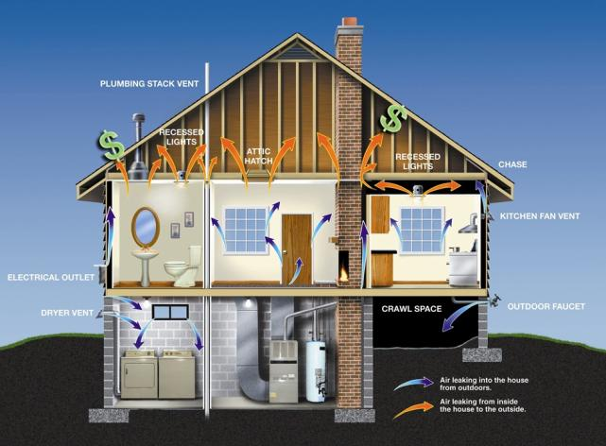
Quantifying Envelope Energy Loss
Calculating Envelope energy loss
Where does the heat go?
Photo courtesy of ENERGY STAR; http://www.energystar.gov/index.cfm?c=behind_the_walls.btw_airsealing
Notes:
This DOE ENERGY STAR illustration shows infiltration and exfiltration patterns in a typical single-family home before air sealing.
Energy moves by conduction, convection, and radiation.
Insulation deals with conduction and radiation by trapping tiny air pockets, which slow conductive and radiant energy flow.
Insulation has a minimal effect on convective energy flow. Air sealing in conjunction with insulation is necessary to control convective (air-transported) energy loss.
Broadly speaking, the building industry has mastered insulation. Any reasonably competent tradesman can install insulation properly. (Note: Quality control can be an issue — “can” does not always equal “will.”) On the other hand, few outside the weatherization program see the value of air sealing.
Q: What is a material that air seals and insulates?
A: Spray foam.
December 2012
3

Slide 4
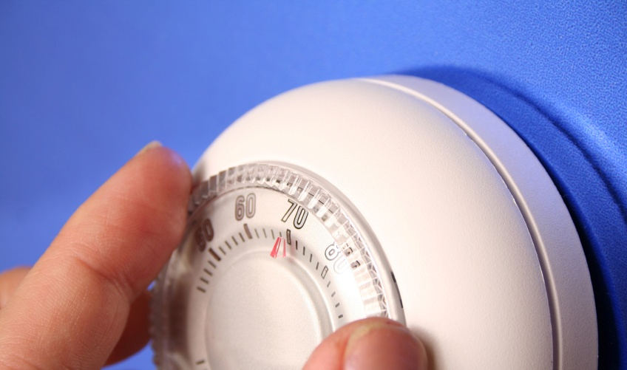
Key Terms
Calculating Envelope energy loss
BTU - British thermal unit
Heating degree days
R-value
Guarded hot box
Photo courtesy of Life123 Inc.
Notes:
Key terms include the following:
British thermal unit (BTU) is the amount of heat required to raise 1 pound of water 1 degree Fahrenheit. The heat resulting from burning one wooden kitchen match to ash is approximately equal to 1 BTU.
Heating degree days (HDD) were developed by the oil heat industry to help predict fuel use. To determine HDD, divide the sum of the day’s high and low temperatures by 2 and subtract the result from 65°F.
Why 65°F? Because of the heat from mechanicals and occupants—called internal gain—the house will stay at 70°F until the exterior temperature drops to 65°F. The heating system will not be needed until then.
The sum of all individual HDD in the heating season is the annual HDD.
Do several calculations. Be sure to do at least one with a nighttime low significantly below zero to illustrate adding negative and positive numbers.
R-value is a number assigned to a material to quantify its resistance to heat transfer. It is expressed in terms of resistance per unit of depth. For example, wood is typically R-1 per inch of thickness.
A process known as guarded hot box testing determines the R-value. Performing a guarded hot box test requires a box enclosed by another box so that the surface of the inner box⎯the guarded hot box⎯can be kept at a known temperature. The tested material is then installed so that it forms a barrier between a constant heat source and a thermometer in the inner box.
The material’s thermal transmittance—its U-factor—is found by measuring how long it takes a known quantity of heat to equalize across the material.
“U” is roughly converted to “R” by dividing it into 1. That is, “U” and “R” are reciprocals: 1/U=R and 1/R=U.
For example, something with a U-value of 0.5 has an approximate R-value of 2. A material with an R-value of 16 has an approximate U-value of 1/16 or 0.06.
December 2012
4

Slide 5
Some Typical R-Values*
Calculating Envelope energy loss
Fiberglass = 2.4 - 4.4 per in. ≈ 3.5 per in.
Cellulose = 3.0 - 3.6 per in. ≈ 3 per in.
Expanded polystyrene ≈ 3.6 per in. (Bead board)
Extruded polystyrene = 5 per in. (Styrofoam™)
Polyisocyanurate board ≈ 5.6 – 7.6 per in.
Glass ≈ 1 per layer
Wood ≈ 1 per in.
Concrete ≈ 1 per 8 in.
* See Krigger, PP 103.
Notes:
Here are a few R-values an auditor should know:
Fiberglass = 2.4 – 4.4 per inch ≈ 3.5 per in.
Cellulose = 3.0 – 3.6 per inch ≈ 3 per in.
Expanded polystyrene (beadboard) ≈ 3.6 per in.
Extruded polystyrene (styrofoam) = 5 per in.
Polyisocyanurate board ≈ 5.6 – 7.6 per in.
Glass ≈ 1 per layer
Wood ≈ 1 per in.
Concrete ≈ 1 per 8 in.
Q: Which material provides the best insulation per inch?
A: Polyisocyanurate board.
Q: Which would have the highest U-factor?
A: Concrete.
December 2012
5

Slide 6

When is an R not an R?
Calculating Envelope energy loss
Graphic developed for the U.S. DOE WAP Standardized Curricula
Intrusion
Wind-washing
Both intrusion and wind-washing significantly lower R value.
The more porous the insulation, the more the R is reduced.
Exposed fiberglass in a well-vented attic will test as much
as 50% below its label rating.
Notes:
Intrusion is air moving into and out of insulation without going through the wall or ceiling assembly. It will occur even when a good air barrier is present on one surface.
Q. How does intrusion in fiberglass batts in an attic work?
Cold air, being more dense than warm air, sinks into the open fiberglass batts, reducing its effective R-value. The colder the air, the greater the intrusion effect.
Wind-washing is a phenomenon particular to fiberglass attic insulation. Air entering and leaving the attic through the attic eave vent openings is frequently able to blow through or underneath flat fiberglass attic insulation, removing heat as it goes.
Intrusion and wind-washing can combine to reduce insulation effectiveness up to 50%.
December 2012
6

Slide 7
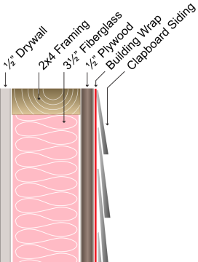
Assembly R-Values
Calculating Envelope energy loss
Building envelopes generally consist of layers of materials, each of which resists heat flow.
In addition, each layer—not in physical contact with another layer—has an air film that also resists heat flow.
The assembly has ½ in. drywall, 3½ in. fiberglass, 2 in. x 4 in. framing, ½ in. plywood,
building wrap and clapboard siding.¹
The assembly has a total theoretical R of ≈ 14.
In reality it will test ≈ 20% lower; ≈ R-10.²
¹ Krigger, page 67. ² Krigger, page 272.
Notes:
R-values for almost any material are listed in books and Websites.
To calculate the R-value of an assembly, look up the R-value for each component and add the R-values together.
Remember that the result is theoretical only. Any audit protocol or software will de-rate an assembly by some percentage—the infamous “fudge factor”—to bring the calculated heat loss more in line with actual performance based on actual fuel use.
It is generally safe to rate an uninsulated wall assembly as R-3, a ceiling with no attic floor as R-1, and a ceiling with an attic floor as R-2.
A properly insulated wall or ceiling assembly will approximate the insulation R-value less 10%. So if there is R-11 insulation in the attic, the assembly would be rated at R-10¹ (11 – 10% = 9.9 ≈ 10).
¹ Krigger, John T., and Chris Dorsi. Residential Energy Cost Savings and Comfort for Existing Buildings. 4th ed. New York: Saturn Resource Management, 2004. Print. pp 274.
December 2012
7

Slide 8
Quantifying Envelope Losses
Calculating Envelope energy loss
Surface Heat Loss:
Air Transported Heat Loss:
A = Area in sq. ft.
ΔT = Difference in temperature in °F
t = Time in hrs
R = Total resistance of assembly to heat flow
A x ΔT x t
R
V x AC/H x 0.0182 BTU/ft³,°F x ΔT
V = Volume of the building.
AC/H = Air change per hr
0.0182 BTU/ft³,°F = Specific heat of air.
Notes:
Surface heat loss is calculated in BTU per hour.
The surface loss formula can also be written A x ∆T x t x U. This formula is useful for calculating heat loss through windows, which are always listed in U, not R-values.
A = Area in square feet.
t = Time in hours.
T = Temperature in degrees Fahrenheit.
U = U-factor, heat transmittance.
R = Resistance to heat transmittance.
R is the inverse of U; therefore, U = 1/R and R = 1/U.
R-values can be added.
U-values cannot be added.
Windows and sometimes doors are listed in U.
Mobile home insulation is always given in U.
To calculate BTU per heating season, insert HDD x 24 hours in place of ∆T x t.
Air-transported heat loss is calculated in BTU per cubic feet per hour (CFH).
The specific heat of air is the number of BTUs needed to raise 1 cu. ft. of air 1 degree Fahrenheit. This is a constant.
December 2012
8

Slide 9
Example: Wall Section Surface Loss
Calculating Envelope energy loss
8 ft. x 12 ft. wall; no windows = 96 sq. ft.
70°F inside - 30°F outside = 40°F ΔT
7,200 HDD
R-11 Insulation
(Remember: R-11 insulation = R-10 assembly)
How many BTU/hr?
How many BTU per heating season?
Notes:
Given the following characteristics, what is the heat loss?
A = 8 ft. x 12 ft. wall; no windows = 96 sq. ft.
∆T = 70°F inside – 30F °outside = 40F° ΔT.
7,200 HDD.
R = R-11 insulation – 10% = R-10 assembly.
December 2012
9

Slide 10
Wall Section Surface Loss Calculation
Calculating Envelope energy loss
BTU/hr?
(96 sq. ft. x 40°F x 1 hr)/10 =
How many BTU per heating season?
(96 sq. ft. x 7,200 HDD x 24 hrs)/10 =
384 BTU/hour
1,658,880 BTU per heating season
Notes:
In BTU/hr:
(96 sq. ft. x 40°F x 1 hr)/10 = 384 BTU/hr.
How many BTU per heating season?
(96 sq. ft. x 7,200 HDD x 24 hrs)/10 = 1,658,880 BTU per heating season.
Have students work through problem on scrap paper.
Click to reveal answers to calculations.
December 2012
10

Slide 11
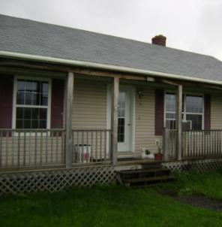
Example: Uninsulated Ranch
Calculating Envelope energy loss
20 ft. x 30 ft. on slab
8 ft. walls
10% wall area is windows and doors
7200 HDD
70°F inside – 30°F outside = 40° ∆T
No insulation in walls and ceiling
1.25 air change per hr (AC/H)
Photo courtesy of the U.S. Department of Energy
Notes:
Totally uninsulated houses are rare, but they do exist. Many were constructed in the 1950s and 1960s when energy was cheap. It was cheaper to heat them than insulate them!
House characteristics:
Footprint: 20 ft. x 30 ft.
Walls are 8 ft. high
10% of wall area is windows and doors
7,200 HDD
70°F indoors – 30°F outside = 40°F ΔT
No insulation in walls or ceiling
1.25 air changes per hour (ACH)
December 2012
11

Slide 12
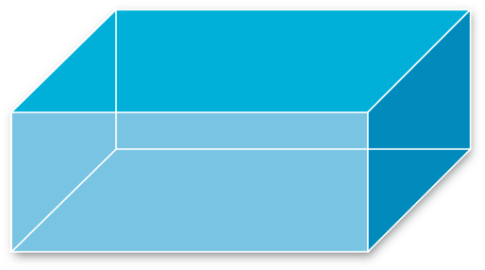
Calculating Area
Calculating Envelope energy loss
Rough wall area = 2 x (240 + 160) = 800 sq. ft.
Windows and Doors = 10% of wall area = 80 sq. ft.
Walls = 800 - 80 = 720 sq. ft.
Ceiling = 20 x 30 = 600 sq. ft.
20 ft. x 30 ft. = 600 ft.
20 ft. x 8 ft. = 160 ft.
8 ft.
30 ft. x 8 ft. = 240 ft.
20 ft.
30 ft.
Notes:
To calculate heat loss through surface area, it is necessary to calculate areas. Every home is essentially a block or some combination of blocks. For this example, a simple rectangle works to visualize the home.
Click to reveal wall and ceiling calculations on the diagram.
Click to reveal rough wall area calculation; windows and doors calculation; walls and ceiling calculations in that order.
Wall area
20 ft. + 30 ft. + 20 ft. + 30 ft. = 100 ft. x 8 ft. = 800 sq. ft. – 80 sq. ft. windows and doors = 720 sq. ft. net wall area
Ceiling area
20 ft. x 30 ft. = 600 sq. ft. ceiling area
December 2012
12

Slide 13
Calculating Volume
Calculating Envelope energy loss
Volume
Length x Width x Height
30 x 20 x 8 =
4,800 cu. ft.
8 ft.
20 ft.
30 ft.
Notes:
To calculate heat loss through air infiltration, we need to calculate the volume of conditioned space.
Volume = Length x Width x Height
20 ft. x 30 ft. x 8 ft. = 4,800 cu. ft.
Let students do calculations on scrap paper.
Click to reveal volume within rectangle.
December 2012
13

Slide 14
Heat Loss Through Surface Area
Calculating Envelope energy loss
EXAMPLE: UNINSULATED RANCH
How many BTU/hr surface?
Walls = (720 sq. ft. x 40°F) / 3 =
Ceiling = (600 sq. ft. x 40°F) / 1 =
How many BTU/Heat season surface?
Walls = (720 sq. ft. x 7,200 HDD x 24 hrs) / 3 =
Ceiling = (600 sq. ft. x 7,200 HDD x 24 hrs) / 1 =
( A x ΔT x t ) / R
9,600 BTU/hr
24,000 BTU/hr
( A x #HDD x 24 hrs ) / R
41,472,000 BTU/yr
103,680,000 BTU/yr
Notes:
Example: Uninsulated ranch
Wall area = 720 sq. ft.
Wall R-value = 3
Windows and doors = 80 sq. ft.
Ceiling area = 600 sq. ft.
Ceiling R-value = 1
Volume = 4,800 cu. ft.
ΔT = 40°F
ACH = 1.25
HDD = 7,200
How many BTU/hr are lost through surface area?
Click to reveal formula. Let students work through problem, then click to reveal answers.
Formula: (A x ΔT x 1 BTU/hr) / R
Walls = (720 sq. ft. x 40°F)/3 = 9,600 BTU/hr
Ceiling = (600 sq. ft. x 40°F)/1 = 24,000 BTU/hr
How many BTU/heating season are lost through surface area?
Click to reveal formula. Let students work through problem, then click to reveal answers.
Formula: (A x HDD x 24 hrs) / R
Walls = (720 sq. ft. x 7,200 HDD x 24 hrs)/3 = 41,472,000 BTU/yr
Ceiling = (600 sq. ft. x 7,200 HDD x 24 hrs)/1 = 103,680,000 BTU/yr
December 2012
14

Slide 15
Heat Loss Through Air Infiltration
Calculating Envelope energy loss
EXAMPLE: UNINSULATED RANCH
How many BTU/hr are lost through air infiltration?
4,800 cu. ft. x 1.25 ACH x (0.0182 BTU/cu. ft., °F) x 40°F
=
How many BTU/heating season are lost through air infiltration?
4,800 cu. ft. x 1.25 ACH x (0.0182BTU/cu. ft. °F) x 7,200 HDD x 24 hrs
=
V x ACH x 0.0182 x ∆T
4,368 BTU/hr
V x ACH x 0.0182 x #HDD x 24 hrs
18,869,760 BTU/ heating season
Notes:
Example: Uninsulated Ranch –
Volume = 4,800 cu. ft.
ΔT = 40°F
ACH = 1.25
HDD = 7,200
How many BTU/hr are lost through air infiltration?
Click to reveal formula. Let students work through problem, then click to reveal answers.
Formula¹: V x ACH x 0.0182 x ΔT
4,800 cu. ft. x 1.25 ACH x (0.0182 BTU/cu. ft., °F) x 40°F = 4,368 BTU/hr
How many BTU/heating season are lost through air infiltration?
Click to reveal formula. Let students work through problem, then click to reveal answers.
Formula: V x ACH x 0.0182 x HDD x 24 hrs
4,800 cu. ft. x 1.25 ACH x (0.0182BTU/cu. ft., °F) x 7,200 HDD x 24 hrs = 18,869,760 BTU/heat season
¹This number, in BTU/cu. ft., °F, is the specific heat of air.
December 2012
15

Slide 16
Example: Minimally Insulated House
Calculating Envelope energy loss
20 ft. x 30 ft. on slab
8 ft. walls
10% wall area is windows and doors
7200 HDD
70°F inside – 30°F outside = 40° ∆T
3.5 in. R-11 fiberglass in walls;
6 in. R-19 fiberglass in ceiling
1.25 air change per hour (AC/H)
Photo courtesy of the U.S. Department of Energy
Notes:
The areas and volumes in a typical minimally insulated home are the same as in the last example:
Footprint: 20 ft. x 30 ft.
Walls are 8 ft. high
10% of wall area is windows and doors
Total wall area is 720 sq. ft.
Ceiling area is 600 sq. ft.
7,200 HDD
70°F indoors – 30°F outside = 40°F ΔT
R-11 batts in walls (= R-10 assembly)
R-19 batts in ceiling (= R-17 assembly)
1.25 ACH
December 2012
16

Slide 17
Heat Loss Through Surface Area
Calculating Envelope energy loss
EXAMPLE: MINIMALLY INSULATED HOUSE
How many BTU/hr surface?
Walls = (720 sq. ft. x 40°F) / 10 =
Ceiling = (600 sq. ft. x 40°F) / 17 =
How many BTU/heat season surface?
Walls = (720 sq. ft. x 7,200 HDD x 24 hrs) / 10 =
Ceiling = (600 sq. ft. x 7,200 HDD x 24 hrs) / 17 =
( A x ΔT x t ) / R
2,880 BTU/hr
1,412 BTU/hr
( A x #HDD x 24 hrs ) / R
12,441,600 BTU/yr
103,680,000 BTU/yr
Notes:
Example: Minimally Insulated House
How many BTU/hr are lost through surface area?
Formula: (A x ΔT x 1 BTU/hr) / R
Walls = (720 sq. ft. x 40°F)/10 = 2,880 BTU/hr
Ceiling = (600 sq. ft. x 40°F)/17 = 1,412 BTU/hr
How many BTU/heating season are lost through surface area?
Formula: (A x HDD x 24 hrs) / R
Walls = (720 sq. ft. x 7,200 HDD x 24 hrs)/10 = 12,441,600 BTU/yr
Ceiling = (600 sq. ft. x 7,200 HDD x 24 hrs)/17 = 6,098,824 BTU/yr
December 2012
17

Slide 18
Heat Loss Through Air Infiltration
Calculating Envelope energy loss
EXAMPLE: MINIMALLY INSULATED HOUSE
How many BTU/hr are lost through air infiltration?
4,800 cu. ft. x 1.25 ACH x (0.0182 BTU/cu. ft., °F) x 40°F
=
How many BTU/heating season are lost through air infiltration?
4,800 cu. ft. x 1.25 ACH x (0.0182BTU/cu. ft. °F) x 7,200 HDD x 24 hrs
=
V x ACH x 0.0182 x ∆T
4,368 BTU/hr
V x ACH x 0.0182 x #HDD x 24 hrs
18,869,760 BTU/ heating season
Notes:
Example: Minimally Insulated House
How many BTU/hr are lost through air infiltration?
Formula: V x ACH x 0.0182 x ΔT
4,800 cu. ft. x 1.25 ACH x (0.0182 BTU/cu. ft., °F) x 40°F = 4,368 BTU/hr
How many BTU/heating season are lost through air infiltration?
Formula: V x ACH x 0.0182 x HDD x 24 hrs
4,800 cu. ft. x 1.25 ACH x (0.0182BTU/cu. ft., °F) x 7,200 HDD x 24 hrs = 18,869,760 BTU/heat season
Q: In this building, almost as much heat is being lost through air movement as by surface loss. Where should weatherization activities be targeted?
A: Air sealing this building to the IAQ minimum air change rate will have a much higher SIR than installing additional insulation in either walls or ceilings.
December 2012
18

Slide 19
Program Standard House
Calculating Envelope energy loss
20 ft. x 30 ft. on slab
8 ft. walls
10% wall area is windows and doors
7200 HDD
70°F inside – 30°F outside = 40° ∆T
3.5 in. R-11 fiberglass in walls; Attic raised to R-38
0.35 air change per hour (AC/H)
Photo courtesy of the U.S. Department of Energy
Notes:
This example assumes the minimally insulated home of the last example has been air sealed and insulated.
All the characteristics of this home are the same as the minimally insulated home, except that the attic has been improved to R-38/40 and ACH reduced from 1.25 to 0.35.
R-11 batt walls and R-38 ceiling. Air seal building to 0.35 AC/H.
December 2012
19

Slide 20
Heat Loss Through Surface Area
Calculating Envelope energy loss
EXAMPLE: PROGRAM STANDARD HOUSE
How many BTU/hr surface?
Walls = (720 sq. ft. x 40°F x 1 hr) / 10 =
Ceiling = (600 sq. ft. x 40°F x 1 hr) / 38 =
How many BTU/heat season surface?
Walls = (720 sq. ft. x 7,200 HDD x 24 hrs) / 10 =
Ceiling = (600 sq. ft. x 7,200 HDD x 24 hrs) / 38 =
( A x ΔT x t ) / R
2,880 BTU/hr
632 BTU/hr
( A x #HDD x 24 hrs ) / R
12,441,600 BTU/yr
2,728,421 BTU/yr
Notes:
Example: Program Standard Home
How many BTU/hr are lost through surface area?
Walls = (720 sq. ft. x 40°F)/10 = 2,880 BTU/hr
Ceiling = (600 sq. ft. x 40°F)/38 = 632 BTU/hr
How many BTU/heating season are lost through surface area?
Walls = (720 sq. ft. x 7,200 HDD x 24 hrs)/10 = 12,441,600 BTU/yr
Ceiling = (600 sq. ft. x 7,200 HDD x 24 hrs)/38 = 2,728,421 BTU/yr
December 2012
20

Slide 21
Heat Loss Through Air Infiltration
Calculating Envelope energy loss
EXAMPLE: PROGRAM STANDARD HOUSE
How many BTU/hr are lost through air infiltration?
4,800 cu. ft. x 0.35 ACH x (0.0182 BTU/cu. ft., °F) x 40°F
=
How many BTU/heating season are lost through air infiltration?
4,800 cu. ft. x 0.35 ACH x (0.0182BTU/cu. ft. °F) x 7,200 HDD x 24 hrs
=
V x ACH x 0.0182 x ∆T
1,223 BTU/hr
V x ACH x 0.0182 x #HDD x 24 hrs
5,283,533 BTU/heating season
Notes:
Example: Program Standard Home
How many BTU/hr are lost through air infiltration?
4,800 cu. ft. x 0.35 ACH x (0.0182 BTU/cu. ft., °F) x 40°F = 1,223 BTU/hr
How many BTU/heating season are lost through air infiltration?
4,800 cu. ft. x 0.35 ACH x (0.0182 BTU/cu. ft., °F) x 7,200 HDD x 24 hrs = 5,283,533 BTU/heating season
Weatherizing this house reduced energy loss through the building envelope by 3 million BTU/yr through added attic insulation, and almost 14 million BTU/yr through air sealing!
Give the class measurements for a cape with ell and have them calculate hourly and annual BTU loss attributable to surface and air transported heat loss as either homework or a class exercise. Use an HDD number appropriate for the training area.
December 2012
21

Slide 22
Law of Diminishing Returns
Calculating Envelope energy loss
First 6 in. of attic insulation saved 97 million BTU/yr.
Second 8 in. saved only 3 million BTU/yr.
Projected savings = energy loss through existing assembly – energy loss through proposed assembly
General rule of thumb:
Each successive “R” added to attic saves about
50% of “R” immediately prior.
Materials and labor remain constant.
Notes:
Projected savings from installing surface insulation must always be calculated by figuring the energy loss through the existing assembly and subtracting that from the energy loss through the proposed assembly.
Generally speaking, each successive “R” installed in any assembly saves ≈ 50% of the energy saved by the previous “R.”
This concept is central to energy auditing. Stress it! Relate diminishing returns to SIR.
Discuss the implications:
Q: Why is the DOE Program Standard for attics R-38 to R-40?
A: Because of the law of diminishing returns, combined with the DOE SIR requirement that each measure must pay for itself in conserved energy. Each successive “R” saves approximately 50% as much as the previous R while the material and labor costs remain constant. The break-even point in a heating environment is R-38 to R-40.
Q: Why wouldn’t wall insulation be added to the minimally insulated ranch?
A: The insulated wall assembly is already ≈ R-10. Adding insulation to existing walls is an expensive proposition. The combination of high cost and low potential to further reduce heat loss results in an SIR below 1. The same logic applies to attics: while the cost per square foot for insulating is lower for attics than walls, attics start with a higher existing R, reducing the potential benefit.
Q: If this home had a semi-conditioned basement, should basement wall insulation be considered? (8 in. concrete = R-1)
A: Yes. Basement wall insulation is relatively inexpensive to install per square foot. Raising the existing R-1 to as little as R-10 produces a much higher return than adding the same insulation to any surface that is already at a higher existing R. The combination of low cost and high return produces an excellent SIR.
December 2012
22

Slide 23
Summary
Calculating Envelope energy loss
Surface heat loss is a function of time, temperature difference, and area.
To estimate space heating fuel use accurately, both surface and air-transported heat loss must be considered.
Internal gain is the heat generated by occupants & mechanicals.
“R” and “U” are reciprocals. That is, each is found by dividing the other into 1.
Each successive “R” saves ≈ ½ the previous “R.”
The law of diminishing returns drives SIR calculations.
Heat loss formulas are calculated per hour. To annualize them, substitute HDD x 24 hrs for ∆T x time.
Notes:
Surface heat loss is a function of time, temperature difference, and area.
To estimate space heating fuel use accurately, both surface and air-transported heat loss must be considered.
Internal gain is the heat generated by occupants and mechanicals.
“R” and “U” are reciprocals. That is, each is found by dividing the other into 1.
Each successive “R” saves ≈ ½ the previous “R.”
The law of diminishing returns drives SIR calculations.
Heat loss formulas are calculated per hour. To annualize them, substitute HDD x 24 hrs for ∆T x time.
Present this slide as an interactive discussion, soliciting personal examples from the trainees. Add your own personal examples and knowledge to supplement.
December 2012
23

