Slide 1
Energy Movement
WEATHERIZATION ENERGY AUDITOR SINGLE FAMILY
WEATHERIZATION ASSISTANCE PROGRAM STANDARDIZED CURRICULUM – December 2012

Slide 2
Learning Objectives
Energy Movement
By attending this session, participants will be able to:
Discuss the principles of energy and energy movement.
List the three methods of heat transfer.
Differentiate between thermal boundaries and air barriers and the proper location of each.
Describe the forces that cause air leakage.
Explain the connection between air leakage, energy waste, and moisture problems.
Explain how air ducts affect pressure balance within the home.
Notes:
By attending this session, participants will be able to:
Discuss the principles of energy and energy movement.
List the three methods of heat transfer.
Differentiate between thermal boundaries and air barriers and the proper location of each.
Describe the forces of air leakage.
Explain the connection between air leakage, energy waste, and moisture problems.
Explain how air ducts affect pressure balance within the home.

Slide 3
What is energy? What controls it?
ENERGY MOVEMENT
A measurable quantity of:
Heat: Molecular movement.
Work: Expended energy with a result.
Light.
Some key terms:
Potential energy
Kinetic energy
Temperature
Sensible heat
Phase change
Latent heat
Notes:
Energy is a measurable quantity of:
Heat – molecular movement, or
Work – expended energy with a result, or
Light.
Some key terms:
Potential energy – Stored energy
Gasoline has potential energy.
A heavy object on a high ledge has potential energy.
Kinetic energy – Moving or transitional energy
A heavy object falling from a high ledge has kinetic energy. It may be used to do work, like lifting an elevator through a cable and pulley system.
Fire is another form of kinetic energy.
Temperature – A measure of the heat present
Sensible heat – Potential energy in the form of thermal energy of water; the relationship of water to its heat content
One British Thermal Units (BTU) will raise 1 pound of water 1°F as long as there is no phase change.
Phase change – The act of changing from one state of matter to another, e.g., solid to liquid or liquid to gas.
Latent heat – The amount of heat absorbed or released in a phase change; for water, the latent heat is 970 BTU/lb liquid to gas and 144 BTU/lb liquid to solid.

Slide 4
How Does Energy Move?
Energy Movement
Laws of Thermodynamics
Energy is neither created nor destroyed.
Energy always* goes from high to low.
*Absent an outside influence expending other energy.
Notes:
Laws of Thermodynamics:
Energy is neither created nor destroyed.
Energy always goes from high to low (absent an outside influence expending other energy).
Use weather maps or a clip of the local weather station as an illustration of the laws of thermodynamics in action. Hurricanes move and eventually dissipate, but the energy is never destroyed. Fronts move into low-pressure zones, and so on.

Slide 5
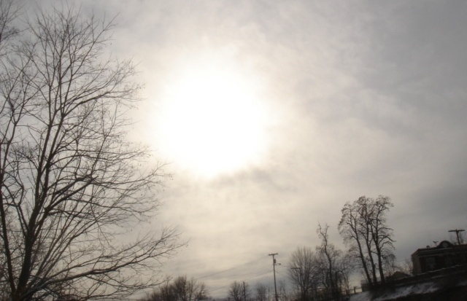
Where Does Our Energy Come From?
Energy Movement
Photo courtesy of The U.S. Department of Energy
Notes:
More than 99% of our energy comes from the sun.
Energy reaches us from the sun by pure radiation.
Coal and oil come from plants grown by the sun or dinosaurs that ate what the sun grew.
Once it’s here, other mechanisms get involved:
Conduction
Convection
Radiation
Chemicals, e.g., plants using sun and chlorophyll to grow mass
Q: What about wind?
A: Wind is caused by temperature differences caused by solar radiation, or its absence.

Slide 6
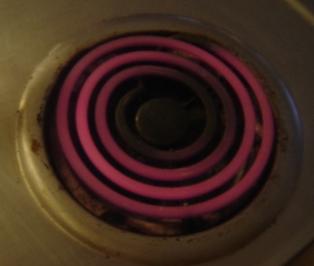
Heat Transfer
Energy Movement
Heat is transferred through three processes:
Radiation
Conduction
Convection
Photo courtesy of The U.S. Department of Energy
A burner can illustrate all three processes.
Notes:
Heat is transferred through three processes:
Radiation
Conduction
Convection
Tell students the class will use a stove burner to illustrate all three processes and they’ll have an opportunity to apply this knowledge by identifying the examples.

Slide 7
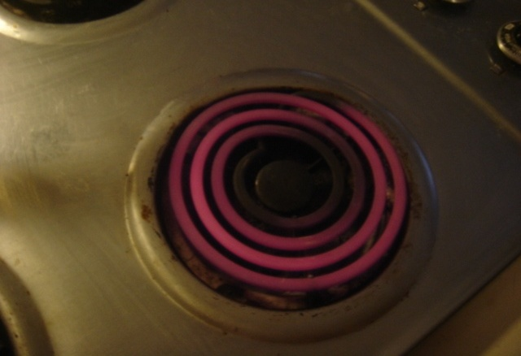
Radiation
Energy Movement
Photo courtesy of The U.S. Department of Energy
Notes:
Radiation does not require physical contact or a medium.
Heat is radiating from this burner, warming any object in its vicinity. That’s radiation.
Q: What are some other forms of radiation in homes?
A: Fireplaces radiate heat to nearby occupants, although often more heat is sucked from the home up through the chimney through the stack effect, causing net cooling.
A: Radiators
A: An incandescent light bulb radiates heat.

Slide 8
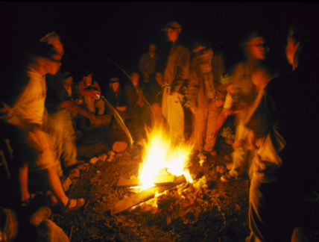
Everything Radiates and Absorbs Energy
Energy movement
Always
The campfire radiates heat onto the people, who in turn radiate heat out to space.
Photo courtesy of The U.S. Department of Energy
Notes:
The fire heats the people who, in turn, radiate their heat out to space.
Usually most solids are absorbing and radiating energy simultaneously.

Slide 9
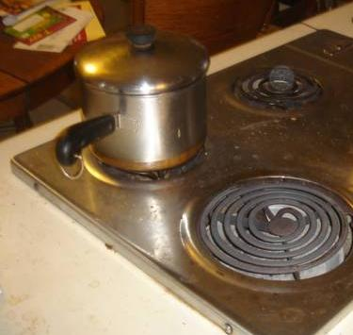
Conduction
Energy movement
Conduction requires physical contact.
The pot is in contact with the burner.
Heat is transferred from the burner to the bottom of pot by conduction.
Photo courtesy of The U.S. Department of Energy
Notes:
Conduction requires physical contact–touching.
The pot is in contact with the burner. Heat is transferred from the burner to the bottom of the pot by conduction.
Q: What are some other examples of conductive heat transfer?
A: Stirring a hot cup of tea with a cold spoon, the spoon gets warm through conduction as heat travels up the handle. Conduction also warms your hands if you’re holding the hot teacup.

Slide 10
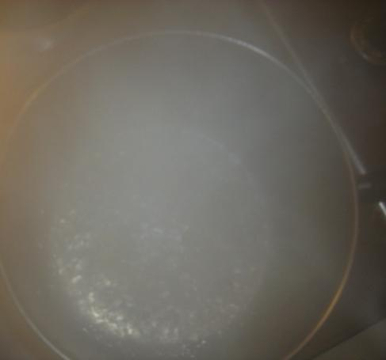
Convection
Energy movement
Convection is heat movement in a fluid.
Air
Oil
Water
Convection requires a medium.
Photo courtesy of The U.S. Department of Energy
Convection transfers heat throughout the pot of boiling water.
Notes:
Convection is heat movement in liquids and gases.
Convection requires a medium.
Heat conducted to the bottom of the pan warms the water. The water temperature will stabilize at 212°F—the boiling point of water—because of the convection of heat in the water.
Q: What are some examples of convective heat loss in a home?
A: Cold air near a single-pane window is heavier than nearby warm air, so it sinks to the floor, which pulls more heated air next to the window where it will be cooled, and so on.
A: Air moving within a wall cavity: In the winter, air against the outer siding can cool and sink within the cavity. Warmer air against the interior drywall is pulled around and cooled in turn.

Slide 11
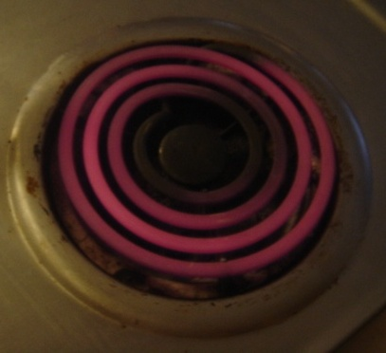
Heat Transfer Mechanisms
Energy movement
All three mechanisms are in operation:
Conduction: Brackets supporting the burner
Convection: Air above coil
Radiation: Ceiling above stove
Photo courtesy of The U.S. Department of Energy
Notes:
All three mechanisms are in operation in this stovetop burner.
Conduction: The brackets supporting the burner are being heated by conduction, in turn heating the metal stovetop.
Convection: Heat is warming the air above the coil. The warmed air rises and heats the room by convection.
Radiation: Heat radiates from the burner, heating the ceiling above.
Some of the heat reaching the ceiling will be absorbed and radiated back, while some—depending on how shiny the ceiling is—will be reflected.
Illustrate the following content by sketching a house on the whiteboard or other media and adding elements as each bullet is discussed.
How does this apply to buildings?
Heat inside a building warms the inside surfaces by convection and radiation.
Heat is transferred through building surfaces mostly by conduction, with help from convection and radiation.
On the cold side of the wall assembly, heat leaves by convection (moving air carries it away) and radiation.
Anything physically touching the building assembly will remove heat by conduction.
Air-transported heat loss occurs when conditioned air leaves the building and is replaced by outside air.

Slide 12
Comfort, Safety, and Efficiency
Energy movement
A comfortable, safe, and energy-efficient home requires:
A fully insulated thermal envelope.
A well-sealed air boundary.
The thermal and air boundaries to be continuous and in contact with one another.
Efficient, properly sized equipment to condition the living space and heat water.
A well-designed and balanced air distribution system.
Healthy indoor air quality.
Notes:
The Weatherization Assistance Program has determined that a comfortable, safe, and energy-efficient home requires:
A fully insulated thermal envelope or thermal boundary.
A well-sealed air barrier – Since air carries heat and moisture, the condition of the air barrier plays a major role in the movement of heat and moisture through the building. It also affects indoor air quality (IAQ).
Thermal and air boundaries that are continuous and in contact with one another. The motto is, “seal tight, insulate right.”
Efficient, properly sized equipment to condition the living space and heat water. Bigger is not better. For example, oversized air-conditioners make a house cold and clammy, and short cycle times produce problems down the road. Moisture in the air condenses on building surfaces instead of on the condenser coil, which can cause mold and rot. This course focuses on the first three factors. To learn more about proper sizing of equipment, refer to Manual J.
A well-designed and balanced air distribution system.
Healthy indoor air quality – IAQ is a key health and safety concern. We test for carbon monoxide (CO) levels, backdrafting, and mold and moisture issues to make sure we leave all homes safe for the residents.

Slide 13
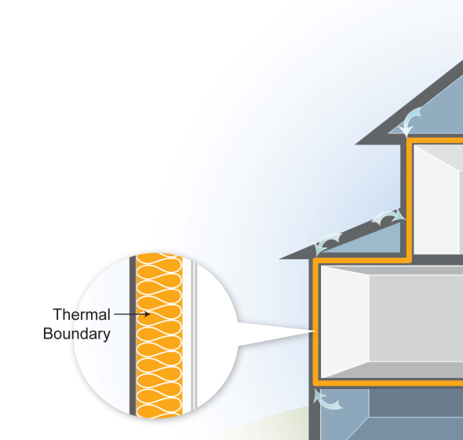
Thermal Boundary
Energy movement
The thermal boundary:
Limits heat flow between inside and outside.
Easy to identify by presence of insulation.
The location of insulation in relation to other building components is critical to its effectiveness.
Even small areas of missing insulation are very important.
Voids of 7% can reduce effective R-value by almost 50%.
Image developed for the US DOE WAP National Standardized Curriculum
Notes:
The thermal boundary:
Limits heat flow between inside and outside by reducing conductive heat loss through the building envelope.
Is easy to identify by the presence of insulation.
The location of insulation in relation to other building components is critical to its effectiveness. When air passes through insulation, it carries heat and moisture away.
Even small areas of missing insulation must be remedied.
Voids totaling 7% can reduce the effective R-value by almost 50%. The effective R-value in the attic of a 1,000-square-foot single-story rambler insulated to R-38 falls to an effective R-value of 19 when 70 square feet of insulation is pushed aside.
The thermal boundary is the insulation. Common materials include fiberglass batts, blown-in cellulose, and vermiculite in some older homes. If the thermal and air boundaries are continuous and in contact with each other, air will not pass from the house out through the insulation.
It is common for cold air to bypass the insulation—not just in low-income homes, but in large, new homes as well.
Q: What materials serve as both the thermal boundary and the air barrier?
A: Foam board, spray foam, and dense-packed cellulose insulation, properly installed, greatly reduces airflow.

Slide 14
Photo courtesy of The U.S. Department of Energy
Notes:
The thermal boundary is usually easy to identify.
Q: Where is the air barrier?
A: The air barrier cannot always be determined through visual inspection. Pressure diagnostics are the best way to determine the location and condition of air boundaries.

Slide 15
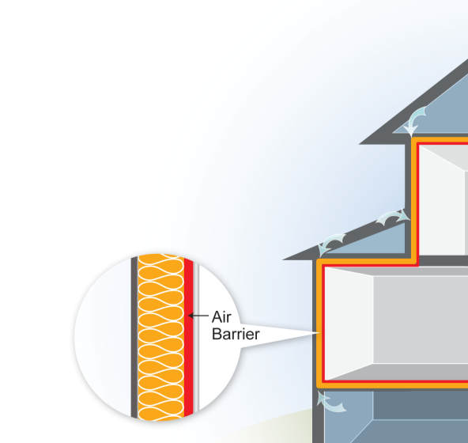
Air Barrier
Energy movement
The Air Barrier:
Limits airflow between inside and outside.
Is more difficult to identify than the thermal boundary.
Is not always where you think it is.
Is located using a blower door.
Image developed for the US DOE WAP National Standardized Curriculum
Notes:
The air barrier:
Limits airflow between inside and outside and reduces the loss of heat and moisture carried by that air.
Is more difficult to identify than the thermal boundary, because it can be hard to see.
Is not always where you think it is.
Is located using a blower door. Pressure readings taken with the blower door running help locate air leakage and the air barrier.
Q: What is the air barrier in most homes?
A: Usually the interior drywall.

Slide 16
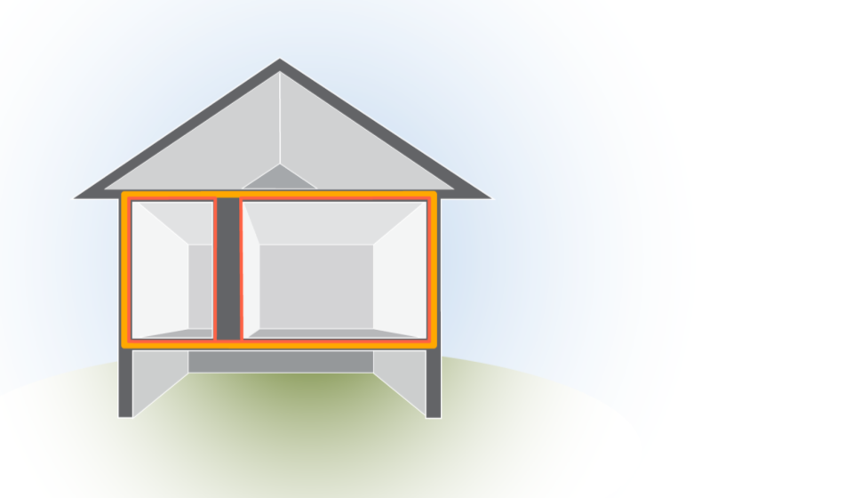
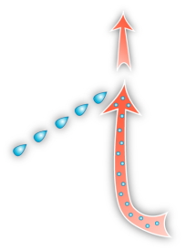
Moisture
Energy movement
Moisture flows with warm air through breaks in the air barrier, causing damage when it condenses on cool surfaces.
Air Barrier
Thermal Barrier
Image developed for the US DOE WAP National Standardized Curriculum
Notes:
Moisture flows with warm air through breaks in the air barrier, causing damage when it condenses on cool surfaces.
If the attic is colder than the living space, moisture from the conditioned air will condense as soon as it comes into contact with colder building surfaces, like roof decking. This moisture can cause mold and mildew, or drip down onto the ceiling, leading residents to think there is a roof leak.
Moisture in the attic degrades the performance of insulation, damages building materials, and can harm residents’ health.

Slide 17
Driving Forces of Air Movement
Energy movement
Driving Forces of Air Movement
Temperature and pressure differences – usually between inside the house and outside.
The bigger the temperature or pressure difference, the greater the air and heat flow.
Notes:
The most misunderstood and most frequently ignored heat transfer mechanism in homes is air-transported heat loss.
Temperature and pressure differences drive air movement throughout, into, and out of a home.
We are usually concerned with air movement between the inside and outside of the house. Air movement within the conditioned space is less important for energy efficiency.
The bigger the temperature or pressure difference, the greater the air and heat flow. The temperature difference between inside and outdoors in a very cold climate in winter is two to three times greater than the difference in even the hottest climate in summer. This is why measures that reduce heating needs are often more cost-effective than those that reduce cooling needs.

Slide 18
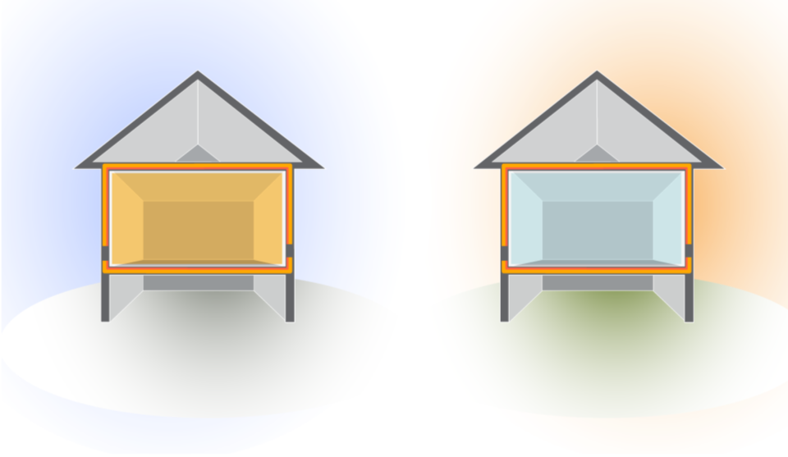
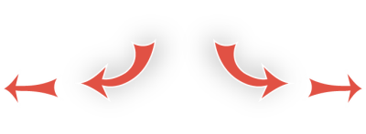
Air Movement: Temperature
energy movement
T = Temperature Difference
Winter
Summer
70°
10°
90°
70°
T=60°
T=20°
hot
cold
Flow is from _____ to _____.
The higher the T, the ______ likely heat and air will escape or enter the building.
more
Image developed for the US DOE WAP National Standardized Curriculum
Notes:
Delta T is the temperature difference.
Click ahead to reveal heat flow in winter versus summer.
Ask students to fill in the blanks before you click ahead.
Airflow is from hot to cold.
The higher the delta T, the greater the force on heat and air to escape or enter the building.
The rate of heat and air transfer increases as the delta T increases. The leakage rate of a home in the summer might be 40 CFM_{natural}, but increase to 120 CFM_{natural} in the winter with the increased delta T.
Cost-effectiveness of cooling system replacements is less than that of heating system replacements because of the smaller delta T.

Slide 19
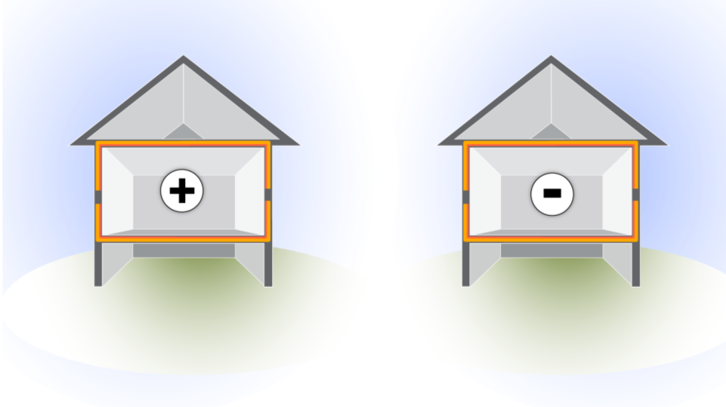
Air Movement: Pressure
Energy movement
P = Pressure Difference
Positive
Negative
positive (high)
negative (low)
Flow is from ________________ to ______________ pressure
For every CFM that _______, one CFM _______
Flow takes the path of _______ resistance.
enters
exits
least
Image developed for the US DOE WAP National Standardized Curriculum
Notes:
Click ahead to reveal the direction of air leakage.
Review the terms infiltration and exfiltration.
Ask students to fill in the blanks before you click ahead.
Flow is from positive (high) to negative (low) pressure.
For every CFM that enters, one CFM exits.
Flow takes the path of least resistance. Air isn’t smart. Air goes where flow is easiest, not where you want it to flow.
Pressure acts on all sides of the home.
Q: What is a danger associated with negative pressure in the home?
A: Backdraft

Slide 20
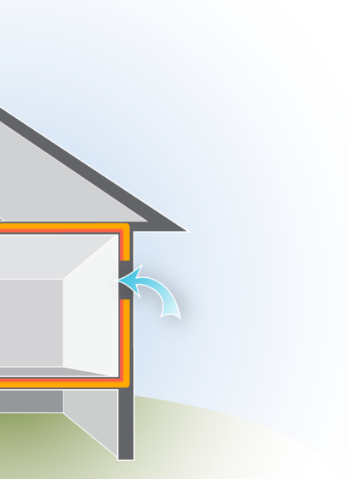
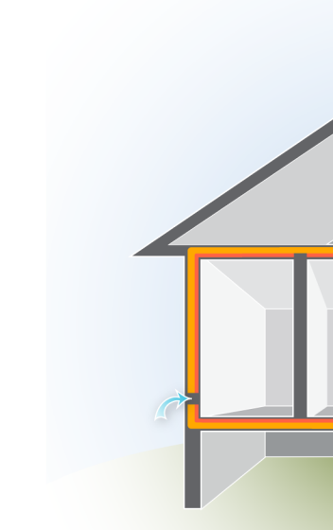
Air Leakage
Energy movement
Air leakage requires:
A hole.
Pressure difference across that hole.
The bigger the hole or higher the pressure difference, the more airflow.
To reduce airflow, we can reduce the size of the hole or lower the pressure difference.
Image developed for the US DOE WAP National Standardized Curriculum
Notes:
Holes in the air barrier wouldn’t matter without pressure differences.
Air leakage requires:
A hole.
Pressure difference across that hole.
The bigger the hole or higher the pressure difference, the greater the volume of air leakage.
To reduce airflow, reduce the size of the hole or lower the pressure difference. Holes and pressure differences usually go hand in hand.

Slide 21
Air Leakage
Energy movement
Airflow is measured in cubic feet per minute.
Also written as ft³/min, or CFM
1 CFM out = 1 CFM in
Airflow takes the path of least resistance.
Air moves from high- to low-pressure areas.
Air usually moves from high- to low-temperature areas.
Notes:
Airflow is measured in cubic feet per minute, also written ft³/min or CFM. A cubic foot is a little larger than a basketball.
1 CFM out = 1 CFM in − The same volume of air that leaks out of a home also leaks into the home, often at a different location.
Airflow takes the path of least resistance. Air leakage leads to moisture issues when warm, relatively moist air leaks into colder areas and condenses on building surfaces.
Air moves from high to low pressure areas. Air moves from high to low temperature areas.
Air leakage affects energy use because conditioned air leaks out and unconditioned air seeps in, increasing the total volume of air that must be cooled or heated to maintain comfortable indoor temperatures.

Slide 22
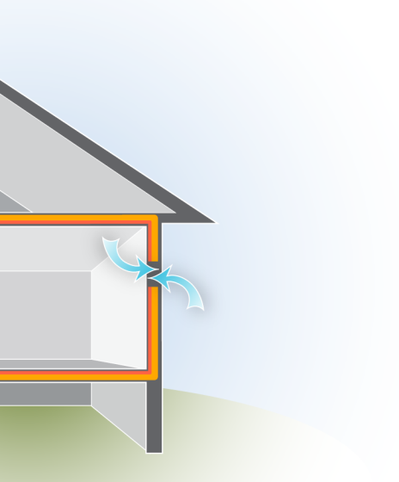
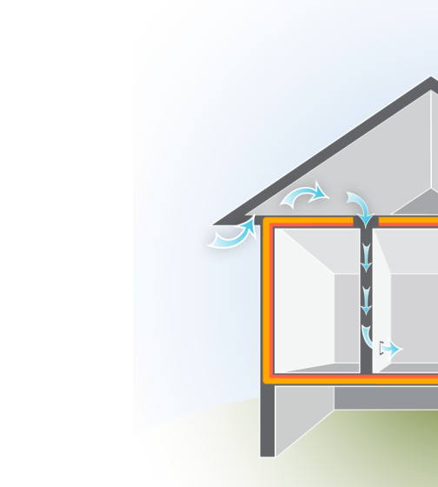
Air Leakage
Energy movement
Direct Leakage occurs at direct openings to outdoors. Leakage enters and exits at same location.
Indirect Leakage enters at one location, moves through building cavities and exits at a different location.
Image developed for the US DOE WAP National Standardized Curriculum
Notes:
Direct leakage occurs at direct openings to the outdoors.
Leakage enters and exits at the same location.
Direct leakage is common around doors and windows.
Indirect leakage enters at one location, moves through building cavities, and exits at a different location.
Indirect leakage is common in older homes where interior walls have no top plates.
Another typical example is where a porch roof joins the side of a house. Often the siding is left off where the porch roof and house intersect. Cold air in the porch attic flows into the floor cavity and into wall cavities or soffits. A cold wall or floor in the winter is your evidence. A blower door test will track these leaks.
Q: What are some typical spots for direct leakage?
A: Dryer vents, around doors and windows, and any other place there are penetrations in the building envelope.

Slide 23
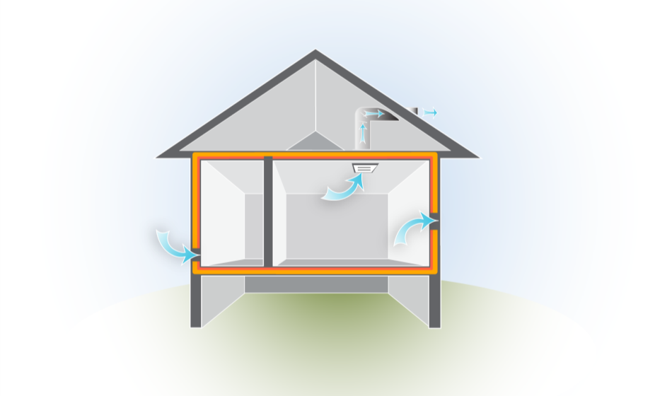
Air Leakage Definitions
Energy movement
Ventilation = Controlled air leakage
Infiltration = Air leaking in
Exfiltration = Air leaking out
Image developed for the US DOE WAP National Standardized Curriculum
Notes:
Infiltration – Air leaking in
Exfiltration – Air leaking out
Ventilation – Controlled air leakage
Q: What are some common examples of each type of air leakage?
A: Infiltration: Cold air coming in under a door in the winter
Exfiltration: Warm air rushing up through recessed can lights into the attic in the winter
Ventilation: Bathroom fan, hood fan, heat recovery ventilation

Slide 24
Air Leakage: Driving Forces
Energy movement
Air movement carries heat with it as it goes.
Types of Driving Forces
Wind
Heat: Stack effect, combustion
Fans: Exhaust fans, duct leaks, interior doors
Notes:
Air movement into or out of a home is caused by pressure differences. The forces that cause pressure differences are:
Wind.
Heat – stack effect, combustion.
Fans – exhaust fans, duct leakage, interior doors.
Technically, heat moving within any fluid, including air, is convection.
Because heat passes to cold, any body of fluid will eventually stabilize at a uniform temperature.
In addition, any surface surrounding the fluid will heat or be heated by that fluid until the surface and fluid temperatures equalize.
This accounts for heat movement within a fluid and to and from the fluid and the solids it contacts. What happens if the whole mass of conditioned air moves somewhere else?

Slide 25
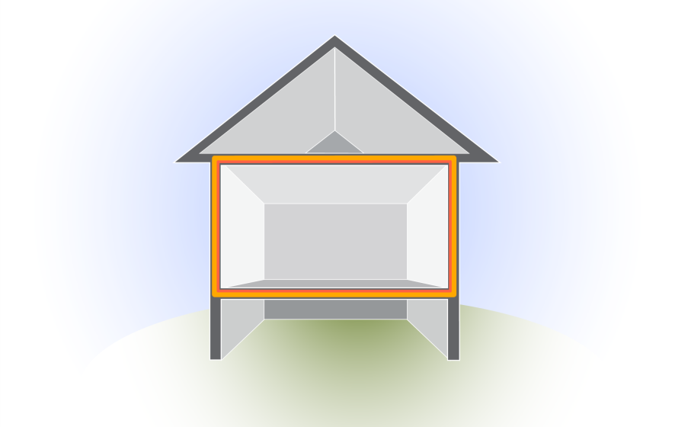
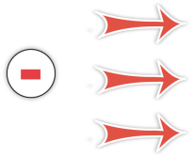
Driving Forces: Wind Effect
Energy movement
WIND DIRECTION
Positive pressure
Negative pressure
Wind creates a positive pressure on the windward side of the building…
…which creates a negative pressure on the other sides of the house.
Image developed for the US DOE WAP National Standardized Curriculum
Notes:
Wind creates a positive pressure on the windward side of the building, which creates a negative pressure on the other sides of the house.
The leeward (protected) side of the house has negative pressure that sucks air out of the home. This is why during big storms, people will crack the windows open to equalize the pressure and reduce the chances of windows blowing in or out.
During blower door tests, the hose taking external readings must be thrown clear of the wind path created by the blower door fan to avoid faulty readings from the wind effect.

Slide 26
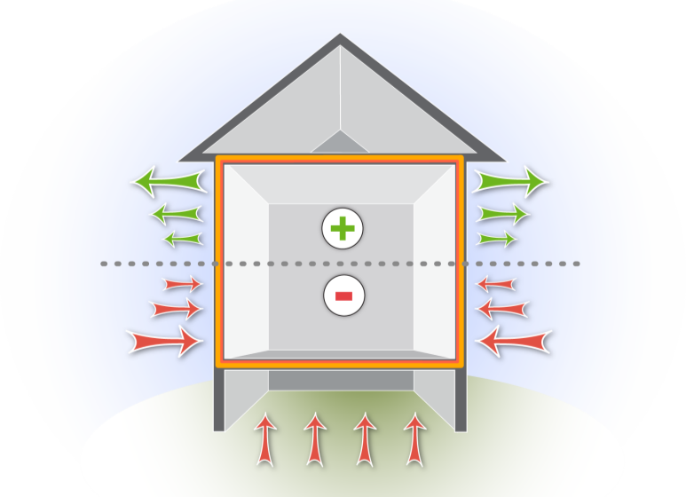
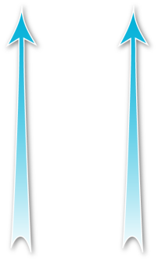
Driving Forces: Stack Effect
Energy movement
Stack Effect
Warmer air rises and escapes out of the top of the house which creates a suction that pulls in outside air at the bottom of the house.
Positive pressure
Neutral pressure plane
Negative pressure
Image developed for the US DOE WAP National Standardized Curriculum
Notes:
Warmer air rises and escapes out of the top of the house, which creates suction that pulls outside air in at the bottom of the house.
Every CFM that escapes has to be replaced from somewhere else.
Click to reveal airflow rising to the top and entering through the bottom.
Q: What is a useful version of stack effect?
A: Proper draft of a chimney
The wrapped building photo on the next slide illustrates stack effect at work. Air leakage in a building suffering from the stack effect is predictable.

Slide 27
Positive pressure (with reference to outside)
Neutral pressure plane
Negative pressure (with reference to outside)
Photo courtesy of David Keefe Vermont Energy Investment Corp.
Notes:
Hot air rises, creating a negative pressure in the lower portion of the building. Negative pressure leads to air infiltration.
The neutral pressure plane is not always located halfway up the building, but wherever there are points of escape for the rising air.
Positive pressure in the top of the building causes exfiltration.

Slide 28
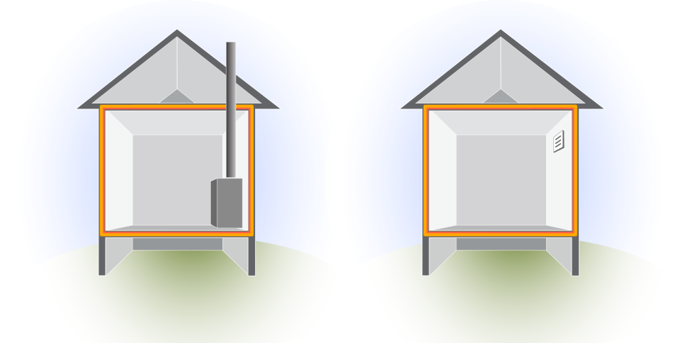
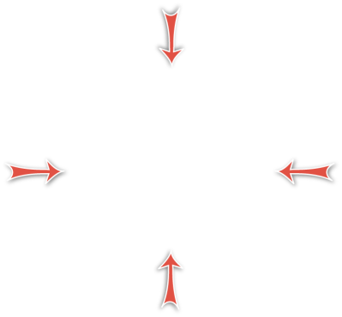
Driving Forces: Combustion & Fans
Energy movement
Combustion Equipment & Exhaust Fans
Negative pressure
Exhaust Fan
Negative pressure
Image developed for the US DOE WAP National Standardized Curriculum
Notes:
Click to reveal the anatomy of depressurization in both situations.
Combustion appliances and exhaust fans can create negative pressure in the home. This pressure difference increases infiltration.
Combustion appliances that take their combustion air from inside the home⎯e.g., most 80+ furnaces and conventional gas water heaters⎯can create negative pressure in the home. In a tight house, this could result in unsafe levels of CO.
Direct-vented appliances that take combustion air directly from the outside⎯e.g., most 90+ furnaces⎯don’t cause depressurization.
Exhaust fans also create negative pressure.

Slide 29
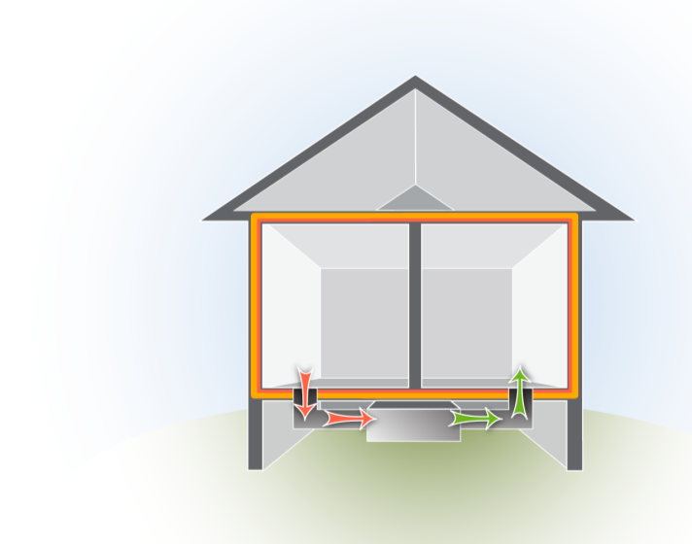
Driving Forces: Duct Leakage
Energy movement
Duct Leakage
Duct leakage can create positive and negative pressures in different areas of the house.
The pressures associated with duct leaks can be larger and more important because the driving force is stronger.
All holes are not created equal!
Return
Supply
Image developed for the US DOE WAP National Standardized Curriculum
Notes:
Duct leakage can create positive and negative pressures in different areas of the house.
The pressures associated with duct leaks can be greater because the driving force is stronger. All holes are not created equal.
In this situation, when the door between the bedroom and main body of the home is open, pressure remains balanced throughout the home.
Q. What happens if you close the door to the bedroom in this situation?
Click ahead to reveal the answer.

Slide 30
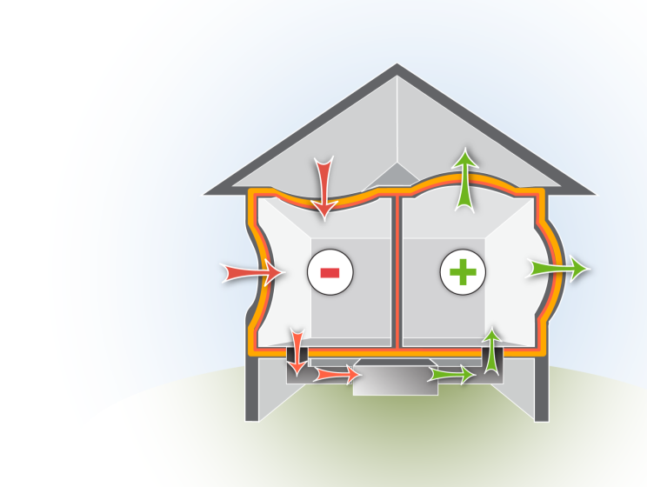
Driving Forces: Duct Leakage
Energy movement
Duct Leakage
Closed doors that prevent supply air from getting back to a return cause positive pressures in those rooms.
This starves the return for air, causing negative pressure in the zone where the return is located.
Return
Supply
Image developed for the US DOE WAP National Standardized Curriculum
Notes:
Closed doors that prevent supply air from getting back to a return vent cause positive pressures in rooms with supply vents.
This starves the return for air, causing negative pressure in the zone where the return vent is located.

Slide 31
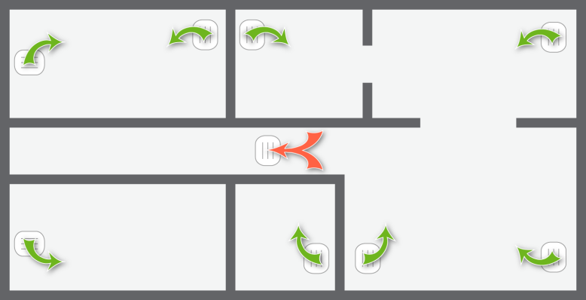
Driving Forces: Imbalances
Energy movement
Room Pressure Imbalances
Master
Bedroom
Utility Room
Kitchen
Whole-house return in hallway
Living Room
Bedroom
Bath
Image developed for the US DOE WAP National Standardized Curriculum
Notes:
It is easy to predict pressure imbalances based on the locations of return and supply vents throughout a home, even without the use of a blower door.
Ask students which rooms of the house will have positive pressure and which will have negative pressure, and whether air will leak into or out of that room.
Click to reveal answers in this order:
Master bedroom: positive, exfiltration
Utility: negative, infiltration
Kitchen: negative, infiltration
Living room: negative, infiltration
Bathroom: positive, exfiltration
Bedroom: positive, exfiltration
Q: What are some methods for balancing the pressure in this home?
A: Add returns in bedrooms and bathroom. Undercut doors. Add grates to the doors.

Slide 32
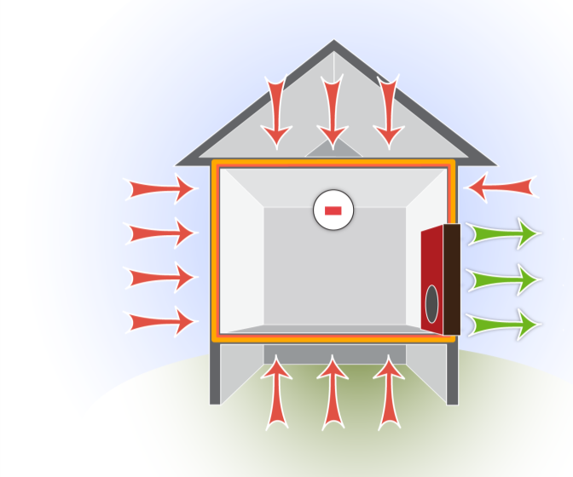
Controlled Driving Force: Blower Door
Energy movement
Use a Blower Door as a Controlled Driving Force
Using the blower door depressurizes the house drawing air through all the holes between inside and outside.
Negative pressure
Blower Door
Image developed for the US DOE WAP National Standardized Curriculum
Notes:
Using the blower door depressurizes the house, drawing air through all the holes in the pressure boundary of the home.
Using the blower door as a driving force, air is sucked out of the house faster than it can be replaced. This creates a measurable pressure difference for performing diagnostics.
This is different from how the house behaves under normal conditions. Usually, air would be infiltrating some of the holes and exfiltrating others. With the blower door running, the home is depressurized so air infiltrates all the holes except the one in the door where the fan is set up.

Slide 33
Summary
Energy movement
Energy is a measurable quantity of heat, light, or work.
Energy moves by conduction, convection, and radiation.
The Second Law of Thermodynamics explains why energy moves.
Heat moves constantly by whatever mechanism is available at any given moment.
Pressure and temperature differences are the driving factors of air movement.
Air leaking into and out of a home carries heat and moisture with it.
An understanding of these principles is essential to properly audit a building.
Notes:
Energy is a measurable quantity of heat, light, or work.
Energy moves by conduction, convection, and radiation.
The Second Law of Thermodynamics explains why energy moves.
Heat moves constantly by whatever mechanism is available at any given moment.
Pressure and temperature differences are the driving factors of air movement.
Air leaking into and out of a home carries heat and moisture with it.
An understanding of these principles is essential for a proper building audit.
Present this slide as an interactive discussion, soliciting personal examples from the trainees. Add your own personal examples and knowledge to supplement.

