Slide 1

Comfort and Climate
WEATHERIZATION ENERGY AUDITOR SINGLE FAMILY
WEATHERIZATION ASSISTANCE PROGRAM STANDARDIZED CURRICULUM – December 2012

Slide 2
Learning Objectives
COMFORT AND CLIMATE
By attending this session, participants will be able to:
List the basic principles of human thermal comfort.
Describe relative humidity.
Demonstrate how to use a psychrometric chart.
Notes:
By attending this session, participants will be able to:
List the basic principles of human thermal comfort.
Describe relative humidity.
Demonstrate how to use a psychrometric chart.

Slide 3
Comfort Defined
COMFORT AND CLIMATE
Most humans share a general range of comfort.
  68°F – 85°F
  15% to 75% relative humidity (RH)
Air movement speeds heat transfer
Mean radiant temperature
Activity level
Conditioning matters! People grow accustomed to heat, cold, and humidity.
Notes:
Most humans share a general range of comfort:
68°F – 85°F
15% to 75% RH
Air movement speeds heat transfer. If air is moving over us, our evaporative cooling system works better, making us feel cooler at the same absolute temperature.
Mean radiant temperature (MRT) affects comfort. Radiant heat transfer happens without a medium—air isn’t necessary! More importantly, the temperature of the air surrounding us doesn’t matter either.
If our body surface temperature is higher than the temperature of surrounding surfaces, we will radiate heat to them regardless of the air temperature. This is why windows feel cold.
The inverse also happens. This is why a wood stove feels so good on a cold day.
Our bodies try to maintain a core temperature of about 96°F by either burning fat or “dumping” heat.
Because we never stop burning fat, we’re not comfortable unless we’re losing some heat to our surroundings.
Activity level – The more active we are, the warmer we will be. Metabolism plays a large role.
A sedentary person is typically more comfortable at higher and more humid temperatures than an active person would be.
Conditioning – What we’re used to matters a lot.
A Floridian might be cold at 70°F while the snowbird beside him thinks it’s really warm.

Slide 4
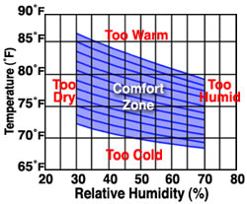
Factors in Thermal Comfort
COMFORT AND CLIMATE
Environmental:
  Air temperature
  Relative humidity (RH)
  Air motion
  Mean radiant temperature
Personal:
  Clothing insulation value
  Metabolic rate
This chart shows the interaction of two of the environmental factors in thermal comfort.
Notes:
Six variables determine personal thermal comfort. Four are environmental, and two are personal.
Environmental:
Air temperature
Relative humidity (RH)
Air motion
Mean radiant temperature
Personal:
Clothing insulation value
Metabolic rate; typically around 360 BTU/hr for a seated person
All of these factors interact with each other. People feel cooler on a hot day if the relative humidity is low and there is a breeze than if the air is humid and still.
Air temperature, relative humidity, and air motion play big roles in our work. We seek to control air movement, to reduce leakage, and to efficiently carry conditioned air through ducts to the rooms of the house.

Slide 5
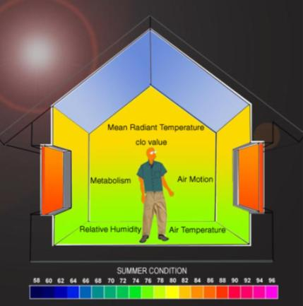
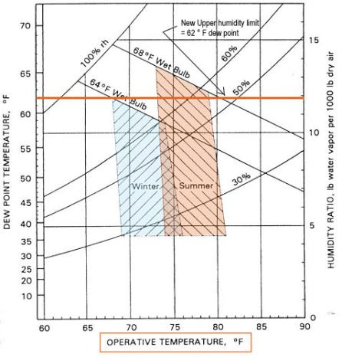

Visualizing Thermal Comfort
COMFORT AND CLIMATE
Image courtesy of
Notes:
These pictures from Arizona State University graphically represent the factors of thermal comfort.
Notice the orange line. The 62°F dew point (not RH) is key to comfort. High humidity (>60%) is uncomfortable for most.
People are often more comfortable at higher temperatures when the humidity is lower. The most acceptable range is 68°F to 76°F and about 20% to 40% RH.

Slide 6



Air Temperature
COMFORT AND CLIMATE
Photos courtesy of Bill Van der Meer
While humans are generally
comfortable between 68°F and 82°F, relative humidity affects the comfort range.
Notes:
Air temperature is the factor with which people are most familiar.
It’s intuitive. If we’re surrounded by air that’s at a substantially different temperature than our comfort zone, we’ll be uncomfortable.
Relative humidity (RH) is a big factor. Cold winter air typically carries very little moisture. When heated, the RH falls even lower.

Slide 7


Relative Humidity
COMFORT AND CLIMATE
Relative Humidity (RH)
The amount of water vapor contained in a given volume of air relative to the total amount of water vapor it is capable of containing, expressed as a percentage.
100% RH = Condensation
Humans are comfortable at 15% - 75% RH, depending on activity level.
Tolerance to upper limit drops as activity level rises.
Below 15% RH, medical issues arise.
Photos courtesy of Bill Van der Meer
Notes:
Relative humidity is the amount of water vapor contained in a given volume of air relative to the total amount of water vapor it is capable of containing, expressed as a percentage.
At 100% relative humidity, condensation happens on all hard surfaces. If there is no hard surface, there is no condensation.
Every raindrop has a speck of dust inside it that serves as the surface area for condensation to collect around.
Relative humidity is the most complicated of the comfort issues.
Broadly speaking, humans adapt well to extremes of humidity: 15% to 75% is tolerable for most people. Tolerance to the upper limit drops as activity level rises: 75% is ok when sitting but not when running.
Below 15% RH medical issues arise. Humidity above 75% interferes with our body’s natural cooling system.

Slide 8
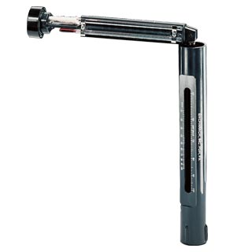


Measuring Relative Humidity
COMFORT AND CLIMATE
Sling Psychrometers
Two thermometers side-by-side
One is wrapped in wet wick (wet bulb), the other is dry (dry bulb)
Spinning it around speeds temperature stabilization
Plot wet bulb and dry bulb temperature on psychrometric chart to determine dew point and RH.
Photos courtesy of Bacharach Sling Psychrometer
Notes:
We can measure RH with a sling psychrometer.
A sling psychrometer has two thermometers side by side, one with a wetted wick around the bulb (the wet bulb), and one with a dry bulb. Spinning it in the air speeds up the temperature stabilization process.
Because of heat absorbed by evaporation, the wet bulb will register a lower temperature than the dry bulb. The point where the wet bulb temperature stabilizes is the wet bulb temperature.
Plotting the two temperatures on a psychrometric chart gives us dew point and relative humidity.

Slide 9
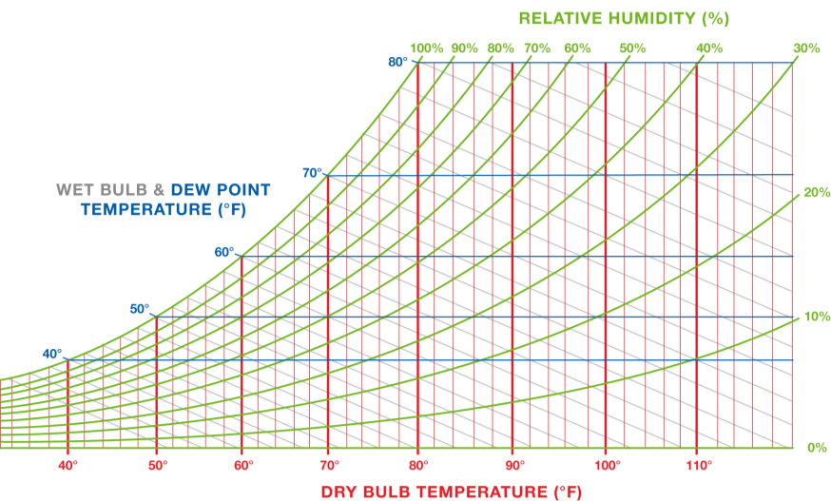
Psychrometric Chart #1
COMFORT AND CLIMATE
Dry bulb = 80°
Wet bulb = 66°
Dew point = 60°
RH = 50%
Grains of water per pound of dry air
Table created for the US DOE WAP National Standardized Curricula
Notes:
The psychrometric method was developed by the air conditioning and refrigeration industry.
Click to add lines to chart illustrating the information available and how the chart is to be used.
To use:
Locate the dry bulb temperature on the lower horizontal axis.
Locate the wet bulb temperature on the curved line at the left.
Locate the intersection of the vertical line up from the dry bulb temperature and the slanting line running down to the right from the wet bulb temperature.
Follow the horizontal line to the left from the intersecting point to its end to reach the dew point temperature, in this case 60°F.
Follow the curved line up and to the right from the intersecting point to its end (the horizontal line at the top of the chart) to reach the RH, in this case, 50%.

Slide 10
Psychrometric Chart #2
COMFORT AND CLIMATE
156
78
Grains of water per pound of dry air
Table created for the US DOE WAP National Standardized Curricula
Notes:
Following the dew point line to the right gives the absolute humidity or grains of water per pound of dry air.
Absolute humidity does not rely on temperature. It remains constant unless water is added or removed.
The range is 0 (bottom) to 156 (top).

Slide 11
Psychrometric Chart #3
COMFORT AND CLIMATE
Grains of water per pound of dry air
Table created for the US DOE WAP National Standardized Curricula
Notes:
This chart illustrates the relationship between air temperature and RH.
Warmer air can hold more moisture.
If the air temperature rises from 80°F to 90°F, this lowers the RH from 50% to 38%.

Slide 12
Psychrometric Chart #4
COMFORT AND CLIMATE
Grains of water per pound of dry air
Table created for the US DOE WAP National Standardized Curricula
Notes:
Click to reveal lines illustrating the points made in order below.
Cooling the air from 80°F to 70°F raises the RH to 70%.
Further cooling it to 60°F raises RH to 100%.
Notice that the water content—dew point temperature and absolute humidity in grains of water per pound of dry air, indicated by the horizontal blue line—always remains constant.

Slide 13
Psychrometric Chart #5
COMFORT AND CLIMATE
Grains of water per pound of dry air
Table created for the US DOE WAP National Standardized Curricula
Notes:
Q: What happens if we cool the air below its dew point temperature?
A: It can’t hold the water.
Click to reveal an illustration of what happens if we cool the air to 50ºF. Water will be released until air temperature reaches that of the dew point.
When air is cooled below the dew point temperature, condensation happens instantly on any hard surface the air contacts.
This is the principal cause of wet attics in heating environments.

Slide 14
RH Things to Remember
COMFORT AND CLIMATE
Warm, wet air contacting cold surfaces creates condensation instantly.
Cold winter air typically contains very little moisture.
When that air is heated, the RH drops even further.
RH below 15% can lead to respiratory problems,
failure of furniture glue and other problems.
Notes:
Warm, wet air contacting cold surfaces creates condensation instantly.
Cold winter air typically contains very little moisture and therefore has a low RH. When air is brought indoors and heated, the RH drops even further.
RH below 15% can lead to respiratory problems, furniture glue failure, and other problems.
Discuss attic condensation, mold, and roof rot. High interior RH can lead to these problems.

Slide 15
Summary
COMFORT AND CLIMATE
Air temperature, movement and relative humidity
effect thermal comfort.
Ideal conditions:
  Heating season: 68°F, 20% to 40% RH.
  Cooling season: 75°F, keep RH below 60%.
Control drafts.
Minimize temperature swings.
Be aware of mean radiant heat transfer.
Plot wet and dry bulb temperatures on a psychrometric chart to determine dew point and relative humidity.
Notes:
As an auditor and building scientist, it should be your goal to create homes that are not only safe and efficient, but also comfortable for occupants. You can achieve this by paying attention to the factors influencing thermal comfort.
Remember:
Air temperature, movement, and relative humidity affect thermal comfort.
Ideal conditions:
Heating season ─ 68°F, 20% to 40% RH
Cooling season ─ 75°F, keep RH below 60%
Control drafts. Minimize temperature swings. Be aware of mean radiant heat (MRT) transfer.
Plotting the wet bulb and dry bulb temperatures on a psychrometric chart gives us dew point and relative humidity.
Present this slide as an interactive discussion, soliciting personal examples from the trainees. Add your own personal examples and knowledge to supplement.

