Slide 1
Overview
Background
Goals
Methodology
Participants
Findings
Recommendations

Slide 2
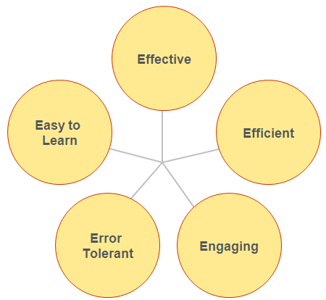
What is Usability?
Background
What is a Usable Site?
Usable sites allow users to:
Find what they need
Recognize and understand what they find
Use the information to accomplish their goals.
Usable sites/applications are:
Credit: Whitney Quesenbery
http://www.wqusability.com/index.html
Notes:
Website and applications that are highly usable are those that allow site visitors to find what they need, recognize and understand what they find, and make use of the information to accomplish their tasks.
And why should we care if our sites or applications are usable? Well, our websites are one of our most important and cost-effective ways of reaching a wide audience, and often they are the only interaction an individual has with our organization.
If our customers have a poor interaction with our website, they often form a negative impression of EERE as well.
In addition, if our visitors can’t accomplish their tasks, we aren’t able to effectively accomplish EERE’s goals.
So making sure our sites are user friendly is really critical to the success of all our programs.

Slide 3
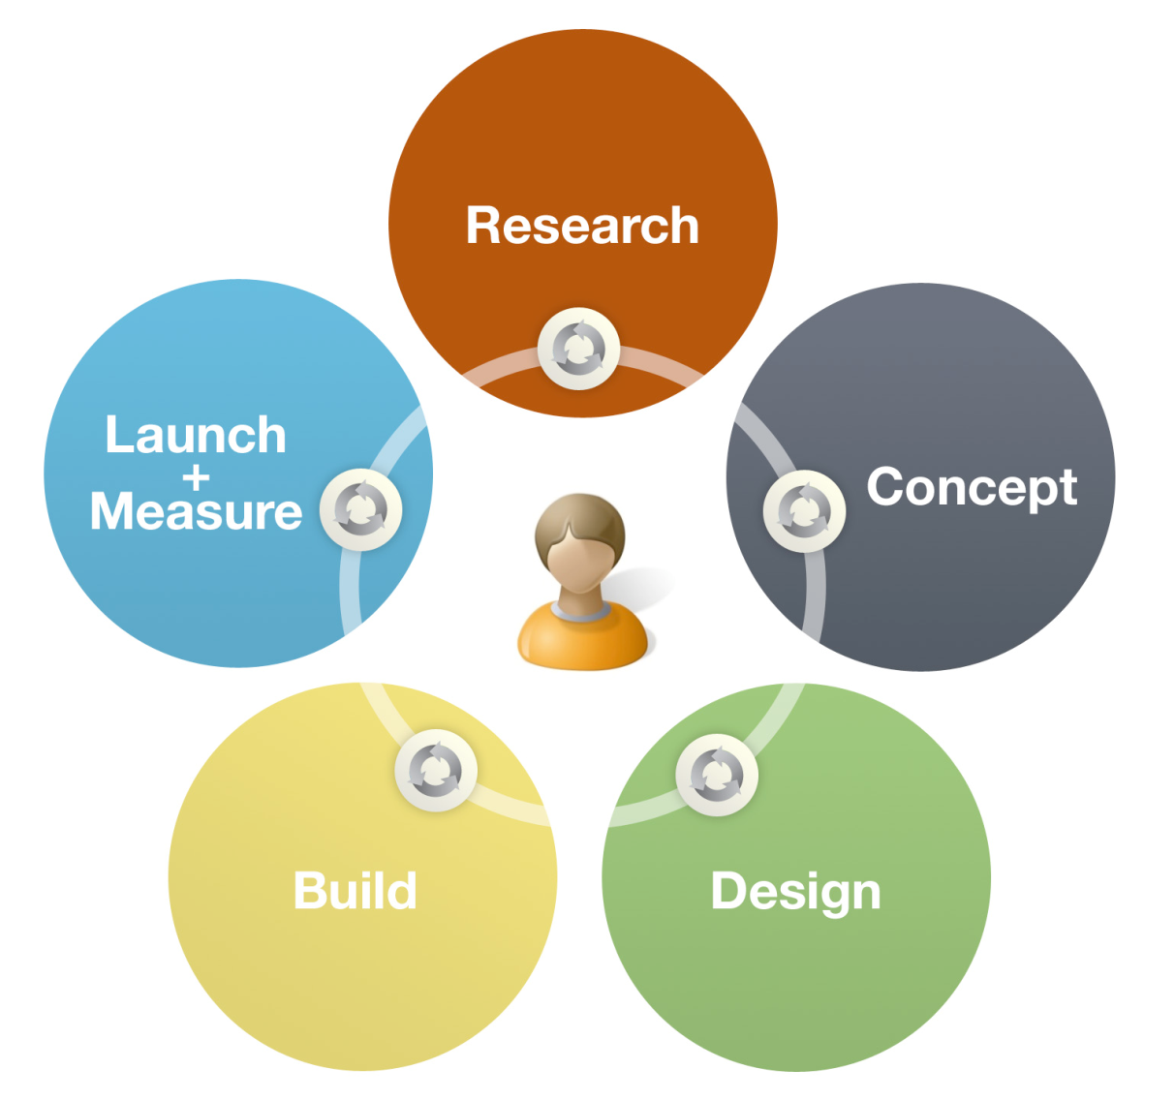
UCD helps create products that are relevant to users and easy to use by focusing on user needs at every stage of development.
Background
Credit: Anthro-Tech I http://www.anthro-tech.com/
Notes:
[Overview of the user-centered design process and the user research phase, in particular]

Slide 4


Background
Who are our customers?
What is the customer experience like on our website?
How can we improve the customer experience?
[ADD image of the product you are testing here]

Slide 5
Background
Phase 1
Phase 2
Phase 3
User Research
User Experience Testing
Site Improvements
User Research
Data-driven understanding of key audiences and their top tasks on our site
2. User Experience Testing
Watch key audiences interact with our site; identify usability issues
3. Site Improvements
Implement recommendations; test improvements to ensure effectiveness

Slide 6


[Briefly review the data sources you examined to complete your user research and explain how the user research informed your test design]
Background
Interviews
Click analytics
Site usage statistics
Survey

Slide 7
Goals
[Go over the goals for the usability test.]

Slide 8
A usability test is a research activity in which:
Methodology
Based on:
User research
Business goals
Such as:
Learn about EERE initiatives
Find out how to do an energy assessment for your home
Find funding for your research
Learn about emerging technologies in renewable energy and energy efficiency
Such as:
Task completion
Time on task
Pathways and keywords
Heatmaps of site usage
Requests for help or hints from the facilitator
Users’ verbal comments
Collected with:
Unmoderated study software
Database
Screen capture software
Qualitative notes
Moderated-remote and in person
Participants outside of Washington state connected remotely via WebEx
Local Washington state participants came to Anthro-Tech headquarters
Unmoderated
Invited participants across the nation, connected through remote usability software (UserZoom)
Anthro-Tech facilitator:
Suzanne Boyd
Notetaker:
Karen Saville
Study design
Transition Team
Representative users
133 unmoderated participants
11 moderated participants
Advisers
Ambassadors
Enterprise Implementers
Innovators
Investors
Interested Public
Perform realistic tasks
An interdisciplinary team
Collects empirical data
In a usability lab or with remote usability software
[SEE NOTES FOR EXPLANATION OF SLIDE]
Notes:
NOTE: This slide includes animation – you need to update each of the overlapping text panels to describe the methodology you used in conducting your usability test. This is the methodology used for the 2011 EERE usability study as an example.

Slide 9
Participants
[Table with the main characteristics of each test participant (gender, age, job, etc.). Remember to use participant codes instead of participant names to protect anonymity.]

Slide 10
Findings
[Detail your main findings in this section. Generally findings are organized by category; for example:
Positive findings
Success metrics (graphs/tables of success rates by scenario/participant; System Usability Score, NetPromoter score)
Navigation and information architecture issues
Search issues
Language and content issues
Design issues
Perceptions and consequences
Typically, plan 1-2 slides per finding. Your findings pages should include participant quotes and counts – e.g. X out of X participants went here instead of here – to illustrate your findings.]

Slide 11
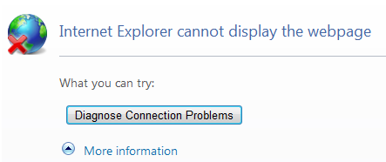
Findings – EXAMPLE
Users experience technical problems on the site
5 out 6 users experienced technical problems.
The site doesn’t work properly in some browsers. IE experienced the most hiccups.
Performance slowed when search returned a high number of results.
“My connection between the laptop and the server isn’t working well.”
– P3
“I’m waiting for the results to load…this is taking so long. Normally, Internet searches don’t take this long.”
– P4

Slide 12
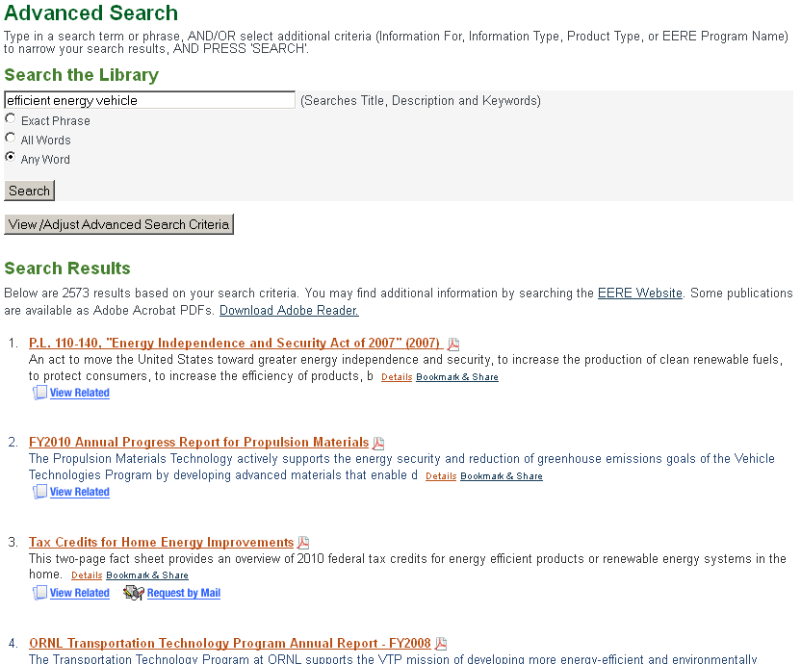
Findings – EXAMPLE
Search results are overwhelming and not helpful
“I need to perhaps change my search terms. Right now the results are too broad to be useful.” – P3
“I typed in ‘installing solar panels’ and the first result was ‘Distributed Wind Case Study.’”
– PP
“Too many choices to pick from.”
Top results are not relevant.

Slide 13
Recommendations
[Detail your main recommendations for improving the site in this section. Provide screen shots of sites that are good examples of each recommendation where possible.]

Slide 14
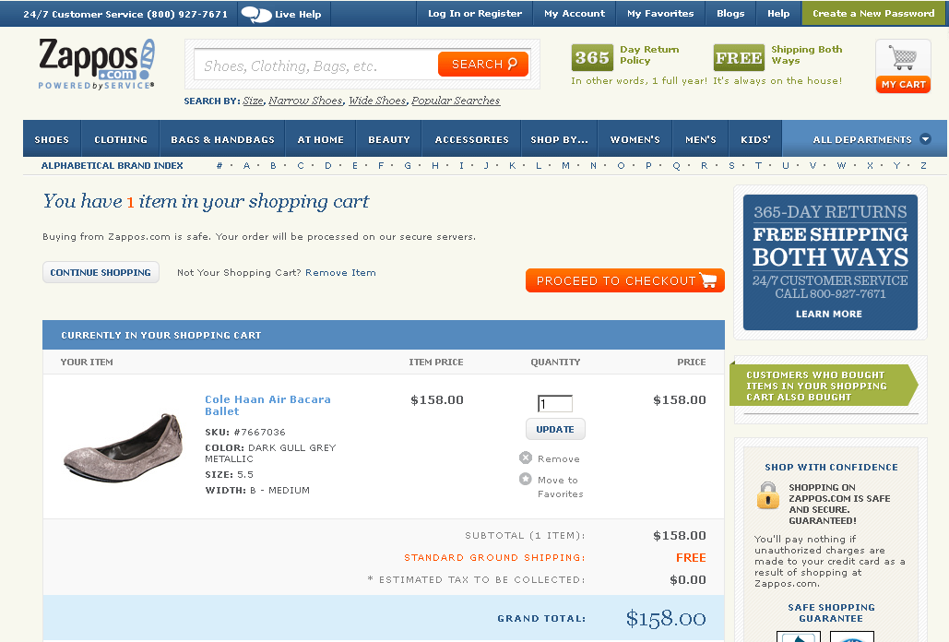
Recommendations - EXAMPLE
Make the publication ordering process more intuitive
Flexible: Consider allowing users to order more than 5 publications
Familiar: Use an ordering model that is familiar to users
Or proceed to checkout
Option to continue shopping…
Updating quantity is intuitive

Slide 15

[Questions and discussion]

