Slide 1
Introduction and Overview of the National Labor Relations Act: Labor Law 101
Office of the Assistant
General Counsel for
Labor and Pension Law
Tom O’Connor
Office of Assistant General Counsel for
Labor and Pension Law (GC-63)
5-18-15

Slide 2
The National Labor Relations Act (NLRA)
GC-63
General purposes of the NLRA:
To reduce industrial strife and maintain full economic production;
To encourage collective bargaining, and
To eliminate practices by labor and management that cause labor disputes that are harmful to general & economic welfare.

Slide 3
The Collective Bargaining Representative
GC-63
Section 9(a) certification: Employee representatives are selected by majority of employees democratically, through:
Election, or
Voluntary recognition upon showing that a majority support in proposed bargaining
Unions can also be decertified
Section 8(f): Employers in the Construction Industry can recognize a union as the exclusive bargaining representative and sign a CBA –
before employees are hired or have designated the union as their representative, and
parties can walk away upon CBA’s expiration.
Section 8(f) status can be converted to Section 9(a) status upon appropriate showings.

Slide 4
Unfair Labor Practice (ULP) Process
Any person can file a ULP allegation, called a “charge”
NLRB General Counsel staff (GC) investigates and has discretion whether to prosecute ULPs through a “complaint”
NLRB ALJ holds a hearing and issues decision
Board then reviews and enforces or reverses ALJ decision
Parties can go into federal courts of appeals to enforce Board orders – the Board’s orders are not self-enforcing

Slide 5
Section 8(a)(1)
GC-63
Section 8(a)(1): Interference with, restraint, or coercion of employees in exercise of rights guaranteed in Section 7.
Section 7: “Employees shall have the right to self-organize, to form, join, or assist labor organizations, to bargain collectively through representatives of their own choosing, and to engage in other concerted activities …,” or to refrain from such activities
E.g., threats of loss of jobs/benefits, or to close a plant if employees join a union; coercively questioning employees about union affiliation

Slide 6
Question 1:
True or False? Assisting a union to organize the employees of an employers, going out on strike to secure better working conditions, and picketing are all examples of Section 7 rights guaranteed by the NLRA.
TRUE
FALSE

Slide 7

WRONG ANSWER!
<< Try again

Slide 8


“Early retirement incentives that are funded through contractor pension plans will continue to be unallowable . . . .”
CORRECT!
Next Slide >>
Department of Energy

Slide 9
Section 8(a)(2)
Section 8(a)(2): Domination or interference with the formation or administration of any labor organization –
Domination:
Entity is employer creation, not true bargaining representative
E.g., where an employer takes part in forming union or in its meetings, exerts significant financial control, determines how labor organization is set up
Assistance/support:
exertion of lesser financial control
E.g., where an employer, during organizing campaign by rival unions, gives favored union privileges that it denies rival union, such as access to property to solicit employee support

Slide 10
Section 8(a)(3)
Section 8(a)(3): Discrimination against employees “in regard to hire or tenure of employment or any term or condition of employment” to either encouraging or discouraging union membership.
Includes:
Refusal to Hire;
Discharge;
Demotion;
Giving less desirable job or work assignments; or
Withholding Benefits
…when these actions are taken either because of union or group activity, or because an employee refrains from such activity

Slide 11
Section 8(a)(5)
GC-63
Section 8(a)(5): Refusal to bargain in good faith or taking unilateral action about employee terms or conditions of employment (T&Cs); refusal to supply relevant, non-confidential information at request of union
Bargaining Subjects –
Mandatory:
wages, benefits (including future retiree benefits for current employees), working conditions
Permissive:
Basic change in operation or a change in the company's scope or direction; retirement benefits of current retirees
May not force other party to bargain over permissive subjects, or insist to impasse over permissive subjects
Even for permissive subjects, employers must bargain about effects

Slide 12
Question 2:
Wages
Changes in retirement benefits of current retirees
Which of the following would be considered a permissive bargaining subject?
Union security
Health and safety practices

Slide 13
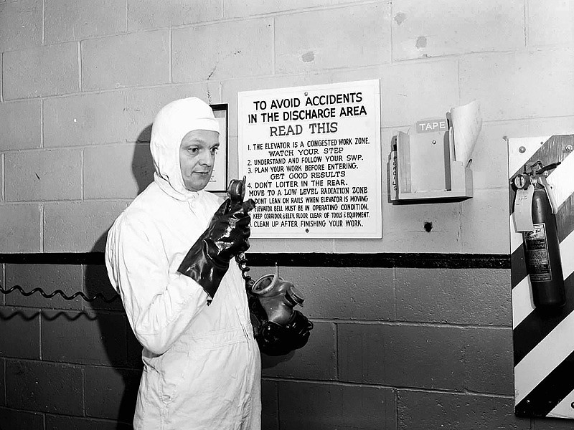
WRONG ANSWER!
<< Try again

Slide 14
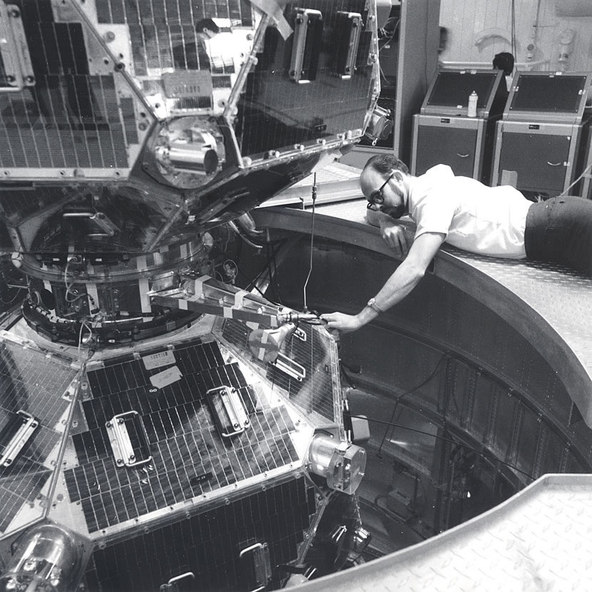
“Early retirement incentives
CORRECT!
Next Slide >>
Department of Energy

Slide 15
Section 8(a)(5) (continued)
GC-63
Successor employer: an employer succeeds to bargaining obligation of its predecessor when (1) new employer continues predecessor business in substantially the same form, and (2) a majority of the new employer’s workforce were formerly employed by the predecessor
E.g., employer that purchases or acquires operations of another, such as DOE M&O contractor that succeeds to an existing facility contract, may succeed to bargaining obligation of predecessor
Successor
need not adopt a predecessor’s CBA and is ordinarily permitted to set initial T&Cs of employment
must initially consult with union when a “perfectly clear” successor (i.e., shows intent to hire all predecessor employees)

Slide 16
Defining the Employer
Section 2(2) of NLRA: Employer “includes any person acting as an agent of an employer, directly or indirectly …”
Excludes governmental entities
If entity other than nominal employer is found an employer, it may be obligated to bargain, abide by a CBA, or be liable for ULPs
Various doctrines on defining the NLRA “employer” to include other entities than the nominal employer:
Joint employer: codetermine T&Cs of employment; NLRB currently reviewing standards for joint employer status
single employer: common ownership/financial control; common mgmt, interrelation of operations, integrated control of labor relations
alter ego: disguised continuance of old employer, intent to evade obligations under the NLRA

Slide 17
Union Unfair Labor Practices: Section 8(b)
GC-63
Section 8(b) – Most of the ULPs for Employers have parallel prohibitions for Labor Organizations, e.g.,
Section 8(b)(1)(A) – Restraint and Coercion of Employees: Forbids a labor organization or its agents “to restrain or coerce employees in the exercise of the rights guaranteed in Section 7.”
Section 8(b)(2) – Causing or Attempting to Cause Discrimination: Prohibits a labor organization from causing an employer to discriminate against an employee in violation of Section 8(a)(3).
Section 8(b)(d) – Refusal to Bargain in Good Faith: Makes it illegal for a labor organization to refuse to bargain in good faith with an employer on matters pertaining to wages, hours or other conditions of employment.

Slide 18
Remedies Under the NLRA
GC-63
Primarily = to remedy or prevent ULPs; not punitive.
Reinstatement, backpay, notice posting are typical remedies
Section 10(j) – authorizes federal courts to grant temporary injunctive relief in to stop ULPs pending completion of case before ALJs and the Board, where –
There is “reasonable cause” to believe a violation has occurred, and
Injunctive relief is “just and proper”

Slide 19
Question 3:
True or False? A successor employer must adopt its predecessor’s CBA and is not permitted to set its own initial terms & conditions of employment.
TRUE
FALSE

Slide 20
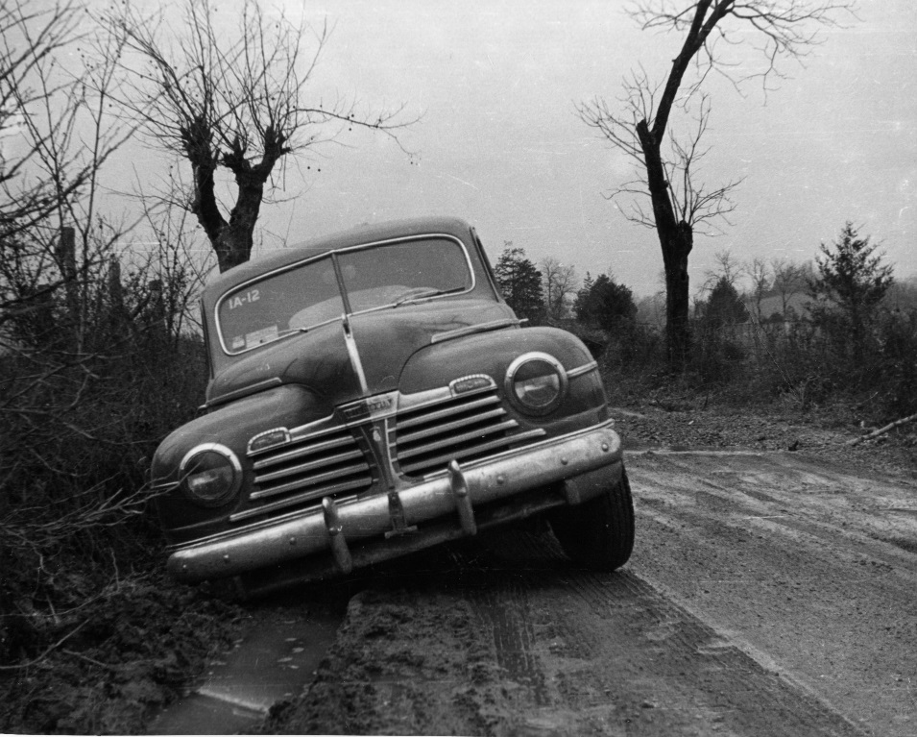
WRONG ANSWER!
<< Try again

Slide 21
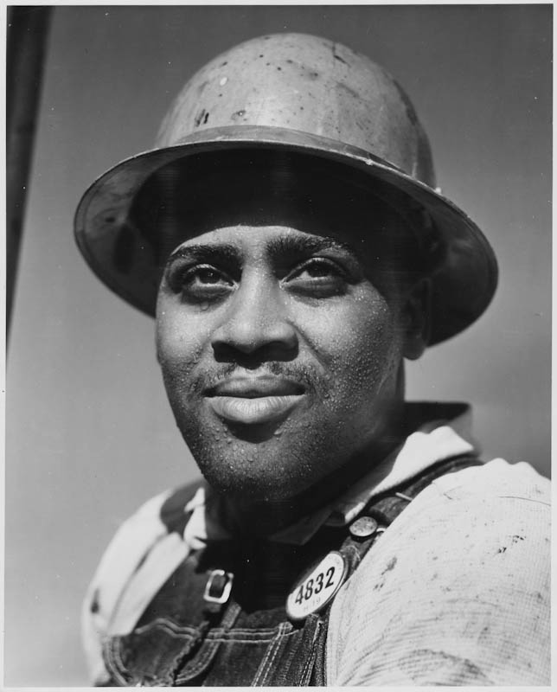
“Early
CORRECT!
A successor employer need not adopt a predecessor’s CBA and is ordinarily permitted to set initial T&Cs of employment.
Next Slide >>
Department of Energy

Slide 22
Wrap up
GC-63
If you have questions on specifics as they relate to your site and your contractors or unions, please call the individual site leads at GC-63 or the NNSA-GC. If you have forgotten who that is, please check the listing at
http://energy.gov/gc/leadership/contact-us/contacts-assistant-general-counsel-labor-and-pension-law
Questions?

