Slide 1


Energy Data Collection and Tracking for Internal Benchmarking and Energy Management:
Best Practices from State and Local Governments and School Districts
Mona Khalil
Department of Energy
EERE
Weatherization and Intergovernmental Program
December 18, 2014

Slide 2
DOE’s State & Local Technical Assistance
Priority Areas
Resources
Peer Exchange & Trainings
Direct Technical Assistance
Strategic Energy Planning
Program & Policy Design and Implementation
Financing Strategies
Data Management and EM&V
Technology Deployment
General Education (e.g., fact sheets, 101s)
Implementation Models (i.e., case studies)
Research & Tools for Decision-Making
Protocols (e.g., how-to guides, model documents)
Webinars
Better Buildings Project Teams
On a limited basis
High impact efforts
Opportunities for replicability
Filling gaps in the technical assistance marketplace
Conferences & in-person trainings
Accelerators
In-depth efforts will be focused on:
Level of effort will vary
Notes:
DOE’s State & Local Policy & Technical Assistance Team provides state, local, and tribal officials with resources to advance successful, high-impact, and long-lasting clean energy policies, programs, and projects
Supports one of EERE’s key missions – taking clean energy to scale through high impact efforts
WE’ve been around for about a decade and handled thousands of inquiries. Under the Recovery Act we were able to expand our range of resources, including:
More robust one-on-one assistance
An extensive online resource library
Facilitation of peer exchange
Just like state and local governments, TAP has a post-ARRA transition to contend with, but rather than reverting back to our pre-ARRA framework, TAP is evolving
TAP’s mission will continue to be supporting states, locals, and tribes take clean energy to scale
But now, more than ever, we want to get the biggest bang for our more limited buck – and help you do this as well
Moving forward we will be focused on:
Key priority areas to address specific market barriers
Resources to disseminate standardized approaches and best practices
Facilitating communication and learning among peers
Targeted one-on-one assistance
One-on-One Assistance – states and locals will have to submit application
In-depth requests will be evaluated based on set of criteria, including. . .
General shift toward program and policy-based assistance, versus one-off projects

Slide 3
How to Tap into These and Other TAP Offerings
Visit the Solution Center www.eere.energy.gov/wip/solutioncenter/
Sign up for TAP Alerts, the TAP mailing list, for updates on our latest and greatest TechnicalAssistanceProgram@ee.doe.gov

Slide 4
WIP – Who we are and what we do
Mission: Accelerate deployment of energy efficiency and renewable energy technologies over a wide range of stakeholders in partnership with states and local governments.
Strategic objective: “Deploy the clean energy technologies we have” through near-term activities that result in greater energy efficiency, expanded renewable energy capacity, and economic development.
Pathways:
Financial assistance: Formula and competitive awards > $200 M per year to weatherize low-income homes, and assist states to deploy EE and RE projects and programs
Voluntary programs: Better Buildings Challenge (BBC) & Accelerators
Technical assistance: Resources to assist the public sector with planning, financing, evaluating and deploying EE and RE programs and projects
Notes:
Mission and Strategic Objectives
WIP is part of EERE’s balanced research, development, demonstration, and deployment (RDD&D) approach to accelerate America’s transition to a clean energy economy
Our mission: Accelerate deployment of energy efficiency and renewable energy technologies over a wide range of government, community, and business stakeholders in partnership with states and local governments.
Our strategic objective: “Deploy the clean energy technologies we have” through near-term activities that result in greater energy efficiency, lower energy use, expanded renewable energy capacity, and economic development.
Pathways
Financial assistance: Formula and competitive awards > $200 M per year to weatherize low-income homes, and assist states to deploy EE and RE projects and programs
Voluntary programs: Better Buildings Challenge (BBC) & Accelerators
BBC Partnerships with 8 states, 43 local governments and 11 school districts to reduce energy use 20% by 2020
BBC Accelerators to break down barriers to use of performance contracting in the public sector and state and local government retrofits to high performance outdoor lighting
Technical assistance: Create resources to assist the public sector with planning, financing, evaluating and deploying EE and RE programs and projects
Goal for this work: Identify and characterize effective and replicable solutions that states, locals and K-12 are using to enhance their energy management practices

Slide 5






































Slide 6
Coming in 2015
Best Practices in Energy Data Collection and Tracking in the Public Sector
A new step-by-step guide on data tracking for internal benchmarking and energy management purposes featuring effective and replicable solutions that states, locals and K-12 are using to enhance their energy data management practices
Step-by-step framework with five key elements for establishing a robust and sustainable energy data management system
Detailed best practice profiles and tactics featuring state, municipal and K-12 practitioners
Checklists, tools, and templates

Slide 7
Outline for Today’s Presentation
Best Practices in Energy Data Collection and Tracking
Study methodology
Benefits of tracking energy use
Five key elements for effective energy data tracking
Examples of cities and a State
Case Study: Portland Public Schools
Key takeaways

Slide 8
Best Practices Study Methodology
Approach: Primary research through in-depth interviews with ~60 state and local governments, school districts and subject matter experts
  10 states (NY, CA, DE, MA, MD, MN, RI, WI, NC, IA)
  26 local governments (14 large cities, 7 medium, 5 small)
  3 school districts (one small, one medium, and one large)
  18 subject matter experts from public and not-for-profit organizations
Best Practice Criteria: Solutions screened against specific criteria:
  Effectiveness
  Replicability
  Sustainability
  Impact
Metrics: Specific metrics to compare and rank solutions
  Entities provided data/results as evidence of level of efficacy
  Principal metric: Energy and cost savings;
  Secondary metrics: time savings; change in resource requirements (cost, time, human capital); etc.

Slide 9
Why track energy data?
Interviewees report the ability to:
Improve strategic energy management capabilities
    Build the case to leadership on the value of energy management and gain additional support
Improve control and transparency of energy costs and budgets
Improve operational efficiency
Facilitate demand response and energy purchasing
“Measuring your energy usage and cost is the first step to properly managing energy”
- City of Virginia Beach Mayor William Sessoms, Jr.

Slide 10





How did they get there?
Best Practices in Energy Data Management
Five Elements for Success
Asset
Inventory
Data
Access
Tools and
Analytics
Organizational
Structure
Engagement
Communication
Comprehensive
Centralized
Verified
Up to Date
Comprehensive
Streamlined
Automatic
Prompt
Flexible
Secure
Accessible
QA/QC
Integrated
Centralized
Dedicated Staff
Streamlined
Targeted
Clear
Transparent
Mission-focused

Slide 11
Comprehensive Asset Inventory
Asset
Inventory
Central Asset Inventory
Locate Sources of Asset Data
Create Standard Organizational Structure
Maintain Inventory Integrity
Reconcile Data and Fill Gaps

Slide 12
Streamlining Data Access
What do we mean by “streamlined data access”?
Electronic data transfer from utility to customer
Efficient and timely access to comprehensive utility billing data
Monthly or more frequent energy use intervals
Minimal manual data entry
Data for all commodities and all energy- and water-using assets
Data
Access
Benefits
Speed to data receipt: lower time gap between usage period and when data can be viewed
Cost savings: use consumption, cost, demand charges, rate schedules, etc. to maximize savings
Data quality: reduce errors introduced during data transfer, perform audits
Operational efficiency: save staff time, reduce redundancy in operations, add value
Utility 1
Your
Organization
Utility 2
Database
Utility 3

Slide 13
Solutions for Streamlining Data Access
Consolidated Billing
Most common approach for entities with municipal utilities with no other data access options
Feasible to develop custom solutions
Electronic Data Interchange (EDI)
Good option for entities with >100 accounts with EDI-capable utility
Generally limited to electric and some natural gas IOUs
Portfolio Manager
Data Exchange Web Services
Streamlines data transfer to Portfolio Manager facilitating benchmarking; additional sectors and functionalities added
A growing number of utilities offer this solution
Green Button Connect My Data
Emerging best practice solution for sharing near real-time and comprehensive bill data
A growing number of utilities are adopting Green Button
Third Party
Services
Best option for medium to large entities with many vendors and data formats
Least common but effective

Slide 14
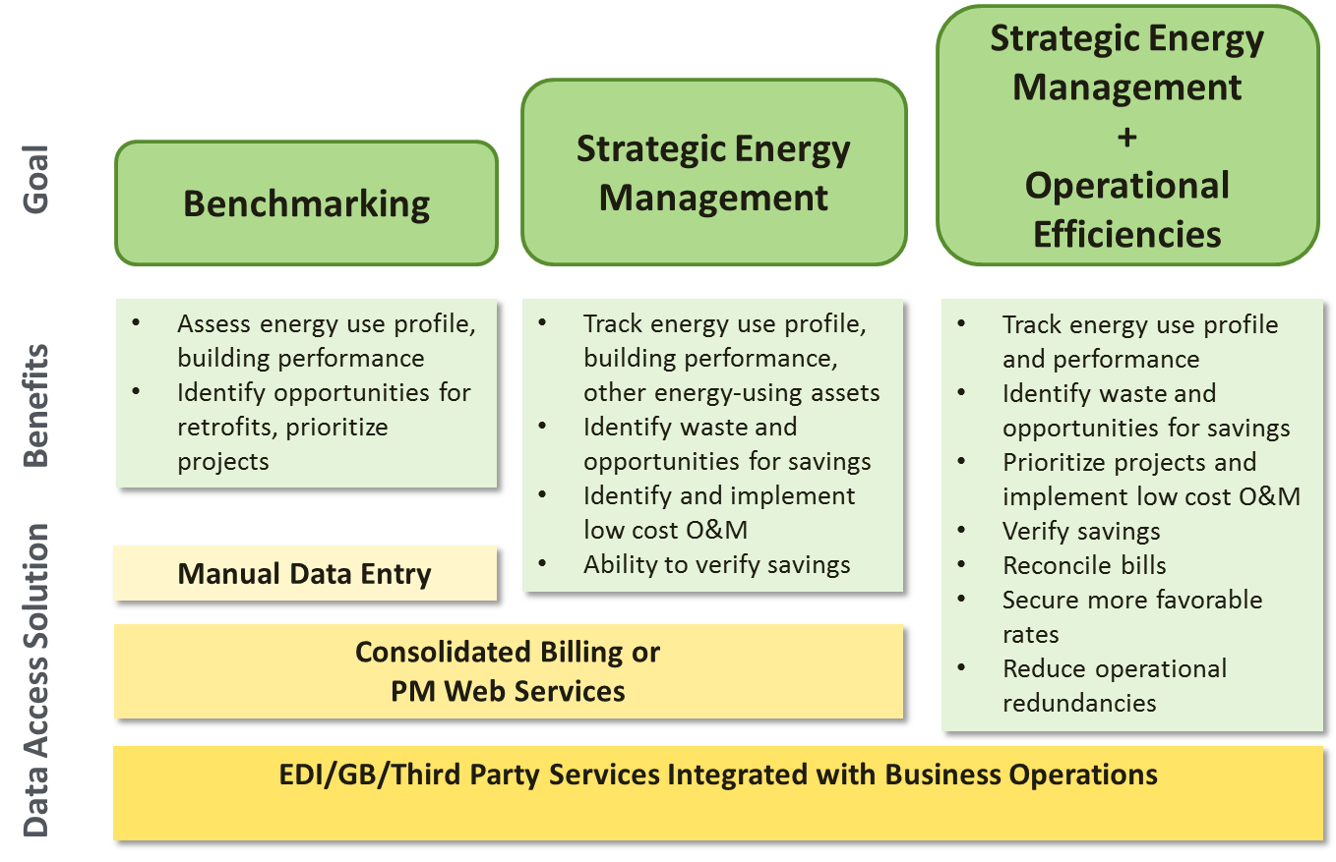
Contribution to Organizational Goals

Slide 15


Data Tools and Analytics
Structure
Data management, organization
Data entry and interoperability
Analytics
Data processing
Users
Dashboards and reporting
Customer support and training
Stakeholder access to data
Flexibility
Data back-up and security
Data analysis
Search and sort functions
Data auditing
Tools and
Analytics

Slide 16
Organizational Structure
Organizational
Structure
Decentralized
Accounts Payable
Data Entry
Utility Bill Data
Energy or Sustainability Office
Accounts Payable
Data Entry
Accounts Payable
Data Entry
Centralized
Accounts Payable
Utility Bill Data
Energy or Sustainability Office
Data Entry
Accounts Payable
Accounts Payable

Slide 17
Organizational Structure
Example of a Partially-Centralized Organizational Structure
Organizational
Structure
Department of General Services
Agencies/ Departments
Utility
Third
Party
Energy Database
Energy Manager/ Engineer
Energy Coordinator
Accounts Payable

Slide 18
Engagement and Communications
Incentivize and Recognize Key Stakeholders
Energy Data Manager
Leaders
Agency/Depart-ment
Asset Managers
Finance
Staff/ Public
Utilities
Develop Partnerships
Engagement
Communication
Establish Effective Working Groups
Tailor Reports to Individual Audiences
Create Transparency
Drive participation through a uniform collection platform

Slide 19

City of Knoxville, TN: Consolidated Billing
Goal: Track and manage the city’s progress in achieving a 20% reduction in energy intensity by 2020
Solution: The City of Knoxville worked with the municipal utility to develop a consolidated bill containing electric, natural gas, water, and sewer cost and consumption data for the city’s facilities and non-metered fire hydrant and outdoor lighting infrastructure
Ability to Track Progress
The city tracks energy consumption, cost and rate structure for more than 1,000 utility accounts
Energy Project Savings Verification
Verification of savings from ESPCs and other retrofit projects
Efficient Use of City Staff Time
It takes 1 hour per month to import data into the tracking software
Data demonstrates savings from EE upgrades to buildings and other city infrastructure
Project Manager spends 8-10 hours per month on data management activities centered on data analysis, reporting, and entry updating.
Achieved a 13% reduction in GHG in 2014 relative to 2005

Slide 20

City of Virginia Beach: Integrated Tracking & Payment
Goal: Improve efficiency of operations and control of energy budget
Solution: The City of Virginia Beach has eliminated nearly 1,000 paper bills monthly, reducing staff time needed for data entry by 85% . VB metropolitan area is now ranked fourth among mid-sized cities for ENERGY STAR certified buildings. CVB received the Government Finance Officers Association’s Award for Innovation in Government for the utility bill management process
Energy Management and Conservation
Track energy usage
City Planning, Budgeting and Operations
Make wise energy purchasing decisions
Eliminate billing errors and late payment
perform energy savings verification on completed retrofits
Energy reports to motivate occupants to take action
Improve budgeting, accruals, accounting

Slide 21

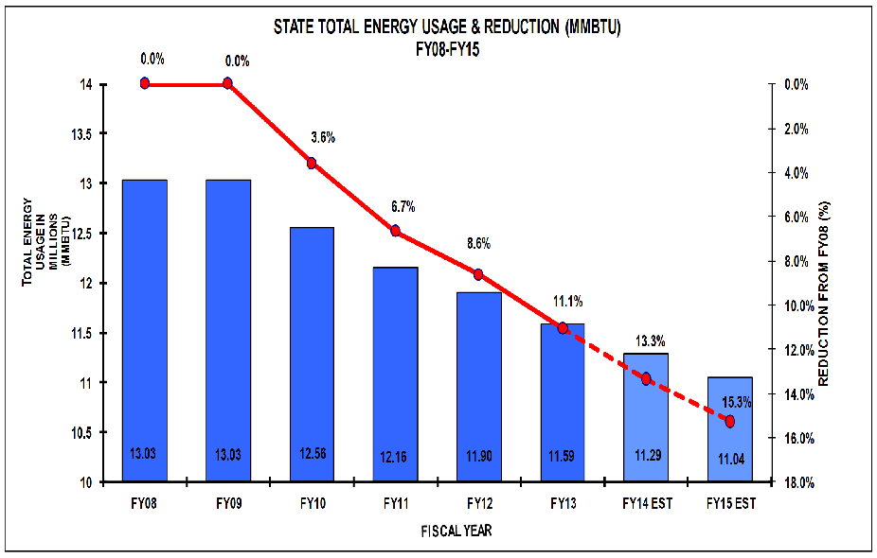
State of Maryland: Centralized Energy Database
Goal: Track consumption across all facilities (124 vendors, >16,000 utility accounts, 120 accounts payable departments, 58 agencies)
Solution: A centralized energy data collection and tracking process using a third party to assist in the compilation of a central energy database, development of streamlined utility data access solutions, and maintenance of a transparent web-based portal.
Annual energy budget >$200MM, Cost of contract: $0.8-1MM
FY2013 Block & Index Commodity Purchasing Savings
(Millions $)

Slide 22

Case Study: Portland Public Schools
Leveraging a Third Party Service Provider to Streamline Data Entry
Jeff Hamman, CEM
Energy Specialist
Buildings Operations and Energy Program Manager
Portland Public Schools
jhamman@pps.net

Slide 23


Portland Public Schools: Building Portfolio
Portland Public Schools: Portland, OR
Largest School District North of San Francisco
Over 9 Million Square Feet Managed
  104 Facilities Managed
  65 years Ave Building Age
  800+ Utility Accounts
  47,000+ Students
  6,000+ Staff
  $10.4M FY 13-14 Utility Budget

Slide 24

Portland Public Schools: Goals
  Achieve a 20% reduction in energy intensity by 2020 as per the Better Buildings Challenge goal
  Quicker access to data for analysis and reporting
  Reallocate staff time to more productive matters
  Simplify invoice payment and processing
  Comply with a statewide mandate to report annual energy consumption

Slide 25
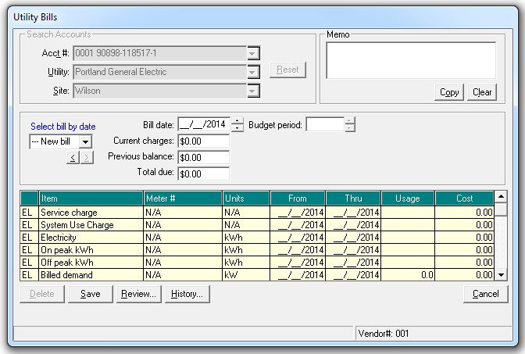
Portland Public Schools: Barrier
  Implementation cost
  Cost effectiveness
  Procurement, project management and implementation
  Accounts payable process integration
Process | Timeline from Bill Date
Invoiced Received | 1-2 weeks
Payment Processed | 2-3 weeks
Manual Data Entry | 4-12 weeks
Usage and Cost Review | 4-12 weeks
Address Issues | 6-12 weeks
Reporting | 12-14 weeks
Manual Data Entry

Slide 26
Portland Public Schools: Barrier
School District Personnel | Average Monthly Hours Saved | Equivalent Internal Personnel and Other Savings
Energy Specialist | 20 | $10,468
Resource Conservation Manager | 8 | $4,395
Finance Clerk I | 18 | $6,359
Annual Service Fee for Utility Database | - | $1,975
Total Savings | 46 | $23,897
Notes:
To make the business case for entering into a long-term contract with a third party vendor, the energy specialist worked with the accounts payable department to determine the amount of staff time PPS was spending on data collection, tracking, and bill payment every month. This analysis found that approximately 46 hours of internal personnel savings could be realized through the utilization of a third party contract that included comprehensive utility bill data entry, a tracking tool, and invoice analysis and processing services. The new contract with Ecova also eliminated a utility database fee PPS was paying, reducing the cost of the new contract. The analysis estimated that the savings in personnel time would be approximately equal to or greater than the cost of the third party service at $25,000 per year. While the annual contract cost was estimated at $25,000 annually, historic costs have been less at approximately $20,000 annually.

Slide 27
Portland Public Schools: Solution
Portland Public Schools (PPS) contracted with a third party energy and utility management company to develop a comprehensive solution for its utility data access, tracking, and processing needs.
Utility Bill Management
Energy Management Tool
  Improved reporting capabilities including custom reports
  Budget tracking, analysis and modeling
  Annual review of utility rate schedules
  Automatic Energy Star upload
  Web-based platform, enabling access to data to a greater number of staff
  Training and technical assistance
  Continuous utility bill data entry
  Invoice processing and auditing
  Late fee avoidance
  Missing invoice/late arriving notification
  Correspondence and bill insert
  Invoice archiving

Slide 28
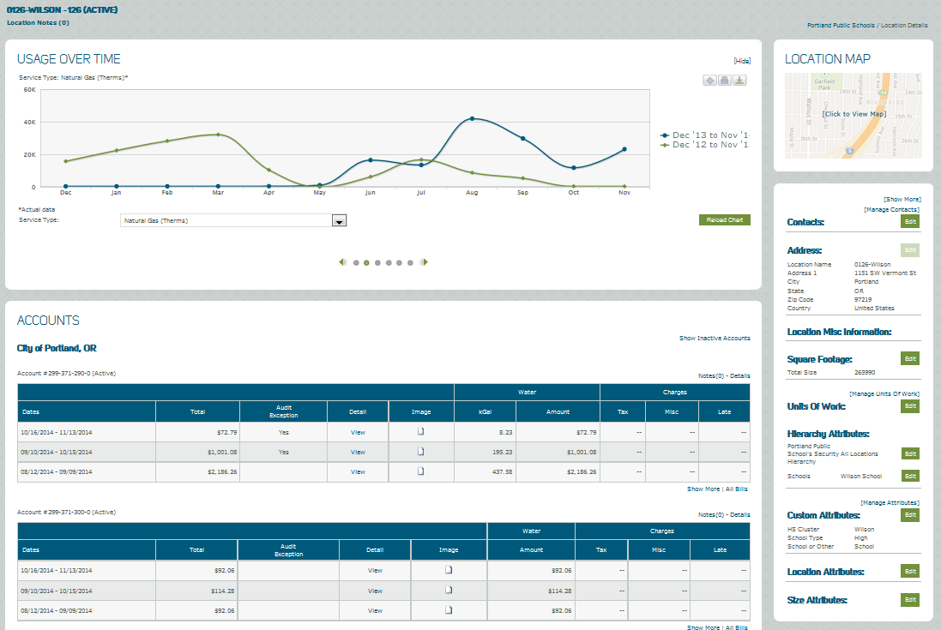
Portland Public Schools: Solution
New Data Portal and Invoice Processing Work Flow

Slide 29
Portland Public Schools: Outcomes
Manual data entry of utility bills is virtually eliminated through the third party vendor contract
Staff time reallocated to address usage anomalies and improve the energy performance of school facilities
Decreased invoice processing times
Automated usage and cost notifications
Process flow efficiencies
Access to data

Slide 30
Portland Public Schools: Outcomes

Slide 31
Portland Public Schools: Outcomes
Current Issues

Slide 32
Portland Public Schools: Outcomes
Notes:
Show direct correlation between weather and energy usage.
Weather Normalized Energy consumption allows for a comparison of the districts energy use relative to itself over time, accounting for year-to-year differences in weather.
Heating Degree Day (HDD) measure the deviation from a temperature of 65 degrees over the course of the year. For each day with an average temperature lower than 65 degrees, HDD is the difference between the average temperature and 65 degrees. The annual HDD is the sum of this difference across all days with an average temperature below 65 degrees. *
The heating requirements for a given structure at a specific location are considered to be directly proportional to the number of HDD at that location.
*www.energystar.gov

Slide 33
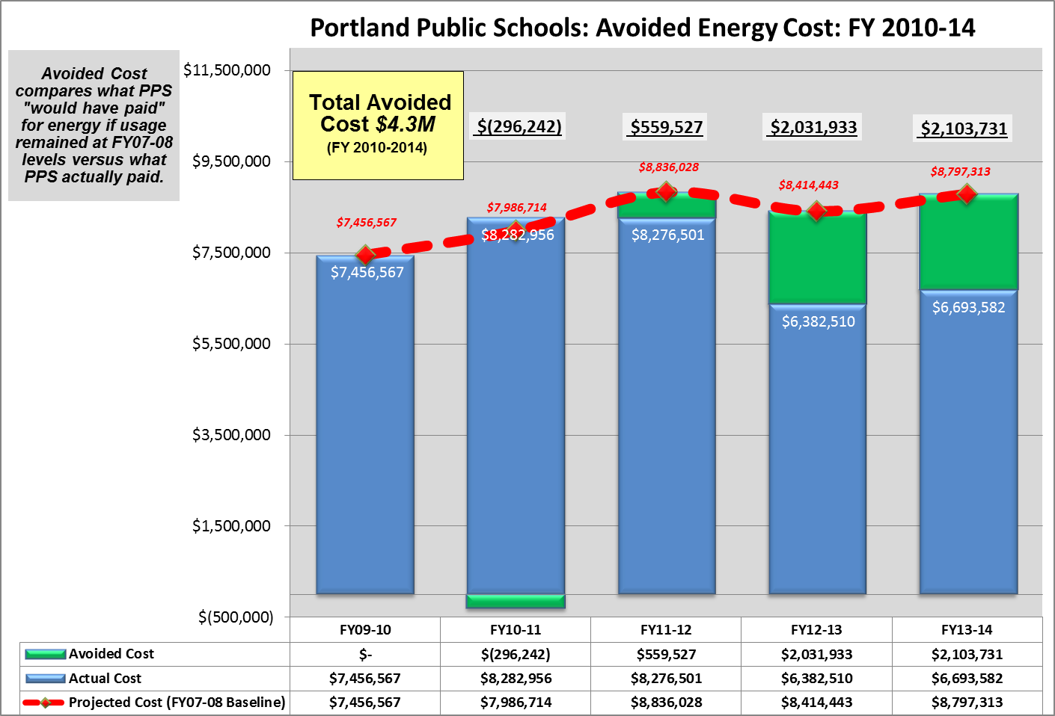
Portland Public Schools: Outcomes

Slide 34
Key Takeaways
A robust data tracking strategy is a foundation for strategic energy management and pays additional dividends
Development of a robust tracking system takes time
Dialogue and collaboration with utilities is critical to develop and implement a streamlined data access solutions
Medium to large entities use a combination of approaches to gain access to data
A robust analysis tool is critical for “making good use of the data collected”
An integrated and centralized structure can create a win-win situation for all stakeholders
It’s important to implement available solutions, while remaining flexible to adopt new and more efficacious solutions as they become available

Slide 35
Contacts
WIP
State & Local Solution Center
Mona Khalil
Policy and Technical Assistance
Weatherization and Intergovernmental Program
DOE EERE
Mona.Khalil@ee.doe.gov
Phone: 202-586-7983
Jeff Hamman, CEM
Energy Specialist
Buildings Operations and Energy Program Manager
Portland Public Schools
jhamman@pps.net

