Slide 1


Hexavalent Chromium Project Expert Technical Review
Jessica Kunkle, Manager, Department of Energy (DOE) Environmental Management Los Alamos Field Office (EM-LA)
JohnDavid Nance, Hazardous Waste Bureau Chief, New Mexico Environment Department (NMED)
January 29, 2025

Slide 2
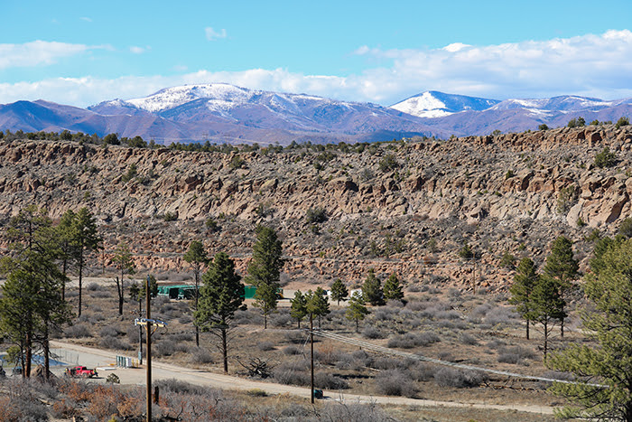
Hexavalent Chromium Plume
From 1956-1972, potassium dichromate, with the active ingredient hexavalent chromium, was commonly used as a corrosion inhibitor in power plants worldwide, including at Los Alamos National Laboratory (LANL)
Plume discovered in 2004—first detection above New Mexico groundwater standard of 50 micrograms per liter
~1,000 feet beneath Mortandad & Sandia Canyons at LANL
Approximately 1 mile long x ½ mile wide
Overlooking top of Mortandad Canyon & operation of Chromium Plume Control Interim Measures
2

Slide 3
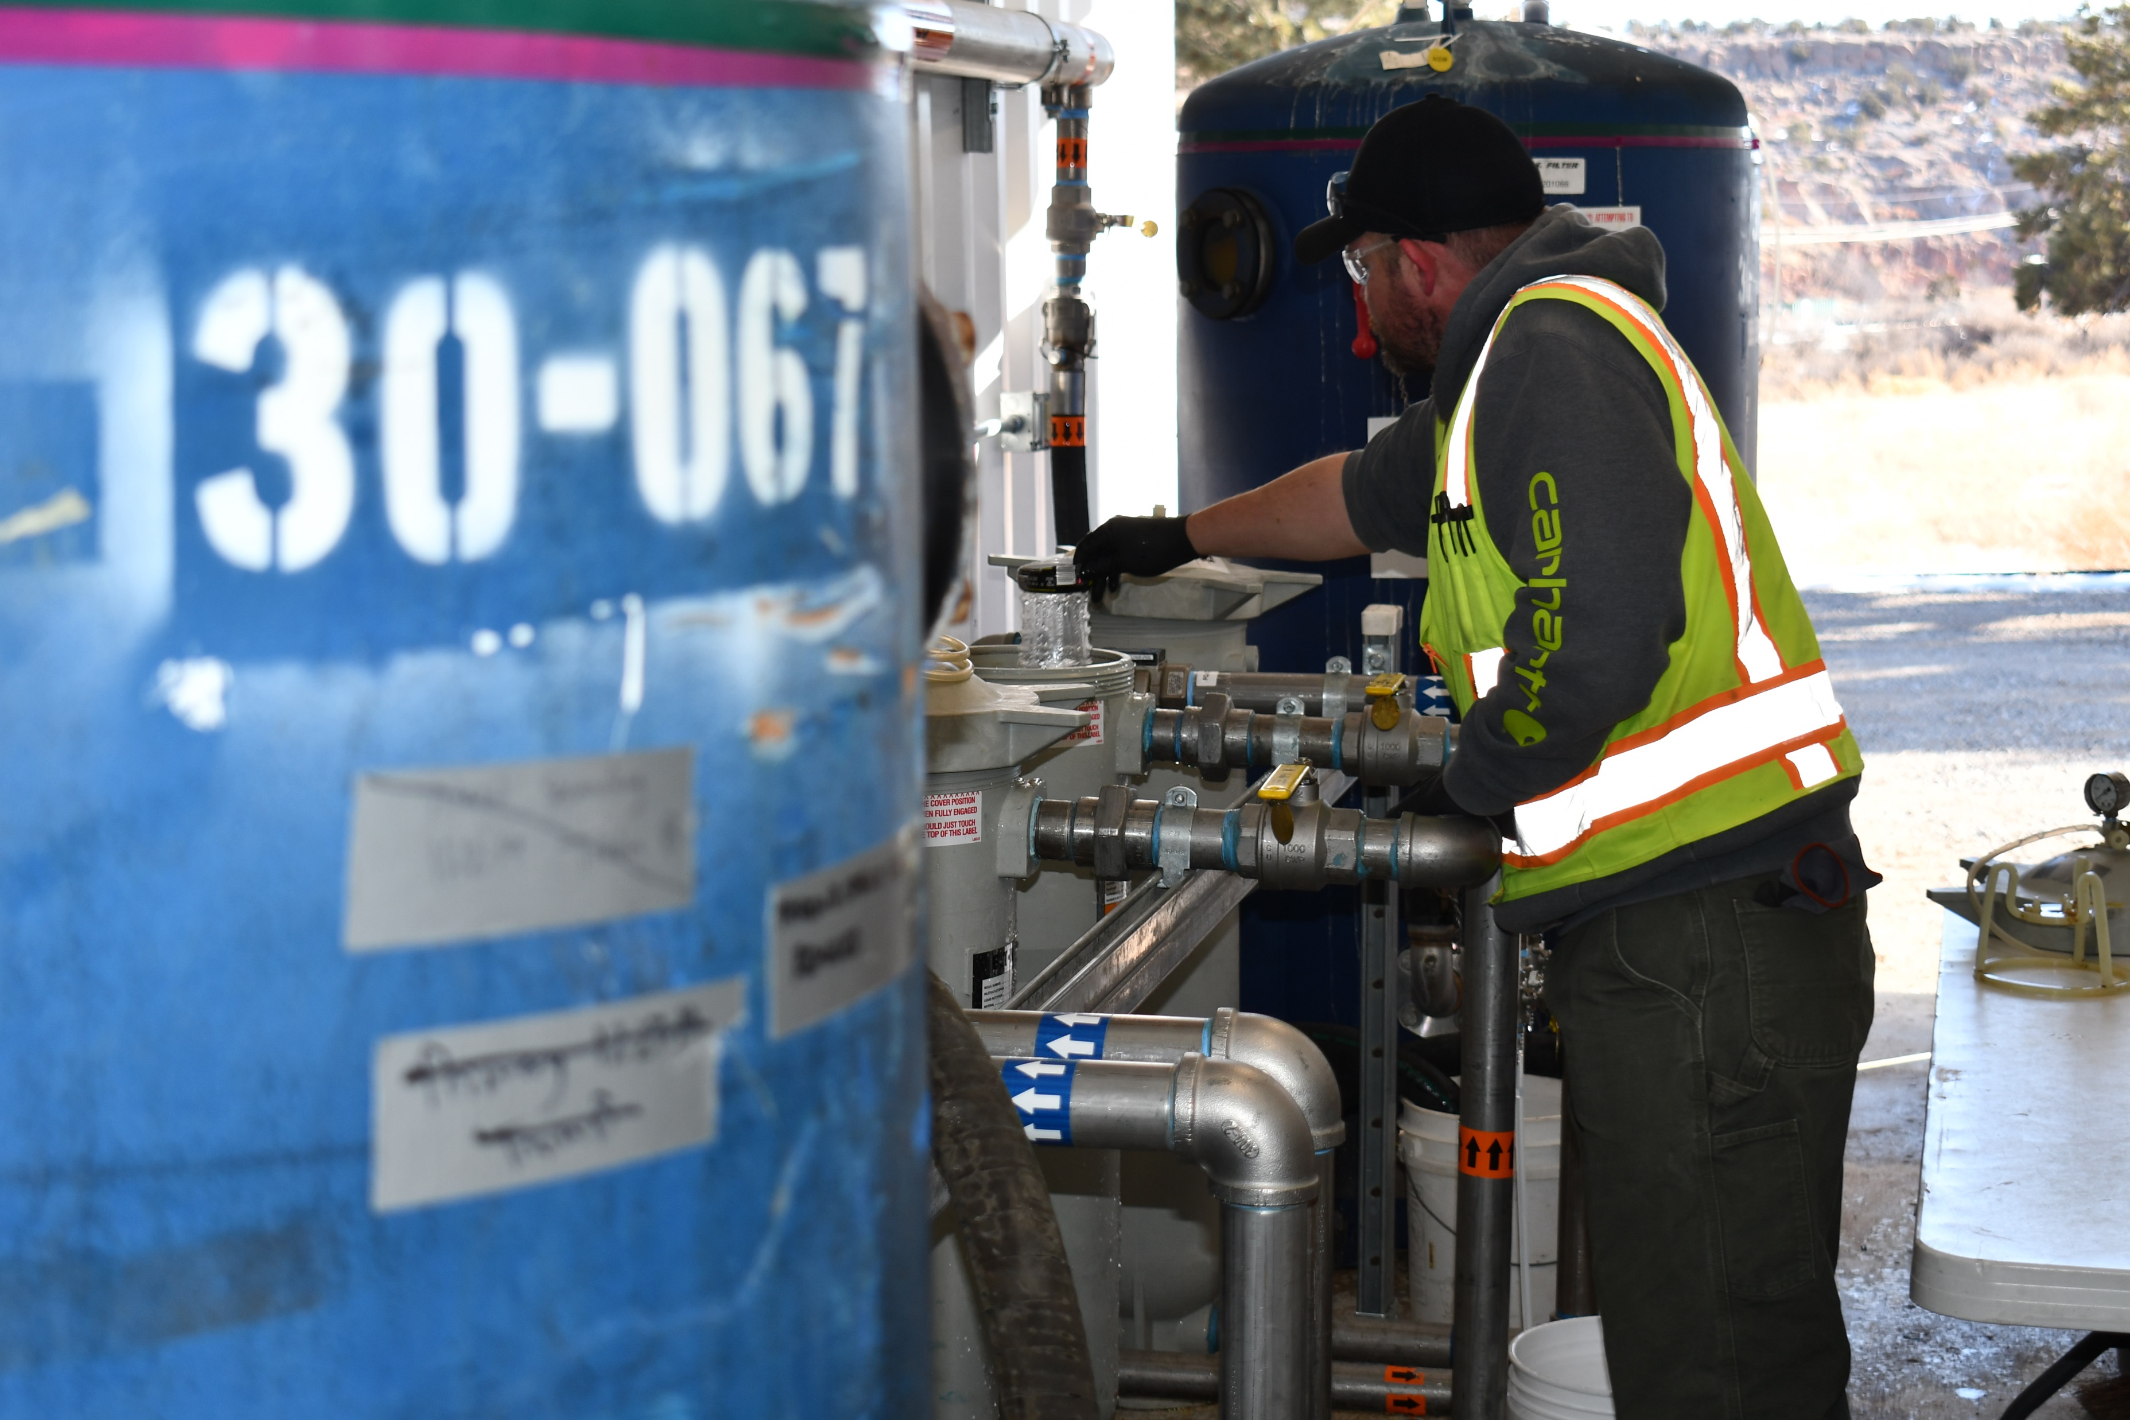

Chromium Plume Control Interim Measures (IM)
PRIMARY OBJECTIVE: prevent migration of the plume beyond LANL boundary
Full operation of the IM commenced 2018 (under NMED approved 2015 work plan)
Hydraulic plume control IM consists of:
  5 extraction wells
  Groundwater treatment system
  5 injection wells along downgradient plume edge
  Over 3 miles of buried conveyance pipelines
3

Slide 4
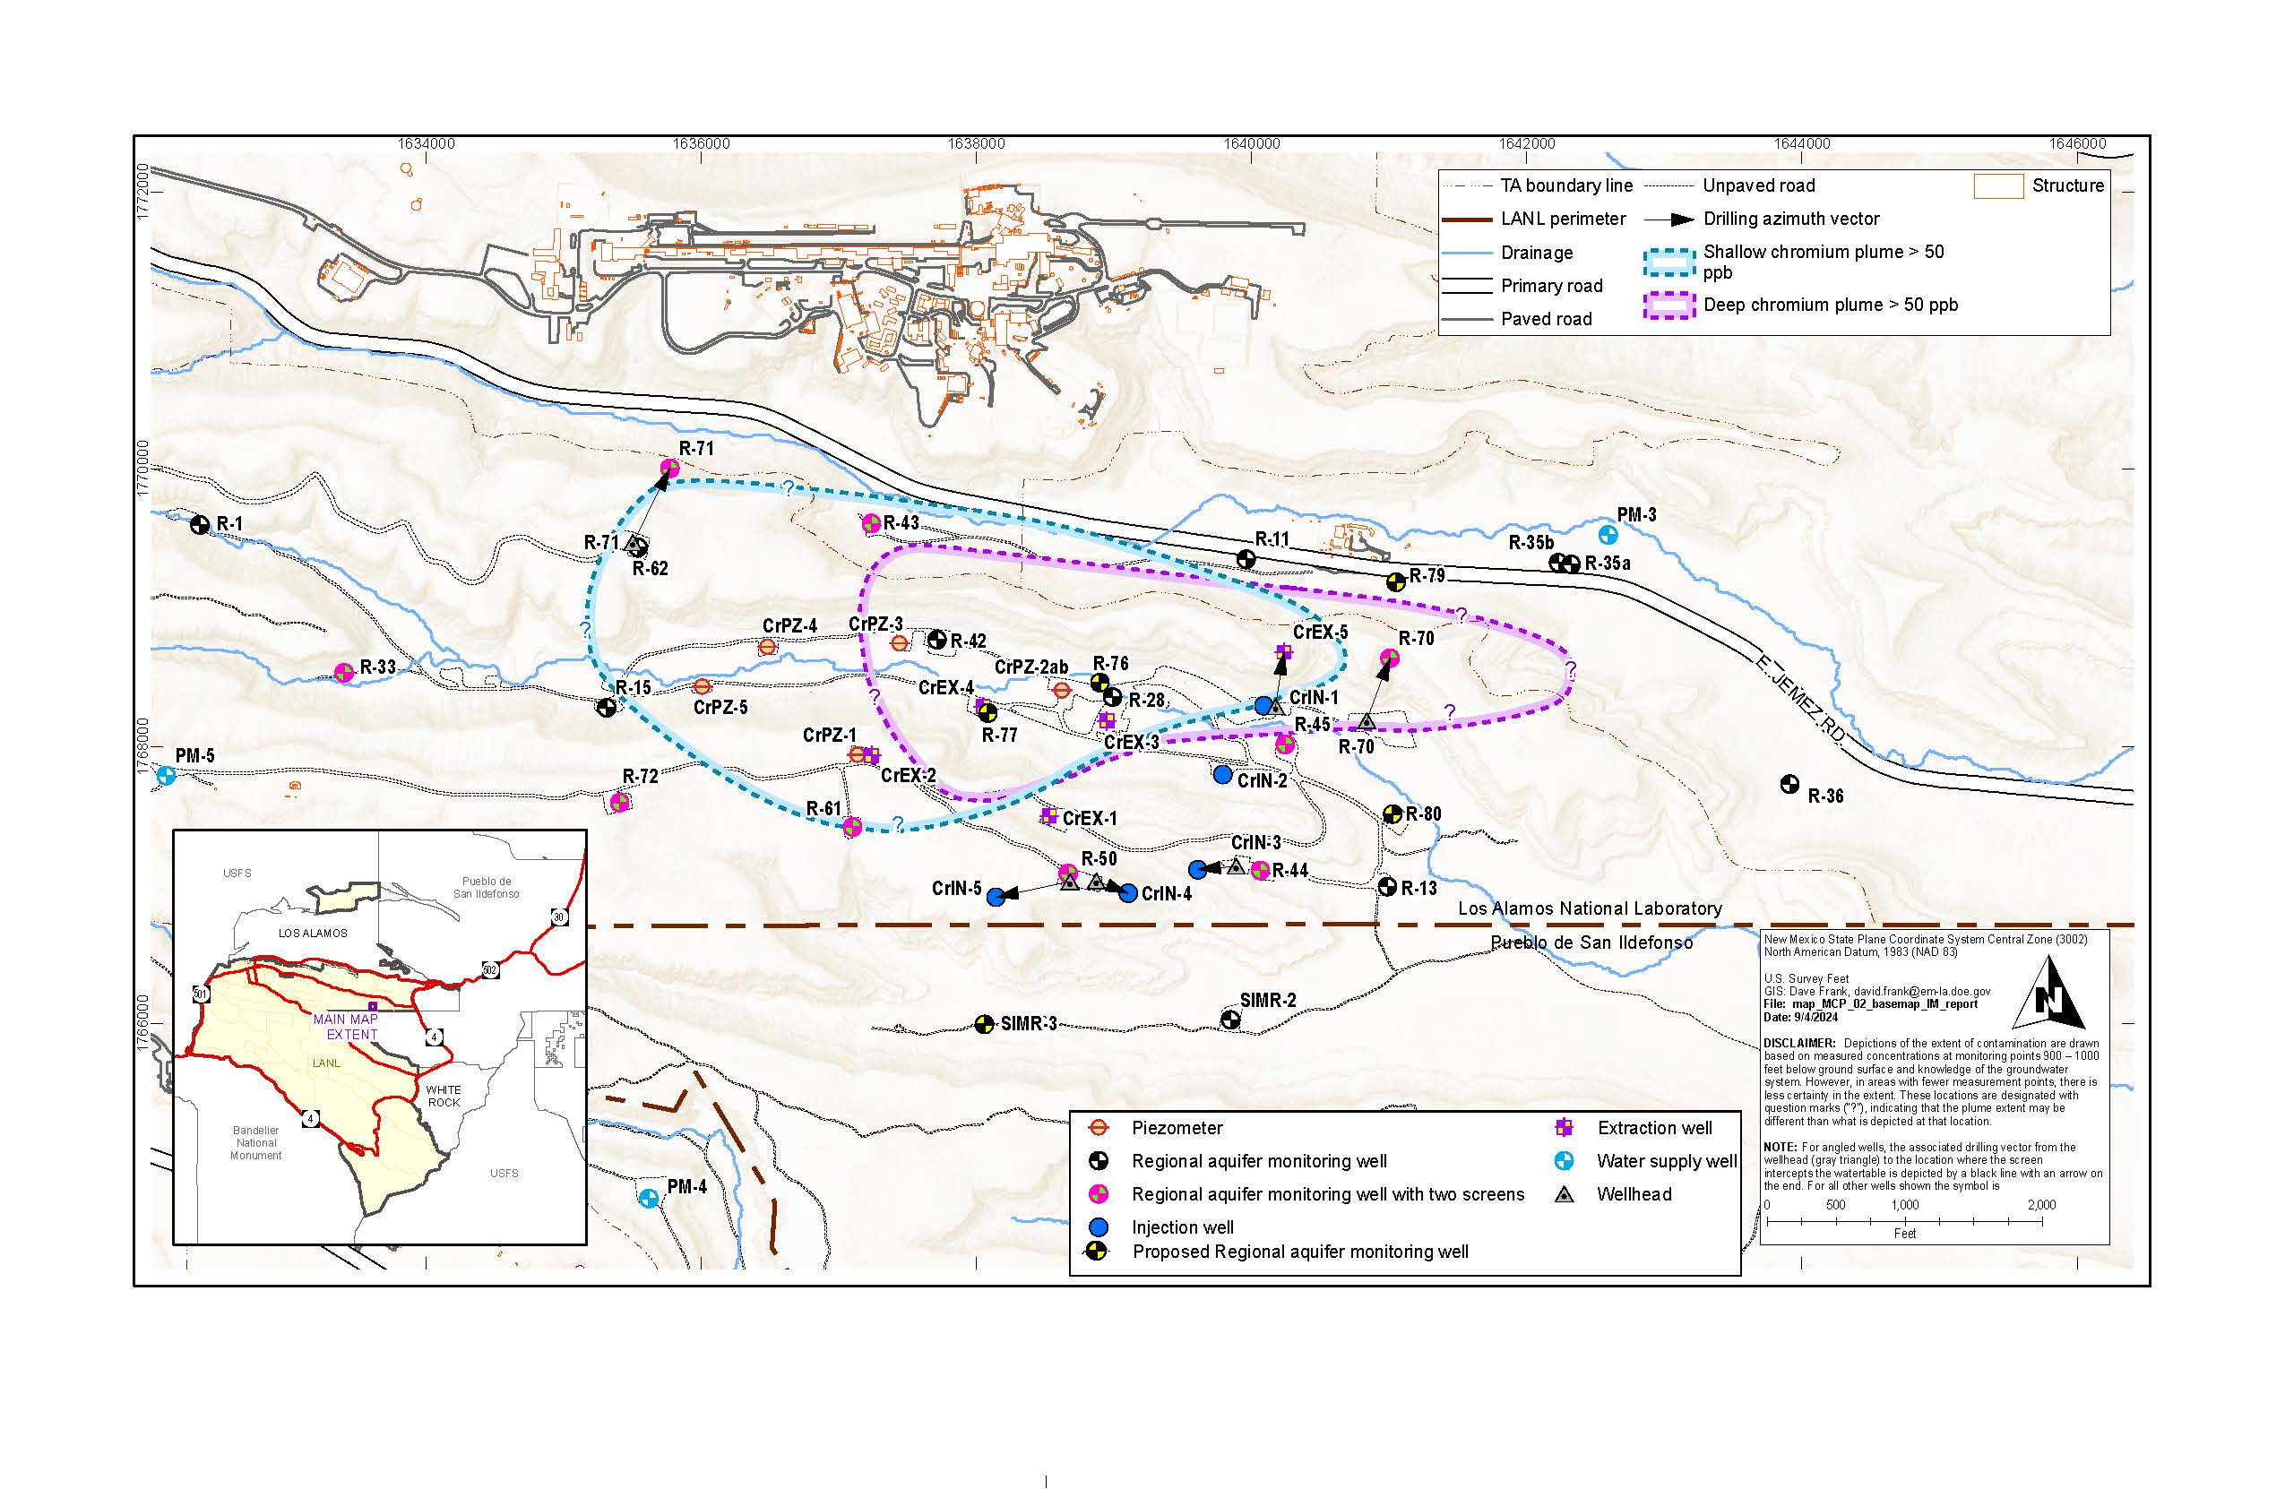

IM Operations
Chromium concentration was increasing in R-45 Screen 2 since installation
NMED believes use of nearby injection wells may have been forcing contamination deeper into regional aquifer in Eastern area
March 30, 2023, IM operation was shutdown to comply with NMED direction to cease injection by April 1, 2023
  Extraction not feasible without injection
After IM shutdown, chromium concentrations in all but 1 well began rebounding immediately
4

Slide 5
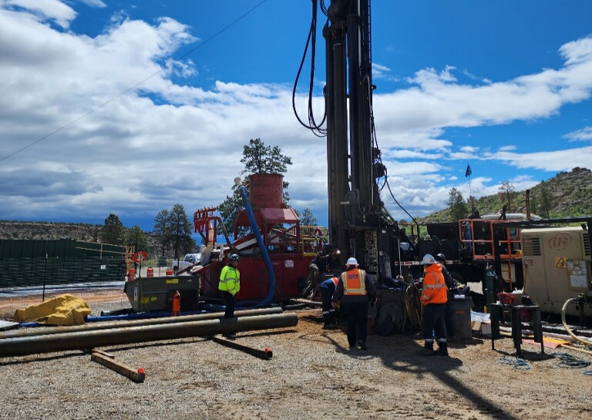
Collaboration to Engage Expert Technical Review
Acted on feedback from New Mexico Radioactive & Hazardous Materials Committee
EM-LA & NMED agreed to evaluate 5 specific topics:
Ability of Chromium IM to hydraulically control plume
Plume modeling: is the model currently used appropriate
NMED’s proposed corrective actions & conditions
Regulatory: readiness to propose & begin evaluating remedial alternatives
Well design
5

Slide 6
Expert Technical Review
Primary recommendation is to restart IM—using a portion of the original system—while other studies & field investigations move forward
EM-LA & NMED will work together to evaluate & prioritize the recommendations from the expert technical review report
EM-LA & NMED will mutually agree on implementation of the recommendations
EM-LA & NMED jointly convened a team of experts from the Network of National Laboratories for Environmental Management & Stewardship, industry, academia, & the U.S. EPA, Region 6
6

Slide 7
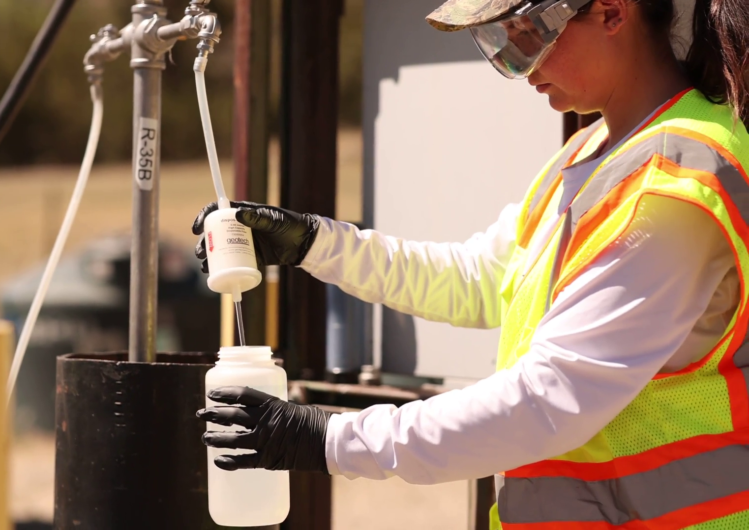
Status of Chromium Plume Control IM
EM-LA worked with NMED to resume partial operation of the IM September 30, 2024
Since mid-November, the IM is running 24/7 at ~70% capacity with 2 extraction wells & 3 injection wells
EM-LA continues monthly sampling
7

