Slide 1

BUILT Nonprofits Media Promotion Toolkit Selectee Announcement
December 19, 2024

Slide 2

WELCOME!
The U.S. Department of Energy (DOE) is thrilled to announce the selectees of the BUILT Nonprofits funding opportunity.
This toolkit provides content to help you amplify news about the selectees, and to ensure consistent DOE branding.

Slide 3

DEMONSTRATED Need
Strong, healthy communities need strong nonprofits.
There are approximately 1.5 million 501(c)(3) nonprofits in America, representing diverse missions such as libraries, worship facilities, community centers, animal shelters, hospitals, healthcare clinics, museums, art institutions, youth sports leagues, food banks, and more.
Nonprofits employ approximately 10% of the U.S. workforce – more than 12.8 million Americans.
Citizens are deeply connected to nonprofits as beneficiaries, volunteers, and donors. By funding energy improvements in nonprofit buildings, DOE is investing in both the physical and social infrastructure of communities – many of which are historically disadvantaged communities.
Nonprofits are often asked to do more with less, forced to choose between funding mission-critical work or urgent infrastructure needs.
Most nonprofits report annual revenues of $500,000 or less.
Behind salaries, energy costs are nonprofits’ second highest operational expense.
The nonprofit sector represents a significant opportunity to reduce energy use and build organizational capacity to expand vital community services..
More than half a million facilities are operated by nonprofits in the United States, and most are in commercial spaces where up to 30% of energy can be wasted due to building inefficiencies.
Energy savings in community-based nonprofits can inspire local transformation in towns and cities across the country, demonstrating the impact of energy efficiency on building comfort, costs, and indoor air quality.

Slide 4
Overview
On October 1st, 2024, the DOE Office of State and Community Energy Programs (SCEP), in collaboration with Techwerx, opened applications for BUILT Nonprofits, a $2 million funding opportunity for energy efficiency upgrades in community-based 501(c)(3) nonprofits.​
This competitive funding opportunity – made possible through the Bipartisan Infrastructure Law (BIL) – is a part of the $50 million Renew America’s Nonprofits Program, which aims to reduce energy use and energy costs in nonprofit buildings, generating sustainable savings that can amplify nonprofits’ community impacts. ​ ​
BUILT Nonprofits received unprecedented interest from the nonprofit sector. By submission close on November 12:
DOE received 738 eligible applications across 50 states and the district of Columbia
Funding requests for energy improvement projects totaled more than $61 million—30 times the available funding
Across all applications
95% had never previously received DOE funding or support
79% were located in or directly serving disadvantaged communities
Dedicated to investing $2 million in the nonprofit sector through this opportunity, DOE has selected 22 nonprofits to receive awards up to $100K for projects across 17 states​
95% of selectees have never received funding or support from DOE
95% of selectees are located in or directly serve disadvantaged communities
Total project costs amount to $2,470,178, adding approximately 25% to DOE’s $2 million investment.

Slide 5
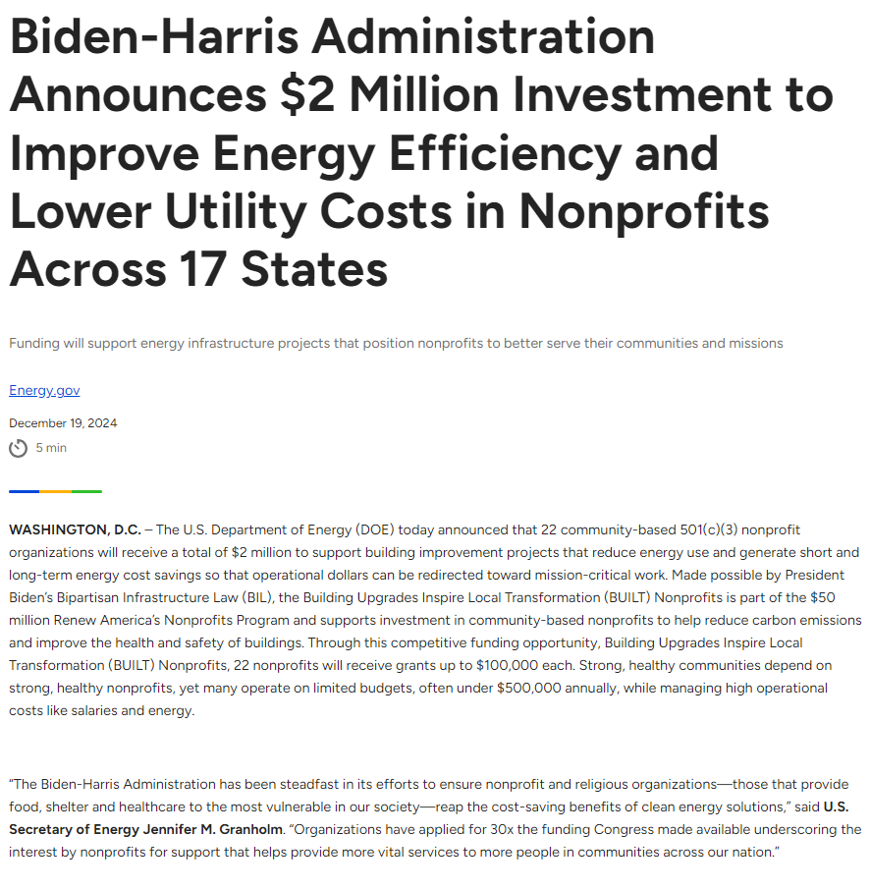
Press release
Click here to read:
Biden-Harris Administration Announces $2 Million Investment to Improve Energy Efficiency and Lower Utility Costs in Nonprofits Across 17 States | Department of Energy

Slide 6


Congratulations to the 22 selectees!
Atlanta Masjid of Al-Islam (GA)
Coalfield Development Corp. (WV)
Community Health Care, Inc. (IA)
Community Partnership of SE Missouri (MO)
Covenant House Illinois, Inc. (IL)
Crow River Players, Inc. dba Little Theatre Auditorium (MN)
Frank Callen Boys and Girls Club (GA)
Health Brigade (VA)
Jacksonville Urban League Economic and Community Development Foundation, Inc. (FL)
Little Manila Rising (CA)
Marbles Kids Museum (NC)
Moab Free Health Clinic (UT)
National Avenue Christian Church (MO)
Neighborhood Innovation Center (MO)
Operation Fresh Start (WI)
Peace Neighborhood Center (MI)
Share Food Program (PA)
Star House (OH)
Union Gospel Mission of Yakima Wash (WA)
WRTP BIG STEP (WI)
YMCA of Metro North (MA)
Youth Employment Partnership, Inc. (CA)

Slide 7
WHAT CAN YOU DO?
Amplify the news about the BUILT Nonprofits selectees. Share the information in this toolkit with your network by…
Engaging with social media (Twitter, Facebook, LinkedIn, Instagram)
Posting blogs or newsletters on your website
Writing a story for media publication
Discussing the grant on a podcast, video, or local radio station
Follow the selectees as they proceed to the award period and complete their portfolios. Learn how they are bringing their projects to fruition.
Highlight quotes, comments, pictures, videos, success stories, and more!
Raise awareness! Amplify the need for energy efficiency upgrades and infrastructure funding across the nonprofit sector and how these investments are tied to community impact.
Photo Credit: Adobe Stock/weerapat1003

Slide 8
Social media content to amplify
Reach a larger audience for your social media posts by tagging or linking to applicable energy accounts for cross promotion:
DOE
Facebook: DOE: https://www.facebook.com/energy @energy | X (Twitter): DOE: https://twitter.com/ENERGY @ENERGY Office of Infrastructure: https://twitter.com/ENERGYDeploy @ENERGYDeploy | Instagram: DOE: https://www.instagram.com/energy/?hl=en @energy | LinkedIn: DOE: https://www.linkedin.com/company/u-s--department-of-energy/ SCEP: https://www.linkedin.com/company/office-of-state-and-community-energy-programs/ Office of Infrastructure: https://www.linkedin.com/company/energyinfrastructure/
On the following slides, you will find sample social media posts published by the accounts above. Please use them as inspiration to write your own, or simply share/retweet on your platform. If you choose to share/retweet, you will have the option to craft a more personalized message in addition to what’s already been published.

Slide 9
X (Twitter): Sample content
Option 1: 📢 Announcing the #BUILTNonprofits selectees! In collaboration with TechWerx, @ENERGY will be awarding up to $100K to 22 nonprofits for energy upgrades! Read more about the selectees and opportunity here: ​https://tinyurl.com/4pjrnf3s
Option 2: Exciting news for nonprofits! DOE has announced the 22 selectees who will each receive up to $100,000 to support infrastructure upgrades that cut costs and lower energy use. Learn more about the announcement here: https://tinyurl.com/4pjrnf3s

Slide 10
LinkedIn or Facebook: sample content
**📢 Today, @DOE announced that 22 nonprofits across the US will receive awards of up to $100K to improve energy efficiency and lowering operating costs. In collaboration with TechWerx, the DOE Office of State and Community Energy Programs (SCEP) previously announced that the Building Upgrades Inspiring Local Transformation (BUILT Nonprofits) opportunity will provide a total of $2 million for energy efficiency upgrades in community-based 501(c)(3) nonprofits. The funding opportunity was widely oversubscribed, receiving 738 applications from 50 states and the district of Columbia requesting a total of $61 million—30 times the available funding.
Selectees across 17 states will now enter negotiations with TechWerx to determine final project details.
View a full list of selectees and read more from the DOE here: Biden-Harris Administration Announces $2 Million Investment to Improve Energy Efficiency and Lower Utility Costs in Nonprofits Across 17 States | Department of Energy

Slide 11
images for promotional use
Below are approved visual assets for use in promoting the programs on social media and communications materials.

Slide 12
images for promotional use, CONT’D
Below are approved visual assets for use in promoting the programs on social media and communications materials.

Slide 13
Communications checklist:
Use #RenewAmericasNonprofits in all social media communication
Click any #RenewAmericasNonprofits hyperlink to follow the awards
Like, share, and/or comment on BUILT Nonprofits content when possible
Notify Nonprofits@doe.gov of any upcoming media opportunities or social media features

Slide 14

KEY RESOURCES
To learn more about the Renew America’s Nonprofits Program, please view the:
Renew America's Nonprofits | Department of Energy
To read more about the announcement, read the press release: Biden-Harris Administration Announces $2 Million Investment to Improve Energy Efficiency and Lower Utility Costs in Nonprofits Across 17 States | Department of Energy
If you have any questions that are not addressed in these slides, please contact us at Nonprofits@doe.gov
Photo Credit: Unsplash/Desola Lanre-Ologun

