Slide 1
Welcome to the Grid Modernization Initiative Strategy Webinar!
GMI Website (for a copy of the strategy and FAQs following the webinar): https://www.energy.gov/gmi/grid-modernization-initiative
GMLC Website: https://gmlc.doe.gov/index.php/
If you have questions or follow-up items after the webinar, please email GMI@hq.doe.gov

Slide 2
Geraldine Richmond Department of Energy Undersecretary for Science and Innovation

Slide 3
Gil Bindewald Department of Energy, Office of Electricity Principal Deputy Assistant Secretary

Slide 4
Juan Torres National Renewable Energy Laboratory Associate Lab Director, GMLC Co-chair

Slide 5
Jud Virden Pacific Northwest National Laboratory Associate Lab Director, GMLC Co-chair

Slide 6
Administration Goals
Decarbonization
Infrastructure Modernization
Climate Adaption and Mitigation
Equity and Energy Justice
Workforce Development
Power System
Objectives
Clean Energy Integration
Grid Infrastructure Expansion
Managing Electrification
Reliability, Resilience, and Security
Affordability
Pillars
Devices and Integrated Systems
Operations
Planning
Markets, Policies, and Regulations
Resilient and Secure Systems
Flexible Generation and Load
Power Electronics
Energy Storage
Integrated Energy Systems
Inverters/ Distributed Energy Resources Interconnection
Cables and Conductors
Transformers
Codes & Standards
Transmission & Distribution Integration
Flexible Grid Management
Sensing & Measurement
Data Analysis
Controls
Protection
Climate Adaptation and Mitigation
Data Science and Forecasting
Power System Modeling Tools
Economic Modeling
Interdependent Infrastructures
Multi-Model Integration
Behavioral Science
Policies and Regulations
Market Design
Economic Valuation
Energy Justice
Cybersecurity
Microgrids
Inter- and Intra- System Risk Assessment
Flexible Generation
Flexible Load
Hybrid Systems/ Integrated Energy Systems
Topic
Areas
Program
Types
R&D
Testing & Validation
Simulation
Demonstrations
Technical Assistance
Analysis
6

Slide 7
Grid Modernization Pillar 1: Devices and Integrated Systems
Teja Kuruganti
Oak Ridge National Laboratory

Slide 8
Administration Goals
Decarbonization
Infrastructure Modernization
Climate Adaption and Mitigation
Equity and Energy Justice
Workforce Development
Power System
Objectives
Clean Energy Integration
Grid Infrastructure Expansion
Managing Electrification
Reliability, Resilience, and Security
Affordability
Pillars
Devices and Integrated Systems
Operations
Planning
Markets, Policies, and Regulations
Resilient and Secure Systems
Flexible Generation and Load
Power Electronics
Energy Storage
Integrated Energy Systems
Inverters/ Distributed Energy Resources Interconnection
Cables and Conductors
Transformers
Codes & Standards
Transmission & Distribution Integration
Flexible Grid Management
Sensing & Measurement
Data Analysis
Controls
Protection
Climate Adaptation and Mitigation
Data Science and Forecasting
Power System Modeling Tools
Economic Modeling
Interdependent Infrastructures
Multi-Model Integration
Behavioral Science
Policies and Regulations
Market Design
Economic Valuation
Energy Justice
Cybersecurity
Microgrids
Inter- and Intra- System Risk Assessment
Flexible Generation
Flexible Load
Hybrid Systems/ Integrated Energy Systems
Topic
Areas
Program
Types
R&D
Testing & Validation
Simulation
Demonstrations
Technical Assistance
Analysis
8

Slide 9
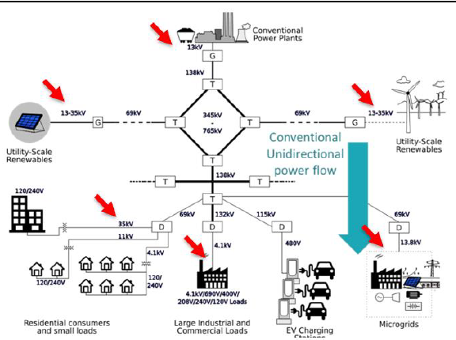
Devices and Integrated Systems Pillar - Overview
Top drivers/challenges in next 5 years
Integrated devices and systems technologies to address balance of systems costs and reliability at different power and voltage levels
Robust characterization of devices and integrated systems to meet interconnection and interoperability requirements.
Key activities
Develop, characterize, and deploy novel device-to-system level architectures to support control, protection, and grid services
Develop and deploy intelligent power electronic devices and modular designs necessary to meet power, voltage, and packaging requirements to support grid flexibility
Develop and deploy technologies at distribution and transmission scale to increase capacity, robust power flow control, and scalable renewable integration
Notes:
The electrical grid is fundamentally composed of devices physically connected together and linked by control systems and markets, which form integrated systems.
Devices: individual technologies (e.g. generation, storage, delivery, and consumption) that connect to the electric grid.
Examples include but are not limited to: PV, wind, EVs, batteries, thermal storage, capacitors, flywheels, building loads, appliances, HVAC, lighting, fuel cells, electrolyzers, CHP, engines, turbines, wires, cables, switches, transformers
Integrated systems: Networks of devices that are physically connected and linked by control systems.
Examples include but not limited to: microgrids, distribution voltage management schemes that accommodate high penetrations of PV solar and other distributed energy resources; autonomous fault location, isolation, sectionalization, and restoration systems for distribution reliability and resilience; and bulk variable generation connected to transmission systems.
This Pillar Area will develop devices and integrated systems that securely interoperate and interconnect to maintain stable grid operations while providing quantifiable benefits for grid and local energy services. It also covers the embedded controls and decision-making components of technologies that need to be designed with cybersecurity as one of the main objectives.
The main drivers and the project milestones for the pillar are: mention form the slide bullet points

Slide 10
Devices and Integrated Systems Pillar – Strategic Areas
Power Electronics
Grid-level device technologies to overcome scaling challenges in power, packaging, and thermal management.
Efficiently move electricity over long distances onshore and offshore using muti-terminal DC systems.
Energy Storage
Integrated energy storage systems through flexible control schemes
Operational architectures to increase grid reliability, resilience, and demand management
Inverters/ Distributed Energy Resources Interconnection
Innovative architectures, topologies, and integration approaches
Flexible, modular, and efficient power electronics from materials to devices and controls
Cables and Conductors & Transformers
Support HVDC/MVDC development and Grid Enhancing Technologies (GETs) to increase grid capacity
Address supply chain issues for next generation transformers through technological innovations
Codes & Standards
Accelerate industry adoption by enabling robust interoperability

Slide 11
Grid Modernization Pillar 2: Operations
Jim Follum
Pacific Northwest National Laboratory

Slide 12
Administration Goals
Decarbonization
Infrastructure Modernization
Climate Adaption and Mitigation
Equity and Energy Justice
Workforce Development
Power System
Objectives
Clean Energy Integration
Grid Infrastructure Expansion
Managing Electrification
Reliability, Resilience, and Security
Affordability
Pillars
Devices and Integrated Systems
Operations
Planning
Markets, Policies, and Regulations
Resilient and Secure Systems
Flexible Generation and Load
Power Electronics
Energy Storage
Integrated Energy Systems
Inverters/ Distributed Energy Resources Interconnection
Cables and Conductors
Transformers
Codes & Standards
Transmission & Distribution Integration
Flexible Grid Management
Sensing & Measurement
Data Analysis
Controls
Protection
Climate Adaptation and Mitigation
Data Science and Forecasting
Power System Modeling Tools
Economic Modeling
Interdependent Infrastructures
Multi-Model Integration
Behavioral Science
Policies and Regulations
Market Design
Economic Valuation
Energy Justice
Cybersecurity
Microgrids
Inter- and Intra- System Risk Assessment
Flexible Generation
Flexible Load
Hybrid Systems/ Integrated Energy Systems
Topic
Areas
Program
Types
R&D
Testing & Validation
Simulation
Demonstrations
Technical Assistance
Analysis
12

Slide 13
Operations Pillar Topic Areas
Transmission and Distribution Integration
Flexible Grid Management
Sensing and Measurement
Optimal dispatch for resource adequacy
Adaptive islanding
Self-organizing microgrids
Application of modern risk science
Probabilistic decision support
Practical architectures for wide-area waveform measurements
Fusing data from diverse sources
Controllable grid enhancing technologies
Data Analysis
Controls
Protection
High-speed control capabilities of inverters
Control of numerous and diverse assets
Addressing low fault current of IBRs
Protection for numerous and diverse assets
Synchrophasors for operations
Real-time waveform analytics

Slide 14
Connection to GMI’s Power System Objectives
Operations-support technologies are critical to many of the power system objectives such as Managing Electrification and Clean Energy Integration.
Better system operations will also support Grid Infrastructure Expansion and Reliability, Resilience, and Security.
Clean Energy Integration
Grid Infrastructure Expansion
Managing Electrification
Reliability, Resilience, and Security

Slide 15
Grid Modernization Pillar 3: Planning
Patrick Harwood
DOE – Grid Deployment Office
Webinar Presentation

Slide 16
Planning Pillar Objective
This pillar area aims to develop next-generation tools for policy analysis, grid expansion planning, and day-ahead planning and to support policy development, economic assessments, engineering design, and risk and vulnerability analyses.
The results of these tools can impact billions of dollars of capital investments and operational costs.

Slide 17
Administration Goals
Decarbonization
Infrastructure Modernization
Climate Adaption and Mitigation
Equity and Energy Justice
Workforce Development
Power System
Objectives
Clean Energy Integration
Grid Infrastructure Expansion
Managing Electrification
Reliability, Resilience, and Security
Affordability
Pillars
Devices and Integrated Systems
Operations
Planning
Markets, Policies, and Regulations
Resilient and Secure Systems
Flexible Generation and Load
Power Electronics
Energy Storage
Integrated Energy Systems
Inverters/ Distributed Energy Resources Interconnection
Cables and Conductors
Transformers
Codes & Standards
Transmission & Distribution Integration
Flexible Grid Management
Sensing & Measurement
Data Analysis
Controls
Protection
Climate Adaptation and Mitigation
Data Science and Forecasting
Power System Modeling Tools
Economic Modeling
Interdependent Infrastructures
Multi-Model Integration
Behavioral Science
Policies and Regulations
Market Design
Economic Valuation
Energy Justice
Cybersecurity
Microgrids
Inter- and Intra- System Risk Assessment
Flexible Generation
Flexible Load
Hybrid Systems/ Integrated Energy Systems
Topic
Areas
Program
Types
R&D
Testing & Validation
Simulation
Demonstrations
Technical Assistance
Analysis
17

Slide 18
Planning Pillar – Some Examples of Technical Areas
Planning under uncertainty
Capacity Expansion and Resource Adequacy Models
Climate models, extreme weather
Model fidelity and validation
Load forecasting – EVs, Data Centers, Crypto-mining, demand-side management
Distributed Energy Resources
Standardization, interoperability, and data security
Interregional model development
Electric/Gas interface
Advanced and emerging computing platforms
Algorithms and methods for scenario-based planning
Integrating Artificial Intelligence and Machine Learning methods into planning simulations
Multi-modal planning processes
Electromagnetic phenomena to capture faster dynamics
Cross-linking economic models with power system models and load models, etc.

Slide 19
Grid Modernization Pillar 4: Markets, Policies and Regulations
Todd levin
Argonne National Laboratory

Slide 20
Administration Goals
Decarbonization
Infrastructure Modernization
Climate Adaption and Mitigation
Equity and Energy Justice
Workforce Development
Power System
Objectives
Clean Energy Integration
Grid Infrastructure Expansion
Managing Electrification
Reliability, Resilience, and Security
Affordability
Pillars
Devices and Integrated Systems
Operations
Planning
Markets, Policies, and Regulations
Resilient and Secure Systems
Flexible Generation and Load
Power Electronics
Energy Storage
Integrated Energy Systems
Inverters/ Distributed Energy Resources Interconnection
Cables and Conductors
Transformers
Codes & Standards
Transmission & Distribution Integration
Flexible Grid Management
Sensing & Measurement
Data Analysis
Controls
Protection
Climate Adaptation and Mitigation
Data Science and Forecasting
Power System Modeling Tools
Economic Modeling
Interdependent Infrastructures
Multi-Model Integration
Behavioral Science
Policies and Regulations
Market Design
Economic Valuation
Energy Justice
Cybersecurity
Microgrids
Inter- and Intra- System Risk Assessment
Flexible Generation
Flexible Load
Hybrid Systems/ Integrated Energy Systems
Topic
Areas
Program
Types
R&D
Testing & Validation
Simulation
Demonstrations
Technical Assistance
Analysis
20

Slide 21
Markets, Policies, and Regulations Pillar - Key Components
Market Design
Ensure that wholesale and retail markets continue to support system reliability and are compatible with clean energy policies.
Policies and Regulations
Achieve decarbonization objectives in a reliable and cost-effective manner.
Economic Valuation
Energy Justice
Understand factors that have contributed to historical injustices in the electricity sector and establish new planning, operations, and market mechanisms to inform decision making and ensure just future outcomes.
Workforce Development
New skill sets will be needed to combine traditional system engineering with data science and behavioral science and new educational pathways and public/private partnerships are needed to foster this expertise.
Develop new approaches to assess resource value as systems evolve and market and incentive structures adapt, particularly in the context of increased electrification and growing distributed energy resource penetration.

Slide 22
Grid Modernization Initiative Pillar 5: Resilient and Secure Systems
Bobby Jeffers
National Renewable Energy Laboratory

Slide 23
Administration Goals
Decarbonization
Infrastructure Modernization
Climate Adaption and Mitigation
Equity and Energy Justice
Workforce Development
Power System
Objectives
Clean Energy Integration
Grid Infrastructure Expansion
Managing Electrification
Reliability, Resilience, and Security
Affordability
Pillars
Devices and Integrated Systems
Operations
Planning
Markets, Policies, and Regulations
Resilient and Secure Systems
Flexible Generation and Load
Power Electronics
Energy Storage
Integrated Energy Systems
Inverters/ Distributed Energy Resources Interconnection
Cables and Conductors
Transformers
Codes & Standards
Transmission & Distribution Integration
Flexible Grid Management
Sensing & Measurement
Data Analysis
Controls
Protection
Climate Adaptation and Mitigation
Data Science and Forecasting
Power System Modeling Tools
Economic Modeling
Interdependent Infrastructures
Multi-Model Integration
Behavioral Science
Policies and Regulations
Market Design
Economic Valuation
Energy Justice
Cybersecurity
Microgrids
Inter- and Intra- System Risk Assessment
Flexible Generation
Flexible Load
Hybrid Systems/ Integrated Energy Systems
Topic
Areas
Program
Types
R&D
Testing & Validation
Simulation
Demonstrations
Technical Assistance
Analysis
23

Slide 24
Cyber and Physical Security
Challenges:
Malicious cyber threats pose a significant challenge to the power grid given its physical immensity, interconnectivity, and enormous operational complexity
Physical threats have increased in frequency, impact, and diversity to include attacks using emerging technologies like unmanned aerial vehicles and consumer-grade drones
Strategies:
Advance the sophistication of national-level exercises to provide an opportunity for electric utilities to demonstrate their response and recovery actions to a hypothetical coordinated cyber and physical attack
Not all utilities are equipped with the resources and knowledge to address threats from higher tier adversaries, so partnerships with government entities is essential to thwart the full spectrum of attacks

Slide 25
Integrated Risk Assessment
What is the likelihood or difficulty of threats that can impact grid components?
When the grid is subject to the threat, how likely are systems to be significantly compromised?
When systems are compromised, what are the consequences to various entities?
RISK
Threat
Vulnerability
Consequence
Challenges:
Our current standard measures of reliability and accepted planning and operational practices do not sufficiently address the increasing complexity and interconnectedness of risks to the system.
Strategies:
Intra-system risk assessment allows deep and precise analysis of risks, while inter-system risk assessment captures feedback and interdependencies at a more holistic level. These complementary risk assessment methods focus on the probability versus consequences of major outages and other failures that involve the grid.

Slide 26
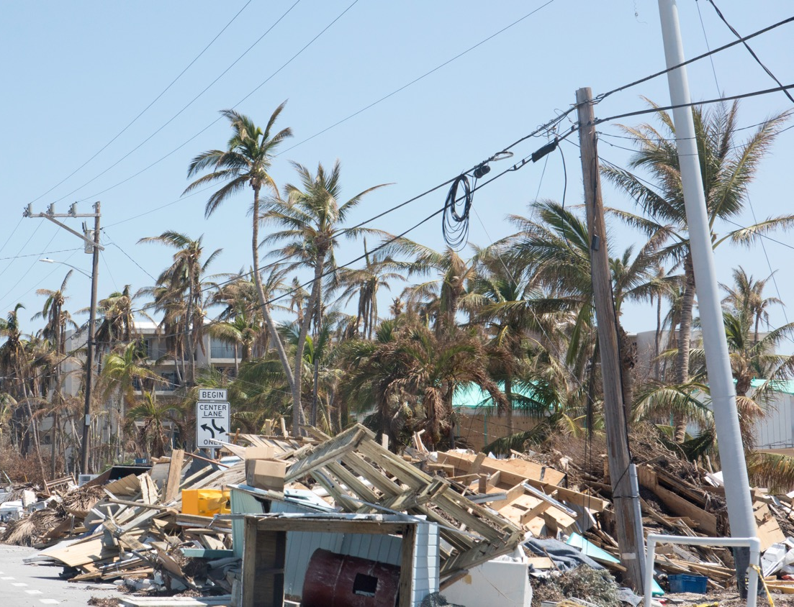
Enhancing Emergency Operation and Response
Challenges:
Situation awareness, emergency operations, response, and recovery are all challenged as we move to a more unpredictable and complex system.
Strategies:
Carefully adopting and integrating increased autonomy, while enabling operators, responders, and other critical personnel can lead to a self healing system of systems. Microgrids are a key building block for this strategy.
Enhanced approaches to cyber resilience that focus on recovery and restoration periods are needed.

Slide 27
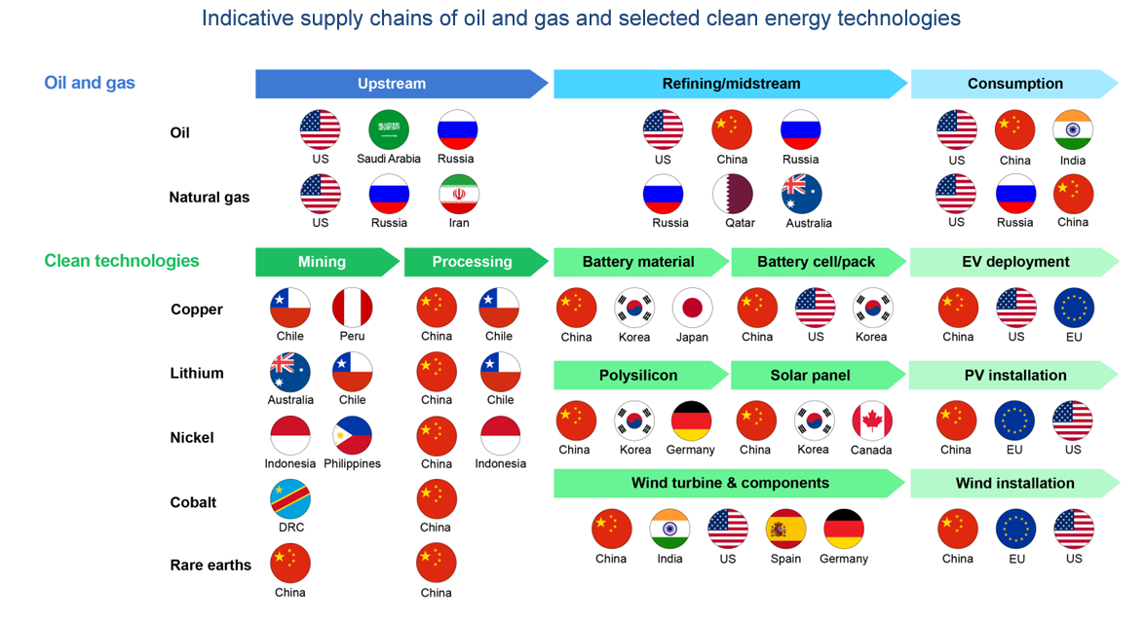
Energy Security and Supply Chains
Challenges:
As we transition to a decarbonized economy, it is expected that the grid will become more interdependent with national economic activity. As such, there is a renewed need to address our Nation’s long-term Energy Security which can be enabled by grid modernization.
Strategies:
Maintaining affordable access to energy by deeply understanding technology life cycle and supply chain risks, while concurrently incorporating the risks of acute shocks, requires new integrated analytical capabilities and technologies.

Slide 28
Grid Modernization Initiative Pillar 6: Flexible Generation and Load
Ning Kang
Idaho National Laboratory

Slide 29
Flexible Generation and Load Pillar - Overview
Objective
Enable and maximize flexibility in energy generation and load that can respond to variability and uncertainty of conditions at multiple temporal and spatial scales for a range of energy futures.
Motivation
Wind and solar generation introduces more variability and uncertainty.
New loads and DERs impact the bulk system by increasing load variation and uncertainty in forecasting net load at multiple timescales.
Hazards such as weather events, potential cyber and physical threats, and other global events increase in frequency and severity.
The aging electric infrastructure poses high probability of failures and interruptions in electricity delivery.

Slide 30
Administration Goals
Decarbonization
Infrastructure Modernization
Climate Adaption and Mitigation
Equity and Energy Justice
Workforce Development
Power System
Objectives
Clean Energy Integration
Grid Infrastructure Expansion
Managing Electrification
Reliability, Resilience, and Security
Affordability
Pillars
Devices and Integrated Systems
Operations
Planning
Markets, Policies, and Regulations
Resilient and Secure Systems
Flexible Generation and Load
Power Electronics
Energy Storage
Integrated Energy Systems
Inverters/ Distributed Energy Resources Interconnection
Cables and Conductors
Transformers
Codes & Standards
Transmission & Distribution Integration
Flexible Grid Management
Sensing & Measurement
Data Analysis
Controls
Protection
Climate Adaptation and Mitigation
Data Science and Forecasting
Power System Modeling Tools
Economic Modeling
Interdependent Infrastructures
Multi-Model Integration
Behavioral Science
Policies and Regulations
Market Design
Economic Valuation
Energy Justice
Cybersecurity
Microgrids
Inter- and Intra- System Risk Assessment
Flexible Generation
Flexible Load
Hybrid Systems/ Integrated Energy Systems
Topic
Areas
Program
Types
R&D
Testing & Validation
Simulation
Demonstrations
Technical Assistance
Analysis
30

Slide 31
Flexible Generation and Load Pillar – Topic Areas
Flexible generation
Encompass all types of generation resources that can provide flexibility, connected at various levels of the T&D system, in front of or behind the meter.
Flexible load
Traditionally-passive consumption devices are evolving to smartly respond to grid conditions.
There are opportunities to utilize more flexible load to support grid operations and planning.
Hybrid Energy Systems
An emerging solution that can enable greater flexibility, reliability, economics, and efficiency than independent alternatives by pairing multiple physically co-located or separate generation, energy storage, or load processes using an overarching control framework.

Slide 32
Thank you for attending the Grid Modernization Initiative Strategy Webinar!
GMI Website (for a copy of the strategy and FAQs following the webinar): https://www.energy.gov/gmi/grid-modernization-initiative
GMLC Website: https://gmlc.doe.gov/index.php/
If you have questions or follow-up items after the webinar, please email GMI@hq.doe.gov

