Slide 1
ITI & DOE Ex Parte Meeting
Energy Conservation Standards for External Power Supplies and Battery Chargers

Slide 2
Agenda
Single-Voltage Adaptive Power Supplies Engineering Analysis
Multiple-Voltage Adaptive Power Supplies
Low Voltage
No Load
Engineering Analysis
New Appendix Z Cable Testing Protocol
Battery Chargers - Data Availability

Slide 3
External Power Supplies
Definitions
Type | Definition | Sub Category | Example
Single Voltage AC-DC Power Supply | means an external power supply that is designed to convert line voltage AC input into lower-voltage DC output and is able to convert to only one DC output voltage at a time | Basic Voltage >= 6V
 |  | Low Voltage <= 6V | USB-A
Multiple-Voltage External Power Supply | means an external power supply that is designed to convert line voltage AC input into more than one simultaneous lower-voltage output. | N/A
Type | Definition | Sub Category | Example
Adaptive Power Supply | means an external power supply that can alter its output voltage during active-mode based on an established digital communication protocol with the end-use application without any user-generated action. | Adaptive Single-Voltage | USB-PD
 |  | Adaptive Multiple-Voltage
1
DOE Maintains two CCD Databases for power supplies.

Slide 4
Single-Voltage Adaptive Power Supplies
Engineering Analysis Data
DOE’s Market Analysis makes use of only one of two databases and does not appear to consider or evaluate future compliance rates for adaptive supplies.
Yet, adaptive supplies contain different components and must operate at a wider range of voltages. They also contain controllers that consume a material amount of power in no-load.
DOE should expand its Engineering Analysis and include the contents of the Single-Voltage Adaptive Power Supply database or clarify that adaptive supplies are out of scope.
1
1. 2023-01. Technical Support Document: Energy Efficiency Program for Consumer Products and Commercial and Industrial Equipment: External Power Supplies. EERE-2020-BT-STD-0006-0026. Last Accessed February 12th, 2024. Page 5-3. https://www.regulations.gov/document/EERE-2020-BT-STD-0006-0026

Slide 5
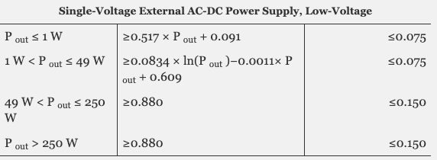
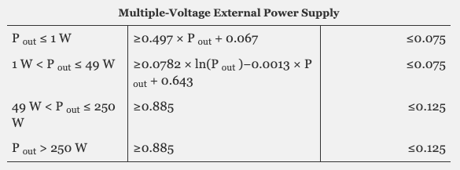
Adaptive Multiple-Voltage Power Supplies
Low Voltage Test Point
Proposed Single-Voltage Power Supply Low Voltage Standards
In 2022, DOE stated that Adaptive Multiple-Voltage Power Supplies must be tested twice, once at the Highest Voltage, and once at the Lowest Voltage.²
However, DOE’s Engineering Analyst does not appear to include any data for these supplies operating at the Lowest Voltage—making standards arbitrary.
Further, Adaptive Multiple-Voltage Power Supplies are not required to disclose their performance at the lowest voltage per the DOE’s current certification requirements.³
Finally, Low-Voltage requirements for Adaptive Multiple-Voltage Power Supplies are inexplicably more strict than equivalent requirements for Single-Voltage Power Supplies despite additional components in Multiple-Voltage Power Supplies.
1
Proposed Multiple-Voltage Power Supply Standards
Table: Comparing Requirements at Lowest Voltage
 | Current | Proposed
Single-Voltage USB-PD EPS at Lowest Voltage (5V, 2A, 10W) | 78.7% | 79.0%
Multiple-Voltage USB-PD EPS at Lowest Voltage (5V, 2A, 10W) | 73.4% | 81.0%
-5.3%
+2%
2. 87 FR 51200, 51209
3. Id. Surprisingly, DOE declined to make a conforming change to certification requirements without a justification.

Slide 6
Adaptive Multiple-Voltage Power Supplies
No-Load Test Point
Proposed Single-Voltage Power Supply No-Load Standards
In 2023, ITI highlighted concerns with no-load standards for Multiple-Voltage supplies.
ITI advocated for a “per port” allowance for no-load requirements because USB-PD controllers require am minimum amount of power to monitor for safety.
We additionally highlight that the standards for Multiple-Voltage Power Supplies are more strict⁴ than the standards for Single-Voltage Power Supplies.
Yet, because 1 Multiple-Voltage Power Supply can replace 2 Single-Voltage Power Supplies, energy would be saved on the whole even if DOE adopts standards less strict than proposed.
1
Proposed Multiple-Voltage Power Supply No-Load Standards
4. In an email comment from July 2023, Erhuan Zhang highlights this point.
Zhang, Erhuan, “DOE VII proposal.” Received by EPS2020STD0006@ee.doe.gov, July 4 2023. EERE-2020-BT-STD-0006-0045. Last accessed on February 12, 2024, https://www.regulations.gov/comment/EERE-2020-BT-STD-0006-0045

Slide 7
Adaptive Multiple-Voltage Power Supplies
Stale and Deficient Data
DOE’s reliance on stale data from 2019 overlooks crucial clarifications to the test method for multiple-output bus supplies that were introduced in 2022, potentially compromising the relevance and accuracy of the Engineering Analysis.
Despite acknowledging deficiencies within the CCD, DOE applied this insight only narrowly, focusing only on excluding those identified unrepresentative units.
Yet, multiple unrepresentative units among a small sample suggests a significant probability of widespread inaccuracies within the entire database, a consideration that should be assessed.
Given the potential volume of data inaccuracies, DOE should reconduct its analysis using data subjected to the clarified test procedures established in 2022.
1
“DOE initially identified 10 representative units, one for each EL at each power level, but observed that the tested active mode efficiency and no-load power for some of these representative units did not match their certified values in the CCD nor the requirements of the EL they were meant to represent. In these instances, DOE discarded the test results […]”
5. Technical Support Document, External Power Supplies at p 5-25.

Slide 8
Adaptive Multiple-Voltage Power Supplies
Practical Effect on USB-PD supplies
Output Type | Compliant with Proposed Standards | Non-Compliant with Proposed Standards
x 2 Custom Ports |  | 1
1 USB-A + 1 other | 1 | 9
1 USB-A + 1 USB-PD | 18 | 56
1 USB-A + 2 USB-PD | 1 | 26
1 USB-A + 3 USB-PD | 1 | 5
1 USB-A + 4 USB-PD | 0 | 1
2 USB-A + 1 USB-PD | 1 | 27
2 USB-A + 2 USB-PD | 1 | 14
2 USB-A + 4 USB-PD | 0 | 1
2 USB-PD | 0 | 44
3 USB-A + 1 USB-PD | 0 | 4
3 USB-A + 1 USB-PD x 1 Custom Port | 0 | 1
3 USB-PD | 1 | 3
4 USB-A + 1 USB-PD | 0 | 2
4 USB-A + 3 USB-PD | 0 | 1
4 USB-C | 0 | 1
Grand Total | 24 | 196
Practically, DOE’s standards put at serious risk the availability of multi-port USB-PD power supplies.
To arrive at this conclusion, ITI downloaded DOE’s databases and manually identified the output type of 202 Multiple-Voltage Power Supplies.
Of those identified, 0/44 dual port USB-PD external power supplies meet future proposed standards.^{6, 7}
Notably, the vast majority of supplies complying with the proposed requirements are those with both USB-A and a USB-PD outputs, limiting consumer choice.
1
6. ‘Meeting future standards’ means that the External Power Supply meets both the proposed efficiency and no-load requirements; if power supplies did not optionally declare efficiency requirements at the lowest-voltage they were assumed to comply.
7. Duplicates or identical registrations under different brands were not removed, but if they were, of 28 potentially unique dual port USB-C supplies, none would comply.

Slide 9
External Power Supplies
Effect of Cable Losses
The DOE did not consider changes made to the testing cable selection criteria in Appendix Z when proposing standards.
DOE acknowledges cable selection is important,⁸ yet does not appear to validate whether it is possible to comply with proposed standards when testing with a “cord with a conductor thickness that is minimally sufficient to carry the maximum required current” nor does DOE adjust standards as appropriate.
By way of example, moving from a 170mΩ cable to a 250 mΩ cable increases cable losses by 47%, or 1.5% average efficiency at the mandatory 5V test point—more than the 0.3% improvements in efficiency the proposed for Single-Voltage Adaptive Supplies at the Lowest Voltage.
Given the uncertainty in the effect of the change in test method on standards, DOE should undertake a survey of the market for cable resistance or collect cable specifications as a part of certification data prior to issuance of a final rule.
Cable Selection Criteria. [New Updates in Blue]
(g) […] If a separate wire or cord is provided by the manufacturer to connect the external power supply to an end-use product, use this wire or cord and perform tests at the end of the cord that connects to an end-use product. An external power supply that is not supplied with a wire or cord must be tested with a wire or an output cord recommended by the manufacturer. If the external power supply is not supplied with a wire or cord and for which the manufacturer does not recommend one, the EPS must be tested with a 3-foot-long output wire or cord with a conductor thickness that s minimally sufficient to carry the maximum required current.
10 CFR Appendix Z to subpart 430 § 2(g)
8. 80 FR 51424, 51429

Slide 10
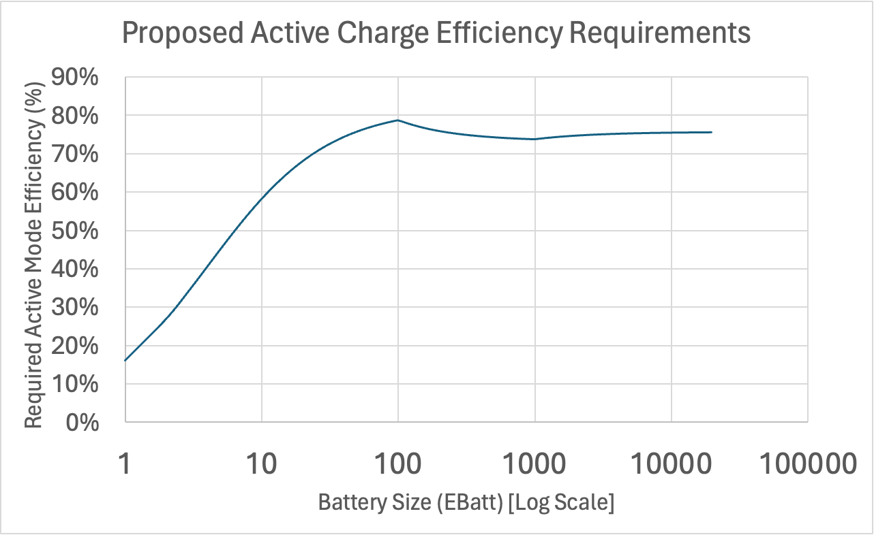
Battery Chargers
Data Availability & Omitted Considerations
ITI believes that the strict requirements on batteries above 20Wh and below 100Wh relative to batteries below 20Wh are unsupported by data.
ITI continues to not have a meaningful ability to respond to DOE’s engineering analysis because of DOE’s lack of specificity therein.
For example, the Engineering Analysis states that DOE “manually removed chargers with negligible power draw in no-battery mode form the CCD dataset used in this analysis.”
Here, it is unclear what qualifies as “negligible”. i.e. 0, 0.1 W, 0.01 W, 0.001 W, or 0.001W?
ITI also believes that DOE did not consider some of the trade-offs with efficiency, such as battery longevity, or optimized battery discharge energy paths. If a device with an integral battery is extremely efficient when charging but highly wasteful during discharge, the DOE’s new standards do not actually promote energy savings.

Slide 11
Thank you

