Slide 1
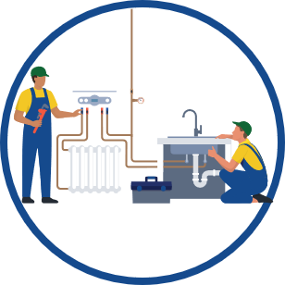
How to Get a Home Efficiency Rebate
Home Efficiency Rebates provide discounts on household upgrades that can lower monthly utility bills while improving the comfort of your home.
Home Efficiency Rebates are recommended when you are installing multiple upgrades to meaningfully reduce your household’s energy usage.*
You can save up to $8,000* on upgrades such as:
ENERGY STAR-certified heating and cooling
ENERGY STAR-certified water heaters
Insulation
Air sealing
Duct sealing
Appliances
Lighting
Sophia wants to save money on her energy bills.
Verify Eligibility
Sophia visits her state’s website and enters her household details. (Renters must include owner’s approval.)
Find a Qualified Contractor
Sophia visits her state's website to find a contractor who can provide a proposal.
Complete Home Assessment
The contractor completes a home assessment to capture Sophia's current energy usage and provides a list of recommended upgrades.
Plan Upgrades
Sophia works with the contractor to select upgrades to reduce her home’s energy usage.
Install Upgrades
After receiving the state’s approval on Sophia’s rebate, the contractor completes the installation and subtracts the rebate amount from her invoice.
*Check your state energy office’s website for more information. Rebate amounts vary depending on your household income and project’s energy savings.
Enjoy Cost Savings
Sophia immediately enjoys the cost savings from her home’s reduced energy usage.

