Slide 1
Renew America’s Schools Media Promotion Toolkit FY24 Prize March 20, 2024

Slide 2
WELCOME!
The U.S. Department of Energy (DOE) is excited to announce that applications are open for the second round of funding from the Renew America’s Schools Program.
This document will equip you with tools to amplify the news through various communication methods and platforms.

Slide 3
About the Prize
The 2024 Renew America’s Schools Prize is the second round of funding from the $500 million Renew America’s Schools Program, which aims to help K-12 public schools across the country make energy improvements that…
Improve air quality and occupant comfort, creating healthier and safer classrooms that support student learning.
Reduce energy use and energy costs, generating sustainable savings that can be redirected towards educational initiatives.
Lower emissions, reducing community exposure to pollutants and putting America on a path to a net-zero energy economy by 2050.
Promote Science, Technology, Engineering, and Math (STEM) education, Career and Technical Education (CTE), and workforce development, creating a pipeline of employees prepared for a clean energy future.
The 2024 Renew America's Schools Prize will invest an anticipated $180 million in school facilities that demonstrate the need for both energy improvements and financing, with a focus on Local Educational Agencies (LEAs) that qualify as disadvantaged and/or rural.
The 2024 Renew America’s Schools Prize iterates on the previous opportunity and furthers DOE’s commitment to school communities.
The 2024 Prize promotes partnerships between school districts and industry experts, encouraging the formation of stakeholder support networks that can help LEAs build internal capacity and seek access to additional financing.
By prioritizing applications that leverage third-party investments, DOE is enhancing the impact of federal funds and ensuring that more LEAs have access to federal support.
Submissions for the 2024 Renew America’s Schools Prize are due on Thursday, June 13 at 5PM ET.

Slide 4
About the Prize
Using an innovative prize-to-cooperative agreement funding mechanism, the 2024 Renew America’s Schools Prize will…
Streamline the application process for federal awards, lowering barriers to entry and increasing the accessibility of funds.
Provide LEAs earlier, more targeted supports during planning and implementation.
Encourage the formation of strategic partnerships for planning and financing, with the goal of stimulating investments in energy infrastructure across the K-12 sector, forging pathways and creating replicable models for districts across the country.
Competitive submissions will establish the need for both energy improvements and financing across the proposed portfolio; demonstrate overall team capacity to manage projects across the portfolio; propose a comprehensive plan for executing Phase 2 (energy auditing and design) activities; engage in replicable, strategic partnerships to build capacity at LEAs/across the K-12 sector while leveraging funds to enhance the impact of federal dollars; and establish a strategic approach to delivering community benefits.
Eligible improvements include energy infrastructure improvements that reduce building operating costs—like new HVAC and ventilation systems, building envelope and lighting projects, and renewable energy technologies. Funding is also available for alternative fueled vehicles and alternative fueled vehicle infrastructure.
During Phase 1, competitors will build a team and curate a list of proposed schools/school facilities that demonstrate both need and eligibility for investment. DOE will prioritize applications that demonstrate replicable partnership models, enhance the impact of federal funds, allow federal dollars to make their way into more communities, and stimulate further investments in the K-12 energy sector.
Phase 1 Winners will earn a cash prize of $300,000.
During Phases 2 and 3, Phase 1 Prize Winners will enter and execute Cooperative Agreements with DOE.
Awards made in Phases 2 and 3 will vary by portfolio size but could range from $7.5 to $15 million; DOE will issue the largest awards to portfolios serving 20 or more schools/school facilities, offering a total of $15,300,000 to Winners in this category for completing all three phases.

Slide 5
Press release
Click here to read:
Biden-Harris Administration Announces $180 Million Investment in School Energy Infrastructure as Part of Investing in America Agenda

Slide 6
HOW CAN YOU USE THESE MATERIALS?
Share the information in this toolkit with your community by…
Posting content about the Prize on your website
Distributing the information through newsletters
Emailing your stakeholders or shareholders
Engaging with and amplifying the 2024 Prize announcement on social media (Twitter, Facebook, LinkedIn, Instagram), using #RenewAmericasSchools
Photo Credit: Unsplash/Mimi Thian

Slide 7
KNOW A PROSPECTIVE COMPETITOR?
Encourage them to…
Read the 2024 Prize Rules and learn how to apply on the HeroX website.
Stay tuned to the Renew America’s Schools website for additional tools and resources.
Add your email HERE to receive updates about the Renew America’s Schools Program.
Read DOE’s Press Release.

Slide 8
Social media websites & handles
Below are social media addresses and handles to assist in cross-promoting the announcements with stakeholder organizations and entities. Follow these channels to stay up-to-date!
Account | Facebook | Twitter | Instagram | LinkedIn
DOE | https://www.facebook.com/energy @energy | https://twitter.com/ENERGY @ENERGY | https://www.instagram.com/energy @energy | https://www.linkedin.com/company/u-s--department-of-energy/
DOE Office of State and Community Energy Programs & Office of Infrastructure |  | https://twitter.com/ENERGYDeploy @ENERGYDeploy |  | https://www.linkedin.com/company/office-of-state-and-community-energy-programs (SCEP)
Prize | Website | Twitter | HeroX Site | YouTube
American-Made Challenges | https://www.americanmadechallenges.org/challenges/energy-class/ | https://twitter.com/AMCprizes @AMCprizes | https://www.herox.com/energy-class | https://www.youtube.com/channel/UCE1idCSIBk-jmiH-78fw9rw
NREL | http://facebook.com/nationalrenewableenergylab | https://twitter.com/NREL @NREL | https://www.instagram.com/nationalrenewableenergylab/ @nationalrenewableenergylab | https://www.linkedin.com/company/national-renewable-energy-laboratory

Slide 9
Social media content to amplify
On the following slides, you will find sample social media posts. Please use them as inspiration to write your own, or simply share/retweet from the accounts listed on the previous slide to your own platform. If you choose to share/retweet, you will have the option to craft a more personalized message in addition to what’s already been published.

Slide 10
Twitter: Sample content
Option 1: 📢 #RenewAmericasSchools is now accepting submissions for its second round of funding!! This $180M from @ENERGY will help K-12 public schools implement infrastructure upgrades that support student learning & health, while decreasing energy costs. https://tinyurl.com/3w9fyc5d
Option 2:💰Need assistance funding energy upgrades at your local public school? @ENERGY just opened applications for the #RenewAmericasSchools Prize, totaling $180M. Build a team and start an application today! https://tinyurl.com/3w9fyc5d

Slide 11
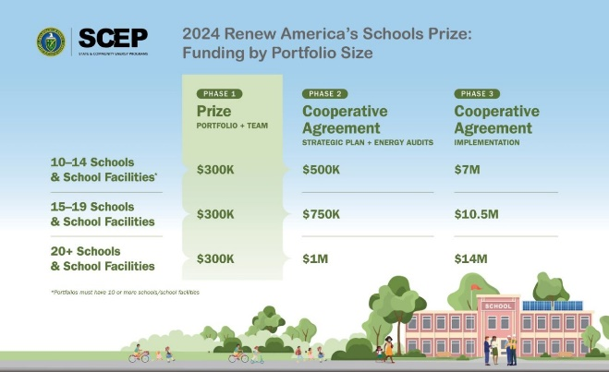
LinkedIn or Facebook: Sample Content
📢 Exciting News for K-12 Public Schools: Applications are now open for the 2024 Renew America’s Schools Prize, a $180 million investment in local educational agencies (LEAs) funded by President Biden’s Bipartisan Infrastructure Law and implemented by the U.S. Department of Energy (DOE). The 2024 Prize is the second round of funding from the $500 million Renew America’s Schools Program, which aims to help school communities make high-impact infrastructure upgrades to lower utilities costs, improve indoor air quality, and foster healthier learning environments.
The three-phase opportunity will help LEAs build capacity, perform energy audits, and plan/implement energy improvement projects across a portfolio of 10 or more school facilities.
Competitive submissions will establish the need for both energy improvements and financing across the proposed portfolio; demonstrate overall team capacity to manage projects across the portfolio; propose a comprehensive plan for executing Phase 2 (energy auditing and design) activities; engage in replicable, strategic partnerships to build capacity at LEAs/across the K-12 sector while leveraging funds to enhance the impact of federal dollars; and establish a strategic approach to delivering community benefits.
Ready to apply? Head to HeroX to read the Rules Document; find information about helpful webinars, Office hours, and the DOE Schools Teaming Partner List; and to start an application.
Want more information? Visit the Renew America’s Schools program website.
Suggested image to
accompany post: Slide 17

Slide 12
Newsletter or blog: Sample content
On March 20, 2024, the U.S. Department of Energy (DOE), through the Office of State and Community Energy Programs (SCEP), announced that applications are open for the 2024 Renew America’s Schools Prize, a $180 million investment in the K-12 energy sector which aims to help school communities make high-impact infrastructure upgrades to lower energy use and costs, improve indoor air quality, and foster healthy learning environments in their facilities. Funded by President Biden’s Bipartisan Infrastructure Law, the 2024 Prize is the second round of funding from the $500 million Renew America’s Schools Program and iterates on the success of the previous Renew America’s Schools grant by delivering an innovative prize-to-cooperative agreement model that will make federal funds more accessible to high-need districts, and provide them earlier, more targeted supports during project planning and implementation.
The 2024 Renew America’s Schools Prize consists of three phases. During Phase 1, competitors will build teams and curate lists of at least 10 schools/school facilities that demonstrate compelling need and eligibility for investment. Competitive submissions will…
Establish the need for both energy improvements and financing across the proposed portfolio;
Demonstrate overall team capacity to manage projects across the portfolio;
Propose a comprehensive plan for executing Phase 2 (energy auditing and design) activities;
Engage in replicable, strategic partnerships to build capacity at school districts/across the K-12 sector, while leveraging funds to enhance the impact of federal dollars;
Establish a strategic approach to delivering community benefits that advance the following goals: 1) community and labor engagement; 2) investing in job quality and workforce continuity; 3) advancing diversity, equity, inclusion, and accessibility (DEIA); and 4) contributing to the Justice40 Initiative.
Phase 1 Winners will earn a cash prize of $300,000 and move on to Phases 2 and 3, during which they will enter and execute Cooperative Agreements with DOE. Awards made in Phases 2 and 3 will vary by portfolio size but could range from $7.5 million to $15 million. Funded improvements – like new HVAC and ventilation systems, building envelope and lighting projects, and alternative fuel and renewable energy technologies – will result in improved health outcomes, energy savings, and/or energy cost savings.
Click here to read the Rules document; find information about helpful webinars, Office hours, and the DOE Schools Teaming Partner List; and to start an application. For more information, visit the Renew America's Schools Program website.

Slide 13
Email Blast or Letter: Sample content
📢 [Insert organization name] is thrilled to share that the U.S. Department of Energy (DOE) has opened applications for the $180 million Renew America’s Schools Prize, which will fund energy assessments and building improvements at K-12 public schools across America. The 2024 Prize calls on Local Educational Agencies (LEAs) and their stakeholders to form partnerships, build portfolios of school facilities in need of investment, and develop strategic plans for pursuing infrastructure upgrades that will improve indoor air quality, build healthier learning environments, and improve overall energy performance – reducing energy use and costs.
What should you know?
Competitive submissions will establish the need for both energy improvements and financing across a portfolio of 10 or more schools and/or school facilities; demonstrate overall team capacity to manage projects across the portfolio; propose a comprehensive plan for executing Phase 2 (energy auditing and design) activities; engage in replicable, strategic partnerships to build capacity at LEAs/across the K-12 sector while leveraging funds to enhance the impact of federal dollars; and establish a strategic approach to delivering community benefits.
The 2024 Renew America’s Schools Prize utilizes a prize-to-cooperative-agreement model to make federal funds more accessible to high-need districts, and to provide them earlier, more targeted supports during project planning and implementation.
Prize winners can earn between $7.8 and $15.3 million across three phases, depending on the number of school facilities they plan to improve.
DOE will prioritize applications that serve schools with a high percentage of students eligible for a free or reduced-price lunch /or are designated as rural. Eligible improvements – like new HVAC and ventilation systems, building envelope and lighting projects, and alternative fuel and renewable energy technologies – will result in improved health outcomes, energy savings, and/or energy cost savings.
At [insert organization name], we believe all children deserve to learn in clean, safe buildings that support their learning. We know that schools can and should be leaders in the energy transition, and we are proud to promote this opportunity.
Join us in getting the word out to prospective applicants! Click here to read the Rules document; find information about helpful webinars, Office hours, and the DOE Schools Teaming Partner List; and to start an application. For more information, visit the Renew America's Schools Program website.
Suggested image to
accompany email: Slide 17

Slide 14
images for promotional use
Below are approved visual assets for use in promoting the programs on social media and communications materials.
3792 x 2133

Slide 15
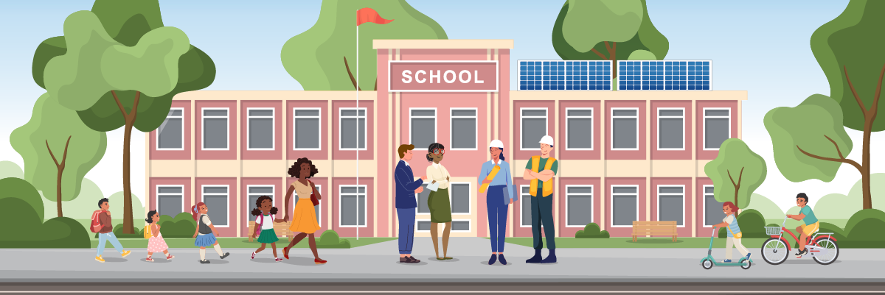
images for promotional use
Below are approved visual assets for use in promoting the programs on social media and communications materials.
1200 x 400

Slide 16
images for promotional use, CONT’D
Below are approved visual assets for use in promoting the programs on social media and communications materials.
859 x 409

Slide 17
images for promotional use, CONT’D
Below are approved visual assets for use in promoting the programs on social media and communications materials.
1297 x 794 (Funding by Portfolio Size graphic with title, school)

Slide 18
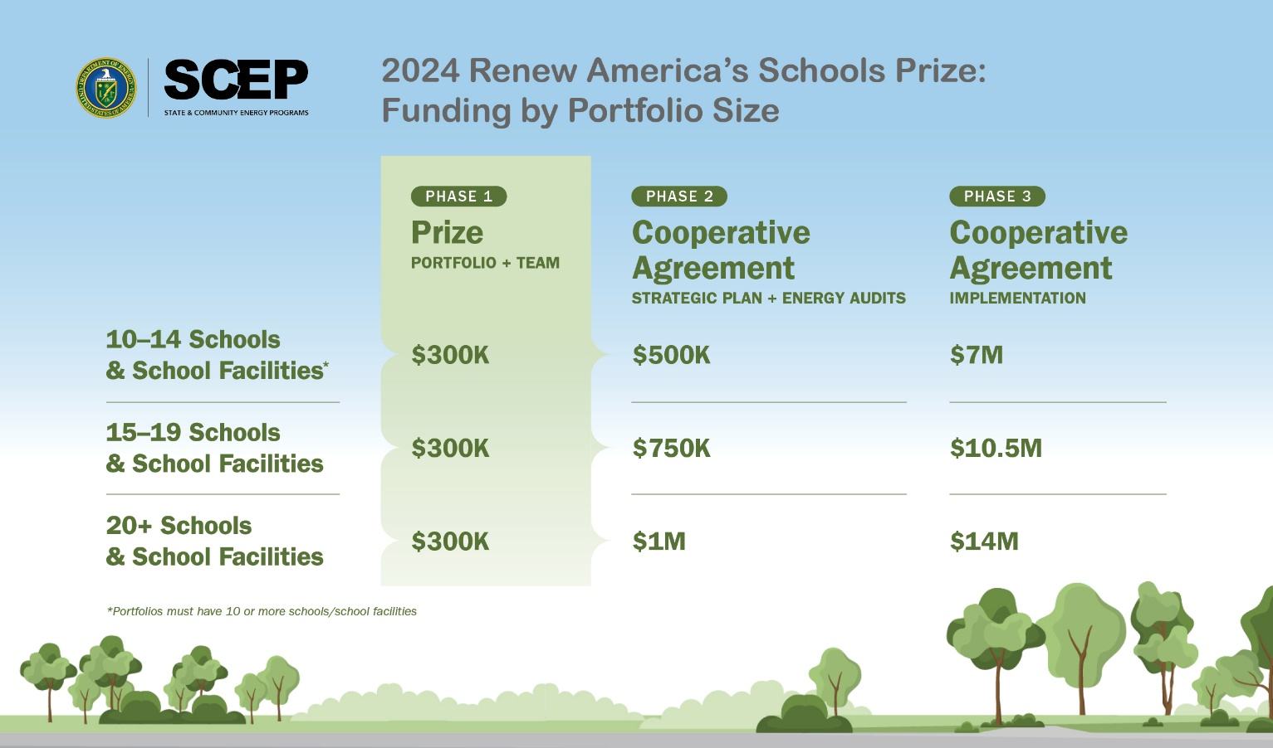
images for promotional use, CONT’D
Below are approved visual assets for use in promoting the programs on social media and communications materials.
2550 x 1500 (Funding by Portfolio Size graphic with title, trees)

Slide 19
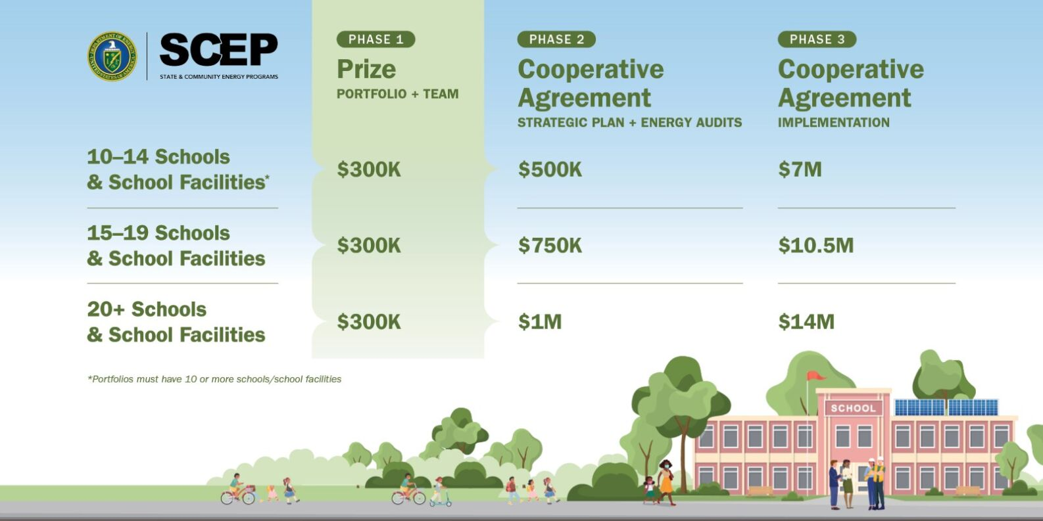
images for promotional use, CONT’D
Below are approved visual assets for use in promoting the programs on social media and communications materials.
1586 x 793 (Funding by Portfolio Size graphic without title, school)

Slide 20
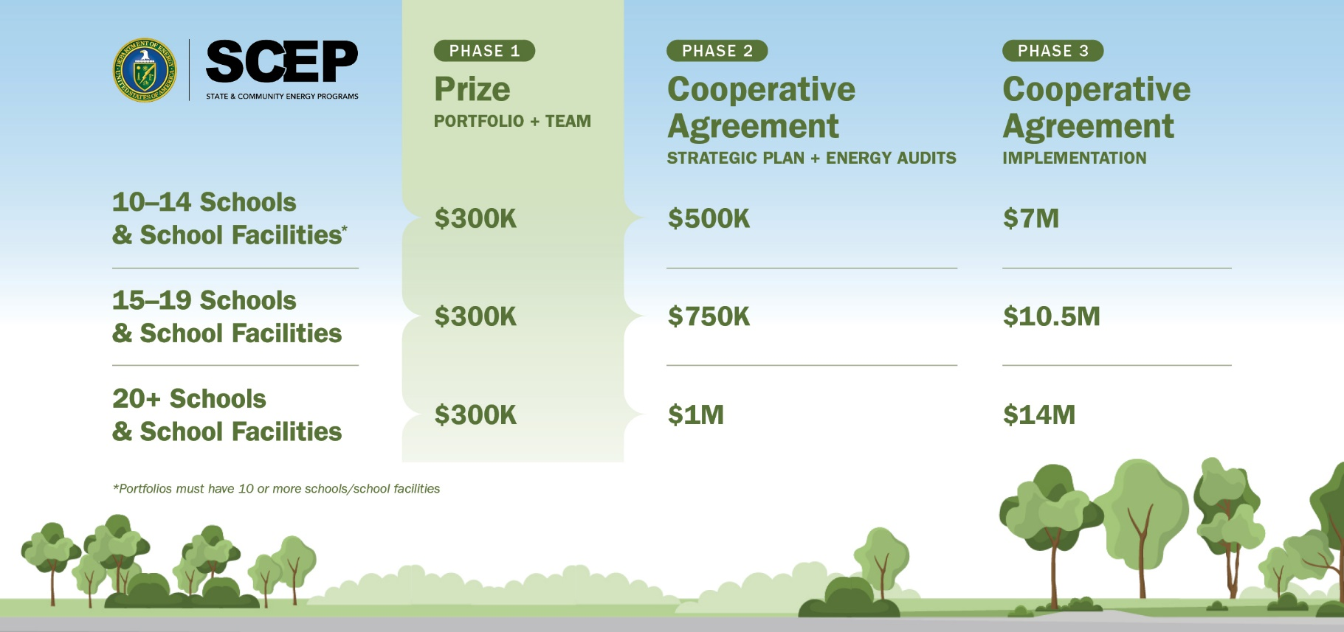
images for promotional use, CONT’D
Below are approved visual assets for use in promoting the programs on social media and communications materials.
2550 x 1200 (Funding by Portfolio Size graphic without title, trees)

Slide 21
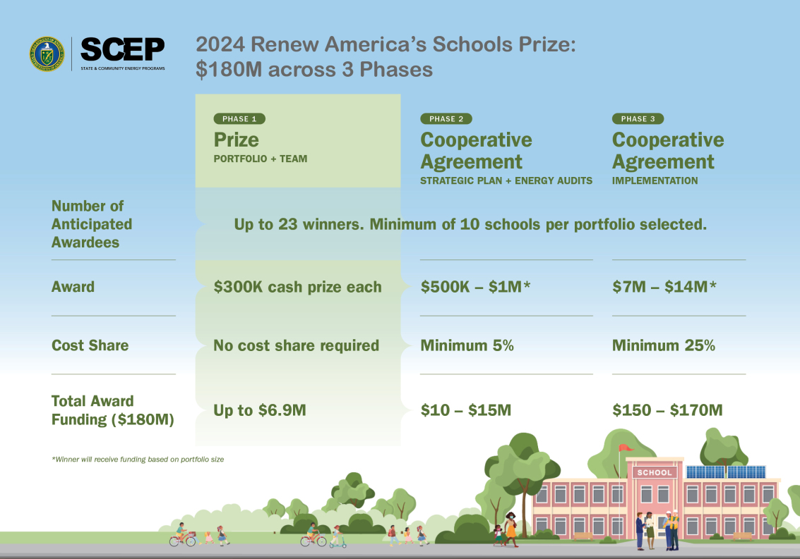
images for promotional use, CONT’D
Below are approved visual assets for use in promoting the programs on social media and communications materials.
1133 x 793 ($180M over 3 Phases with title, school)

Slide 22
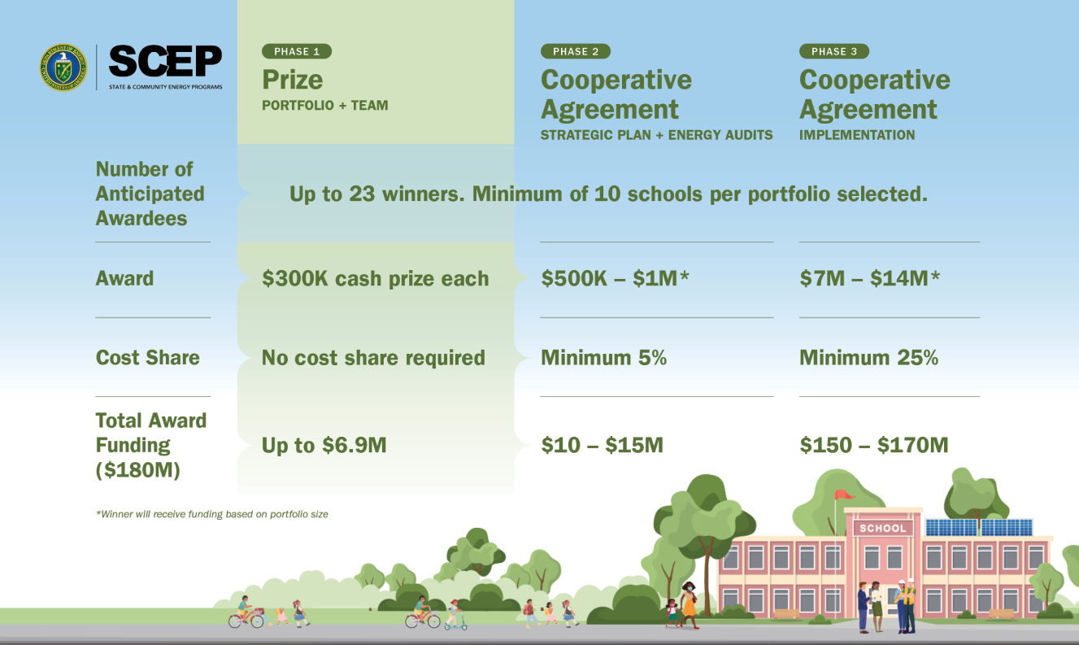
images for promotional use, CONT’D
Below are approved visual assets for use in promoting the programs on social media and communications materials.
1327 x 793 ($180M over 3 Phases without title, school)

Slide 23
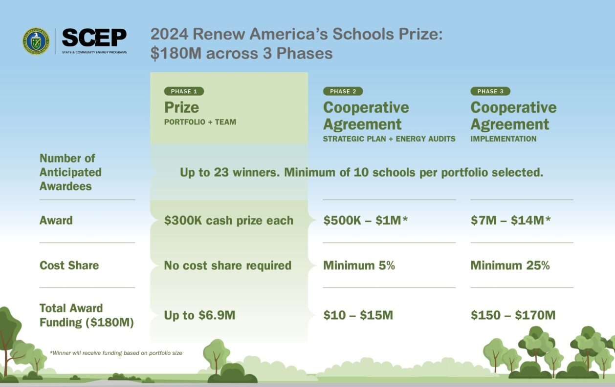
images for promotional use, CONT’D
Below are approved visual assets for use in promoting the programs on social media and communications materials.
1258 x 793 ($180M over 3 Phases with title, trees)

Slide 24
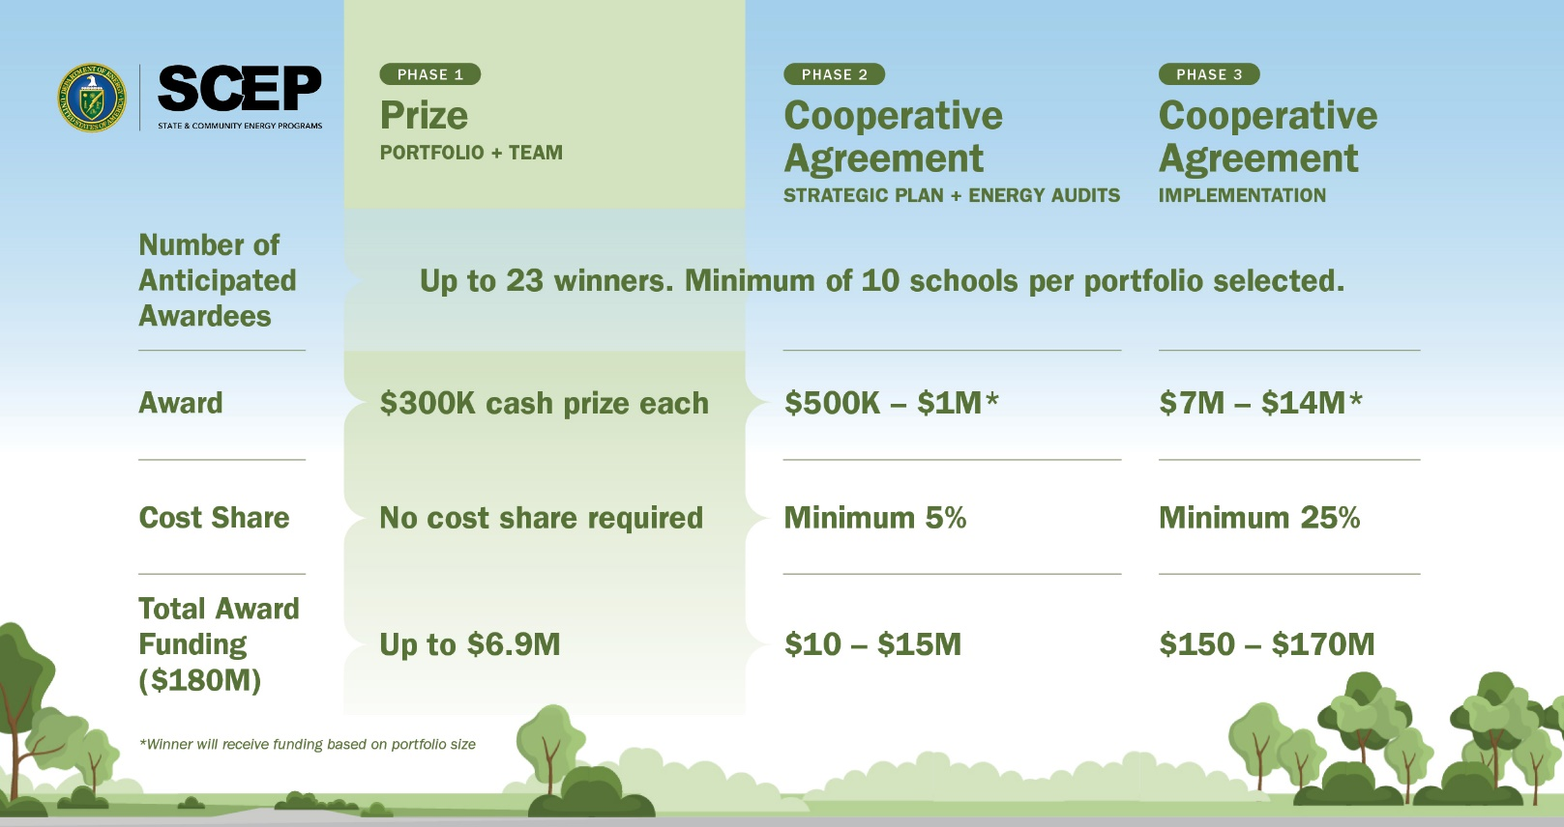
images for promotional use, CONT’D
Below are approved visual assets for use in promoting the programs on social media and communications materials.
2550 x 1350 ($180M over 3 Phases without title, trees)

Slide 25
KEY RESOURCES
To learn more about the Renew America’s Schools Program, please view the:
SCEP | Renew America's Schools Website
Check out our Fact Sheet
Check out our Public Q&A Spreadsheet
To start or view an application, visit the HeroX website.
If you have any questions that are not covered in the previous pages, please contact us at Schools@doe.gov.
Photo Credit: Unsplash/Desola Lanre-Ologun

