Slide 1
Decarbonizing America’s Industrial Sector in 2024 and Beyond
Dr. Avi Shultz, Director,
Industrial Efficiency and Decarbonization Office
Nov. 17, 2023

Slide 2
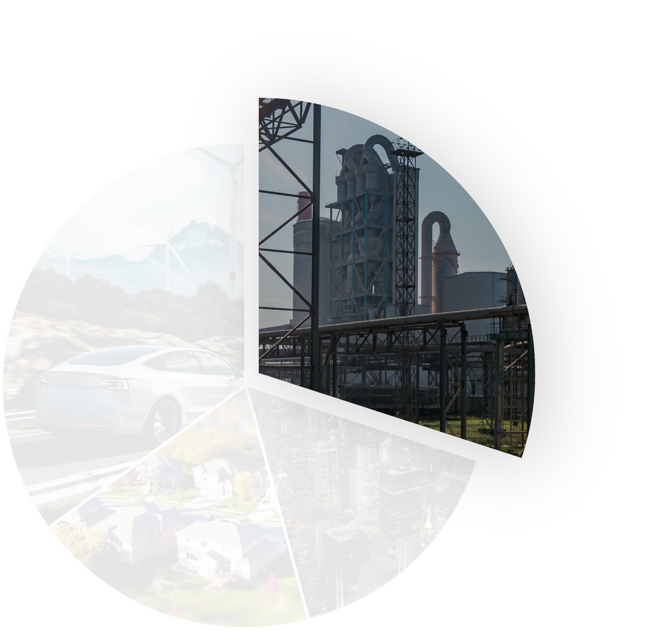
Building a Net-zero, Clean Energy Future
The U.S. industrial sector (manufacturing, agriculture, mining, and construction) accounts for:
of the nation’s
primary energy use
of CO₂
emissions
30%
Industrial
35%
Transportation
33%
30%
Anticipated industrial sector energy demand growth of 30% by 2050 may result in a:
16%
Commercial
19%
Residential
17%
CO₂ emissions
increase*
Energy-Related CO₂ Emissions
By Sector
*EIA, Annual Energy Outlook 2021 with Projections to 2050.

Slide 3
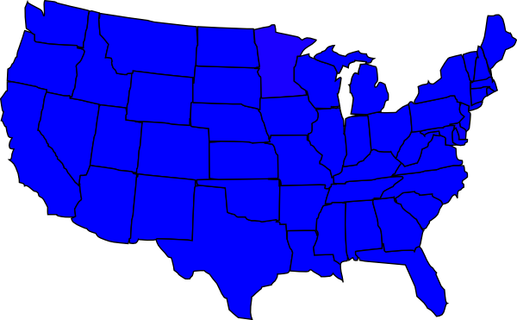
Decarbonizing Industry is an Opportunity for America’s Economy
U.S. manufacturing
subsector…
CONTRIBUTES
$2.35 trillion to
the U.S. Economy
GENERATES
11% of U.S. GDP
CREATES
11.4 million jobs
While working to
DECREASE
CO₂ emissions
Notes:
-----------
Sources:
Manufacturing 11% of GDP and 11.4 million jobs (https://www.energy.gov/eere/doe-industrial-decarbonization-roadmap; https://fred.stlouisfed.org/series/VAPGDPMA; "Annual Survey of Manufacturers (ASM) 2020," U.S. Census Bureau)
Manufacturing $2.35 trillion to U.S. economy (U.S. Bureau of Economic Analysis, International Monetary Fund from Manufacturing USA report)

Slide 4




Systemic barriers to industrial decarbonization
Investment scale → In the range of
$700 Billion –
$1.1 Trillion
just for 8 industrial sector of focus in the IRA :
Estimated that
60%
by 2030 will come from technologies that are not net-positive decarbonization levers with existing IRA tax credits or require further R&D to address
Chemicals
Refining
Iron & Steel
Food & Beverage
Targeted investment for research, development,
and pilot-scale demonstrations is a need and opportunity for U.S. manufacturing
Cement
Pulp & Paper
Aluminum
Glass
Source: DOE Pathways to Commercial Liftoff; Industrial Decarbonization https://liftoff.energy.gov/wp-content/uploads/2023/10/LIFTOFF_DOE_Industrial-Decarbonization_v8.pdf
Notes:
Potential capital deployment of 700 billion to 1.1 trillion from public and private sector investment and leverage of industrial materials small portion of end products price would be required to decarbonize with emerging technologies

Slide 5
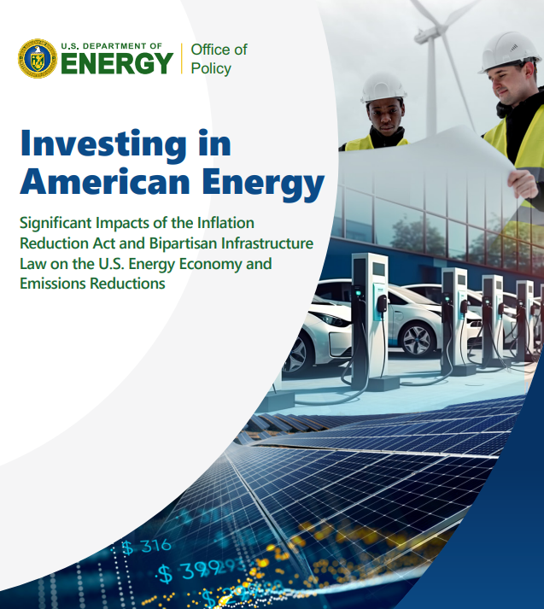
The Inflation Reduction Act of 2022 (IRA) and Bipartisan Infrastructure Law of 2021 (BIL) together represent a historic investment of more than $430 billion toward modernizing the American energy system.

Slide 6

DOE Industrial Decarbonization Roadmap
Industrial Decarbonization Pillars
Energy Efficiency
Industrial Electrification
Low-Carbon Fuels, Feedstocks, and Energy Sources (LCFFES)
Carbon Capture, Utilization, and Storage (CCUS)
Decarbonization pillars: inter-related, cross-cutting strategies to pursue in parallel
Iron & Steel
Chemicals
Food & Beverage
Petroleum Refining
Cement
www.energy.gov/eere/doe-industrial-decarbonization-roadmap

Slide 7
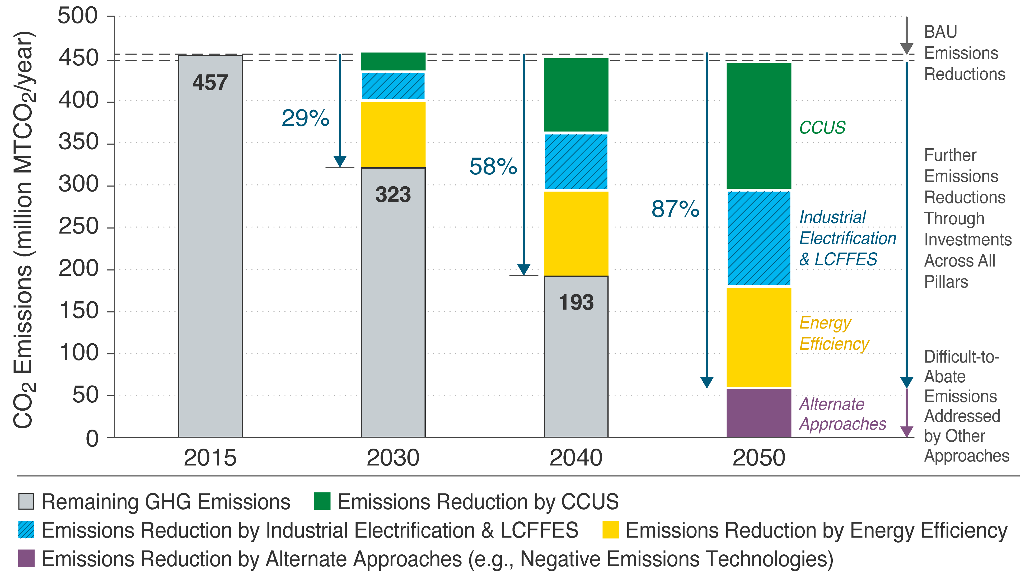
Path to Net-Zero Emissions by 2050

Slide 8
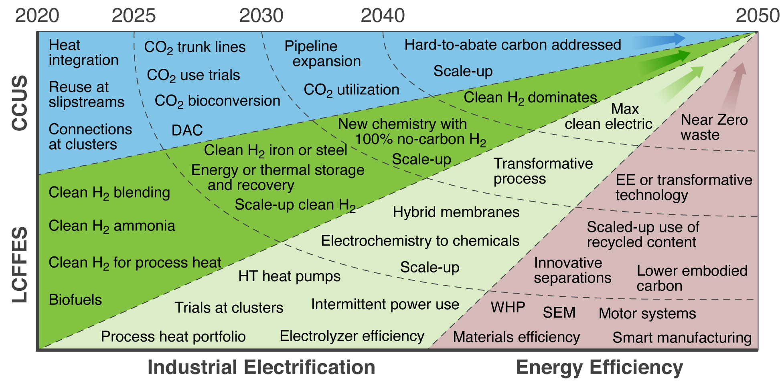
Landscape of Needed RD&D Investment
Industrial GHGs require approaches at multiple levels:
Core process
Facility
Beyond plant bounds
Landscape of major RD&D investment opportunities for industrial decarbonization between now and 2050.
LCFFES = Low-Cost Fuels, Feedstocks, and Energy Sources; CCUS = Carbon Capture Utilization and Storage
Source: Industrial Decarbonization Roadmap
Notes:
Critical Needs:
Expanded H₂ generation & use, New thermal energy sources & systems, HT heat pumps, Transition to clean electricity, Strong policies in the future to continue energy transition
,

Slide 9



IEDO Fit within DOE Landscape
Office of Manufacturing & Energy Supply Chains, Office of Technology Transitions
IEDO
Loan Programs Office
Office of Clean Energy Demonstrations
ACCELERATING ADOPTION
ADOPTION ACCELERATION
AT-SCALE DEPLOYMENT
IEDO
Barrier Analysis and Technical Assistance
LARGE SCALE
DEMONSTRATIONS
LARGE-SCALE
DEMONSTRATIONS
Transition to the market
PILOTING AND VALIDATION
PILOTING AND VALIDATION
Office of Science
Establish value & commercial benefits
TECHNOLOGY MATURITY
APPLIED R&D AND
TECHNICAL DE-RISKING
APPLIED R&D AND
TECHNICAL DE-RISKING
Develop enabling technology and demonstrate technical feasibility
FOUNDATIONAL SCIENCE AND DISCOVERY
Establish technical concept
EMERGING TECHNOLOGIES
ESTABLISHED TECHNOLOGIES
TIMELINE / INVESTMENT STAGE
Project Risk
Market Risk
Technical Risk
RISK PROFILES

Slide 10
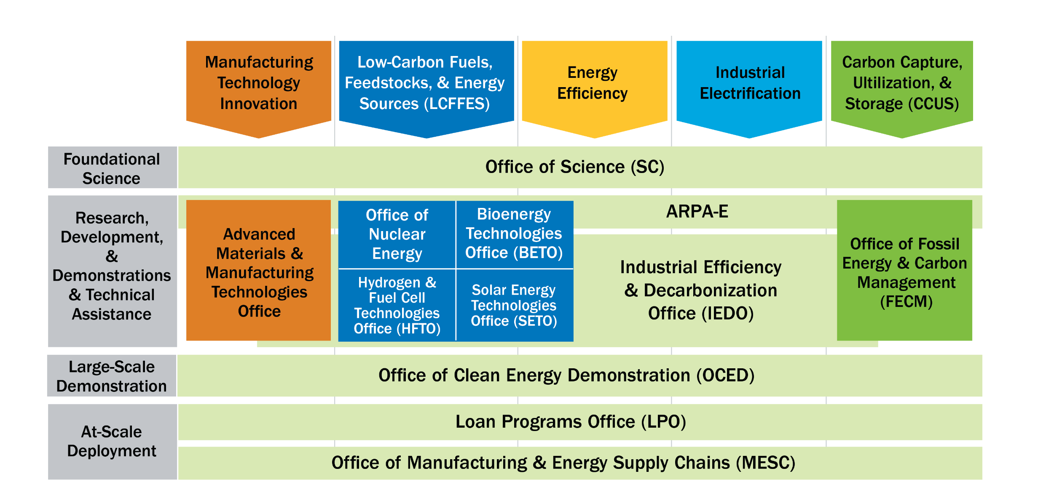
DOE Offices Share a Common Strategic Framework
Technologies for Industrial Emissions Reduction Development
(TIEReD)
Program
Industrial Demonstrations and Deployment Programs
www.energy.gov/industrial-technology

Slide 11





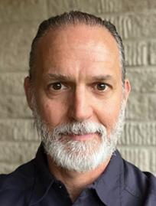





Industrial Efficiency and Decarbonization Office (IEDO)
Energy- and Emissions-
Intensive Industries
FY23 = $131M
Cross-sector Technologies
FY23 = $90.5M
Technical Assistance
and Workforce Development
FY23 = $45M
Dr. Avi Shultz
Director
Anne Hampson
Acting Deputy Director
Joe Cresko
Chief Engineer
Lauren Hall
Operations Supervisor
Dr. Paul Majsztrik
Isaac Chan
Anne Hampson
$266.5
Million FY23 Budget
Ava Coy
Program Manager
Technical Project Officers
Mattie Gainer
Strategic
Communications Lead

Slide 12

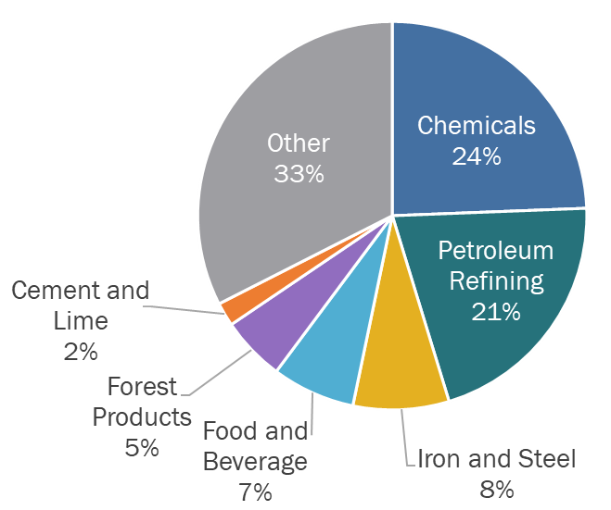
IEDO's Research & Development Strategy
IEDO invests in both sector-specific technology solutions and cross-cutting technologies that can be applied across the industrial sector.
U.S. Manufacturing Energy-related CO₂ Emissions by Sector, 2020: 1124 MMT CO₂. Source: 2021 EIA AEO

Slide 13
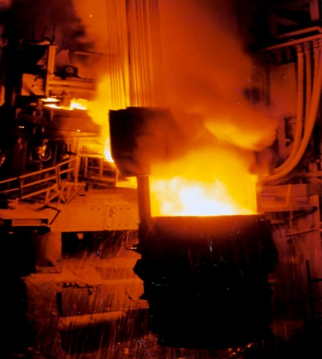
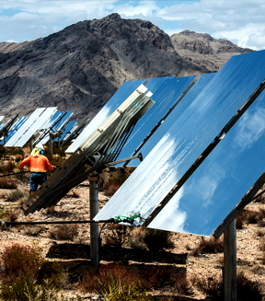
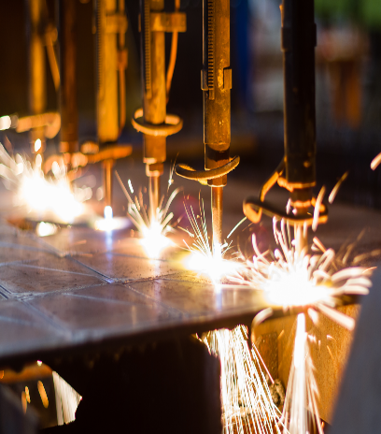

Energy- and Emission-Intensive Industries
IRON & STEEL
1,469 TBtu
100 MMT CO₂e
CHEMICALS
(including production of low-carbon fuels)
4,842 Tbtu
332 MMT CO₂e
FOOD & BEVERAGE
1,935 TBtu
96 MMT CO₂e
FOREST PRODUCTS
2,883 TBtu
80 MMT CO₂e
CEMENT & CONCRETE
367 TBtu
66 MMT CO₂e
Cross-Sector Technologies
Thermal Processes
& Systems
Low-Carbon Fuels,
Feedstocks, & Energy Sources
Emerging Efficiency
Water & Wastewater Treatment

Slide 14
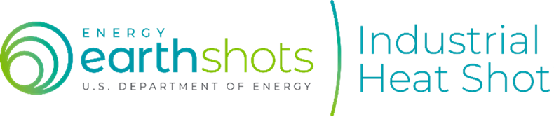
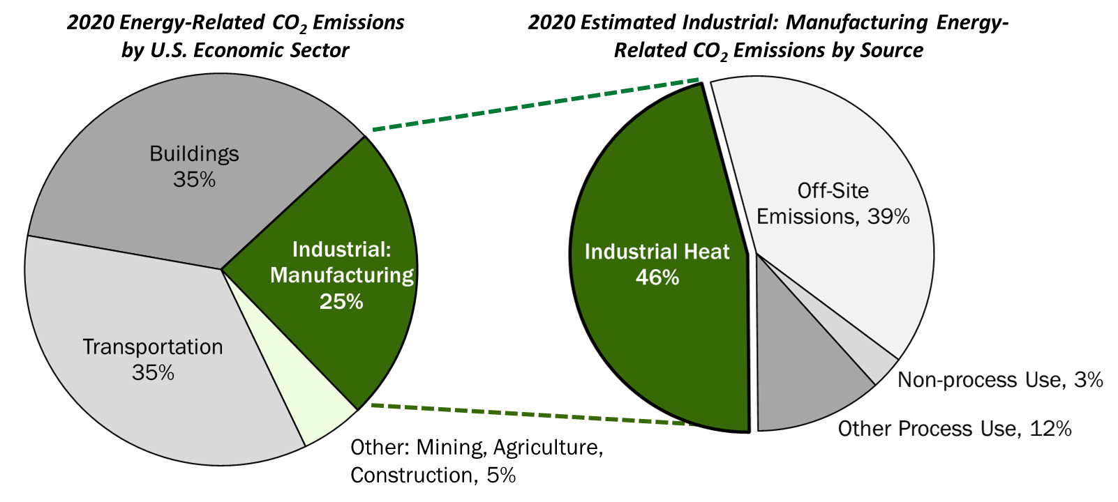




11% of U.S. Energy-Related Emissions are from Industrial Thermal Systems
Develop cost-competitive industrial heat decarbonization technologies with at least 85% lower greenhouse gas emissions by 2035
Sources: EIA Annual Energy Outlook (2021); AMO 2018 Manufacturing Energy and Carbon Footprints (2022)
Goal: Reduce the amount of heat and/or emissions from heat to make cleaner products
Generate Heat from Clean Electricity
Integrate Clean Heat from Alternative Sources
Innovate Low- or No-Heat Process Technologies
Reduce Emissions:
Electrify equipment and use clean electricity, improve energy efficiency
Examples:
Heat pumps, microwave heating, resistive heating, etc.
Reduce Emissions:
Switch to low-emissions heat sources and increase thermal storage
Examples:
Solar thermal, nuclear, geothermal, hydrogen, some sustainable fuels, etc.
Reduce Emissions:
New chemistry and emerging approaches to reduce heat demand
Examples:
Advanced separations, electrolysis, ultraviolet curing, biobased manufacturing, etc.
Enabling technologies and systems (e.g., energy storage, materials modeling, data analysis)
Notes:
Decarbonizing industrial heat is a single, crosscutting approach that addresses almost half of industrial emissions and thus a huge opportunity for DOE to drive innovation that will be essential to meeting climate targets.
50% of emissions comes from combustion.
To fully decarbonize – we will need carbon capture, alternative process chemistry to reduce direct process emissions, more efficient pumps, motors, drives, etc. (the other wedges) but this Shot is focused on the largest source across all of industry…
Assumptions:
Energy-related CO2 emissions
Manufacturing sector excludes agriculture, construction, or mining.
Industrial Heat includes process heating, conventional boilers, and the fraction of combined heat power (CHP)/cogeneration attributable to process heating demand.
Source: DOE Manufacturing Energy and Carbon Footprints (2022)

Slide 15
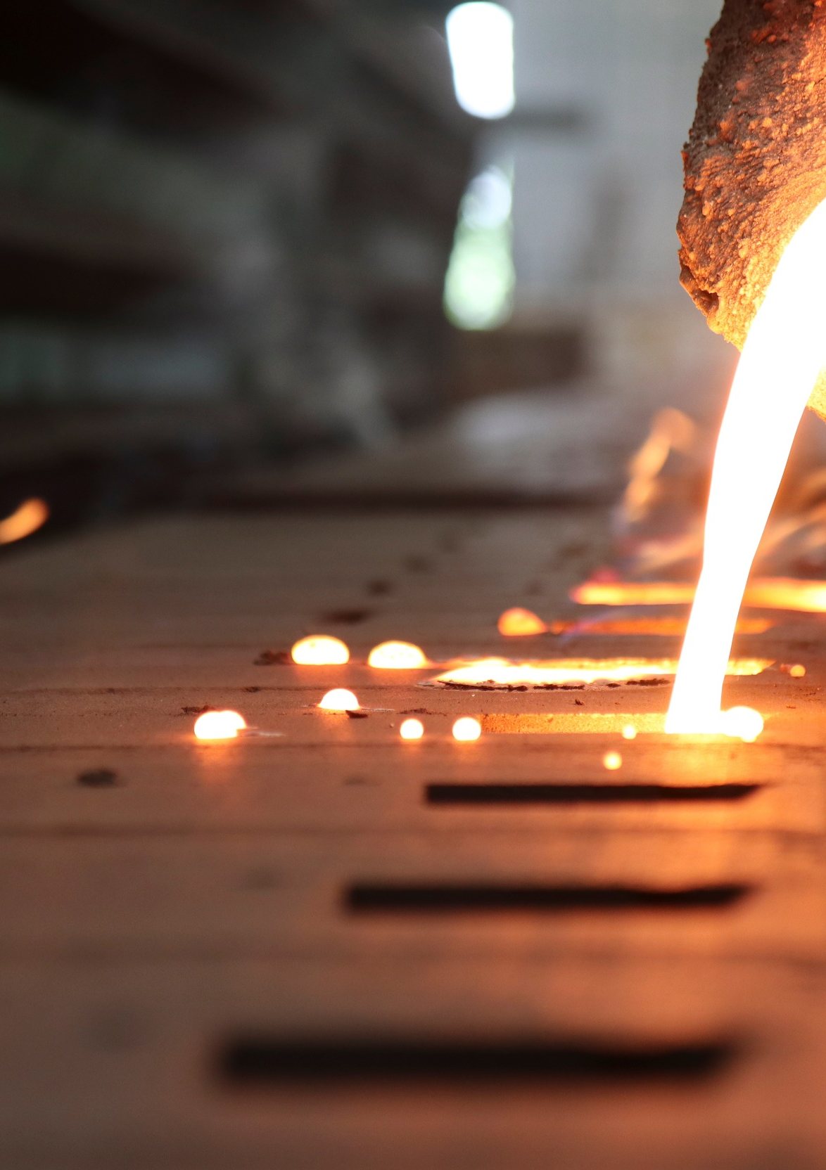


Arizona State University to Lead New DOE Institute Focused on Electrifying Process Heat
  The Electrified Processes for Industry without Carbon (EPIXC) Institute is DOE’s 7th Clean Energy Manufacturing Innovation Institute.
  EPIXC will:
    Allocate up to $70M in federal funding over the next 5 years to fund RD&D projects to electrify process heating.
    Mobilize a multisector coalition of private companies, National Labs, universities, labor unions, and community partners to create an innovation ecosystem.
    Bridge the gap between research and commercialization to move novel electrification processes out of the lab and into the market.

Slide 16
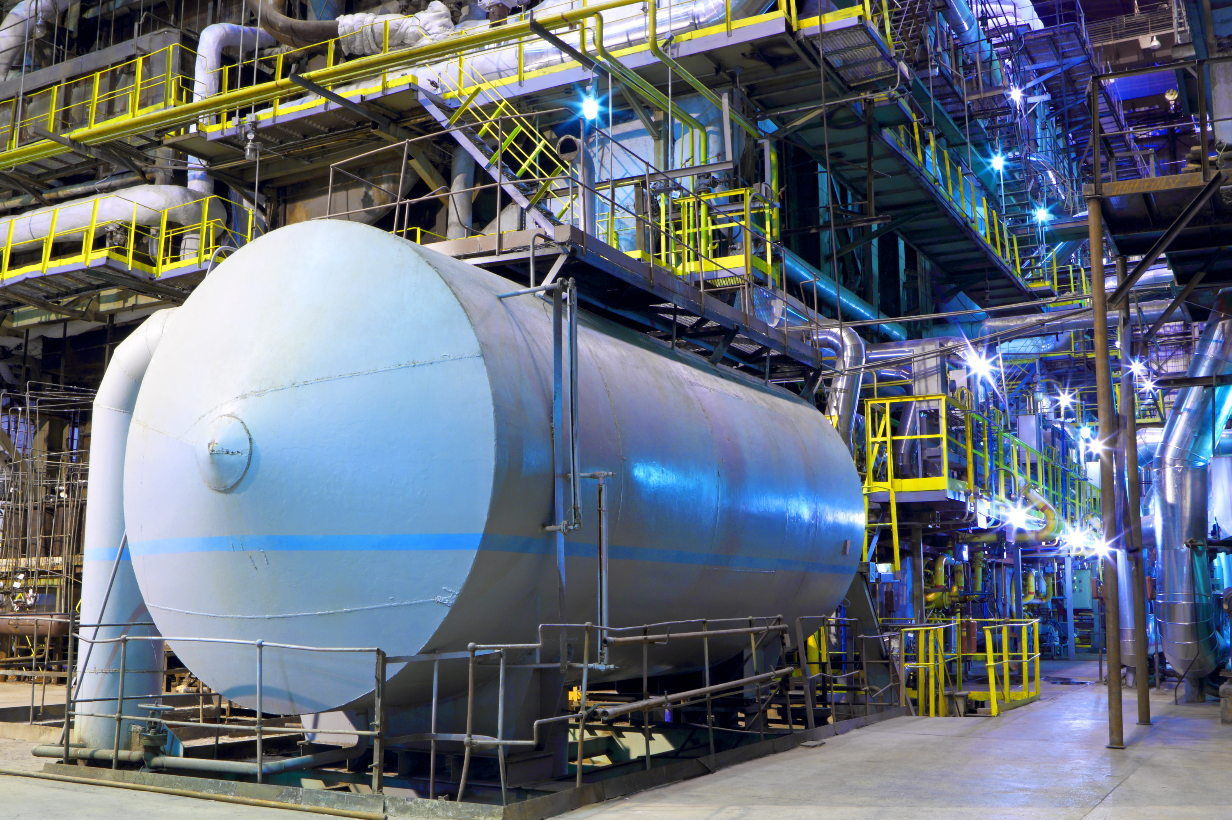
Chemicals and Refining Priorities
Crosscutting
Sector-Specific
Carbon capture integration
Sustainable feedstocks (especially carbon)
Electrochemical reactors
High-efficiency thermal reactors
Advanced separations
Material reuse
Low-carbon fuels
Low-carbon & electrified process heating
Waste heat recovery

Slide 17

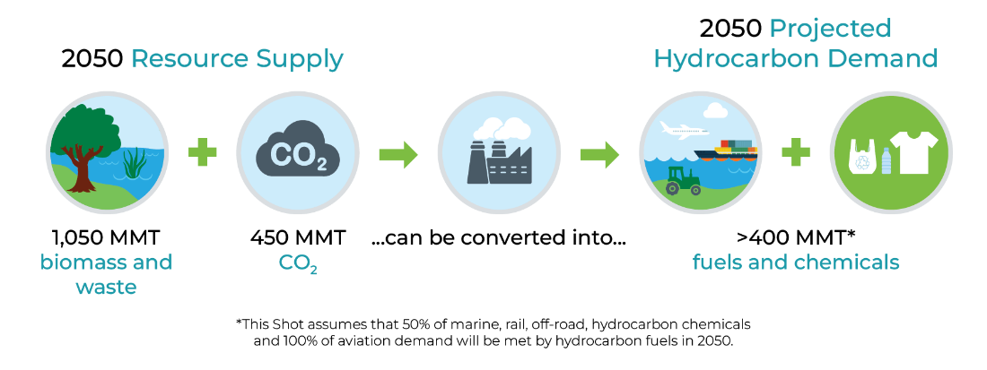
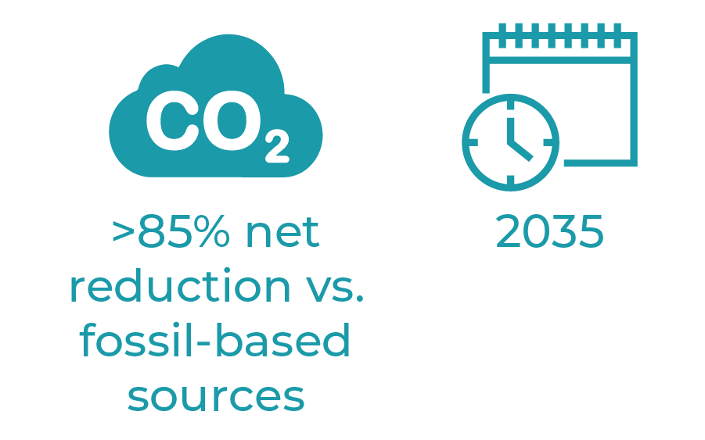

Slide 18
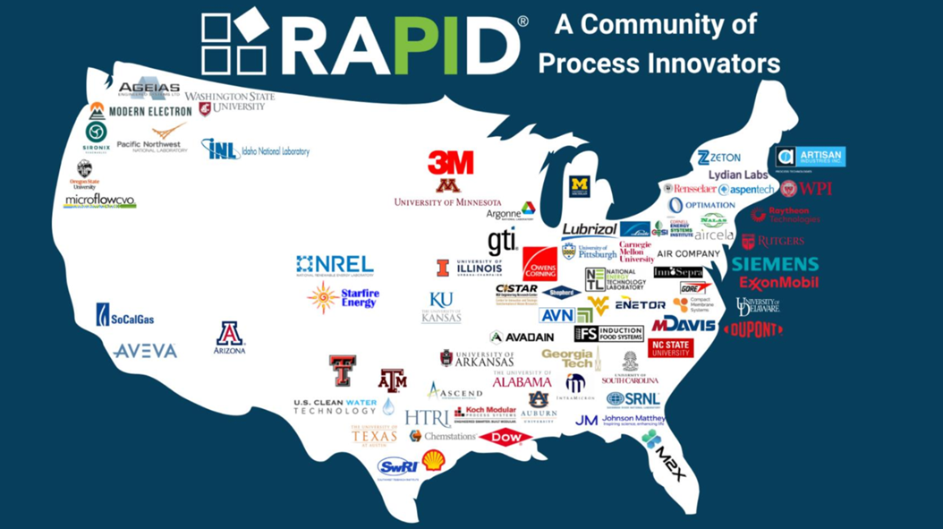
Rapid Advancement in Process Intensification Deployment (RAPID)
A 5-year, $40 million investment to drive RD&D of advanced process technologies to enable more resilient, lower cost, and reduced energy and carbon footprint manufacturing in the process industries.
Includes the production of chemicals and fuels, which account for more than a third of all U.S. industrial emissions and energy consumption.
RAPID’s work will align with the Clean Fuels & Products Shot.

Slide 19
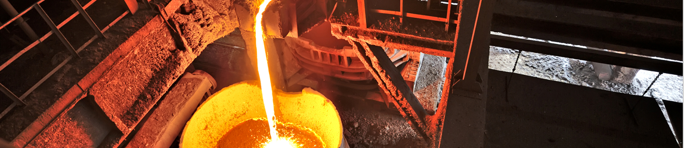
Iron and Steel Priorities
Crosscutting
Sector-Specific
Low-carbon fuels and electrification for process heating, reheats
Alternative reductants – hydrogen, ammonia for DRI/HBI; biomass
for solid pig iron
Molten ore processing – molten
oxide electrolysis; hydrogen plasma direct smelting
Carbon capture and storage on existing BF/BOF facilities
Waste heat recovery

Slide 20
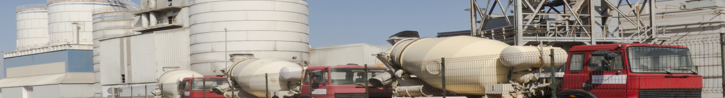
Cement and Concrete Priorities
Crosscutting
Sector-Specific
Carbon capture from limestone decarbonation
Alternative binders and process routes to OPC
Clinker substitutes
CO₂ mineralization
Alternative building materials
Electrification &
low-carbon fuels
Waste heat recovery

Slide 21
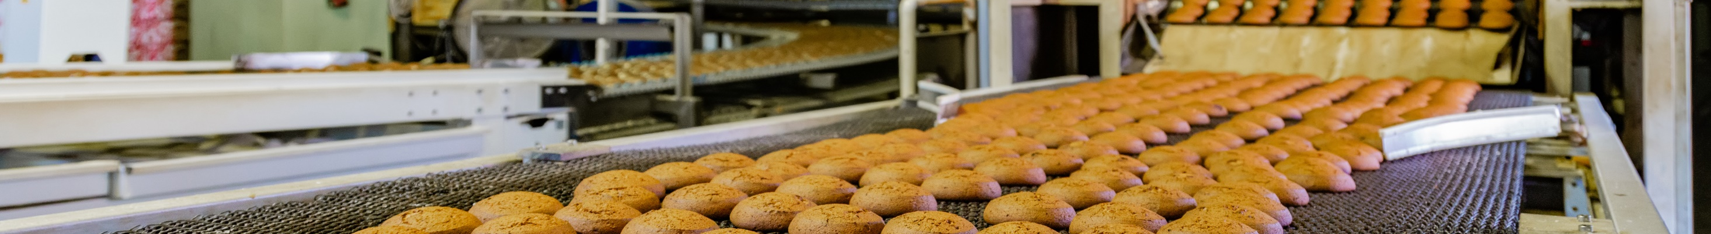

Food and Beverage Priorities
Crosscutting
Sector-Specific
Low-carbon fuels or electrification for steam boilers
Alternative protein products
Waste management
and reduction
Innovative cooling, refrigeration, and freezing solutions
Low-temperature waste heat recovery from process exhausts
Smart/flexible
manufacturing processes
Drying and dewatering innovations
Wastewater recovery and reuse

Slide 22
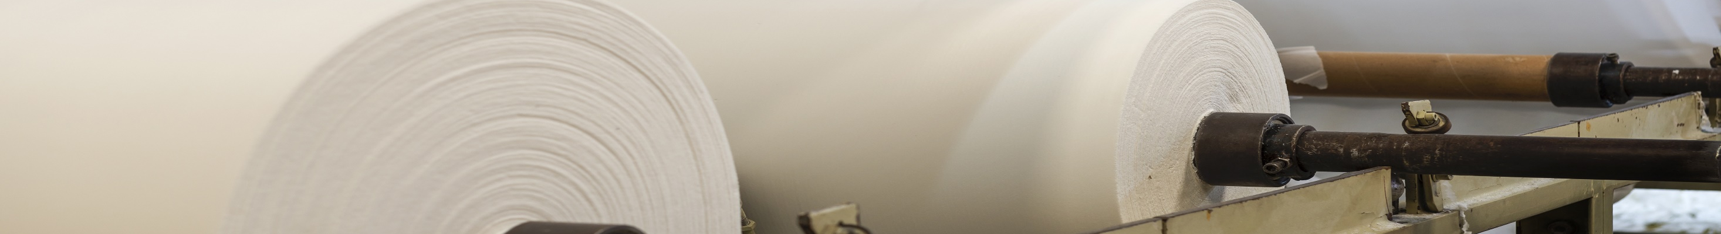
Forest Products Priorities
Crosscutting
Sector-Specific
Carbon capture integration
with boilers
Increase biomass utilization
Energy efficient separations
for concentrating liquor
Increase fiber yield of pulping
Increasing solids content
in paper forming
Low-carbon fuels for lime kilns
Low-carbon fuels or electrification for steam boilers
Drying and dewatering innovations

Slide 23
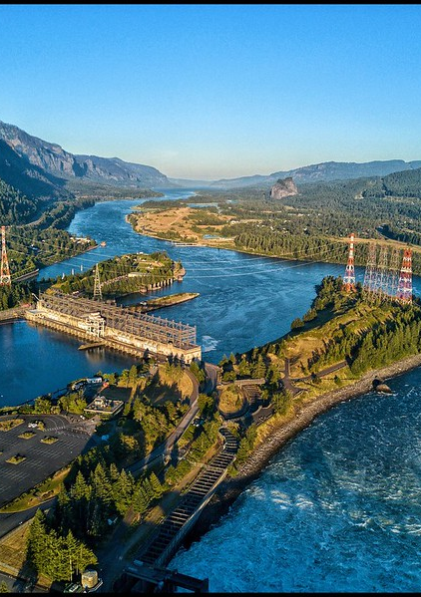
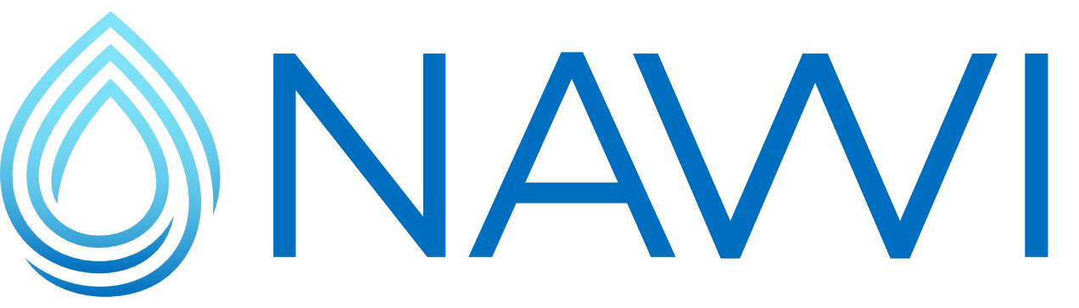
National Alliance for Water Innovation
Energy-water desalination hub led by Lawrence Berkeley National Laboratory
Focused on early-stage research on desalination and water-treatment technologies to secure affordable and energy efficient water supplies from nontraditional water sources
Goal: 75% reduction in cost and energy of desalination

Slide 24
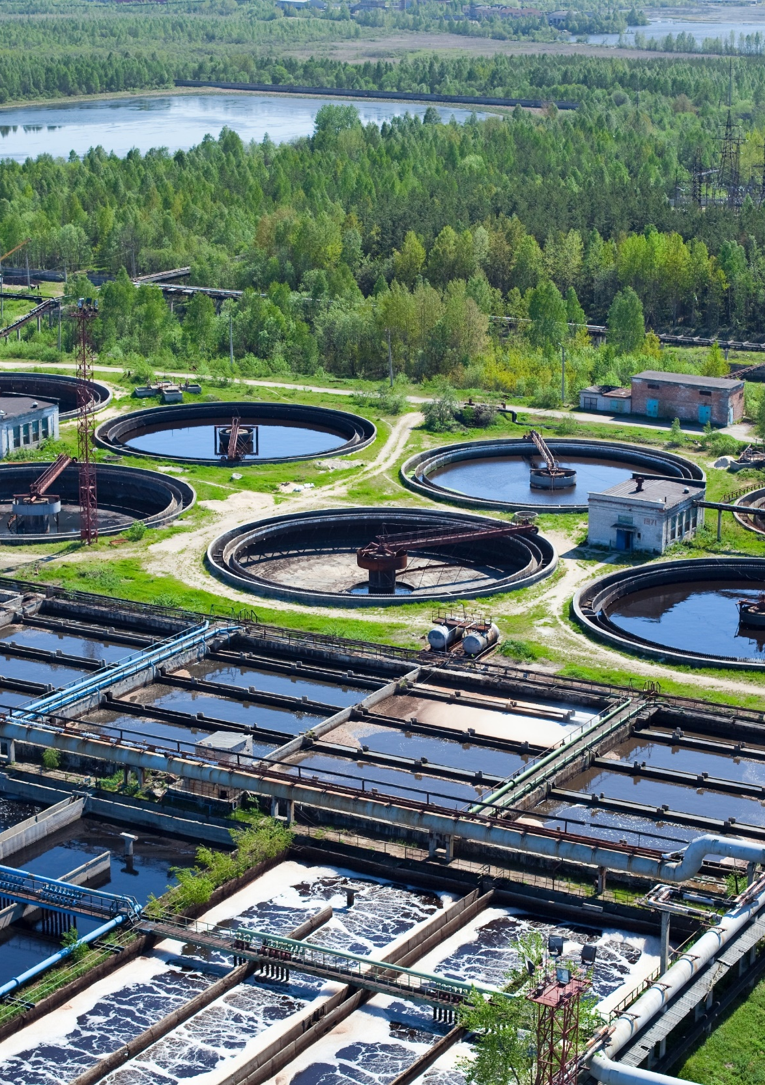
EEII and CST Funding Opportunities
FY22 Industrial Efficiency and Decarbonization FOA: ​
$115M for 33 projects to decarbonize the five highest-emitting industrial subsectors (projects in progress).​
FY23 IEDO Multi-Topic FOA:​
$156M to advance high-impact applied RD&D projects to decarbonize the U.S. industrial​ sector. Includes sector-specific and cross-sector approaches (selections coming soon).
Decarbonization of Water Resource Recovery Facilities FOA:
$28M for 10 projects to decarbonize the entire life cycle of Water Resource Recovery Facilities (projects in progress).

Slide 25
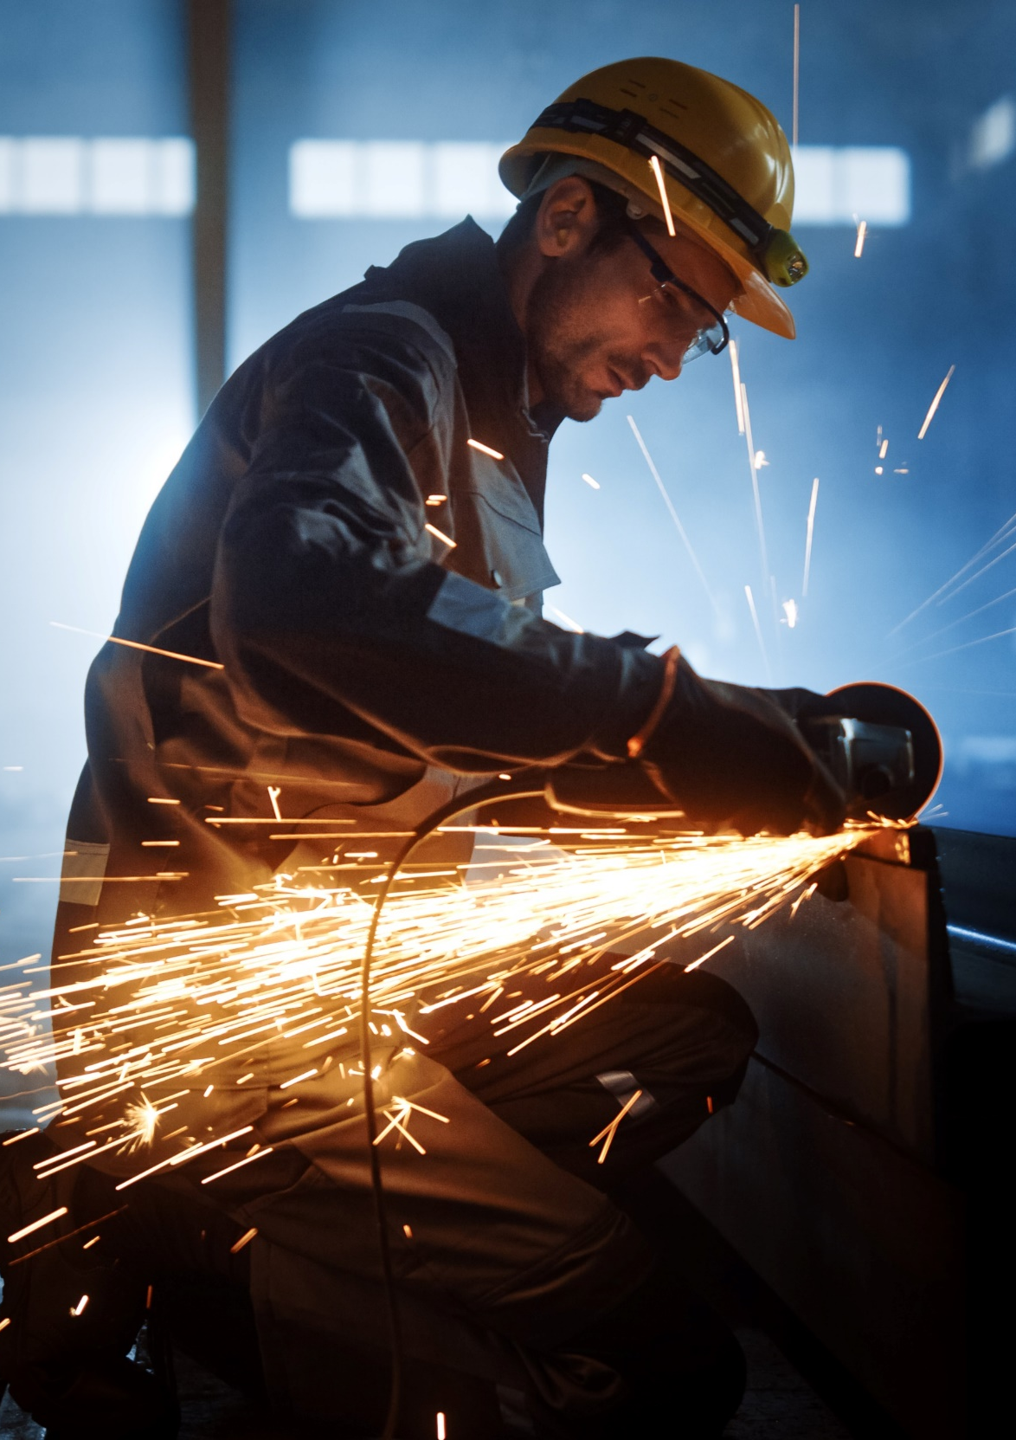
JUST ANNOUNCED : New EEII and CST Funding Opportunities
FY24 Cross-Sector Technologies FOA:
$38M to accelerate the innovative, cross-sector technologies required to decarbonize industry.
FY24 Energy- and Emissions-Intensive Industries
$83M to focus on applied RD&D for the highest GHG-emitting industrial subsectors, specifically: chemicals and fuels; iron and steel; food and beverage; building and infrastructure materials (including cement and concrete, asphalt pavements, and glass); and forest products.

Slide 26
IEDO Technical Assistance & Workforce Development
Public /private partnerships to help manufacturers and industrial organizations set and achieve long-term energy intensity reduction goals
Education and training for the current and future manufacturing workforce
No-cost tools and resources for manufacturers to reduce GHG emissions and improve energy efficiency and competitiveness
End-user support, stakeholder engagement, and technical services for the industrial sector
TA WORK PRODUCTS
INCLUDE:
ENERGY ASSESSMENTS
PEER-TO-PEER NETWORKING
TOOLS & TRAINING
TECHNOLOGY SCREEINING
PROJECT PROFILES

Slide 27

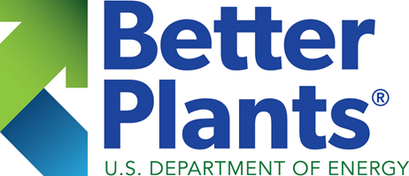
Better Plants & Better Climate Challenge
As of 2021, industrial organizations can join the Better Climate Challenge and set portfolio-wide GHG emission reduction goals (50% reduction in Scopes 1 & 2, without offsets).
Since 2011, through Better Plants, DOE has partnered with industrial organizations to set and achieve ambitious, long-term, portfolio-wide energy efficiency goals (25% improvement in energy intensity in 10 years).

Slide 28
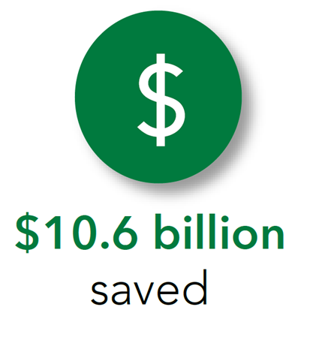
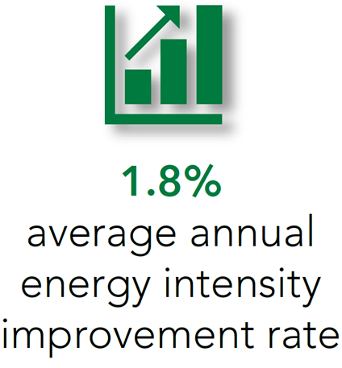
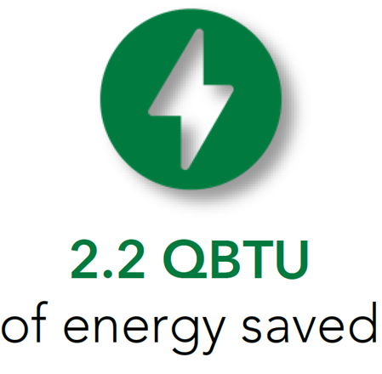
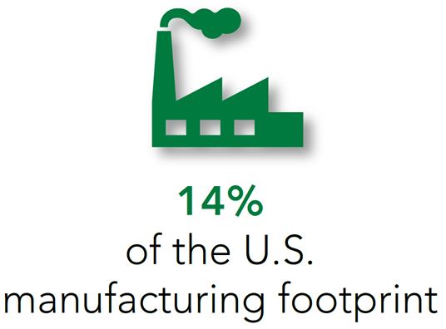
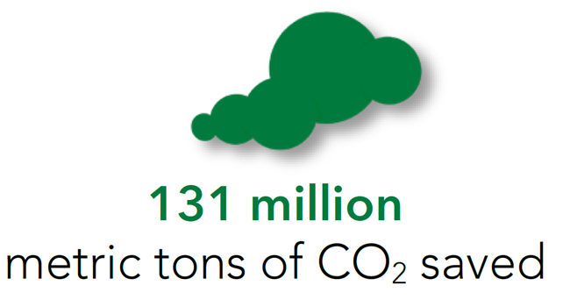
Better Plants & Better Climate Challenge Impact
Resources
Framework for GHG Emissions Reduction Planning – Guidance on developing detailed, actionable, and portfolio-wide plan to decarbonize an industrial portfolio.
Low Carbon Pilot Toolkit – Tools, resources, and solutions developed over the two-year pilot.
Better Plants Energy Bootcamps – A three-day crash course in industrial energy systems, energy management, and a primer on industrial decarbonization.

Slide 29


Energy Management Programs
Leverage diverse domestic energy resources in U.S. manufacturing, while strengthening environmental stewardship
Reduce life cycle energy and resource impacts of manufactured goods
Transition DOE-supported innovative technologies and practices into U.S. manufacturing capabilities
ISO 50001
Improve the productivity and energy efficiency and reduce GHG emissions of U.S. manufacturing
Strengthen and advance the U.S. manufacturing workforce

Slide 30
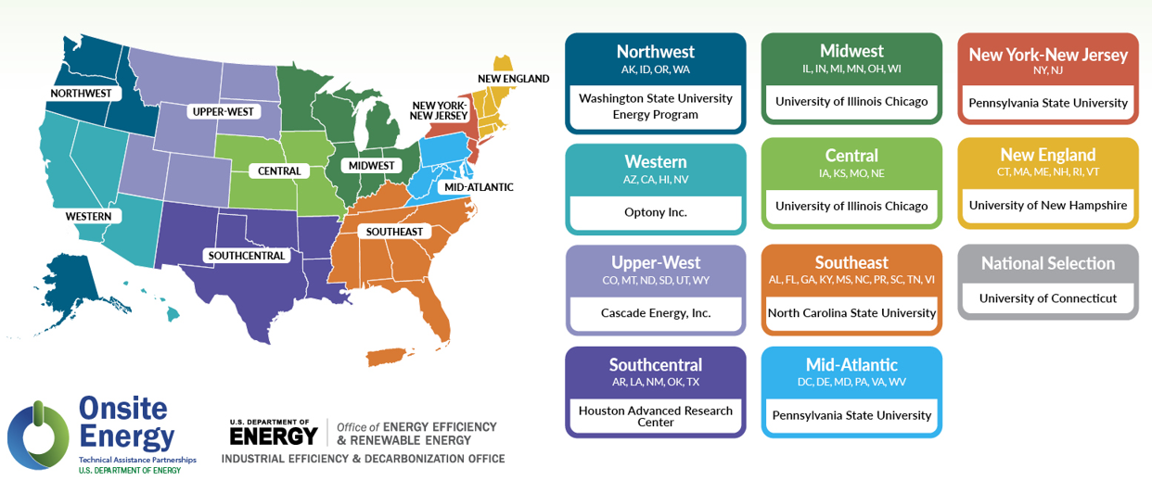
IEDO Onsite Energy Program
battery storage | combined heat and power | district energy | geothermal |
industrial heat pumps | renewable fuels | solar PV | solar thermal | thermal storage | wind

Slide 31
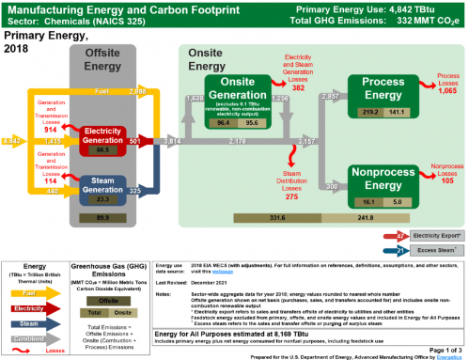
Strategic Analysis Tools & Resources
IEDO’s manufacturing, materials, and lifecycle energy tools and resources use a cross-sector and prospective life cycle assessment (LCA) approach that anticipates future benefits and impacts.
Environmentally Extended Input-output For Industrial Decarbonization Analysis (Eeio-ida) Tool
Techno-economic Energy & Carbon Heuristic Tool For Early-state Technologies (Techtest) Tool
Materials Flows Through Industry (Mfi) Tool
Life Cycle Greenhouse Gas, Technology And Energy Through The Use Phase (Lightenup) Tool
Plant Water Profiler Tool - Excel, Beta Version (Pwpex V0.1)
Carbon Fiber Reinforced Plastic (Cfrp) Energy Estimator Tool
Additive Manufacturing (Am) Energy Impacts Assessment Tool
Manufacturing Energy and Carbon Footprints
https://www.energy.gov/eere/iedo/energy-analysis-data-and-reports

Slide 32




Diversity, Equity, Inclusion, and Accessibility (DEIA) Focus
We seek to create a workforce that reflects the diversity of Americans and ensures that all Americans benefit from a decarbonized industrial sector.
Increasing Diversity in Partnerships, Applicant FOA pool, and FOA Reviewers
Using Inclusive Language to welcome broader participation in funding opportunities
Identifying Equity-related barriers that impact communities
Expanding Accessibility for Disadvantaged Communities (DACs), including through community-based stakeholder engagement
IEDO is committed to empowering diverse communities and amplifying best practices for DEIA internally and externally.

Slide 33

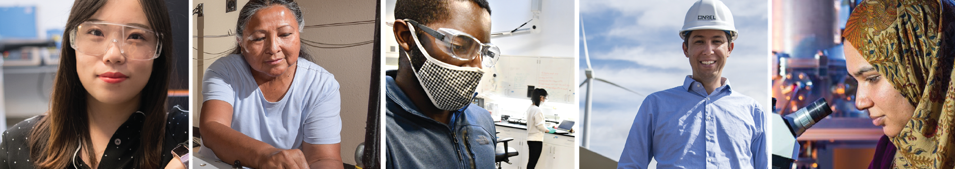
IEDO is Hiring – Join Our Team!
Current IEDO Career Opportunities
  Cement and Concrete Manufacturing Technology Manager
  Iron, Steel, Aluminum, and Other Metals Sr. Technology Manager
  Operations Manager
www.energy.gov/eere/iedo/iedo-careers
Email: IEDOJobs@ee.doe.gov

Slide 34



Interested in becoming a Clean Energy Champion?
Apply for IEDO’s Industrial Decarbonization Fellowship to help identify key technology opportunities for the hardest-to-decarbonize industries.
As a fellow, you’ll contribute to the development and execution of strategies for:
Decarbonizing thermal processes,
Increasing industrial energy efficiency, and
Utilizing low-carbon fuels, feedstocks, and
energy sources.
Applications are accepted on a rolling basis with two annual review dates: January 15 | June 15
Learn more and apply today!
www.energy.gov/eere/iedo/iedo-fellowships

Slide 35

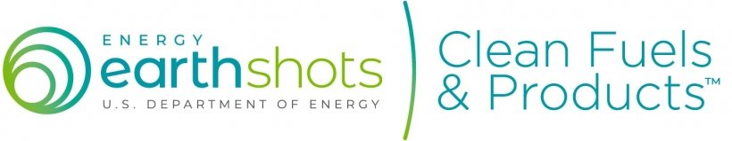



Two-Way Dialogue for Maximum Impact
IEDO Stakeholder Engagement Opportunities
Clean Fuels & Products Shot Webinar: Nov. 28
IEDO Peer Review
Industrial Heat Shot Summit
Many more stakeholder engagement opportunities coming soon!
More than 8 stakeholder workshops
Energy Management Trainings, Boot Camps, Technology Days, and 2024 Better Plants Summit

Slide 36
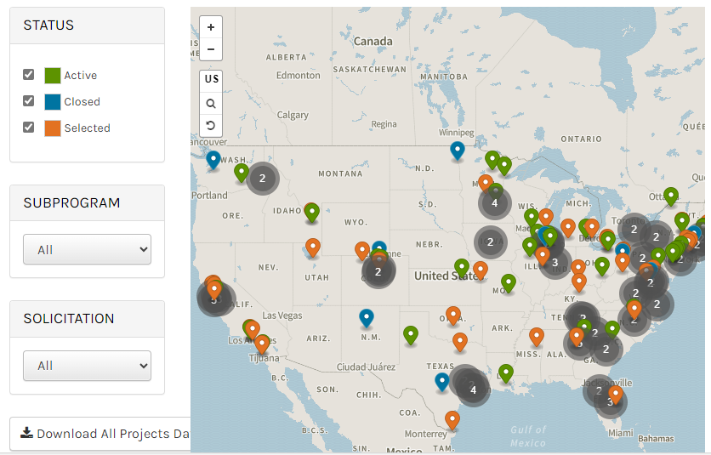

Thank You!
IEDO Project Database
Subscribe to our newsletter “The Production Line” to get the latest information on:
Announcements
Funding opportunities
Events
Tool and resources
And more!
www.energy.gov/eere/iedo/subscribe-iedo-newsletter
www.energy.gov/eere/iedo/iedo-project-database

