Slide 1
Cross Sector Technologies Meeting: Day 2
Cross Sector Technologies Meeting: Day 2
Next-Generation Enabling Technologies
Tuesday, May 30, 2023

Slide 2
Agenda
Time (ET) | Presentation | Presenter
12:00 | Review of Cross Sector Technologies Subprogram | Emmeline Kao, Technology Manager, DOE Industrial Efficiency and Decarbonization Office
12:10 | Introduction to Next-Generation Technologies | Emmeline Kao, Technology Manager, DOE IEDO
12:25 | Panelist session and facilitated Q&A | Azam Thatte, Director of Engineering & Fundamental Research at Energy Recovery, Inc. James Klausner, Executive Chairman, RedoxBlox Kashif Nawaz, Section Head – Buildings Technologies Research Michelle Pastel, Senior Manager of Manufacturing 4.0 at Corning Incorporated
13:00 | Breakout sessions
 | Breakout Room 1: End user and industry needs | Lead: Keith Jamison; Notetaker: Cameron Bordinat
 | Breakout Room 2: Plant management and efficiency | Lead: Zach Pritchard; Notetaker: Daniel Stewart
 | Breakout Room 3: Auxiliary equipment | Lead: Emmeline Kao; Notetaker: David Thaller
14:00 | Break
14:15 | Breakout Group Report Outs
15:00 | Facilitated discussion of potential near- and long-term metrics and goals | Emmanuel Taylor
15:30 | Adjourn

Slide 3
IEDO Cross-Sector Technologies (CST) Subprogram Overview
IEDO Cross-Sector Technologies (CST) Subprogram Overview
Isaac Chan, Program Manager
Industrial Efficiency and Decarbonization Office
Cross-Sector Technologies Stakeholder Meetings

Slide 4










DOE Commitments to Industrial Decarbonization
Industrial Heat ShotTM
Develop technologies to reduce process heating GHG emissions by 85% by 2035
U.S. joins international collaborations to decarbonize energy-intensive industries
Generate Heat
from Clean Electricity
Innovative Low- or No-Heat Process Technologies
Net Zero World Initiative
Partnership between U.S., international governments, and organizations to decarbonize global energy systems
Integrate Clean Heat
from Alternative Sources
G7 Industrial Decarbonization Agenda (IDA)
Initiative to reduce GHG emissions from heavy industries such as steel, cement, and chemicals
Industrial Decarbonization Roadmap
Net-zero CO₂ emissions by 2050
Mission Innovation’s Net-Zero Industries Mission
Global initiative to catalyze action and investment toward net-zero carbon emissions
Energy Efficiency
Electrification
Low-Carbon Fuels, Feedstocks, and Energy Sources (LCFFES)
UNIDO Industrial Deep Decarbonisation Initiative
Global coalition of public and private organizations to stimulate demand for low-carbon steel and cement
Notes:
Two DOE-wide initiatives establish DOE's commitment to decarbonization. These initiatives provide a framework for IEDO's priorities. In addition, the DOE Secretary announced DOE involvement in four international decarbonization initiatives in November 2022.
Press release:
https://www.energy.gov/eere/amo/articles/us-joins-international-collaboration-decarbonize-energy-intensive-industries-0

Slide 5



Industrial Efficiency and Decarbonization Office
MISSION
Accelerates the innovation and adoption of cost-effective technologies that eliminate industrial GHG emissions through investments in research, development, and demonstration activities, as well as technical assistance and workforce development.
MAJOR PROGRAM PILLARS
ENERGY- AND EMISSIONS-INTENSIVE INDUSTRIES
TECHNICAL ASSISTANCE AND WORKFORCE DEVELOPMENT
CROSS-SECTOR TECHNOLOGIES

Slide 6
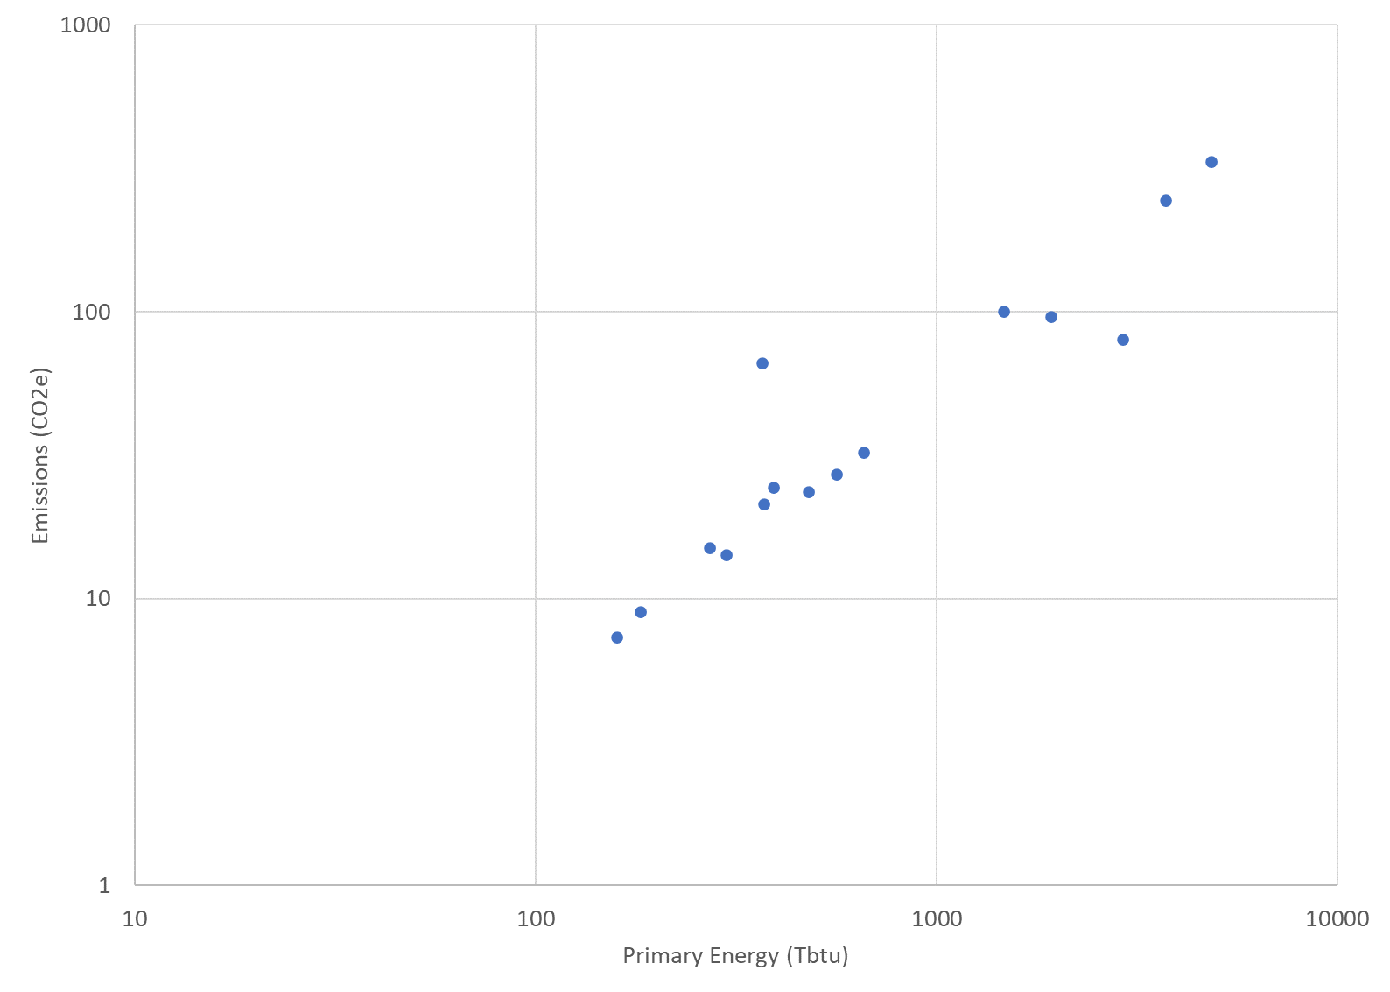
Cross-Sector Technologies within IEDO RD&D
Accelerates the readiness of component and equipment technologies with decarbonization impact across multiple industries.
Industrialize emerging technologies that can be integrated with existing facilities and processes.
Enabling technologies developed under CST (mid-TRL) that present integration challenges in industry-specific applications can be further advanced under EEII.
Advance energy systems and auxiliary components, e.g., waste heat recovery, sensors and controls, thermal energy storage (CST only).
Develop next-generation production technologies.
Reduce energy and emissions from water and wastewater treatment
A significant number of energy and emissions reduction challenges are common across all industrial subsectors.
IEDO RD&D Landscape
Cross-Sector Technologies
Energy- and Emissions-Intensive Industries
Chemicals
Petroleum Refining
Primary Metals
Food and Beverage
Cement
Forest
Products
Computers and
Electronics
Transportation Equipment
Plastics
Glass
Fabricated Metals
Textiles
Machinery
Foundries
Manufacturing Energy and Carbon Footprints, DOE AMO, 2022.
Notes:
Talking Points
The Cross-Sector Technologies subprogram accelerates the readiness of component and equipment technologies with decarbonization impact across multiple industries.
The subprogram
Prioritizes equipment technologies that can be integrated with existing processes.
Advances energy systems and auxiliary components.
And, develops emerging, next generation production technologies.
As the graphic at the bottom of the slide shows, early-to-mid stage R&D of enabling technologies through the CST subprogram can be transitioned and further advanced to industry-specific applications under the EEII subprogram
In addition, RD&D of energy systems and auxiliary components developed through the CST subprogram can further feed into EEII
**click to for animation**
This graph shows the manufacturing sectors plotted against energy and emissions. The EEII subprogram focuses on the most energy and emissions intensive sectors. CST RD&D addresses the significant number of energy and emissions reduction challenges common across all industrial subsectors.

Slide 7
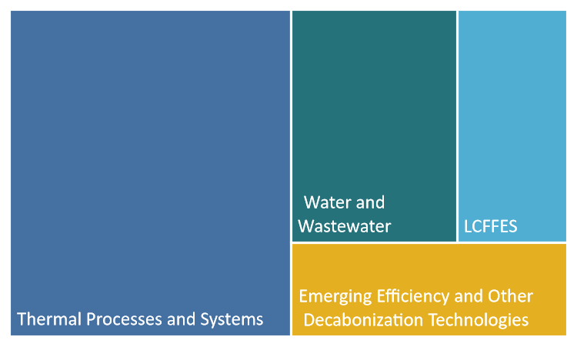
CST Program Priorities and Budget Structure
Industrial Decarbonization is a decades-long journey.
DOE-wide initiatives, inter-office working groups, analysis, and stakeholder technical workshops will continue to refine and inform future priorities.
Key Activity and FY23 Priorities
Thermal Processes and Systems ​ Electrification Innovative low- and no-heat processes
Low Carbon Fuels, Feedstocks, and Energy Sources (LCFFES) Enable use of low carbon fuels and feedstocks, including H₂, bio-derived fuels.
Emerging Efficiency and Other Decarbonization Technologies​ Next generation innovations Flexible industrial energy use Thermal energy storage
Energy & Emissions Reductions from Water and Wastewater Treatment Decarbonization of water resource recovery facilities
CST Budget Breakdown*
FY24 Request: $141M
*Relative size of investment
Notes:
Talking Points
We understand that industrial decarbonization is a decades-long journey, where priorities will continue to evolve as technology advances.
DOE-wide initiatives, inter-office working groups, analysis, and stakeholder workshops will ensure our priorities meet the current need and define future directions.
The CST subprogram is organized into four (4) key activities, FY23 priorities are noted for each.
Thermal Processes and Systems which looks to broadly decarbonize process heat and other thermal processes.
Low carbon, fuels, feedstocks, and energy sources focusing on enabling the use of low carbon fuels and feedstocks
Emerging Efficiency and Other Decarbonization Technologies, exploring innovative concepts and emerging technologies to significantly improve system efficiencies and flexibilities
And Energy and Emissions Reductions from Water and Wastewater Treatment which will decarbonize and increase the efficiency of water and wastewater treatment plants

Slide 8
Next-Generation Decarbonization Technologies
Next-Generation Decarbonization Technologies
Emmeline Kao, Technology Manager, Cross-Sector Technologies Program
Industrial Efficiency and Decarbonization Office
This presentation does not contain any proprietary, confidential, or otherwise restricted information

Slide 9
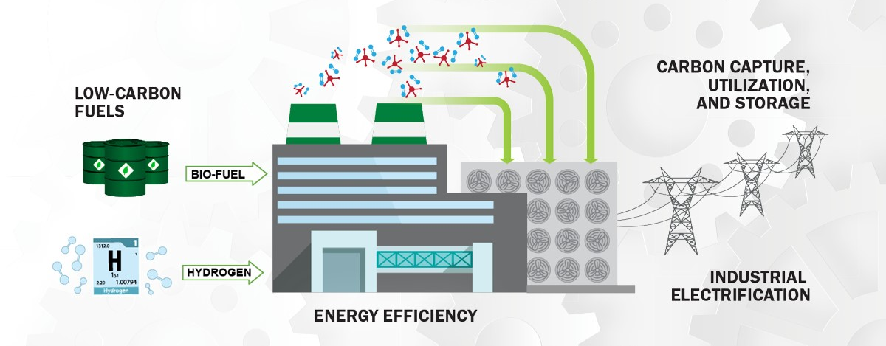
Industrial Decarbonization Roadmap
Four Main Strategies to Decarbonize the Manufacturing Sector
LOW-CARBON FUELS, FEEDSTOCKS, AND ENERGY SOURCES (LCFFES)
ENERGY EFFICIENCY
(INC. MATERIAL EFFICIENCIES)
CARBON CAPTURE, UTILIZATION, AND STORAGE (CCUS)
INDUSTRIAL ELECTRIFICATION
+
OTHER LCFFES
Sources:
(1) DOE Industrial Decarbonization Roadmap, September 2022
Notes:
From the roadmap, 4 pillars and strategies to decarbonize manufacturing sector. Tomorrow you will hear specific talks from TMs that will address low carbon fuels, feedstocks, and energy sources on the left, as well as thermal processing and key industrial electrification efforts.
Emerging efficiency is working across these pillars, specifically focusing on next-generation technologies.
To the peer reviewer’s point yesterday about wanting to aim at the right target, as the targets are moving, want to emphasize that this an evolving portfolio of work to identify cross-sector opportunities that are a) needed, ubiquitious, and ____ in industry, but need further development to drive efficiency gains and emissions reductions, and b) capable enabling industry of the future through deep decarbonization. As there are so many aspects of industry operations to address for industry of the future, this portfolio is quite broad as well. This portfolio is still itself “emerging”. What I’m presenting today is our current approach to this broad area, and I look forward to any comments or input from the peer reviewers on the scoping of this area.

Slide 10
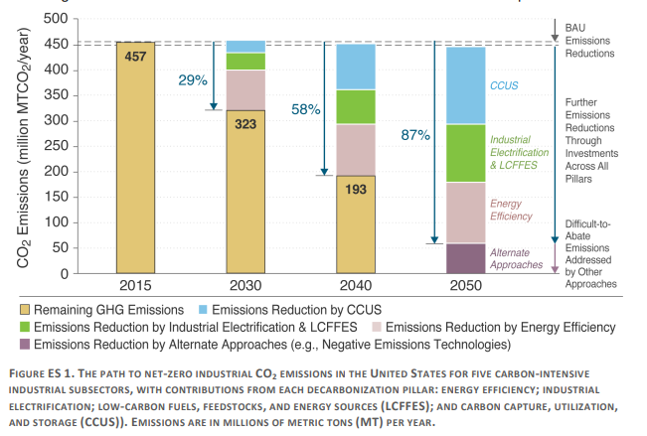

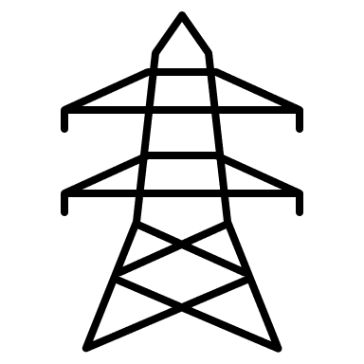



Approach to Emerging Efficiency and Decarbonization
Cross-sector decarbonization will require a multi-modal approach …
addressing RD&D opportunities across all pillars of decarbonization
At the plant: advanced facility management and operations such as smart manufacturing
Outside the plant: enabling and enhancing facility capabilities to interface with the grid of the future
In the plant: Alternative and novel processes that dramatically reduce GHGs
Sources:
(1) DOE Industrial Decarbonization Roadmap, September 2022
Notes:
With this, want to emphasize on the left the need for work across these pillars to achieve decarbonization. Within the x-sector program, in addition to energy efficiency gains, we are focusing on electrification, LCFFES—again, you’ll be hearing presentations on those tomorrow. But there are needs within those pillars as well as “alternate approaches” to fully reach net zero.
So to holistically capture the work we are pursuing in this portfolio, I’ve organized this into three categories: 1) outside the plant—this is referring to the work to interface industrial facilities with new energy sources. With this, we are looking at technologies that enable and enhance the facility’s abilities to effectively and efficiently integrate with the future grid. 2) at the plant—this looks at advanced facility management and operations at the plant to significantly enhance efficiency. And 3) in or within the plant-looks at transformative and novel processes that can dramatically reduce GHGs. These can be processes that utilize entirely different mechanisms to produce products and different feedstocks to achieve transformative impact.
And as much as I’d like everything to fit neatly into 3 categories, the realities are that the technologies we need to invest in will need to span across these different areas. Take, for example, thermal energy storage. This can be a technology that enables industry to interface with a future grid with high renewables penetration, but could also be a technology that allows a facility to manage their thermal operations by capturing and storing heat on site for use later. So in this way, we see this framework as an integrated approach to developing technologies to meet facility needs on multiple levels.

Slide 11
Example Technologies of Interest
Advanced thermal management and operational innovation in 4 key technology areas
Industrial Flexibility
Advanced auxiliary equipment: ultra-high efficiency heat exchangers
Smart Manufacturing
AI/ML: train predictive models for next-generation facilities
Alternative Process Technologies
Non-thermal separations: durable and scalable membranes
Other innovative low- and no-heat processes: electrochemical processes and CO₂ utilization
Advanced sensors and controls: optimize energy productivity in real-time
Waste Heat: efficient and cost-effective concepts in heat recovery and reuse
High Performance Computing to model emerging processes
Demand flexibility: develop technologies for grid-interactive industry
Energy storage: develop and integrate thermal energy storage into industrial processes
Advanced Material and Heat Management
Outside the Plant
At the Plant
In the Plant
Address RD&D opportunities through the pillars of decarbonization
Notes:
To discuss the specific technology areas we are pursuing which all seek to achieve advanced management and operational innovation for industrial facilities.
For enabling industrial flexibility, we are looking across two vectors: (1) energy storage that can provide process heat from waste heat, renewable electricity, or other low-carbon energy sources, (2) demand flexibility, developing the technologies such as components as well as developing processes that can use flexible loading for inputs.
For advanced material and heat management, we are looking at ultra-high efficiency heat exchangers to enable high efficiencies throughout the plant, including, but not limited to, recovering waste heat on site and reusing that heat effectively.
In smart manufacturing, we are pursuing next-generation technologies like AI and machine learning to train predictive models for manufacturing processes. In a similar vein, to enable the next generation of technologies, more advanced sensors and controls are needed to identify and .
Now within the plant, we are really looking to develop completely new processes for industry that will represent the next generation of manufacturing technologies. Processes like non-thermal separations such as membranes or other innovative low- and no-heat processes such as electrochemical and CO2 utilization. We also utilize high performance computing through out HPC4mfg program that uses literally the best computers in the world to model and derisk emerging processes.
The HPC4Mfg program partners national laboratory scientists with industry engineers to help them improve the energy efficiency and carbon intensity of their processes
The DOE funds the national lab partners in these 1 year projects while the industry provides at least 20% in kind support.
We have funded numerous projects across a broad range of industries including: steel, pulp and paper, glass, lead etc.

Slide 12
Stakeholder Engagement and Analysis to Develop Objectives and Targets
Goal: invest in next-generation technologies to achieve an efficient and competitive industrial sector with net-zero greenhouse gas emissions by 2050.
Energy Storage for Manufacturing Workshop
Thermal Process Intensification Workshop
Energy Storage Grand Challenge Roadmap
Technology Assessment on Low-Temperature Waste Heat Recovery in Industry
Industrial Decarbonization Roadmap
Energy Earthshot Lab Ideation Forum
Planned Stakeholder Engagement
Convening a diverse set of stakeholders:
Industry
Academia
National Labs
Non-Profits
Utilities
Labor Groups
State and Federal Government
May 2023 Cross-Sector Technologies Stakeholder Meeting
Industrial Heat Earthshot pre-summit forum
Industrial Heat Earthshot Summit
Roadmap Extension Project 2.0
Industrial Technology Innovation Advisory Committee
Lab & Industry Input
pre-2023
2023+
Notes:
IEDO convenes diverse stakeholders from academia, industry, non-profits, and government to make a big impact and encourages our current performers to contribute to the development of our identity and community.
In the areas relative to the emerging efficiency and decarbonization areas of interest, we have collaborated on the following stakeholder engagement spanning energy storage, thermal processes, waste heat recovery, as well as the analysis that went into the industrial heat Earthshot.
Upcoming for our stakeholder engagement, we plan to have a cross-sector technologies stakeholder meeting to help define our goals in this area. That meeting is happening next week! For the industrial heat Earthshot, there will be a pre-summit ideation forum and workshop, in addition to the summit to address key issues related to decarbonizing process heat. As Joe spoke to yesterday, the strategic analysis team is building upon their existing analysis published in the roadmap and expanding their scope of analysis across all pillars of the decarb roadmap. And lastly, want to talk about the industrial technology innovation advisory committee. This committee was authorized by congress to advise on strategic goals and planning toward achieving emissions reductions within the industrial sector.

Slide 13




Next-Generation Decarbonization Technologies Panel
Azam Thatte Director of Engineering & Fundamental Research at Energy Recovery, Inc.
James Klausner
Executive Chairman, RedoxBlox
Kashif Nawaz
Section Head – Buildings Technologies Research at Oak Ridge National Lab
Michelle Pastel
Senior Manager of Manufacturing 4.0 at Corning Incorporated

Slide 14
Cross-Sector Technologies Session 2: Next-Generation Cross-Sector Technologies
Breakout Session Group 1: End-User and Industry Needs
Breakout Session Group 2: Plant Management & Efficiency
Breakout Session Group 3: Auxiliary Equipment

Slide 15
Breakout Group 1: End-User and Industry Needs
Background: This breakout room will focus around end-user needs, identifying next-generation cross-sector technologies that can serve a wide variety of industrial subsectors, such as chemicals, iron & steel, cement & concrete, food & beverage, and pulp & paper
Potential Discussion Topics:
Low-carbon feedstocks
Technologies of Interest
Challenges & Barriers for Implementation
R&D Opportunities

Slide 16
Breakout Group 2: Plant Management & Efficiency
Background: Energy efficiency improvements represent the most cost-effective option for near-term GHG emissions reductions. Related technologies that can improve industrial production system efficiencies and yields are of primary interest.
Examples:
Energy Systems Analysis
Modeling
Data Analytics
Waste Heat
Smart Manufacturing (e.g., AI/Machine Learning)
Potential Discussion Topics:
Technologies of Interest
Challenges & Barriers for Implementation
R&D Opportunities

Slide 17
Breakout Group 3: Auxiliary Equipment
Background: There is a lack of auxiliary equipment to address infrastructure needs, along with limitations associated with legacy process equipment, which present barriers to implementing next-generation technologies.
Examples:
Advanced Controls and Sensors
Thermal Energy Storage
Ultra-High Efficiency Heat Exchangers
Potential Discussion Topics:
Technologies of Interest
Challenges & Barriers for Implementation
R&D Opportunities

Slide 18
Breakout Session Group 1 Report Out: End-User and Industry Needs
Technologies of Interest
Energy storage solutions
Cascading systems; heat pumps (increasing efficiencies for expansion work recovery)
CO2 capture/utilization
Challenges & Barriers for Implementation
Infrastructure requirements for large energy-using facility transition (either electrical or hydrogen) and associated timeframe for implementation; particular challenging for industries with lower profit margins
Need better insight on future demand and impacts
Permitting concerns
Scale-up challenges for electrotechnologies
Other R&D Opportunities
Electrochemical technologies
New technologies for low carbon fuels/feedstock production
Novel processing routes (cleaner process)

Slide 19
Breakout Session Group 2 Report Out: Plant Management & Efficiency
Smart Manufacturing: Modeling, Simulation, Sensors, & Controls
Opportunities:
Need for hybrid models that combine physics-based models with experimental/process data
Think about both industry-specific plant-level models and subcomponents that are more cross-cutting
Flexible models that can support transition to decarbonized technologies/fuels
Grid integration models
Key challenges: data interoperability; establishing ROI for complex, multi-component systems; lack of industrial resources; need for relationships between academia and industry
Waste Heat & Industrial Heat Pumps
Waste heat-source heat pump opportunities
Lots of component-level challenges still relevant for higher temperatures
Active work in very high temperatures (> 550 C)
Modular, self-contained systems
Driving Commercialization of Next-Generation Technologies
Companies are reluctant to be first-of-a-kind – key is to have flagship success stories
DOE can lower risk by supporting research and demonstration projects at relevant scales
Economics and ROI are still key

Slide 20
Breakout Session Group 3 Notes: Auxiliary Equipment
Heat Exchangers
Designs when incorporating new working fluids
Focus on manufacturing side to drive down costs
Materials required to support design and cost reductions (non-metallic solutions)
Heat Exchangers: Environmental Factors
Flexibly of operation
Variable Capacity
Quality of Heat
Heat Exchangers: Cost Targets
Targeting $25/kw
Effectiveness (pressure drop critical)
Thermal Storage – Critical Barriers
Microchannel heat exchangers to better tune/match conductivity and capacity
Energy storage media considerations in medium temperature ranges
R&D Opportunities for Integration of the Subsystem
Design of the entire system
Determining specific properties of TE storage materials (i.e. conductivity, stability)
Normalizing costs as a function of cycle for TE storage systems
Other Technologies of Interest to DOE
Manufacturing capabilities to produce emerging technologies/equipment at desired cost
Compression devices and expanders (ties to heat pumps): both at system and standalone level.
High temp/pressure applications for standalone
Material and design needs for electro-technologies applications
Thin plate heat exchangers compared to box-type

Slide 21
Breakout Session Group 3 Report Out: Auxiliary Equipment
HX will need innovations on design, manufacturability/cost-effectiveness, and materials
Both materials and design can help drive down manufacturing costs, but innovations in manufacturability will be key to achieving adoption of new designs.
Potential metrics of interest would be cost (e.g.: $25/kW) and performance indicators such as pressure drop to measure effectiveness
HX in industrial settings require focus on corrosion, quality of heat transferred, flexible operation, and variable capacity
Will need to be forward looking as industry adopts other types of process heating equipment
Thermal storage opportunities lie within subsystem design for delivering heat and innovations in materials media
Large opportunity to address process heat between 200-400C
Opportunity for increased flexibility can also extend to temperature or pressure flexibility
Capacity, discharge time, and cost are inseparable—metrics should capture all for given applications or temperature ranges.
Other auxiliary equipment of focus could be…
Pressure exchangers
Compressor/expander development, both in the context of system development (e.g.: heat pump), but also independently as a way to enhance capabilities of high-pressure process heat equipment

