Slide 1
Cross Sector Technologies Meeting: Day 1 - Low-Carbon Process Heating
Cross Sector Technologies Meeting: Day 1
Low-Carbon Process Heating
Thursday, May 25, 2023

Slide 2
Agenda
Time (ET) | Presentation | Presenter
12:00 | Introduction to Cross Sector Technologies Subprogram | Isaac Chan, Program Manager, DOE Industrial Efficiency and Decarbonization Office
12:10 | Introduction to Low-Carbon Process Heating | Keith Jamison, Technology Manager, DOE IEDO
12:25 | Panelist session and facilitated Q&A | Charles Baukal, Founding Engineering Program Director at Oklahoma Baptist University James Checkeye, Director - Aluminum Sales and Business Development, Bloom Engineering Sridhar Seetharaman, Vice Dean for Research and Innovation in the Ira A. Fulton Schools of Engineering at Arizona State University
13:00 | Breakout sessions
 | Breakout Room 1: Electrotechnologies | Lead: Keith Jamison; Notetaker: David Thaller
 | Breakout Room 2: Low-carbon Fuels and Energy Sources | Lead: Emmeline Kao; Notetaker: Cameron Bordinat
 | Breakout Room 3: Low-thermal Budget Pathways | Lead: Zachary Pritchard; Notetaker: Daniel Stewart
14:00 | Break
14:15 | Breakout Group Report Outs
15:00 | Facilitated discussion of potential near- and long-term metrics and goals | Emmanuel Taylor
15:30 | Adjourn

Slide 3
IEDO Cross-Sector Technologies (CST) Subprogram Overview
IEDO Cross-Sector Technologies (CST) Subprogram Overview
Isaac Chan, Program Manager
Industrial Efficiency and Decarbonization Office
Cross-Sector Technologies Stakeholder Meetings

Slide 4


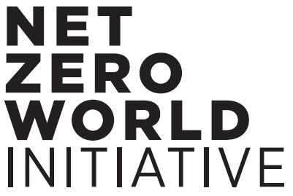







DOE Commitments to Industrial Decarbonization
Industrial Heat ShotTM
Develop technologies to reduce process heating
GHG emissions by 85% by 2035
U.S. joins international collaborations to decarbonize energy-intensive industries
Generate Heat
from Clean Electricity
Innovative Low- or
No-Heat Process Technologies
Net Zero World Initiative
Partnership between U.S., international governments, and organizations to decarbonize global energy systems
Integrate Clean Heat
from Alternative Sources
G7 Industrial Decarbonization Agenda (IDA)
Initiative to reduce GHG emissions from heavy industries such as steel, cement, and chemicals
Industrial Decarbonization Roadmap
Net-zero CO₂ emissions by 2050
Mission Innovation’s Net-Zero Industries Mission
Global initiative to catalyze action and investment toward net-zero carbon emissions
Energy Efficiency
Electrification
Low-Carbon Fuels, Feedstocks, and Energy Sources (LCFFES)
UNIDO Industrial Deep Decarbonisation Initiative
Global coalition of public and private organizations to stimulate demand for low-carbon steel and cement
Notes:
Two DOE-wide initiatives establish DOE's commitment to decarbonization. These initiatives provide a framework for IEDO's priorities. In addition, the DOE Secretary announced DOE involvement in four international decarbonization initiatives in November 2022.
Press release:
https://www.energy.gov/eere/amo/articles/us-joins-international-collaboration-decarbonize-energy-intensive-industries-0

Slide 5



Industrial Efficiency and Decarbonization Office
MISSION
Accelerates the innovation and adoption of cost-effective technologies that eliminate industrial GHG emissions through investments in research, development, and demonstration activities, as well as technical assistance and workforce development.
MAJOR PROGRAM PILLARS
ENERGY- AND EMISSIONS-INTENSIVE INDUSTRIES
TECHNICAL ASSISTANCE AND WORKFORCE DEVELOPMENT
CROSS-SECTOR TECHNOLOGIES

Slide 6
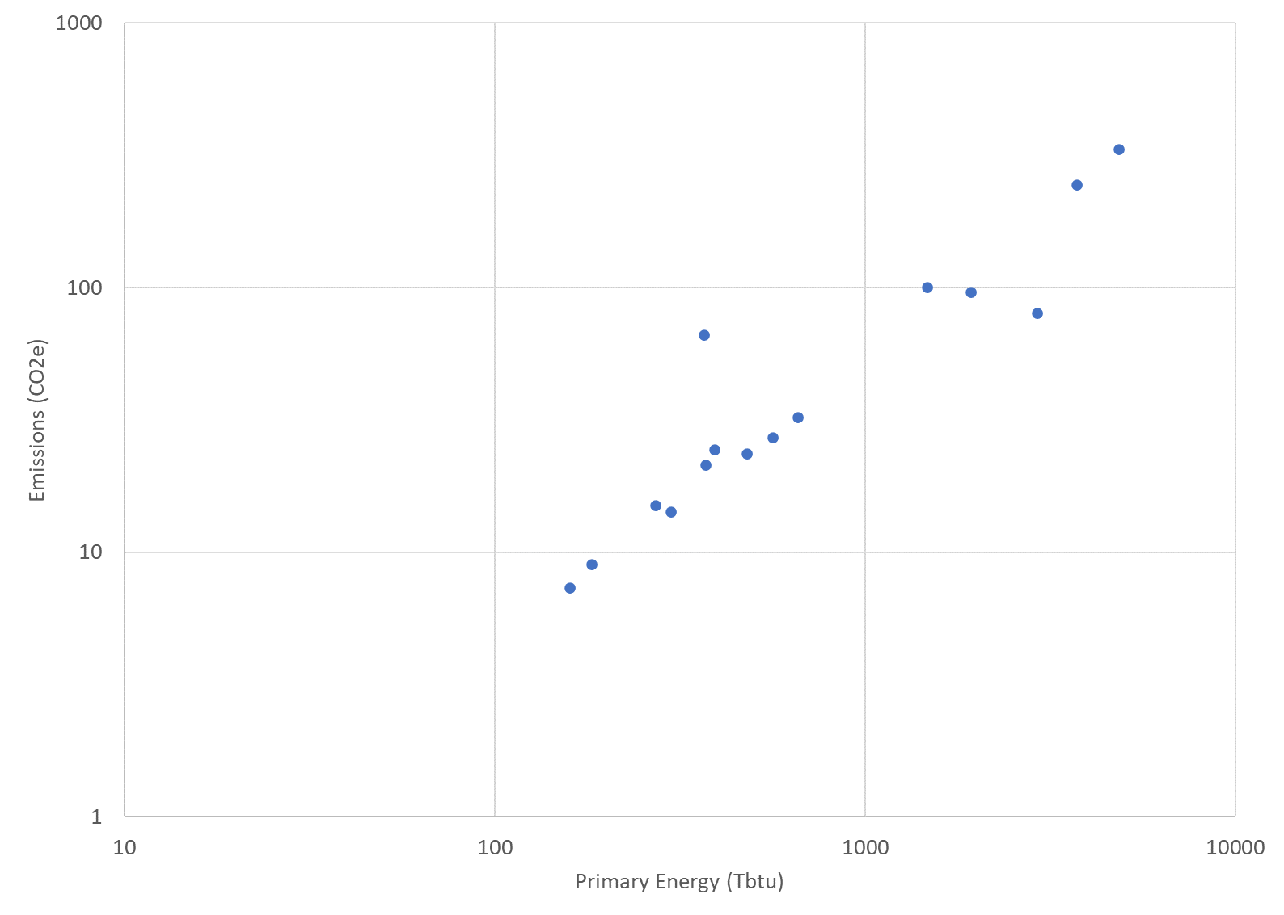
Cross-Sector Technologies within IEDO RD&D
Accelerates the readiness of component and equipment technologies with decarbonization impact across multiple industries.
Industrialize emerging technologies that can be integrated with existing facilities and processes.
  Enabling technologies developed under CST (mid-TRL) that present integration challenges in industry-specific applications can be further advanced under EEII.
Advance energy systems and auxiliary components, e.g., waste heat recovery, sensors and controls, thermal energy storage (CST only).
Develop next-generation production technologies.
Reduce energy and emissions from water and wastewater treatment
A significant number of energy and emissions reduction challenges are common across all industrial subsectors.
IEDO RD&D Landscape
Cross-Sector Technologies
Energy- and Emissions-Intensive Industries
Chemicals
Petroleum Refining
Primary Metals
Food and Beverage
Cement
Forest
Products
Computers and
Electronics
Transportation Equipment
Plastics
Glass
Fabricated Metals
Textiles
Machinery
Foundries
Manufacturing Energy and Carbon Footprints, DOE AMO, 2022.
Notes:
Talking Points
The Cross-Sector Technologies subprogram accelerates the readiness of component and equipment technologies with decarbonization impact across multiple industries.
The subprogram
Prioritizes equipment technologies that can be integrated with existing processes.
Advances energy systems and auxiliary components.
And, develops emerging, next generation production technologies.
As the graphic at the bottom of the slide shows, early-to-mid stage R&D of enabling technologies through the CST subprogram can be transitioned and further advanced to industry-specific applications under the EEII subprogram
In addition, RD&D of energy systems and auxiliary components developed through the CST subprogram can further feed into EEII
**click to for animation**
This graph shows the manufacturing sectors plotted against energy and emissions. The EEII subprogram focuses on the most energy and emissions intensive sectors. CST RD&D addresses the significant number of energy and emissions reduction challenges common across all industrial subsectors.

Slide 7
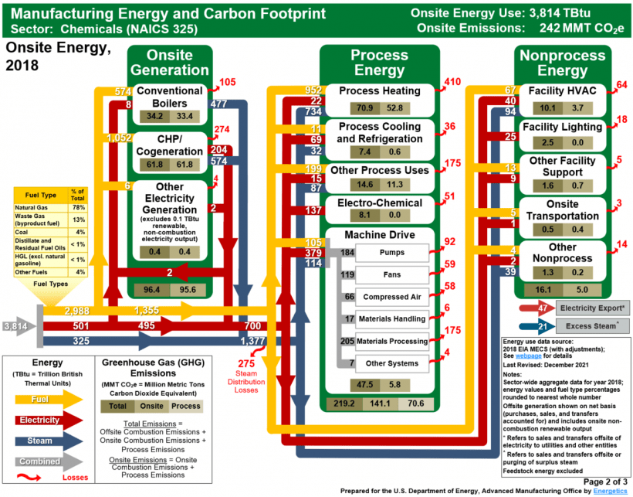
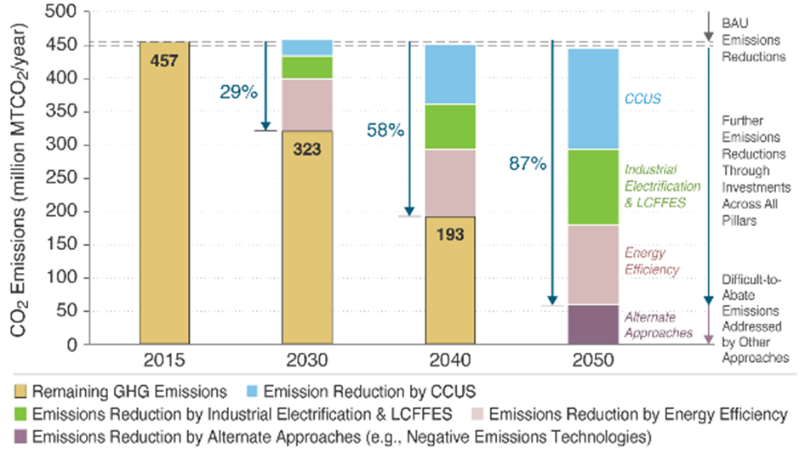
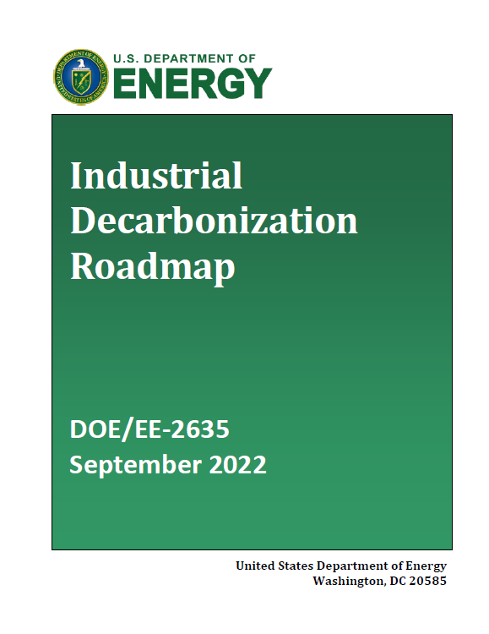
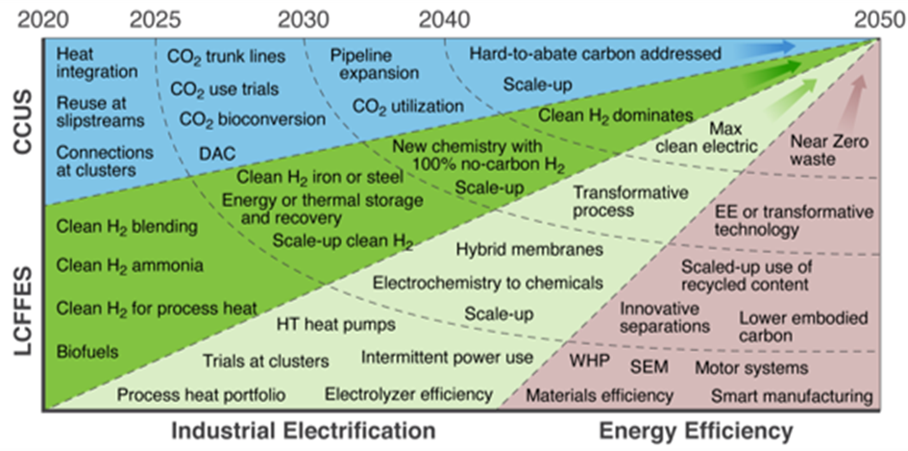
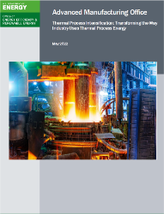
Key Insights from Stakeholder Engagement and Analysis
Manufacturing Energy and Carbon Footprints
Analytical basis to identify cross-cutting opportunities through mapping of energy and emissions by manufacturing end-use
Process heating is the largest source of end-use energy
>60% of energy consumed in the manufacturing sector is from fossil fuels
Industrial Decarbonization Roadmap
Key cross-cutting opportunities, including scaling of electrotechnologies, enabling technologies for hydrogen as a LCFFES, and thermal energy storage
Thermal Process Intensification (TPI) Workshop
R&D needs for thermal processing systems, including:
Increasing use of electrotechnologies and systems utilizing low carbon fuels
Development and use of smart manufacturing technologies
Improvements to waste heat management systems
Materials R&D for next generation thermal systems
DOE Quadrennial Technology Review 2015
R&D opportunities for process heating technologies, including next-generation heat generation systems, sensors and controls, and modeling and simulation.
Notes:
Talking Points
Stakeholder engagement and analysis provide insights to inform program priorities.
Prominent events and sources include
The Thermal Process Intensification workshop series
The Industrial Decarbonization Roadmap
The Manufacturing Energy and Carbon Footprints
The DOE Quadrennial Technology Review for process heating
Examples of the insights from these sources are listed on the slide.

Slide 8
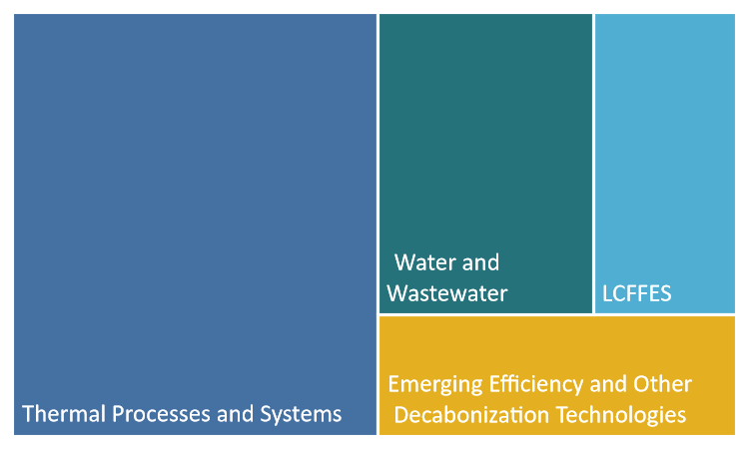
CST Program Priorities and Budget Structure
Industrial Decarbonization is a decades-long journey.
DOE-wide initiatives, inter-office working groups, analysis, and stakeholder technical workshops will continue to refine and inform future priorities.
Key Activity and FY23 Priorities
Thermal Processes and Systems ​ Electrification Innovative low- and no-heat processes
Low Carbon Fuels, Feedstocks, and Energy Sources (LCFFES) Enable use of low carbon fuels and feedstocks, including H₂, bio-derived fuels.
Emerging Efficiency and Other Decarbonization Technologies​ Next generation innovations Flexible industrial energy use Thermal energy storage
Energy & Emissions Reductions from Water and Wastewater Treatment Decarbonization of water resource recovery facilities
CST Budget Breakdown*
FY24 Request: $141M
*Relative size of investment
Notes:
Talking Points
We understand that industrial decarbonization is a decades-long journey, where priorities will continue to evolve as technology advances.
DOE-wide initiatives, inter-office working groups, analysis, and stakeholder workshops will ensure our priorities meet the current need and define future directions.
The CST subprogram is organized into four (4) key activities, FY23 priorities are noted for each.
Thermal Processes and Systems which looks to broadly decarbonize process heat and other thermal processes.
Low carbon, fuels, feedstocks, and energy sources focusing on enabling the use of low carbon fuels and feedstocks
Emerging Efficiency and Other Decarbonization Technologies, exploring innovative concepts and emerging technologies to significantly improve system efficiencies and flexibilities
And Energy and Emissions Reductions from Water and Wastewater Treatment which will decarbonize and increase the efficiency of water and wastewater treatment plants

Slide 9
Thank You
Thank you
Isaac Chan, Program Manager
Industrial Efficiency and Decarbonization Office

Slide 10
Low-Carbon Process Heating
Cross-Sector Technologies Stakeholder Meetings
May 25, 2023
Low-Carbon Process Heating
Keith Jamison, Technology Manager
Industrial Efficiency and Decarbonization Office
This presentation does not contain any proprietary, confidential, or otherwise restricted information

Slide 11
Thermal Processes are Key to Industrial Decarbonization
Thermal Processes are Key to Industrial Decarbonization
Industrial Heat Causes 11% of All U.S. Energy-Related Emissions
Other: Mining, Agriculture, Construction, 5%
2020 Energy-Related CO₂ Emissions by U.S. Economic Sector
2020 Estimated Industrial: Manufacturing Energy-Related CO₂ Emissions by Source
Sources: EIA Annual Energy Outlook (2021); AMO 2018 Manufacturing Energy and Carbon Footprints (2022)

Slide 12






Cross-Sector Approach is Challenging but Necessary
Thermal processes and systems are essential and pervasive in industry,
but every major industrial subsector uses heat in different ways...
drying
paper,
batteries
steam
pasteurized food
distillation
high purity
chemicals
melting
formed plastics,
semiconductors
smelting
iron, copper, aluminum
calcining
cement,
lime
Process Temperatures Needed
~300ºC
>800ºC

Slide 13

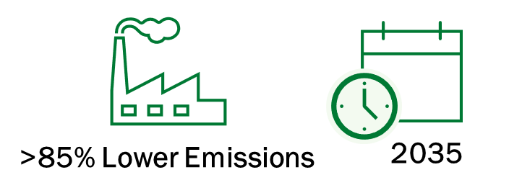
Decarbonization of Thermal Processes & Systems at IEDO
Reduce the amount of heat used and the emissions from generating heat to make cleaner products by…
Overcoming Critical Barriers
Supporting DOE’s Industrial Heat Shot
Develop diverse technology portfolio to address industry’s heterogeneous heat demands
Meet or exceed operational demands
Address cost competitiveness
Quantify non-energy/non-emissions benefits
Scale-up towards commercialization
Develop cost competitive industrial heat decarbonization technologies with at least 85% lower greenhouse gas emissions by 2035
Advancing Key Technologies
Electro-technologies & industrial heat pumps
Innovative low- and no-heat processes & advanced non-thermal separations (e.g., membranes)
Low-carbon fuels and energy sources
Advanced furnace equipment and process control technologies

Slide 14
Industrial Heat Shot: 3 Pathways to Decarbonize Industrial Heat
Reduce the amount of heat and/or emissions from heat to make cleaner products
Generate Heat
from Clean Electricity
Innovative Low- or No-Heat Process Technologies
Integrate Clean Heat
from Alternative Sources
Reduce Emissions:
electrify equipment & use clean electricity, improve energy efficiency
Examples:
heat pumps, microwave heating, resistive heating, thermal storage, etc.
Reduce Emissions:
new chemistry and emerging approaches to reduce heat demand
Examples:
advanced separations, electrolysis, ultraviolet curing, biobased manufacturing, etc.
Reduce Emissions:
switch to low-emissions heat sources and increase thermal storage
Examples:
solar thermal, nuclear, geothermal, hydrogen, some sustainable fuels

Slide 15
Objective and Targets
Objective
Advance cost-effective technologies for process heating that improve the properties of manufactured products, and develop alternative, low thermal budget technologies that reduce the energy and carbon requirements of materials processing.
Targets
Develop electrified process heating technologies to replace existing fuel-based technologies through cost competitiveness, reduced emissions, improved flexibility, and greater efficiency.
Develop low-carbon fuel- and energy source-based process heating equipment that emphasizes integration to industrial processes, product validation, and reduced emissions.
Develop low-thermal-budget manufacturing technologies that reduce energy intensity (energy consumed per unit of physical output) by at least 50% compared to typical technology.
Develop advanced process heating unit operations that provide improved properties, quality, and/or product value at cost parity to conventional techniques.

Slide 16
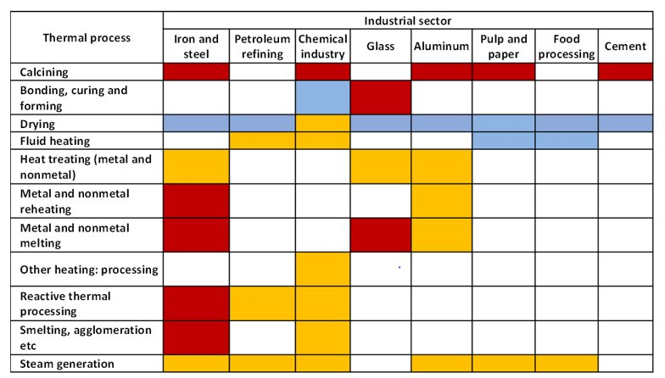
Role of LCFFES in Process Heat Decarbonization
Integrate Clean Heat
from Alternative Sources
Reduce Emissions:
switch to low-emissions heat sources
Alternative for hard-to-electrify applications: high-temperature applications or processes that require direct-fired heating
Examples:
solar thermal, advanced nuclear, geothermal, hydrogen, some sustainable fuels
Blue = low temperature (<800°F);
Orange = medium temperature (800°F to 1,400°F);
Red = high temperature (>1,400°F).
Sources:
(1) Department of Energy Thermal Process Intensification Report, 2022
Notes:
Mapping technologies to the processes for which they’re best suited. The issue at hand here is that there are processes and sectors for which electrification is particularly difficult due to the need for direct-fired heating, or high temperature needs.
We therefore put particular emphasis in this portfolio on hard-to-electrify sectors, where other solutions such as energy efficiency and electrification are not likely to achieve transformative impact by the 2050 net-zero goal.

Slide 17
Thermal Processes & Systems Portfolio
FY19
AMO Multi-Topic FOA. Topic 2: Lower Thermal Budget Processes for Industrial Efficiency & Productivity
  Subtopic 2.1: Advances in Industrial and Process Drying (6 awards; ~$11.7M)
    Area of Interest 1 – Novel Drying Systems in Manufacturing
    Area of Interest 2 – Drying Modeling, Sensing, and Control Strategies
  Subtopic 2.2: Thermal Process Intensification (2 awards; ~$9.4M)
    Area of Interest 1 – R&D of Electromagnetic Sources for Manufacturing
    Area of Interest 2 – Electromagnetic Energy for Advanced Manufacturing Applications
AMO Multi-Topic FOA. Topic 1: Efficiency Improvements in Advanced Manufacturing Processes
  Subtopic 1.2: Enhanced Efficiency of Drying Processes (3 awards; ~$7.7M)
AMO Multi-Topic FOA. Topic Area 1: Manufacturing Process Innovation
  Topic Area 1a: Efficiency Improvements to Drying Processes (3 awards; ~$6.2M)
Clean Energy Manufacturing Innovation Institute for Electrification of Process Heating (Institute 7)
  FOA released June 2022; Selection announcement May 2023 (Arizona State University to lead)
Industrial Efficiency and Decarbonization FOA. Topic Area 6: Cross-sector Decarbonization Technologies
  Area of Interest 2 – Electric Generation from Low Temperature Waste Heat
  Area of Interest 3 – Industrial Heat Pumps
IEDO Multi-Topic FOA. Topic Area 1: Decarbonizing Industrial Heat & Topic Area 2: Low-Carbon Fuels Utilization R&D
FY20
FY21
FY22
FY23

Slide 18
Thermal Processes & Systems
Cross-Sector Technologies
Industrial Efficiency & Decarbonization Office
Keith Jamison, Technology Manager
Questions?
Future Priorities
Stakeholder engagement through Industrial Heat Shot Summit
Advance technologies to achieve IEDO and Industrial Heat Shot goals
Recent Achievements
Completion of CEMI Institute #7 FOA and selection announcement
Completion of Industrial Efficiency & Decarbonization FOA (selections forthcoming)

Slide 19
Cross-Sector Technologies Session 1: Low-Carbon Process Heating
Breakout Session Group 1: Electrotechnologies
Breakout Session Group 2: Low-Carbon Fuels and Energy Sources
Breakout Session Group 3: Low-Thermal Budget Pathways

Slide 20
Breakout Group 1: Electrotechnologies
Background: Electrotechnologies refer to solutions and/or equipment that can support electrification of process heating and use of clean electricity.
Examples:
  Heat Pumps
  Electromagnetic Heating
  Resistive Heating
Potential Discussion Topics:
  Technologies of Interest
  Challenges & Barriers for Implementation
  R&D Opportunities

Slide 21
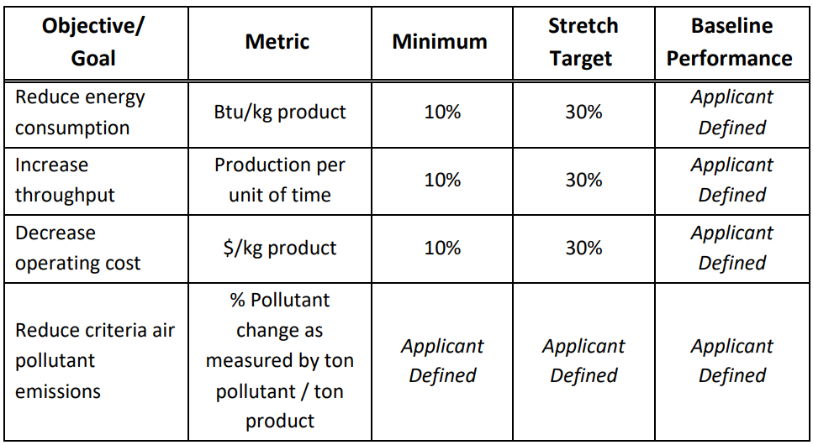
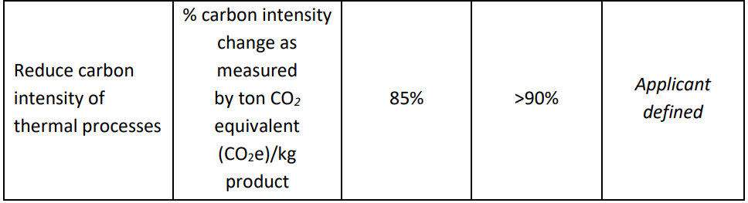
Session 1: Review of Metrics and R&D Focus Areas
Technology Focus Areas Include:
  Electrification of Industrial Heat: development, optimization, and/or integration of electrified thermal processing solutions
  Innovated Low- and No-Heat Processes: Low-thermal budget processes to achieve similar end products to current processes while using much less thermal energy (i.e. mechanical separations, EM, thermomagnetic processing, acoustic/microwave advanced drying processes)

Slide 22
Breakout Group 2: Low-Carbon Fuels and Energy Sources
Background: Low-carbon fuels encompasses clean fuel technologies, clean energy sources, and alternative feedstocks to decarbonize industrial process heating applications (i.e. focus on end use).
Examples:
  Hydrogen
  Biofuels & Biomass
  Integration of Renewables
Potential Discussion Topics:
  Technologies of Interest
  Challenges & Barriers for Implementation
  R&D Opportunities

Slide 23
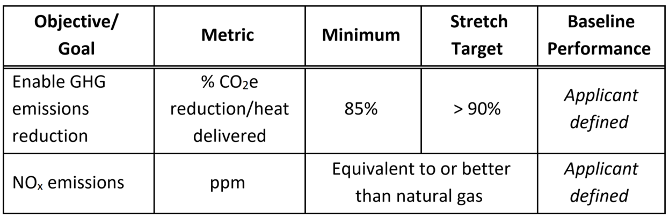
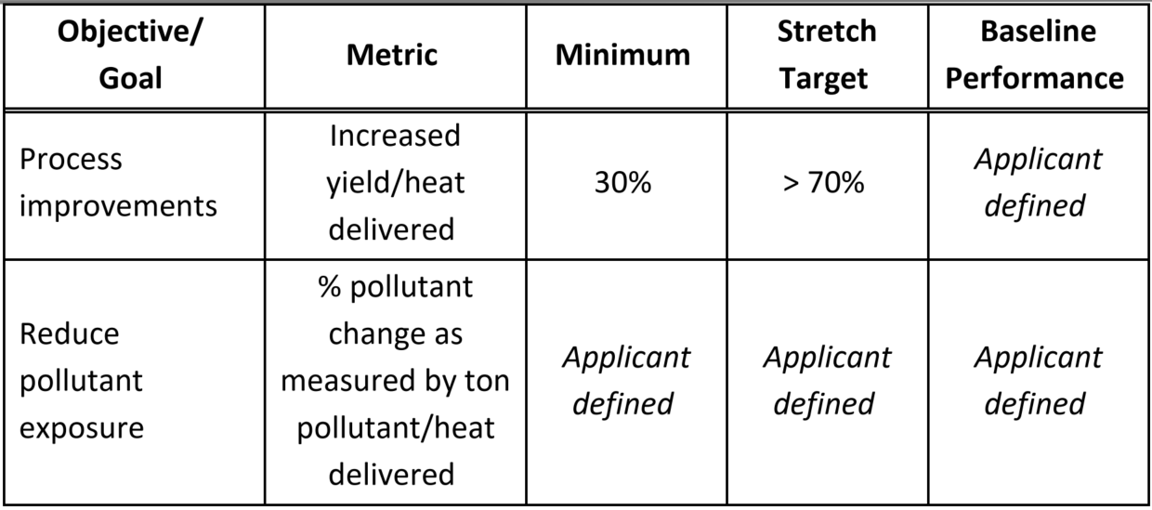
Review of Metrics and R&D Focus Areas Continued…
Technology Focus Areas Include:
  Mitigating H₂ Combustion Impacts on Material and Product Quality: Solutions to address altered heat transfer, heating profiles, and exhaust gas.
  Developing H₂-Based Combustion Systems: Technologies to enable safe and effective hydrogen-blended combustion for process heating.

Slide 24
Breakout Group 3: Low-Thermal Budget Processes
Background: Low-thermal budget processes refer to transformative technologies that use alternative processing routes and/or technologies to achieve equivalent end products manufactured by current processes.
Examples:
  Non-Thermal Separations via durable and scalable membranes
  Non-Heat Based Technologies
Potential Discussion Topics:
  Technologies of Interest
  Challenges & Barriers for Implementation
  R&D Opportunities

Slide 25
Breakout Session Group 1 Report Out: Electrotechnologies
Technologies
  Resistive Heating
  Microwave Heating
  Optical Techniques
  New Reaction Pathways
Challenges & Barriers
  Power electronic needs for grid interface
  Material limitations at high temperatures
  Larger turndown ratios
  Scaling heating elements in electrified equipment for very high temperature processes
R&D Opportunities
  Combining plasma and hydrogen or other combined technologies (i.e. plasma and microwave)
  Driving Chemical Driven Processes with electrical potential as opposed to thermal potential
  Multiple power sources for feed forward control to improve product quality and consistency
  Heat Pumps that can achieve higher temperatures to expand applications

Slide 26
Breakout Session Group 2 Report Out: Low-Carbon Fuels and Energy Sources
Equipment development needs to be future-proof for ALL possible fuels
  Fuels of the future will vary by industry and process
  Still technology issues to be solved to make cross-sectoral impact
Direct vs. indirect heating will dictate much of the technology development
  Getting the right wavelengths (emissivity) is important. Can utilize fuel switching, burner design, or different combustion environments (e.g.: O2 content), or preparation of surfaces to achieve the right heating profiles
  Material properties can be affected by fuel switching (e.g.: steam in exhaust). Tolerances vary but exhaust parameters not completely fixed.
  Flame to flameless technologies are a potential area of interest with boosts in efficiency
Fuels of opportunity include hydrogen, ammonia, ethanol, butanol, waste streams like dilute syngas, and blends such as hythane.
Fuel switching (H2 in particular) unlikely to achieve significantly increased yield—looking at breaking even or even losing on yield/heat input.
Permitting for fuel switching will be a significant barrier toward industry adoption

Slide 27
Breakout Session Group 3 Report Out: Low-Thermal Budget Processes
Technologies & Approaches
  Drying: centrifugal drying, electro-osmotic separations, reducing energy for freeze drying
  High efficiency technologies: industrial heat pumps, supercritical water oxidation
  Microwave-enhanced chemistry
  Hybrid and multi-stage approaches
  Alternate feedstocks and products that fulfill same need
Opportunities for Collaboration
  Industrial Heat Pumps: international partners (Japan, Europe)
  Manufacturing Institutes, including NAWI for membranes
Industrial Heat Pumps
  Smaller plants can use “off-the-shelf” designs, especially for steam generation; larger plants will need to leverage expertise in heat integration to design optimal systems
  Big opportunity for collaboration with boiler manufacturers to develop alternative product lines
  Application is essential when considering heat pump metrics; ultimately CAPEX/OPEX are what matters

