Slide 1
CLEANUP TO CLEAN ENERGY INDUSTRY DAY
July 28th, 2023

Slide 2
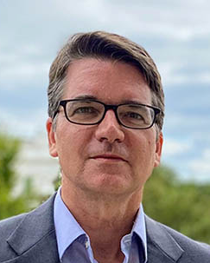
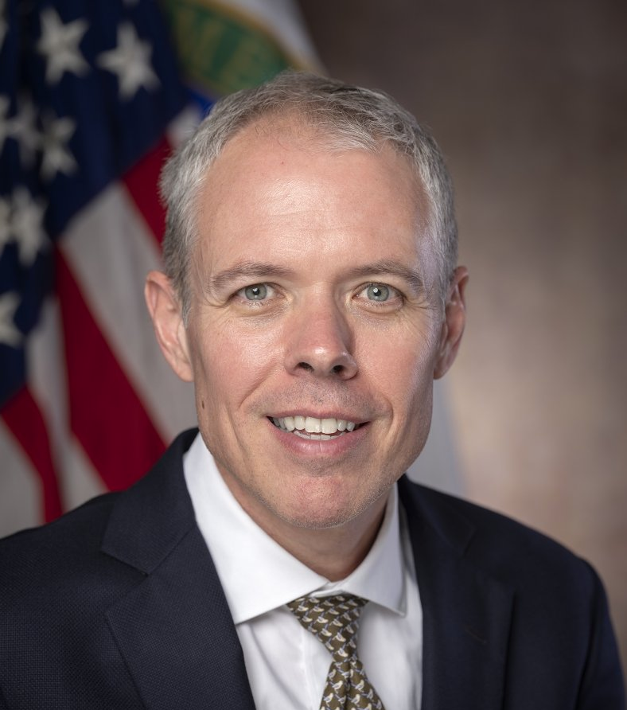
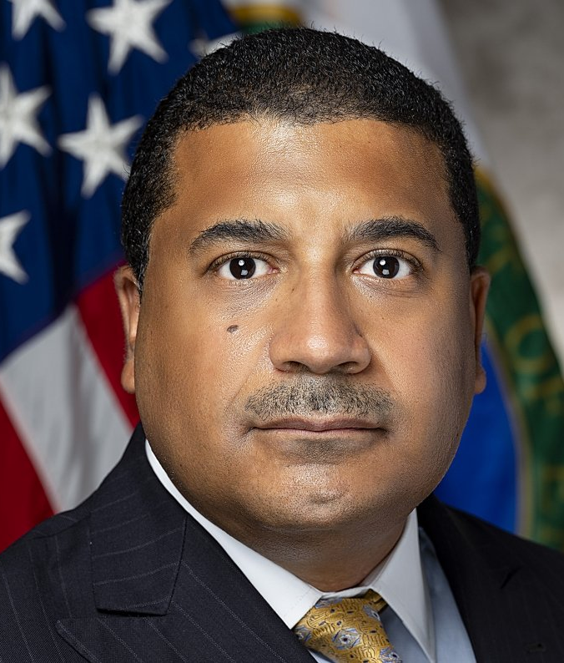
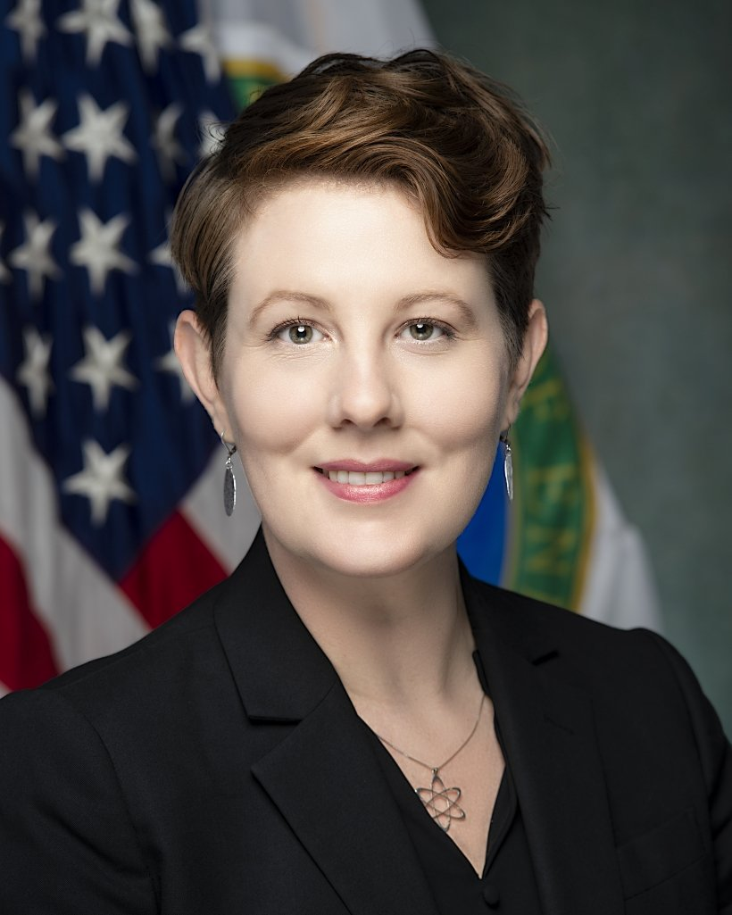
Panel Discussion 1
Andrew Mayock Federal Sustainability Officer, CEQ
Ike White
Senior Advisor, Office of Environmental Management (EM)
Frank Rose
Deputy Administrator, National Nuclear Security Administration (NNSA)
Kathryn Huff Assistant Secretary of Nuclear Energy (NE)

Slide 3
Ike White, Senior Advisor, Office of EM

Slide 4
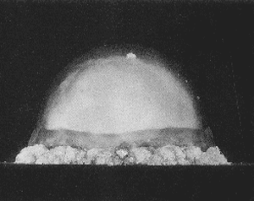
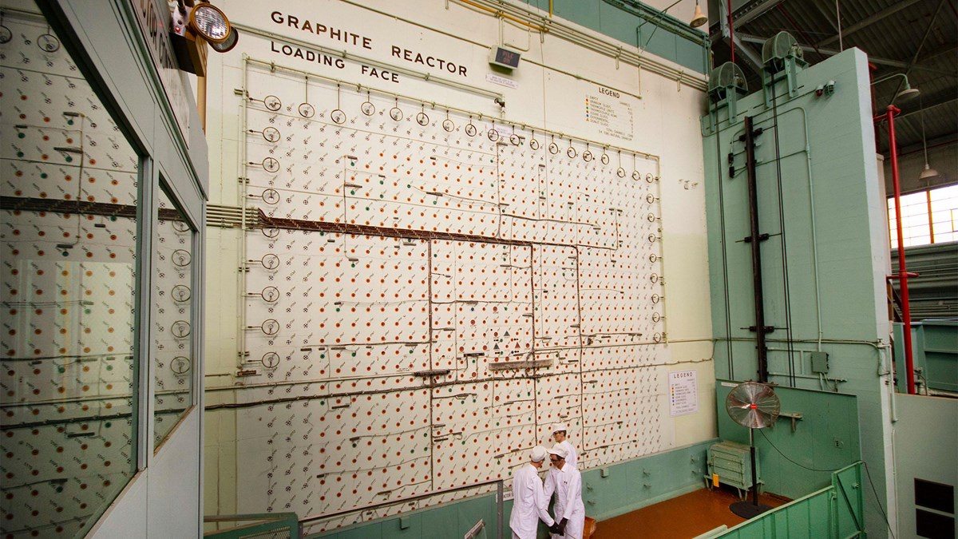
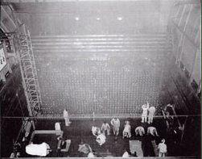
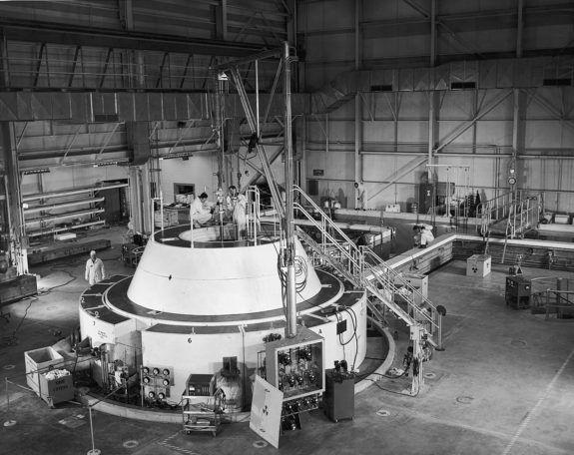
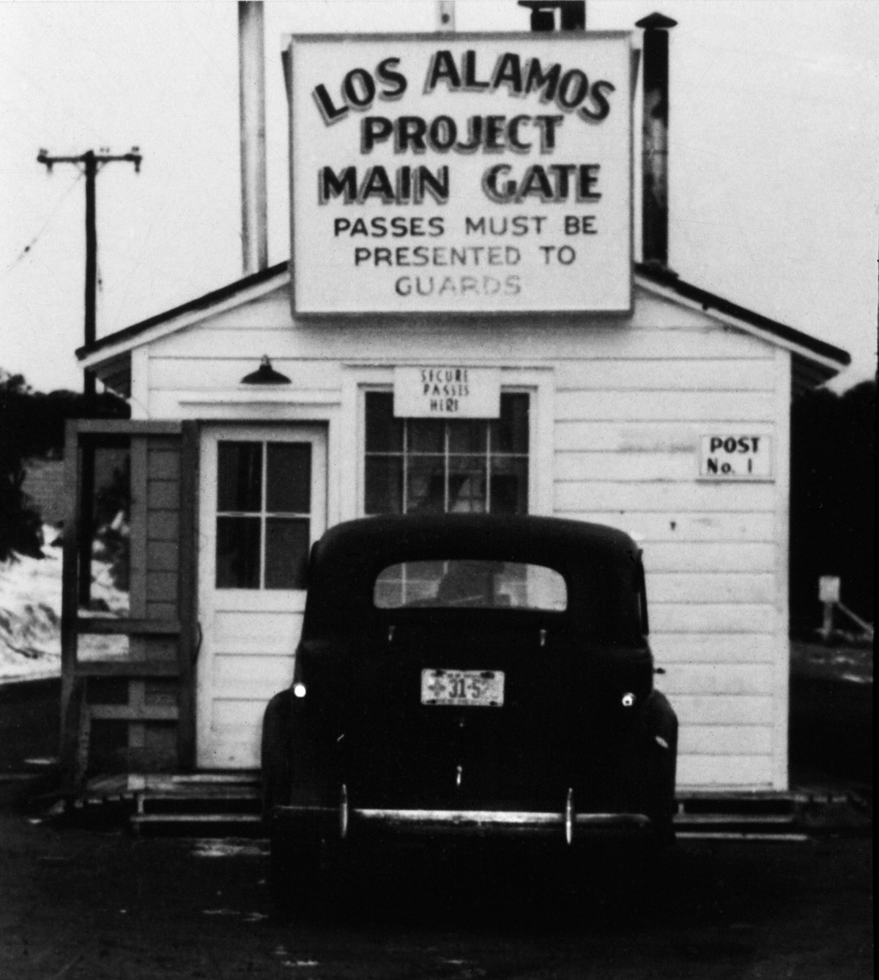
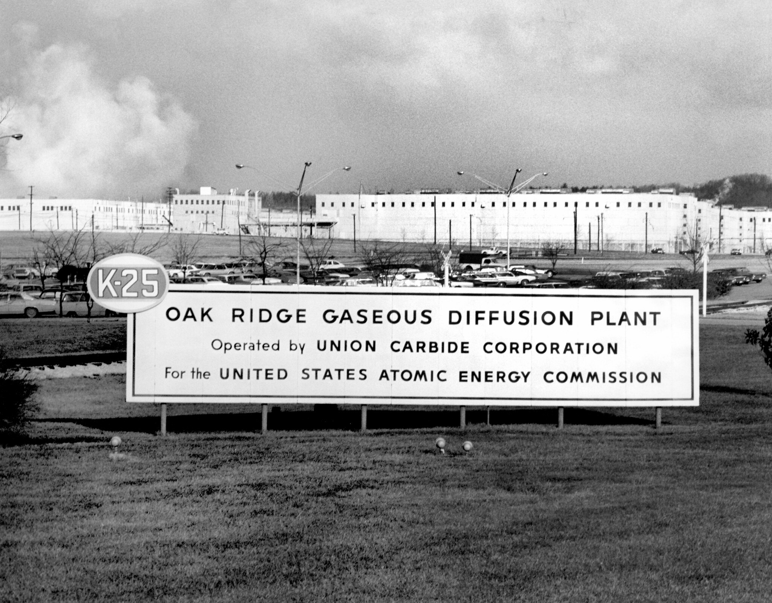
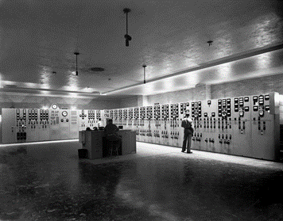
The EM Mission

Slide 5
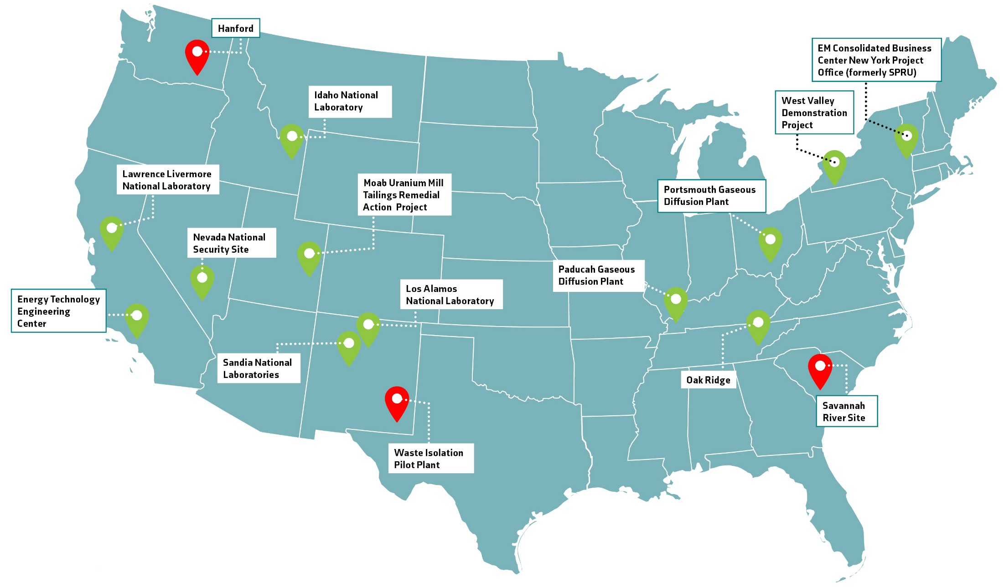
EM Progress

Slide 6
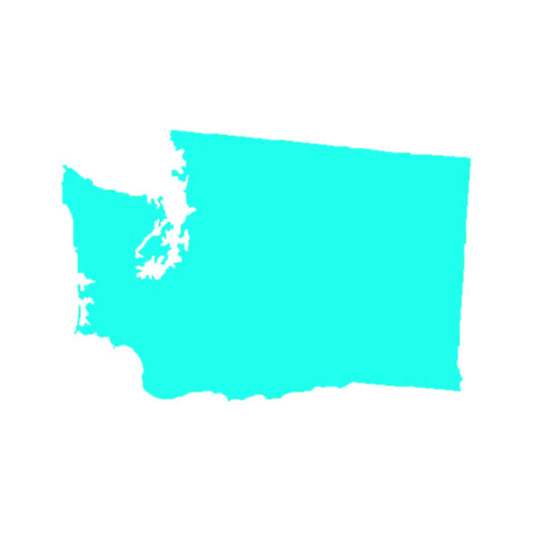
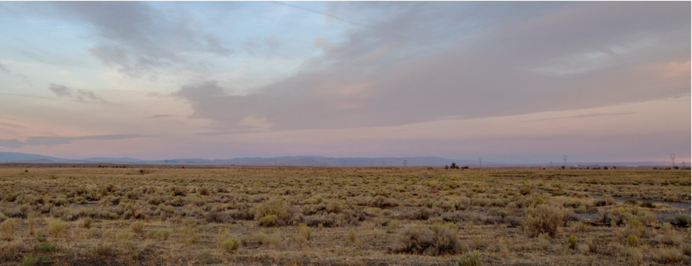
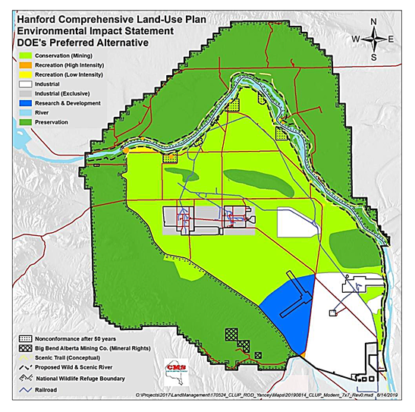
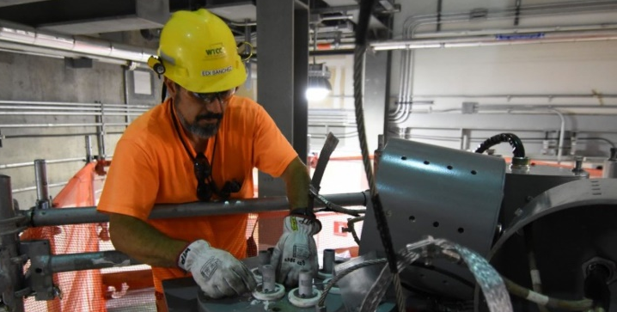
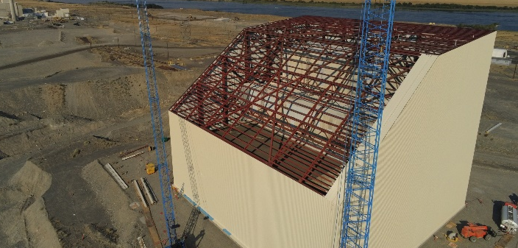
Hanford
Hanford, Washington

Slide 7
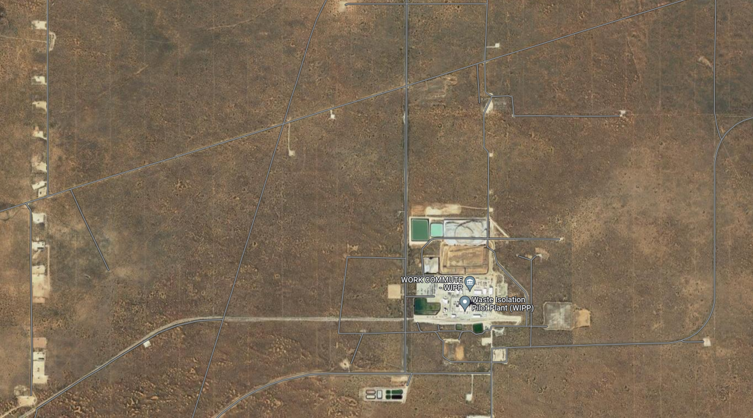
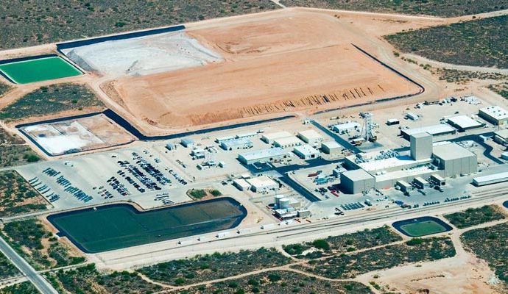
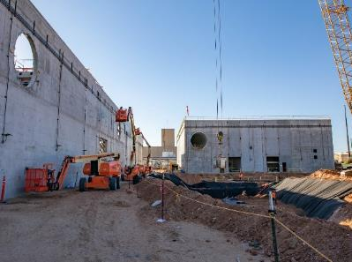
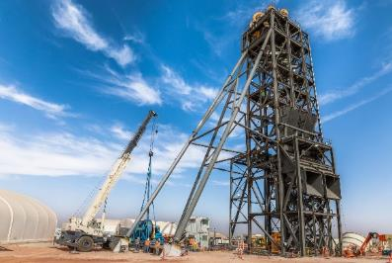
Waste Isolation Pilot Plant
Carlsbad, New Mexico

Slide 8
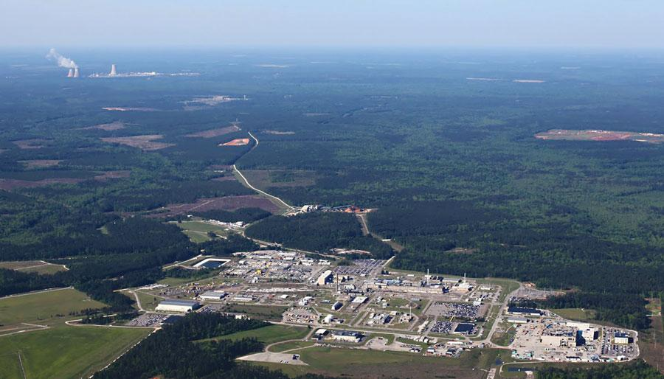
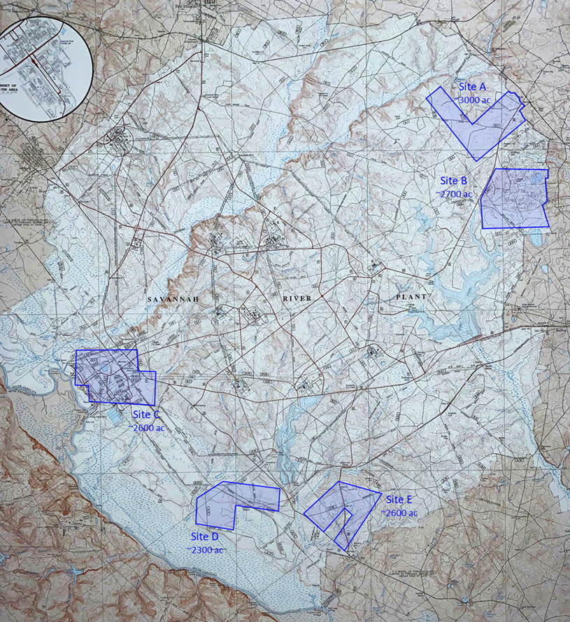
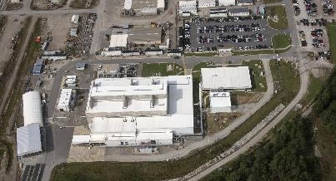
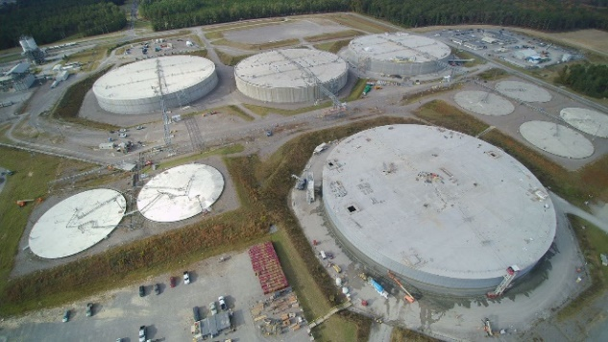
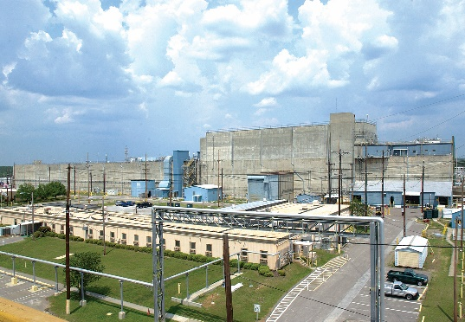
Savannah River Site
Aiken, SC

Slide 9
Frank Rose, Deputy Administrator, NNSA
Nevada National Security Site
Located in Southern Nevada

Slide 10
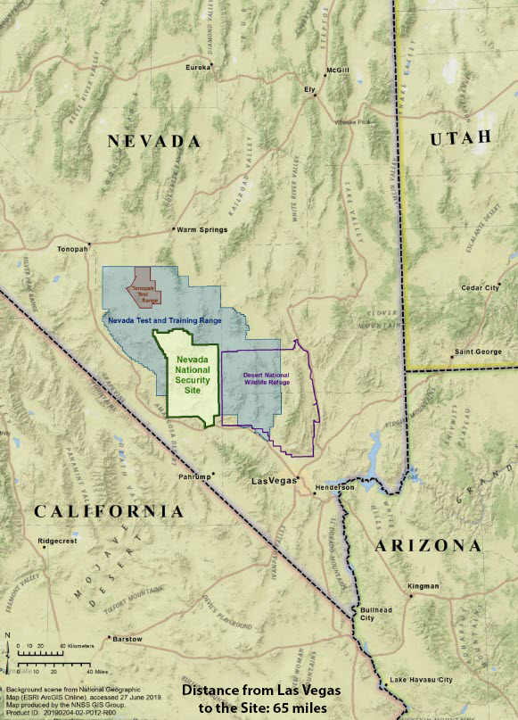
Nevada National Security Site - Vicinity

Slide 11
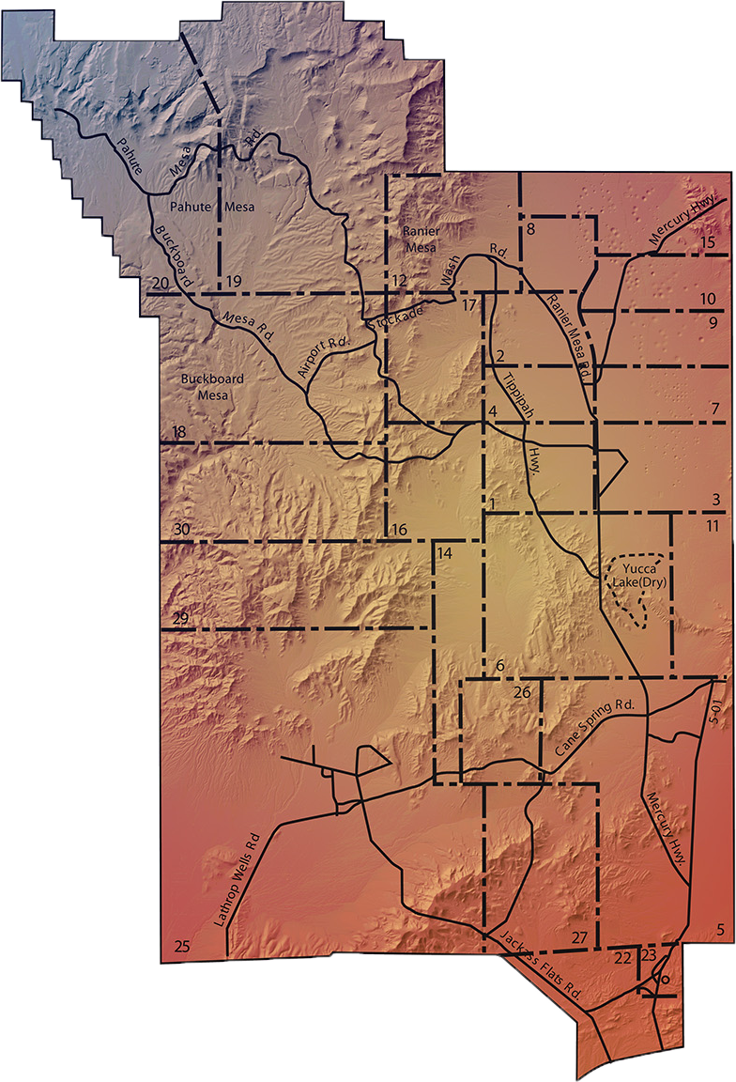
Nevada National Security Site - Roads

Slide 12
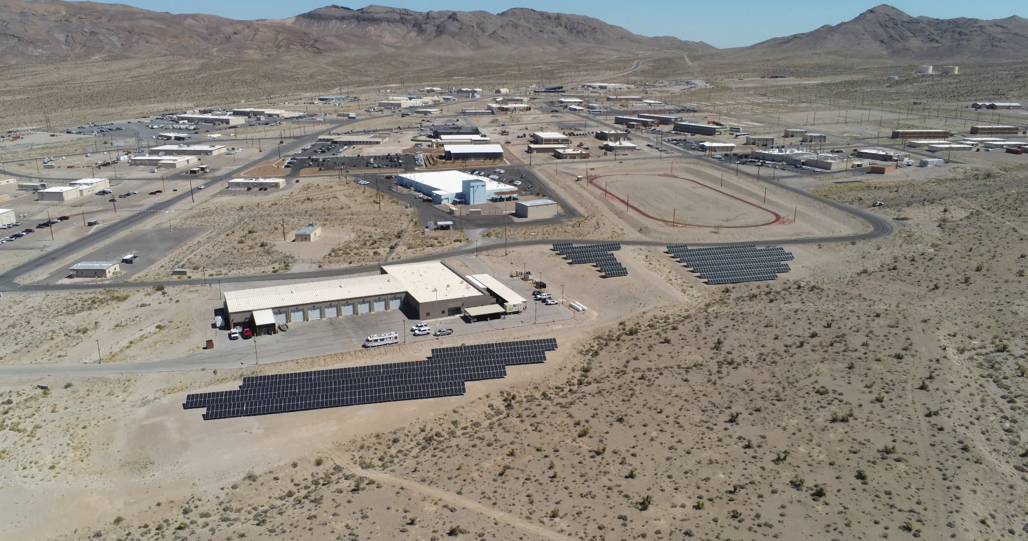
Mercury Building with Solar Array

Slide 13
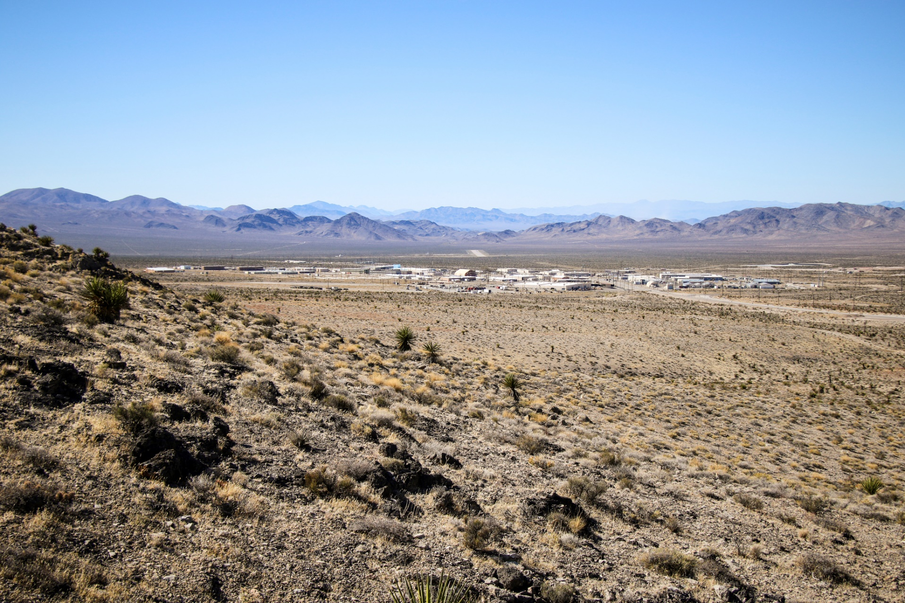
Topography Around Areas 22 & 23

Slide 14
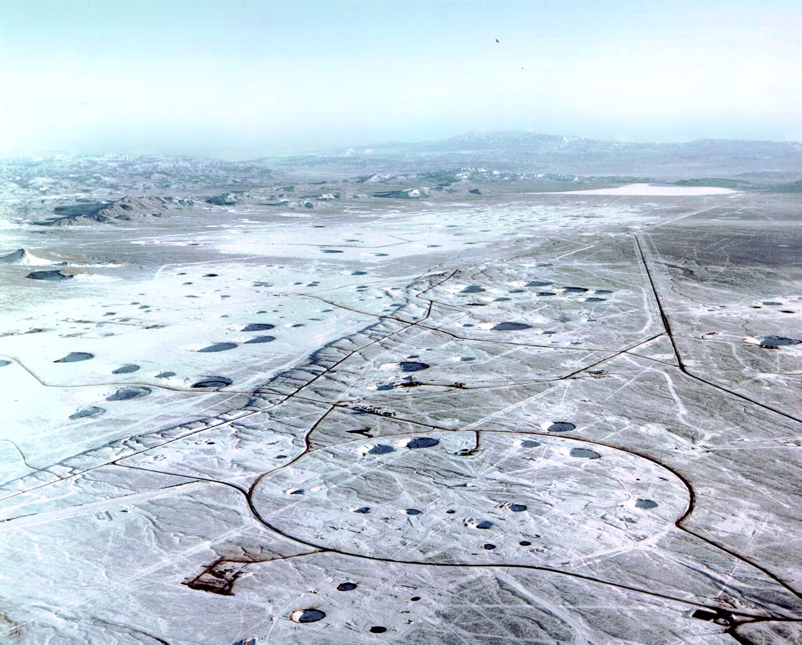
Nevada Test Site Craters

Slide 15
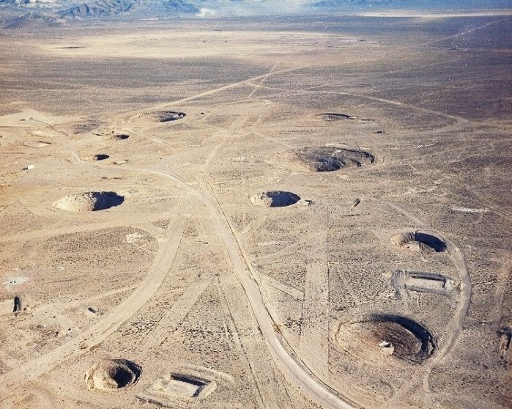
Craters in Yucca Flat

Slide 16
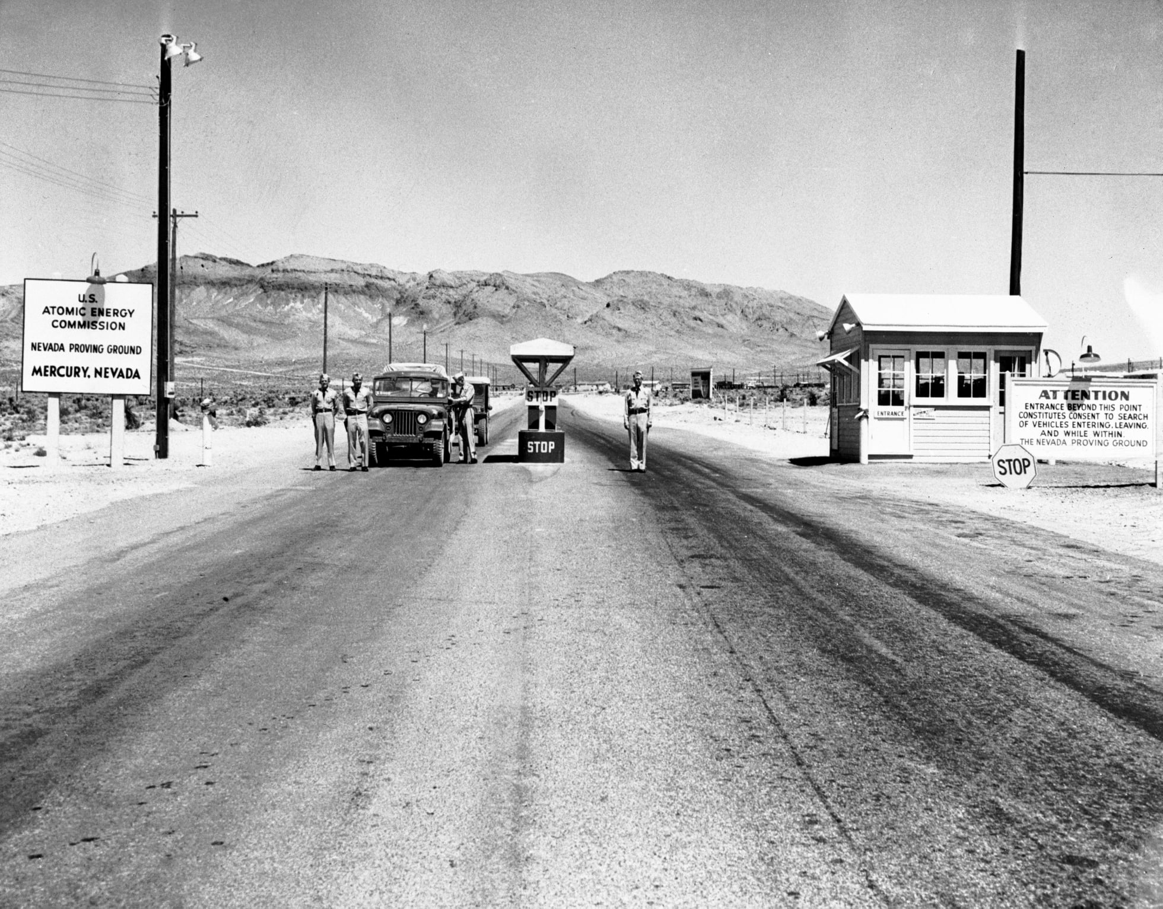
Nevada National Security Site – History (1 of 2)

Slide 17
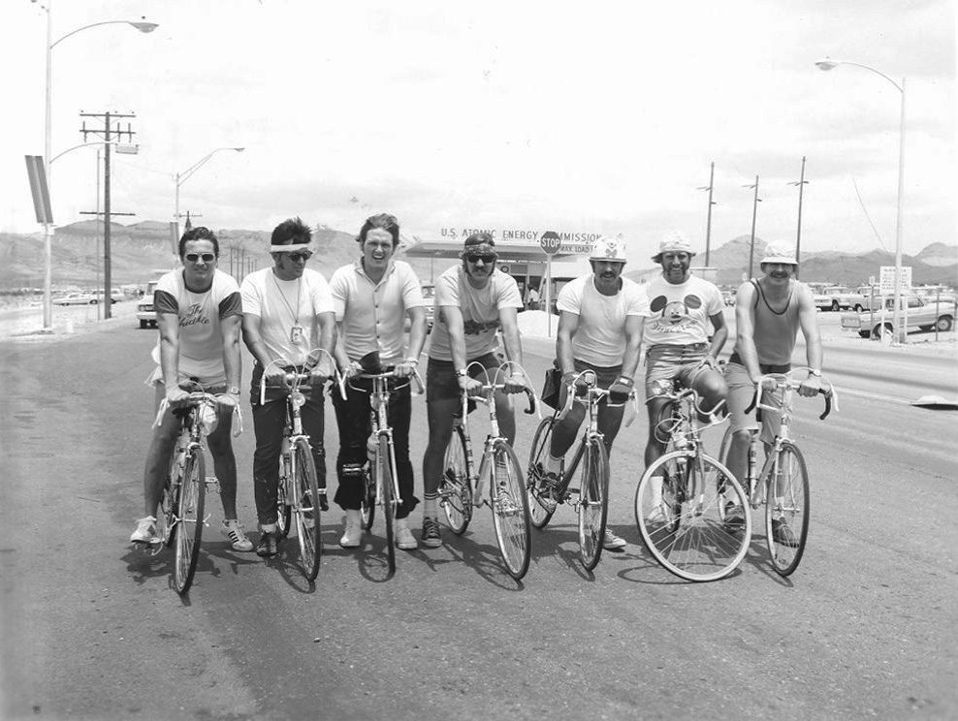
Nevada National Security Site – History (2 of 2)

Slide 18
Kathryn Huff, Assistant Secretary of NE

Slide 19
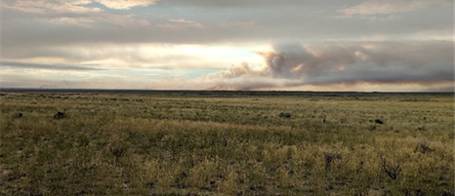
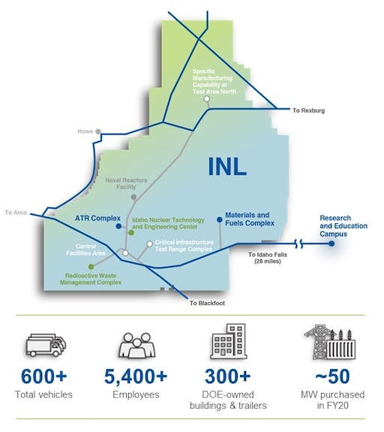
Idaho National Laboratory (INL)
Site | Acreage Available
Carbon-Free Power Project | 2,500
Advanced Reactor Development | 13,440
Advanced Reactor Development Site #29 | 2,500
Energy Technology Proving Ground | 2,485
T6N R33E Section 16 | 640
T7N R31E Section 19 | 640
T8N R31E Section 36 | 640

