Slide 1
A Conversation with Alaskans on Grid Resilience State and Tribal Formula Grants
US Department of Energy
July 19, 2023
Notes:
ICF

Slide 2
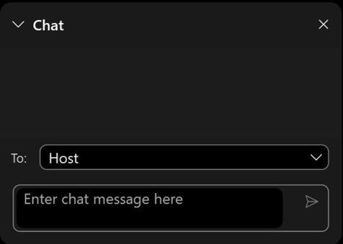
Housekeeping
Questions?
Please submit all questions directly through the chat box.
If you have technical questions – please put them in the chat box for the host.
2
Notes:
ICF

Slide 3
Arctic Energy Office
Advancing energy, science and security in the Arctic

Slide 4
Arctic Energy Office: A Critical Part of the DOE Mission
Department of Energy Mission:
Ensure America’s security and prosperity by addressing energy, environmental and nuclear challenges through transformative science and technology solutions.
Mission:
We bring the Arctic to the Department of Energy (DOE) and DOE to the Arctic.
We collaborate in innovative ways to meet the energy, science and security needs of the United State and our Arctic allies.
Secretary of Energy
Deputy Energy Secretary
Under Secretary for Science and Innovation
Arctic Energy Office
DOE Goals:​
Combat the climate crisis​
Promote energy justice ​​
Facilitate energy transition​​
Create Clean Energy union jobs

Slide 5
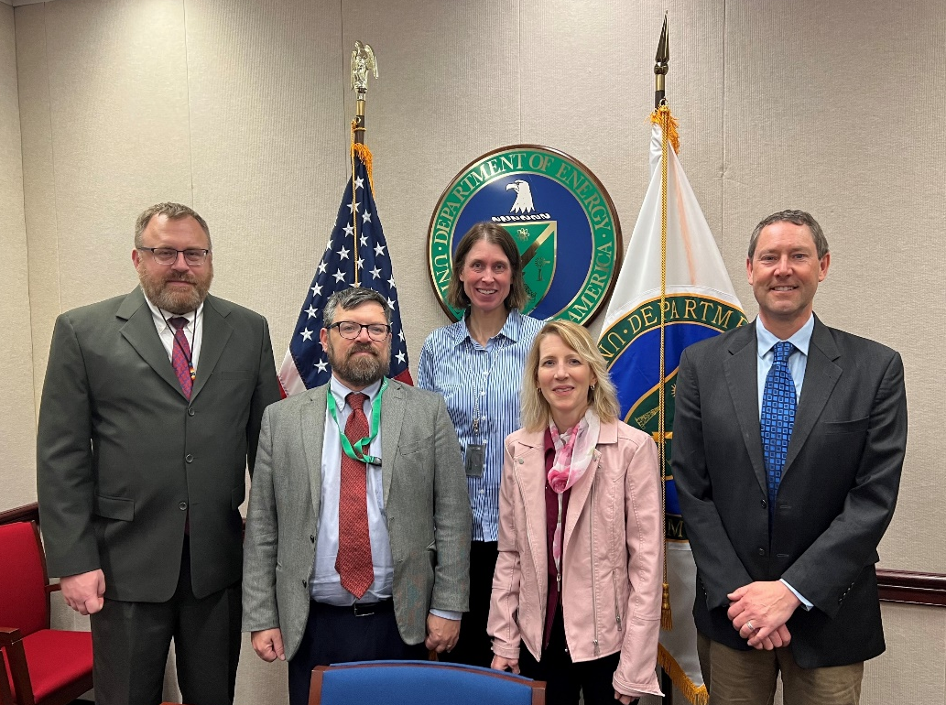
Who We Are, What We Do & How We Can Help
We are:
What we do and how we can help:
A team with expertise in:
Engineering
International affairs
Science and research
Military and government relations
Tribal consultations
Communications
Our main objectives are to:
Support U.S. Department of Energy policies, programs and events
Advance Arctic energy transition in remote and rural communities
Ensure tribal voices are heard
Collaborate with Arctic stakeholders
Connect stakeholders with government resources
Ensure national security of the Arctic

Slide 6
Stay Connected
Visit our website: energy.gov/arctic
Subscribe to the Arctic Energy Newsletter
Follow us on Facebook: facebook.com/ArcticEnergyDOE
Follow us on Twitter: @ArcticEnergyDOE
Connect with us on LinkedIn: https://www.linkedin.com/company/doe-arctic-energy-office/

Slide 7
Grid Resilience Formula Grants for Tribes
US Department of Energy
July 19, 2023
Notes:
ICF

Slide 8
Grid Resilience Tribal Formula Grant Program
Emily Barrett
Technical Advisor,
State and Tribal Assistance Programs
Grid Modernization Division
Ariel Horowitz
Deputy Director,
Grid Modernization Division
Notes:
ICF

Slide 9
Grid Deployment Office
Mission Statement: The Grid Deployment Office (GDO) works to provide electricity to everyone, everywhere by maintaining and investing in critical generation facilities to ensure resource adequacy and improving and expanding transmission and distribution systems to ensure all communities have access to reliable, affordable electricity.
Generation Credits Division
The Generation Credits Division works with existing generation facilities to ensure resilience and reliability.
The Transmission Division supports innovative efforts in transmission reliability and clean energy analysis and programs, and energy infrastructure and risk analysis in support of the Administration’s priorities to enhance grid resilience.
Transmission Division
Grid Modernization Division
The Grid Modernization Division oversees activities that prevent outages and enhance the resilience of the electric grid.
Notes:
Ariel

Slide 10
GDO at a glance
Power Generation
Transmission
Grid Modernization
Civil Nuclear Credit Program: $6 billion
Hydro Incentives:
More than $700 million
Transmission Facilitation Program: $2.5 billion
Transmission Facility Financing:
$2 billion
Transmission Siting and Economic Development Grants: $760 million
NTP and Needs Studies; OSW Convenings
Permitting
Grid Resilience State/Tribal Formula Grants: $2.3 billion
GRIP Program: $10.5 billion
Puerto Rico - Energy Resilience Fund : $1 billion
Territory Recovery Assistance
Annual Appropriations - $65 million
Notes:
Ariel

Slide 11
Grant Program Highlights
Notes:
Dave

Slide 12
Grant program highlights
Non-competitive grant for projects reducing the likelihood and consequences of electrical outages due to extreme weather, wildfire or a natural disaster.
Application deadline for first 2 years of funding was extended for Indian Tribes, including Alaska Native Corporations, to August 31, 2023 (five years total).
Eligible applicant should apply by the deadline to “secure” funding.
Applications do not need to identify specific projects. Projects can be specified after funding is awarded.
Sample application templates and resources available.
Subgrant and cost match requirements.
Notes:
Post: Grant information can be found here: Grid Resilience State/Tribal Formula Grant Program | Department of Energy
Dave

Slide 13
Resilience investments permitted under the Grid Resilience Formula Grant program
Potential Investments include:
Ineligible Investments
Construction of a new electric generating facility
Construction of large-scale battery storage facilities not being used to supply electricity where needed during disruptive events
Cybersecurity measures
Utility pole management
Hardening of power lines, facilities, substations, of other systems
Undergrounding of electrical equipment
Replacement of old overhead conductors and underground cables
Relocation of power lines or the reconductoring of power lines with low-sag, advanced conductors
Vegetation and fuel-load management
Weatherization technologies and equipment
Fire-resistant technologies and fire prevention systems
Monitoring and control technologies
Use or construction of distributed energy resources for enhancing system adaptive capacity during disruptive events, including microgrids, and battery-storage subcomponents
Adaptive protection technologies, and
Advanced modeling technologies
Notes:
Dave

Slide 14
Tribes must subgrant to ‘eligible entities’ to execute grid resilience projects
Eligible Entities
Electric grid operators
Electricity storage operators
Electricity generators
Transmission owners or operators
Distribution providers
Fuel suppliers
14
Notes:
To execute the grid resilience projects, tribes must subgrant to the following eligible entities including electric grid operators, electricity storage operators, electricity generators transmission owners, or operators distribution providers and fuel suppliers. In many cases this may be a utility (such as investor owned, coop, Tribal utility) There are cost match requirements for both the Tribe as well for the eligible entity or subgrantee, and both would need to be fulfilled.

Slide 15
Cost match
Grant recipients much provide a 15% cost match on all federal funds.
All sub-granted funds for resilience projects have a 100% or 1/3 cost match requirement depending on the sub-grantee.
Cost match can be in-kind contributions, such as staff time.
Cost match can be provided by other entities.
With very limited exceptions, federal funding cannot be used as cost match for these federal grants.
15

Slide 16
Funds awarded to date
GDO has awarded
$4.4 million to Tribes to date.
GDO began awarding funds in May.
Awards will continue on a rolling basis.

Slide 17
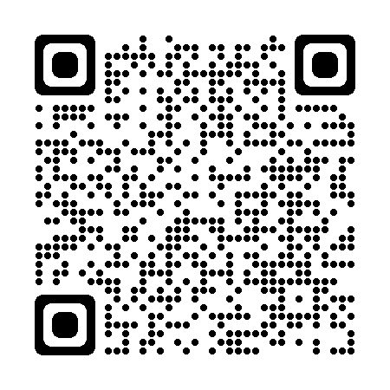
Allocations available to Indian Tribes
$100 Million available for FY22
$92 Million available for FY23
Tribal Allocations for FY22 + FY23
$50K- $100K: | 38 Tribal entities
$100K - $500K: | 661 Tribal entities
$500K - $1M: | 53 Tribal entities
$1M - $5M: | 23 Tribal entities
Use the QR code or URL to find your tribe’s allocations:
https://netl.doe.gov/bilhub/grid-resilience/formula-grants
Notes:
Post: Allocations for FY22 and FY23 can be found here: Microsoft Word - 40101d Formula Grant Allocations - ALRD Amendment 006.docx (doe.gov)
Dave

Slide 18
Recent Program Updates
Notes:
Dave

Slide 19
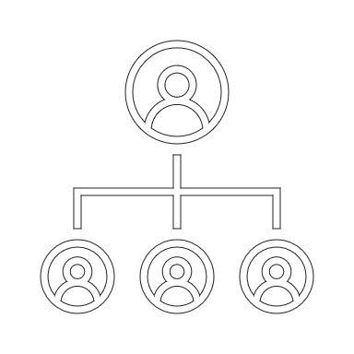
Updates to Grid Resilience Formula Grant Program
Tribal Consortium applications are now accepted
Mail-in option now available
Grant Application Assistance recording resource
Additional application templates available
Notes:
Dave

Slide 20
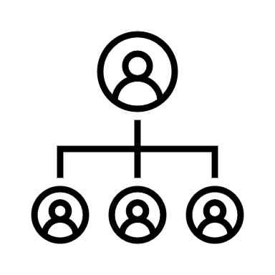
Tribal Consortium Applications are now allowed
A group of Indian Tribes, including Alaska Native Corporations, may submit one single application.
Application should be submitted by a lead Indian Tribe of the Tribal Consortium.
Designated lead Indian Tribe would handle application and administration of the award.
The lead Indian Tribe is responsible for fulfilling grant requirements including cost match and reporting.
Cost match commitment from participating tribes should be submitted with application.
Tribes that have already applied but would like to form a Tribal Consortium should contact GDOTribalAssistance@hq.doe.gov
Tribe A
$100,000 Allocation
Tribe B
$100,000 Allocation
Tribe C
$100,000 Allocation
Tribe D
$100,000 Allocation
Tribe E
$100,000 Allocation
Lead Tribe F
$100,000 Allocation
Combined Grant
Application for
$600,000 submitted
by Tribe F to US
Dept of Energy
Formula Grant
Agreement for Consortium Awarded to Lead Tribe F for $600,000
US Department of Energy issues a single $600,000 Grant Agreement to Tribe F, who will administer the grant, and make payments to vendors & receive reimbursements directly from DOE (ASAP), on behalf of the Tribal Consortium
Notes:
The main update GDO has made is on the acceptance of Tribal Consortium applications. We have heard from many tribes and their representatives on the need to have tribal consortium applications in order for tribes to take advantage of this funding. Last week we made an amendment to increase flexibilities to allow for tribal consortium applications. for the purposes of the grid resilience formula grant, a tribal consortium is a group of Indian tribes including Alaska native village corporations and Alaska native regional corporations that would like to submit one single application. While this definition of a tribal consortium may be different from what you are familiar with, this structure allows multiple tribes to streamline their applications while adhering to the legislative statute.
In a tribal consortium application, a designated lead tribe will handle the application and the administration of the award. The lead tribe will submit one application on behalf of the tribes within the tribal consortium. This lead tribe will be responsible for fulfilling all grant requirements including the cost match and reporting for the combined allocation for the tribal consortium. If participating tribes of a tribal consortium provides any or all of the 15% cost match for the applicant, then the cost match commitment should be documented and submitted with the application through a cost match commitment letter.
I’ve included an example on the screen. In this example Tribes a through F each have an allocation of 100,000 and would like to participate in a consortium application. if tribe F agrees to lead the tribal consortium on behalf of all tribes, Then they would submit a combined grant application for 600,000 for tribes a through F to the Department of Energy. The formula grant agreement would be awarded to Lead tribe F for the full $600,000. lead tribe F will administer the grant and make payments to vendors and receive reimbursements directly from doe through the ASAP payment system on behalf of the tribal consortium.
Tribes that have already applied but would like to form a Tribal Consortium should contact GDOTribalAssistance@hq.doe.gov

Slide 21
Third parties can administer the grant on behalf of Tribal Consortiums
Tribe A
$100,000 Allocation
Tribe B
$100,000 Allocation
Tribe C
$100,000 Allocation
Tribe D
$100,000 Allocation
Tribe E
$100,000 Allocation
Lead Indian Tribe may also authorize a third-party agent to handle the application and administration of the award for a Tribal Consortium.
A third-party can submit on behalf of a Tribe using the lead Indian Tribe’s Unique Entity Identifier (UEI).
Funds can be deposited into the third-party agent’s account on behalf of the eligible Tribal Consortium.
The lead Indian Tribe of a Tribal Consortium will remain ultimately responsible for meeting the grant requirements.
Lead Tribe F
$100,000 Allocation
Combined Grant
Application for
$600,000 submitted
by Third Party using Tribe F’s UEI to US
Dept of Energy
Formula Grant
Agreement for Consortium Awarded to Lead Tribe F for $600,000
US Department of Energy issues a single $600,000 Grant Agreement to Tribe F and the Third Party will administer the grant, and make payments to vendors & receive reimbursements directly from DOE (ASAP), on behalf of the Tribal Consortium
Notes:
Tribal consortiums can also authorize 3rd party agents to administer the grant on their behalf. In this case, a third party can be anyone willing to work with the consortium, including but not limited to a representatives from a tribal health consortium, intertribal regional organization or independent consultant. A 3rd party agent can handle the application and administration of the award for a tribal consortium. a 3rd party can submit on behalf of a tribal consortium using the lead tribes unique entity identifier UEI. Funds can be deposited into the 3rd party agents account on behalf of the eligible tribal consortium as needed to pay for allowable costs. The 3rd party agent can also submit the required reporting for the tribal consortium.
It is important to note that the lead Indian tribe of a tribal consortium will ultimately be responsible for the grant requirements. using the same previous example of tribes a through F with lead tribe being tribe F, a 3rd party could submit the application using tribe F ‘s UEI. the formula grant agreement for the consortium will be awarded to Lead tribe F and the 3rd party will be able to administer the grant and make payments to vendors and receive reimbursements through the ASAP system on behalf of the tribal consortium.

Slide 22
Tribal Consortium applications: Two key application components
Program Narrative
Address how resilience objectives will benefit all participating Consortium Tribes and how Consortium Tribes will participate in decisions regarding use of grant funds.
Sample Program Narrative template is available.
Designation Letter
Each participating Indian Tribe – must submit a letter designating the lead Indian Tribe to act on its behalf as lead Indian Tribe of the Tribal Consortium and receive their allocations.
Lead Indian Tribe – must submit a letter accepting the designation as the lead Indian Tribe for the Consortium. The letter should state that the lead Indian Tribe will apply for grant funding and administer the grant on behalf of all Indian Tribes belonging to the Consortium.
Template letters are available.
Additional guidance on Tribal Consortiums are listed in the Frequently Asked Questions.
Notes:
Post: Sample Program Narrative: Microsoft Word - Example Program Narrative - BIL 40101(d) Nov 19 2022.docx (doe.gov)
The tribal consortium application has 2 key application components that that are different from the application of an individual tribe. In addition to the components of a program narrative that are required by an individual tribe which I will get to on the next slide, a tribal consortium will also need to include how the resilience objectives within the program narrative will benefit all participating consortium tribes and how consortium tribes will participate in decisions regarding the use of grant funds. A sample program narrative template is available on the grant application website.
Additionally. a designation letter will need to be provided by each participating tribe as well as the lead indian tribe. Each participating Indian tribe of a tribal consortium must submit a letter designating the lead Indian tribe to act on its behalf as the lead of the tribal consortium. the participating tribe will need to designate the lead tribe to receive their allocations on their behalf. the lead tribe will also need to submit a letter to except the designation as the lead for the consortium. the letter should state that the lead tribe will apply for grant funding and administer the grant on behalf of all participating consortium tribes and should include a list of the participating tribes in the letter. Template letters are available on our website.

Slide 23
Program Narratives should include the following components
Objectives and Metrics 3-5 objectives and metrics that are driving resilience investments in your application
Equity Approach
A description of how the Tribe will ensure their proposal will incorporate: (a) quality jobs, prioritize the greatest community benefits, and (c) share or maximize project benefits across disadvantaged communities.
Criteria The criteria you will use for selecting and determining awards to eligible entities
Technical Assistance & Administration
An explanation for how you plan to use the 5% of funds for TA and project administration
Methods A description of the process you will use to solicit, award and distribute the funds (and track the proposed metrics)
Public Notice & Hearing
A description of public notice and hearing activities, as required by 40101(d)(2)(B)(ii)
Funding Distribution
A description of the proposed funding distributions and categories of subgrant recipients
At a minimum, the lead Tribe or third-party agent must host one public notice and hearing encompassing all Tribes in the consortium.
Benefits to all Tribes
(only for consortium applications)
Statement on how the resilience projects will benefit all participating Tribes.
Notes:
The program narrative should reflect all tribes of a consortium.
There are 7 required components of a program narrative with one additional requirement for tribal consortium applications. The objectives and metrics can be provisional and the metric should drive the resilience investments for all tribes. a section on criteria will include how to determine awards to eligible entities. The program narrative should also include the methods in which the tribal consortium will solicit awards and distribute funds. Tribe consortium applications will also need to include an additional section on the benefits to all tribes and state how resilience projects will benefit the participating tribes. A description on how the tribal consortium will ensure equitable benefits. An explanation will need to be included on how the tribal consortium plans to use the technical assistance and administration funds which are capped at 5% percent of the federal funds. And a public notice and hearing will need to encompass all tribes in the consortium. at a minimum the lead tribe or a 3rd party agent should host one public notice and hearing that encompasses all tribes in the consortium. The public notice and hearing can be virtual, in person, or a hybrid but must be completed before the August 31st deadline. There is no minimum time requirement between he public notice and hearing. If an individual tribe previously completed a public notice and hearing this will need to be redone if they would like to join a tribal consortium as the public notice and hearing will need to include the updated portions of the program narrative.

Slide 24
Frequently Asked Questions
Notes:
Post: Frequently asked questions for the Grid Resilience Formula Grant: 40101d Frequently Asked Questions Updated ALRD 7.pdf (doe.gov)
We will now highlight a few frequently asked questions. Many of the questions we have received are listed on the frequently asked questions document on the grant application website. Many of the updates to the Tribal Consortium applications are also included in the document. While we will have time at the end of the webinar for questions, if you have questions after this call, you can always send an email to us. Our contact information will be included on the last slidee.

Slide 25
Modification of an existing generation facility may be an eligible project
Examples of allowable projects:
The scope of the project would need to reduce the likelihood and consequences of disruptive events and meet one of the eligible uses of grant funds.
Any work performed on an existing generating system cannot increase the maximum rated output of the original nameplate capacity.
Replacing old generation components with new components of the same type in order to ensure weatherization/resilience, such as wind turbine blade replacement or damaged solar cells within an existing solar farm.
Overhauling a diesel engine including replacement of components and parts that are reducing the performance of the existing system.
Building inventories of parts and components needed for providing grid resilience benefits.
Training and contracts for critical maintenance needs.
Refurbishment of existing transformers.
New fuel tanks, either to replace old or faulty tanks or to increase fuel storage capacity would be an allowable project under this program if it provides resilience benefits for the grid.
Examples of projects that are not allowable:
Expansion of existing generation system such as expanding a solar generation facility.
Replacing a diesel generation with clean generation system, such as a solar farm.
Notes:
As we mentioned earlier the funding for this grant cannot be used for new electric generation. However modification of an existing generation facility may be an eligible project. The project would need to reduce the likelihood and consequences of disruptive events in line with the grants objectives and should meet one of the eligible uses of the grant funds.
modifying an existing generation facility cannot increase the maximum rated output of the original nameplate capacity as this would consider new generation. So expansion of existing generation facilities like increasing solar generation would not be allowed. Replacing one type of generation facility with another is also not allowed. However, replacing old generation components with new components such as replacing wind turbine blades or damaged solar cells in an existing solar farm would be allowed. overhauling a diesel engine of an existing system may be allowed as well as building inventories of parts and components needed to provide grid resilience benefits things like training and contracts for critical maintenance needs. refurbishment of existing Transformers is ok and adding new fuel tanks to either replace old or faulty tanks or to increase fuel storage capacity would be allowable through this program. If you have any questions on allowable modification of existing generation please let us know.

Slide 26
Additional resources
Grant Application Assistance Recordings
One-on-One Meetings
The GDO team is available for one-on-one calls with Tribes to discuss the grant. Please contact: GDOTribalAssistance@hq.doe.gov
Can provide information on cost match and other relevant funding opportunities
Can assist with reaching out to eligible entities
Recordings will be located on the Grid Deployment Office webpage in next few weeks.
Notes:
Post: Requests for meetings and questions can be sent to GDOTribalAsssitance@hq.doe.gov or 240-654-2941.
GDO is continuously adding new resources for grant application based on applicant feedback. We are currently developing recordings on grant application assistance that go into detail on the forms for the grant. these recordings will be located on the grid deployment Office Web page in the next few weeks. We also provide one-on-one meetings with tribes to discuss the grant. we can provide an overview of the grant itself as well as provide cost match information that may be relevant to your project or other relevant funding opportunities based off the conversations that we have. We may also be able to assist in reaching out to eligible entities. if you are interested in a one-on-one meeting please contact reach out.

Slide 27
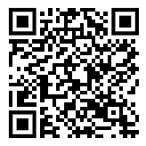
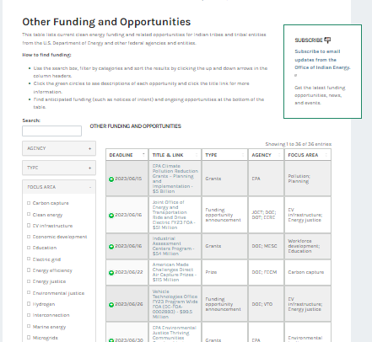
Where to find other energy funding opportunities
Office of Indian Energy
Current Opportunities Page
Contact
GDOTribalAssistance@hq.doe.gov
for more information
https://www.energy.gov/indianenergy/current-funding-opportunities
Notes:
Before we get into the Q&A portion, here are a few other resources that Tribes can use to find energy related funding. White House BIL tribal playbook includes all the funding opportunities available for tribes through the bipartisan infrastructure law. A similar tribal playbook is being developed for the inflation reduction act funding as well. The Department of Energy 's office of Indian energy also has a great resource on current opportunities available for tribes. their web page includes energy related opportunities not just within the Department of Energy but in other agencies as well so I would encourage tribes to look at that page periodically for the latest and greatest

Slide 28
Questions?
Notes:
Reiterate the importance of making the

Slide 29
Thank you!
https://www.energy.gov/gdo/gridresilience
GDOTribalAssistance@hq.doe.gov
240-654-2941
Notes:
With that thank you for your time we will now open it up for questions.

