Slide 1
Renew America’s Schools Media Promotion Toolkit 2022-2023 Selections June 29, 2023

Slide 2
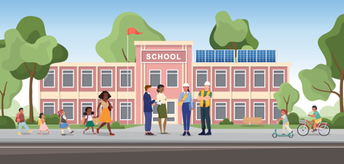
WELCOME!
The U.S. Department of Energy (DOE) is thrilled to announce the Selectees of the Renew America’s Schools grant.
This toolkit provides content to help you amplify news about the Selectees, and to ensure consistent DOE branding.

Slide 3
About the Grant
On June 29, 2023, The U.S. Department of Energy (DOE) through the Office of State and Community Energy Programs (SCEP) announced 24 Selectees for the first round of the Renew America's Schools grant, a historic federal investment in American school facilities made possible by President Biden's Bipartisan Infrastructure Law (BIL).
This competitive grant is a part of the $500 million Renew America’s Schools program, which aims to help K-12 public schools across the country make energy improvements that…
Improve air quality and occupant comfort, creating healthier and safer classrooms that support student learning.
Reduce energy use and energy costs, generating sustainable savings that can be redirected towards educational initiatives.
Lower emissions, reducing community exposure to pollutants and putting America on a path to a net-zero energy economy by 2050.
Promote Science, Technology, Engineering, and Math (STEM) education, Career and Technical Education (CTE), and workforce development, creating a pipeline of employees prepared for a clean energy future.
Public engagement with this funding opportunity has been unprecedented.
LEAs submitted over 1,000 Concept Papers from 48 states and 2 territories, totaling nearly $5.5 billion in requests.
After receiving feedback on their proposals, Local Education Agencies (LEAs) from 44 states submitted 236 eligible Full Applications, totaling $1.62 billion in requests.
Due to high demand and overwhelming evidence of public need, DOE has more than doubled the first tranche of funding from $80 million to $178 million.

Slide 4
About the Grant
Public school facilities are the second-largest sector of American infrastructure after transportation systems, yet historic disinvestment has left many communities – especially those in rural and disadvantaged areas – with crumbling, unhealthy, and inefficient buildings.
The Renew America’s Schools funding opportunity will…
Promote health and safety for students and teachers.
Create better learning environments
Help LEAs modernize their infrastructure, eliminate unnecessary expenditures, and reduce utilities costs.
Interest in the Renew America’s Schools grant was broad, diverse, and indicative of widespread need in school communities. In submitted applications...
95% of projects included schools eligible for Title I Schoolwide Programming
48% of projects included schools located in a DOE-identified Disadvantaged Community (DAC)
45% of projects included schools in a rural locale (identified by National Center for Education Statistics locale classifications 41, 42, and 43).
After extensive review of this highly competitive field, DOE identified 24 Selectees that demonstrated high technical merit and responsiveness to the funding opportunity’s stated goals.
Grant funds will directly benefit 74,000 students and 5,000 teachers, in 97 buildings, across 22 states.

Slide 5
Press release
Click here to read:
Biden-Harris Administration Announces $178 Million To Improve Health and Safety, Lower Energy Costs at K-12 Public Schools

Slide 6
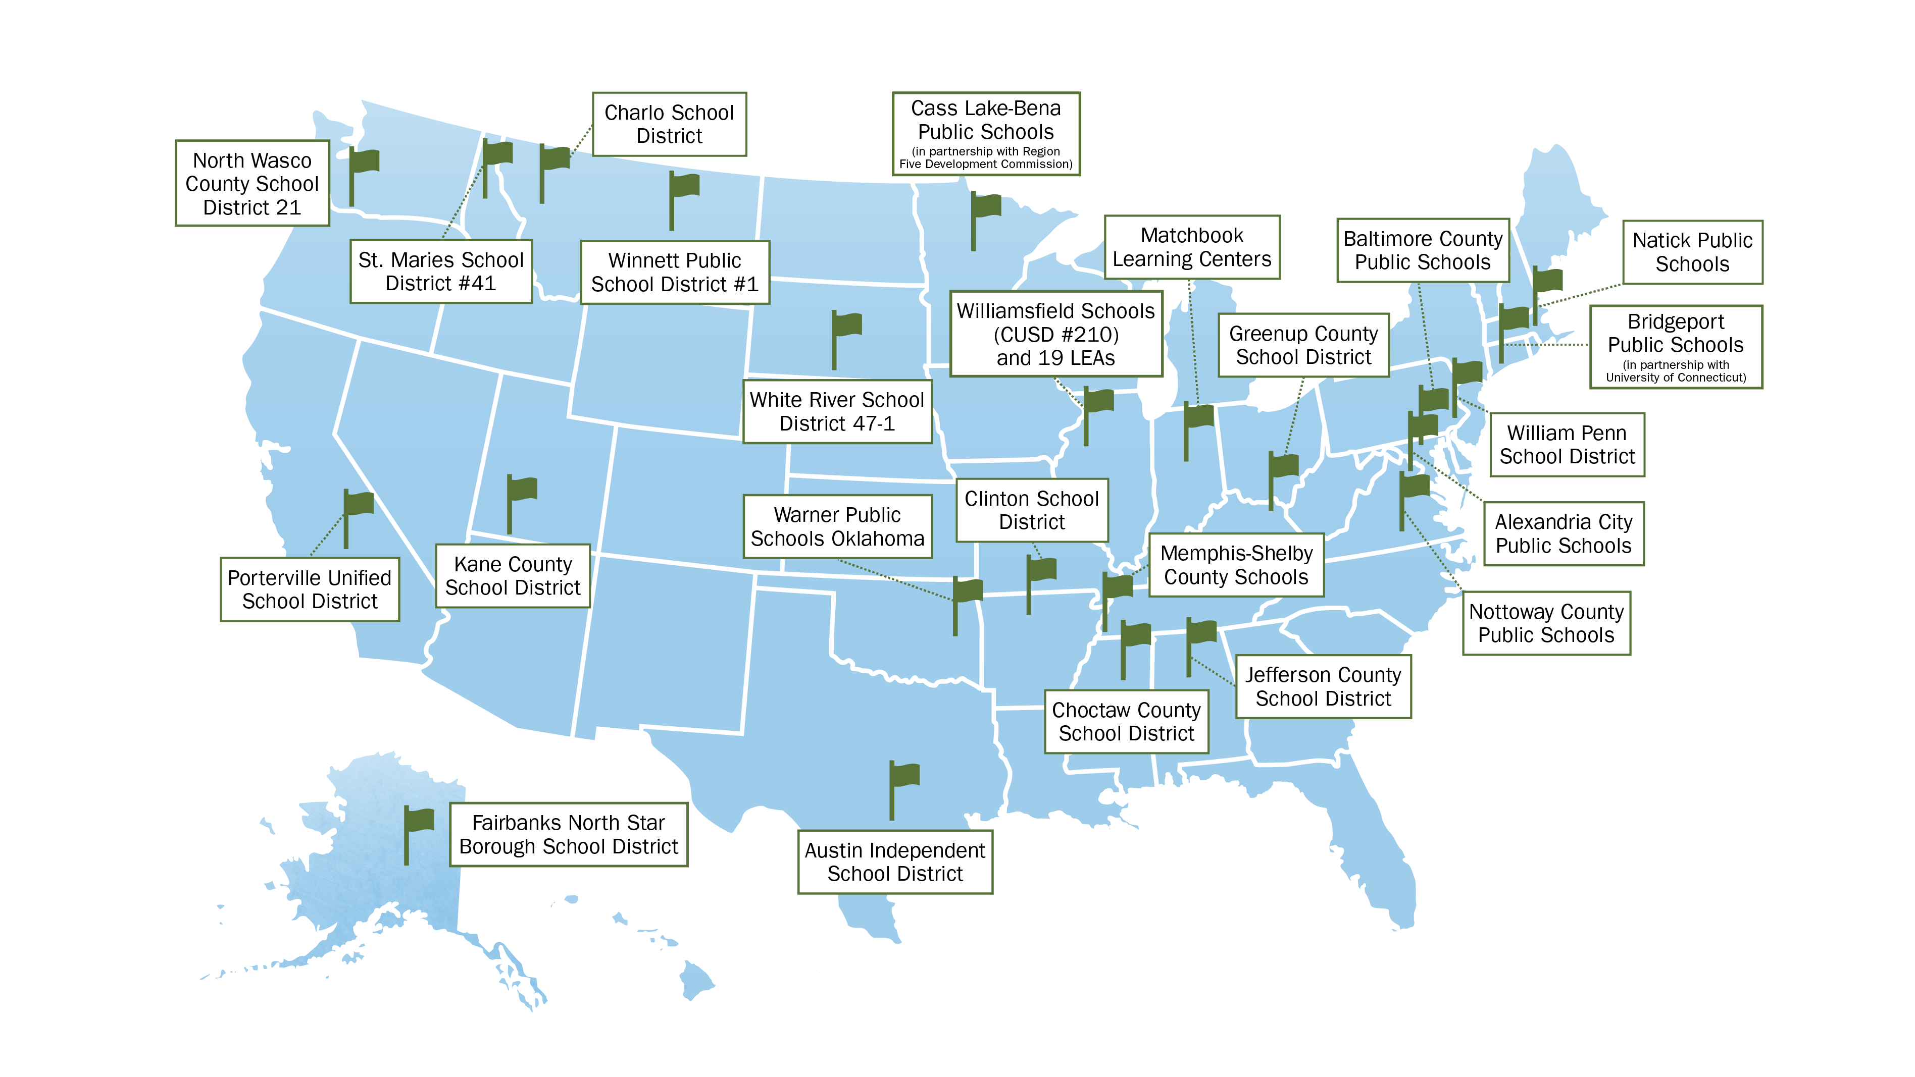
Congratulations to the 24 SELECTEES!

Slide 7
WHAT CAN YOU DO?
Amplify the news about the Renew America’s Schools Selectees. Share the information in this toolkit with your network by…
Engaging with social media (Twitter, Facebook, LinkedIn, Instagram)
Posting blogs or newsletters on your website
Writing a story for media publication
Discussing the competition on a podcast, video, or local radio station ☺
Follow the LEAs as they proceed to the award period and learn how they are bringing their projects to fruition.
Highlight quotes, comments, pictures, videos, success stories, and more!
Photo Credit: Unsplash/Mimi Thian

Slide 8
Social media content to amplify
Reach a larger audience for your social media posts by tagging or linking to applicable energy accounts for cross promotion:
DOE
Facebook: https://www.facebook.com/energygov @energygov | Twitter: https://twitter.com/ENERGY @ENERGY | Instagram: https://www.instagram.com/energy/?hl=en @energy | LinkedIn: https://www.linkedin.com/company/u-s--department-of-energy/ https://www.linkedin.com/company/office-of-state-and-community-energy-programs/
On the following slides, you will find sample social media posts published by the accounts above. Please use them as inspiration to write your own, or simply share/retweet on your platform. If you choose to share/retweet, you will have the option to craft a more personalized message in addition to what’s already been published.

Slide 9
CONGRATULATIONS TO THE 24 SELECTED LEAs!
Tag a Selectee’s social media handle in your posts for specific recognition, where applicable!
Alexandria City Public Schools, Alexandria, VA
Twitter, Facebook
Austin Independent School District, Austin, TX
Twitter, Facebook
Baltimore County Public Schools, Windsor Mill, MD
Twitter, Facebook
Bridgeport Public Schools (in partnership with University of Connecticut), Bridgeport, CT
Twitter, Facebook
Cass Lake-Bena Public Schools (in partnership with Region Five Development Commission), Cass Lake, MN
Twitter, Facebook
Charlo School District, Charlo, MT
Facebook
Choctaw County School District, Weir, MS
Twitter, Facebook
Clinton School District, Clinton, AR
Twitter, Facebook
Fairbanks North Star Borough School District, Fairbanks, AK
Twitter, Facebook
Greenup County School District, Greenup, KY
Twitter, Facebook
Jefferson County School District, Birmingham, AL
Twitter, Facebook
Kane County School District, Kanab, UT
Twitter, Facebook
Matchbook Learning Centers, Indianapolis, IN
Twitter, Facebook
Memphis-Shelby County Schools, Memphis, TN
Twitter, Facebook
Natick Public Schools, Natick, MA
Twitter, Facebook
North Wasco County School District 21, Mosier, OR
Twitter, Facebook
Nottoway County Public Schools, Blackstone, VA
Twitter, Facebook
Porterville Unified School District, Porterville, CA
Twitter, Facebook
St. Maries School District #41, Saint Maries, ID
Facebook
Warner Public Schools Oklahoma, Warner, OK
Facebook
White River School District 47-1, White River, SD
Facebook
William Penn School District, Yeadon, PA
Twitter, Facebook
Williamsfield Schools (CUSD #210) and 19 LEAs, Williamsfield, IL
Twitter, Facebook
Winnett Public School District #1, Winnett, MT
Facebook

Slide 10
Twitter: Sample content
Option 1:
Today kickstarts a first-of-its-kind investment in school infrastructure to create healthier learning environments for America’s students.
Join us in congratulating the 24 LEAs selected for funding in the first round of the #RenewAmericasSchools grant! 🥳 https://tinyurl.com/2r3hw4tt
Option 2:
With over 200 applications and $1.62B in requested funding, interest in the #RenewAmericasSchools grant has been unprecedented.
In response @ENERGY has more than doubled the funding for the 24 selected Local Education Agencies - to $178M!🤩 https://tinyurl.com/2r3hw4tt

Slide 11
LinkedIn or Facebook: sample content
Option 1:📢 Exciting News for K-12 Public Schools: DOE just announced the first round of Selectees for the Renew America's Schools grant! This competitive award, part of the $500 million Renew America’s School Program, aims to improve energy efficiency, lower costs, and enhance learning environments in public school buildings.
Engagement with this funding opportunity was unprecedented. LEAs from 48 states and two Territories submitted over 1,000 concept papers, totaling $5.5 billion in requests. After receiving feedback on their project proposals, 236 LEAs from 44 states submitted eligible full applications, with requests totaling $1.62 billion. In response to this demand, the Department of Energy increased its funding for Round 1 of the competition from $80 million to $178 million.
The Renew America's Schools program focuses on modernizing school infrastructure and promoting energy improvements that foster healthier and safer learning environments. We are excited to support the 24 Selectees in their efforts to reduce energy use while bringing cleaner air, better lighting, and more occupancy comfort to their classrooms. Stay tuned for more updates as we continue to drive energy improvements in schools nationwide. #RenewAmericasSchools #EnergyEfficiency #Education
https://tinyurl.com/2r3hw4tt
Option 2: Join us in congratulating the 24 Local Education Agencies (LEAs) selected for the first round of funding from the Renew America’s Schools grant. This competitive award, a part of President Biden’s Investing in America platform, identified a significant national gap in school infrastructure funding and tapped into the ⚡energy of local communities to effect change. We challenged LEAs to develop projects that would promote health, safety, and energy improvements in their buildings. We received an unprecedented 236 full applications from 44 states, seeking a total of $1.62 billion in funding assistance.
Due to high demand and the overwhelming evidence of public need, we have increased the total funding available in the first round of the competition from $80 to $178 million. These funds will directly impact about 74,000 students and 5,000 teachers across 97 buildings. Supported projects will improve indoor air quality, improve lighting, create more comfortable learning environments, reduce community exposures to pollution, and reduce energy use through improved efficiency and the implementation of renewable technologies.
Click here to learn more about the Renew America’s Schools grant and the 24 Round 1 Selectees.
https://tinyurl.com/2r3hw4tt

Slide 12
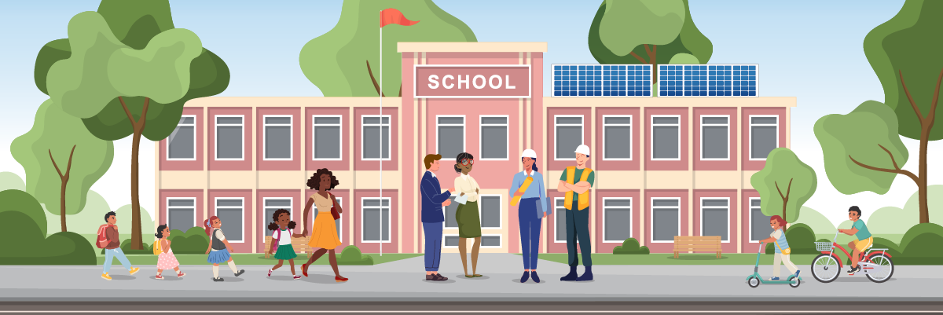
images for promotional use
Below are approved visual assets for use in promoting the programs on social media and communications materials.
1200x400

Slide 13
images for promotional use, CONT’D
Below are approved visual assets for use in promoting the programs on social media and communications materials.
859x409

Slide 14
images for promotional use, CONT’D
Below are approved visual assets for use in promoting the programs on social media and communications materials.
1762 x 916

Slide 15
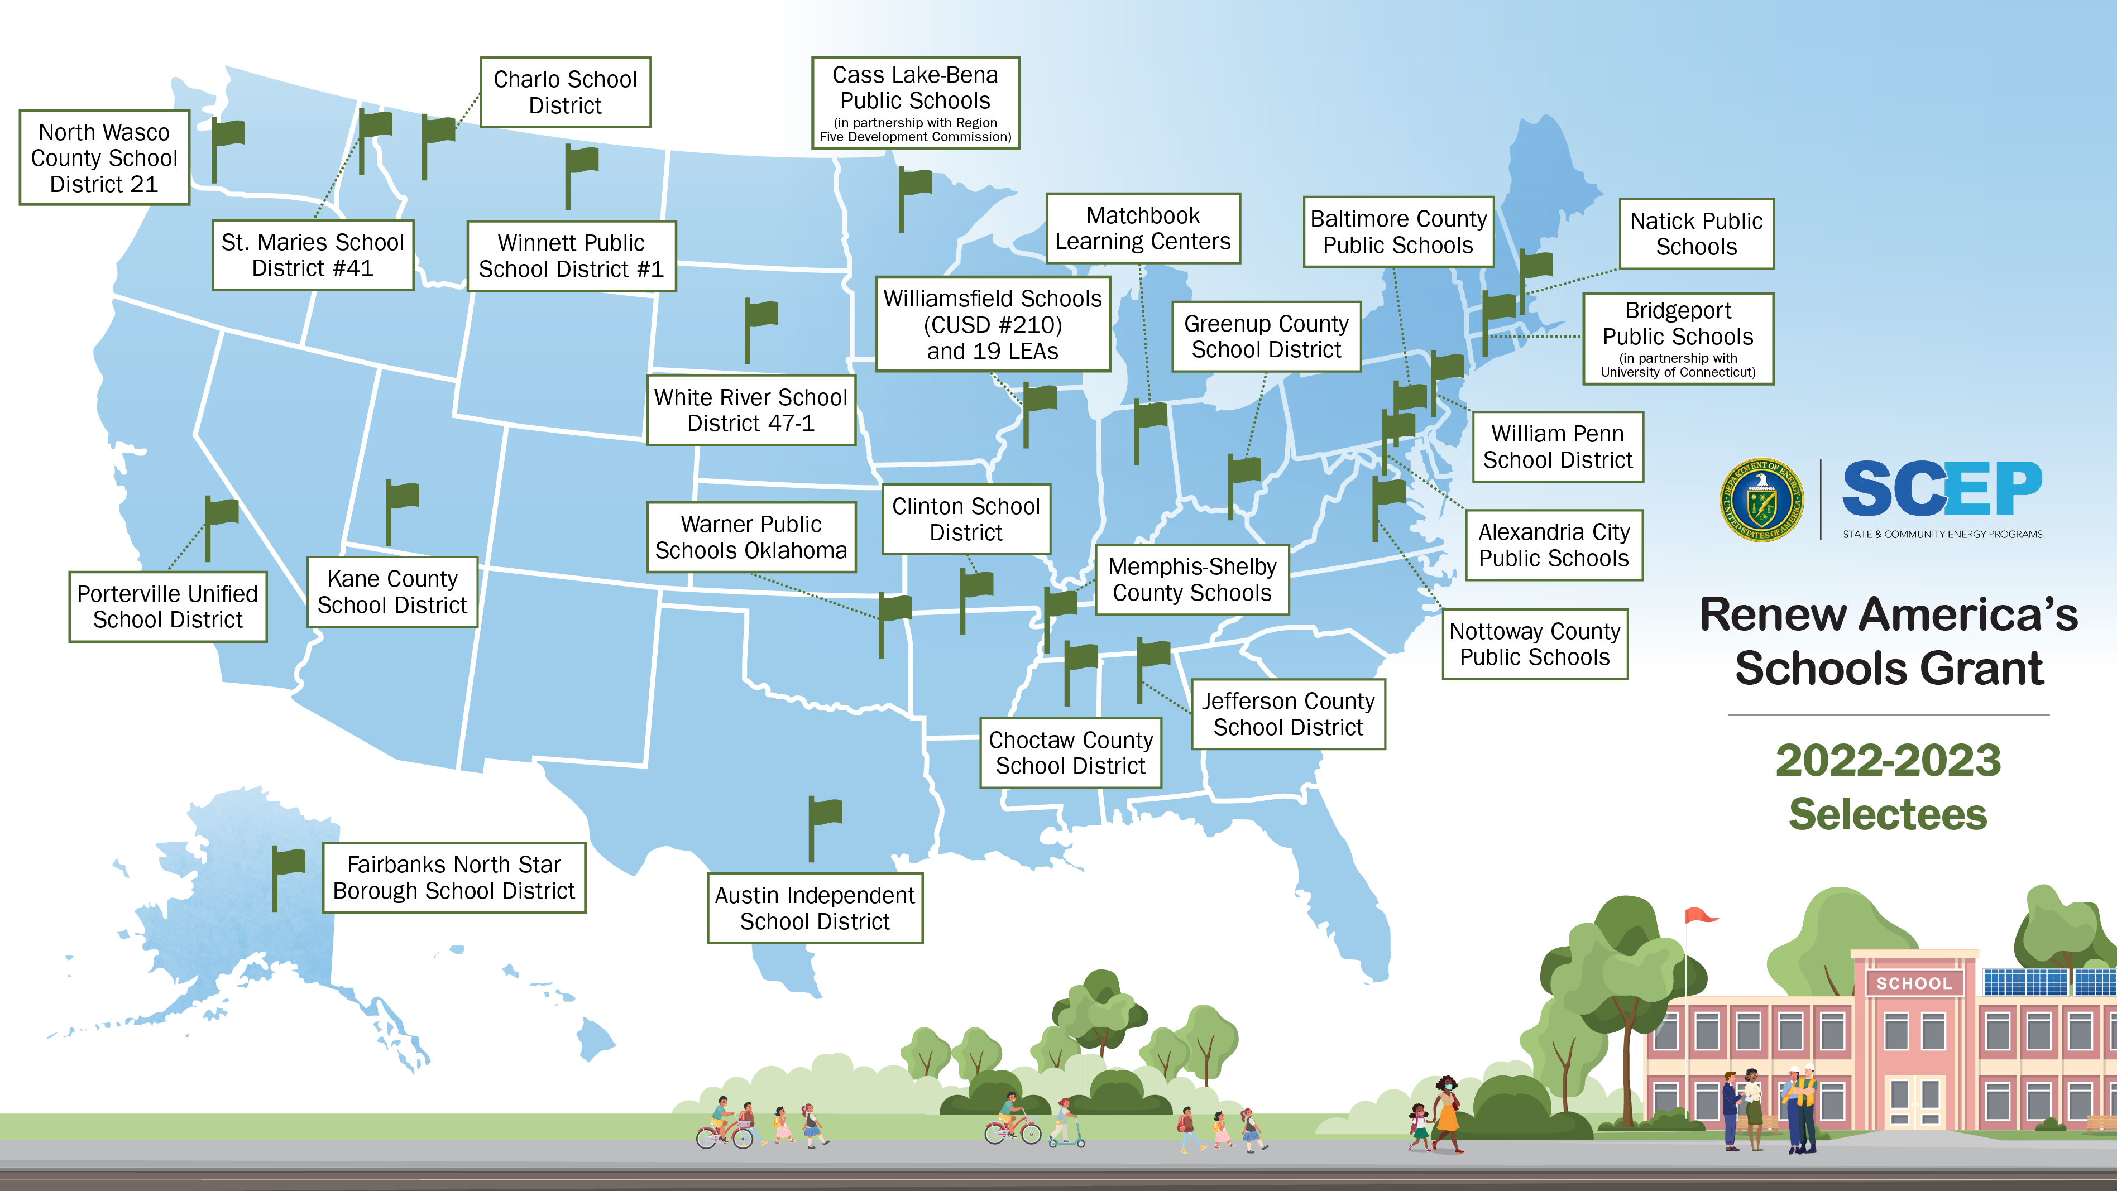
images for promotional use, CONT’D
Below are approved visual assets for use in promoting the programs on social media and communications materials.
3792 x 2134

Slide 16
images for promotional use, CONT’D
Below are approved visual assets for use in promoting the programs on social media and communications materials.
3792 x 2134

Slide 17
KEY RESOURCES
To learn more about the Renew America’s Schools grant, please view the:
SCEP | Renew America's Schools Website
For more context on a specific LEA, click on the name of a Selectee listed here.
If you have any questions that are not addressed in these slides, please contact us at Schools@doe.gov.
Photo Credit: Unsplash/Desola Lanre-Ologun

