Slide 1
Public Scoping Meeting for the Environmental Impact Statement for High-Assay Low-Enriched Uranium (HALEU) Availability Program Activities in Support of Commercial Production of HALEU Fuel
Michael Reim June 2023
Program Manager
U.S. Department of Energy (DOE)
Office of Nuclear Energy (NE)
Office of Advanced Fuels Technologies

Slide 2
Presentation Overview
Purpose of Public Scoping Meetings
Overview of the National Environmental Policy Act (NEPA) and Environmental Impact Statements (EIS)
EIS Process
Purpose and Need
Proposed Action
Public Scoping Comments

Slide 3
Purpose of Public Scoping Meetings
Provide the public with information regarding activities in the Proposed Action, and how DOE plans to evaluate the Proposed Action and alternatives in the EIS
Describe the NEPA Process and objectives of the EIS ​
Receive Public Input on the scope of issues to be analyzed in the EIS, including the Proposed Action and Alternatives

Slide 4
Overview of NEPA and EIS

Slide 5
National Environmental Policy Act
The National Environmental Policy Act of 1969, as amended, and its implementing regulations require Federal agencies to consider environmental effects prior to undertaking major federal actions.
An environmental impact statement (EIS) is prepared for proposed actions likely to have significant effects.
The EIS analyzes the effects of the proposed action and is prepared before actions are taken that could limit selection of an alternative or result in adverse environmental effects.
The EIS process incorporates public input and informs the public and the decision-making process.

Slide 6
Environmental Impact Statement
Identifies the Purpose and Need for the proposed action
Identifies Alternatives
A reasonable range of Action Alternatives that meet the Purpose and Need, including an Agency’s Preferred Alternative
No Action Alternative
Describes the existing environment at candidate sites (areas to be affected by the alternatives)
Evaluates environmental consequences of the alternatives using best available information
Identifies mitigation measures, if applicable
Evaluates direct, indirect, and cumulative impacts

Slide 7
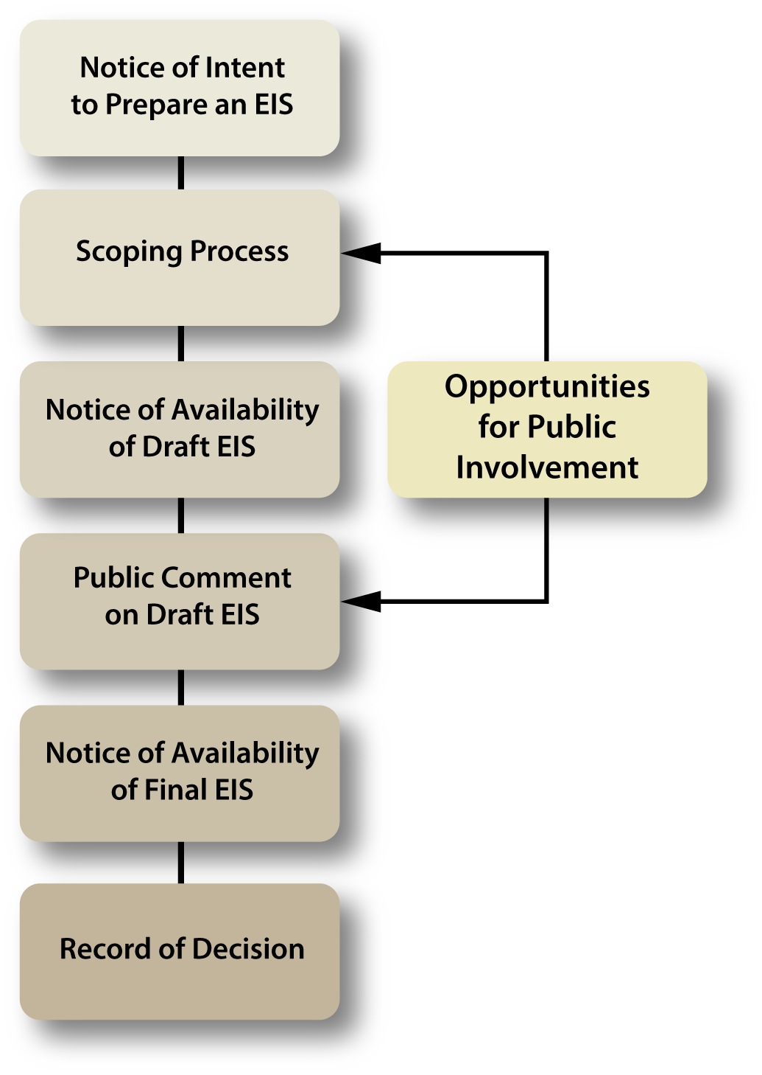
EIS Process
Informs DOE decision-makers and the public about the environmental impacts of the proposed action and alternatives
Designed to obtain public input and provide multiple opportunities for comment
Scoping meetings and public hearings
Minimum 30-day comment period during Scoping
Minimum 45-day comment period on Draft EIS
Engages other agencies through consultations
DOE’s selection of an alternative is announced in a Record of Decision (ROD)

Slide 8
Purpose and Need

Slide 9
Background
HALEU is defined as uranium having an assay greater than 5 weight percent and less than 20 weight percent of the uranium-235 isotope (U-235).
The current U.S. commercial reactor fleet uses low-enriched uranium (LEU), less than 5 weight percent U-235.
Advanced reactor designs require HALEU fuel, with most using above 10 weight percent and less than 20 weight percent U-235.

Slide 10
Purpose and Need
Although some advanced reactor technologies are currently under development, there is no domestic commercial source of HALEU available to fuel them.
The lack of such a source could impede both the demonstration of these technologies being developed and the development of future advanced reactor technologies.

Slide 11
Purpose and Need (continued)
DOE predicts that by the mid-2020s, approximately 22 metric tons of uranium (MTU) of HALEU will be needed for initial core loadings to support DOE’s reactor demonstrations and research reactors
Predicted demand is between 8 and 12 MTU annually for the next 10 years and increasing to over 50 MTU by 2035.

Slide 12
Purpose and Need (continued)
Section 2001(a) of the Energy Act of 2020 (42 U.S.C. 16281; 134 Stat. 2453; Pub. L. 116-260 Div Z) charges the Secretary of Energy with establishing and carrying out, through the Office of Nuclear Energy, a program to support the availability of HALEU for civilian domestic research, development, demonstration, (RD&D) and commercial use.
The Inflation Reduction Act (section 50173) [Pub. L. 117-169] provided $700 million in support of various HALEU program activities directed in the Energy Act of 2020.

Slide 13
Proposed Action

Slide 14
Proposed Action
The Proposed Action is to acquire, through procurement from commercial sources, HALEU enriched to at least 19.75 and less than 20 weight percent U-235 over a ten-year period of performance, and to facilitate the establishment of commercial HALEU fuel production.

Slide 15
Proposed Action (continued)
Given the variety of HALEU applications for RD&D and commercial use, the initial capability is intended to be flexible and able to accommodate
Enrichments of U-235 to greater than 5 and less than 20 weight percent
Production of between 5 and 145 MTU of HALEU per award for a total of up to approximately 290 MTU
Modular HALEU fuel cycle facility design concepts to accommodate future growth
Deconversion of uranium hexafluoride to forms suitable for production of a variety of uranium fuels, to include oxides and metal

Slide 16
EIS Scope
The EIS will analyze reasonable alternatives and the no action alternative, and address the following activities facilitating the commercialization of HALEU fuel production and acquisition of HALEU:
Extraction and recovery of uranium ore (from domestic and/or foreign sources)
Conversion of the uranium ore into uranium hexafluoride
Enrichment (possibly in up to three steps)
Enrichment to no more than 5 weight percent U-235
Enrichment greater than 5 and less than 10 weight percent U-235
Enrichment from 10 to less than 20 weight percent U-235 in an NRC Category II facility
Deconversion of the uranium hexafluoride to uranium oxide, metal, and potentially other forms in an NRC Category II facility
Storage in an NRC Category II facility
DOE acquisition of HALEU
Transportation of uranium/HALEU between facilities

Slide 17
EIS Scope (continued)
In addition to the previous activities, there are several reasonably foreseeable activities that could result from implementation of the Proposed Action. They include:
Fuel fabrication for a variety of fuel types in an NRC Category II facility;
Reactor operation (demonstration and test, power, isotope production); and
Spent fuel storage and disposition.
While not specifically a part of the Proposed Action, the impacts from these reasonably foreseeable activities would be acknowledged and addressed to the extent practicable.

Slide 18
Potential Environmental Issues for Analysis
Potential effects on public health from exposure to radionuclides under routine and credible accident scenarios, such as natural disasters (floods, hurricanes, tornadoes, and seismic events).
Potential impacts on surface and groundwater, floodplains and wetlands, and on water use and quality.
Potential impacts on air quality (including climate change) and noise.
Potential impacts on plants, animals, and their habitats, including species that are Federal- or state-listed as threatened or endangered, or of special concern.
Potential impacts on geology and soils.
Potential impacts on cultural and historic resources.
Socioeconomic impacts on potentially affected communities.

Slide 19
Potential Environmental Issues for Analysis (continued)
Potential disproportionately high and adverse effects on minority and low-income populations.
Potential impacts on land-use plans, policies and controls, and visual resources.
Potential impacts on waste management practices and activities.
Potential impacts from the transportation of HALEU-related radioactive materials.
Potential impacts of intentional destructive acts, including sabotage and terrorism.
Unavoidable adverse impacts and irreversible and irretrievable commitments of resources.
Potential cumulative environmental effects of past, present, and reasonably foreseeable future actions.
Compliance with all applicable Federal, state, and local statutes and regulations, and with international agreements, and required Federal and state environmental permits, consultations, and notifications.

Slide 20
Public Scoping Comments

Slide 21
Public Scoping
DOE invites input from Federal agencies, tribal, state, and local governments, the general public, and the commercial community to comment on the scope of the EIS.
DOE invites comment on the identification of reasonable alternatives and information and analyses relevant to the Proposed Action and specific environmental issues to be addressed.
All public scoping comments, verbal and written, will be part of the official record and a summary will be included in the Draft EIS.

Slide 22
Timeline For Public Scoping and Draft EIS
45-day Public Comment Period Starts
June 5, 2023
Public Scoping Meetings
June 21, 2023
45-day Public Comment Period Ends
July 20, 2023
Draft EIS Issued for Public Comment
By the end of 2023

Slide 23
How to Submit Scoping Comments
Provide comments TODAY by:
Providing a verbal comment in this webcast
Submit comments by July 20, 2023:
Via email, with “HALEU EIS” in the subject line: HALEU-EIS@nuclear.energy.gov
Or via U.S. Mail:
ATTN: Mr. James Lovejoy, HALEU EIS U.S. Department of Energy, Idaho Operations Office, 1955 Fremont Avenue, MS 1235 Idaho Falls, Idaho 83415
Comments should be postmarked by July 20, 2023 to ensure consideration in the Draft EIS.

