Slide 1
Renew America’s Nonprofits - Informational FOA Webinar
June 6, 2023
2023 Funding Opportunity Announcement (FOA) for Energy Improvements at Nonprofit Facilities
Bipartisan Infrastructure Law (BIL) - DE-FOA-0003066
- RENEW AMERICA’S NONPROFITS (DE-FOA-0003066)
Notes:
Gretchen
Hello, everyone and welcome to this informational webinar. Thank you for your interest in the U.S. Department of Energy’s Renew America’s Nonprofits program. During this webinar, we will provide a comprehensive overview of the Funding Opportunity Announcement for energy efficiency upgrades in nonprofits.
​
I am Gretchen Gigley from the Schools & Non-profits team here at DOE. I am joined today by my colleagues Luke Gomes, Sarah Zaleski, and Annabelle Swift who will present later on in this webinar.

Slide 2
Welcome
This webinar is being recorded and will be published on the Infrastructure eXCHANGE website.
Please note that video and speaking capability has been disabled for attendees.
If you have questions during this webinar, you can use the chat feature and all questions and answers will be posted to the Q&A Spreadsheet at a future date to the Infrastructure eXCHANGE website under DE-FOA-0003066.
Live questions will not be answered during the webinar itself.
A copy of today’s slides will be posted on Infrastructure eXCHANGE within 2-3 business days of the webinar.
Please be careful not to submit any language that might be business sensitive, proprietary or confidential.
https://infrastructure-exchange.energy.gov/Default.aspx#FoaId11fea744-0ca6-451b-8ce3-ea291b4b3aab
- RENEW AMERICA’S NONPROFITS (DE-FOA-0003066)
Notes:
Gretchen
​
This WebEx call is being recorded and may be posted on DOE's website or used internally. If you do not wish to have your voice recorded, please do not speak during the call. If you do not wish to have your image recorded, please turn off your camera or participate by phone. If you speak during the call or use a video connection, you have presumed consent to recording and use of your voice or image.
READ SLIDE +​
A copy of the webinar slides have been posted to the Nonprofits webpage. A link has been provided in the chat if you would like to download and follow along.
Questions posted in the chat will be answered through the Q&A process discussed later. We recommend saving your questions until the end, as your question may be answered in the presentation.

Slide 3
Announcements
NO NEW INFORMATION OTHER THAN THAT PROVIDED IN THE FOA WILL BE DISCUSSED IN THE WEBINAR.
Participation in today’s webinar will not convey any advantages or disadvantages in the application evaluation process.
Your participation is completely voluntary.
- RENEW AMERICA’S NONPROFITS (DE-FOA-0003066)
Notes:
Gretchen
READ SLIDE

Slide 4
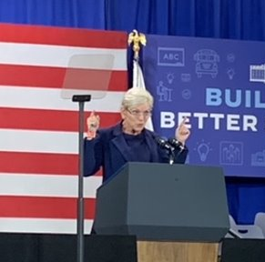
Announcements
All applicants are strongly encouraged to carefully read the Funding Opportunity Announcement DE-FOA-0003066 (“FOA”) and adhere to the stated submission requirements.
This presentation summarizes the contents of the FOA. If there are any inconsistencies between the FOA and this presentation, or statements from DOE personnel, the FOA is the controlling document and applicants should rely on the FOA language and seek clarification by submitting a question to nonprofits@doe.gov.
- RENEW AMERICA’S NONPROFITS (DE-FOA-0003066)
Notes:
Gretchen
READ SLIDE

Slide 5
Agenda
Funding Opportunity Description and Award Information (pg. 13)
Aggregator Model and Teaming List Overview (pg. 19)
Eligibility Information (pg. 25)
Application Review and Evaluation (pg. 41)
Q&A Approach (pg. 47)
Conclusion (pg. 52)
Application Information (pg. 31)
Renew America’s Nonprofits Overview (pg. 6)
I.
II.
III.
IV.
V.
VI.
VII.
VIII.
- RENEW AMERICA’S NONPROFITS (DE-FOA-0003066)
Notes:
Gretchen
Please note we will not go through every section of the FOA in this webinar, but we will highlight key sections for applicants. We encourage you to have a copy of the FOA in front of you for reference as we go through the presentation. Please note that we’ve included the section reference to the FOA aligned with each agenda item at the top of the slides.

Slide 6
I. Renew America’s Nonprofits Overview
Notes:
Gretchen:
I will now turn it over to Sarah Zaleski, the Program Manager of the Schools and Non-profits team within the Office of State and Community Energy Programs (SCEP) who will share a brief overview of this first-of-its-kind program.​
​

Slide 7
Renew America's Nonprofits
Investing in Energy Upgrades for 501(c)(3) Nonprofit Buildings: The Department of Energy (DOE) has launched a $45 million funding opportunity through President Biden’s Bipartisan Infrastructure Law (BIL) to make nonprofits more energy efficient.
- RENEW AMERICA’S NONPROFITS (DE-FOA-0003066)
Notes:
Sarah:​
As a reminder, the Renew America’s Nonprofit Program and this Funding Opportunity Announcement is made possible by the Bipartisan Infrastructure Law (BIL). This is a first-of-its-kind engagement between DOE and the nonprofit sector and recognizes the central role that nonprofits play in American’s lives, as well as their potential significance in the nation’s clean energy transition. By investing in nonprofits, DOE is investing in America’s physical and social infrastructure, reducing energy use and utility costs in vital institutions so that savings can be redirected to mission-critical work serving communities.

Slide 8
Renew America's Nonprofits: Context
Approximately 1.5 million 501(c)(3) nonprofits in the U.S.​
Nonprofits employ more than 10% of the workforce - more than 12.4 million workers.​
Energy costs are the second largest operational expense for nonprofits behind salaries.​
Citizens and communities are deeply connected to nonprofits as beneficiaries, volunteers, and donors.​
Many nonprofits serve disadvantaged populations. Energy cost savings can redirect limited funds to their mission-critical work. ​
Strong, resilient communities need strong nonprofits.
- RENEW AMERICA’S NONPROFITS (DE-FOA-0003066)
Notes:
Sarah:
Strong, healthy communities need strong nonprofits. Connecting energy efficiency to operational savings and increased community impact has been a missing link for most nonprofits. Energy costs are the second highest operational expense for nonprofits after salaries. With approximately 1.5 million eligible nonprofits operating in the United States that employ more than 12.4 million workers and provide a vast array of social benefits, the potential for energy, environmental, organizational, and community impact is significant.

Slide 9
Award Overview (II.A.)
Total Amount to be Awarded
Approximately $45,000,000*
Average Award Amount
DOE anticipates making awards that range from $3,000,000 to $9,000,000 per Prime Recipient
Types of Funding Agreements
Cooperative Agreement (a type of grant)
Anticipated Period of Performance
Cost Share Requirement
36 to 48 months
At least 20% of Total Project Costs
*Subject to the availability of appropriated funds
Notes:
Sarah
DOE expects to make approximately $45 million of Federal funding available for new awards under this FOA subject to the availability of appropriated funds. DOE anticipates making approximately 5-15 awards under this FOA. Individual awards may vary between $3,000,000 and $9,000,000. The anticipated period of performance is between 36 and 48 months. Finally, the total cost share requirements is at least 20% of the Total Project Costs.

Slide 10
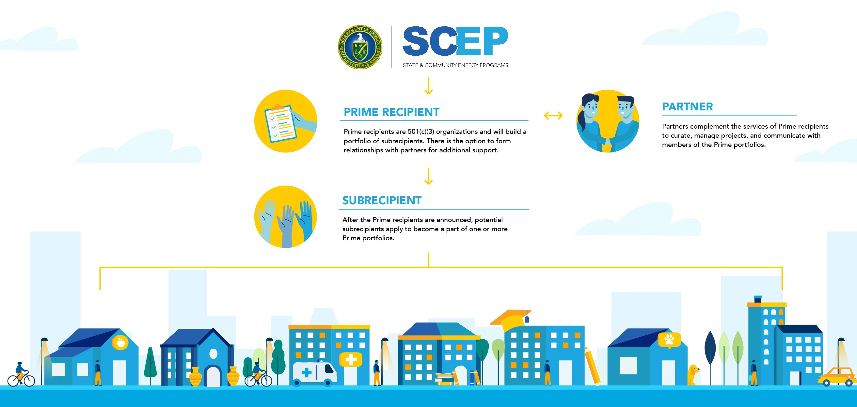
Renew America's Nonprofits: Aggregator Model
- RENEW AMERICA’S NONPROFITS (DE-FOA-0003066)
Notes:
Sarah
DOE is using an aggregation model for this FOA that will enable the bundling of eligible building efficiency projects into portfolios while providing technical and administrative support for individual nonprofits. Proposals for this FOA will be submitted to DOE by nonprofit 501(c)(3) applicants interested in serving as “Prime recipients” who will eventually assemble a portfolio of nonprofit buildings owned and operated by 501(c)(3) organizations in need of energy efficiency upgrades. This grant creates multiple pathways for participation and is a pivotal opportunity to create partnerships between nonprofit stakeholders that stimulate widespread energy improvements in the sector, with nonprofits helping nonprofits. We will dive deeper into to each role later in the presentation.

Slide 11
Timeline
APPLICATION TIMELINE: *Note: Letters of Intent are not required in order to submit a full application.
FOA ISSUED
May 24, 2023
REGISTER FOR INFORMATION SESSIONS:
Webinars: June 6 and June 8
Office Hours: June 22 and July 13
COMPLETE REQUIRED REGISTRATIONS, COMPILE YOUR TEAM, & DESIGN YOUR PROGRAM
As soon as possible
SUBMIT AN OPTIONAL LETTER OF INTENT
Due June 29
SUBMIT YOUR FULL APPLICATION
Due August 3
REVIEW AT-A-GLANCE AND FUNDING OPPORTUNITY ANNOUNCEMNTS
Located on: https://www.energy.gov/scep/renew-americas-nonprofits
AWARD TIMELINE:
Expected Reply to Reviewer Comments Deadline
August 31, 2023
Expected Date for DOE Selection Notifications
October 6, 2023
Expected Timeframe for Award Negotiations
January 5, 2024
- RENEW AMERICA’S NONPROFITS (DE-FOA-0003066)
Notes:
Sarah
This slide shows the anticipated schedule for both the FOA application process and award timeline. The FOA was posted on May 24th, and we are conducting the FOA Informational Webinars and Office Hours beginning now and leading up to the FOA submission deadline. Before diving deeper into the FOA requirements in the upcoming slides, we’d like to highlight a couple of key dates:
The Letter of Intent is encouraged, but not required to submit a full application. If you choose to submit an LOI it is due on June 29, 2023.
The Full Application must be submitted through the Infrastructure eXCHANGE by August 3, 2023. Note that Letters of Intent and Full Applications received after 5PM EST will not be accepted.

Slide 12
Timeline
APPLICATION TIMELINE: *Note: Letters of Intent are not required in order to submit a full application.
FOA ISSUED
May 24, 2023
REGISTER FOR INFORMATION SESSIONS:
Webinars: June 6 and June 8
Office Hours: June 22 and July 13
COMPLETE REQUIRED REGISTRATIONS, COMPILE YOUR TEAM, & DESIGN YOUR PROGRAM
As soon as possible
SUBMIT AN OPTIONAL LETTER OF INTENT
Due June 29
SUBMIT YOUR FULL APPLICATION
Due August 3
REVIEW AT-A-GLANCE AND FUNDING OPPORTUNITY ANNOUNCEMNTS
Located on: https://www.energy.gov/scep/renew-americas-nonprofits
AWARD TIMELINE:
Potential Subrecipients can propose eligible projects to selected Prime Recipients if not already part of a portfolio.
Expected Reply to Reviewer Comments Deadline
August 31, 2023
Expected Date for DOE Selection Notifications
October 6, 2023
Expected Timeframe for Award Negotiations
January 5, 2024
- RENEW AMERICA’S NONPROFITS (DE-FOA-0003066)
Notes:
Only organizations interested in being a prime recipient submit applications. If you are a 501(c)(3) non-profit interested in accessing funds for a retrofit in your facility as a sub-recipient, you do not need to submit an application. You may, however, engage with potential prime recipients to propose eligible projects for consideration as part of the projects they bundle into a portfolio. Potential Subrecipients can propose eligible projects to selected Prime Recipients once those selections are made in October 2023 if not already part of a portfolio.
Now, I will turn it back to Gretchen who will provide more details on the funding opportunity.

Slide 13
II. Funding Opportunity Description and Award Information
Notes:
Gretchen
Thank you, Sarah, for the introduction of the Renew America’s Nonprofits funding opportunity.​ In the next section, we’ll review the funding opportunity and award information.

Slide 14
Background and Context (I.A.)
The activities to be funded under this FOA to support BIL section 40542 will:
Facilitate innovative and sustaining partnership models,
Leverage funding and economies of scale,
Focus on disadvantaged communities and energy communities,
Reduce energy use and emissions and lower utility costs in nonprofit facilities
Enable scalable impacts
As part of the whole-of-government approach to advance equity and encourage worker organizing and collective bargaining, this FOA and any related activities will seek to encourage meaningful engagement and participation of workforce organizations, including labor unions, as well as underserved communities and underrepresented groups, including consultation with Tribal Nations.,
- RENEW AMERICA’S NONPROFITS (DE-FOA-0003066)
Notes:
Gretchen
Here is a list of the activities to be funded under this FOA to support BIL section 40542. DOE is interested in proposals that are replicable, scalable, innovative, and much more. ​

Slide 15
Topic Area (I.B.)
Proposals contemplated under this FOA will be submitted by nonprofit 501(c)(3) applicants interested in serving as “Prime recipients” to assemble a portfolio of nonprofit buildings owned and operated by 501(c)(3) organizations in need of energy efficiency upgrades.
High Impact Energy Efficiency Improvement Portfolios
Reduced emissions;
Effective plan for evaluation, measurement, and verification of energy savings;
Plan for prioritizing the financial need of subrecipients; and
Alignment with the Justice40 Initiative goals.
Significant energy and cost savings;
- RENEW AMERICA’S NONPROFITS (DE-FOA-0003066)
Notes:
Gretchen
This funding opportunity includes projects that fall under the topic area: High-Impact Energy Efficiency Improvement Portfolios.
​
Proposals contemplated under this FOA will be submitted by nonprofit 501(c)(3) applicants interested in serving as “Prime recipients” to assemble, post-award, a portfolio of nonprofit buildings owned and operated by 501(c)(3) organizations in need of energy efficiency upgrades. Prioritization will be given to applicants proposing to assemble portfolios that will achieve significant energy and cost savings; will reduce emissions; have an effective plan for evaluation, measurement, and verification of energy savings; demonstrate a plan for prioritizing the financial need of subrecipients; and align with the Justice40initiative goals. Applicants are encouraged to articulate a plan for recruiting building energy efficiency projects that meet or exceed the above priorities on a portfolio basis.
Energy efficient improvements include the installation of materials (product, equipment, or system) which results in a reduction in use of energy or fuel by a nonprofit organization. Note that all work for projects selected under this FOA must be performed in the United States.

Slide 16
Applications Specifically Not of Interest (I.C.)
The following applications will be deemed nonresponsive and will not be reviewed or considered:
An eligible ‘‘applicant’’ must be a 501(c)(3) nonprofit organization as described in section 501(c)(3) of the Internal Revenue Code of 1986 and exempt from tax under section 501(a) of such Code. Additionally, all renovations, repairs, or installations under this provision must be performed on building(s) owned and operated by a nonprofit 501(c)(3) organization(s).
Applications that fall outside the technical parameters specified in Section V of the FOA.
Applications that do not include do not include an “energy efficiency improvement” as defined in Section 40542 of the BIL
Applications that do not include an “energy efficiency improvement” as defined in Section 40542(a)(2) of the BIL;
Applications that propose technologies that are not based on sound scientific principles.
- RENEW AMERICA’S NONPROFITS (DE-FOA-0003066)
Notes:
Gretchen
Applications can be deemed nonresponsive and will not be reviewed or considered based on the bullets provided here on the slide and within the FOA. Please be reminded that all applicants and subrecipients must be 501(c)(3) nonprofit organizations.

Slide 17
III. Aggregator Model and
Teaming List Overview
Notes:
Gretchen
Let’s dive into the details of the Aggregator model and the teaming list.

Slide 18
Aggregator Model: Prime Recipient
Prime recipient will serve as the portfolio aggregator, recruiting eligible building projects that meet performance criteria, establishing subrecipient relationships with building owners, flowing down award terms and conditions, managing program implementation, and synthesizing the project results.
Prime recipients are not expected to identify the individual subrecipient buildings that comprise their portfolios in their applications, as this may be done after selection and award.
Once portfolios are assembled and shared with DOE, selected Prime recipients will then subaward up to $200,000 to Subrecipients for individual building energy efficiency projects in their assembled portfolios.
- RENEW AMERICA’S NONPROFITS (DE-FOA-0003066)
Notes:
Gretchen
Through the aggregator model, there are three pathways for engagement in the Renew America’s Nonprofits program. First the Prime recipient.
Prime recipients must be 501c3 nonprofit organizations and will serve as the FOA applicant and portfolio aggregator. Primes will recruit eligible building projects that meet performance criteria, establish subrecipient relationships with building owners, flow down award terms and conditions, manage program implementation, and synthesize the project results.
It’s important to note that Prime Recipients do not have to have their portfolios assembled prior to applying. Once awarded, portfolios will need to be presented to DOE for a Go/No Go decisions.
Once portfolios are assembled and shared with DOE, selected Prime recipients will then subaward up to $200,000 to Subrecipients for individual building energy efficiency projects in their assembled portfolios.

Slide 19
Aggregator Model: Subrecipient
A Subrecipient networks with and/or presents a project for consideration to one or more prospective Prime recipient to be part of their portfolio and receive a grant for energy efficiency upgrades.
- RENEW AMERICA’S NONPROFITS (DE-FOA-0003066)
Notes:
Gretchen
501c3 nonprofit organizations looking to access these funds for upgrades to buildings they own and operate will participate as a Subrecipient. Subrecipients do not apply directly to DOE. A Subrecipient networks with and/or presents a project for consideration to one or more Prime recipient portfolios to receive a grant for energy efficiency upgrades.
Subrecipients should demonstrate financial need, a high potential for significant energy savings and potential to benefit disadvantaged communities.

Slide 20
Aggregator Model: Partner
- RENEW AMERICA’S NONPROFITS (DE-FOA-0003066)
Notes:
Gretchen
Prime applicants may choose to include partners on their applications. Partners may or may not be a nonprofits. Partners should compliment the capacities of a Prime recipient by providing technical, financial, program management, and/or community engagement assistance.

Slide 21
How to Use the Teaming List
Join the Teaming List
Any organization that would like to be included on the “Teaming Partner List” should fill out this Microsoft form: https://forms.office.com/g/RVY40GVRpv. Refer to the graphics on the form to determine which roles are of interest.
View the Teaming List
Updates to the Teaming Partner List will be available in the Infrastructure eXCHANGE website under this funding opportunity. The Teaming Partner List will be regularly updated here: https://infrastructure-exchange.energy.gov/Default.aspx#FoaId11fea744-0ca6-451b-8ce3-ea291b4b3aa.
Connect with others.
The Teaming List downloads as a spreadsheet which can be sorted, filtered, and searched as one method to find potential Prime Recipients, subrecipients, and partners.
Notes:
Gretchen
To facilitate the formation of new project teams for this FOA, DOE will continue to gather information for the “Teaming Partner List,” first presented in the Notice of Intent (DE-FOA-0003065). The Teaming Partner List allows organizations who may wish to participate to express their interest to other applicants and to explore potential partnerships. This is a great way for specifically prospective subrecipients and partners to connect with prospective Primes.
Updates to the Teaming Partner List will be available in the Infrastructure eXCHANGE website under this funding opportunity. The Teaming Partner List will be regularly updated to reflect new teaming partners who provide their organization’s information.
As a reminder, Prime recipients are not required to finalize their portfolios prior to submitting an application to the FOA and will continue to assemble portfolio projects beyond the deadline. Prospective subrecipients are encouraged to join the teaming list to connect and engage with Prime recipients.

Slide 22
Teaming List (I.B.i.)
Joining the Teaming List DOES NOT commit you or your organization to applying for this program or serving as a subrecipient or partner.
Joining the Teaming List DOES NOT serve as a Letter of Intent or full application. Applicants must submit those through eXCHANGE.
By submitting a request to be included on the Teaming Partner List, the requesting organization consents to the publication of the above-referenced information.
DOE is not endorsing, sponsoring, or otherwise evaluating the qualifications of the individuals and organizations that are self-identifying themselves for placement on this Teaming Partner List
Notes:
Gretchen
READ+
Note that DOE will not directly form collaborations for the Renew America’s Nonprofits program. Again, the Teaming Partner List allows organizations who may be interested in participating in Renew America’s Nonprofits as a Prime recipient, Subrecipient or Partner to explore potential partnerships.

Slide 23
IV. Eligibility Information
Notes:
​I will now pass it over to my colleague Luke Gomes to review Eligibility Information.

Slide 24
Eligible Applicants (V.A.)
- RENEW AMERICA’S NONPROFITS (DE-FOA-0003066)
Notes:
Luke:
An eligible Prime ‘‘applicant’’ must be a nonprofit 501(c)(3) organization as described in section 501(c)(3) of the Internal Revenue Code of 1986 and exempt from tax under section 501(a) of such Code.
Additionally, all renovations, repairs, or installations under this provision must be performed on building(s) owned and operated by a nonprofit 501(c)(3) organization(s).
Eligible applicants may have project partners and subrecipients critical to the implementation of the proposed project that are not 501(c)(3) nonprofits.
Prime Recipients must be legally formed in the United States and have a physical location for business operations in the United States.

Slide 25
Cost Share Information (V.B. and Appendix A)
This FOA has a cost share of 20% of the total allowable costs. Cost share contributions must be:
Specified in the project budget;
Verifiable from the Prime recipient’s records;
Necessary and reasonable for proper and efficient accomplishment of the project.
Cash Cost Share
In-Kind Cost Share
Encompasses all contributions to the project made by the recipient or subrecipient(s) that do not involve a payment or reimbursement and represent donated items or services.
Funds from other Federal Sources
MAY NOT be counted as cost share - includes FFRDC subrecipients or any source not originally derived from federal funds. Cost sharing commitment letters from subrecipients must be provided with the original application.
Fee or Profit
Are NOT allowable as project costs (including cost share) under any resulting award.
Encompasses all contributions to the project made by the recipient or subrecipient(s), for costs incurred and paid for during the project.
- RENEW AMERICA’S NONPROFITS (DE-FOA-0003066)
Notes:
Luke:
Please ensure that you thoroughly read and understand Section III.B and Appendix A of the FOA that both provide Cost Share Information. ​As all sources of cost share are considered part of total project cost, the cost share dollars will be scrutinized and subject to the same federal regulations as federal dollars to the project.
​
This FOA has a cost share of at least 20% of the total allowable costs.​ The cost share requirement is required at the portfolio level and may be met by the Prime recipient independently or from an aggregation perspective by the subrecipients.
Appendix A outlines the cost sharing rules for a DOE Award which includes cash cost share, in-kind cost share, funds from other federal sources and fee or profit.​

Slide 26
Cost Share Information (Appendix A)
How Cost Sharing is Calculated
As stated above, cost sharing is calculated as a percentage of the Total Project Cost. FFRDC costs must be included in Total Project Costs. The following is an example of how to calculate cost sharing amounts for a project with $1,000,000 in federal funds with a minimum 20% non-federal cost sharing requirement:
Formula: Federal share ($) divided by federal share (%) = Total Project Cost
Example: $1,000,000 divided by 80% = $1,250,000
Formula: Total Project Cost ($) minus federal share ($) = Non-federal share ($)
Example: $1,250,000 minus $1,000,000 = $250,000
Formula: Non-federal share ($) divided by Total Project Cost ($) = Non-federal share (%)
Example: $250,000 divided by $1,250,000 = 20%
FFRDC – Federally Funded Research and Development Center aka National Laboratory
- RENEW AMERICA’S NONPROFITS (DE-FOA-0003066)
Notes:
Luke:
Appendix A also provides an example of how to calculate cost sharing amounts for a project with $1,000,000 in federal funds with a minimum 20% non-federal cost sharing requirement. As a reminder for this FOA, the cost share is at least 20% of the total project cost.​
​
Cost sharing is calculated as a percentage of the Total Project Cost. FFRDC costs must be included in Total Project Costs.

Slide 27
Compliance Criteria (V.C.)
Comply with the applicable content and form requirements listed in Section III. of the FOA.
Include all required documents.
Be successfully uploaded in Infrastructure eXCHANGE, including clicking the “Submit” button.
Be submitted by the deadline stated in the FOA.
Optional Letters of Intent may be submitted by:
June 29th, 2023
Full Application must be submitted by 5PM ET
August 3rd, 2023
​DOE will not review or consider proposals submitted through means other than Infrastructure eXCHANGE, those submitted after the applicable deadline, or incomplete submissions.
- RENEW AMERICA’S NONPROFITS (DE-FOA-0003066)
Notes:
Luke:
All applicant submissions must:
Comply with the applicable content and form requirements listed in Section III. of the FOA;
Include all required documents;
Be successfully uploaded in Infrastructure eXCHANGE, https://infrastructure-exchange.energy.gov, including clicking the “Submit” button; and
Be submitted by the deadline stated in the FOA.
DOE will not review or consider submissions submitted through means other than Infrastructure eXCHANGE, submissions submitted after the applicable deadline, or incomplete submissions

Slide 28
Funding Restrictions (III.J.)
National Environmental Policy Act (NEPA) Requirements
SCEP’s decision whether and how to distribute federal funds under this FOA is subject to NEPA. Applicants should carefully consider and should seek legal counsel or other expert advice before taking any action related to the proposed project that would have an adverse effect on the environment or limit the choice of reasonable alternatives prior to DOE completing the NEPA review process.
Davis-Bacon Act Requirements
Applicants shall provide written assurance acknowledging the DBA requirements above, and confirming that the laborers and mechanics performing construction, alteration, or repair work on projects funded in whole or in part by awards made as a result of this FOA are paid or will be paid wages at rates not less than those prevailing on projects of a character similar in the locality as determined by subchapter IV of Chapter 31 of Title 40, United States Code (Davis-Bacon Act).
- RENEW AMERICA’S NONPROFITS (DE-FOA-0003066)
Notes:
Luke:
This slide highlights the National Environmental Policy Act (NEPA) Requirements Related to pre-Award Costs, and Davis-Bacon Act Requirements. See Section III.J “Application and Submission Instructions – Funding Restrictions” for a full list of funding restrictions applicants should be aware of. Potential applicants are encouraged to refer to the FOA for other funding restrictions and for further details.

Slide 29
V. Application Information
Notes:
Thanks Luke. Let’s now talk through the application – including some important dates and logistics.

Slide 30
Infrastructure eXCHANGE
https://infrastructure-exchange.energy.gov/Default.aspx#FoaId11fea744-0ca6-451b-8ce3-ea291b4b3aab
- RENEW AMERICA’S NONPROFITS (DE-FOA-0003066)
Notes:
Gretchen
First, throughout the webinar today, we’ve referred to the Infrastructure eXCHANGE website. This slides contains a screenshot of the information under this FOA found on Infrastructure eXCHANGE. The specific link to this FOA can be found at the bottom of this slide. Here you can access helpful and required forms and templates that we will discuss throughout the presentation.

Slide 31
Application Process (III.A. and VI.B.)
All application forms and instructions are available on Infrastructure eXCHANGE.
Registration Requirements:
Grants.gov
Register in Grants.gov (http://www.grants.gov) to receive automatic updates when Amendments to this FOA are posted. However, please note that Letters of Intent and Full Applications will not be accepted through Grants.gov.
 | Website
SAM | https://www.sam.gov
FedConnect | https://www.fedconnect.net
Infrastructure eXCHANGE | https://infrastructure-exchange.energy.gov/
- RENEW AMERICA’S NONPROFITS (DE-FOA-0003066)
Notes:
Gretchen
There are several one-time actions before submitting an application in response to this FOA, and it is vital that applicants address these items as soon as possible. Some may take several weeks, and failure to complete them could interfere with an applicant’s ability to apply to this FOA, or to meet the negotiation deadlines and receive an award if the application is selected. ​
​
First, register and create an account on the Infrastructure eXCHANGE.
Second, register with the System for Award Management or SAM. This step is required before completely step number.
Third, register in FedConnect.net.​
​
Finally, register in Grants.gov to receive automatic updates if and when Amendments to the FOA are posted.​ This step is not required, but recommended.
​
​

Slide 32
Letters of Intent (III.C.)
Project team including Prime Applicant and proposed partner organizations;
Approach to recruiting sub-recipient building efficiency projects, including any organizational and building evaluation processes;
Plan for providing technical and administrative assistance to subrecipients;
Project management approach, including measurement and verification approach for the portfolio building efficiency projects; and
Plan to leverage funds, achieve economies of scale, and lay groundwork for enduring impact beyond the period of performance.
Letters of Intent are due by 5pm EST on June 29th, 2023 through Infrastructure eXCHANGE
- RENEW AMERICA’S NONPROFITS (DE-FOA-0003066)
Notes:
Gretchen
Here is the suggested list of topics to include in a letter of intent. We’d like you to discuss at a high-level your project team, approach to recruiting sub-recipient building projects, plan for technical and administrative assistance, project management approach and plan to leverage funds.
Letters of Intent are limited to two pages and will be used by DOE to plan for the merit review process. The letters should not contain any proprietary or sensitive business information. The letters will not be used for down-selection purposes and do not commit an applicant to submit an application. Letters of intent are encouraged but not required. DOE will not provide comments for Letters of Intent to applicants.
Letters of Intent are due June 29th and should be submitted through the Infrastructure Exchange.

Slide 33
Full Application Requirements (III.D.)
Section | Component | Details | Page Limit
i. | Project Narrative | Required – Template Available | 15 pages
i. | Resumes | Required | 3 pages each
ii. | Letters of Commitment | Required | 1 page each
iii. | 990 Form | Required – Use existing 990 | n/a
iv. | SF-424: Application for Federal Assistance | Required – Form Available | n/a
v. | Budget Justification Workbook (SF-424A) | Required – Template Available | n/a
vi. | Summary Slide | Required – Template Available | 1 slide
vii. | Community Benefits Plan | Required – Template Available | 5 pages
viii. | Community Partnership Documentation | Optional | 10 pages
ix. | Budget for DOE/NSSA FFRDC (if applicable) | Required if applicable | 1
x. | Authorization from cognizant Contracting Officer for FFRDC | Required if applicable | n/a
xi. | SF-LLL | Required – Form Available | n/a
xii. | Foreign Entity Waiver Requests | Optional | n/a
 | Transparency of Foreign Connections | Required | n/a
xiii. | Potentially Duplicative Funding Notice | Required | n/a
Where available, templates and forms can be found on the FOA posting on Infrastructure eXCHANGE.
Refer to the listed FOA section for details on each component.
Applications are due August 3rd, 2023
- RENEW AMERICA’S NONPROFITS (DE-FOA-0003066)
Notes:
Gretchen
Full Applications must conform to the requirements listed in this table and must not exceed the stated page limits.
The section reference explains where you can find more specific information in the FOA.
​
Applicants should review the table, notes and all requirements for the full application in the FOA under the Section listed at the top of this slide. We will highlight just a few application components on the following slides. Note that applications are due August 3rd through the Infrastructure Exchange.

Slide 34
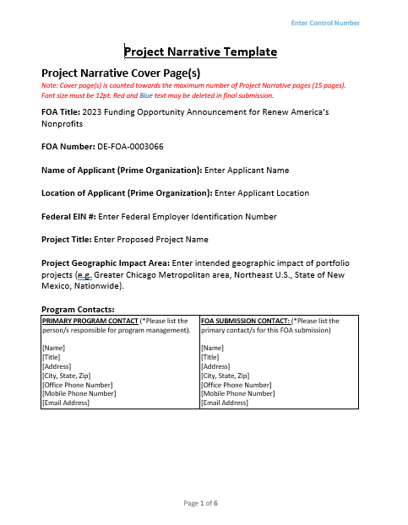
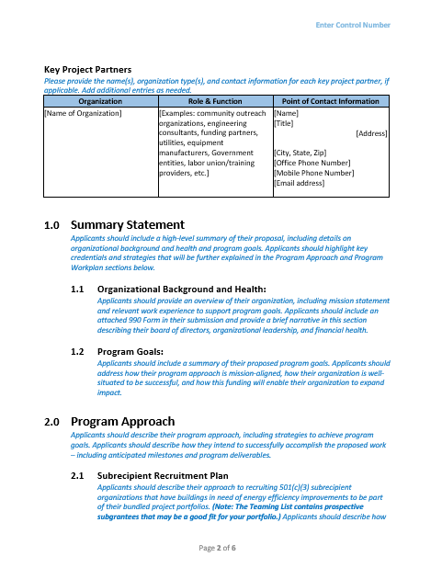
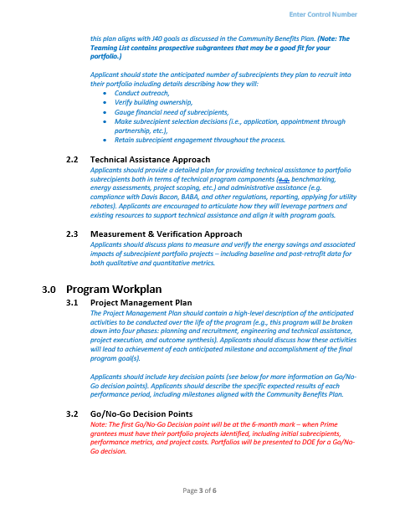
Full Application – Project Narrative (III.D.i.)
Applicants are encouraged to use the “Project Narrative Template” provided on Infrastructure eXCHANGE. If applicants choose not to use the template, the content requirements as specified in the “Project Narrative Template” are still required. The Project Narrative is submitted as part of the Full Application and may not be more than [fifteen] 15 pages, including the cover page and all citations, charts, graphs, maps, photos, and other graphics.
- RENEW AMERICA’S NONPROFITS (DE-FOA-0003066)
Notes:
Gretchen
Applicants are encouraged to use the “Project Narrative Template” provided on Infrastructure eXCHANGE. If applicants choose not to use the template, the content requirements as specified in the “Project Narrative Template” are still required. The Project Narrative is submitted as part of the Full Application and may not be more than [fifteen] 15 pages, including the cover page and all citations, charts, graphs, maps, photos, and other graphics.
​
An editable word version of the project narrative template is available for download on the Infrastructure eXCHANGE webpage.

Slide 35
Full Application - Project Narrative (III.D.i.)
1.0 Summary Statement
Organizational Background and Health; and Program Goals.
2.0 Program Approach
Subrecipient Recruitment Plan; Technical Assistance Approach; and Measurement & Verification Approach.
3.0 Program Workplan
Project Management Plan; Go/No-Go Decision Points; and Financial Plan.
4.0 Project Team
5.0 Energy Related Impacts of Portfolio
Applicants should discuss the composition and capabilities of the project team including partnerships and teaming; and provide examples of experience engaging in successful partnerships.
The application should estimate projected: Energy Savings; Energy Cost Savings; Emission Reductions; and Cost Effectiveness.
6.0 Leverage and Sustainability Potential
Leveraging Funds and Investments; and Enduring Impact.
- RENEW AMERICA’S NONPROFITS (DE-FOA-0003066)
Notes:
Gretchen
The following is a summary of the content requirements for the Project Narrative. Again, it should not exceed 15 pages, including the cover page. Applicants should provide a summary statement and clearly describe their program approach, program workplan, project team, energy-related impacts of the portfolio and plan for leveraging funds and investment and enduring impact. The content must address the technical review criteria as stated in the FOA. We will review these criteria in detail later in the presentation.
​
​

Slide 36
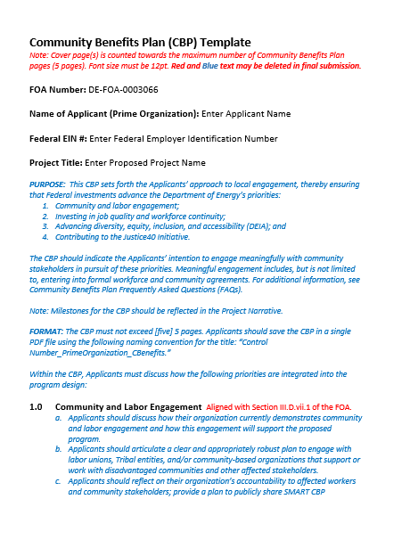
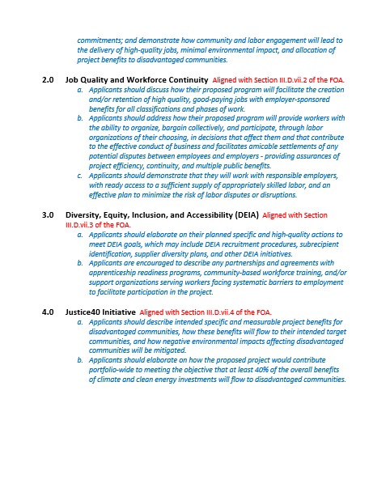
Full Application – Community Benefits Plan (III.D.vii.)
To foster equitable implementation of the Bipartisan Infrastructure Law (BIL), DOE requests that Community Benefits Plans accompany all agency funding opportunity announcements (FOAs).
The Community Benefits Plan must not exceed [five] 5 pages. Applicants must address the categories below. Applicants may use the Community Benefits Plan template located on Infrastructure eXCHANGE. . If applicants choose not to use the template, the content requirements as specified in the “Community Benefits Plan Template” are still required.
Community and Labor Engagement
Investing in Job Quality and Workforce;
Diversity, equity, inclusion, and accessibility (DEIA); and
Justice 40 Initiative.
- RENEW AMERICA’S NONPROFITS (DE-FOA-0003066)
Notes:
Gretchen
READ SLIDE +

Slide 37
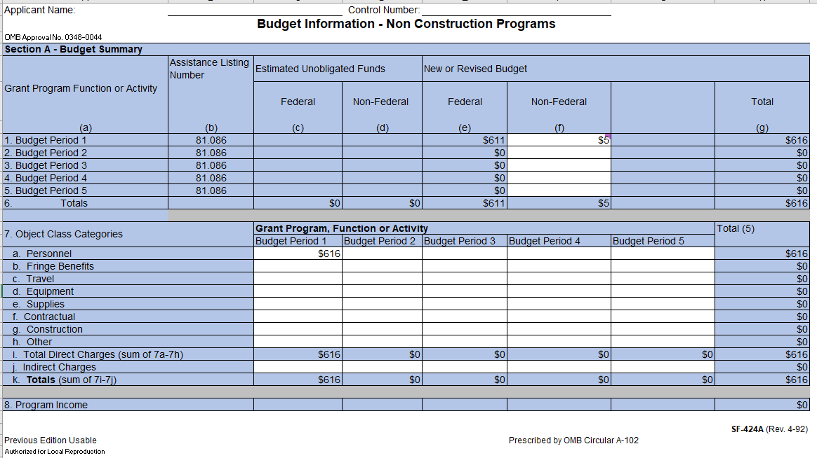
Full Application – Budget Workbook SF-424A
- RENEW AMERICA’S NONPROFITS (DE-FOA-0003066)
Notes:
Gretchen
Applicants must complete the Budget Justification Workbook (SF-424A) spreadsheet. Applicants should consider all costs associated with implementing the project as outlined in the Project Narrative.​
​
The blank or white cells are the only cells that are required to be completed in this workbook. Blue colored cells contain instructions, headers, or summary calculations and should not be modified. ​The Budget Justification Workbook is located on the Infrastructure Exchange.

Slide 38
Reply to Reviewer Comments (III.E.)
DOE will provide applicants with reviewer comments following the evaluation of all eligible Full Applications. Applicants have a brief opportunity to prepare a short Reply to Reviewer Comments (Reply). The Reply must not exceed [three] 3 pages. If a Reply is more than [three] 3 pages in length, SCEP will review only the first three (3) pages and disregard any additional pages. Applicants may use the Reply to respond to one or more comments or to supplement their Full Application. The Reply may include text, graphs, charts, or data. DOE will post the reviewer comments in Infrastructure eXCHANGE. APPLICANTS ARE NOT REQUIRED TO SUBMIT A REPLY.
The expected Submission Deadline for Replies to Reviewer Comments: 8.31.2023 5:00pm ET
However, it is the applicant’s responsibility to monitor Infrastructure eXCHANGE in the event that the expected date changes. The deadline will not be extended for applicants who are unable to submit their Reply due to failure to check Infrastructure eXCHANGE or relying on the expected date alone.
- RENEW AMERICA’S NONPROFITS (DE-FOA-0003066)
Notes:
Gretchen
DOE will provide applicants with reviewer comments following the evaluation of all eligible Full Applications. Applicants have a brief opportunity to prepare a short Reply to Reviewer Comments (Reply). The Reply must not exceed three (3) pages. If a Reply is more than three (3) pages in length, DOE will review only the first three (3) pages and disregard any additional pages. Applicants may use the Reply to respond to one or more comments or to supplement their Full Application. The Reply may include text, graphs, charts, or data. DOE will post the reviewer comments in Infrastructure eXCHANGE. APPLICANTS ARE NOT REQUIRED TO SUBMIT A REPLY.
Expected Submission Deadline for Replies to Reviewer Comments: 8.31.2023 5:00pm ET

Slide 39
VI. Application Review and Evaluation
Notes:
Gretchen
Let’s discuss the application review and evaluation next. Performance-based criteria will guide the applicant review process to assist with prioritizing eligible applicants. Full Applications will be evaluated specifically against four, weighted technical review criteria. Note that all sub-criteria are of equal weight. Let’s review the 4 technical review criteria now.

Slide 40
Review Criteria – Full Application (IV.A.i)
Criterion 1: Project Team and Program Plan (40%)
Project team composition: Degree to which the team represents the experience and qualifications necessary to successfully achieve program goals.
Organizational Health: Degree to which the Prime recipient demonstrates sound fiscal standing and leadership strength.
Effective Recruitment Plan: Degree to which the plan will likely result in successful recruitment and retention of eligible sub recipients that demonstrate financial need aligned with Justice40 goals.
Effective Technical Assistance Approach: Soundness of a plan to provide assistance to portfolio participants both in terms of technical program components (e.g., benchmarking, energy assessments, etc.) and administrative assistance (e.g., reporting, applying for utility rebates, etc.).
Effective Measurement & Verification Approach: Clarity, robustness, and feasibility of narrative discussing plans to measure and verify the impacts of project portfolio projects.
Notes:
Gretchen
Criterion 1 is Project Team and Program Plan. This criterion reviews …READ SLIDE

Slide 41
Review Criteria – Full Application (IV.A.i)
Criterion 2: Energy Related Impacts of Portfolios (30%)
Energy Savings: Degree to which proposed portfolio to be assembled will likely result in significant energy or fuel savings.
Energy Cost Savings: Degree to which proposed portfolio to be assembled will likely result in significant energy cost savings.
Emission Reductions: Degree to which proposed portfolio to be assembled will likely result in significant emission reductions.
Cost Effectiveness: Degree to which proposed portfolio to be assembled will likely result in benefits, both financial and other non-monetary benefits, that outweigh the cost in terms of funds invested.
*Applicants should provide anticipated percentages for energy savings, energy cost savings
and emission reductions across the total portfolio.
Notes:
Gretchen
Criterion 2 is Energy Related Impacts of Portfolios. This criterion evaluates the degree to which…READ SLIDE
Because portfolios are not required to be finalized prior to applying, note that applicants should provide anticipated percentages for energy savings, energy cost savings and emission reductions across a total portfolio.

Slide 42
Review Criteria – Full Application (IV.A.i)
Criterion 3: Leverage and Sustainability (15%)
Leverage: Degree to which proposed project demonstrates leverage of Federal investment. Examples include cost share, economies of scale to drive down per unit cost, attracting private investment, and braiding funds across other programs.
Enduring Impact: Degree to which the proposed project establishes pathways for enduring impact that continues beyond the life of the grant. Examples include the standing up of sustainable organizational programs that continue to assist in facility retrofits.
Notes:
Gretchen
Criterion 3 is Leverage and Sustainability. This criterion evaluates the degree to which …READ SLIDE

Slide 43
Review Criteria – Full Application (IV.A.i and III.D.viii)
Criterion 4: Community Benefits Plan (15%)
The Community Benefits Plan: (Plan) must set forth the applicant’s approach to ensuring that Federal investments advance the following four goals:
Community and Labor Engagement
Job Quality and Workforce Continuity
Diversity, Equity, Inclusion, and Accessibility
Justice40 Initiative
See Sections IV.A.i. and III.D.vii. for a detailed description of each goal and more information on how this criterion will be evaluated. Note that applicants may review and use (but are not required to use) the Community Benefits Plan template located on Infrastructure eXCHANGE website.
Notes:
Gretchen
Criterion 4 is Community Benefits Plan. The Community Benefits Plan must set forth the applicant’s approach to ensuring that Federal investments advance the following four goals: 1) community and labor engagement; 2) investing in job quality and workforce continuity; 3) advancing diversity, equity, inclusion, and accessibility (DEIA); and 4) contributing to the Justice40 Initiative. See Section III D vii for additional detail on the Community Benefits Plan. Applicants are encouraged to review and use – but are not required to use - the Community Benefits Plan Template.

Slide 44
Evaluation and Selection Process (IV.D.i.)
The evaluation process consists of multiple phases; each includes an initial eligibility review and a thorough technical review. Rigorous technical reviews of eligible submissions are conducted by reviewers that are experts in the subject matter of the FOA.
Ultimately, the Selection Official considers the recommendations of the reviewers, along with other considerations such as program policy factors (IV.C.i), in determining which applications to select.
Notes:
Gretchen
READ SLIDE

Slide 45
VII. Q&A Approach
Notes:
Now I will pass it over to my colleague Annabelle Swift to review the Q&A Approach for this FOA.

Slide 46
Q&A Approach
Upon the issuance of a FOA, DOE personnel are prohibited from communicating (in writing or otherwise) with applicants regarding the FOA except through the established question and answer process as described below:
Questions regarding this FOA must be submitted
to: nonprofits@doe.gov. Questions must be submitted not later
than 3 business days prior to the application due date and time. Please note, feedback on individual concepts will not be provided through Q&A.
The Q&A Spreadsheet serves as a resource for organizations interested in this program. To find responses relevant to certain topics, sort the spreadsheet or Control-F for specific keywords.
Questions related to the registration process and use of the Infrastructure eXCHANGE website should be submitted to:
InfrastructureExchangeSupport@hq.doe.gov.
Notes:
(ANNABELLE)
As you may know, upon the issuance of a FOA, DOE personnel are prohibited from communicating with applicants about the FOA except through the established question and answer process as described on this slide.
Questions about the FOA can be emailed to nonprofits@doe.gov. All questions and answers will be posted on Infrastructure eXCHANGE in a Q&A Spreadsheet. That includes questions received during this webinar in the chat.
The Q&A Spreadsheet serves as a resource for organizations interested in this program. To find responses relevant to certain topics, you can sort the spreadsheet or Control-F for specific keywords.

Slide 47
Have a Question?
Our team anticipates and welcomes questions about the Renew America’s Nonprofits Funding Opportunity. We will be working to keep you updated!
Typically, it takes about 1 week to answer questions posed in the Q&A, though it can take longer.
For the fastest answers to your questions, we suggest following these steps, in order:
See if the question has already been answered
Check the Fact Sheet: FOA At a Glance
Check existing answers in the Q&A
Email Nonprofits@doe.gov
Check the Q&A for a response, starting 1 week later
Notes:
(ANNABELLE)
Our team anticipates and welcomes questions about the Renew America’s Nonprofits Funding Opportunity, and we are working to keep you updated. Typically, it takes about 1 week to answer questions posed in the Q&A, though it can take longer.
For the fastest answers to your questions, we suggest following these steps:
First, see if the question has already been answered in the FOA at a Glance Fact Sheet or in existing answers in the Q&A. Next, email Nonprofits@doe.gov and check the Q&A for a response, starting 1 week later.

Slide 48
Q&A Spreadsheet: Examples
Eligible Building Improvements
QUESTION: WHAT KINDS OF BUILDING ENERGY IMPROVEMENT UPGRADES ARE ELIGIBLE?
ANSWER: Energy efficient improvements include materials (product, equipment, or system), the installation of which results in a reduction in use by a nonprofit organization of energy or fuel. Examples include lighting upgrades, roof replacements with insulation, HVAC upgrades, and door or window replacements. Energy efficiency projects that include fuel switching may also be eligible if they result in energy savings. Refer to FOA Section I.B. "Topic Area."
QUESTION: ARE SOLAR IMPROVEMENTS ELIGIBLE?
ANSWER: No. Grants cannot be used to fund solar panels and other renewable energy upgrades. However, a Prime Recipient or Partner may independently fund other energy improvements in conjunction with energy efficiency upgrades supported by the grant.
Notes:
(ANNABELLE)
Here are examples of some common questions already posted in the Q&A Spreadsheet. These are classified under the topic area "Eligible Building Improvements", as the spreadsheet can be sorted by topic to help you find information. Please see the appendix for additional examples. Read slide.

Slide 49
VIII. Conclusion
Notes:
Thank you Annabelle!
Just a few more important notes as we wrap up this webinar.

Slide 50
FOA Modifications (IV.D.i.)
Amendments to this FOA will be posted on the Infrastructure eXCHANGE website and the Grants.gov system. However, you will only receive an email when an amendment or a FOA is posted on these sites if you register for email notifications for this FOA in Grants.gov. DOE recommends that you register as soon as possible to ensure you receive timely notice of any amendments to this FOA.
Notes:
READ SLIDE

Slide 51
Key Submission Reminders
Check entries in Infrastructure eXCHANGE
Submissions could be deemed ineligible due to an incorrect entry.
DOE strongly encourages Applicants to submit 1-2 days prior to the deadline to allow for full upload of application documents and to avoid any potential technical glitches with Infrastructure eXCHANGE.
Make sure you click the “submit” button
Any changes made after you hit submit will un-submit your application and you will need to click the submit button again.
For your records, print out the Infrastructure eXCHANGE page at each step, which contains the application’s Control Number.
Notes:
READ SLIDE

Slide 52
Ways to Engage
OFFICE HOURS: June 22, 2023, 1 p.m. ET AND July 13, 2023, 1 p.m. ET
DOE will hold office hours to highlight key questions asked on the Q&A, provide timeline reminders for deadlines and important steps, present possible program scenarios and assist with navigating the Q&A spreadsheet using questions posted in the chat with published answers. You can register for one or more of the Informational Webinars listed above via the Infrastructure Exchange or the Renew America’s Schools website.
QUESTIONS:
Please remember to submit and questions to nonprofits@doe.gov and note that these will be answered and posted on the Infrastructure eXCHANGE weekly.
TEAMING LIST:
Prospective Prime Recipients, Subrecipients, and Partners are encouraged to join the teaming list to engage and explore partnerships. Please remember, potential Subrecipients can propose eligible projects to selected Prime Recipients once selections are made in October 2023 if not already part of a portfolio.
Notes:
Gretchen:
READ SLIDE + Note that there will be another Renew America’s Nonprofits Webinar this Thursday at 3PM, where we will present this webinar again.

Slide 53
​THANK YOU
Renew America’s Nonprofits – FOA Webinar
U.S. Department of Energy (DOE)
Office of State and Community Energy Programs (SCEP)
FOA Webinar​
DE-FOA-0003066​
June 6, 2023​
Nonprofits@doe.gov
Notes:
As a reminder, this webinar is being recorded. A copy of today's slides will be posted online within 2-3 business days. The recording of today's webinar will be posted online within two weeks. All items will be posted to the Infrastructure eXCHANGE under FOA-0003066 and under Resources on the Renew America’s Nonprofits website.
Thank you for attending the Renew America’s School Informational FOA Webinar. This concludes our webinar for today.
​

Slide 54
APPENDIX

Slide 55
Q&A Spreadsheet: Examples
Organization Eligibility
QUESTION: I AM NOT A NONPROFIT – CAN I STILL PARTICIPATE IN A RENEW AMERICA’S NONPROFITS PROJECT?
ANSWER: Yes, applications can include partners. Project partners may include but are not limited to: governmental entities such as states and local governments; for-profit entities such as utilities and companies that provide energy services or manufacture energy systems; and non-governmental organizations such as community-based organizations, national associations, labor unions, workforce training providers, and energy-focused groups. For a general overview of the funding opportunity, see FOA Section I.A.
QUESTION: WHICH TYPES OF BUILDINGS ARE ELIGIBLE TO RECEIVE FUNDING FROM THE RENEW AMERICA'S NONPROFITS GRANT?
ANSWER: BIL Section SEC. 40542(a)(3) specifies: “The term “nonprofit building'' means a building operated and owned by an organization that is described in section 501(c)(3) of the Internal Revenue Code of 1986 and exempt from tax under section 501(a) of such Code.” If you have an eligible building needing energy efficiency improvements, you may be sub-awarded up to $200,000 by a Prime Recipient. DOE recommends all interested organizations join the teaming list and connect with potential Prime Recipients.

Slide 56
Q&A Spreadsheet: Examples
Partnering/Teaming
QUESTION: WILL DOE ASSIST IN FORMING REGIONAL COLLABORATIONS?
ANSWER: DOE will not directly form collaborations for the Renew America's Schools program. To facilitate connections, DOE has created a Teaming Partner List specifically for the Renew America's Schools FOA. To be added to the teaming form, fill out this Microsoft form and review the instructions thoroughly: https://forms.office.com/g/RVY40GVRpv.
QUESTION: WHAT ROLE CAN STATES AND LOCAL AGENCIES PLAY IN FACILITATING PROJECTS?
ANSWER: States and local agencies may serve many roles for program activities within their state that are tailored to their unique resources, delivery capacity, and energy goals. Local agencies may serve as partners for the Renew America's Nonprofits program, facilitate partnerships, or provide assistance to Prime Recipients.

Slide 57
Renew America's Nonprofits: Program Goals
Facilitate substantial investment in nonprofit buildings
Prioritize nonprofits serving disadvantaged communities.
Lay the groundwork for enduring impact
Minimize administrative burden
Reduce energy use, emissions and utility costs in nonprofit facilities
- RENEW AMERICA’S NONPROFITS (DE-FOA-0003066)

