Slide 1
Tribal Consultation on Tribal Home Energy Rebates Programs (IRA Section 50122)
February 2023

Slide 2
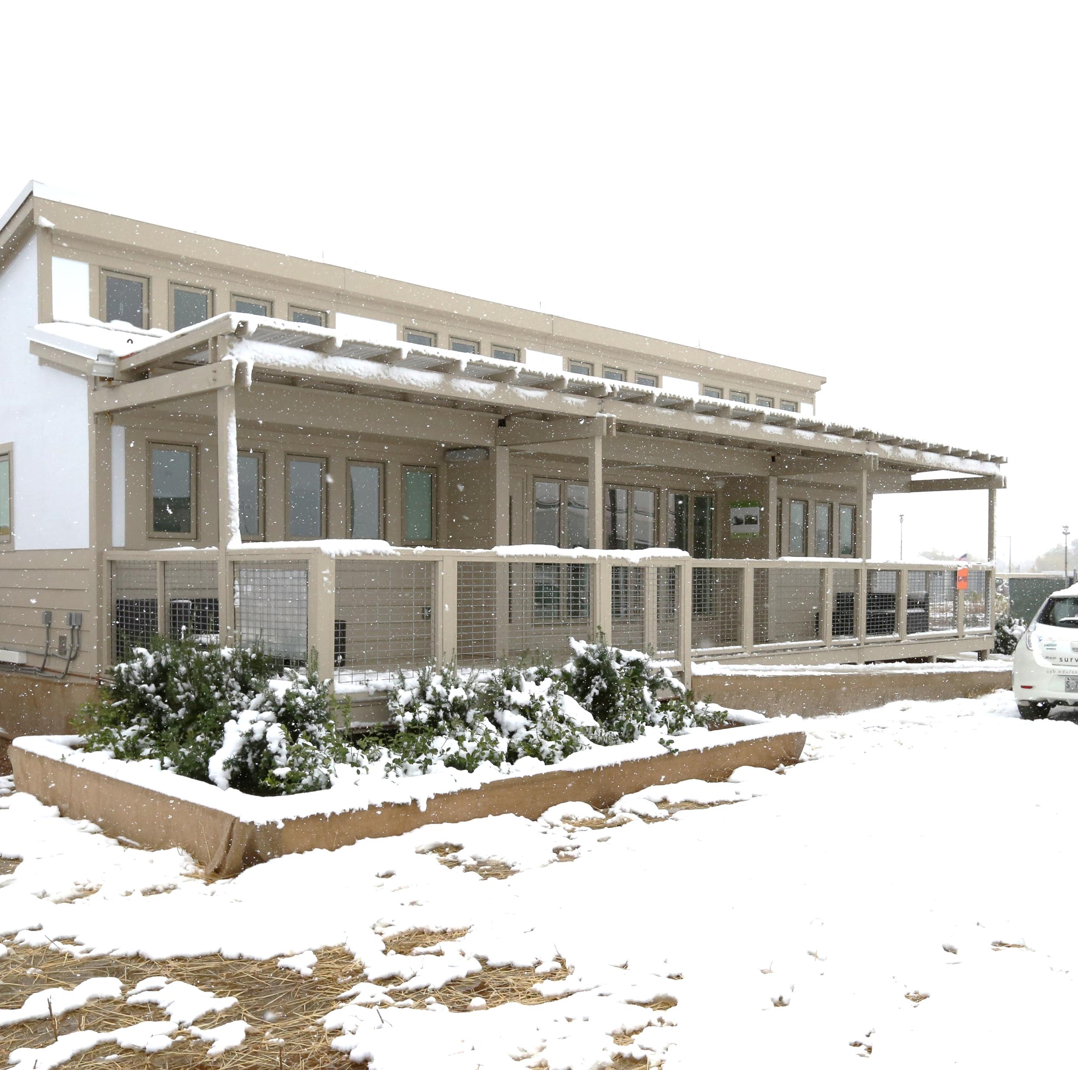
Introduction to the DOE Office of State and Community Energy Programs (SCEP)
Overview of DOE Home Energy Rebate Programs available to Indian Tribes
Timeline for Tribal Consultation process
Key Questions from DOE for the Tribal Home Energy Rebate Programs

Slide 4
Office of State and Community Energy Programs (SCEP)
Created to implement nearly $16 billion in programs from the
Bipartisan Infrastructure Law (BIL) and Inflation Reduction Act (IRA)
Deploy clean energy technologies
Center equity and deliver on J40 priorities
Catalyze local economic development
Create jobs
Avoid pollution through place-based strategies
Reduce energy costs
Notes:
SCEP works to –
Accelerate high-impact, self-sustaining clean energy projects that improve people’s lives
Aid state & local governments, tribes, community-based organizations, & others in deployment
Center the needs of low-income households and Disadvantaged Communities (DACs)

Slide 5
Programs Coming Out of SCEP
$3.5B for
Weatherization Assistance Program
$260M for Building Efficiency Workforce Training
$750M for
State Energy Program & Revolving Loan Fund
$500M for
Energy Efficiency & Renewable Energy in Public Schools
$100M for
Energy
Future
Grants
$50M for Energy Efficiency for Non-Profits
$550M for
Energy Efficiency & Conservation Block Grants Program
$1B for
Energy Codes Technical Assistance
$8.8B for Home Energy Rebates

Slide 6
The Inflation Reduction Act

Slide 7
The Landmark Inflation Reduction Act (IRA) of 2022
The largest climate investment in US history at $391 Billion
Save Households Money. Reduce household energy bills through rebates and incentives for clean energy deployment.
Grow American Manufacturing & Clean Energy Jobs. Provide 10+ years of financial support for clean energy manufacturers & installers. Incentivize prevailing wages and apprenticeships for good jobs.
Fight Climate Injustice. Deliver benefits to low-income households and energy-burdened communities. Reduce greenhouse gas pollution to 40% below 2005 levels by 2030.

Slide 8
Clean Energy Investments Through IRA
Home Energy Rebates
Energy Code Assistance
Clean Energy Business Loans
Energy Grid & Industry
Affordable Housing
Clean Transportation
$8.8B
U.S. DOE
$1B
U.S. DOE
$14B
U.S. DOE
$9B
U.S. DOE
$1B
U.S. HUD
$7B
U.S. EPA
Energy Tax Credits
Greenhouse Gas Reduction Fund
Enviro. Justice Block Grants
Rural Energy Assistance
Coastal Climate Resilience
+ Other Programs
~$277B*
U.S. Treasury
$27B
U.S. EPA
$3B
U.S. EPA
$12B
USDA
$2.6B
NOAA
~$7B
Various Agencies
*Congressional Budget Office (CBO), Estimated Budgetary Effects

Slide 9
Overview of the DOE Home Energy Rebate Programs
Amount: $8.8B, including up to $225M for Indian Tribes
Through: September 30, 2031
Recipient: State Energy Offices & Indian Tribes
Home Energy Rebates
Sec. 50121 & 50122 of Inflation Reduction Act
Goal: Develop, implement, and subsidize residential energy efficiency and electrification projects in US households.
States & Indian Tribes may use funds to:
Provide rebates to households, building owners, and contractors
Determine eligibility of households for rebates based on income
Work with trusted contractors & retailers to streamline rebate processing
Verify quality installation and document home upgrades
Help households bundle funds & financing to further reduce upfront costs
DOE is consulting with States, Tribes, and other key stakeholders to develop program guidance for this funding.

Slide 10
DOE Home Energy Rebate Program Objectives
Help households across the US enjoy lower energy bills and more comfortable homes
Make it easier to access and implement residential energy improvements by decreasing the cost through instant “point of sale” rebates
Attract and retain qualified workforce to serve both single and multifamily markets
Spur durable market demand for residential efficiency and electrification by demonstrating value of energy upgrades and efficient homes to homeowners, tenants, and investors

Slide 11
Where Will the Tribal Home Energy Rebates Funds Go?
20% for
Admin
80% for Rebates
for Households
~$4.17 billion to States and Territories for whole home efficiency rebates
$8.8 Billion in Home Energy Rebate Funds
Up to
$1.66B
At least $6.65B
for rebates
$4.275
~$4.15 billion to States and Territories
~$4.37 billion to States, Territories, and Tribes for efficient electric rebates
Up to
$45M
Up to $225 million to Indian Tribes
Up to $180M
for rebates
Up to $264 million for DOE admin & TA*
*The law authorizes up to 3% of total funds for DOE program administration & technical assistance as well as up to 20% of State & Indian Tribe funds for program administration. The amounts shown in the funds for Indian Tribes have not removed the potential 3% for DOE-provided technical assistance.

Slide 12
Details on the Tribal Home Energy Rebate Provisions in Section 50122
Up to $225 million* is available through 2031 to “award grants to Indian Tribes to develop and implement a high-efficiency electric home rebate program.”
Funding for Indian Tribes shall be reserved “in a manner determined appropriate by the Secretary.” DOE has not yet determined the funding allocation for each Indian Tribe.
“Indian Tribes” is defined by the section to mean “any Indian tribe, band, nation, or other organized group or community, including any Alaska Native village or regional or village corporation as defined in or established pursuant to the Alaska Native Claims Settlement Act, which is recognized as eligible for the special programs and services provided by the United States to Indians because of their status as Indians”
Funds will be distributed to Tribal Governments and Alaska Native entities after they submit an application that is approved by DOE. DOE has not yet determined the application structure or the exact approval process that will be required for Tribes and Alaska Native entities to receive funding.
Home Energy Rebates
*The law authorizes up to 3% of this funding to be used by DOE for program administration & technical assistance.

Slide 13
Rebates must be used for “Qualified Electrification Projects”*
Maximum Rebate Per Improvement
Electric heat pump HVAC system | up to $8,000
Electric heat pump hot water system | up to $1,750
Electric stove, cooktop, range, or oven | up to $840
Electric heat pump clothes dryer | up to $840
Electric circuit panel upgrade | up to $4,000
Insulation & air sealing | up to $1,600
Electric wiring upgrades | up to $2,500
Total electrification rebates cannot exceed $14,000 per household
Rebate funding is to be used to offset the costs of equipment, materials, and installation of “qualified electrification projects” via a point-of-sale rebate; an immediate discount on the cost of equipment or installation of an upgrade
While subject to the caps noted in the chart, rebates can cover –
up to 100% of home electrification project costs for low-income households (less than 80% AMI)
up to 50% of home electrification project costs for moderate-income households (80 – 150% AMI)
*Section 50122 also requires that projects must use equipment that is Energy Star certified.

Slide 14
Legislative Requirements For Grant Applications For Rebate Funding
APPLICATION — A State energy office or Indian Tribe seeking a grant under the program shall submit to the Secretary an application that includes a plan to implement a high-efficiency electric home rebate program, including—
a plan to verify the income eligibility of eligible entities seeking a rebate for a qualified electrification project;
a plan to allow rebates for qualified electrification projects at the point of sale in a manner that ensures that the income eligibility of an eligible entity seeking a rebate may be verified at the point of sale;
a plan to ensure that an eligible entity does not receive a rebate for the same qualified electrification project through both a high-efficiency electric home rebate program and any other Federal grant or rebate program,* ; and
any additional information that the Secretary may require.
Home Energy Rebates
*Section 50122 of the Inflation Reduction Act prohibits using other federal funding sources for a project that receives a Tribal Home Energy Rebate. For full details, see section 50122 starting on page 220: https://www.congress.gov/117/plaws/publ169/PLAW-117publ169.pdf

Slide 15
Timeline for Tribal Consultation on Tribal Home Energy Rebates
Tribal Consultation + Tribal Program Guidance
~Feb 27:
“Dear Tribal Leader” Letter invitation for DOE Tribal Consultation
~Late Spring:
DOE issues allocations, guidance for Tribes to apply for program admin funds
Summer 2023:
DOE guidance issued for Tribes to apply for rebate funds
March 29: Virtual Tribal Consultation Session
April 28:
Tribal Consultation Written Responses Due
~Jan 18:
Request for Information issued for overall programs
March – May:
DOE creates State program guidance based on RFI responses
Spring 2023:
DOE guidance issued for States to apply for program admin funds
Summer 2023:
DOE guidance issued for States to apply for rebate funds
State Program Guidance
March 3:
RFI Written Responses due to DOE

Slide 16
Key Questions for Tribal Consultation on Tribal Home Energy Rebates
Section 50122 of the Inflation Reduction Act states that the funding for Tribal Home Energy Rebates programs will be allocated in “a manner determined appropriate by the Secretary.”
What factors should DOE consider in determining the allocation? Factors could include the population of each Tribe, the average cost of energy for Tribal members, and/or average cost of construction in a Tribe’s area, among other indicators.
Should the allocation formula be similar to or different from the allocation of other programs (e.g., the formula used for the EECBG Program)?
What minimum funding amount would allow for viable Tribal Home Energy Rebate programs for Indian Tribes that receive the smallest allocations?
What does your Tribal Government or Alaska Native entity need from DOE to inform planning and preparation for designing and applying for funding for a Tribal Home Energy Rebates program?
What role could DOE play in supporting your Tribe’s design and implementation of a rebate program, including overcoming access to infrastructure, technology, or other barriers?
Is your Indian Tribe likely to administer your Tribal Home Energy Rebates program directly or engage a third party?
What national or regional entities might be best suited to help administer rebate programs for small Indian Tribes or Tribes with lower administrative capacity?
How might DOE, States, and Territories ensure that Tribal households have equitable access to other home energy rebates that are made available through state and territorial governments?
What program design features will allow for the Tribal Home Energy Rebates programs to be used by the same household or building as other federal funding for Tribal housing upgrades, such as the Department of the Interior’s Bureau of Indian Affairs Tribal Electrification Program or Tribal programs from the Department of Housing and Urban Development?
What best practices and lessons learned from other Tribal energy efficiency or incentive programs should DOE consider in drafting program requirements and guidance?
What other questions, comments, or feedback do you have for DOE regarding the Tribal Home Energy Rebates programs?
Home Energy Rebates

Slide 17
1. Funding Allocation
Section 50122 of the Inflation Reduction Act states that the funding for Tribal Home Energy Rebates programs will be allocated in “a manner determined appropriate by the Secretary.”
What factors should DOE consider in determining the allocation? Factors could include the population of each Tribe, the average cost of energy for Tribal members, and/or average cost of construction in a Tribe’s area, among other indicators.
Should the allocation formula be similar to or different from the allocation of other programs (e.g., the formula used for the Energy Efficiency Conservation Block Grant Program)?
What minimum funding amount would allow for viable Tribal Home Energy Rebate programs for Indian Tribes that receive the smallest allocations?
Home Energy Rebates

Slide 18
Tribal Allocation Formula used for EECBG Program
A_{i} = Total amount of funding allocated to Indian tribe i
m = $10,000 (minimum funding each Indian tribe must receive)
F = Total amount of EECBG Program funding allocated to grants
t = 0.02 (percentage of total funding available to eligible Indian tribes)
n = number of Indian tribes
E_{i} = Tribal population based on a combination of U.S. Census Bureau, Decennial Census Redistricting Data (Pub. L. 94-171), 2020 and American Community Survey 5-year Estimates, 2020 and/or self-reported Tribal enrollment data
For more details, see https://www.federalregister.gov/documents/2022/06/29/2022-13859/notice-of-availability-of-state-local-and-tribal-allocation-formulas-for-the-energy-efficiency-and

Slide 19
2. Needs from DOE for Planning and Preparation
What does your Tribal Government or Alaska Native entity need from DOE to inform planning and preparation for designing and applying for funding for a Tribal Home Energy Rebates program?
Home Energy Rebates

Slide 20
3. Role of DOE support for design and implementation of rebates
What role could DOE play in supporting your Tribe’s design and implementation of a rebate program, including overcoming access to infrastructure, technology, or other barriers?
Home Energy Rebates

Slide 21
4. Direct Administration or Third Party Administration
Is your Indian Tribe likely to administer your Tribal Home Energy Rebates program directly or engage a third party?
Home Energy Rebates

Slide 22
5. National / Regional Entities that can help Administer Rebates
What national or regional entities might be best suited to help administer rebate programs for small Indian Tribes or Tribes with lower administrative capacity?
Home Energy Rebates

Slide 23
6. Equitable Access to State Home Energy Rebate Programs
How might DOE, States, and Territories ensure that Tribal Households have equitable access to other home energy rebates that are made available through state and territorial governments?
Home Energy Rebates

Slide 24
7. Multiple federal funding options for upgrading Tribal Housing
What program design features will allow for the Tribal Home Energy Rebates programs to be used by the same household or building as other federal funding for Tribal housing upgrades, such as the Department of the Interior’s Bureau of Indian Affairs Tribal Electrification Program or programs from the Department of Housing and Urban Development?
Home Energy Rebates

Slide 25
Other Federal Programs available for Tribal Housing Upgrades
IRA § | Program | Agency | Funding ($ million) | Notes
80003 | Tribal Electrification Program | BIA | $145.50 | No cost-sharing or matching requirements. For electrifying homes with zero-emissions systems and associated repairs.
50145 | Tribal Energy Loan Guarantee Program | DOE | $75.00 | Loan authority raised to $20 billion. Loan guarantee may now cover 100% of debt.
80001 | Tribal Climate Resilience | BIA | $220.00 | No cost-sharing or matching requirements
80002 | Native Hawaiian Climate Resilience | BIA | $23.50 | No cost-sharing or matching requirements
60103 | Greenhouse Gas Reduction Fund | EPA | $27,000.00 | Tribal Governments eligible to apply. FY 2024 expiration.
60114 | Climate Pollution Reduction Grants | EPA | $5,000.0 | Tribal Governments eligible to apply. FY 2026 expiration.
60201 | Environmental and Climate Justice Block Grants | EPA | $3,000.00 | Tribal Governments in partnership with non-profits eligible to apply. FY 2026 expiration. FY 2026 expiration.
Home Energy Rebates
For individual program details, see the relevant sections in the Inflation Reduction Act: https://www.congress.gov/117/plaws/publ169/PLAW-117publ169.pdf

Slide 26
8. Best practices from existing Tribal EE Programs
What best practices and lessons learned from other Tribal energy efficiency or incentive programs should DOE consider in drafting program requirements and guidance?
Home Energy Rebates

Slide 27
9. Other Questions, Comments, and Feedback for DOE
What other questions, comments, or feedback do you have for DOE regarding the Tribal Home Energy Rebates programs?
Home Energy Rebates

Slide 28
Additional Resources
Email address for the DOE Home Energy Rebates Team:
irahomerebates@hq.doe.gov
DOE Home Energy Rebates Website:
https://www.energy.gov/scep/slsc/home-energy-rebate-programs
Request for Information on the DOE Home Energy Rebates:
Request for Information on Inflation Reduction Act Home Energy Rebate Programs (office.com)
Home Energy Rebates

