Slide 1
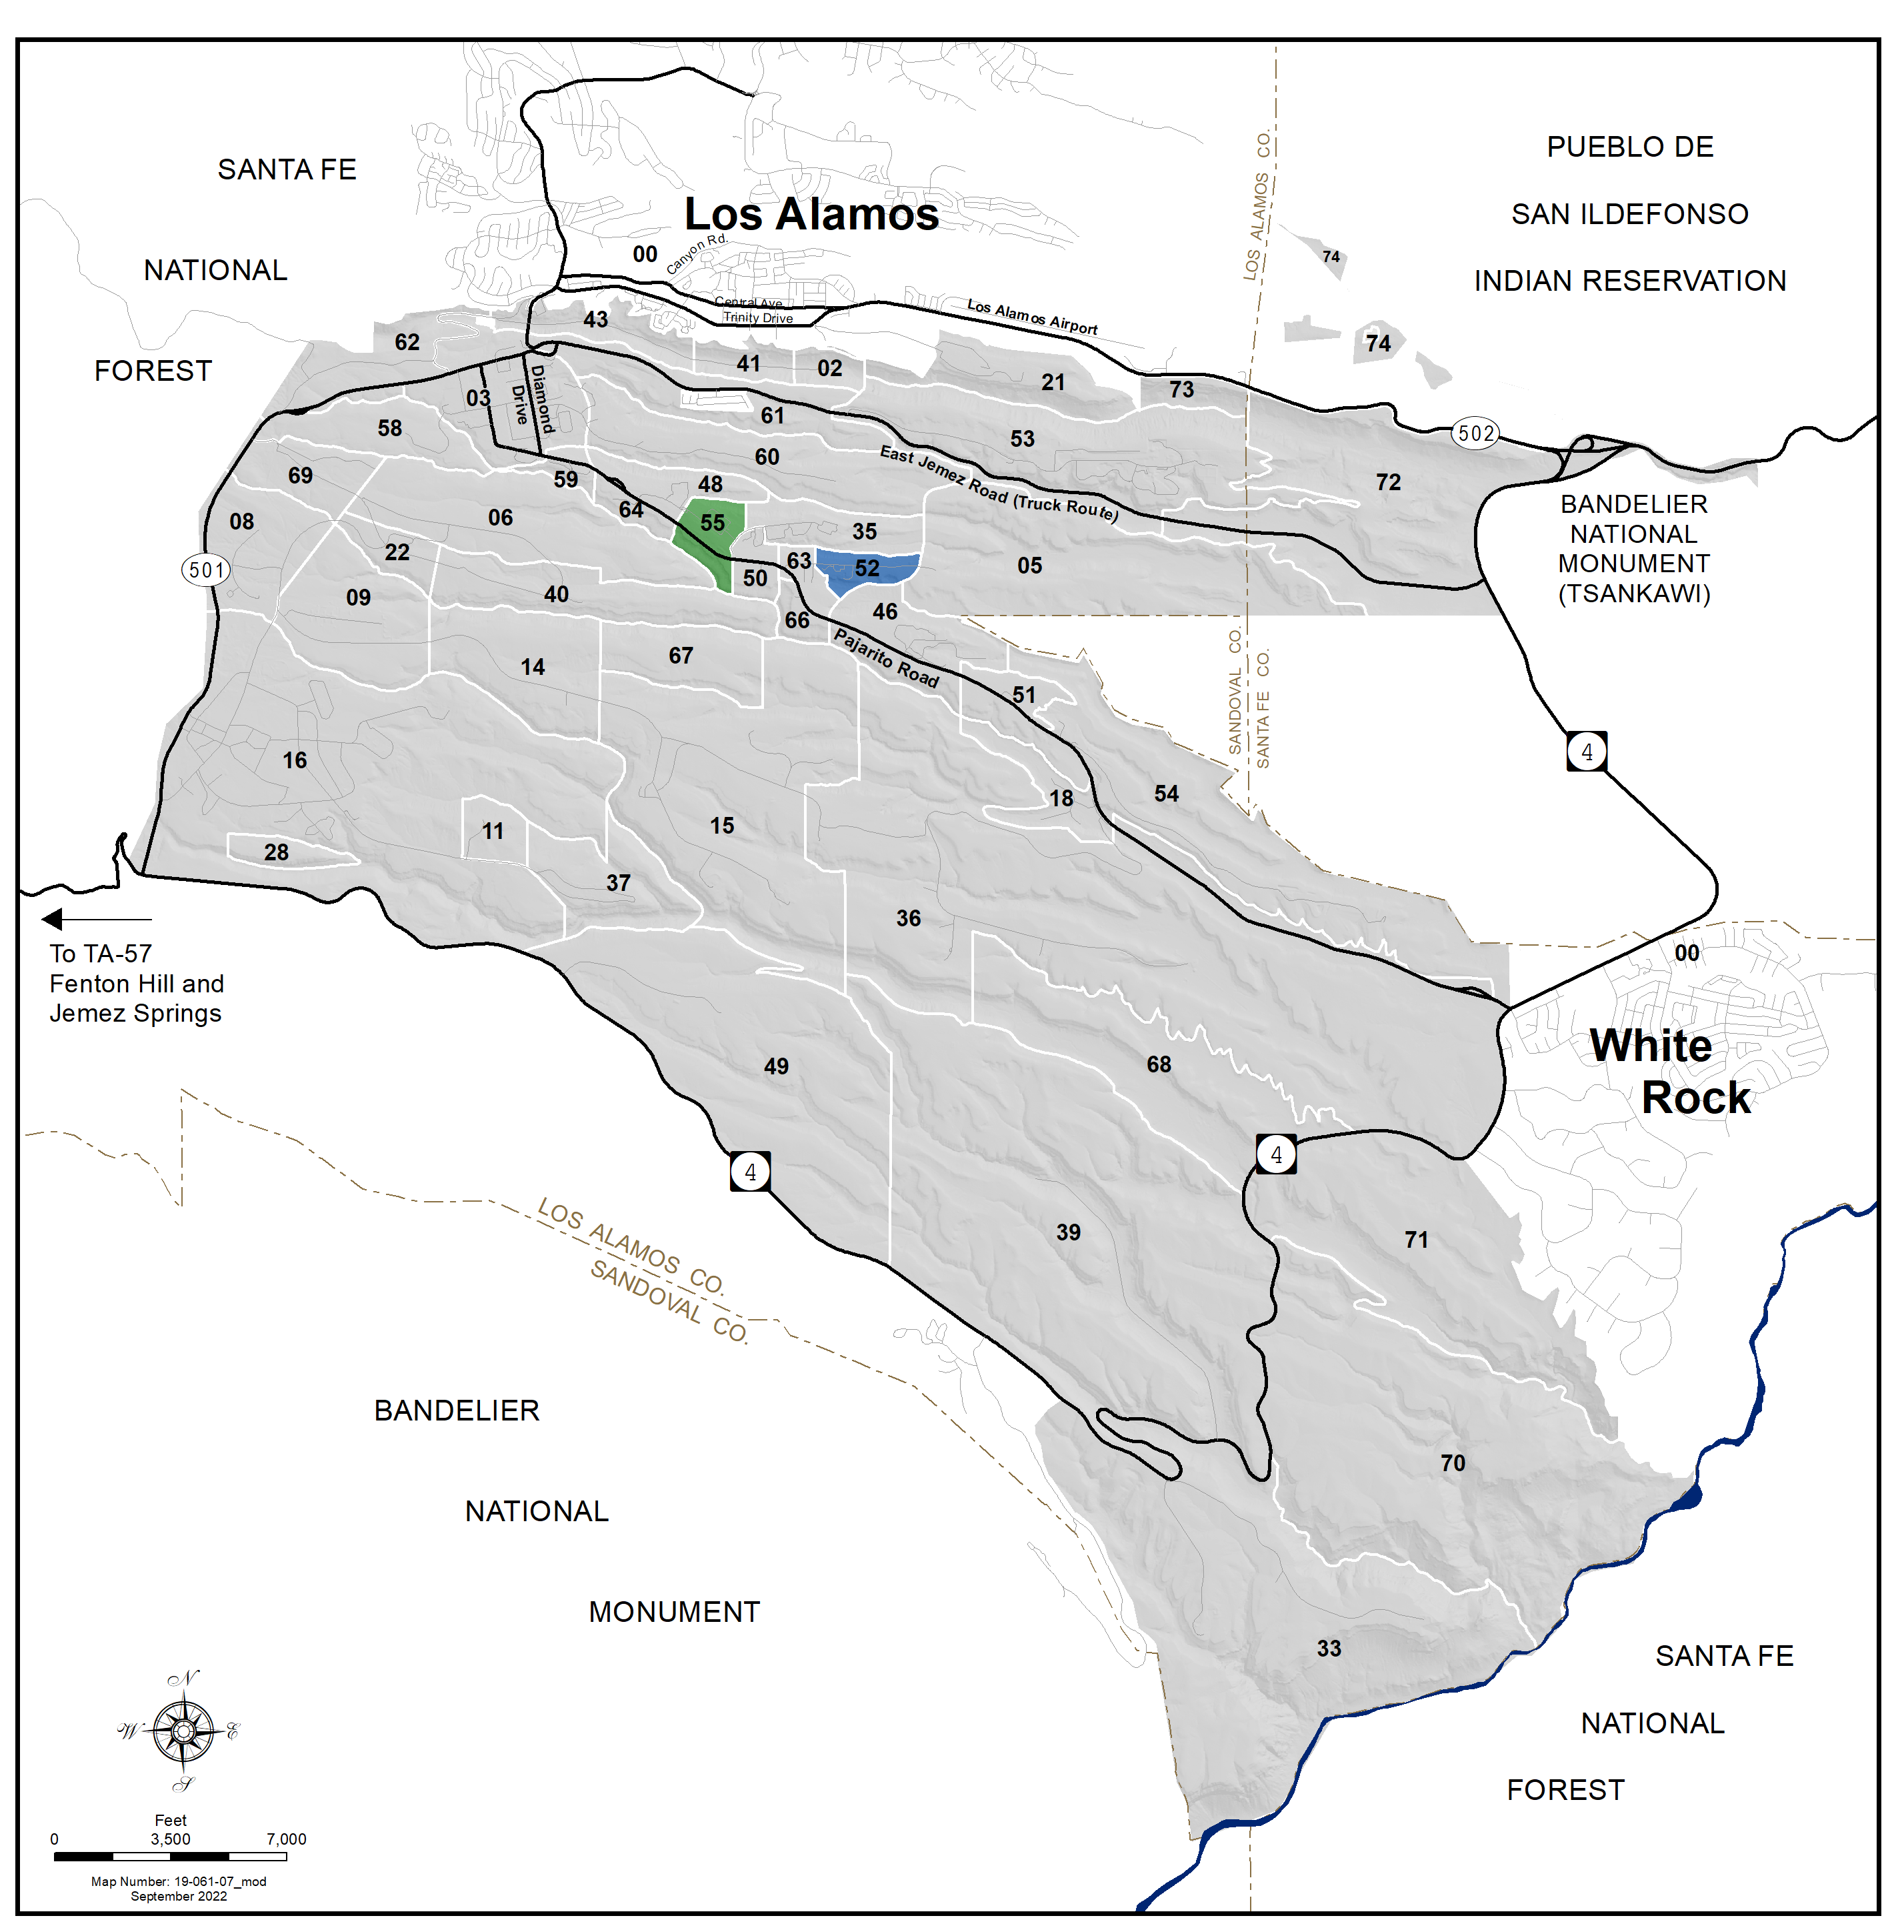
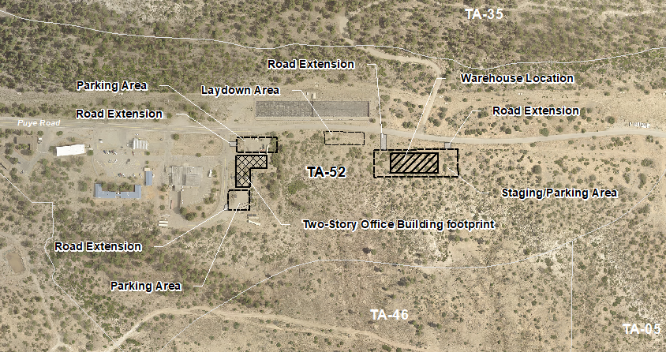
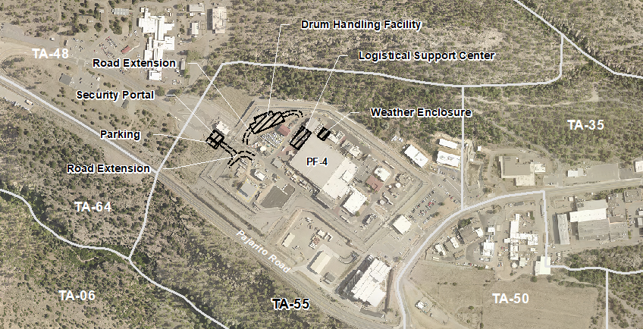
Surplus Plutonium Disposition PROGRAM: Los Alamos National Laboratory Affected Environment
N
TA-52
N
Technical Area (TA)
TA-52 Support Facilities
TA-55 Plutonium Facility
TA-55

