Slide 1
WELCOME
This webinar is being recorded and
will be published on the FECM website
We will begin momentarily

Slide 2
^{WELCOME TO THE}
^{CARBON MANAGEMENT DAY WEBINAR}
December 1, 2022 at 12:01 p.m. EST

Slide 3
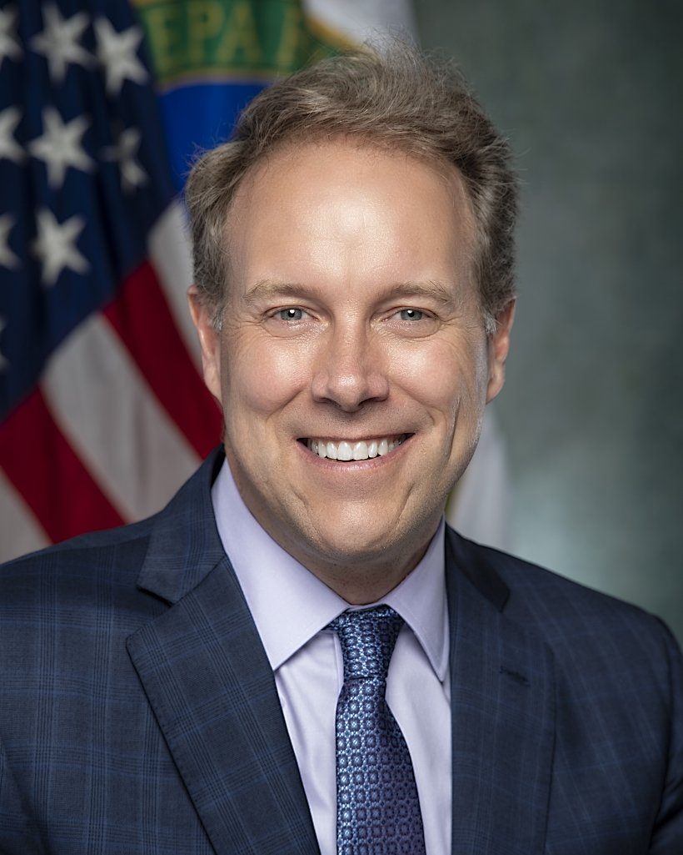
Brad Crabtree Assistant Secretary Office of Fossil Energy and Carbon Management
Introduction to Carbon Management Day
Notes:
Welcome, 4 minutes
Brad provides opening remarks to kick off the 12.01 Carbon Management Webinar
Assistant Secretary Brad Crabtree will provide the welcome and introductory remarks for the Carbon Management Day webinar, as well as the closing remarks. His introductory remarks will highlight the importance of the Bipartisan Infrastructure Law, Inflation Reduction Act, along with the impacts it will have to FECM’s research, development, demonstration, and deployment efforts.

Slide 4
Robust Federal Policy Framework for Carbon Management
Bipartisan Infrastructure Law - $12 billion in federal carbon management investments over 5 years
Includes commercial-scale carbon capture demos, direct air capture and hydrogen hubs, regional geologic storage sites and CO₂ transport infrastructure
Expands federal funding to include commercial scale demonstration and infrastructure
Inflation Reduction Act – Transformative enhancements to the 45Q tax credit to stimulate private investment in carbon capture, carbon conversion and direct air capture projects
Available for projects beginning construction by 2032; direct payments for first 5 years of operation
$85/tCO₂ for carbon capture from industrial facilities and power plants with dedicated storage; $180/tCO₂ for direct air capture
Reduced minimum project size to 1,000 tons for direct air capture, 12,500 tons for industrial facilities, and 18,750 tons for power plants

Slide 5
Agenda
Carbon Management Overview
Domestic and International Stakeholder Engagement
Fireside Chat with FECM Project Awardees
Public Q&A

Slide 6
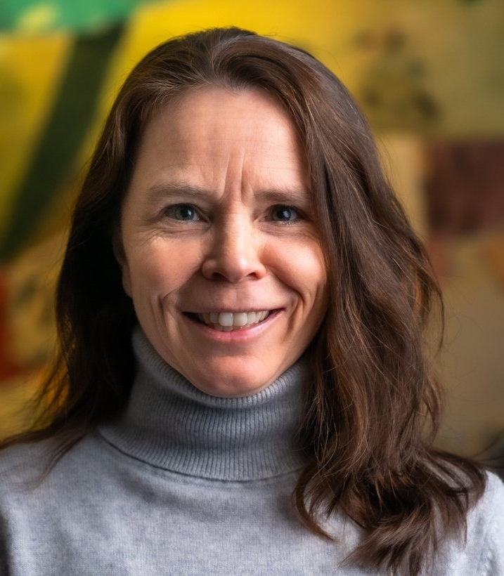
Carbon Management Overview
Dr. Jennifer Wilcox
Principal Deputy Assistant Secretary
Office of Fossil Energy and Carbon Management
Notes:
Carbon Management Overview, 10 minutes
Principal Deputy Assistant Secretary Dr. Jennifer Wilcox will provide remarks summarizing the key takeaways since the last Carbon Management Day webinar. Suggested topics include the release of FECM’s Strategic Vision; the significance of the Carbon Negative Shot Launch & Summit; total funding released in the past year for funding opportunity announcements and project selections; CIFIA Future Growth Grants; and encourage individuals interested in joining the clean energy revolution to learn more about hiring opportunities in FECM.

Slide 7
FECM: Our Mission
FECM supports the research, development, demonstration, and deployment of critical technologies and infrastructure to manage carbon emissions and reduce the environmental impacts of fossil fuel production and use, with the goal of achieving net-zero greenhouse gas emissions economy-wide by midcentury.
Notes:
FECM recognizes that global decarbonization is essential to meeting climate goals and works to engage with international partners to leverage expertise in these areas.
FECM is committed to improving the economic and environmental conditions of communities and workers through the development of clean energy and industrial solutions that accelerate the growth of good-paying jobs.

Slide 8
8
FECM Strategic Vision
Advancing Carbon Management Approaches Toward Deep Decarbonization
Priorities: Carbon capture, carbon dioxide conversion, carbon dioxide removal, and carbon dioxide transport and storage
Advancing Technologies that Lead to Sustainable Energy Resources
Priorities: Hydrogen with carbon management, domestic critical minerals production, and methane mitigation
Advancing Justice, Labor, and Engagement
Priorities: Justice, labor, and international and domestic partnerships
https://www.energy.gov/fecm/strategic-vision-role-fecm-achieving-net-zero-greenhouse-gas-emissions
Notes:
A carbon management framework that will guide FECM’s engagement with offices across the Department, Federal agencies, Tribal and international governments, industry, non-governmental organizations, and communities

Slide 9
9
Carbon Negative Shot
Achieving the Carbon Negative Shot goal will spur innovation and position U.S. enterprises as leaders in research, manufacturing, and deployment in a carbon dioxide removal industry that must have rapid, global ramp-up by mid-century.
Less than $100/net metric ton CO₂e
Robust accounting of full lifecycle emissions
High-quality, durable storage with costs demonstrated for monitoring, reporting, and verification
Enables scaling to giga-ton
Carbon Negative Shot is an all-hands-on-deck call for innovation in pathways to carbon removal from the atmosphere.
This effort is being deployed to counterbalance hard-to-decarbonize sectors and after achieving net-zero, can tackle legacy emissions in the atmosphere.
Notes:
Carbon Negative Shot is an all-hands-on-deck call for innovation in carbon dioxide removal pathways that will capture carbon dioxide (CO2) from the atmosphere and store it at gigaton scales for less than $100/net metric ton of CO2-equivalent. To put this into perspective, one gigaton of CO2 is equivalent to the annual emissions from approximately 250 million vehicles driven in one year. Carbon dioxide removal, in conjunction with aggressive decarbonization, is a climate-critical activity required to reach our nation’s climate goal of achieving net-zero emissions by 2050.

Slide 10
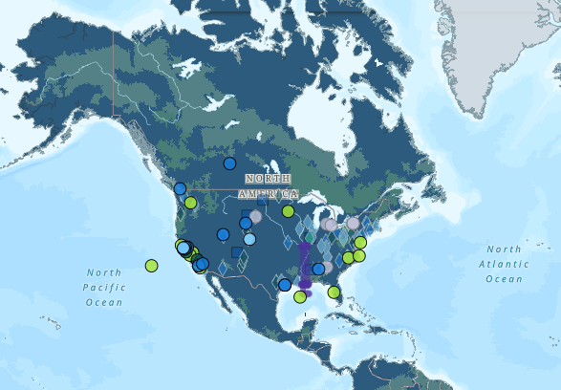
10
FECM Carbon Management Investments
Total funding opportunities:
~$ 3.3 billion
Total project selections:
~$ 346 million
Since January 2021
FECM launched a new webpage that features a list of the current funding opportunities, along with a Carbon Matchmaker tool.
This serves as a ‘one stop shop’ for all potential FOAs, RFIs, and NOIs.
Visit FECM.energy.gov to access these tools. They can be found under the ‘Resources’ and ‘Services’ tab.
https://www.energy.gov/fecm/carbon-matchmaker
Notes:
Total funding opportunities & total project selection numbers are SINCE JANUARY 2021.

Slide 11
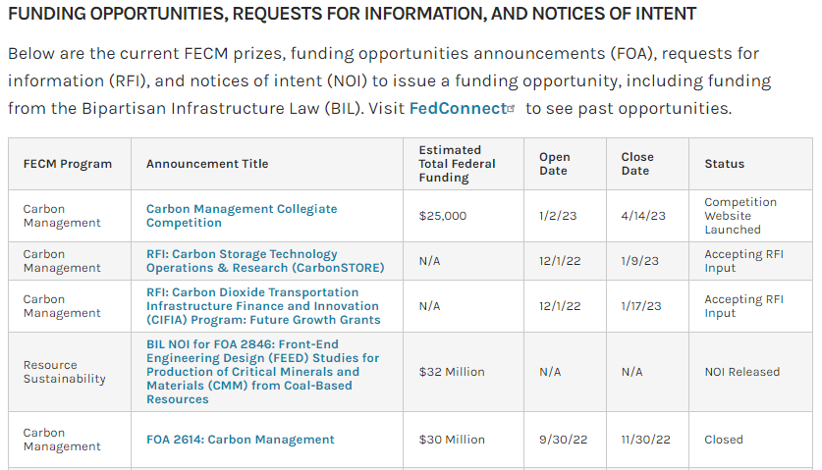
11
Solicitations and Business Opportunities
https://www.energy.gov/fecm/solicitations-and-business-opportunities

Slide 12
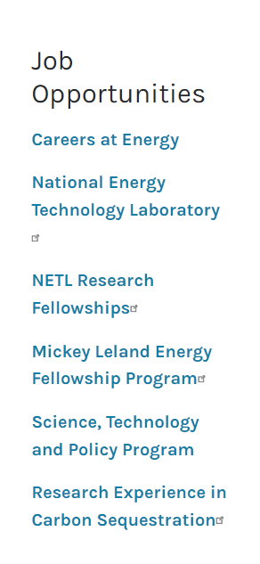
12
Become an FECM All-Star
FECM is looking for enthusiastic, driven professionals to join our team and be a part of the clean energy revolution.
We have a lead role in the clean energy transition and are seeking highly skilled individuals who are passionate about helping FECM achieve its mission.
If you or anyone you know are interested in joining our team, visit FECM.energy.gov and click the ‘Services’ tab—we have many opportunities!
#CleanEnergyJobs #FECMAllStar
https://www.energy.gov/fecm/jobs-and-internships
Notes:
We have a lead role in the clean energy transition and are seeking highly skilled individuals who are passionate about helping FECM achieve its mission, which is focused on minimizing the environmental impacts of fossil fuels while working toward net-zero emissions.

Slide 13
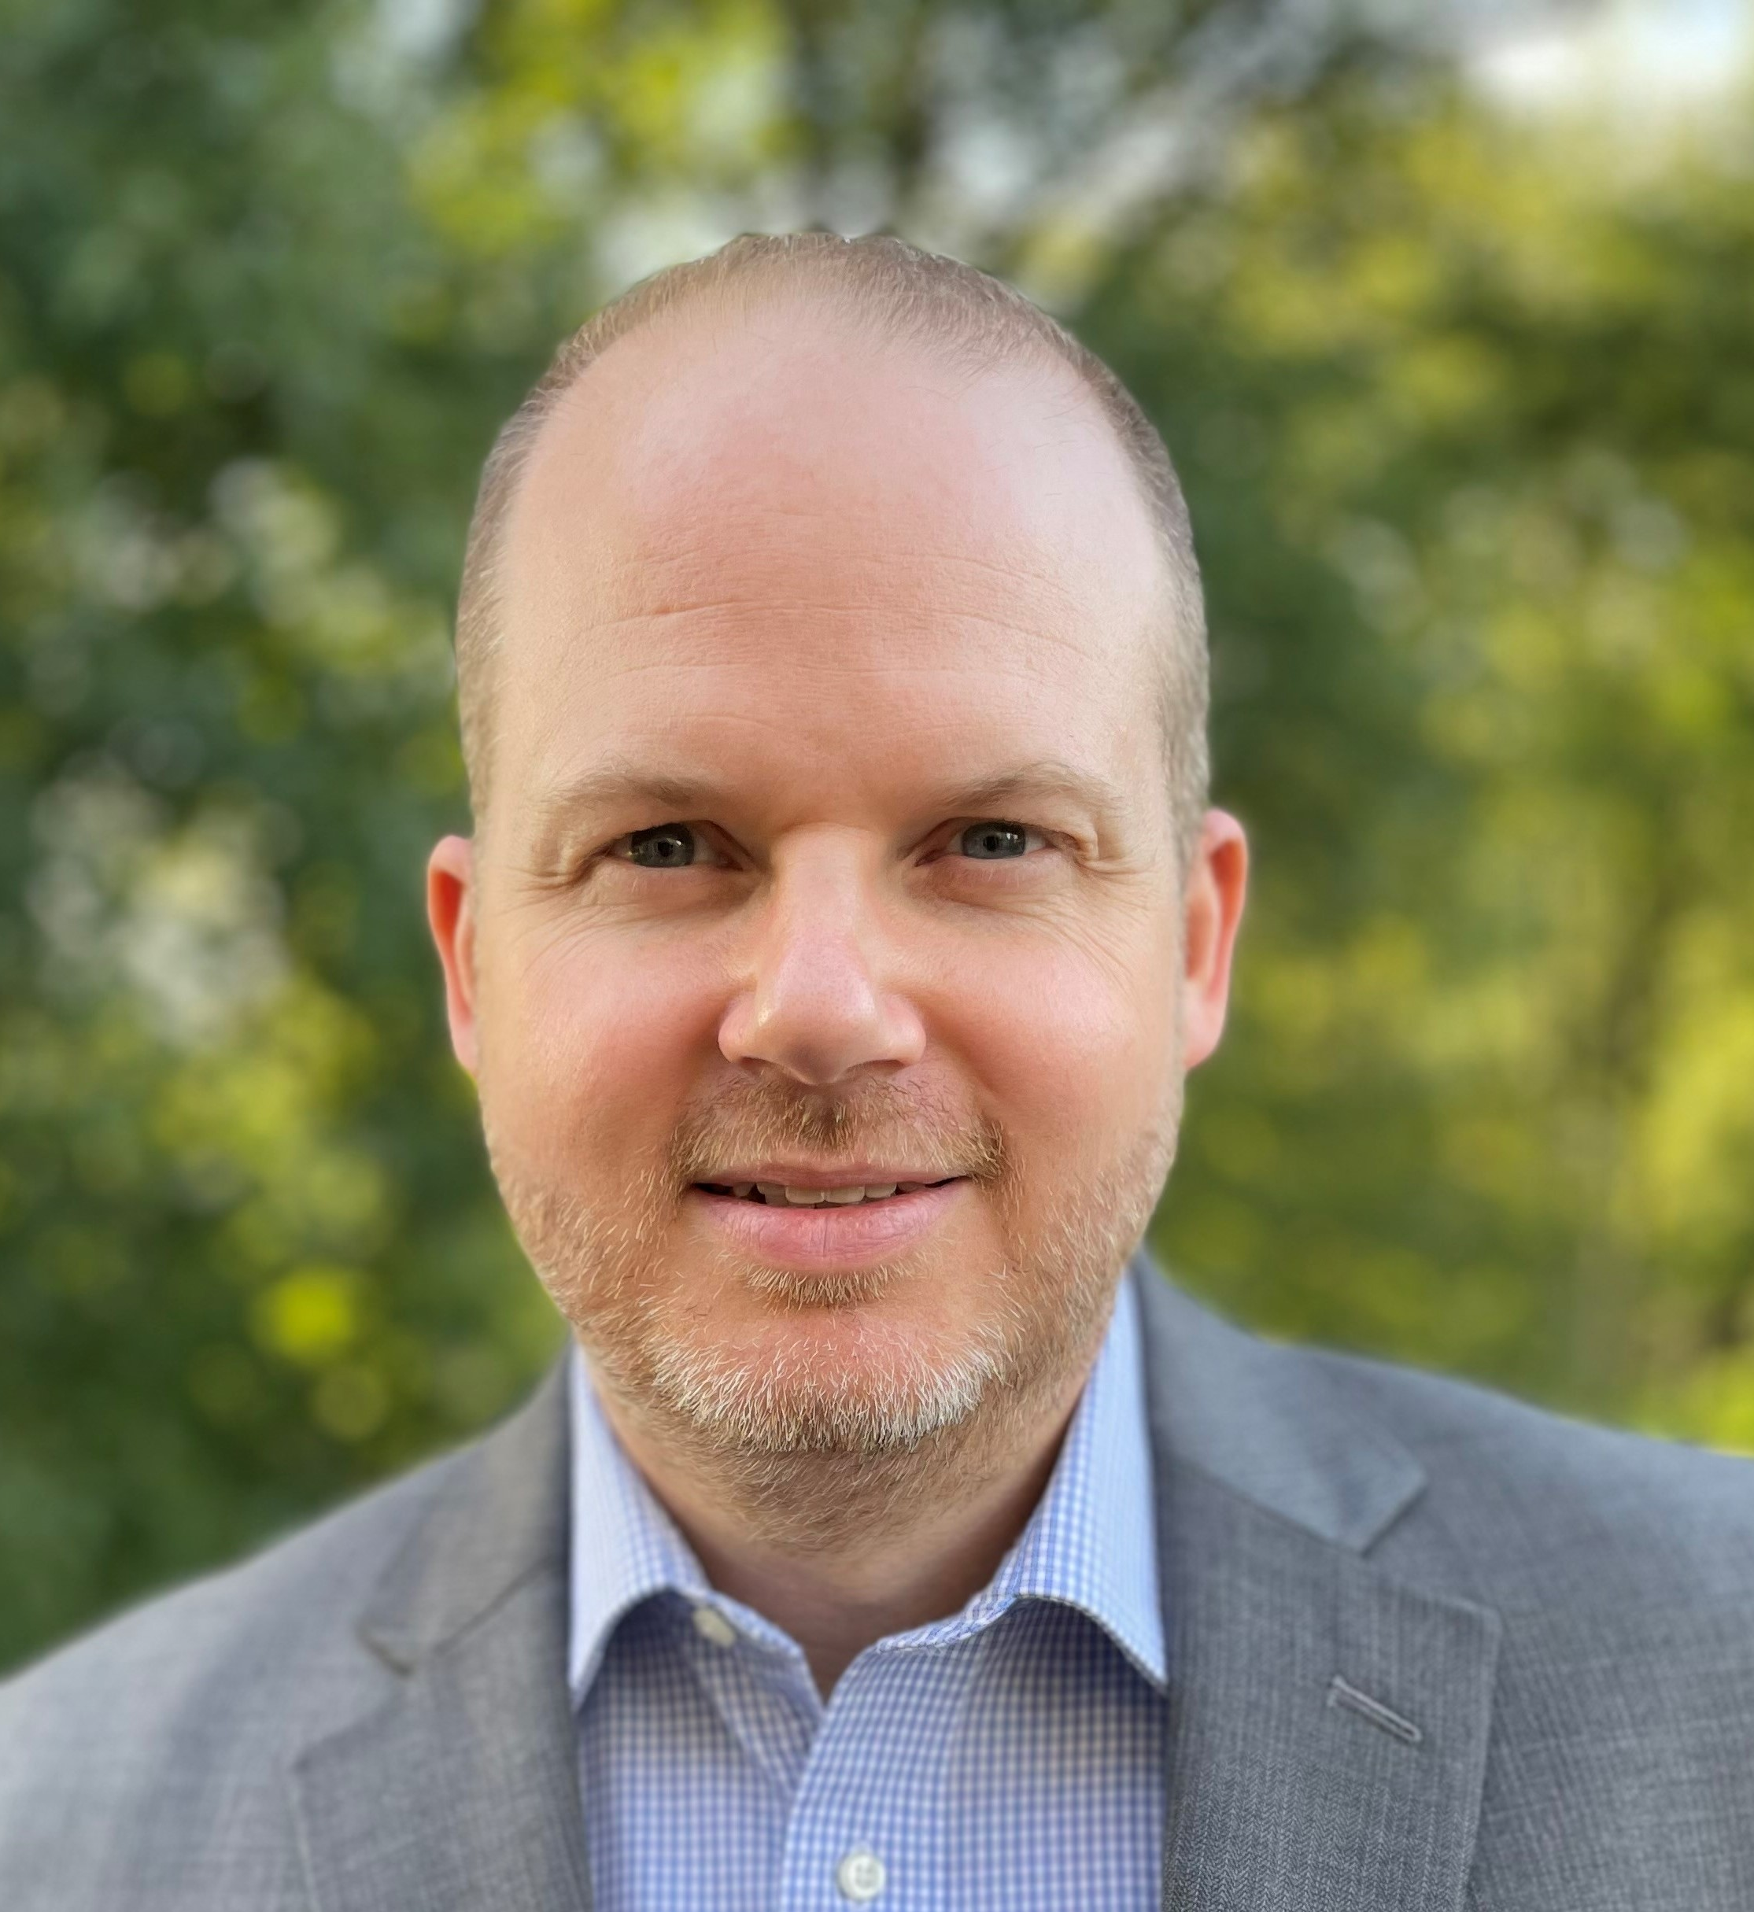
Stakeholder Engagement Update
Dr. Holly Buck
Matt Antes
Management and Program Analysts
Strategic Engagement, Office of Carbon Management
Notes:
Stakeholder Engagement, 15 minutes
Holly will provide remarks regarding FECM’s domestic stakeholder engagement activities, including upcoming engagements and community workshops.
Matt will provide remarks regarding FECM’s international stakeholder engagement activities, including CDR Launch Pad and key messages from COP27.

Slide 14
FECM Engagement in 2022 – and What We Learned From It
Implemented Societal Considerations and Impacts Plans in our Funding Opportunity Announcements
Developed Engagement Framework
Piloted Community Carbon Interactive Workshop Series

Slide 15
Four Big Challenges
There is a lack of diversity in STEM — which can lead to continued inequality, as well as lost opportunities for both workers and firms
The benefits, harms, and risks from innovation and industrial development are often unevenly distributed
The public is often left out of decision-making on energy infrastructure, which can lessen trust between decision-makers and experts and the public, and inhibit deployment
Many communities are struggling with a lack of quality jobs that pay a family-sustaining wage

Slide 16
Societal Considerations and Impacts / Community Benefits Plans
Diversity, Equity, Inclusion, and Accessibility (DEIA)
Justice40 Initiative
Community, Labor, and Stakeholder Engagement
Quality Jobs

Slide 17
Key point: Plans are Action-Oriented
Vision
Assessment
Goals
Outcomes
Implementation
Vision: We affirm we care about justice/engagement/DEIA
Assessment: We mapped or assessed underserved communities/stakeholders/DEIA
Goals: From our assessment, we know X is lacking, so we want to improve in X
Outcomes: We know we have succeeded when Y (specific target) is reached
Implementation: To achieve Y, [specific actor] has to do Z [in specific timeframe]

Slide 18
FECM Engagement Framework
Guiding principles
Two-way
Proactive and early
Place-based
Community-based knowledge, including technical assistance
Engagement that scales
Focus areas
• Energy and industrial communities
• Tribes and Alaska Native Communities
• Environmental Justice Communities
• Labor
• States
• Rural communities

Slide 19
Two-Way Model of Engagement
MOVE FROM... | TOWARD...
Engagement as one-way informing or educating | Two-way model of engagement as dialogue and relationship
Engagement with goal of securing acceptance | Engagement as listening to ideas in order to make adaptations
Defining engagement in terms of project footprint | “Communities” as both geographic areas and broader groups that could be impacted
Engagement focused upon physical infrastructure | Engagement that also encompasses data, including community-based monitoring and science
Notes:
Based on past experience as well as best practices, this is the kind of engagement we want to move towards
We now have an opportunity to do some of this

Slide 20
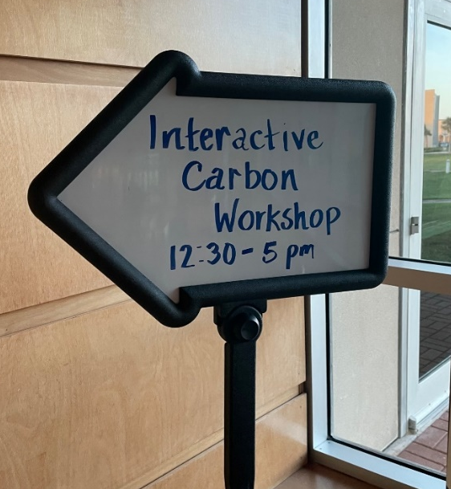
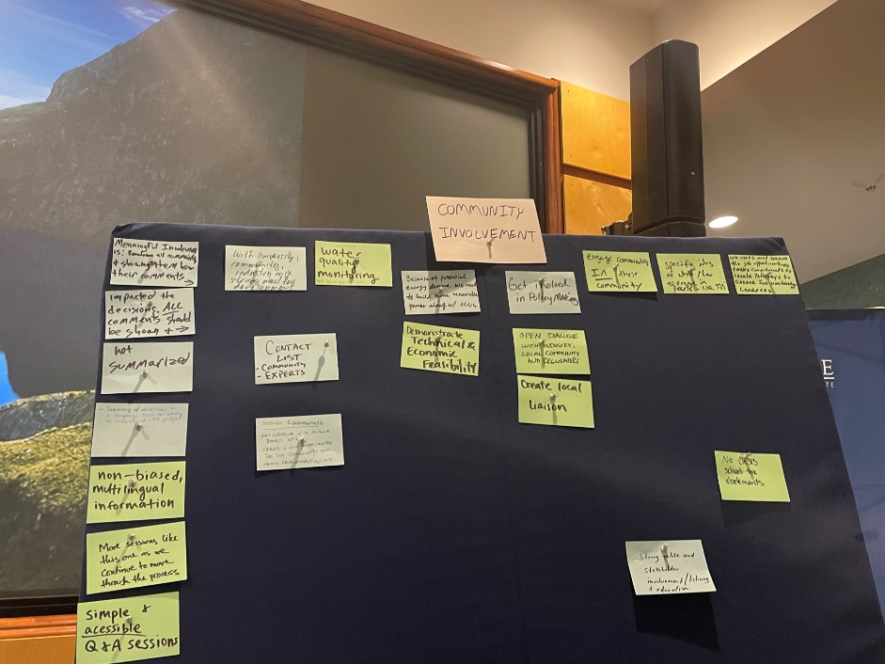
Community Carbon Interactive Workshops
For DOE/USG to learn about community concerns, questions, and how they want to be involved
For communities to learn about carbon capture, utilization, and storage technologies and how the government mitigates risks
Tulsa, OK; Corpus Christi, TX; Tri-cities, WA; Pittsburgh, PA; Virtual
Partnering with other federal agencies on this and additional engagement initiatives

Slide 21
International Engagement
Scaling up carbon management technologies and approaches represents global challenge
Opportunity to responsibly implement carbon management projects domestically and advance global industry
New Collaborations
Africa Center of Excellence for Carbon Management Technology and Innovation
Collaboration Agreement: Decarbonizing Cement with Carbon Capture, Utilization, and Storage
Carbon Dioxide Removal Launchpad

Slide 22
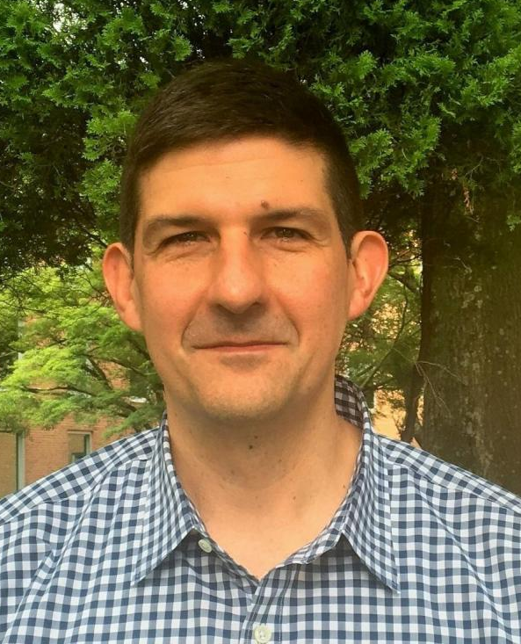
Mark Ackiewicz Director Office of Carbon Management Technologies
Fireside Chat With FECM-Funded Projects
Notes:
Mark will serve as the moderator during the fireside chat with two FECM awardees who can discuss their projects and why carbon management is critical to their organization.
John Northington, Director, National Carbon Capture Center
Dr. Raghubir Gupta, President & Co-founder, Susteon

Slide 23
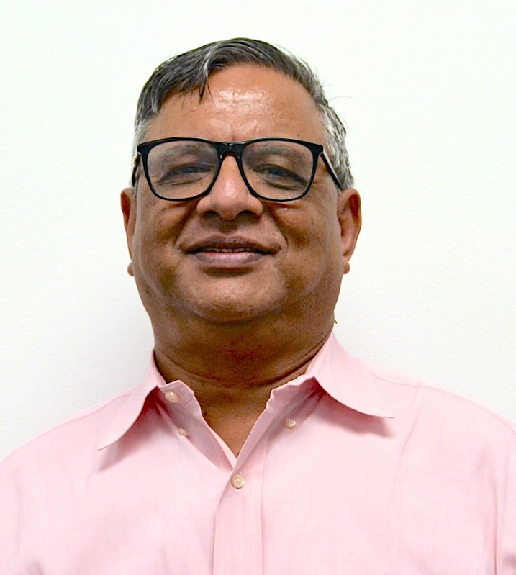
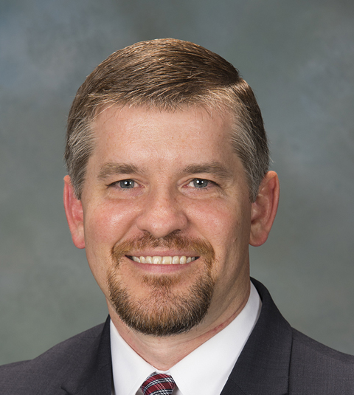
Fireside Chat
Dr. Raghubir Gupta President & Co-founder, Susteon
John Northington Director, National Carbon Capture Center

Slide 24
Closing Remarks
Brad Crabtree
Assistant Secretary
Office of Fossil Energy and Carbon Management
Notes:
Brad to provide closing marks to conclude the Carbon Management Day webinar and to thank attendees for their attendance.

Slide 25
ANY QUESTIONS? Submit them through the chat feature!
…And, if you haven’t already, follow FECM on social media!
…And, if you haven’t already, follow FECM on social media!
@FECMgov
@Fossil Energy and Carbon Management
@Fossil Energy and Carbon Management
Notes:
Q&A, 10 minutes
FECM Comms will moderate the Q&A - Mark will direct and/or address questions received from the audience to the appropriate subject matter expert.

