Slide 1

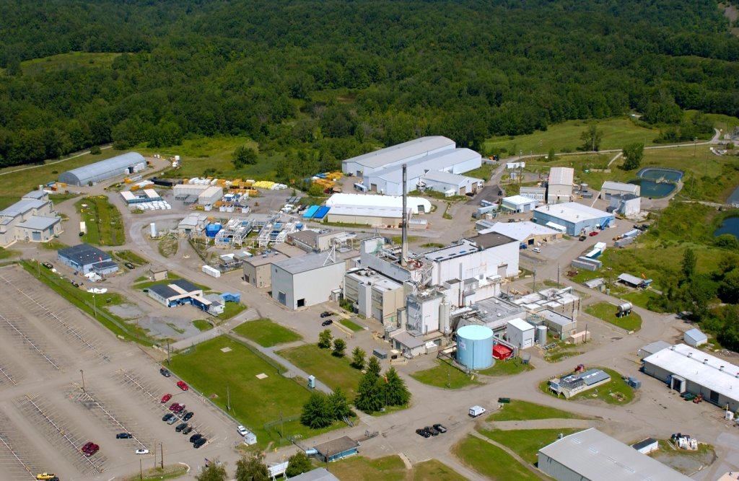

Phase 1 Studies Update
Quarterly Public Meeting
May 22, 2013

Slide 2
Evaluating Uncertainty
Feedback from stakeholders and the Independent Scientific Panel (ISP) stressed that the understanding and evaluation of uncertainty is important in the prioritization of the Phase 1 Studies
DOE and NYSERDA are discussing how best to incorporate uncertainty considerations in Phase 1 Studies and in evaluation of study results with respect to Phase 2 Decisionmaking
The agencies continue to meet frequently, good progress is being made

Slide 3
Exhumation Working Group (EXWG)
EXWG has been tasked to address 3 Potential Areas of Study (PAS)
  Alternative approaches to, costs of, and risks associated with complete tank and waste exhumation
  Viability, cost, and benefit of partial exhumation of waste and removal of contamination
  Exhumation uncertainties and benefit of pilot exhumation activities
EXWG has been on hold since late February as agencies discuss approaches to uncertainty

Slide 4
Exhumation Working Group (EXWG)
Agencies believe the EXWG’s work toward study recommendations should proceed at this time
EXWG ‘s recommendations will include information on the nature of uncertainty with respect to the exhumation study area topics.
  e.g. inventory uncertainties
The recommendations will discuss how the studies may serve to characterize and/or reduce uncertainties in support of agency consensus.

Slide 5
Exhumation Working Group (EXWG)
EXWG path forward
  The EXWG can proceed to develop and submit study recommendations to DOE and NYSERDA
  Recommendations will be discussed with stakeholders, Independent Scientific Panel input
  Agencies will decide on path forward with respect to study recommendations

Slide 6
Erosion Working Group
(EWG)
“The EWG's assessment is that perceptions of uncertainty
associated with long-term predictions of the effects of erosion on critical facilities presented in the FEIS lie at the root of differences in agency views, and that consensus may be achieved if this perceived uncertainty could be better quantified and reduced.”

Slide 7
ISP Review of EWG Recommendations
The EWG Recommendations “should explicitly address expected uncertainty issues with regard to the principal erosion threat (gully advance) more fully, and include consideration of the following:
  Deterministic versus probabilistic methods for evaluating uncertainty - advantages and disadvantages of each with respect to evaluating the principal erosion threat.”

Slide 8
Erosion Working Group (EWG)
DOE and NYSERDA will task the EWG to provide additional information before authorizing studies:
  EWG will prepare a report on uncertainty estimates for a range of erosion prediction methodologies applied over a range of time and space scales
    Provide the agencies additional information regarding nature of uncertainty in erosion estimates

Slide 9
Erosion Working Group (EWG)
Concurrently, EWG will assess current study recommendations 1-3 to Identify studies/study components likely to reduce uncertainty in erosion prediction regardless of analytical framework ultimately used

Slide 10
Engineered Barriers Working Group (EBWG)
On hold since late February as agencies discuss approaches to uncertainty
Agencies feel more progress on Exhumation and Erosion study areas will allow for more effective definition of objectives for Engineered Barriers study area.
Remain on hold for now until progress is made on other topics.

