Slide 1
NEPA Process Overview
The National Historic Preservation Act (NHPA)
and
The Weatherization and Intergovernmental Programs Office (WIPO)
Energy Efficiency and Conservation Block Grant (EECBG)
State Energy Program (SEP) and
Weatherization Assistance Program (WAP)

Slide 2
NHPA Review
Section 106 of the National Historic Preservation Act of 1966 (NHPA) requires federal agencies to consider the effects on historic properties of projects they carry out, assist, fund, permit, license, or approve throughout the country.

Slide 3
Terminology
Award
The written documentation executed by a Contracting Officer which contains the negotiated terms and conditions for providing Financial Assistance
Recipient
A non-federal entity that receives a federal award directly from a federal awarding agency to carry out an activity under a federal program
Subrecipient
A non-federal entity that receives a subaward from a pass-through entity to carry out part of a federal program
NEPA
National Environmental Policy Act
NEPA determination
The DOE form that documents DOE’s NEPA review of a project or activities
SHPO
State Historic Preservation Office or State Historic Preservation Officer
Notes:
Add DOE?
WIPO=EECBG, SEP, and WAP?

Slide 4
Terminology Continued
NHPA
National Historic Preservation Act
Historic Preservation Programmatic Agreement
Historic Preservation Programmatic Agreements (PAs) offer a streamlined process for grantees to satisfy their historic preservation requirements with minimum or no consultation with the State Historic Preservation Officer based on the type of activity that is being undertaken
Undertaking
Any project, activity, or program with federal agency involvement, such as those carried out by federal agencies, assisted by federal agencies, or that require a federal permit, license, or approval.
Any activity that compacts or disturbs the ground within a project area
Ground disturbance

Slide 5
NHPA
In 2010, DOE, the Advisory Council on Historic Preservation and the National Conference of State Historic Preservation Officers developed a first-of-its-kind Programmatic Agreement (PA) for National Historic Preservation Act Section 106 reviews. The PA provides a streamlined Section 106 process for projects funded under DOE’s Weatherization Assistance Program, State Energy Program, and Energy Efficiency Conservation Block Grant program.

Slide 6
NHPA and Programmatic Agreements
DOE’s Weatherization Assistance Program, State Energy Program, and Energy Efficiency Conservation Block Grant program provide funding for tens of thousands of Historic Preservation-related activities each year.
The PAs make it possible for DOE recipients to execute a large number of undertakings, in compliance with Section 106, by expediting reviews for those that do not have the potential to adversely impact historic properties and establishing the review process for those projects that require individual consideration.

Slide 7
NHPA and Programmatic Agreements
A total of 55 state and territory PAs have been executed with DOE as of August 2022.
DOE, in cooperation with the Advisory Council on Historic Preservation and the National Conference of State Historic Preservation Officers, developed an Amendment to extend the expiration date of the PAs. Nearly all agreements were extended through 2030, although 3 states opted to extend their PAs through 2025.
The PAs and their amendments can be found here:
https://www.energy.gov/eere/wipo/historic-preservation-executed-programmatic-agreements

Slide 8
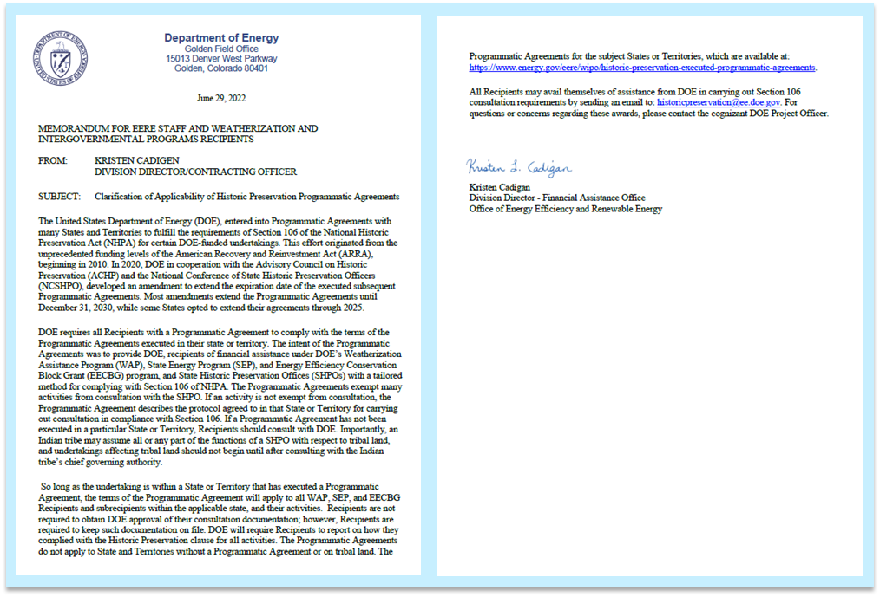
NHPA and Programmatic Agreements
Per this June 29, 2022 DOE memo, “So long as the undertaking is within a State or Territory that has executed a Programmatic Agreement, the terms of the Programmatic Agreement will apply to all WAP, SEP, and EECBG Recipients and subrecipients within the applicable state, and their activities.”
The memo is posted at: www.energy.gov/node/4816816

Slide 9
NHPA and Programmatic Agreements
Not all states or territories have a PA. Additionally, DOE does not have programmatic agreements with any tribal governments.
WIPO states or territories without a PA have additional restrictions in their NEPA determination. The restrictions in the NEPA determination must be followed.
The remainder of this presentation is specific to recipients and subrecipients in a state or territory with a programmatic agreement.

Slide 10
NHPA and Programmatic Agreements
Disclaimer
The next slides will outline the general process most recipients should follow for implementing their PA. However, many PAs are tailored with state or territory specific protocols or restrictions. This presentation is not intended to contradict any PA. Carefully review your PA to ensure you fully understand the restrictions and processes outlined by your SHPO, and follow your specific PA.

Slide 11
NHPA and Programmatic Agreements
Review your Historic Preservation Programmatic Agreement (PA)*
Does project involve a property
45 or 50 years or older per your PA?*
NO
YES
Does the project involve ground disturbance limited to boundaries of your ND?
Are the individual activities of the project listed in your PA?
NO
YES
NO
YES
Do the individual activities of the project comply with the restrictions for each activity listed in the PA?
See the NEPA Review Process PowerPoint for next steps**
Consult with SHPO as outlined in your PA
NO
YES
Questions: GONEPA@ee.doe.gov*
Notes:
*https://www.energy.gov/eere/wipo/historic-preservation-executed-programmatic-agreements
**www.energy.gov/node/4816816

Slide 12
NHPA and Programmatic Agreements
Review your Historic Preservation Programmatic Agreement (PA)*
Does project involve a property
45 or 50 years or older per your PA?*
NO
YES
Does the project involve ground disturbance limited to boundaries of your ND?
Are the individual activities of the project listed in your PA?
NO
YES
NO
YES
Do the individual activities of the project comply with the restrictions for each activity listed in the PA?
See the NEPA Review Process PowerPoint for next steps**
Consult with SHPO as outlined in your PA
NO
YES
Questions: GONEPA@ee.doe.gov*
Notes:
*https://www.energy.gov/eere/wipo/historic-preservation-executed-programmatic-agreements
**www.energy.gov/node/4816816

Slide 13
NHPA and Programmatic Agreements
Review your Historic Preservation Programmatic Agreement (PA)*
Does project involve a property
45 or 50 years or older per your PA?*
NO
YES
Does the project involve ground disturbance limited to boundaries of your ND?
Are the individual activities of the project listed in your PA?
NO
YES
NO
YES
Do the individual activities of the project comply with the restrictions for each activity listed in the PA?
See the NEPA Review Process PowerPoint for next steps**
Consult with SHPO as outlined in your PA
NO
YES
Questions: GONEPA@ee.doe.gov*
Notes:
*https://www.energy.gov/eere/wipo/historic-preservation-executed-programmatic-agreements
**www.energy.gov/node/4816816

Slide 14
NHPA and Programmatic Agreements
Review your Historic Preservation Programmatic Agreement (PA)*
Does project involve a property
45 or 50 years or older per your PA?*
NO
YES
Does the project involve ground disturbance limited to boundaries of your ND?
Are the individual activities of the project listed in your PA?
NO
YES
NO
YES
Do the individual activities of the project comply with the restrictions for each activity listed in the PA?
See the NEPA Review Process PowerPoint for next steps**
Consult with SHPO as outlined in your PA
NO
YES
Questions: GONEPA@ee.doe.gov*
Notes:
*https://www.energy.gov/eere/wipo/historic-preservation-executed-programmatic-agreements
**www.energy.gov/node/4816816

Slide 15
NHPA and Programmatic Agreements
Review your Historic Preservation Programmatic Agreement (PA)*
Does project involve a property
45 or 50 years or older per your PA?*
NO
YES
Does the project involve ground disturbance limited to boundaries of your ND?
Are the individual activities of the project listed in your PA?
NO
YES
NO
YES
Do the individual activities of the project comply with the restrictions for each activity listed in the PA?
See the NEPA Review Process PowerPoint for next steps**
Consult with SHPO as outlined in your PA
NO
YES
Questions: GONEPA@ee.doe.gov*
Notes:
*https://www.energy.gov/eere/wipo/historic-preservation-executed-programmatic-agreements
**www.energy.gov/node/4816816

Slide 16
NHPA and Programmatic Agreements
Review your Historic Preservation Programmatic Agreement (PA)*
Does project involve a property
45 or 50 years or older per your PA?*
NO
YES
Does the project involve ground disturbance limited to boundaries of your ND?
Are the individual activities of the project listed in your PA?
NO
YES
NO
YES
Do the individual activities of the project comply with the restrictions for each activity listed in the PA?
See the NEPA Review Process PowerPoint for next steps**
Consult with SHPO as outlined in your PA
NO
YES
Questions: GONEPA@ee.doe.gov*
Notes:
*https://www.energy.gov/eere/wipo/historic-preservation-executed-programmatic-agreements
**www.energy.gov/node/4816816

Slide 17
NHPA and Programmatic Agreements
Review your Historic Preservation Programmatic Agreement (PA)*
Does project involve a property
45 or 50 years or older per your PA?*
NO
YES
Does the project involve ground disturbance limited to boundaries of your ND?
Are the individual activities of the project listed in your PA?
NO
YES
NO
YES
Do the individual activities of the project comply with the restrictions for each activity listed in the PA?
See the NEPA Review Process PowerPoint for next steps**
Consult with SHPO as outlined in your PA
NO
YES
Questions: GONEPA@ee.doe.gov*
Notes:
*https://www.energy.gov/eere/wipo/historic-preservation-executed-programmatic-agreements
**www.energy.gov/node/4816816

Slide 18
NHPA and Programmatic Agreements
Review your Historic Preservation Programmatic Agreement (PA)*
Does project involve a property
45 or 50 years or older per your PA?*
NO
YES
Does the project involve ground disturbance limited to boundaries of your ND?
Are the individual activities of the project listed in your PA?
NO
YES
NO
YES
Do the individual activities of the project comply with the restrictions for each activity listed in the PA?
See the NEPA Review Process PowerPoint for next steps**
Consult with SHPO as outlined in your PA
NO
YES
Questions: GONEPA@ee.doe.gov*
Notes:
*https://www.energy.gov/eere/wipo/historic-preservation-executed-programmatic-agreements
**www.energy.gov/node/4816816

Slide 19
NHPA and Programmatic Agreements
Review your Historic Preservation Programmatic Agreement (PA)*
Does project involve a property
45 or 50 years or older per your PA?*
NO
YES
Does the project involve ground disturbance limited to boundaries of your ND?
Are the individual activities of the project listed in your PA?
NO
YES
NO
YES
Do the individual activities of the project comply with the restrictions for each activity listed in the PA?
See the NEPA Review Process PowerPoint for next steps**
Consult with SHPO as outlined in your PA
NO
YES
Questions: GONEPA@ee.doe.gov*
Notes:
*https://www.energy.gov/eere/wipo/historic-preservation-executed-programmatic-agreements
**www.energy.gov/node/4816816

Slide 20
NHPA and Programmatic Agreements
Review your Historic Preservation Programmatic Agreement (PA)*
Does project involve a property
45 or 50 years or older per your PA?*
NO
YES
Does the project involve ground disturbance limited to boundaries of your ND?
Are the individual activities of the project listed in your PA?
NO
YES
NO
YES
Do the individual activities of the project comply with the restrictions for each activity listed in the PA?
See the NEPA Review Process PowerPoint for next steps**
Consult with SHPO as outlined in your PA
NO
YES
Questions: GONEPA@ee.doe.gov*
Notes:
*https://www.energy.gov/eere/wipo/historic-preservation-executed-programmatic-agreements
**www.energy.gov/node/4816816

Slide 21
NHPA and Programmatic Agreements
Review your Historic Preservation Programmatic Agreement (PA)*
Does project involve a property
45 or 50 years or older per your PA?*
NO
YES
Does the project involve ground disturbance limited to boundaries of your ND?
Are the individual activities of the project listed in your PA?
NO
YES
NO
YES
Do the individual activities of the project comply with the restrictions for each activity listed in the PA?
See the NEPA Review Process PowerPoint for next steps**
Consult with SHPO as outlined in your PA
NO
YES
Questions: GONEPA@ee.doe.gov*
Notes:
*https://www.energy.gov/eere/wipo/historic-preservation-executed-programmatic-agreements
**www.energy.gov/node/4816816

Slide 22
NHPA and Programmatic Agreements
Review your Historic Preservation Programmatic Agreement (PA)*
Does project involve a property
45 or 50 years or older per your PA?*
NO
YES
Does the project involve ground disturbance limited to boundaries of your ND?
Are the individual activities of the project listed in your PA?
NO
YES
NO
YES
Do the individual activities of the project comply with the restrictions for each activity listed in the PA?
See the NEPA Review Process PowerPoint for next steps**
Consult with SHPO as outlined in your PA
NO
YES
Questions: GONEPA@ee.doe.gov*
Notes:
*https://www.energy.gov/eere/wipo/historic-preservation-executed-programmatic-agreements
**www.energy.gov/node/4816816

Slide 23
NHPA and Programmatic Agreements
Review your Historic Preservation Programmatic Agreement (PA)*
Does project involve a property
45 or 50 years or older per your PA?*
NO
YES
Does the project involve ground disturbance limited to boundaries of your ND?
Are the individual activities of the project listed in your PA?
NO
YES
NO
YES
Do the individual activities of the project comply with the restrictions for each activity listed in the PA?
See the NEPA Review Process PowerPoint for next steps**
Consult with SHPO as outlined in your PA
NO
YES
Questions: GONEPA@ee.doe.gov*
Notes:
*https://www.energy.gov/eere/wipo/historic-preservation-executed-programmatic-agreements
**www.energy.gov/node/4816816

Slide 24
NHPA and Programmatic Agreements
Review your Historic Preservation Programmatic Agreement (PA)*
Does project involve a property
45 or 50 years or older per your PA?*
NO
YES
Does the project involve ground disturbance limited to boundaries of your ND?
Are the individual activities of the project listed in your PA?
NO
YES
NO
YES
Do the individual activities of the project comply with the restrictions for each activity listed in the PA?
See the NEPA Review Process PowerPoint for next steps**
Consult with SHPO as outlined in your PA
NO
YES
Questions: GONEPA@ee.doe.gov*
Notes:
*https://www.energy.gov/eere/wipo/historic-preservation-executed-programmatic-agreements
**www.energy.gov/node/4816816

Slide 25
NHPA and Programmatic Agreements
Review your Historic Preservation Programmatic Agreement (PA)*
Does project involve a property
45 or 50 years or older per your PA?*
NO
YES
Does the project involve ground disturbance limited to boundaries of your ND?
Are the individual activities of the project listed in your PA?
NO
YES
NO
YES
Do the individual activities of the project comply with the restrictions for each activity listed in the PA?
See the NEPA Review Process PowerPoint for next steps**
Consult with SHPO as outlined in your PA
NO
YES
Questions: GONEPA@ee.doe.gov*
Notes:
*https://www.energy.gov/eere/wipo/historic-preservation-executed-programmatic-agreements
**www.energy.gov/node/4816816

Slide 26
NHPA and Programmatic Agreements
Review your Historic Preservation Programmatic Agreement (PA)*
Does project involve a property
45 or 50 years or older per your PA?*
NO
YES
Does the project involve ground disturbance limited to boundaries of your ND?
Are the individual activities of the project listed in your PA?
NO
YES
NO
YES
Do the individual activities of the project comply with the restrictions for each activity listed in the PA?
See the NEPA Review Process PowerPoint for next steps**
Consult with SHPO as outlined in your PA
NO
YES
Questions: GONEPA@ee.doe.gov*
Notes:
*https://www.energy.gov/eere/wipo/historic-preservation-executed-programmatic-agreements
**www.energy.gov/node/4816816

Slide 27
NHPA and Programmatic Agreements
Review your Historic Preservation Programmatic Agreement (PA)*
Does project involve a property
45 or 50 years or older per your PA?*
NO
YES
Does the project involve ground disturbance limited to boundaries of your ND?
Are the individual activities of the project listed in your PA?
NO
YES
NO
YES
Do the individual activities of the project comply with the restrictions for each activity listed in the PA?
See the NEPA Review Process PowerPoint for next steps**
Consult with SHPO as outlined in your PA
NO
YES
Questions: GONEPA@ee.doe.gov*
Notes:
*https://www.energy.gov/eere/wipo/historic-preservation-executed-programmatic-agreements
**www.energy.gov/node/4816816

Slide 28
NHPA and Programmatic Agreements
Review your Historic Preservation Programmatic Agreement (PA)*
Does project involve a property
45 or 50 years or older per your PA?*
NO
YES
Does the project involve ground disturbance limited to boundaries of your ND?
Are the individual activities of the project listed in your PA?
NO
YES
NO
YES
Do the individual activities of the project comply with the restrictions for each activity listed in the PA?
See the NEPA Review Process PowerPoint for next steps**
Consult with SHPO as outlined in your PA
NO
YES
Questions: GONEPA@ee.doe.gov*
Notes:
*https://www.energy.gov/eere/wipo/historic-preservation-executed-programmatic-agreements
**www.energy.gov/node/4816816

Slide 29
NHPA and Programmatic Agreements
Review your Historic Preservation Programmatic Agreement (PA)*
Does project involve a property
45 or 50 years or older per your PA?*
NO
YES
Does the project involve ground disturbance limited to boundaries of your ND?
Are the individual activities of the project listed in your PA?
NO
YES
NO
YES
Do the individual activities of the project comply with the restrictions for each activity listed in the PA?
See the NEPA Review Process PowerPoint for next steps**
Consult with SHPO as outlined in your PA
NO
YES
Questions: GONEPA@ee.doe.gov*
Notes:
*https://www.energy.gov/eere/wipo/historic-preservation-executed-programmatic-agreements
**www.energy.gov/node/4816816

Slide 30
NHPA and Programmatic Agreements
Review your Historic Preservation Programmatic Agreement (PA)*
Does project involve a property
45 or 50 years or older per your PA?*
NO
YES
Does the project involve ground disturbance limited to boundaries of your ND?
Are the individual activities of the project listed in your PA?
NO
YES
NO
YES
Do the individual activities of the project comply with the restrictions for each activity listed in the PA?
See the NEPA Review Process PowerPoint for next steps**
Consult with SHPO as outlined in your PA
NO
YES
Questions: GONEPA@ee.doe.gov*
Notes:
*https://www.energy.gov/eere/wipo/historic-preservation-executed-programmatic-agreements
**www.energy.gov/node/4816816

Slide 31
Annual Historic Preservation Report
The Annual Historic Preservation Report must be submitted to DOE by September 15th, per your Federal Assistance Reporting Checklist
Review the Historic Preservation Report Guidance:
https://www.energy.gov/node/4504129

Slide 32
Tips for Success
Reach out to your SHPO; introduce yourself
When required to consult with your SHPO, reference the PA to ensure SHPO’s awareness of the PA and of federal funding
Undertakings requiring more than “minimal” ground disturbance require consultation with your SHPO
Note: SHPO can help to define “minimal” ground disturbance
Review your PA to ensure understanding of allowances, restrictions as well as documentation and reporting requirements

Slide 33
NHPA Review
Questions?
Contact GONEPA@ee.doe.gov

