Slide 1


NEPA Process Overview
The National Environmental Policy Act (NEPA) Review Process
and
The Weatherization and Intergovernmental Programs Office (WIP)
Energy Efficiency and Conservation Block Grant (EECBG)
State Energy Program (SEP) and
Weatherization Assistance Program (WAP)

Slide 2






NEPA Review
Now that you have completed the NEPA Overview presentation and have an understanding of NEPA, this presentation will now focus on the DOE NEPA review process and recipient responsibilities.

Slide 3
Terminology
Award
The written documentation executed by a Contracting Officer which contains the negotiated terms and conditions for providing Financial Assistance
Recipient
A non-federal entity that receives a federal award directly from a federal awarding agency to carry out an activity under a federal program
Subrecipient
A non-federal entity that receives a subaward from a pass-through entity to carry out part of a federal program
NEPA determination
The DOE form that documents DOE’s NEPA review of a project or activities
Bounded Categories
Activities listed in a NEPA determination that restrict the size, location, installation methods, or other elements to complete a project; bounded categories must be documented in a NEPA log
NEPA
National Environmental Policy Act

Slide 4
Terminology Continued
NEPA Log
A document that provides evidence of a recipient’s review of Bounded Categories of activities
Historic Preservation Programmatic Agreement
Programmatic Agreements (PAs) offer a streamlined process for grantees to satisfy their historic preservation requirements with minimum or no consultation with the State Historic Preservation Officer based on the type of activity that is being undertaken
Categorical Exclusion
Categories of actions that DOE has determined, by regulation, normally do not have a significant effect on the human environment and for which neither an environmental assessment nor an environmental impact statement is required
Scope of Work
An explanation of specific activities and steps to complete a project
PMC
Project Management Center, an online system for DOE NEPA reviews

Slide 5
NEPA Review: First Step
Has an award been made for your project?
YES
If you have an award, do you have the NEPA determination in your award documents?
YES
If you have a NEPA determination, review the NEPA determination.
NO
If you have an award, but do not have the NEPA determination, contact your DOE Project Officer.
NO
If an award has not been made for your project, contact your DOE Project Officer for next steps.
NOT SURE
If unsure if an award has been made for your project or if a NEPA determination has been completed, contact your DOE Project Officer.

Slide 6
Reviewing the NEPA Determination
A NEPA determination with Bounded Categories –which includes a list of restricted activities that must be documented in a NEPA log.
A NEPA determination specific to one project or types of project activities but does not include Bounded Categories and does not require a NEPA log.
There are two kinds of NEPA determinations:
If you are unsure about your NEPA determination, contact your DOE Project Officer or email NEPA at: GONEPA@ee.doe.gov

Slide 7
NEPA Review
Let’s review a NEPA determination.
If you are unsure about your NEPA determination, contact your DOE Project Officer or email NEPA at: GONEPA@ee.doe.gov

Slide 8
Highlights of a NEPA Determination
Recipient: May include individual recipient name, or program name including distinction for recipients with or without a historic preservation programmatic agreement
Project Title: May include the funding source
Rationale for Determination: Defines either the individual project or multiple types of projects with restrictions
NEPA Provision: Will include restrictions on the award
Note: All restrictions in the NEPA determination must be followed.

Slide 9
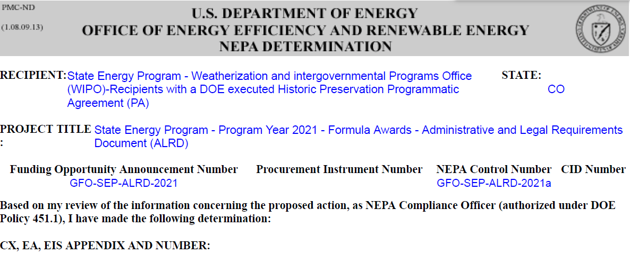
Sample NEPA Determination

Slide 10
Sample NEPA Determination
Let’s look closer at a NEPA Determination with Bounded Categories.
Remember from our list of terms: Bounded Categories are activities listed in a NEPA determination that restrict the size, location, installation methods, or other elements to complete a project.
All Bounded Categories must be documented in a NEPA log to demonstrate that a project meets all the restrictions of the Bounded Category.

Slide 11
If the NEPA Determination Includes Bounded Categories
The Recipient must demonstrate the proposed project meets the restrictions of the Bounded Category for each project.
A completed NEPA log provides the documentation to demonstrate the project fits within the Bounded Category.
The proposed project must:
Be listed in NEPA determination
Be documented in a NEPA log.
Follow the restrictions listed in NEPA determination
Not have extraordinary circumstances, cumulative impacts, connected actions, integral elements, be located in the 100-year floodplain or wetlands
Notes:
Extraordinary circumstances are identified during the NEPA review

Slide 12

NEPA Review
On the next slide is a flow chart to help you understand the process.
Follow the highlighted boxes to understand Recipient responsibilities under Bounded Categories.

Slide 13


NEPA Review for projects with Bounded Categories in NEPA Determination - skip to slide 33 for projects without Bounded Categories
Review NEPA determination for proposed project
Does project fit with Bounded Category?
No
Yes
Recipient submits EQ1 in PMC*
Any Extraordinary Circumstances/Cumulative Impacts/Connected Actions/Integral Elements?
Project Officer submits EQ2 in PMC
No
Yes
Recipient submits
EQ1 in PMC*
Work with DOE Staff as they complete NEPA review
Recipient documents
review in NEPA Log
Project Officer submits EQ2 in PMC
ND is completed
Review award docs. If CO has approved award, project may begin
Work with DOE Staff as they complete NEPA review
ND is completed
Project may begin with approval from the DOE Contracting Officer!
Questions: GONEPA@ee.doe.gov
All NEPA Reviews must be documented!
Notes:
Start by reviewing your NEPA determination – this flow chart is for NEPA determinations with Bounded Categories

Slide 14
NEPA Review for projects with Bounded Categories in NEPA Determination
Review NEPA determination for proposed project
Does project fit with Bounded Category?
No
Yes
Recipient submits EQ1 in PMC*
Any Extraordinary Circumstances/Cumulative Impacts/Connected Actions/Integral Elements?
Project Officer submits EQ2 in PMC
No
Yes
Recipient submits
EQ1 in PMC*
Work with DOE Staff as they complete NEPA review
Recipient documents
review in NEPA Log
Project Officer submits EQ2 in PMC
ND is completed
Review award docs. If CO has approved award, project may begin
Work with DOE Staff as they complete NEPA review
ND is completed
Project may begin with approval from the DOE Contracting Officer!
Questions: GONEPA@ee.doe.gov
All NEPA Reviews must be documented!
Notes:
Start by reviewing your NEPA determination – this flow chart is for NEPA determinations with Bounded Categories

Slide 15
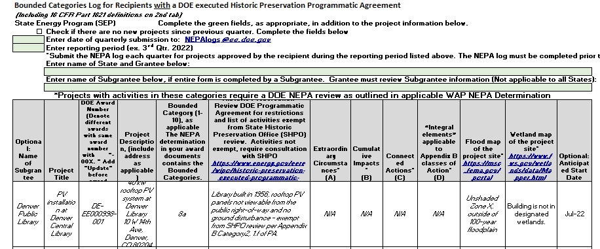
NEPA Review
Sample DOE NEPA log for recipients with a Historic Preservation PA:
Notes:
This sample NEPA log for recipients with a PA, lists all the restrictions that must be met to document a project fits within the Bounded Categories. This sample log can be found at www.energy.gov/node/4816816. Keep the NEPA log for your records and quarterly submission to NEPAlogs@ee.doe.gov

Slide 16
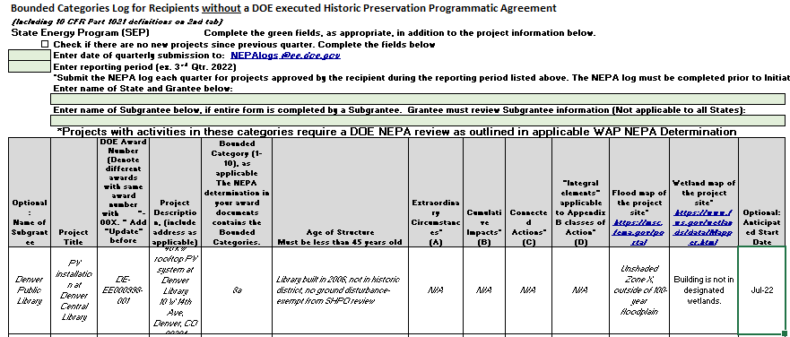
NEPA Review
Sample DOE NEPA log for recipients withOUT a Historic Preservation PA:
Notes:
The sample NEPA log for recipients withOUT a PA, lists all the restrictions that must be met to document a project fits within the Bounded Categories. This sample log can be found at www.energy.gov/node/4816816. Keep the NEPA log for your records and quarterly submission to NEPAlogs@ee.doe.gov

Slide 17
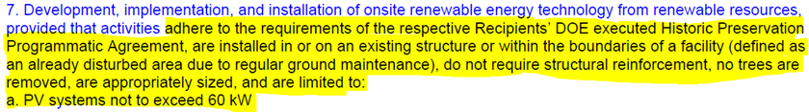
NEPA Review
Example of a “Bounded Category” from a NEPA determination with restrictions highlighted:
Notes:
All the restrictions listed in the Bounded Category must be met.

Slide 18
NEPA Review for projects with Bounded Categories in NEPA Determination
Review NEPA determination for proposed project
Does project fit with Bounded Category?
No
Yes
Recipient submits EQ1 in PMC
Any Extraordinary Circumstances/Cumulative Impacts/Connected Actions/Integral Elements?
Project Officer submits EQ2 in PMC
No
Yes
Recipient submits
EQ1 in PMC
Work with DOE Staff as they complete NEPA review
Recipient documents
review in NEPA Log
Project Officer submits EQ2 in PMC
ND is completed
Review award docs. If CO has approved award, project may begin
Work with DOE Staff as they complete NEPA review
ND is completed
Project may begin with approval from the DOE Contracting Officer!
Questions: GONEPA@ee.doe.gov
All NEPA Reviews must be documented!
Notes:
Start by reviewing your NEPA determination – this flow chart is for NEPA determinations with Bounded Categories

Slide 19
NEPA Review
One of the Integral Elements you may remember from the NEPA Overview PowerPoint, is historic preservation.
To streamline historic preservation reviews, most WIP recipients have a Historic Preservation Programmatic Agreement.
DOE Historic Preservation Programmatic Agreements can be found at:
https://www.energy.gov/eere/wipo/historic-preservation-executed-programmatic-agreements
It is important to review your historic preservation agreement, so you are familiar with the requirements, restrictions, activities exempted from historic preservation review as well as the process for historic preservation reviews with your State Historic Preservation Office.
See the “Historic Preservation” PowerPoint presentation at www.energy.gov/node/4816816

Slide 20
NEPA Review for projects with Bounded Categories in NEPA Determination
Review NEPA determination for proposed project
Does project fit with Bounded Category?
No
Yes
Recipient submits EQ1 in PMC
Any Extraordinary Circumstances/Cumulative Impacts/Connected Actions/Integral Elements?
Project Officer submits EQ2 in PMC
No
Yes
Recipient submits
EQ1 in PMC
Work with DOE Staff as they complete NEPA review
Recipient documents
review in NEPA Log
Project Officer submits EQ2 in PMC
ND is completed
Review award docs. If CO has approved award, project may begin
Work with DOE Staff as they complete NEPA review
ND is completed
Project may begin with approval from the DOE Contracting Officer!
Questions: GONEPA@ee.doe.gov
All NEPA Reviews must be documented!
Notes:
Start by reviewing your NEPA determination – this flow chart is for NEPA determinations with Bounded Categories

Slide 21
NEPA Review for projects with Bounded Categories in NEPA Determination
Review NEPA determination for proposed project
Does project fit with Bounded Category?
No
Yes
Recipient submits EQ1 in PMC
Any Extraordinary Circumstances/Cumulative Impacts/Connected Actions/Integral Elements?
Project Officer submits EQ2 in PMC
No
Yes
Recipient submits
EQ1 in PMC
Work with DOE Staff as they complete NEPA review
Recipient documents
review in NEPA Log
Project Officer submits EQ2 in PMC
ND is completed
Review award docs. If CO has approved award, project may begin
Work with DOE Staff as they complete NEPA review
ND is completed
Project may begin with approval from the DOE Contracting Officer!
Questions: GONEPA@ee.doe.gov
All NEPA Reviews must be documented!
Notes:
Start by reviewing your NEPA determination – this flow chart is for NEPA determinations with Bounded Categories

Slide 22
NEPA Review for projects with Bounded Categories in NEPA Determination
Review NEPA determination for proposed project
Does project fit with Bounded Category?
No
Yes
Recipient submits EQ1 in PMC
Any Extraordinary Circumstances/Cumulative Impacts/Connected Actions/Integral Elements?
Project Officer submits EQ2 in PMC
No
Yes
Recipient submits
EQ1 in PMC
Work with DOE Staff as they complete NEPA review
Recipient documents
review in NEPA Log
Project Officer submits EQ2 in PMC
ND is completed
Review award docs. If CO has approved award, project may begin
Work with DOE Staff as they complete NEPA review
ND is completed
Project may begin with approval from the DOE Contracting Officer!
Questions: GONEPA@ee.doe.gov
All NEPA Reviews must be documented!
Notes:
Start by reviewing your NEPA determination – this flow chart is for NEPA determinations with Bounded Categories

Slide 23
NEPA Review for projects with Bounded Categories in NEPA Determination
Review NEPA determination for proposed project
Does project fit with Bounded Category?
No
Yes
Recipient submits EQ1 in PMC
Any Extraordinary Circumstances/Cumulative Impacts/Connected Actions/Integral Elements?
Project Officer submits EQ2 in PMC
No
Yes
Recipient submits
EQ1 in PMC
Work with DOE Staff as they complete NEPA review
Recipient documents
review in NEPA Log
Project Officer submits EQ2 in PMC
ND is completed
Review award docs. If CO has approved award, project may begin
Work with DOE Staff as they complete NEPA review
ND is completed
Project may begin with approval from the DOE Contracting Officer!
Questions: GONEPA@ee.doe.gov
All NEPA Reviews must be documented!
Notes:
Start by reviewing your NEPA determination – this flow chart is for NEPA determinations with Bounded Categories

Slide 24
NEPA Review for projects with Bounded Categories in NEPA Determination
Review NEPA determination for proposed project
Does project fit with Bounded Category?
No
Yes
Recipient submits EQ1 in PMC
Any Extraordinary Circumstances/Cumulative Impacts/Connected Actions/Integral Elements?
Project Officer submits EQ2 in PMC
No
Yes
Recipient submits
EQ1 in PMC
Work with DOE Staff as they complete NEPA review
Recipient documents
review in NEPA Log
Project Officer submits EQ2 in PMC
ND is completed
Review award docs. If CO has approved award, project may begin
Work with DOE Staff as they complete NEPA review
ND is completed
Project may begin with approval from the DOE Contracting Officer!
Questions: GONEPA@ee.doe.gov
All NEPA Reviews must be documented!
Notes:
Start by reviewing your NEPA determination – this flow chart is for NEPA determinations with Bounded Categories

Slide 25
NEPA Review for projects with Bounded Categories in NEPA Determination
Review NEPA determination for proposed project
Does project fit with Bounded Category?
No
Yes
Recipient submits EQ1 in PMC
Any Extraordinary Circumstances/Cumulative Impacts/Connected Actions/Integral Elements?
Project Officer submits EQ2 in PMC
No
Yes
Recipient submits
EQ1 in PMC
Work with DOE Staff as they complete NEPA review
Recipient documents
review in NEPA Log
Project Officer submits EQ2 in PMC
ND is completed
Review award docs. If CO has approved award, project may begin
Work with DOE Staff as they complete NEPA review
ND is completed
Project may begin with approval from the DOE Contracting Officer!
Questions: GONEPA@ee.doe.gov
All NEPA Reviews must be documented!
Notes:
Start by reviewing your NEPA determination – this flow chart is for NEPA determinations with Bounded Categories

Slide 26
NEPA Review for projects with Bounded Categories in NEPA Determination
Review NEPA determination for proposed project
Does project fit with Bounded Category?
No
Yes
Recipient submits EQ1 in PMC
Any Extraordinary Circumstances/Cumulative Impacts/Connected Actions/Integral Elements?
Project Officer submits EQ2 in PMC
No
Yes
Recipient submits
EQ1 in PMC
Work with DOE Staff as they complete NEPA review
Recipient documents
review in NEPA Log
Project Officer submits EQ2 in PMC
ND is completed
Review award docs. If CO has approved award, project may begin
Work with DOE Staff as they complete NEPA review
ND is completed
Project may begin with approval from the DOE Contracting Officer!
Questions: GONEPA@ee.doe.gov
All NEPA Reviews must be documented!
Notes:
Start by reviewing your NEPA determination – this flow chart is for NEPA determinations with Bounded Categories

Slide 27
NEPA Review for projects with Bounded Categories in NEPA Determination
Review NEPA determination for proposed project
Does project fit with Bounded Category?
No
Yes
Recipient submits EQ1 in PMC
Any Extraordinary Circumstances/Cumulative Impacts/Connected Actions/Integral Elements?
Project Officer submits EQ2 in PMC
No
Yes
Recipient submits
EQ1 in PMC
Work with DOE Staff as they complete NEPA review
Recipient documents
review in NEPA Log
Project Officer submits EQ2 in PMC
ND is completed
Review award docs. If CO has approved award, project may begin
Work with DOE Staff as they complete NEPA review
ND is completed
Project may begin with approval from the DOE Contracting Officer!
Questions: GONEPA@ee.doe.gov
All NEPA Reviews must be documented!
Notes:
Start by reviewing your NEPA determination – this flow chart is for NEPA determinations with Bounded Categories

Slide 28
NEPA Review for projects with Bounded Categories in NEPA Determination
Review NEPA determination for proposed project
Does project fit with Bounded Category?
No
Yes
Recipient submits EQ1 in PMC
Any Extraordinary Circumstances/Cumulative Impacts/Connected Actions/Integral Elements?
Project Officer submits EQ2 in PMC
No
Yes
Recipient submits
EQ1 in PMC
Work with DOE Staff as they complete NEPA review
Recipient documents
review in NEPA Log
Project Officer submits EQ2 in PMC
ND is completed
Review award docs. If CO has approved award, project may begin
Work with DOE Staff as they complete NEPA review
ND is completed
Project may begin with approval from the DOE Contracting Officer!
Questions: GONEPA@ee.doe.gov
All NEPA Reviews must be documented!
Notes:
Start by reviewing your NEPA determination – this flow chart is for NEPA determinations with Bounded Categories

Slide 29
NEPA Review for projects with Bounded Categories in NEPA Determination
Review NEPA determination for proposed project
Does project fit with Bounded Category?
No
Yes
Recipient submits EQ1 in PMC
Any Extraordinary Circumstances/Cumulative Impacts/Connected Actions/Integral Elements?
Project Officer submits EQ2 in PMC
No
Yes
Recipient submits
EQ1 in PMC
Work with DOE Staff as they complete NEPA review
Recipient documents
review in NEPA Log
Project Officer submits EQ2 in PMC
ND is completed
Review award docs. If CO has approved award, project may begin
Work with DOE Staff as they complete NEPA review
ND is completed
Project may begin with approval from the DOE Contracting Officer!
Questions: GONEPA@ee.doe.gov
All NEPA Reviews must be documented!
Notes:
Start by reviewing your NEPA determination – this flow chart is for NEPA determinations with Bounded Categories

Slide 30
NEPA Review for projects with Bounded Categories in NEPA Determination
Review NEPA determination for proposed project
Does project fit with Bounded Category?
No
Yes
Recipient submits EQ1 in PMC
Any Extraordinary Circumstances/Cumulative Impacts/Connected Actions/Integral Elements?
Project Officer submits EQ2 in PMC
No
Yes
Recipient submits
EQ1 in PMC
Work with DOE Staff as they complete NEPA review
Recipient documents
review in NEPA Log
Project Officer submits EQ2 in PMC
ND is completed
Review award docs. If CO has approved award, project may begin
Work with DOE Staff as they complete NEPA review
ND is completed
Project may begin with approval from the DOE Contracting Officer!
Questions: GONEPA@ee.doe.gov
All NEPA Reviews must be documented!
Notes:
Start by reviewing your NEPA determination – this flow chart is for NEPA determinations with Bounded Categories

Slide 31
NEPA Review for projects with Bounded Categories in NEPA Determination
Review NEPA determination for proposed project
Does project fit with Bounded Category?
No
Yes
Recipient submits EQ1 in PMC
Any Extraordinary Circumstances/Cumulative Impacts/Connected Actions/Integral Elements?
Project Officer submits EQ2 in PMC
No
Yes
Recipient submits
EQ1 in PMC
Work with DOE Staff as they complete NEPA review
Recipient documents
review in NEPA Log
Project Officer submits EQ2 in PMC
ND is completed
Review award docs. If CO has approved award, project may begin
Work with DOE Staff as they complete NEPA review
ND is completed
Project may begin with approval from the DOE Contracting Officer!
Questions: GONEPA@ee.doe.gov
All NEPA Reviews must be documented!
Notes:
Start by reviewing your NEPA determination – this flow chart is for NEPA determinations with Bounded Categories

Slide 32
NEPA Review for projects with Bounded Categories in NEPA Determination
Review NEPA determination for proposed project
Does project fit with Bounded Category?
No
Yes
Recipient submits EQ1 in PMC
Any Extraordinary Circumstances/Cumulative Impacts/Connected Actions/Integral Elements?
Project Officer submits EQ2 in PMC
No
Yes
Recipient submits
EQ1 in PMC
Work with DOE Staff as they complete NEPA review
Recipient documents
review in NEPA Log
Project Officer submits EQ2 in PMC
ND is completed
Review award docs. If CO has approved award, project may begin
Work with DOE Staff as they complete NEPA review
ND is completed
Project may begin with approval from the DOE Contracting Officer!
Questions: GONEPA@ee.doe.gov
All NEPA Reviews must be documented!
Notes:
Start by reviewing your NEPA determination – this flow chart is for NEPA determinations with Bounded Categories

Slide 33
NEPA Review for projects with Bounded Categories in NEPA Determination
Review NEPA determination for proposed project
Does project fit with Bounded Category?
No
Yes
Recipient submits EQ1 in PMC
Any Extraordinary Circumstances/Cumulative Impacts/Connected Actions/Integral Elements?
Project Officer submits EQ2 in PMC
No
Yes
Recipient submits
EQ1 in PMC
Work with DOE Staff as they complete NEPA review
Recipient documents
review in NEPA Log
Project Officer submits EQ2 in PMC
ND is completed
Review award docs. If CO has approved award, project may begin
Work with DOE Staff as they complete NEPA review
ND is completed
Project may begin with approval from the DOE Contracting Officer!
Questions: GONEPA@ee.doe.gov
All NEPA Reviews must be documented!
Notes:
Start by reviewing your NEPA determination – this flow chart is for NEPA determinations with Bounded Categories

Slide 34
NEPA Determinations without Bounded Categories
What if you have a NEPA determination specific to one project or types of project activities but does not include Bounded Categories?
Review the NEPA determination.
Follow any restrictions included in the NEPA determination; a NEPA log is not required.
Questions on the NEPA determination? Contact GONEPA@ee.doe.gov

Slide 35
NEPA Review
Has your DOE Project Officer told you that you need to complete an Environmental Questionnaire for a NEPA review?
Review the following documents at
www.energy.gov/node/4816816
EQ Sample
This is a Word document of the online Environmental Questionnaire1. Recipients are encouraged to complete the Word document before attempting to complete the online form. Information from the Word document can then be “cut and pasted” into the online form.
EQ Submission Guide
This document provides the steps to set up an account in the Project Management Center to enable you to submit an EQ1.
Sample Scope of Work
This sample scope of work details the information needed to ensure all elements of a project are addressed
Sample Layout of Project
This document demonstrates useful information you are encouraged to submit with a scope of work to lessen the likelihood of questions during the NEPA review process.

Slide 36
Lessons Learned
Multiple sites for similar project types?
  Contact GONEPA@ee.doe.gov, we may be able to submit just one EQ1!
Make it easier on yourself
  Use a project title that is descriptive, especially if you are submitting multiple EQ1s. For Example: “40kW PV Roof Installation at Denver Public Library”
A scope of work is required for each EQ1 submission
  Do you have an application for funding from a subrecipient? Including contractor estimates or sub-recipient applications with your EQ1 submission often fills in gaps of missing information omitted from a scope of work.
Unsure what information to submit?
  Contact GONEPA@ee.doe.gov

Slide 37
NEPA Review
Questions?
Contact GONEPA@ee.doe.gov

