Slide 1
This webinar is being recorded and will be published on the EERE Program Information Center website
Welcome
If you do not wish to have your voice recorded, please do not speak during the call
If you do not wish to have your image recorded, please turn off your camera or participate by phone
If you speak during the call or use a video connection, you are presumed to consent to recording and use of your voice or image
Please mute your phones and we’ll begin momentarily

Slide 2
Grid Services Funding Opportunity Announcement Webinar
DE-FOA-0002745
SI.Grid-FOA.SETO@ee.doe.gov
August 17, 2022

Slide 3
Notice
NO NEW INFORMATION OTHER THAN THAT PROVIDED IN THE FOA WILL BE DISCUSSED IN THE WEBINAR.
There are no particular advantages or disadvantages to the application evaluation process with respect to participating on the webinar today.
Your participation is completely voluntary.

Slide 4
Notice
All applicants are strongly encouraged to carefully read the Funding Opportunity Announcement DE-FOA-0002745 (“FOA”) and adhere to the stated submission requirements.
This presentation summarizes the contents of FOA. If there are any inconsistencies between the FOA and this presentation or statements from DOE personnel, the FOA is the controlling document and applicants should rely on the FOA language, reference section VII, and seek clarification by submitting a question to
SI.Grid-FOA.SETO@ee.doe.gov

Slide 5
DE-FOA-0002745 Bipartisan Infrastructure Law: Solar and Wind Grid Services and Reliability Demonstration
Anticipated Schedule:
FOA Issue Date: | 8/2/2022
FOA Informational Webinar: | 8/17/2022 1:00pm ET
Submission Deadline for Concept Papers: | 9/15/2022 5:00pm ET
Submission Deadline for Full Applications: | 11/17/2022 5:00pm ET
Submission Deadline for Replies to Reviewer Comments: | 12/15/2022 5:00pm ET
Expected Date for EERE Selection Notifications: | February 2023
Expected Timeframe for Award Negotiations: | February 2023 - June 2023

Slide 6
Agenda
Topic Areas/Technical Areas of Interest
Award Information
Statement of Substantial Involvement
Cost Sharing
FOA Timeline
Concept Papers
Full Applications
Merit Review and Selection Process
Pre-Selection Interviews
Registration Requirements

Slide 7
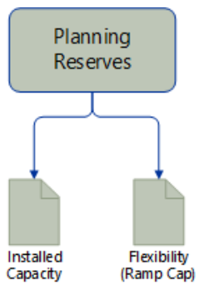
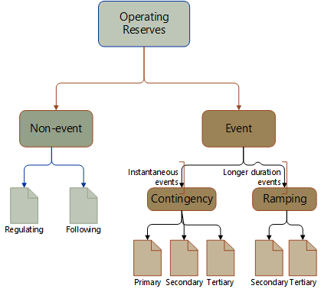
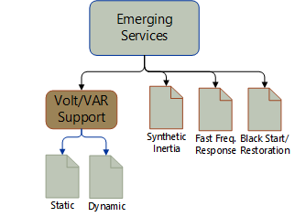
Topic 1: Grid Services Demonstrations
Through joint SETO and WETO funding, this topic area supports demonstration projects that integrate renewable generation with other large-scale or aggregated distributed energy resource (DER) technologies to provide grid services to the bulk power grid.
Primary Research Objectives
Research and develop technologies to provide grid service solutions
Define and validate the deployment specifications required for the proposed solutions to ensure reliable and resilient operation of electric grids.
Design, develop and implement central, local or hybrid controls with large-scale field demonstrations of these grid services.
Identify barriers and opportunities for various combinations of solar, wind and energy storage resources with or without other aggregated DERs to provide grid services
Analyze the economics and potential values added of the project demonstration
nrel.gov

Slide 8
Topic 1 Project Requirements

Slide 9
Topic 1 Project Requirements

Slide 10
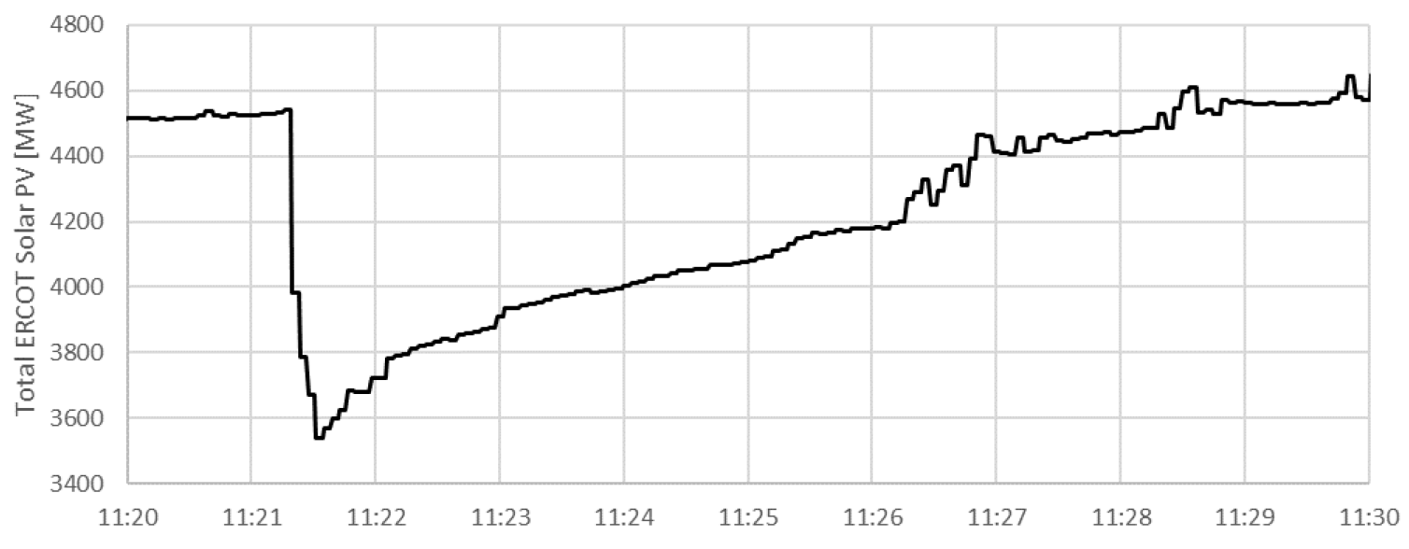
Topic 2: Transmission Protection for High-IBR Grids
This topic area supports the development of power system protection tools and strategies for the electric power transmission system as it transitions to and operates under high penetrations of inverter-based resources (IBRs). This topic area aims to develop a better understanding of how transmission protection systems operate in very-high IBR scenarios. The tools, studies, and solutions developed in these projects should help improved confidence in the transmission system protection, operation, and planning industry that the grid can operate safely and reliably at any mix of synchronous and IBR generation, including up to 100% IBR generation.
Primary Research Objectives
Develop or improve protection study software/tools
Perform protection studies up to 100% IBR
Develop new protection schemes to address any identified technology gaps
Validate new technologies in lab or field setting
Develop a commercialization and implementation roadmap for new tools, technologies, or strategies
NERC. Odessa Disturbance. September, 2021.

Slide 11
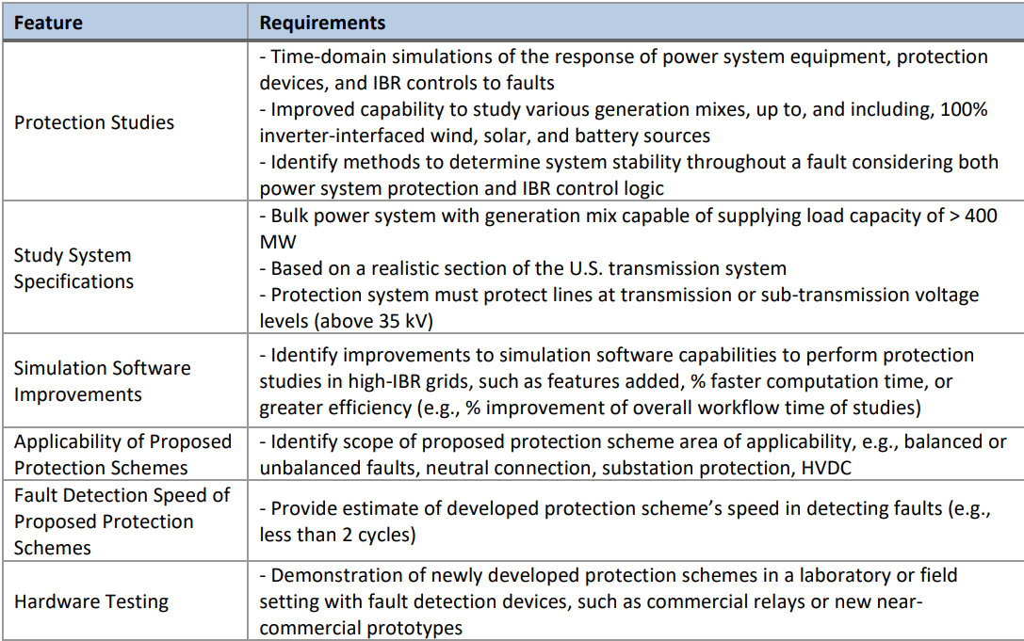
Topic 2 Project Requirements

Slide 12
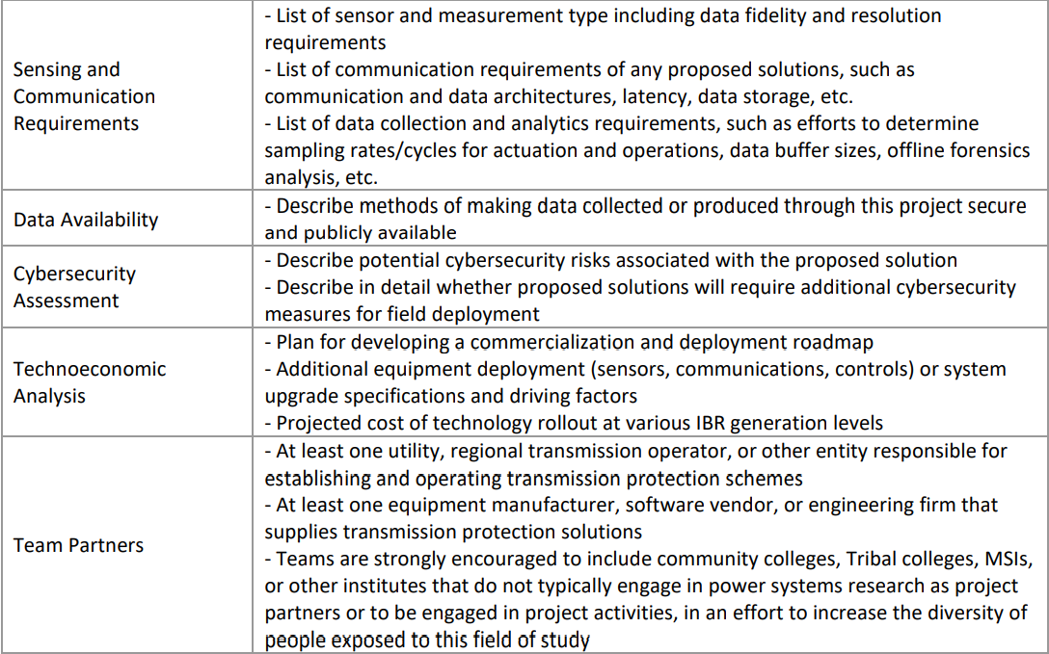
Topic 2 Project Requirements

Slide 13
Non-Responsive Applications
The following types of applications will be deemed nonresponsive and will not be reviewed or considered for an award:
Applications that fall outside the technical parameters specified in Section I.A or I.B of the FOA
Applications for proposed technologies that are not based on sound scientific principles (e.g., violates the law of thermodynamics)
Applications that are described as not of interest in the topic area description in Section I.B. of the topic area to which they are applying:
Topic 1 Applications Not of Interest Applications that primarily focus on system modeling, simulations and study of renewable energy resources. Applications from companies seeking the full or incremental funding of an existing or a new project for installation. Projects with micro-grid field demonstrations for traditional services. | Topic 2 Applications Not of Interest • Applications that do not include the assessment of solar generation. • Applications for which the majority of federal funding would be used for topics that are not the primary interest of this topic area

Slide 14
Teaming Partner List
To facilitate the formation of new project teams for this FOA, a Teaming Partner List is available on EERE Exchange and at https://www.energy.gov/eere/solar/articles/funding-notice-solar-and-wind-grid-services-and-reliability-demonstration
Any organization that would like to be included on this list should submit the following information to SI.Grid-FOA.SETO@ee.doe.gov:
  Organization Name, Contact Name, Contact Address, Contact Email, Contact Phone, Organization Type, Area of Technical Expertise, and Brief Description of Capabilities
By submitting this information, you consent to the publication of the above-referenced information
By facilitating this Teaming Partner List, EERE does not endorse or otherwise evaluate the qualifications of the entities that self-identify themselves for placement on the Teaming Partner List

Slide 15
Award Information
Topic Area Number | Topic Area Title | Anticipated Number of Awards | Anticipated Minimum Award Size for Any One Individual Award (Fed Share) | Anticipated Maximum Award Size for Any One Individual Award (Fed Share) | Approximate Total Federal Funding Available for All Awards* | Anticipated Period of Performance (months) | Cost Share Percentage
1 | Wind and Solar Grid Services Design, Implementation, and Demonstration | 3-5 | $2,000,000 | $4,000,000 | $17,000,000 | 36 | 50% Demonstration
2 | Protection of Bulk Power Systems with High Contribution from Inverter-Based Resources | 3-4 | $2,000,000 | $3,000,000 | $9,000,000 | 36 | 20% R&D 50% Demonstration
All awards will be Cooperative Agreements
*Subject to the availability of appropriated funds

Slide 16
Statement of Substantial Involvement
EERE has substantial involvement in work performed under awards made following this FOA. EERE does not limit its involvement to the administrative requirements of the award. Instead, EERE has substantial involvement in the direction and redirection of the technical aspects of the project as a whole. Substantial involvement includes, but is not limited to, the following:
EERE shares responsibility with the Recipient for the management, control, direction, and performance of the Project.
EERE may intervene in the conduct or performance of work under this award for programmatic reasons. Intervention includes the interruption or modification of the conduct or performance of project activities.
EERE may redirect or discontinue funding the Project based on the outcome of EERE’s evaluation of the Project at that the Go/No Go decision point.
EERE participates in major project decision-making processes.

Slide 17
Topic 1: Cost Sharing Requirements
Cost Share 50%
The cost share must be at least 50% of the total allowable costs for demonstration projects (i.e., the sum of the government share, including FFRDC costs if applicable, and the recipient share of allowable costs equals the total allowable cost of the project) and must come from non-federal sources unless otherwise allowed by law. (See 2 CFR 200.306 and 2 CFR 910.130 for the applicable cost sharing requirements.)

Slide 18
Topic 2: Cost Sharing Requirements
Cost Share 20% and 50%
The cost share must be at least 20% of the total allowable costs (i.e., the sum of the government share, including FFRDC costs if applicable, and the recipient share of allowable costs equals the total allowable cost of the project) for research and development projects and 50% of the total allowable costs for demonstration and commercial application projects and must come from non-federal sources unless otherwise allowed by law. (See 2 CFR 200.306 and 2 CFR 910.130 for the applicable cost sharing requirements.)
Demonstration activities for this topic include installing and operating prototype or commercial hardware in field demonstration site or pilot site, such as a utility grid, substation, solar generation facility, or campus microgrid. Installations may be permanent or temporary for the duration of the demonstration.
To assist applicants in calculating proper cost share amounts, EERE has included a cost share information sheet and sample cost share calculation as Appendices A and B to the FOA document.

Slide 19
Cost Share Contributions
Contributions must be:
  Specified in the project budget
  Verifiable from the Prime Recipient’s records
  Necessary and reasonable for proper and efficient accomplishment of the project
If you are selected for award negotiations, every cost share contribution must be reviewed and approved in advance by the Contracting Officer and incorporated into the project budget before the expenditures are incurred
Please note, vendors/contractors may NOT provide cost share. Any partial donation of goods or services is considered a discount and is not allowable.

Slide 20
Allowable Cost Share
    Cost Share must be allowable and must be verifiable upon submission of the Full Application
    Refer to the following applicable Federal cost principles:
Entity | Cost Principles
For-profit entities | FAR Part 31 http://farsite.hill.af.mil/reghtml/regs/far2afmcfars/fardfars/far/31.htm
All other non-federal entities | 2 CFR Part 200 Subpart E - Cost Principles https://www.ecfr.gov/cgi-bin/text-idx?node=2:1.1.2.2.1.5&rgn=div6

Slide 21
Allowable Cost Share
Cash Contributions
  May be provided by the Prime Recipient, Subrecipients, or a Third Party (may not be provided by vendors/contractors)
In-Kind Contributions
  Can include, but are not limited to: the donation of space or use of equipment.
For more information, see the Cost Share Appendix A in the FOA

Slide 22
Unallowable Cost Share
The Prime Recipient may NOT use the following sources to meet its cost share obligations including, but not limited to:
Revenues or royalties from the prospective operation of an activity beyond the project period
Proceeds from the prospective sale of an asset of an activity
Federal funding or property
Expenditures reimbursed under a separate Federal Technology Office
The same cash or in-kind contributions for more than one project or program
Vendor/contractor contributions

Slide 23
Cost Share Payment
Recipients must provide documentation of the cost share contribution, incrementally over the life of the award
The cumulative cost share percentage provided on each invoice must reflect, at a minimum, the cost sharing percentage negotiated
In limited circumstances, and where it is in the government’s interest, the EERE Contracting Officer may approve a request by the Prime Recipient to meet its cost share requirements on a less frequent basis, such as monthly or quarterly. See Section III.B.vi of the FOA.

Slide 24
FOA Timeline
EERE
Concept Paper Review
Full Application Review
Concept Paper Due
9/15/2022
Receive Encourage/ Discourage Notification
~10/11/2022
Full Application Due
11/17/2022
Receive Reviewer Comments
~12/12/2022
Reply to Reviewer Comments
Due
~12/15/2022
Receive notification of Selection/Non-Selection
February 2023
EERE anticipates making awards by June 2023

Slide 25
Concept Papers
  Applicants must submit a Concept Paper
    Each Concept Paper must be limited to a single concept or technology
  Section IV.C of the FOA states what information a Concept Paper should include and the page limits.
    Failure to include the required content could result in the Concept Paper receiving a “discouraged” determination or the Concept Paper could be found to be ineligible
  Concept Papers must be submitted by 9/15/2022, 5:00 PM ET, through EERE Exchange
  EERE provides applicants with an “encouraged” or “discouraged” notification

Slide 26
Concept Paper Review
Overall FOA Responsiveness and Viability of the Project (Weight: 100%)
This criterion involves consideration of the following factors:
• The applicant clearly describes the proposed technology, describes how the technology is unique and innovative, and how the technology will advance the current state-of-the-art;
• The applicant has identified risks and challenges, including possible mitigation strategies, and has shown the impact that EERE funding and the proposed project would have on the relevant field and application;
• The applicant has the qualifications, experience, capabilities and other resources necessary to complete the proposed project; and
• The proposed work, if successfully accomplished, would clearly meet the objectives as stated in the FOA.

Slide 27
Full Applications
The Full Application includes:
Technical Volume: The key technical submission - info relating to the technical content, project team members, etc.
Resumes, Letters of Commitment
SF-424 Application for Federal Assistance: The formal application signed by the authorized representative of the applicant.
SF-424A Budget & Budget Justification: a detailed budget and spend plan for the project.
Summary for Public Release
Summary Slide
SF-LLL Disclosure of Lobbying Activities: for both the Prime applicant and Subrecipients
Community Benefits Plan: Job Quality and Equity

Slide 28
Full Applications: Technical Volume Content
Technical Volume: the key technical component of the Full Application
  (1) Cover Page
Content of Technical Volume | Suggested % of Technical Volume
Cover Page
Project Overview | 10%
Technical Description, Innovation and Impact | 30%
Workplan and Market Transformation Plan | 40%
Technical Qualifications and Resources | 20%
The Technical Volume must not exceed 15 pages.

Slide 29
Community Benefits Plan: Job Quality and Equity
The Community Benefits Plan should describe the applicant’s framework to address the following priorities:
• Community and Labor Engagement
• Quality Jobs
• Diversity, Equity, Inclusion, and Accessibility
• Justice40 Initiative Plan
See Section IV.D.xvii of the FOA for details on these priorities.
The Community Benefits Plan must not exceed 6 pages.

Slide 30
Full Application Eligibility Requirements
  Applicants must submit a Full Application by 11/17/2022 5:00 pm ET
Full Applications are eligible for review if:
  The Applicant is an eligible entity Section III.A of FOA;
  The Applicant submitted an eligible Concept Paper;
  The Cost Share requirement is satisfied Section III.B of FOA;
  The Full Application is compliant Section III.C of FOA; and
  The proposed project is responsive to the FOA Section III.D of FOA
  The Full Application meets any other eligibility requirements listed in Section III of the FOA.

Slide 31
Who is Eligible to Apply?
Eligible applicants for this FOA include:
U.S. citizens and lawful U.S. permanent residents
For-profit entities
Educational institutions
Nonprofits
State, local, and tribal government entities
DOE/NNSA FFRDCs
For more detail about eligible applicants, please see Section III.A of the FOA
Nonprofit organizations described in Section 501(c)(3) of the Internal Revenue Code of 1986 that engaged in lobbying activities after December 31, 1995, are not eligible to apply for funding.
Prime Recipients must be in must be incorporated (or otherwise formed) under the laws of a State or territory of the United States and have a physical location for business operations in the United States. See Section III.A.ii for requirements applicable to foreign entities applying under this FOA.

Slide 32
Multiple Applications
An entity may submit more than one Concept Paper and Full Application to this FOA, provided that each application describes a unique, scientifically distinct project and provided that an eligible Concept Paper was submitted for each Full Application.

Slide 33
Merit Review and Selection Process (Full Applications)
The Merit Review process consists of multiple phases that each include an eligibility review and a thorough technical review
Rigorous technical reviews are conducted by reviewers that are experts in the subject matter of the FOA
Ultimately, the Selection Official considers the recommendations of the reviewers, along with other considerations such as program policy factors, to make the selection decisions

Slide 34
Technical Merit Review Criteria
Criterion 1: Technical Merit, Innovation, and Impact (45%)
This criterion involves consideration of the following factors:
Technical Merit and Innovation
• Extent to which the proposed technology or process is innovative;
• Degree to which the current state of the technology and the proposed advancement are clearly described;
• Extent to which the application specifically and convincingly demonstrates how the applicant will move the state-of-the-art to the proposed advancement; and
• Sufficiency of technical detail in the application to assess whether the proposed work is scientifically meritorious and revolutionary, including relevant data, calculations and discussion of prior work in the literature with analyses that support the viability of the proposed work.
Impact of Technology Advancement
• How the project supports the topic area objectives and target specifications and metrics; and
• The potential impact of the project on advancing the state-of-the-art.

Slide 35
Technical Merit Review Criteria
Criterion 2: Project Research and Market Transformation Plan (25%)
This criterion involves consideration of the following factors:
Research Approach, Workplan and SOPO
• Degree to which the approach and critical path have been clearly described and thoughtfully considered; and
• Degree to which the task descriptions are clear, detailed, timely, and reasonable, resulting in a high likelihood that the proposed Workplan and SOPO will succeed in meeting the project goals.
Identification of Technical Risks
• Discussion and demonstrated understanding of the key technical risk areas involved in the proposed work and the quality of the mitigation strategies to address them.

Slide 36
Technical Merit Review Criteria
Criterion 2: Project Research and Market Transformation Plan (25%) (Con’t)
This criterion involves consideration of the following factors:
Baseline, Metrics, and Deliverables
• The level of clarity in the definition of the baseline, metrics, and milestones; and
• Relative to a clearly defined experimental baseline, the strength of the quantifiable metrics, milestones, and a mid-point deliverables defined in the application, such that meaningful interim progress will be made.
Market Transformation Plan
• Identification of target market, competitors, and distribution channels for proposed technology along with known or perceived barriers to market penetration, including mitigation plan; and
• Comprehensiveness of market transformation plan including but not limited to product development and/or service plan, commercialization

Slide 37
Technical Merit Review Criteria
Criterion 3: Team and Resources (15%)
This criterion involves consideration of the following factors:
• The capability of the Principal Investigator(s) and the proposed team to address all aspects of the proposed work with a high probability of success. The qualifications, relevant expertise, and time commitment of the individuals on the team;
• The sufficiency of the facilities to support the work;
• The degree to which the proposed consortia/team demonstrates the ability to facilitate and expedite further development and commercial deployment of the proposed technologies;
• The level of participation by project participants as evidenced by letter(s) of commitment and how well they are integrated into the Workplan; and
• The reasonableness of the budget and spend plan for the proposed project and objectives.

Slide 38
Technical Merit Review Criteria
Criterion 4: Community Benefits Plan: Job Quality and Equity (15%)
The extent to which applicant’s Community Benefits Plan illustrates project viability and social risk mitigation through the delivery of high-quality jobs, minimal environmental impact, and allocation of 40% of project benefits to disadvantaged communities.
Community and Labor Engagement
• Extent to which project demonstrates a clear plan to engage local stakeholders, including labor unions and community-based organizations that support or work with disadvantaged communities.
Job Quality
• Quality and manner in which the proposed project will create or retain high-paying, quality, safe jobs and assurances of ability to attract, train, and retain skilled workers
• Extent to which applicant supports workers’ free and fair choice to join a union and demonstrates partnership with labor and worker organizations.

Slide 39
Technical Merit Review Criteria
Criterion 4: Community Benefits Plan: Job Quality and Equity (15%) (Con’t)
Diversity, Equity, Inclusion, and Accessibility
• The quality and manner in which the proposed project incorporates DEIA goals and a commitment to accountability, as reflected in the Community Benefits Plan.
Justice40 Initiative
• Extent to which the project illustrates the ability to meet or exceed the objectives of the Justice40 Initiative, including the extent to which the project benefits disadvantaged or underserved communities and/or partners with Tribal Nations and commitment to accountability, as reflected in the Community Benefits Plan.

Slide 40
Replies to Reviewer Comments
EERE provides applicants with reviewer comments
Applicants are not required to submit a Reply - it is optional
To be considered by EERE, a Reply must be submitted by ~ 12/15/2022 5:00 pm ET and submitted through EERE Exchange
Content and form requirements:
Section | Page Limit | Description
Text | 2 pages max | Applicants may respond to one or more reviewer comments or supplement their Full Application.
Optional | 1 page max | Applicants may use this page however they wish; text, graphs, charts, or other data to respond to reviewer comments or supplement their Full Application are acceptable.

Slide 41
Pre-Selection Interviews
EERE may invite one or more applicants to participate in Pre-Selection Interviews
All interviews will be conducted in the same format
EERE will not reimburse applicants for travel and other expenses relating to the Pre-Selection Interviews, nor will these costs be eligible for reimbursement as pre-award costs
Participation in Pre-Selection Interviews with EERE does not signify that applicants have been selected for award negotiations

Slide 42
Selection Factors
The Selection Official may consider the merit review recommendation, program policy factors, and the amount of funds available in arriving at selections for this FOA

Slide 43
Program Policy Factors
The Selection Official may consider the following program policy factors in making his/her selection decisions:
The proposed project exhibits technological diversity when compared to the existing DOE project portfolio and other projects selected from the subject FOA;
The proposed project exhibits geographic, climate, and regional diversity when compared to the existing DOE project portfolio and other projects selected from the subject FOA;
The proposed project supports demonstrations in economically distressed areas;
The proposed project supports demonstrations that provide the greatest potential to reduce energy costs as well as promote accessibility and community implementation;
The proposed project, including proposed cost share, optimizes the use of available EERE funding to achieve programmatic objectives;
The proposed project exhibits an advanced level of industry involvement and demonstrated ability that will likely accelerate commercialization and overcome key market barriers;

Slide 44
Program Policy Factors (Con’t)
The Selection Official may consider the following program policy factors in making his/her selection decisions:
The proposed project is likely to lead to increased employment and manufacturing in the United States;
The proposed project will accelerate transformational technological advances in areas that industry by itself is not likely to undertake because of technical and financial uncertainty;
The proposed project incorporates diversity, equity, and inclusion elements, including but not limited to team members from Minority Serving Institutions (e.g., Historically Black Colleges and Universities (HBCUs)/Other Minority Institutions), and team members that include Minority Business Enterprises, Minority Owned Businesses, Woman Owned Businesses, Veteran Owned Businesses, Tribal Nations, or members within disadvantaged communities;
The proposed project maximizes benefits to disadvantaged communities; and
The proposed project minimizes environmental impacts to disadvantaged communities.

Slide 45
Registration Requirements
To apply to this FOA, Applicants must register with and submit application materials through EERE Exchange: https://eere-Exchange.energy.gov/
Obtain a “control number” at least 24 hours before the first submission deadline
Although not required to submit an Application, the following registrations must be complete to received an award under this FOA:
Registration Requirement | Website
SAM / UEI (Prime and Subrecipients) | https://www.sam.gov
FedConnect | https://www.fedconnect.net
Grants.gov | http://www.grants.gov

Slide 46
Means of Submission
Concept Papers, Full Applications, and Replies to Reviewer Comments must be submitted through EERE Exchange at
https://eere-Exchange.energy.gov
  EERE will not review or consider applications submitted through other means
The Users’ Guide for Applying to the Department of Energy EERE Funding Opportunity Announcements can be found at https://eere-Exchange.energy.gov/Manuals.aspx

Slide 47
Key Submission Points
Check entries in EERE Exchange
  Submissions could be deemed ineligible due to an incorrect entry
EERE strongly encourages Applicants to submit 1-2 days prior to the deadline to allow for full upload of application documents and to avoid any potential technical glitches with EERE Exchange
Make sure you hit the submit button
  Any changes made after you hit submit will un-submit your application and you will need to hit the submit button again
  For your records, print out the EERE Exchange page at each step, which contains the application’s Control Number

Slide 48
Applicant Points-of-Contact
Applicants must designate primary and backup points-of-contact in EERE Exchange with whom EERE will communicate to conduct award negotiations
It is imperative that the Applicant/Selectee be responsive during award negotiations and meet negotiation deadlines
  Failure to do so may result in cancellation of further award negotiations and rescission of the Selection

Slide 49
Questions
Questions about this FOA? Email SI.Grid-FOA.SETO@ee.doe.gov
  All Q&As related to this FOA will be posted on EERE Exchange
    You must select this specific FOA Number in order to view the Q&As
  EERE will attempt to respond to a question within 3 business days, unless a similar Q&A has already been posted on the website
Problems logging into EERE Exchange or uploading and submitting application documents with EERE Exchange? Email EERE-ExchangeSupport@hq.doe.gov.
  Include FOA name and number in subject line
All questions asked during this presentation will be posted on EERE Exchange

