Slide 1
Technology for
EVMS Certification Review
PM-30
<TBD – Enter Date of Presentation>

Slide 2
Platform
DOE will host using Cisco Webex. DOE CIO has locked the version of Webex at version 41.4.6.9 for now, uncertain if will support 4K monitors.
For those with a 4K monitor, please add one with lower resolution to computer if you are going to share your screen. (Yes there are some with monitor – generally 2560 X 1080 has worked fine)
Provides End user to End user encryption – supports CUI level conversation and sharing
More than one Webex meeting room and breakout rooms will be used
Three audio options
Camera required
Good internet strength (LAN or WiFi)

Slide 3
Internet
Webex quality is controlled by the host, but all need adequate bandwidth. The hosts are critical to have a good connection.
DOE and corporate Virtual Private Networks or CITRIX environments can greatly reduce band width.
  Example - I have Internet from Spectrum that provides 400 megabyte/second (Mb/S) download and 25 Mb/sec upload with latency about 20 ms and jitter about 2 ms. DOE VPN adds latency, jitter from Washington State to Maryland and reduces bandwidth to 25 Mb/s down and 20 Mb/sec up. Normally, this is inadequate to host or participate in Webex.
  With DOE updates pushed or other events – have seen bandwidth cut in half with more latency, over 200 ms – Webex does not work well
Recommendations that have worked with respect to VPN
  System admin move Webex to outside the tunnel (DOE will not)
  Drop out of VPN for meetings – lose connection to email
  Have two systems – one for Webex and one to look up items
  Do not try to connect from within CITRIX environment
  Do not rely on cellular hotspot if you do not have strong 5G connection

Slide 4
Computer Set Up
As few will likely use a conference room, recommend users have the following
  Two screens – one to view shared material and one for participant list, chat, notes, and video of self and others attending the meeting.
  This can be an external monitor and the laptop monitor or something more robust.
  A large screen such as using a higher end large TV plugged into the HDMI port can also work
  POC to help Contractor folks with advice on set up?
  <TBD – list here> are POC to help Review Team members with advice on set up
  External camera is best, but placing laptop in right location can work. Be aware that many DOE / DOE Contractor laptops have the camera disabled to support work site security needs. For this review, cameras are a must as it is critical all can read body language to ensure good communications are taking place in the short time windows set up.

Slide 5
Webex Logon
For this review – all will need to log in such that their name and audio are connected.
  Use the correct logon – we will have more than one room. Need to make sure you are going to the right one for each meeting
  Connect online first – then audio
  Follow the instruction inside for audio (discussed more on next slide)
  Respond to the request that you state your name
  Mute your microphone after joining
  Turn on your camera

Slide 6
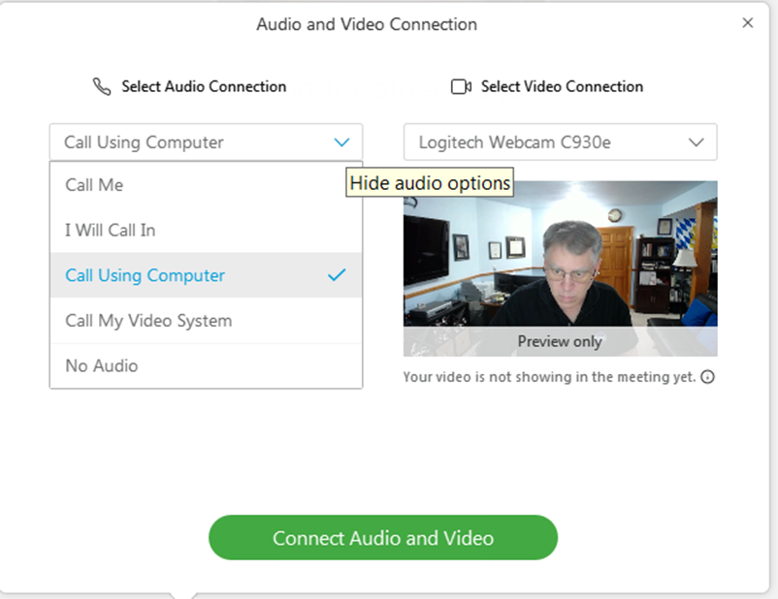

Webex Audio and Video
DOE offers options for audio on their build of Webex
Recommend two be primary for your use
  Call Me – System will call the phone number you enter (it memorizes this for your account, so change it if you use it again with another phone
  Call Using Computer – only if you have good microphone and speaker, either headphones with boom mic or system like Jabra or similar designed to mute background noise
The first option – Call me also works well to a conference room phone if someone is using this arrangement.
I will call in works as well, but follow the instructions exactly to make sure you are connected right.
Video is better from an external camera, but generally fine from a laptop camera. Verify lighting to make sure you are visible from your location.
For video in a conference room – if limited to narrow field of view, the interviewee / primary speaker must be visible
Connecting Audio right will show audio by users name

Slide 7
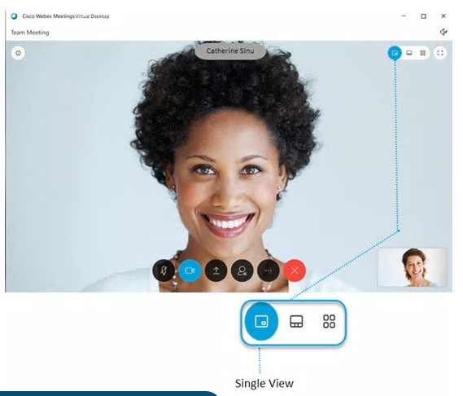
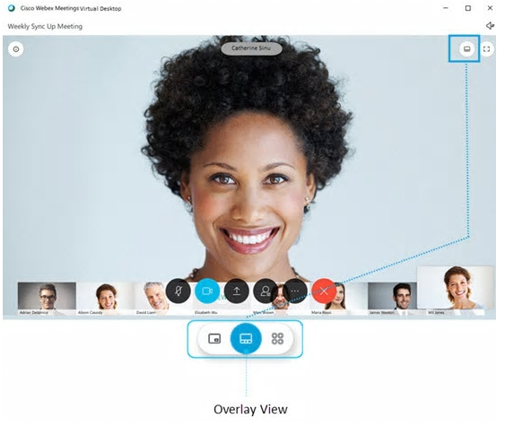
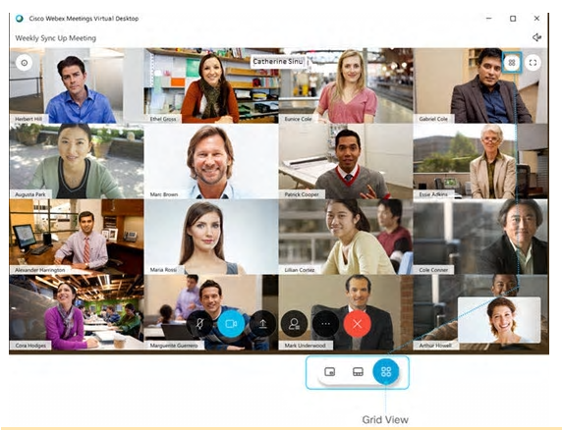
Screen Display - Host
With more than 2 participant – you have options
Displays up to 8 participants in bottom row
Displays up to 16 participants at the same time (or more)
You also have an option to view full screen or not
When Screen Share is in use – you get the option to share full screen view, panel view, break out items in second screen

Slide 8


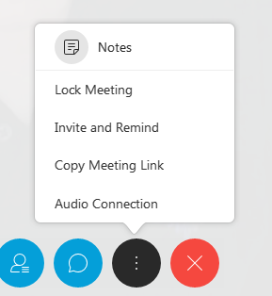
Webex Tools
File
Edit
Share
View
Audio
Video
Participant
Meeting
We will take a look at each on a bit more detail and explain how we can use it in this review.
All can be accessed from the menu bar and several from the round circle which appear when you mouse click on the screen

Slide 9
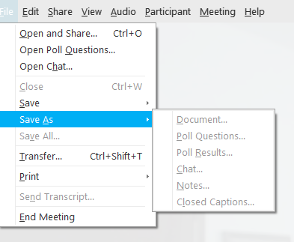
Webex Tools – File
Key items here -
Save As – before closing a meeting, the facilitator should save the chat, notes, or shared document here.
Polling is available if needed.
Transfer is available to provide a reasonable size file to all connected. Generally used by the host.
Print will print the chat

Slide 10
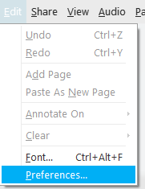
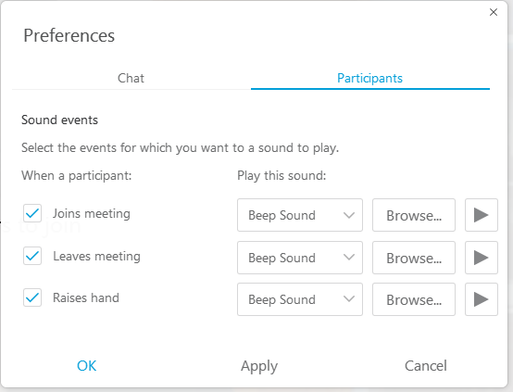
Webex Tools – Edit
Key items here is Preferences…
Facilitator should turn on sound to alert
  When someone joins
  When someone leaves
  When a hand is raised (optional)
Intent is to make sure who enters and exits the Webex and not to miss a question or pertinent comment.

Slide 11



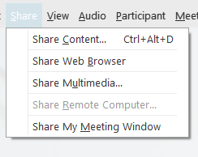
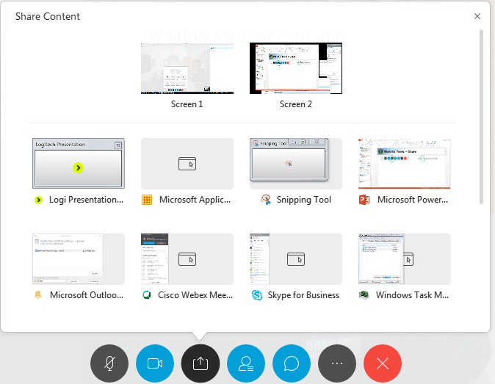

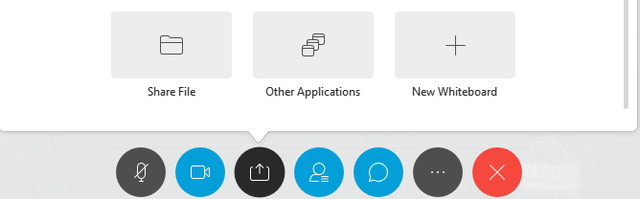
Webex Tools – Share
Multiple monitors supported – pick one
Either method of sharing a screen works
Must be a presenter to share (host will ensure you can)
If sharing from a conference room, facilitator must ensure both camera and share are possible – best with two monitors
Best to share a monitor vs an application
Whiteboard Share generally works poorly with this version of Webex and will not be used.
One share option some smaller teams may want is Share File near the bottom of the pick list for team editing of document.

Slide 12

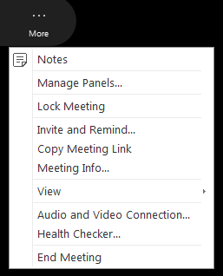
Webex Tools – Share Menu
Webex Tools – Share – when you are sharing
Pause – freezes what others see until you resume
Share – lets you change what you are sharing in the share window
Assign – lets you pass annotation, mouse and keyboard to another
Connection – lets you go to audio connection while sharing
Participant list – drag to other screes
Chat – drag to other screen
Annotate – next slide
More (…)
  Lock and unlock meeting
  Invite / remind
  Health Check – see if your internet is not up to the task

Slide 13

Webex Tool – Share Annotate
Can mark up a screen during discussion
Can use laser pointer or arrow to direct attention
Can pass annotation to others
Can save to Jpeg
Drawing with a mouse is a challenge – better with touch screen for pen/pencil (time waster)
Or switch to Laser Pointer
Make note on slide
Draw line or arrow
Draw Box or other
Pen (thicker) / Pencil (thinner)
Color
Eraser or Clear All
Undo last
Save to JPEG
Pointer

Slide 14
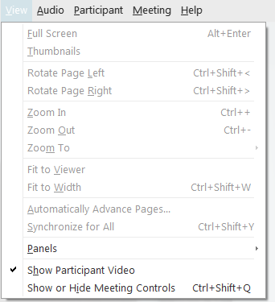
Webex Tools – View
Key items here are Zoom and Panels
  Facilitator should add polling here if they want to use under panels
  All can use Zoom in or out to help with their system . Those with smaller monitors may need to use.

Slide 15

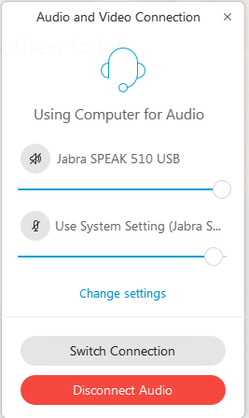
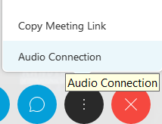
Webex Tools – Audio
Key items here are audio and video connection
  If the option you chose when you joined fails – go here to connect differently
    Phone battery dies – connect to new phone
    Computer audio acts up – connect to phone
    Do not drop out of meeting

Slide 16
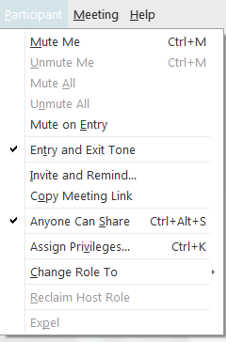
Webex Tools – Participant
Key items here Invite and Remind, Copy Meeting Link, Anyone can share, Assign Privileges, and Change Role to
If anyone needs to send an invite or copy the link to an email, you can get these here.
Anyone can share can be turned off. Right now it is on such than anyone can claim presenter status. If needed this be changed.
Can change Chat and participant rights in Assign Privileges - Plan to leave as is to start.
Change Role to lets the user try to change role. Normally: - Host would right click on participant to change role.
- Needed if facilitator turns off “Anyone can share”.

Slide 17
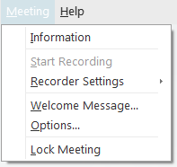
Webex Tools – Meeting
Key items here are Recorder Settings and Lock Meeting
  If we record session this is useful for host/facilitation to control recording
  Lock meeting lets the facilitator bar entry to additional folks. This provides a location to lock and unlock the meeting.

Slide 18
Webex Protocols
Meetings will start on time and end on time – additional meetings can be scheduled.
Web Meeting sites will be opened 5 minutes prior to let all connect before the meeting starts.
If two or more people share a connection (conference room) the names of all present will be announced and typed into the chat.
An appointed time keeper will watch to make sure they end on time.
Each room will have a facilitator - More on this next slide.
Each interviewer will take individual notes.
Camera is required for person or persons being interviewed and for those conducting the interview. Others should have camera off when not speaking.
If stepping away from a meeting, let facilitator know in Chat when you leave and when you return.
Only the person(s) conducting the interview or being interviewed will have audio on. Others may raise their hand to gain permission to add to the discussion or type a note in chat to everyone. Facilitator will ensure the interview lead see the question or request to discuss. Interviewer can also direct a question at someone else in the meeting, in which case they should unmute and join discussion.
Chat will be used either to all or targeted people to signal time management, pass instructions, or share notes. Chat will be saved after each meeting / interview by the review team.
Rooms can be locked at the discretion of the facilitator, usually locked 10-15 minutes into the meeting.

Slide 19
Facilitators
Both DOE and Contractor will have a facilitator to support this event. For DOE, there will be one per room as host.
Facilitators will make sure the technology is ready to support the interview so the interview team and interviewee can focus on the content of the interview.
Facilitator is not a note taker.
Facilitator will monitor the web meeting at all times to control entry after the meeting start, will advise the interview lead of any technical issues, and work to help keep the meeting on time with the time keeper.
Facilitator will monitor Chat and hand raising and at appropriate time, let the interview lead know of either items raised in chat or of a raised hand. The interview lead will advise if they want to be interrupted or wait until the end to address others in the room or chat comments.
Facilitator will be responsible for screen capture, when needed.
Facilitators will make sure all chat, note, and polls, if used, are saved before closing the room. Facilitator will verify all others who may have had a private chat have save them before closing the room.
Facilitators will control recordings, if used. If DOE records, the Facilitator will confirm from each member present that they understand it is being recorded.

Slide 20
Screen Capture with Webex
Screen Capture is best done with Snip it from Microsoft Windows or Snag it, an add on a user can by.
When requested by the interview lead, the facilitator will use this tool to capture what is visible in the Webex and save them to a PowerPoint slide deck and email to interview lead at the end of each meeting with the interview name and date as the file name
  Example - CAM Smith May 20 2021.pptx
Requests for documents or items not associated with a screen capture will be done through the review Document Request log and not via a facilitator.

Slide 21
Chat/Notes/Poll Questions
During the meeting, the overall Chat log will be kept open and used. For the chats to everyone, the list will be saved at the end of the meeting by the facilitator and named with the appropriate interview name and date.
  Example – CHAT CAM Smith May 20 2021.txt
Private Chats will be the responsibility of the users to save, if they want them. Two ways to save – File Save As Chat or in the Chat select Ctrl A to highlight all of it, Ctrl C to copy it and paste it where you would like. Facilitator will verify all who want to are done before closing the meeting.
Notes are an option in Webex that can be used and saved.
Polls are an option that can be used in Webex, but need to be set up before the meeting by the facilitator. If needed, please coordinate prior.

Slide 22
Controlled Unclassified Information (CUI)
DOE Webex is set up to support conversations and screen shares through CUI.
Classified material will not be discussed on Webex.
Screen Capture will not be saved to a personal computer if there is CUI material and the file name must include the appropriate caveat, either OUO or UCNI in the file name.
If a there is a concern following an interview with respect to notes or chats, DOE and Contractor will request a classifier to review the material before further dissemination. It will be critical that both Contractor and DOE raise the concern if needed. Contractor will provide the DC to review and facilitator and interview lead will work with them in a separate session to conduct.
If OUO or UCNI, all appropriate markings will be added and it may only be emailed by encryption or placed in the appropriate only tools for sharing.

Slide 23
Tech Rehearsals – Webex Dry Run
The week prior to meetings, there will be time for a tech rehearsal Webex Dry Run. Each person attending the review should connect and verify functionality with DOE and Contractor facilitators so corrective actions can take place before the review dates.
Test with the same set up you plan to use during the review.
Each will logon, verify audio and video, share a screen, test features, and logoff.

Slide 24
Facilitator Check List (draft)
Coordinate with Interview Leader as to:
  Who timekeeper is. Make sure chats go out to all when 30 minutes remain, 10 minutes remain, 2 minutes. Time keeper should be sending out
  Any special requests
    Room locked
    Polling questions
    How they want to handle raised hands and chat comments
    Other
Open Room 5 to 10 minutes prior to meeting
If recording
  Let all know you will record the meeting
  If someone objects, let Interview lead address
  Start recording
  Ask each participant to acknowledge they are being recorded such that it is captured in the recording
  Stop the recording at the end
  It will archive in the DOE account holders recording files and will need to be converted to an MP4 later.
Confirm all have camera and audio set up – let interview lead know of any issues as they occur
Prepare for screen shots – PowerPoint open and snip it or snag it ready
Troubleshoot technology issues as they occur
Monitor room and let interview lead know if anyone joins the meeting after the introductions
Monitor chat and look for raised hands. Let interview lead know if the do not see them
If Lead asks – expel a member from the review
Change roles as needed
Enforce mute, as needed
Save chat, notes, and poll before closing room.
Ask if all have saved notes and chat before closing room.
Close room / email screen captures

