Slide 1

EVMS [Enter Type: Certification, Surveillance, Implementation, Review for Cause] Review
In Brief
for
Contractor Name
City, State
Month XX, 20XX
By
Melvin Frank
Director, Project Controls (PM-30)
U. S. Department of Energy
Office of Project Management (PM)

Slide 2
EVMS Policy and Expectations
Contractor EVM system compliant with EIA-748
Reliable, accurate, timely, actionable data
Reports/assessments reflect actual conditions
Realistic forecasts
Corrective actions directed to root causes
Basis for management decisions at all levels
Consistent/compliant implementation, execution
Effective Self-Governance
Continuous Improvement (Learning Organization)

Slide 3
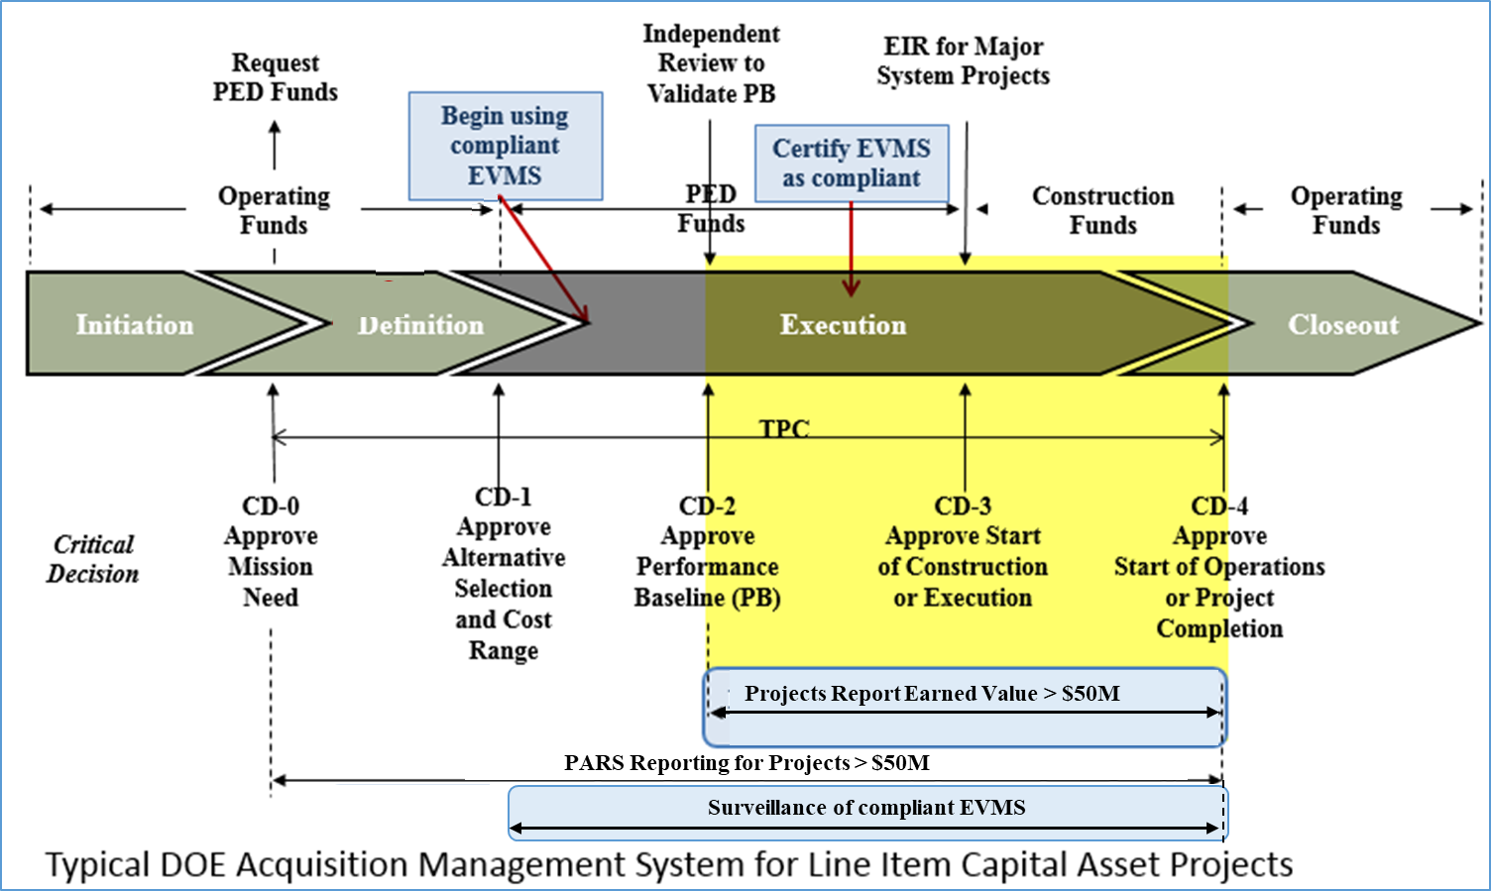
EVMS Requirements Tied to DOE’s Acquisition Lifecycle
DOE O 413.3B - Acquisition Management System
Notes:
The DOE acquisition lifecycle is broken down into five Critical Decision milestones (0 through 4). PARS 2 reporting is required for projects greater than or equal to $10M to $20M at the total project level from CD-0 through CD-4. A project level performance baseline is established at CD-2 at which time contractors must begin reporting Earned Value Management data into PARS 2 from CD-2 through CD-4 at the control account level, for projects greater than or equal to $20M (see area highlighted with yellow background).

Slide 4
EVMS Compliance
[Contractor name] Contract
  Use a certified EVMS to deliver projects on schedule, within budget
  Compliance with DOE Order 413.3B
DOE O 413.3B
  PM certify compliance on projects > $100M
  PM conduct risk-based, data driven surveillance of contractor EVMS

Slide 5
EVMS Review Team & Responsibilities
NAME | ORG | FUNCTION [add/delete based on # of team]
 |  | Review Director
 |  | Review Chief
 |  | Review Deputy
 |  | Review Assistant
 |  | Organization Area Lead
 |  | Organization Team Member
 |  | Planning, Scheduling and Budgeting Area Lead
 |  | PSB Team Member
 |  | PSB Team Member
 |  | Accounting and Indirect Area Lead
 |  | Accounting/Indirect Team Member
 |  | Analysis & Managerial Reports Area Lead
 |  | AMR Team Member
 |  | Revisions Area Lead
 |  | Revisions Review Team Member
 |  | Review Observer
Notes:
5

Slide 6
EVMS Review Schedule
Dates [if conducted separately from entire team]
Accounting and Indirect Considerations
Monday [Date]
8:00 – 8:30 am PM-30 In Brief
8:30 – 9:30* am [Contractor] In Brief [longer if includes tool demonstrations, storyboard*]
9:30 – Noon Project Overview [may include tour]
12:00 – 1:00 pm Lunch
1:00 – 4:00 pm Interviews / Documentation [list specific team assignments/Interviewees/length of interviews / documentation times either here or on a separate page as interviews may vary in length depending on specific scope]
4:00 – 4:30 pm Review Team Meeting
4:30 – 5:00 pm Daily PM-30 to [Contractor] Out Brief
Notes:
6

Slide 7
EVMS Review Schedule
Tuesday / Wednesday [Dates]
7:30 – 8:00 am Review Team Meeting
8:00 – 12:00 pm Interviews / Documentation [list specific team assignments/Interviewees/length of interviews / documentation times either here or on a separate page as interviews may vary in length depending on specific scope]
12:00 – 1:00 pm Lunch
1:00 – 3:30 pm Interviews / Documentation [list specific team assignments/Interviewees/length of interviews / documentation times either here or on a separate page as interviews may vary in length depending on specific scope]
3:30 – 4:30 pm Review Team Meeting
4:30 – 5:00 pm Daily PM-30 to [Contractor] Out Brief
Notes:
7

Slide 8
EVMS Review Schedule
Thursday [Date]
7:30 – 8:00 am Review Team Meeting
8:00 – 12:00 pm Interviews / Documentation [list specific team assignments/Interviewees/length of interviews / documentation times either here or on a separate page as interviews may vary in length depending on specific scope]
12:00 – 1:00 pm Lunch
1:00 – 4:30 pm Review Team Meeting / Follow-Up Questions
4:30 – 5:00 pm Daily PM-30 to [Contractor] Out Brief
Friday [Date]
7:30 – 12:00 pm Review Team Meeting
9:00 – 10:00 am DOE Senior Leadership Pre-brief
12:00 – 1:00 pm Lunch
1:00 – 2:00 pm PM-30 Certification Review Out Brief
Notes:
8

Slide 9
Interview Rules of Engagement
CAMs must have access to all information and ready to capture and provide screenshots
No coaching/talking by anyone other than CAM unless approved by the Interview Lead
Scope of interviews limited to [project name(s)] and based on [month – month XXXX] data
Limited number of observers
Notes:
9

Slide 10
Historical Review
[Update / delete Table and Ribbon Chart
as necessary]
Year | 20XX | 20XX | 20XX | 20XX
Type
# CARs
# GLs Non-Compliant
Period
 | EIA-748 GUIDELINES
Type/MON YY | 1 | 2 | 3 | 4 | 5 | 6 | 7 | 8 | 9 | 10 | 11 | 12 | 13 | 14 | 15 | 16 | 17 | 18 | 19 | 20 | 21 | 22 | 23 | 24 | 25 | 26 | 27 | 28 | 29 | 30 | 31 | 32
 |  |  |  |  |  |  |  |  |  |  |  |  |  |  |  |  |  |  | X |  |  |  |  |  |  | X | X | X | X |  |  | X
 |  |  |  |  |  |  |  |  |  |  |  |  |  |  |  |  |  |  |  | N/A
High Risk GL | X |  | X |  |  | X | X | X | X | X |  | X |  |  |  | X |  |  |  |  | X |  | X |  |  | X | X | X |  | X |  | X
Includes CAR/Material Finding Includes only Discrepancy/Non-Material Finding No Findings

Slide 11
Materiality
Assessment to determine how non–compliance impacts ability to produce accurate information needed for project management purposes; addresses both process (written word) and implementation non-compliances
  Pervasiveness (systemic, across the project vice isolated noncompliance)
  Magnitude (impact to managerial assessment and decision making)
  Explain impact to managements ability to:
    Know scope/cost/schedule status vs baseline
    Know cost/schedule forecast
    Take corrective action to address root causes
    Make informed decisions

Slide 12
Materiality
Evidenced through EVMS data; interviews used to explore concern(s) and substantiate basis of non-compliance
Impact to performance measurement (cost/schedule impacts to baseline/forecast) is key in determining whether non-compliance is a Corrective Action Request (CAR) or a Discrepancy Report (DR)
  CAR – pervasive, high dollar, high risk, systemic, non-compliances that have/could significantly influence performance measurement, accuracy, validity, reliability, and timeliness of the data
  DR – rare, low dollar, minimal risk, non-systemic, isolated, infrequent, nonrecurring, non-compliances (e.g., minor clarifications to processes, errors or oversights) that would not significantly influence performance measurement
Continuous Improvement Opportunity (CIO) – recommendations, not a non-compliance

Slide 13
Materiality
Do not get distracted by noise and one-offs; answer “so what” factor
While metrics are indicators, need to articulate impact on reporting and decision making
Perfection not expected; don’t insist on personal preference in interpretations and expectations
Interviews focused on fishing-out specific themes from data assessment flags; not general fishing expedition
Directly address impact of deficiency or finding on (for example):
  Cost reporting
  EAC calculations
  Critical path determination
  Accuracy of performance measurement

Slide 14
Projected Schedule [insert past dates in regular font, future dates in italics]
Conduct the Review
Data review
On-site review
Document the Review
CAR/DR Factual accuracy review
Develop draft report
Review draft report
Finalize CARs/DRs/CIOs
Finalize report
CAMP Process

Slide 15

Questions

