Slide 1
Bruce Lung
Trailblazers and Goal Achievers: How Better Plants Partners Achieved Ambitious Energy Goals
Office of Energy Efficiency and Renewable Energy

Slide 2
Meeting Recording Announcement
This Zoom call is being recorded and may be posted on DOE's website or used internally. If you do not wish to have your voice recorded, please do not speak during the call or disconnect now. If you do not wish to have your image recorded, please turn off your camera or participate only by phone. If you speak during the call or use a video connection, you are presumed to consent to recording and to the use of your voice or image.

Slide 3

Agenda & Purpose
What is Better Plants
Snapshot & High-Level Goal Achiever Statistics
Goal Achiever Characteristics
Resources Leveraged
Common Approaches & Steps for Any Industrial Organization
Conclusion & Partner Testimonials

Slide 4
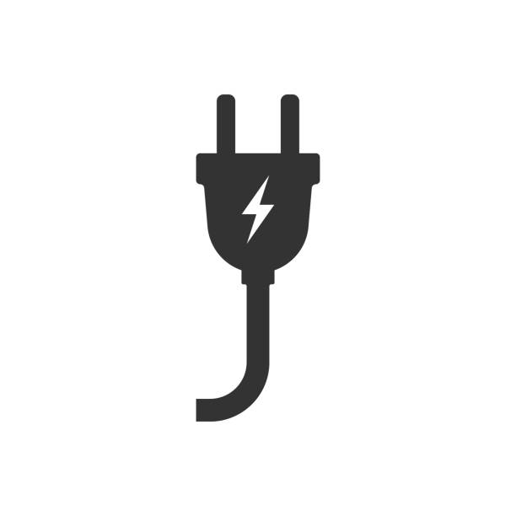

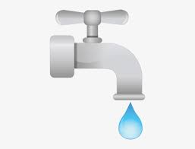

DOE’s Better Plants Program
Helping manufacturers and other industrial organizations save money and improve sustainability
Increased
Energy Productivity
Lower Carbon Emissions
CO₂
Waste
Reduction
Water
Savings

Slide 5

New - Better Climate Challenge
Portfolio-wide reduction in carbon emissions of at least 50% in 10 years
  25% in 10 years for energy intensive sectors
Goal Parameters
Reduction includes Scope 1 & 2 emissions – no carbon offsets
Baseline up to 5-years back from join date
Encouraged to establish an absolute target, but intensity-based targets will be accepted
Pursue an energy efficiency target that will contribute towards the 50% emissions reduction. This target is intended to encourage prioritizing energy efficiency when pursuing a decarbonization plan.

Slide 6
Core program components – transparency, accountability, and technical assistance
Transparency & Accountability
Annual energy and emissions data reporting for 10-year commitment
Breakdown of emissions reductions by energy efficiency, renewable energy, and renewable energy certificates
Technical Assistance
Data driven solutions to address barriers and overcome hurdles, that can be deployed at scale to the market
Identify technology gaps that can inform R&D
Technical Assistance
Collaborating to Demonstrate Pathways
Transparency
& Accountability
Collaborating to Demonstrate Pathways
Partners commit to work with DOE and showcase their barriers and solutions
Regularly connect with DOE to provide updates and discuss progress
Actively participate in a working group with peers and technical experts to discuss barriers, exchange best practices, and identify solutions

Slide 7
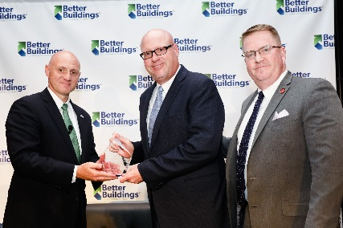
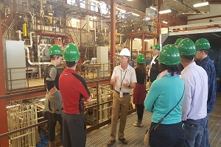
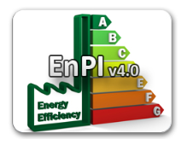
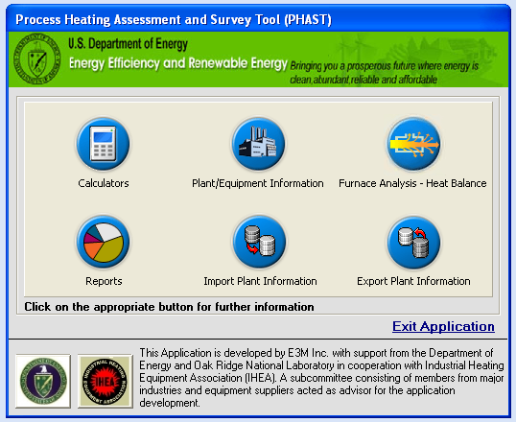
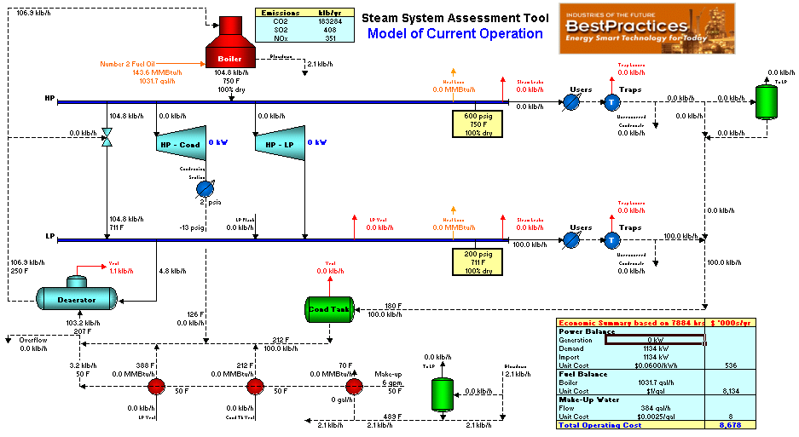
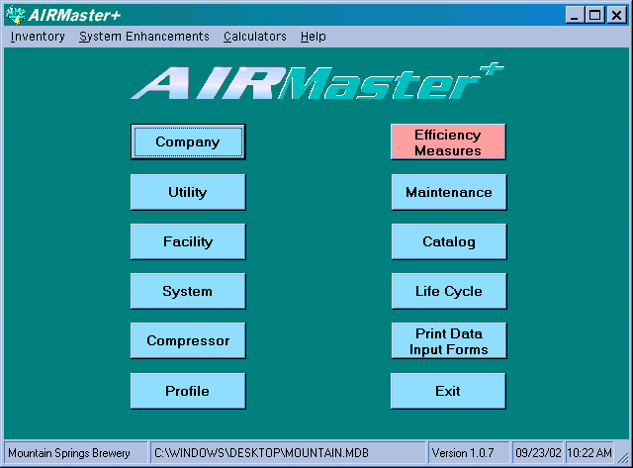

Partner Goal Achievement: Typical Pathway
1.
Partner joins Better Plants, signs and sends pledge form to DOE
8.
Partner achieves goal, is recognized at summit and/or during DOE visit
Better Plants Welcome Materials
2.
Partner is assigned a TAM who conducts kickoff call & subsequent regular calls/visits
7.
Partner leverages programmatic resources such as the summit, technology days & field validation.
3.
TAM works with partner to develop energy metrics and baseline, submit annual report
6.
Partner implements energy efficiency best practices & projects in coordination with TAM support.
4.
TAM helps partner prioritize efforts and develop energy management action plan.
5.
TAM helps partner accesses INPLT trainings, software & diagnostic tools, AMO resources (50001 Ready, IAC, CHP), and external resources.
Notes:
External resources like the ReOpt tool

Slide 8
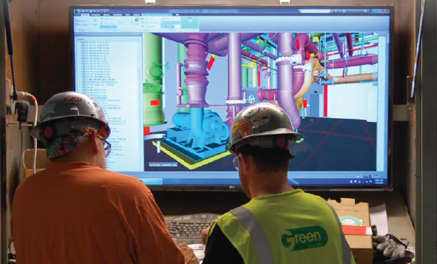
B
Better Plants Goal Achievers: Statistics (as of 2019)
221
partners
3,000+
plants
56
goal achievers
63
>$6.7B
cumulative energy
cost savings since 2013
total goals achieved
(some partners
achieved twice)
>1.3+
quads saved

Slide 9
Industrial Assessment Centers
Better Plants Goal Achievers: Characteristics
(14)
(28)
(14)
Notes:
Large = more than 500 employees, > 25 plants and >$100 million in sales

Slide 10
Industrial Assessment Centers
Better Plants Goal Achievers: Characteristics
Notes:
Most partners reached goal in less than 10 years
Greatest number in year 5 (11)
Average time to reach goal = 5.72 years

Slide 11
Industrial Assessment Centers
Better Plants Goal Achievers in Industrial Sectors
  Goal achievers were distributed across many sectors and regions around the U.S.
Notes:
Electronics and Transportation had the highest
Next highest were 333, 321 and 339.
Paper/Forest products are had the highest of energy intensive sectors (6).

Slide 12
Industrial Assessment Centers
Better Plants Goal Achievers in States
  Goal achievers with the greatest number of plants (by state)
Notes:
States with strong industrial presence had high numbers of goal achievers: Ohio, Indiana, Michigan, Tennessee, Minnesota, Louisiana, and Texas

Slide 13
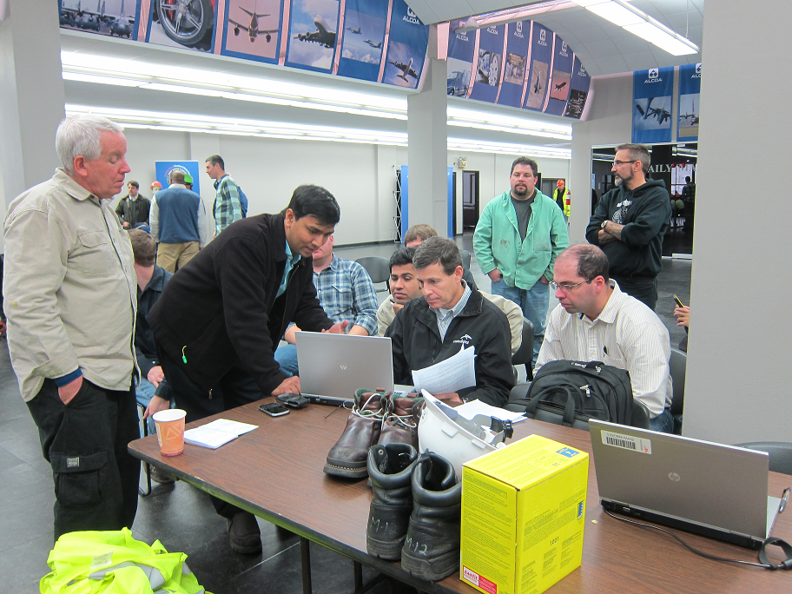
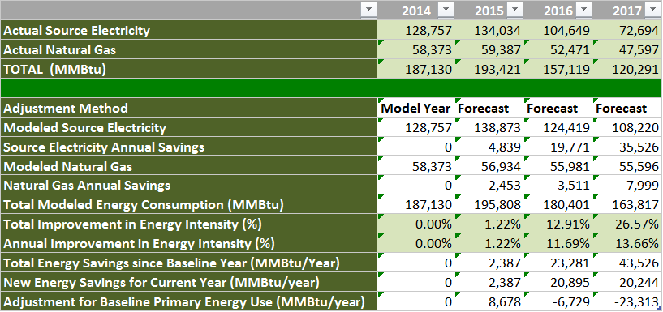
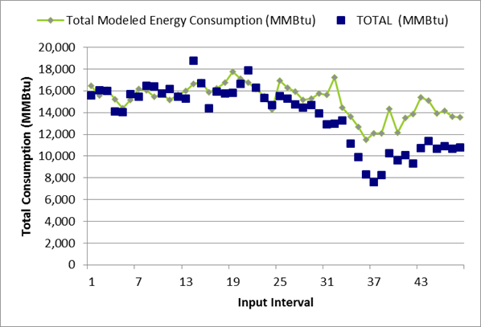
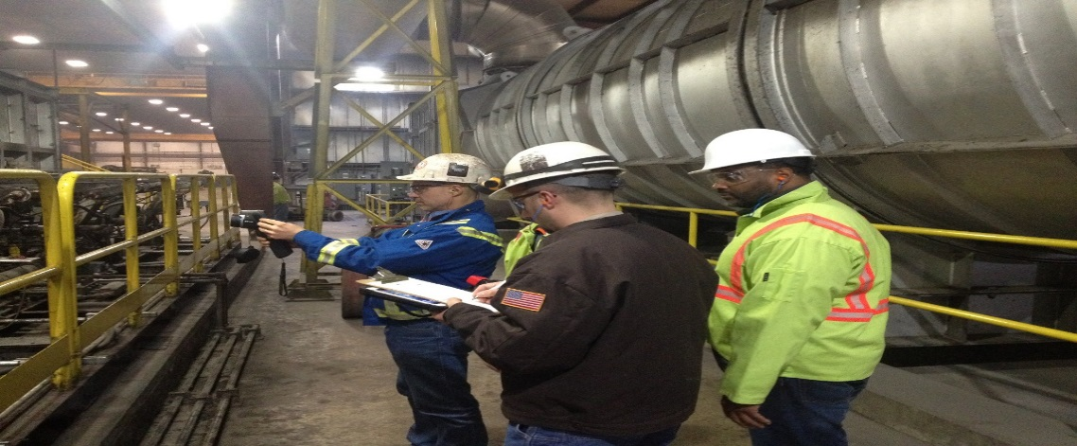
Industrial Assessment Centers
Better Plants Goal Achievers: Resources Leveraged
  Technical Account Manager (TAM) support was indispensable for:
  Establishing energy baselines
  Understanding energy uses & which in-plant
  trainings to get
  Using DOE software tools & diagnostic instruments
  Leveraging other programs: IACs & CHP TAPs

Slide 14
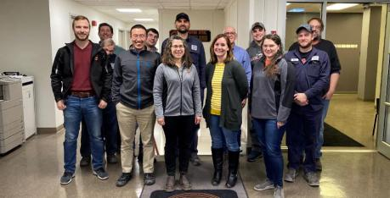
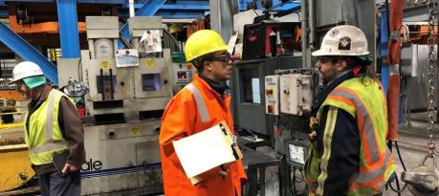
Industrial Assessment Centers
Better Plants Goal Achievers: Resources Leveraged
In Plant Trainings (INPLTs)
Each INPLT yields between 5 to 15 energy-saving opportunities
Between 2011 and 2019, 140 INPLTs awarded
53 INPLTs (38%) awarded to eventual goal achievers
23 goal achievers awarded 1 INPLT
15 goal achievers awarded at least 2 INPLTs
Total energy cost savings from INPLTs awarded to goal achievers was $19M
TAMs supported each INPLT with diagnostic tool support and tips/best practices
Notes:
Primary education & workforce development resource in Better Plants

Slide 15
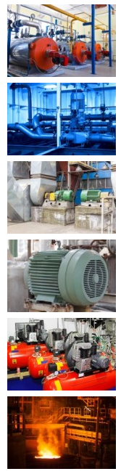
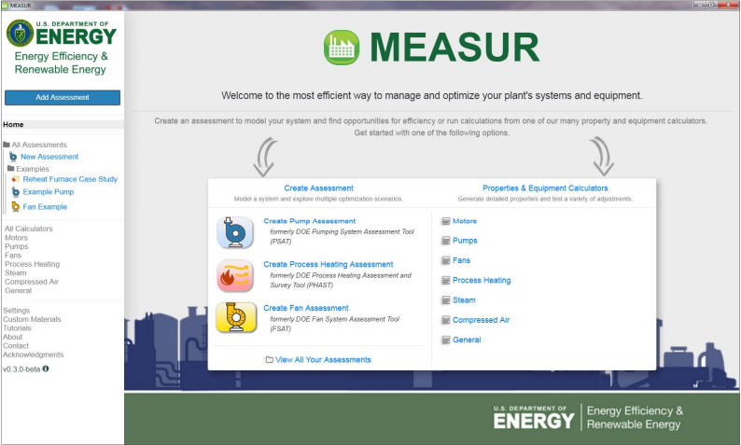
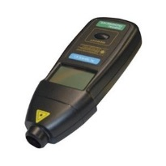
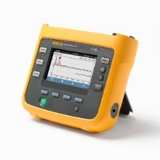
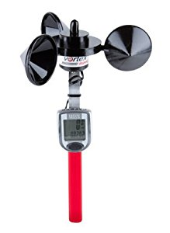
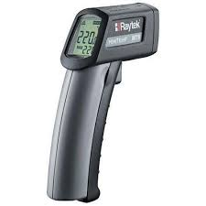
Industrial Assessment Centers
Better Plants Goal Achievers: Resources Leveraged
https://www.energy.gov/eere/amo/measur
  DOE software tools & diagnostic instruments
Steam/Boiler Systems
Pumping Systems
Fan Systems
Motor Systems
Compressed Air
Process Heating/Furnace Systems
Notes:
TAMs provided support during In Plant trainings on the system software tools. They also helped partners figure out how to use and interpret the results from various diagnostic tools.

Slide 16


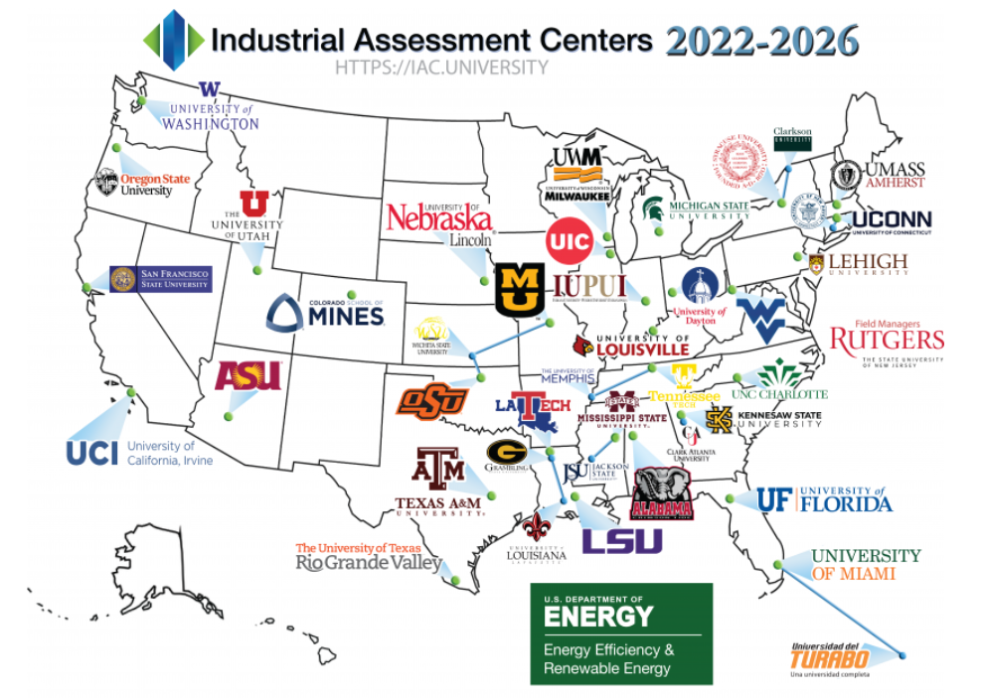
Industrial Assessment Centers
Better Plants Goal Achievers: Resources Leveraged
  Industrial Assessment Centers (IAC) and CHP TAPs
  32 of the 56 goal achievers received at least one IAC audit
  TAMs connected several goal achievers to CHP TAPs
    One goal achiever used the TAP technical assistance to install a 14.1 MW CHP system

Slide 17


Industrial Assessment Centers
Better Plants Goal Achievers: Resources Leveraged
  The impact of energy management (SEP | 50001 Ready)
9
Goal achievers had
SEP-certified plants
Goal Achievers had at
least one 50001 Ready-attested plant
3
Notes:
Several Goal Achievers with SEP-certified plants reached the goal early:
Volvo Trucks (4 years), Harbec (5 years), Schneider Electric (7 years), Comau (5 Years), and General Dynamics (3 years).

Slide 18
Industrial Assessment Centers
Better Plants Goal Achievers: Resources Leveraged
  The impact of energy management: Common Practices
  Every partner with SEP-certified and 50001 Ready attested plants had:
  Senior Management Support
  Energy baselines normalized to production
  Energy performance indicators for all major energy-using systems
  Established objectives, targets and action plans
  Established procedures to foster continuous improvement in energy performance

Slide 19
Industrial Assessment Centers
Better Plants Goal Achievers: Types of Projects
  Three Categories of Projects Implemented to Reach the Goal
    One or few big, capital-intensive projects (9 partners)
      Examples include: CHP, major system/plant retrofits
    Combination of small, medium & large capital projects (38 partners)
      Examples include: VFD installations, HVAC/Chiller upgrades, controls upgrades, compressed air storage
    Mostly small (low cost) or medium projects (8 partners)
      Examples include: Repairing compressed air leaks, shutting off unneeded equipment, set point verification
$
$
$
Notes:
The most commonly optimized system: compressed air
10 partners started with some small, low- or no-cost projects and moved onto more sophisticated, capital-intensive projects after achieving robust energy savings from the initial energy-saving efforts. Legrand started this way and later was able to get CEO approval for a fuel cell.

Slide 20
Better Plants Goal Achievers
Here are 5 characteristics of Better Plants Goal Achievers:
Achieved Management Support and Funding
Goal achievers engaged top management for project and energy management staff support
Data-Driven Approach to Identify Energy Savings
Goal achievers use data to make decisions. Data came from external audits, INPLTs, and metering equipment
Engaged Colleagues from Other Departments
Goal achievers worked with other teams within the organization, which was essential for making efficiency gains
Leveraged DOE Tools & Guidance
Goal achievers got the right support and training to improve employee competence in energy efficiency and management
Communicated Energy Savings Successes
Goal achievers used internal and external communications resources, e.g., case studies, to highlight successful energy efficiency projects/practices

Slide 21
Industrial Assessment Centers
Better Plants Goal Achievers: Success Factors
  Nine success factors of goal achievers:
    Management Support and Funding – permanent energy manager & budget
    Data Collection/Analysis – submetering, historians, analysis software
    Identification of Energy Efficiency Measures – assessments, periodic reviews of energy-using systems
    Energy Action Plan – setting goals and project implementation schedules
    Engage Other Departments/ Business Units – operations, maintenance, engineering, EHS
    Communicate Success – internal bulletin boards; external case studies
    Train Employees – AEE, CAC, CP EnMS
    Internal Recognition – posters, gift certificates, in-person accolades
    Integrate Energy Efficiency Into Procurement – oversight of new equipment purchases by energy management staff
Notes:
Management Support and Funding – Schneider Electric created a permanent management job title so that there will always be an energy manager.
Data Collection – Legrand U.S., installed submeters to gather real-time energy data and determine the energy flows within the plants.
Identification of Energy – Cummins Engine trained facility energy leaders to identify top energy-consuming applications and operator-level improvements that could be done on them.
Energy Action Plan – 3M energy management staffs categorized various energy-saving projects based on payback periods to determine which ones to implement. Since starting their program, the company has implemented more than 1,500 energy efficiency projects using this approach.
Engage Other Departments/ Business Units – TE Connectivity’s energy manager leveraged the Better Plants Treasure Hunt In Plant training to engage employees that didn’t typically focus on energy into the company’s energy efficiency efforts.
Communicate Success –Celanese leveraged DOE’s communications capability to generate case studies each time they had a big energy-saving project or process upgrades that enhanced their ability to save energy. They also highlighted employees’ accomplishments and global energy team meetings in internal newsletters.
Training Employees – General Motors trained employees from multiple plants on 50001 Ready to educate them on energy management. Since 25 GM sites have completed the 50001 Ready Navigator.
Internal Recognition of Employees – 3M established an internal recognition program that bestowed gift certificates to restaurants to employees that came up with energy-saving ideas/projects.
Integrate Energy Efficiency Into Procurement – Volvo Trucks (truck assembly plant in Dublin, Virginia), the plant’s energy manager has oversight over procurement and if a piece of equipment that is proposed for purchase could increase the plant’s energy intensity/consumption, the energy manager flags it for the plant manager who then decides whether to approve the purchase (instead of the procurement manager).

Slide 22
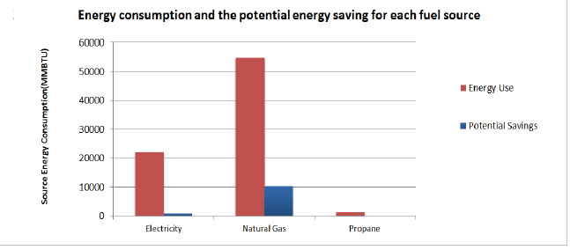
Industrial Assessment Centers
Better Plants Goal Achievers: Concrete Steps
  Any industrial company can achieve success using the following steps:
    Perform Energy Review
      Acquire, Analyze & Track Data – use DOE’s Plant Energy Profiler tool
      Determine Significant Energy Uses – understand energy flows
      Use DOE energy footprint tool
      Use Sankey diagram tool
      Identify Energy Savings Opportunities
      Prioritize Energy Savings Opportunities

Slide 23
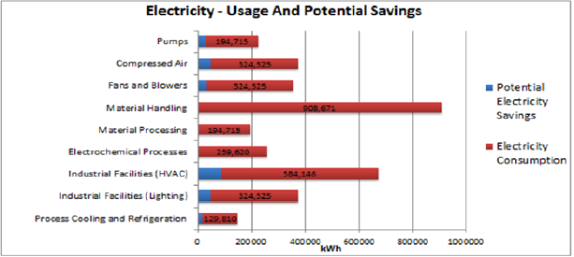
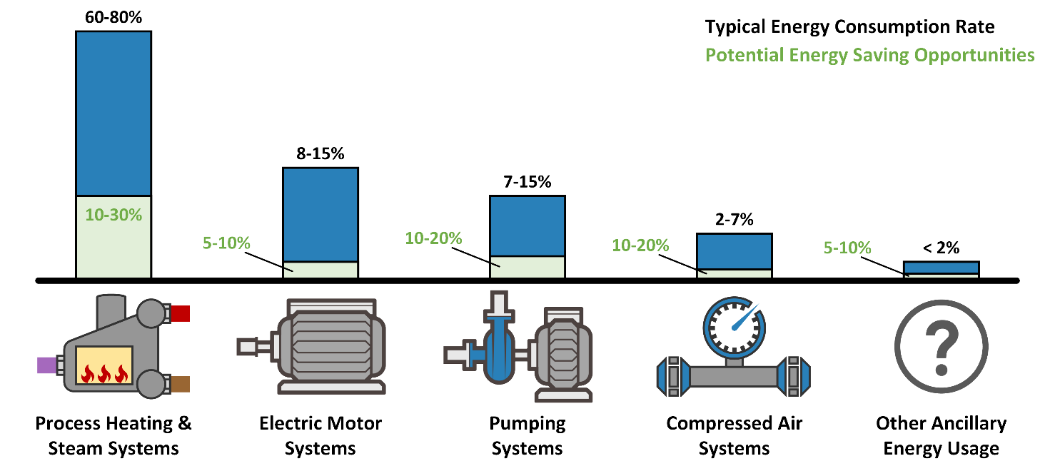
Industrial Assessment Centers
Better Plants Goal Achievers: Concrete Steps
  Any Industrial Company can Achieve Success Using the Following Steps:
    Estimate Energy Savings
    Implement Energy Management Best Practices (ISO 50001)
Notes:
The most commonly optimized system: compressed air
10 partners started with some small, low- or no-cost projects and moved onto more sophisticated, capital-intensive projects after achieving robust energy savings from the initial energy-saving efforts.

Slide 24
Industrial Assessment Centers
Better Plants Goal Achievers: Conclusions
  Key takeaways from the research:
    No “one-size-fits-all” approach for manufacturing
    Large, capital projects are not necessary to save large amounts of energy
    System-level approach is superior to equipment replacement in
    industrial plants
    Peer-based knowledge-sharing is highly beneficial
Notes:
1) Industrial plants are very different and energy consumption patterns change. Each plant needs to be treated as a unique facility.
2) Most partners (46) met the goal with low or medium cost measures.
3) Industrial energy consumption is affected by numerous factors beyond the “prime mover” types of equipment. Understanding how these systemic aspects affect energy consumption will lead to optimal solutions that save the greatest amount of energy.
4) Manufacturers learn well from each other.

Slide 25


Partner Testimonials:
“By joining the Better Plants program and receiving the encouragement of DOE staff and our TAM it helped push towards the goal and make others realize that we were not pursuing this effort in a vacuum.”
Victor Valley Wastewater Reclamation Authority
“Our TAM has been instrumental in identifying and communicating opportunities for DOE assistance and helping with the application process. He has also been very proactive in informing us about good practices he has seen at other manufacturing sites and in assisting with our annual reporting.”
Volvo Group North America

Slide 26

Partner Testimonials:
“We have a small staff working on energy efficiency/sustainability and with as many plants and locations as we have making the sites aware of our commitment and how to reach the goal was a big lift. Fortunately, the educational resources (sourcebooks, case studies, tip cards) and the treasure hunt in plant training helped us spread the word and get site employees involved, which we previously could not do as well.”
- TE Connectivity
“By knowing how DOE can help us track energy consumption amongst certain equipment, having a TAM that can provide further insight, and collaborating more with other partners down the road are certainly ways that we can leverage what we have available in order to be successful.”
3M

Slide 27
Thank you!
For More Information:
Download the report from the Better Plants resource library:
Better Plants Resource Library | Better Buildings Initiative (energy.gov)
Bruce Lung, robert.lung@ee.doe.gov, 202-586-4411,
(remote) 202-316-2754
Questions?

