Slide 1
Technical Partnerships
Eli Levine, Technology Manager
Advanced Manufacturing Office
AMO Peer Review
June 2020 | Washington, DC
manufacturing.energy.gov

Slide 2
Technical Partnerships
The Technical Partnerships subprogram provides critical support to the adoption of advanced energy efficiency technologies and practices. The subprogram supports public-private partnerships and provides outreach and technical assistance to advance the adoption of cost-effective combined heat and power (CHP) technologies; provides resources to assist manufacturers in reducing their energy intensity; promotes the adoption of continuous improvement energy management programs, provides targeted energy efficiency, productivity, and waste/water use reduction practices to small- and medium-sized manufacturers.
This presentation does not contain any proprietary, confidential, or otherwise restricted information

Slide 3
Alignment with Goals and Objectives
Alignment with EERE Priorities:
“Develop a cross-sector strategy to promote awareness around quality installation to realize the full potential of energy efficiency technologies and promote workforce development”
Multi-Year Program Plan:
Vision: U.S. global leadership in sustainable and efficient manufacturing for a growing and competitive economy.
Mission: Catalyze research, development and adoption of energy-related advanced manufacturing technologies and practices to drive U.S. economic competitiveness and energy productivity.
Goals:
Improve the productivity and energy efficiency of U.S. manufacturing.
Transition DOE supported innovative technologies and practices into U.S. manufacturing capabilities.
Strengthen and advance the U.S. manufacturing workforce.

Slide 4




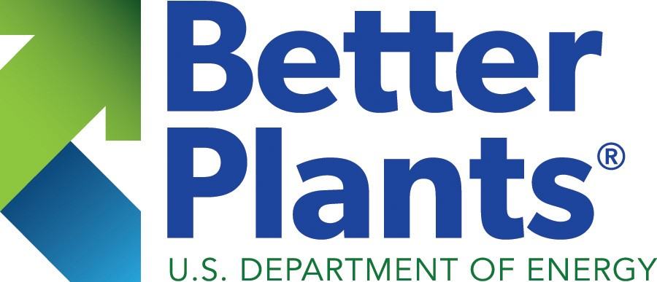

Technical Partnerships Programs
Technologist in Residence

Slide 5
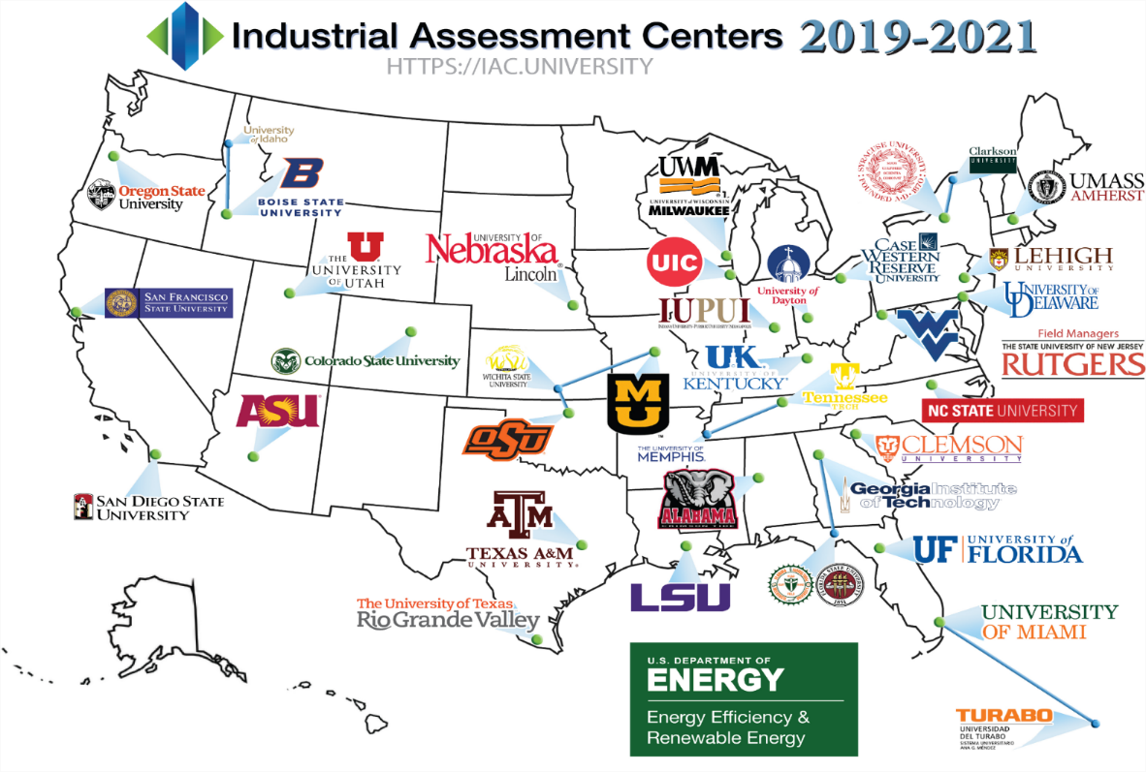
Operating Since 1976
IACs are located at 31 ABET-accredited engineering programs at American universities (plus 6 satellite locations)
Includes three new IAC “Extensions” to address formerly underserved areas
  Case Western Reserve
  University of Delaware
  Colorado State
$12M FY 20 AMO Budget

Slide 6
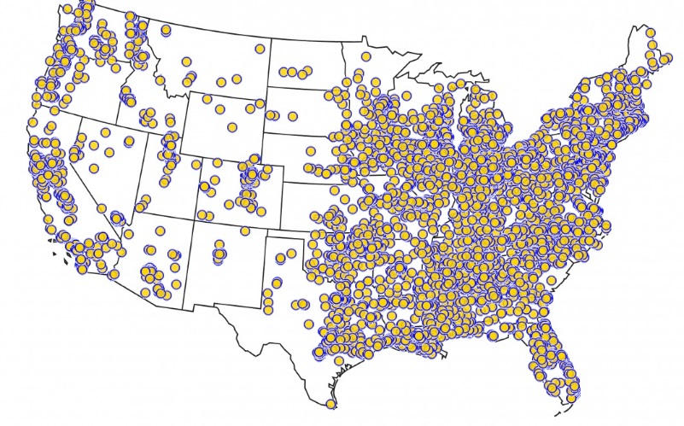
Results and Accomplishments
Costs to DOE are less than one-fourth of energy savings
  Savings do not account for persistence
  Savings do not account for activities associated with IAC graduates
IACs have conducted more than 19,100 assessments and provided more than 144,225 recommendations
Average recommended yearly savings is $135,989
For every $1 invested in the IACs between 1997 and 2013:
  $5 were invested in energy efficiency improvements by participating firms
On average, an IAC client saves approximately $45,000 in energy savings, productivity enhancements, and water use and waste reduction per assessment in one year
More than 50 percent of IAC graduates initial job includes energy efficiency as a primary responsibility
IAC Assessments Since 2000

Slide 7
IAC Results and Accomplishments (continued)
8.9
5.5
4.3
Graduates have an average of 8.9 specific, applicable skills in energy efficiency, as opposed to 5.5 or 4.3 for peer control groups
Graduates have a skill mix estimated to be $6,210 more valuable than the skill mix of an energy peer control group
Graduates spend 42% of their career in EE, as opposed to 28% for an energy peer control group
Alumni Resumes
Energy Resumes
Cohort Resumes
Alumni Resumes
$72,964
Energy Resumes
$66,754
Alumni Resumes
42%
Energy Resumes
28%

Slide 8
ISO 50001 Delivers Value: This voluntary global standard for energy management systems helps organizations to identify top opportunities to save energy and money, ensure that savings persist and grow, establish data-driven processes and procedures to build energy efficiency, and cost-efficiently scale up energy savings across multiple facilities.
50001 Ready
First steps to EnMS savings
Step-by-step guidance and self-paced process
Self-attestation to use of ISO 50001 principles
Recognition of achievement—with no third-party audit
Superior Energy Performance 50001
Certification and verified savings
ISO 50001 certification
Third-party verification of energy performance improvements
Elevated recognition at Silver, Gold, and Platinum available

Slide 9


DOE’s Spectrum Approach to ISO 50001 Adoption
DOE has developed an energy management continuum that begins with market-driven business culture and culminates in verified savings.
50001 Ready:
Recognition for ISO 50001 conformance using guidance in DOE’s 50001 Ready Navigator tool
Superior Energy Performance 50001™ (SEP 50001™):
Recognition for ISO 50001 certification and 3rd party verification of energy performance improvements
ISO 50001 Certification
200-300 (est.) facilities ISO 50001-certified
60 facilities with
50001 Ready recognition
51 facilities
SEP-certified
Self attested
Top down energy data results
No cost and no audit required
DOE recognition, not certification, for established 50001 EnMS in place
ISO 50001 certification required
Top down and bottom up energy calculations
Audit required at cost
Provides 3rd party verification of savings from 50001
Guidance / Training / Management Tools / Data Analysis / Business Case / Success Stories / Recognition / Promotion

Slide 10
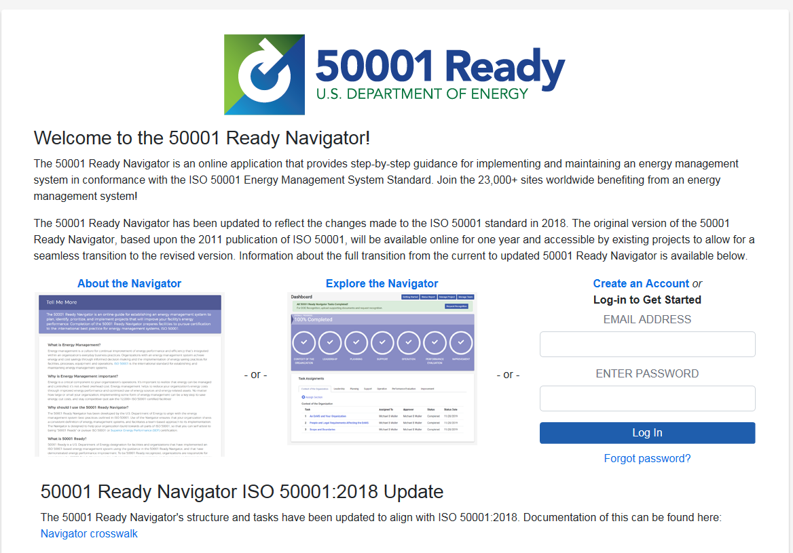
50001 Tools and Strategic Outreach
Key changes since last program review
Development and launch of Navigator “3.0” to align design and guidance with revisions in the ISO 50001:2018 standard
4 verification bodies now recertified to perform audits for updated SEP program
50001 Ready - Partnerships
Utilities and other implementers
  50001 Ready is an offering that can complement a utility’s Strategic Energy Management (SEM) program during the performance period, and as a customer engagement tool after “graduating” from a program
  Cohorts at Focus on Energy (WI), Efficiency Vermont, TVA
  Partner platform allows for customized Navigator experience for utilities and others to offer to their customers while monitoring progress
Foreign governments
  Multi-national corporations operating in the US have asked for recognition program that can encompass more than just US sites, as such we are working with Canada and Mexico to stand up separate 50001 Ready recognition programs to be administered by those governments
  Saudi Arabia also creating a licensed 50001 Ready program, other countries interested
SEP 50001
SEP measurement and verification protocol integration with utility SEM programs and carbon reporting programs
ISO 50001/SEP 50001 top-down , facility-wide, systematic approach needs more acceptance by industry, utilities, environmental NGOs, state-level energy policy planning, carbon reporting programs
Hand off of SEP 50001 administration to third party in future
50001 Ready Navigator
Online tool, with simple, step-by-step approach to ISO 50001 implementation
25 tasks divided into 7 sections
Ability to assign tasks to team members
Extensive guidance available in each module
Hosted and managed by LBNL team and subcontractors

Slide 11
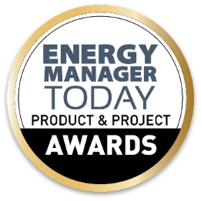
50001 Results and Accomplishments
50001 Ready Growth | 19PR | 20PR
Recognized facilities | 30 | 60
Navigator projects | 815 | 1192
Navigator user accounts | 1705 | 2473
5R Program Updates
9 supporting organizations assisting facilities through Partner platforms
Upgraded Navigator for ISO 50001:2018 and added Task Playbook capability
Saudi Arabia, Canada, and Mexico programs being established
SEP 50001
73 facilities have achieved SEP certification since 2010, 51 are current
Average savings 4.6% per year for current certified facilities
75% of energy savings from operational improvement - compared to ~40% operation savings from “project approach” (DOE Save Energy Now data)
Near-term ISO 50001 Program Plans
Competitive solicitation focused on EnMS education and workforce development
SEP 50001 (2019) transition period extended by 6 months due to Covid-19 impacts
Expanded cohort support, with shift in promotional activities due to social distancing
Cross-office coordination for validation efforts beyond manufacturing (FEMP, BTO, WIP)

Slide 12
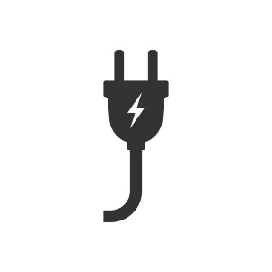
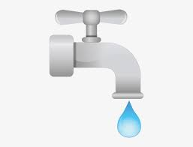

Helping manufacturers and other industrial organizations save money and improve their competitiveness
Increased
Energy Productivity
Water
Savings
Waste
Reduction

Slide 13
Objective: Drive leadership in energy innovation in the industrial sector through helping industry in setting and meeting ambitious energy efficiency targets, sharing solutions, and facilitating field validation and adoption of energy-saving technologies.
AMO Mission: Better Plants helps fulfill AMO’s strategic goals of:
Improving the productivity and energy efficiency of US manufacturing
Reducing lifecycle energy and resource impacts of manufacturing goods
Transitioning DOE supported innovative technologies and practices into US manufacturing capabilities
Strengthening and advancing the US manufacturing workforce
Better Plants partners join for 5 reasons:
Technical Assistance
Connections to Labs and Innovation
National Recognition
Peer-to-Peer Networking Opportunities
Workforce development
Through Better Plants, companies set long-term efficiency goals. Organizations with publicly stated energy reduction goals:
  Implemented 50% more efficiency and renewable energy measures than organizations without goals.
  Are 2.7 times more likely to increase investments, and say they see brand value and other co-benefits beyond energy savings

Slide 14
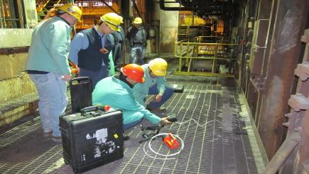
Better Plants Technical Assistance
Technical Account Manager
  Based through ORNL. Help with energy baselines and data tracking/reporting
  Keep partners informed about available DOE resources and opportunities
In Plant Trainings
  139+ In Plant Trainings offered to date, for 2,400 participants
  Over $50M in identified savings
  New Industrial water savings topic was rolled out
Field Validation and Diagnostic Equipment Program/Software Tools
  Help evaluate system performance, measure energy losses/saving opportunities
  Free of charge access to borrow various instruments – ~60 loans to date
  New Plant Water Profiler Tool
Toolkits, Tip Cards, Sourcebooks, Cheat Sheets
  Dedicated webpages for 13 technology focus areas with best practices, point of contact with expertise, case studies, etc
  Created Treasure Hunt Exchange Toolkit, Water Management Strategic Primer
Financing Navigator
  Online tool to help partners find financing solutions. The tool helps users understand the array of financing solutions for energy projects that are available in the market and easily explore which option may be best for them.
Water Savings and Waste Reduction
Accessible, Replicable Solutions

Slide 15
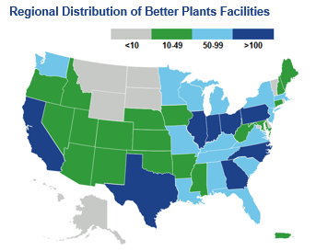
Better Plants Year in Review
235+
$6.7B
Better Plants partners,
across all 50 states
Cumulative Better Plants dollars saved
15
12%
Goal-achieving partners who have ‘doubled-down’ on success
Better Plants percent of U.S. manufacturing footprint
1,000
22
3,200
Partner solutions in the
Solutions Center
New partners
Number of facilities

Slide 16
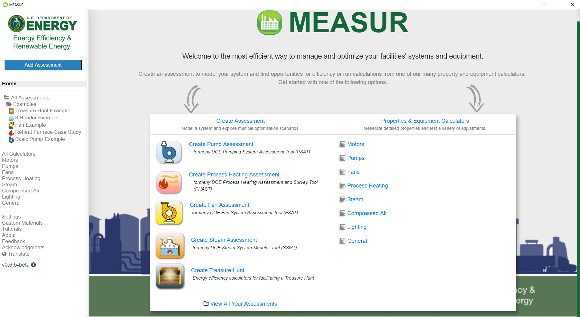
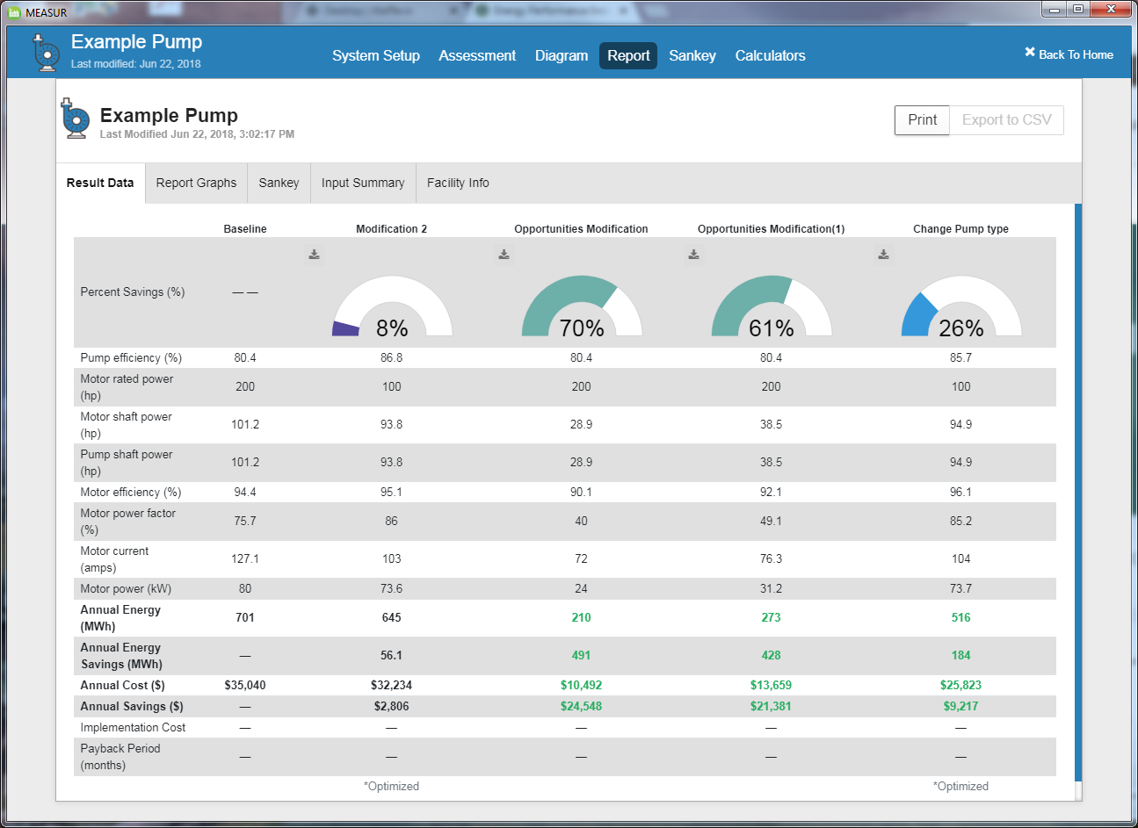
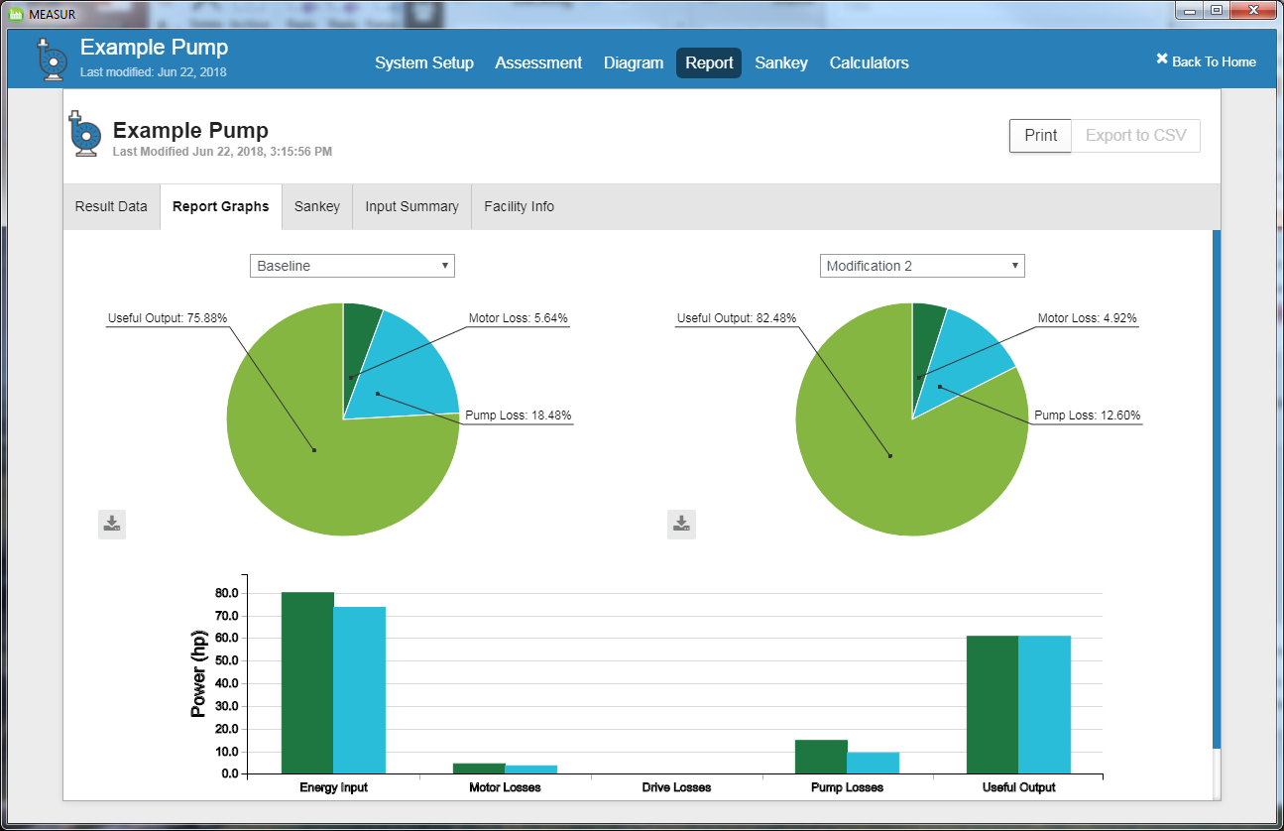
Results and Accomplishments
AMO Tool Development Overview
Update and Schedule
  Systems completed:
    Process Heat (PHAST)
    Pumps (PSAT)
    Fans (FSAT)
    Steam (SSMT/SSAT)
    Treasure Hunt Module
    Data Visualization & Analysis (LogTool)
  Under Development:
    Motors (MotorMaster+) - 6/2020
    Compressed Air (AirMaster+) – 9/2020
    Wastewater (BioTiger) – 1/2021
    Process Cooling (CWSAT) - 4/2021
    Online Mirror of MEASUR – 6/2021
    VERIFI (alpha version) – 9/2021
Activity to Date:
    Total downloads for MEASUR installers and related files: 25,374

Slide 17
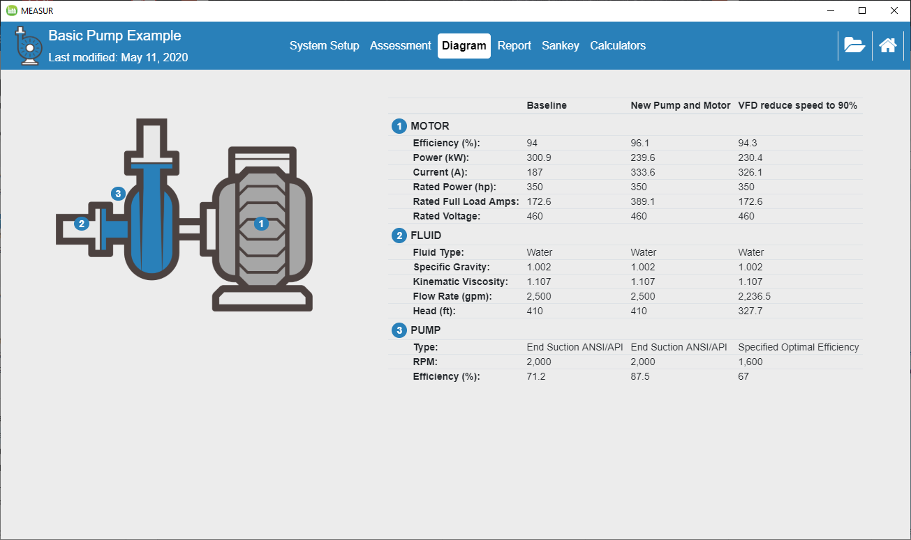
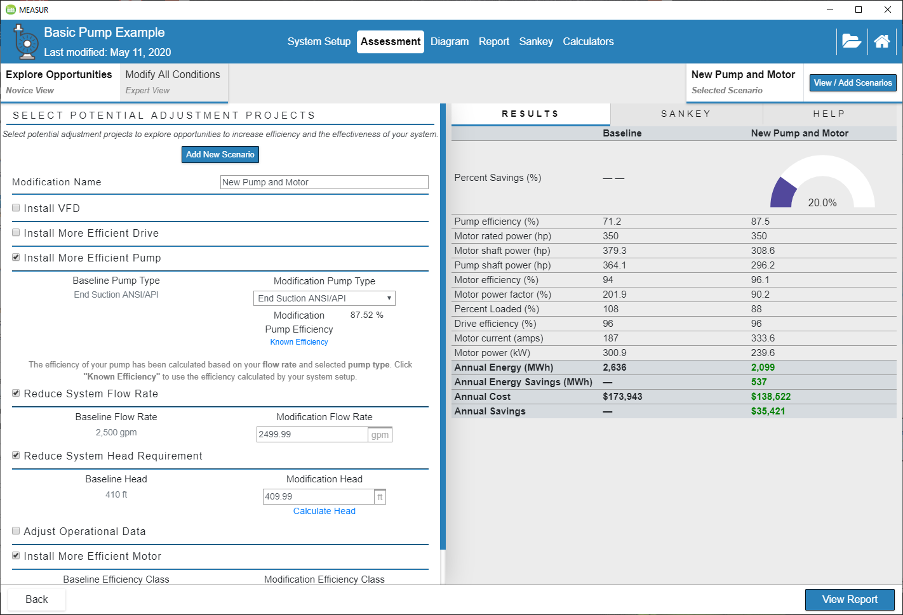
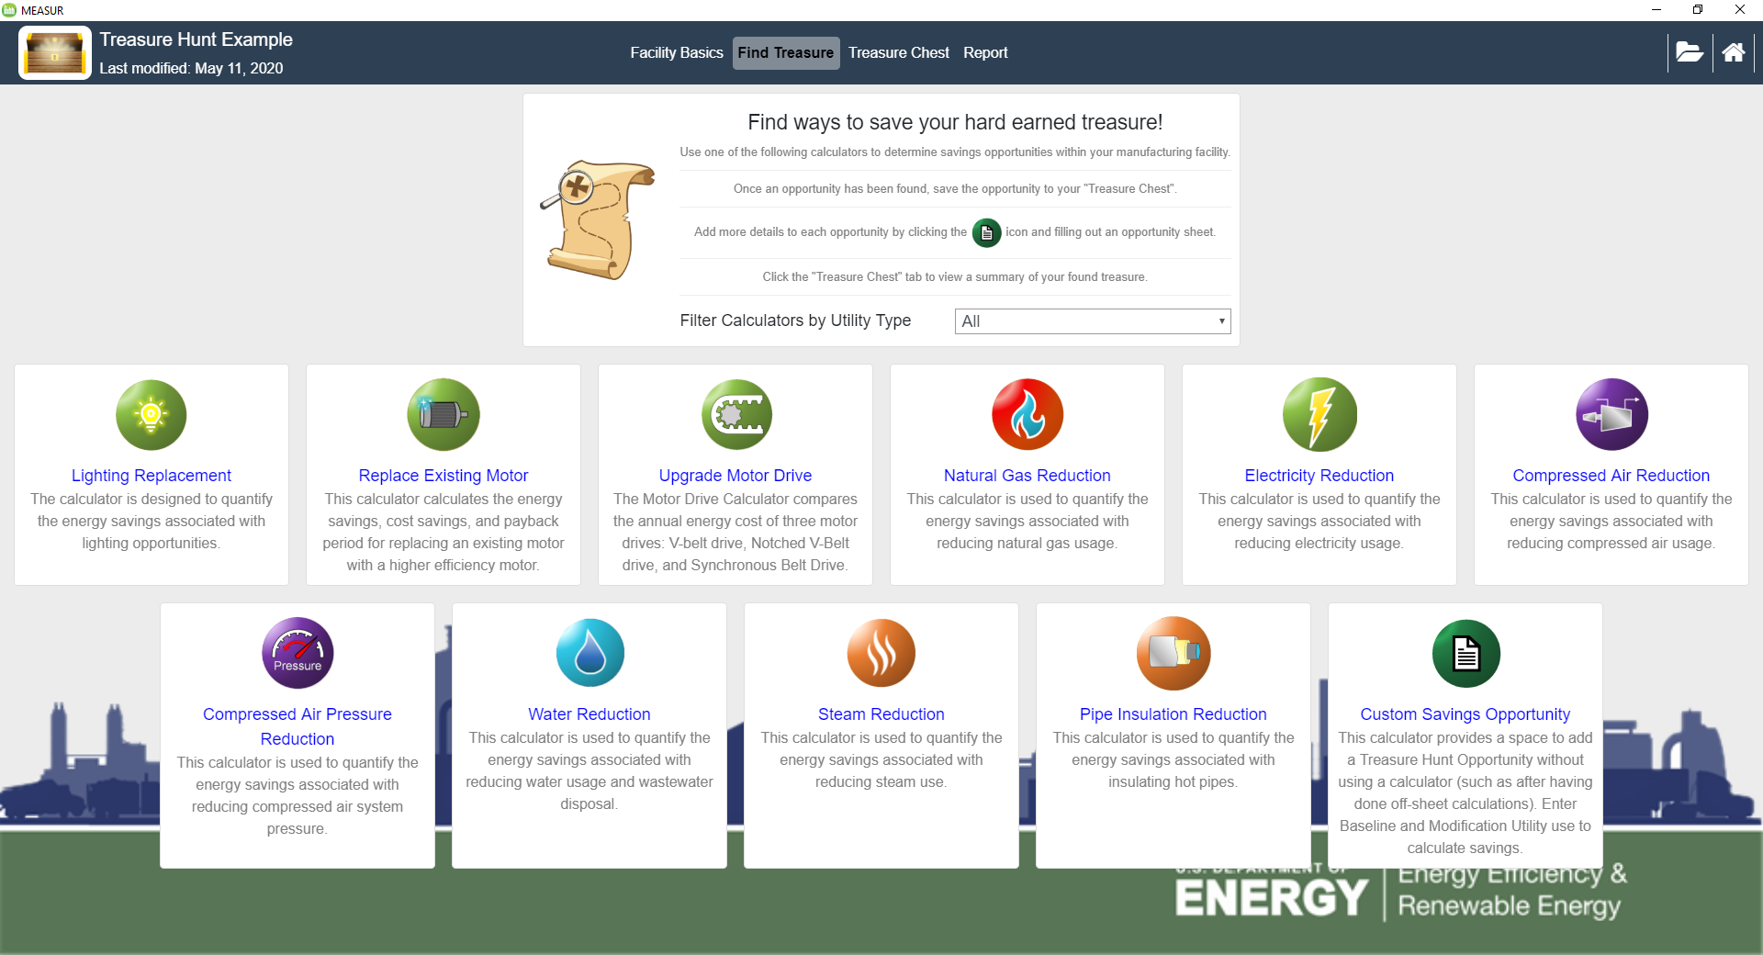
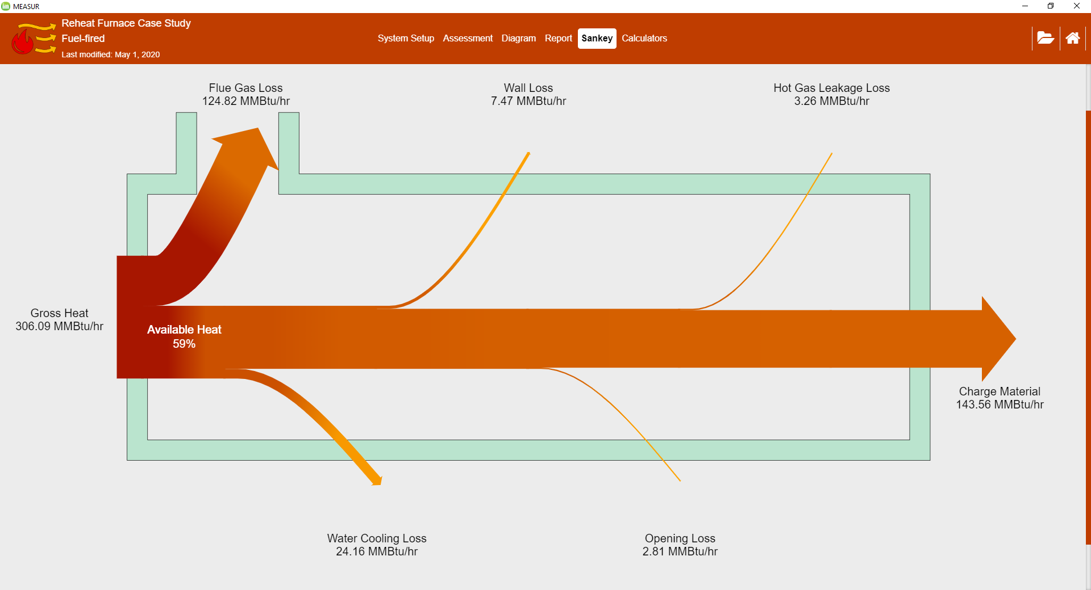
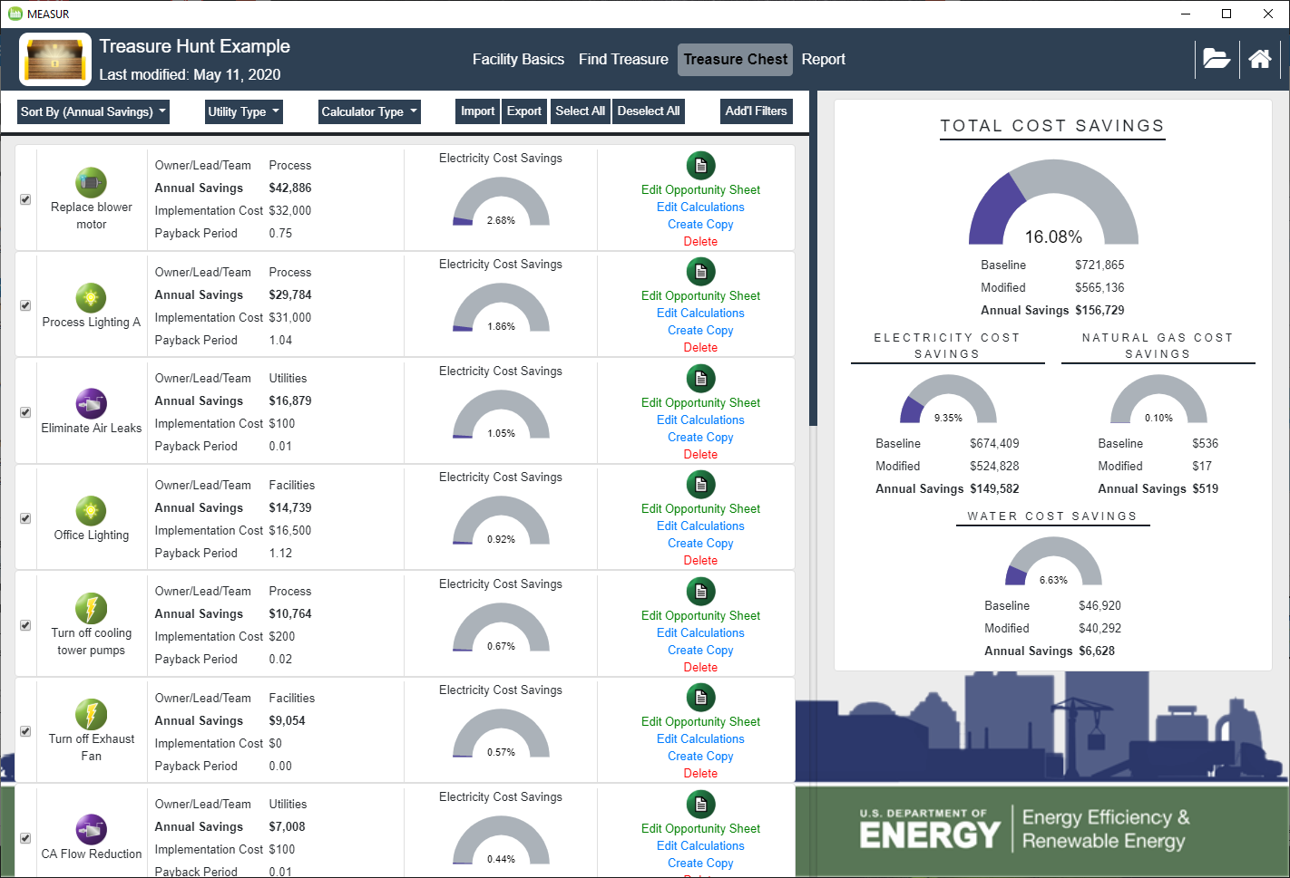
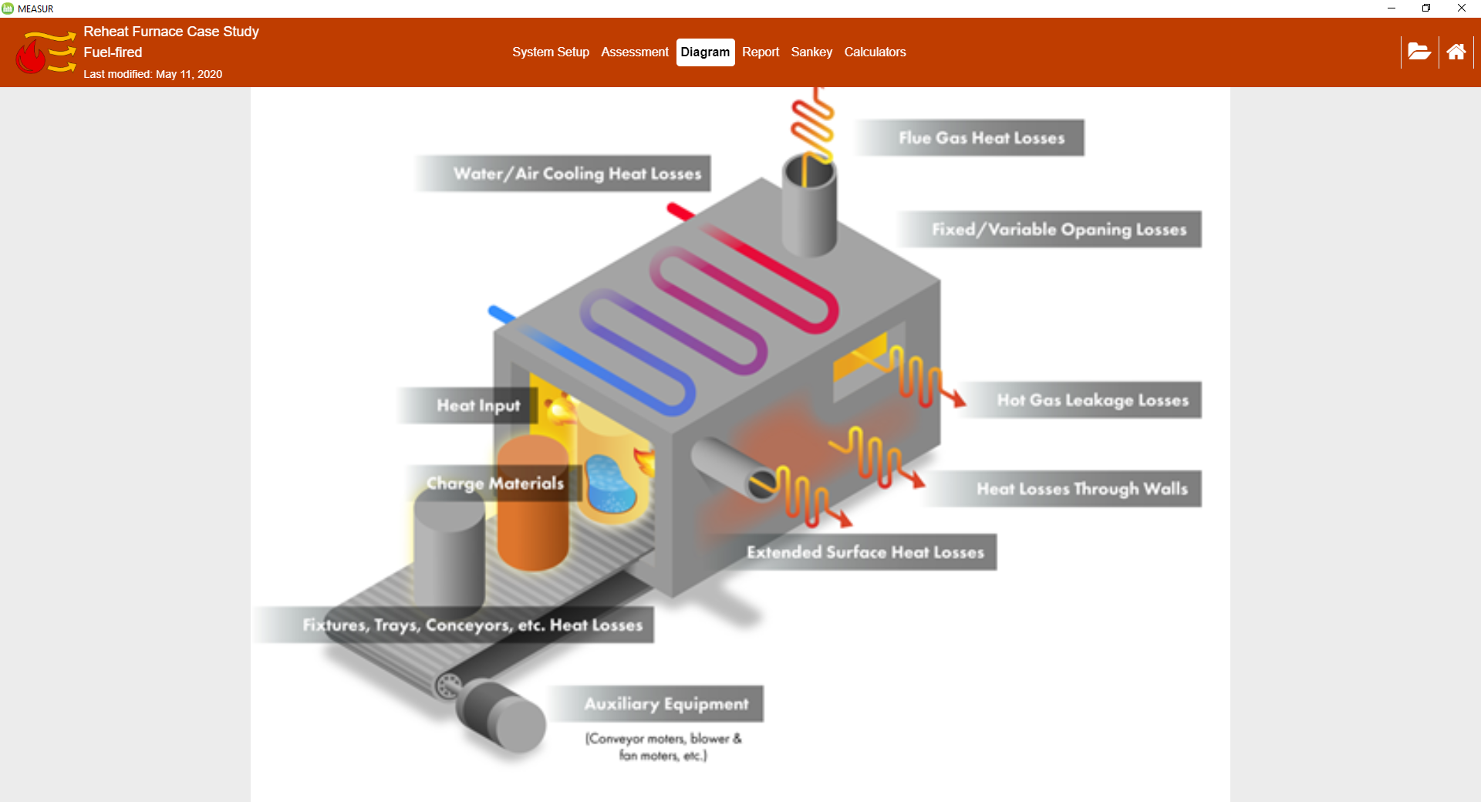
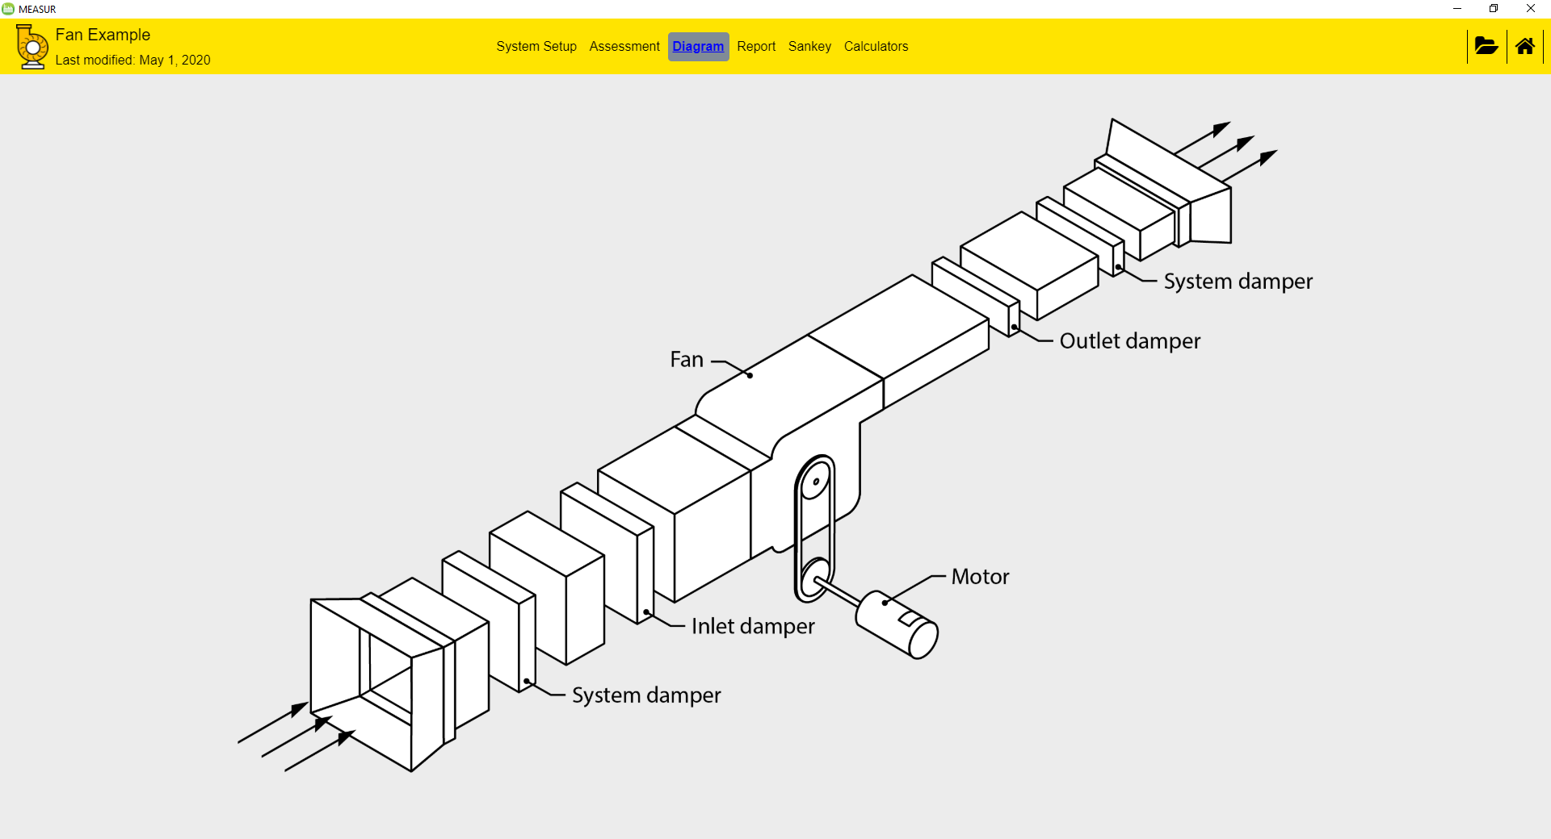
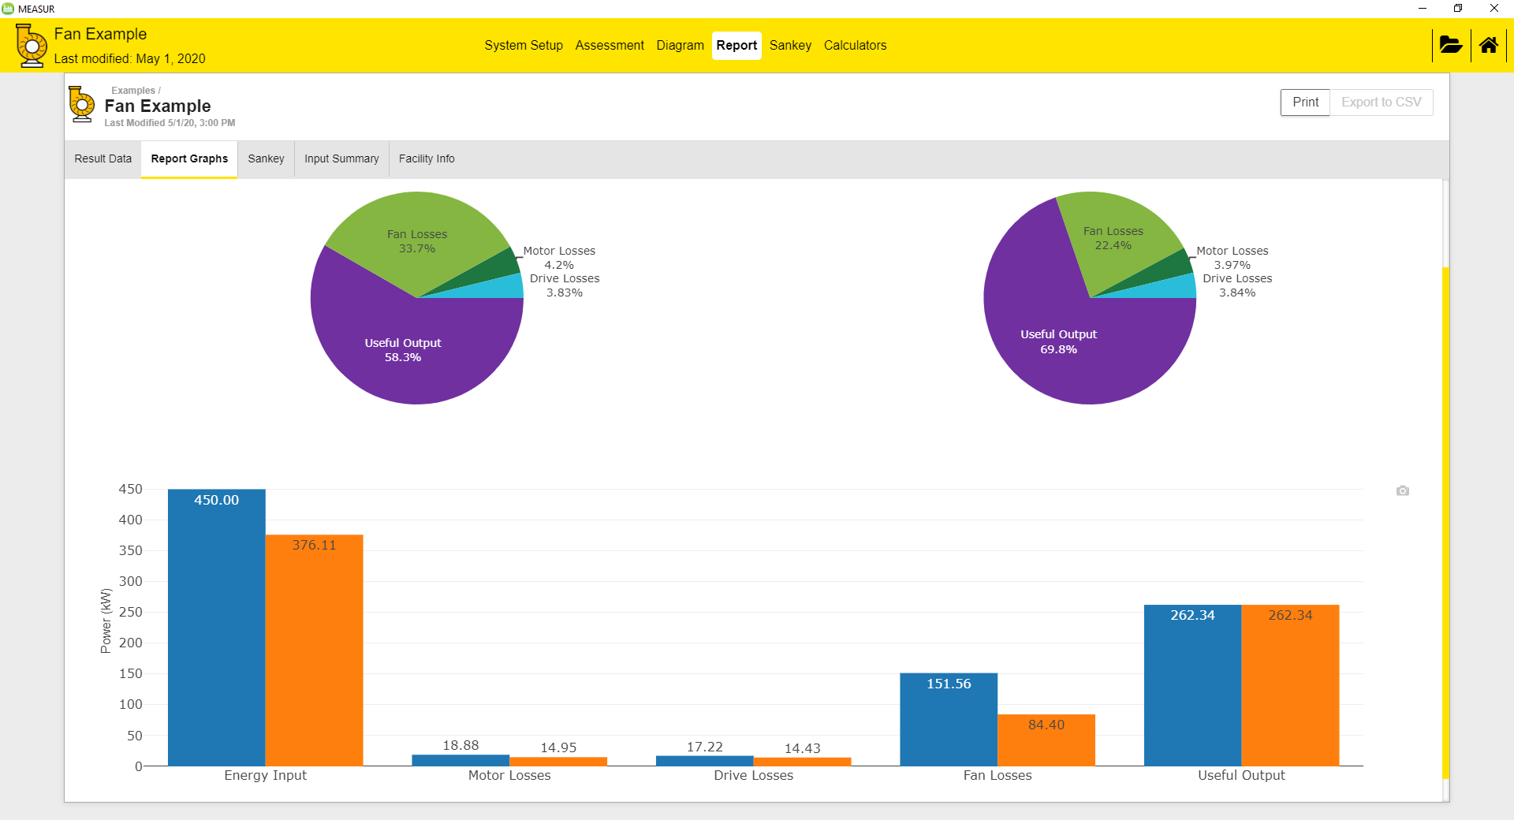
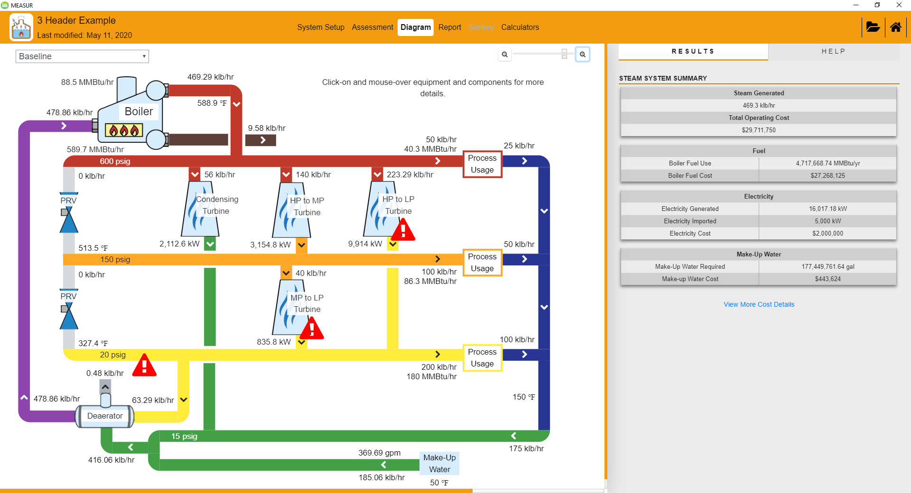
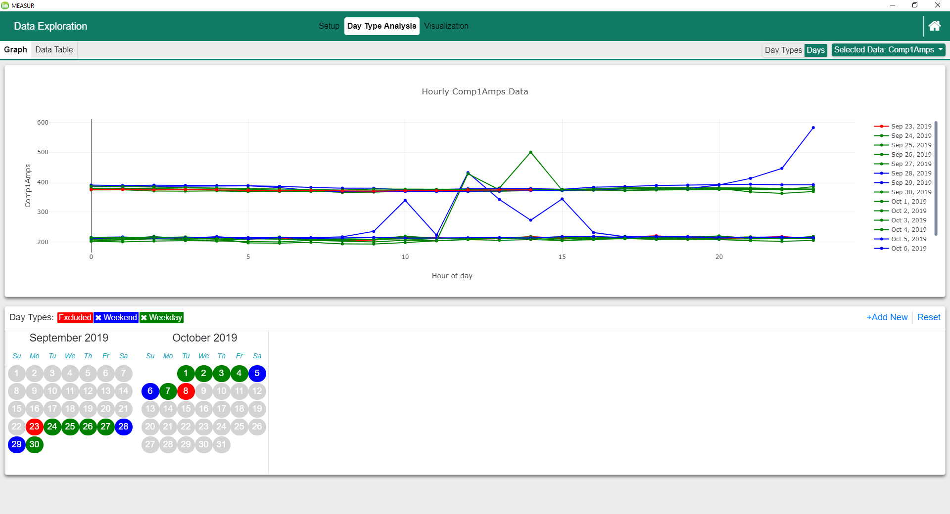
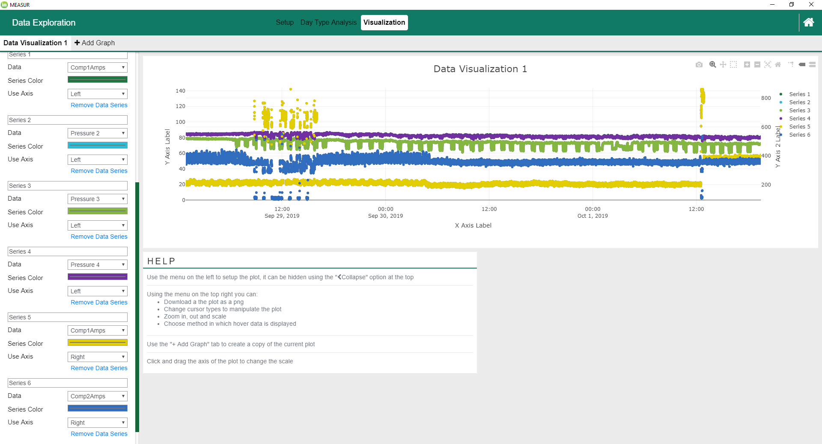
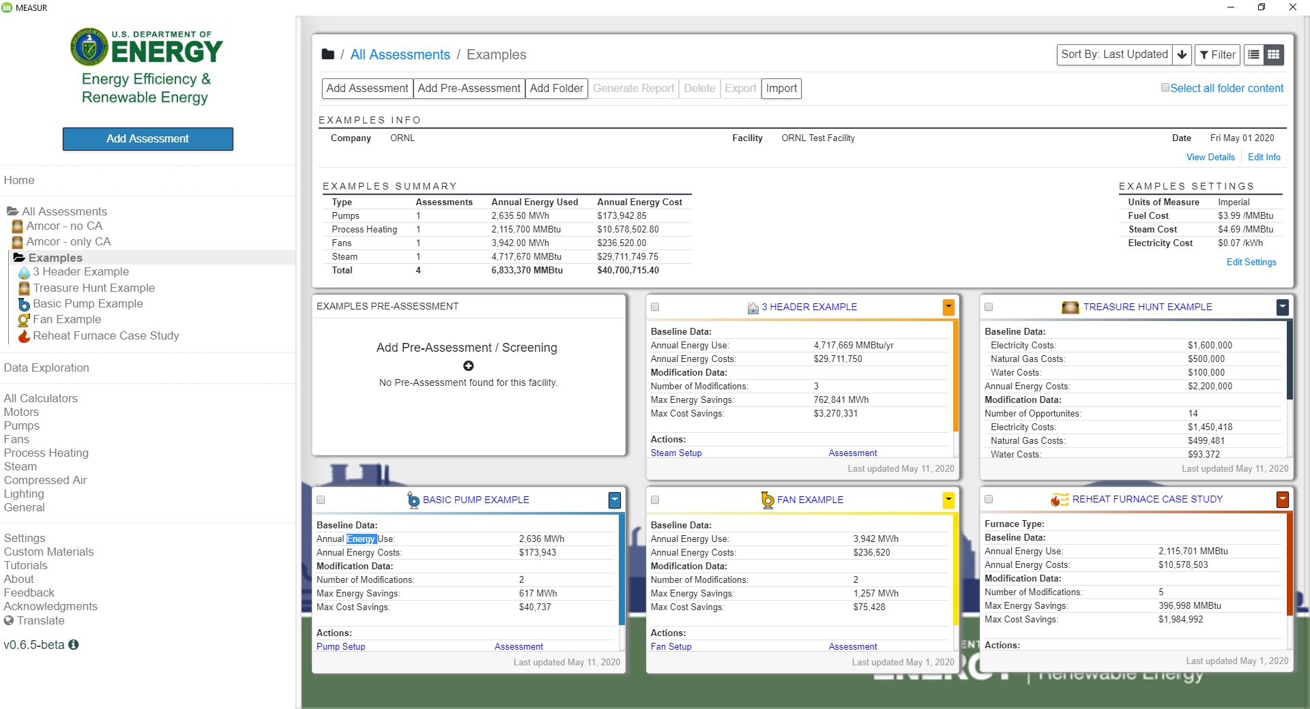
Results and Accomplishments - Select Screenshots
  Pumps (PSAT)
  Treasure Hunt Module
  Process Heat (PHAST)
  Fans (FSAT)
  Steam (SSMT/SSAT)
  Data Visualization & Analysis (LogTool)
  Assessment Dashboard

Slide 18

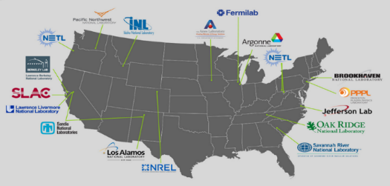
Technologist in Residence
Senior Technologists are identified within a National Lab and a manufacturing company.
The Technologists work together…
…to identify new areas of collaborative research for industry and Lab, and create an agreement and specific scopes of work
Broadening beyond ‘one company – one lab’…
TIR Vision: Catalyze strong Lab-Industry relationships that result in significant growth in high-impact collaborative research and development

Slide 19

Technologist in Residence Program
    Technologist in Residence (TIR) pairs senior technical staff from national laboratories and manufacturing companies to work together towards impactful manufacturing solutions.
Immediate Objectives:
    Identify areas of collaborative R&D
    Develop a streamlined method for companies to establish long term relationships with laboratories that result in collaborative research and development
    Long-term, strategic public-private partnerships
Additional Objectives:
Enhance transparency into the national lab innovation infrastructure
Enhance awareness of high-impact industrially relevant technology challenges within the national laboratory system; and
Broaden and strengthen networks of Technologists in national laboratories and in industry to more effectively support industry needs and leverage the national laboratory enterprise.

Slide 20

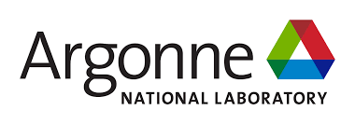

New TIR Pairs
Brookhaven National Lab – Northrup Grumman
Lawrence Berkeley National Lab – Viking Cold Storage
Argonne National Lab – Qorvo
Argonne National Lab CCEFP

Slide 21
Technical Partnerships FY20 Budget
Industrial Assessment Centers: $12M
CHP:
  District Heating $10M
  CHP TAPs $5M
  Related CHP Activities $7M
Better Plants (+ Tool Development) $5.5M
ISO 50001 $4.5M
Technologist in Residence: $700k
TOTAL: $45M

