Slide 1
Energy Storage and AMO: Strategic Initiatives and Future Directions
Diana Bauer, Technology Lead
Joseph Cresko, Brian Valentine, Technology Managers
Advanced Manufacturing Office
AMO Peer Review
June 2020 | Washington, DC
manufacturing.energy.gov

Slide 2
Energy Storage Background
AMO Approach
Opportunity Space
AMO views “Energy Storage” encompassing technologies and systems that are needed for affordable and reliable energy storage, conversion, and transmission to points of use on demand
Includes mobile and stationary energy storage, electric grid integrated, off-grid, and hybrid
Address materials, manufacturing methods, and barriers to commercial deployment of energy storage needs in a circular economy
Address the integration of EERE objectives through technology development for energy storage
Energy storage is critical to the deployment of a “smart grid” comprising distributed and utility power generation, diverse energy sources and end uses
Overcome challenges and barriers to the widespread application of diverse CHP technologies
Overcome barriers to widespread EV deployment
Reduce or eliminate dependence on foreign sources for energy storage technologies and materials

Slide 3
DOE Advanced Energy Storage Initiative
Presidential initiative announced in the budget request of January 2020
AESI Objectives
R&D innovation to enhance performance and reduce cost
Identify or increase the value of storage functions
Accelerate cost-effective adoption and commercialization
Technology Development
Policy and Valuation
Technology Transition
Domestic Manufacturing and Supply Chain
Workforce Development
RTIC Tracks
Notes:
Manufacturing effectively links R&D to accelerated adoption.
Manufacturing facilities can also provide energy storage for the grid.

Slide 4
Advanced Energy Storage Initiative
AMO FY20 AESI Budget Language Summary
“AMO will contribute $5 million to the Advanced Energy Storage Initiative, AMO Advanced Energy Storage Initiative research R&D will specifically focus on the integration of advanced process controls, medium-voltage power electronics, modular processing, combined heat and power, and chemical and thermal energy storage to enable flexible manufacturing plants with increased electricity dispatchablity for enhanced grid stability and resiliency.”

Slide 5
DOE Response to AESI – Energy Storage Grand Challenge

Slide 6
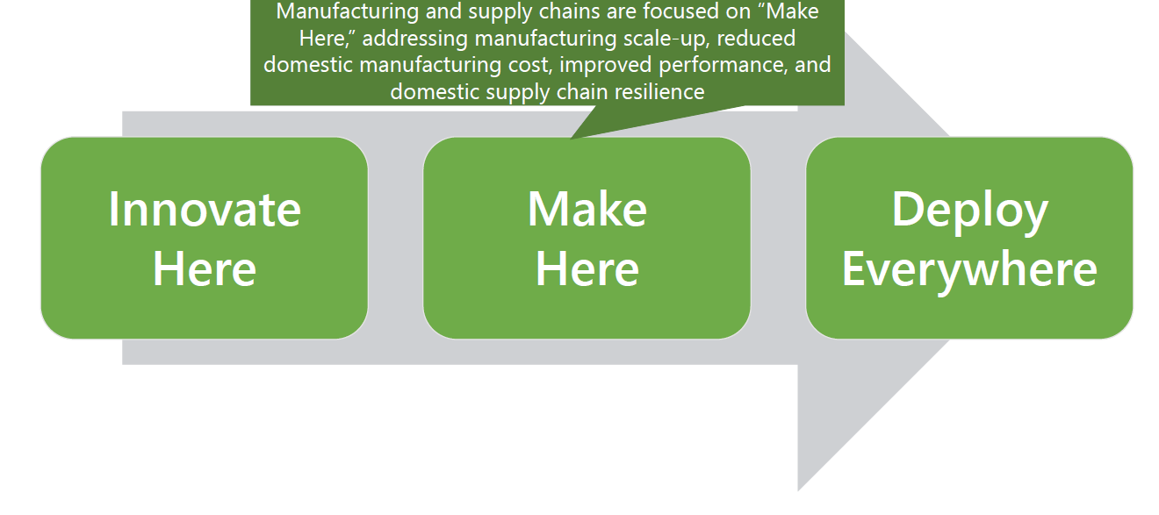
AMO focus in ESGC – Manufacturing and Supply Chains

Slide 7
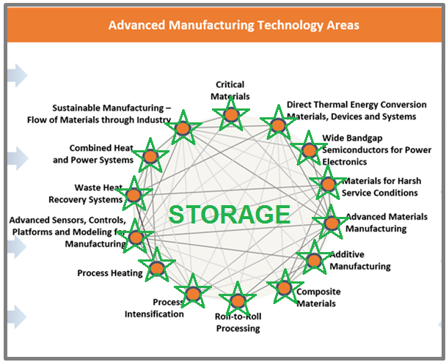
Energy Storage – Unifying Technology Theme for AMO
Rapid Advancement in Process Intensification Deployment (RAPID)
Advanced Sensors & Controls and Modeling for Manufacturing – Clean Energy Smart Manufacturing Innovation Institute (CESMII) and HPC4Mfg
Sustainable Manufacturing
Direct Thermal Energy Conversion
Advanced Materials Manufacturing (AMM)
Additive Manufacturing (AM)
REMADE Institute
Inter- and intra-agency connectivity → through AESI

Slide 8
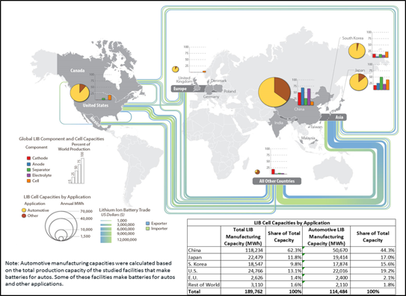
Competitiveness Focus – Li Ion Batteries
2017

Slide 9
Barriers to the introduction of new storage technology
Barrier
AMO response
Critical materials needed for storage technologies (such as Li, Co)
Cost, performance of energy storage concepts technically feasible but not yet economically viable
Validation, verification of technology to be introduced into marketplace
Policy and regulatory barriers
CMI, REMADE work in materials reduction, elimination, substitution, recovery
R&D projects activities to bridge feasible storage technology from early to development stage needed for commercialization
AMO addressing V&V needs through technology cooperative agreements
Communication and understanding of such barriers through AESI coordination

Slide 10
Technical Topic Objectives and Targets
OBJECTIVES
Low cost thermal, electrical, thermochemical, hybrid thermo/electrical, mechanical energy storage for wide applications and time scales. AMO addresses materials and technologies for the next generation of storage
TARGETS
Very Short Term (<1 s) Storage (such as supercapacitors) – Power control, transient control, power quality
Short duration (seconds) Storage (Li ion batteries)
Medium term (minutes) Storage (such as SMES, flywheel, Li batteries, flow batteries, reversible fuel cells) – Bridging power
Longer term (hours) Storage (such as thermochemical conversion)
Very long term storage (such as hydrogen)
Balance of system – Inverters, power conditioning, transmission

Slide 11
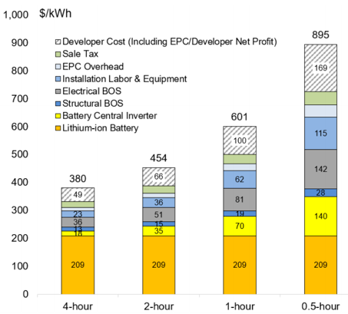
Balance of Storage System
The energy conversion, power conditioning, and other components necessary to make the system work cannot be overlooked as manufacturing costs are addressed
For a 0.5 hour system, the electrical balance of system and inverter costs more than the battery
  Even for the 4-hour storage system the electrical is 25% of the battery cost
2018 U.S. utility-scale lithium-ion standalone storage costs for durations of 0.5-4 hours (50MW_{DC})
Source: 2018 U.S. Utility-Scale Photovoltaics Plus-Energy Storage System Costs Benchmark Ran Fu, Timothy Remo, and Robert Margolis

Slide 12
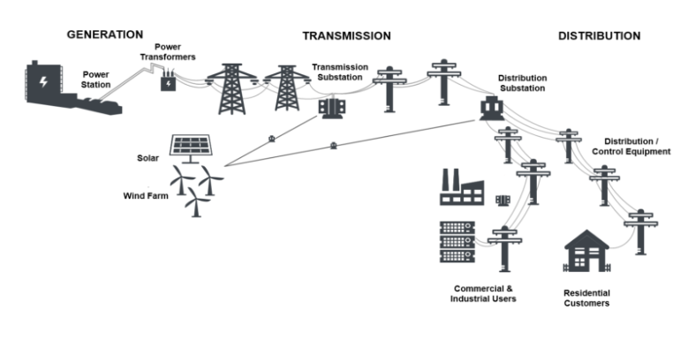
Current AMO Activities
Beyond Batteries
An EERE-wide initiative to develop new technologies and analytical tools that provide increased flexibility and grid services from renewable generation, load, and alternative storage technologies.
Greater flexibility and grid services from:
Flexible renewable generation
Alternative grid storage technologies
(e.g. PSH, CAES)
Behind-the-meter generation, storage and load

Slide 13
FY 19 funds for AMO Beyond Batteries
Overview: AMO’s Beyond Batteries activities center around R&D on use of medium-voltage power conditioning systems to enable resilient and grid-dispatchable manufacturing facilities as energy storage and generation sources.
The energy generation and delivery grid sectors are tightly coupled with a secure and resilient industrial sector. The resiliency and security of one is dependent on the other. Multi-megawatt Power Conditioning Systems provide the potential to the utilize the intrinsic chemical, thermal and mechanical energy storage of manufacturing processes to provide electricity generation and storage to the grid as well as to provide resiliency and stability to the manufacturing plants.
AMO BB Representative Projects
The R&D uses a new class of > 10 kV Wide-Bandgap power semiconductor to produce power conditioning system (PCS) devices that can operate efficiently with high bandwidth in multi-megawatt range.
Analysis, enabling PCS technology, and Medium-Voltage PCS test facility - $5M to NREL with FSU and OSU (lab call awarded)
Research on PCS for Grid-Dispatchable/Resilient Manufacturing Facilities- $5.5M (new FOA)
52% FOA ($5.5M)
48% Lab
($5M)

Slide 14
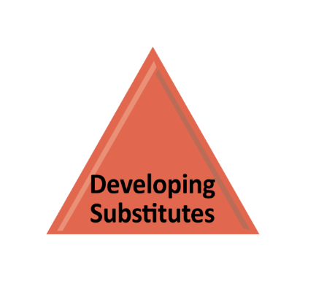
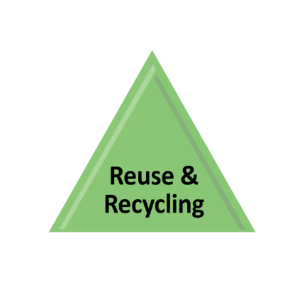
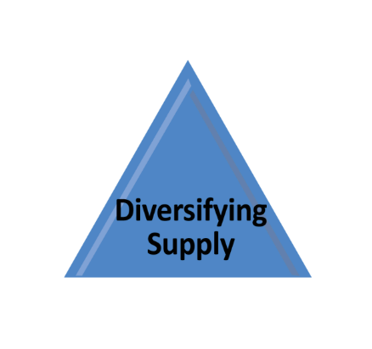
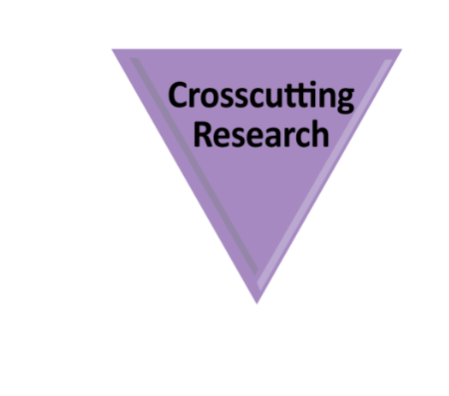
Critical Materials Institute (CMI)
Launched: June 2013
Lead: Ames National Laboratory
Current Number of Members: 23
Federal Funding: $25 million/year
R&D to improve separation and processing, develop substitutes and improve reuse and recycling. Key 7-year targets:
Validate a potential reduction in energy (30%), water (40%) and costs (50%) associated with REE separations and processing
Validate a new magnet alloy as a viable substitute for neodymium magnets at room temperature
Develop the acceptance criteria for returning recycled material into the rare earth and lithium-ion battery supply chains
Improve processing and manufacturability of cerium-aluminum alloys

Slide 15
AMO FY19 FOA
Topic 1: Innovations for the Manufacture of Advanced Materials.
Subtopic 1.1: Accelerate the Manufacturing Process Design and Development Cycle for Advanced Energy Storage and Conversion Materials. (up to $5M) Industry has used AI/ML techniques to probe large, unstructured materials data sets to optimize existing materials, but not for the design of new materials and new manufacturing processes. The goal of this subtopic is to reduce development time from discovery to marketable product to less than 5 years (currently 15-20 years).
  Manufacture of Materials for Energy Conversion and Storage: Develop manufacturing processes for materials with higher energy conversion efficiencies or energy densities, improved mechanical and chemical properties, and increased component lifetime. This approach could optimize battery manufacturing, esp. in the formation stage which takes days to weeks, significantly shortening time and production costs.

Slide 16
AMO FY19 FOA
Topic 1 (Continued): Innovations for the Manufacture of Advanced Materials.
Subtopic 1.2: Innovative Manufacturing Processes for Battery Energy Storage. (up to $30M) New manufacturing techniques can reduce the cost and improve the performance of high energy density batteries. Additional R&D is needed to develop processes and techniques that can be applied to energy storage technologies. Funding on this topic includes $5M from VTO.
  Area of Interest 1 – Battery Storage. New and/or improved manufacturing processes for energy storage applications, including scale-up and device development with lower cost manufacturing processes, to catalyze more domestic battery manufacturing.
  Area of Interest 2 – Novel Energy Storage Concepts. Manufacturing approaches for new energy storage products (e.g. latent heat plus storage, thermoelectric plus storage, etc.).
Congressional Direction: “$20,000,000 for a competitive solicitation to accelerate development of manufacturing processes needed for clean energy materials to go from discovery to scale-up with the goal of lowering battery energy storage costs and spurring job creation.”

Slide 17
AMO FY 19 FOA
Topic 3: Connected, Flexible and Efficient Manufacturing Facilities and Energy Systems.
Subtopic 3.1: Medium-Voltage (MV) Power Conditioning Systems to Enable Grid-Dispatchable and Resilient Manufacturing Facilities. (up to $8.8M) Apply recent advancements in Wide Bandgap (WBG) semiconductors to enable MV power electronics for industrial motor systems and other clean energy technologies, enabling these facilities to provide electricity and storage to the grid. Develop new power system architectures that enable a >10% increase in dispatchable load/generation without process interruptions, and control electric power flow between asynchronously connected electrical equipment in manufacturing facilities and electrical grid subsystems.
FY19 Request: “$5.5 million supports Beyond Batteries R&D through competitively selected cooperative agreements between industry and National Laboratories focused on secure and reliable hybrid power systems, as well as new storage technologies.”

Slide 18
Technology Office Storage Manufacturing Activities
SETO
  Storage + PV Report: Captures the entire system cost
    2018 US Utility-Scale Photovoltaics-Plus-Energy Storage System Costs Benchmark
  Awarded $12.4 Million for Thermal Storage Research
ARPA-E
  Awarded a total of more than $28 million to 10 projects as a part of its Duration Addition to Electricity Storage (DAYS) program
FCTO
  Manufacturing Cost Analysis for Proton Exchange Membrane Water Electrolyzers
  Manufacturing Competitiveness Analysis for PEM and Alkaline Water Electrolysis Systems
  Manufacturing competitiveness analysis for hydrogen refueling stations
  Emerging Manufacturing Technologies for Fuel Cells and Electrolyzers
  Fuel Cell Systems: Total Cost of Ownership
VTO
  Supply-Chain Analysis of Li-Ion Battery Material and Impact of Recycling
  Supply Chain of Raw Materials Used in the Manufacturing of Light-Duty Vehicle Li-Ion Batteries
  BTMS Project with SETO & BTO
WETO
  Historical contributions to Pumped Hydro Storage
BTO
  BTMS Project with SETO & VTO

Slide 19
Technical Topic Accomplishments/Successes last 2 years
Medium voltage solid state semiconductor devices – inverters, regulators
Superconducting tapes that may contribute to cost-effective SMES
Novel electrochemistry exploratory research for batteries
Novel storage integration concepts with CHP
Promising research in cobalt reduction/elimination in batteries
Novel battery metal separation and recovery technology
New R2R manufacturing technology for Li Batteries
New electrical conductor materials for power transmission

Slide 20
Thanks to …
Diana Bauer, AMO – leading Storage Roadmap efforts on behalf of AMO
Joe Cresco, AMO – providing quantitative analysis needed for making technology investments

