Slide 1
Process Intensification/Chemical Manufacturing
G. Jeremy Leong, Kate Peretti, and Melissa Klembara
Technology Managers
Advanced Manufacturing Office
AMO Peer Review
June 3, 2020 | Washington, DC
manufacturing.energy.gov

Slide 2
Process Intensification (PI)/Chemical Manufacturing Background
Process Intensification (PI) targets dramatic improvements in chemical products manufacturing and processing. Intensified processes lead to more efficient, economic and often safer operations and can enable modular/distributed manufacturing. PI innovations optimize process performance by:
developing new chemistry;
exploiting high selectivity, molecular-level kinetics, thermodynamics and heat transfer properties;
establishing processes that reduce the number of processing steps and equipment needed; and
taking advantage of dynamic operations to enhance efficiency.
Chemical Manufacturing is the largest consumer of energy in the industrial sector
R&D Projects continues to support projects that can help current, established industry reduce energy use in current processes as well as invest in high risk transformative research
Fundamental research is needed to:
Enable and discover PI innovations that can be developed for chemical products and processes and develop new innovative tools or capabilities to accelerate process development

Slide 3
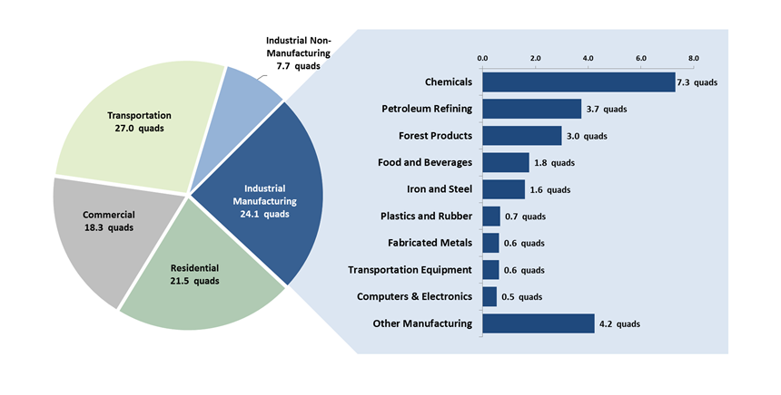
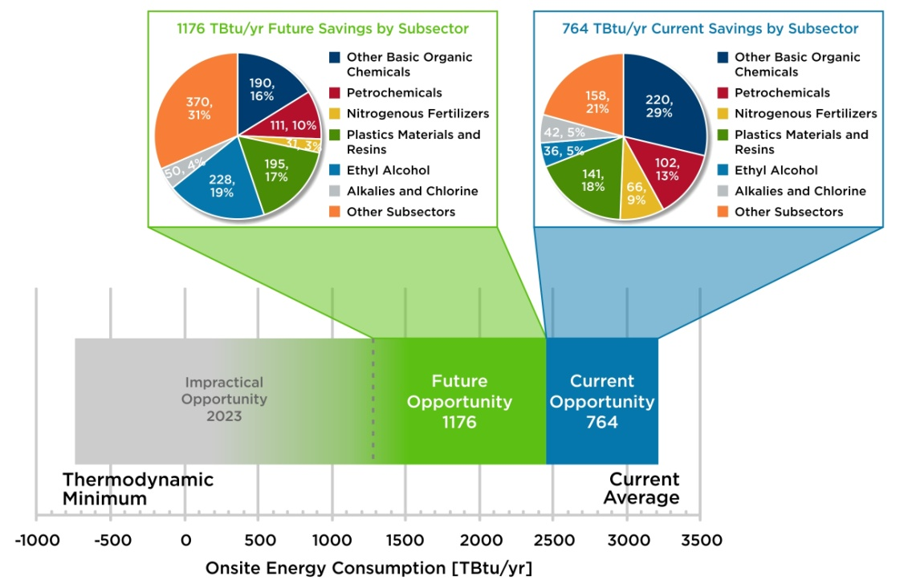
PI/Chemical Manufacturing Opportunities
More than 95% of all manufactured products rely on chemistry. Any improvements in the energy intensity of chemical production would have lifecycle energy improvements in manufactured products
The bulk chemical industry consumed more than 7 Quadrillion BTU in 2018 and is expected to grow to consume >30% more energy by 2030.
Ethylene production via ethane steam cracking is energy-intensive and represents the most energy-consuming single process in chemical industry.
Domestic natural gas production presents opportunity for chemical production at the wellhead
It is estimated that improvements to chemical manufacturing processes, including catalyst development, could reduce the energy intensity of these products by 20-40% by 2050.
Overall U.S. Energy Consumption, 2014
U.S. Energy Savings Opportunity by Chemical Subsector
Notes:
Explain Chem& PI and highlight key points
The industrial sector is the largest consumer of energy in the U. S. (left figure) with industrial manufacturing accounting for 76% of the sector’s energy consumption in 2014. Chemicals manufacturing is the largest consumer of energy of the industrial manufacturers accounting for 30% of the total (right figure). Note: other manufacturing is the cumulative consumption of all other manufacturing industries with each indvidual industry consuming less than 0.5 Quads.
U.S. Energy Savings Opportunity by Chemical Subsector from Chemical Bandwidths Study (2015) based on 2010 MECS data
1-2 slides on topic
How do we (AMO) define this topic
What is the opportunity space, etc (e.g., QTR content)
What is AMO’s role/interest in this technical area
Make sure to cover any major EERE/DOE

Slide 4
Framework for informing programmatic direction
Congressional Direction in Dynamic Catalyst Science 2020
Anticipated Workshop on Chemicals Manufacturing of the Future
Congressional Direction in Transient Kinetics and Industrial Process Catalysis 2018
Industry Round Table on Dynamic Catalyst Science 2020
Quadrennial Technology Review 2015
2018
2019
2020
2017
2021+
Analysis: Bandwidth Study U.S. Chemical Manufacturing 2015
IPA efforts:
5 RAPID
3R&D projects
Workshops on Catalysis, Chemicals Manufacturing and PI 2015-2016
Established the RAPID Institute
DOE Investment: $70M over 5 yrs (‘17-’21)
Address PI-related AMO targets (1-3)
RAPID Road Mapping Workshop 2017
7 RAPID-led Workshops in 2018, including opportunities for MCPI in:
Food Industry
Natural Gas Utilization
Waste Valorization
10 RAPID-led Workshops in 2019, including opportunities for MCPI in:
Water processing
Pulp and Paper
Carbon Capture
Bioenergy
RAPID through AIChE has been successful in leveraging their semiannual conferences to reach a large audience for participation and input

Slide 5
PI/Chemical Manufacturing Challenges and Barriers
Research Challenges
New Chemistry: Lack of validated new conversion chemistries which combine multiple chemical steps or enable simplified process designs.
Highly selective conversions: Lack of highly selective chemistries and catalysts which minimize by-product formation and simplify product separations.
Separations: High selectivity, High throughput: Lack of sufficiently selective low-energy separation agents (e.g., membranes and molecular sieves) with sufficient throughput (flux, loading capacity, etc.) to replace energy-intensive distillation and evaporation.
Modeling and simulation: Lack of integrated predictive tools at multiple scales to better understand entire system.
Materials complexity: Lack of advanced tools and instrumentation for understanding mechanism and detailed kinetic properties of complex materials under operating environments.
Barriers
Large capital investments currently in place – represent a high barrier for economics of the new technology relative to the technology being replaced.
Catalyst Improvements – are typically made incrementally by industry. Developing and designing new catalysts with new materials, may also require new reactor designs.
Scaling up new technologies – from bench-scale to lab-scale to pilot-scale with successful demonstration of the technology.
Notes:
These challenges and barriers are what we use to inform future FOAs,Lab Calls, etc...

Slide 6
PI/Chemical Manufacturing Objectives and Targets
OBJECTIVE
Advance technologies that significantly improve industrial process productivity and energy efficiency through new chemistry, high selectivity, optimized molecular level kinetics, thermodynamics, and heat and mass transfer at the unit operation level or by combining unit operations.
TARGETS
Develop, and validate process intensification (PI) technologies with an order of magnitude energy efficiency (% energy use reduction to produce a unit of output) improvement.
Develop and validate modular PI technologies that double energy productivity (economic output per unit energy input).
Develop modular PI technologies with capital and operating cost parity.
Develop technologies that optimize catalyst conversion rates, selectivity, activity, and stability, and enable at least 20% improvement in energy intensity.
Notes:
All targets relative to 2015 state-of-the-art technology.

Slide 7
PI/Chemical Manufacturing Coordination
Meetings
Workshops
Reviews
Early-applied fundamental science is critical to informing process design and optimization while process design and end use is critical to informing early stage R&D direction (programmatic and technical)
High level of coordination between AMO pillars
R&D projects pillar serves on RAPID TAB
Consortia pillar serves on FCB to FOA topics
General involvement with project reviews and management
Analysis: IPA efforts help inform progress and coordinate portfolio
Prospective → Introspective → Retrospective
Toolsets
Proof of Concept
Chemical Manufacturing R&D Projects
TRL 2-5
0-20% Cost Share
RAPID
Institute
TRL 4-7
≥ 50% Cost Share
Coordinated Hand-off
Cross-attendance
End-use input
Applications
Meetings
Workshops
Reviews
AMO serves in various capacities as well as external workshops across multiple agencies and organizations
Enhances situational awareness towards informed programmatic decisions
RAPID works with other agencies, including:
Responding to DOD funding opportunities
Collaborating with other Manufacturing USA Institutes (DOD and NIST)
Discussing potential for coordination/collaboration with early state research (NSF IUCRC)
Notes:
Foundational science (earlier TRL) is necessary/essential for higher TRL applied informed process design and engineering optimization (e.g. kinetics and multiscale modeling for reaction/seps optimization to address barriers/increase energy efficiency (cyclic, interconnected development continuum)
AMO covers a broad TRL space which situates us well for addressing multiple “valleys of death”

Slide 8
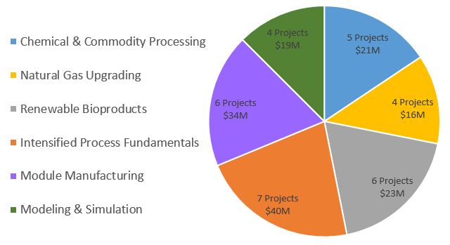
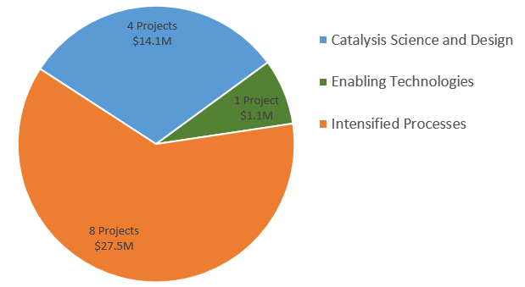
PI/Chemical Manufacturing Current Portfolio
RAPID Institute
Expected total of investment >$165M, $70M DOE funding
32 projects across 6 Focus Areas:
Chemical Manufacturing R&D Projects
Current investment >$42.68M, $35.17M DOE funding
13 projects across 3 Focus Areas:
AMO invested over $105M in this area through its R&D Projects and consortia pillars
>$207M grand total investments including non federal cost share

Slide 9
PI/Chemical Manufacturing Prospective/near term Portfolio
FY20 Funding Opportunity: Chemical Manufacturing
Advanced Chemical Manufacturing R&D - $7M
Dynamic Catalyst Science with Data Analysis - $5M
RAPID 2019 (4th) RFP
Based on an assessment of RAPID’s available funds and current portfolio, RAPID conducted their 4th call for proposals. In the solicitation, areas of interest were highlighted based on feedback from several workshops conducted earlier in the year.
5 new projects were selected and are being added to the award.
RAPID projects spending $4M on these projects.
RAPID is in its 4th year as an institute, so these projects are 12-15 months long.
Related EERE Initiatives
FY20: Plastics Innovation Challenge - to accelerate innovations in energy-efficient plastics recycling technologies
BOTTLE - Bio-Optimized Technologies to Keep Thermoplastics out of Landfills and the Environment Funding Opportunity Announcement
Notes:
Talk about the near term approach for AMO

Slide 10
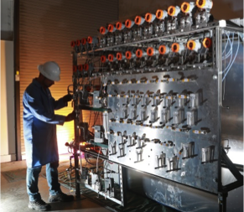
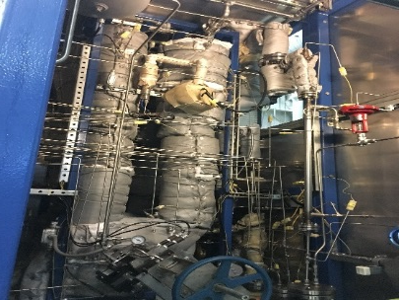
PI/Chemical Manufacturing Accomplishments & Successes
Integrated Hydrogen Combustion with Energy Efficient Ethylene Production
PI: EcoCatalytic
Partners: Dow and Southwest Research Institute
Sept 2018 – August 2020
Developing oxygen transfer agents (OTAs) to convert ethane to ethylene via the selective combustion of hydrogen in the presence of hydrocarbon feed and products.
Rational Design Platform for Transition Metal Catalyzed Electrochemical Synthesis
PI: Lawrence Livermore NL
Partners: Opus 12, TOTAL
May 2018 – Sept 2020
Improve the energy efficiency, selectivity, and scale-up potential of Cu-based catalysts for electrochemical CO₂-to-fuel conversion by engineering the potential energy landscape
Accomplishments
Improved the energy efficiency of CO₂ to ethylene yield by more than 15%
Both Opus 12 and TOTAL have agreed to further support the development of the dilute alloy catalyst technology established in this project.
Submitted TCF Proposal to further scale e-beam catalyst layer deposition technology for commercialization
Cu alloy catalyst developed with e-beam catalyst layer deposition
Demonstrated at Pilot Scale:
Energy Savings of 46% - 58%
80% fewer CO2 emissions
Nearly 100% NOx Reductions
Pilot Unit for EcoCatalytic’s new ethylene production process

Slide 11
PI/Chemical Manufacturing Accomplishments & Successes
RAPID’s key accomplishments
In 4th year of their 5 year award.
Working on developing and testing their sustainability plan with some success:
Worked with a company to develop a PI education program for interns and staff.
Received DOD funding to manage a team of researchers working on modular waste utilization.
32 active projects:
26 are on track to develop technology with an energy efficiency increase of >20%
10 are on track to double energy productivity compared to baseline technology
18 are developing technology with 10x reduction in capitol cost, 20% improved energy efficiency, and 20% lower emissions/waste.
11 are reducing the manufacturing cost of PI modules by >20%
7 will reduce the cost of deploying modular PI technology by >50%
2 projects have developed technology that is moving into commercialization, including:
Transitioning a batch to continuous process that improves energy efficiency by >40%, reduced capacity cost by 80% and lowered emissions by >50%.
Modular steam methane reforming for which PI innovations developed through RAPID will reduce module cost by >85%.
Notes:
Recent accomplishments/successes (if available/relevant, high level; 1-2 slides)
Include impacts to extent available (IPA, TAP metrics, IAC metrics, etc.)
Can also mention supporting analytical work (completed or in-progress)

Slide 12
RAPID Institute Success Metrics
Institute Deliverable | Progress | Outlook
1. Technology - Energy Efficiency | 26 projects beginning in 2020 that have potential to meet this metric | Positive
2. Technology - Energy Productivity | 12 projects beginning in 2020 that have potential to meet this metric | Positive
3. Technology - Intensified Process Modules | 18 projects beginning in 2020 that have potential to meet this metric | Positive
4. Technology - Cost-Effective Module Manufacturing | 8 projects beginning in 2020 that have potential to meet this metric | Positive
5. Technology - Potential for Cost Effective Deployment | 6 projects beginning in 2020 that have potential to meet this metric | Positive
6. Technology - R&D Portfolio | 11 projects beginning in 2020 that have potential to meet this metric | Positive
7. Build Industrial Partnership and Ecosystem | 38 member companies, 37 of 37 contracted projects with joint industry/academic participation | Positive
8. Self-Sustainment | Annual dues to exceed $0.6M. Executing on financial sustainability plan | Positive
9. Train the Trainers | Faculty training workshop Fall 2018 & 2019. Face-to-face short courses took place at Oregon State and Univ. of Arizona. Teaching resource page live on RAPID website for faculty. AIChE Design Prob. | Positive
10. Educate Students | 17 webinars hosted in 2018 and 2019 with 4,845 registrations to-date. Two eLearning courses launched with 874 registrations to date. Highly successfully student intern program annualized for 2019 (targeting 30 students in 2020). | Positive
11. Annual Planning Process | Well-defined process for updating strategic and operating plans and ensuring strong engagement with members and market. | Positive
12. Industrial Roadmap | Constantly refining roadmap to include industry-relevant areas, added emergency focus area in early 2020 to address COVID-19 response. | Positive
13. Emerging Supply Chain | Engaging equipment suppliers and engineering, procurement, & construction firms to enable the module manufacturing supply chain | Addressing
14. Diversity | Continuing to work with MEP network to identify minority- and women-owned businesses and small/medium-sized firms as member prospects. | Addressing
Notes:
All the projects in RAPID connect to 1 or more of the above 14 metrics and they have projects that asses the impacts/progress at the project level against these metrics (for more in-dept description of metrics, see “RAPID Institute Metrics” back up slide
Analogy: what we do with IPA at AMO, RAPID is doing with their metrics project within RAPID

Slide 13
AMO Technical Topic Team
Thanks to the PI/Chemical Manufacturing Team:
Melissa Klembara, Technology Manager
Kate Peretti, Technology Manager
G. Jeremy Leong, Technology Manager
Theresa Miller, Senior Technical Staff
John Winkel, Technical Project Officer
Gibson Asuquo, Technical Project Officer
Debbie Schultheis, Technical Project Officer
Lexie Kim, Program Specialist
Paul Kingham, Program Specialist
Chad Sapp, Project Engineer
Colleen Lipps, Project Engineer
Dickson Ozokwelu, Technology Manager (former)
THANK YOU!

Slide 14
Additional slides

Slide 15
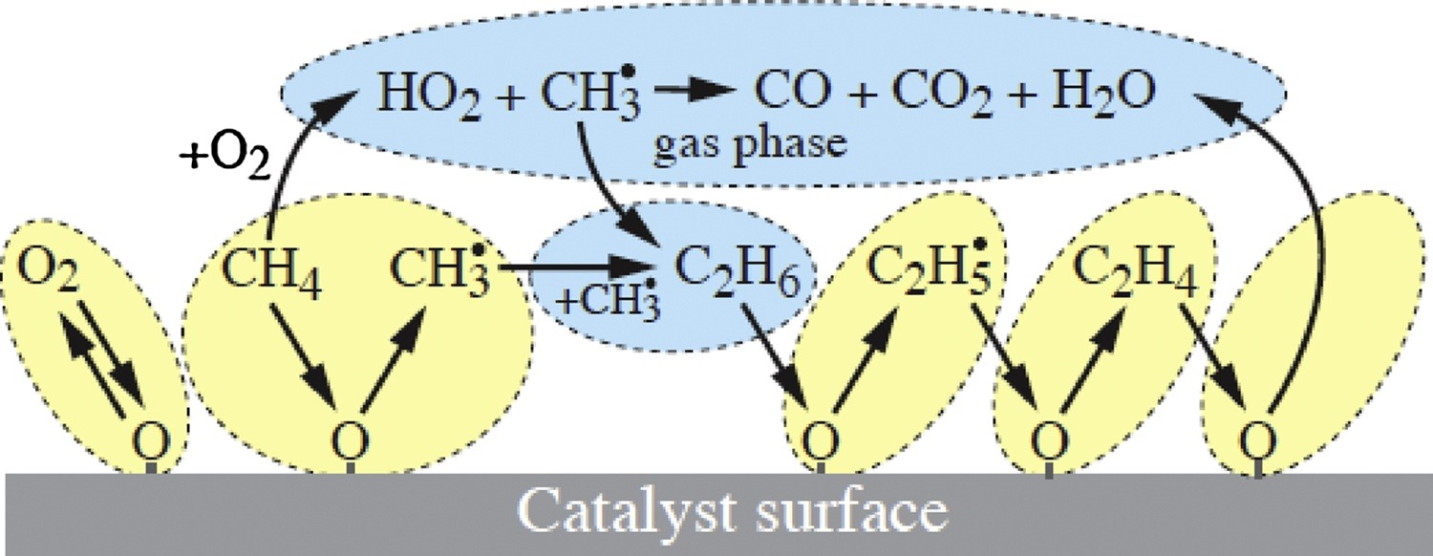
PI/Chemical Manufacturing Key Concepts/Thrusts, continued
New Thrust: Dynamic Catalyst Science: Employing advanced tools to understand complex industrial catalysts by using temperature, concentration, or pressure transients to perturb the state of a chemical system
Satisfy intent of FY18 and FY20 Congressional Language
Stakeholder Workshop in February 2020 organized to identify R&D needs which informed the FY20 MT FOA
Supports an overall effort to develop a comprehensive catalyst knowledge set that will enable design and development of more effective catalysts

Slide 16
RAPID Institute Metrics
Technical Approach
1. Energy Efficiency: Demonstrate MCPI with >20% energy efficiency / 1st-of-kind pilot demo within 5 years. Demonstrate an order of magnitude improvement in energy productivity in 1 or more processes within 10 years.
2. Energy Productivity: Demonstrate a doubling of energy productivity by a combination of capital ($/kg per day) and operating cost related to improved feedstock and fuel efficiencies.
3. Individual Process Modules: Demonstrate 1,000 pilot hours in 1 or more processes with 10x reduced capacity cost ($/kg per day), 20% improvement in energy efficiency and 20% lower emissions/waste relative to commercial state-of-the-art.
4. Cost-Effective Module Manufacturing: Demonstrate technologies to scale-out module manufacturing that reduce by over 20% cost/unit, with each doubling in module manufacturing production.
5. Potential for Cost Effective Deployment: Develop tools to reduce the cost of deploying MCPI in existing processes by 50% in 5 years. Be on pathway for installed & operating cost parity for MCPI at full scale in one or more applications.
6. R&D Portfolio: Establish a portfolio of enabling technologies for next generation PI with quantitative goals
7. Build Industrial Partnership and Eco-System: Demonstrate potential for industry adoption of MCPI.
8. Self-Sustainment: Establish a portfolio of external support that directly replaces the initial Federal funding of $14 million/yr, starting in Year 6.
9. Train the Trainers: Train at least 50 professionals per year in MCPI by year 3.
10. Educate Students: Train at least 500 students per year in MCPI by year 3.
11. Annual Planning Process: Develop an annual planning process & funding - how new ideas & partners will be included, and how changes to plan will align with roadmaps and enable partnerships with other Fed agencies.
12. Industrial Roadmap: Develop a roadmap for MCPI that is updated annually, using a process that engages key stakeholders, including Institute members and subject matter experts
13. Emerging Supply Chain: Document the existence of the domestic supply chain for MCPI. Assess its health annually and document Institute capabilities supporting the supply chain.
14. Diversity: Demonstrate participation of SME’s, MOBs, WOBs in technology development, workforce development and Institute governance.

Slide 17
Chemical Manufacturing Key Thrusts
Current and Future R&D Funding Areas to Address Opportunity Space and Satisfy DOE/EERE Initiatives and Congressional Direction
Catalysis Science and Design
Develop understanding of the catalytic mechanism in order to design catalysts or catalytic systems that will produce great technical advances in the science of catalysis or great benefits in energy efficiency in specific applications.
Intensified Processes
Combine reaction and separation steps to lower pressures and/or lower temperatures
Develop modular processes allowing for chemical conversion chemistry at locality-specific resources, like natural gas wellheads.
Develop efficient modular electrochemical processes for use with renewable energy sources
Enabling Technologies
Incorporate innovative tools or capabilities to accelerate process development cycles
Analysis of large amounts of data through AI/ML to quickly discover new layers of chemical information
Notes:
Vision for current or future comprehensive program to address the opportunity space
Program pitches/thrusts (current or potential; as appropriate – e.g. Flexible CHP, atomically precise manufacturing; preferably 1 slide each)
For consortia – explain at high level (more details can be provided as appropriate under portfolio and activities slides)
Don’t go into details on FY20 MT FOA topics (whether open or not); OK to mention a Congressionally directed FY20 activity in the space

Slide 18
Chemical Manufacturing Current Portfolio
FY18 Lab Call: Topic 4: Process Intensification
6 Awards totaling $19.7M
Satisfy FY18 Direction: Provides $5,000,000 for transient kinetic analysis for scaling of industrial processes and developing new catalysis programs for industrial applications.
Focused in three areas:
Catalysis Design & Development – 2 projects
Advanced Catalysis for Industrial Applications – 3 projects
Hybrid/Integrated Reaction–Separation Processes – 1 project
Emerging Research Explorations Funding Opportunity
6 Awards totaling $8.95M
Focused in
Novel Materials for New Highly Effective Chemical Catalysts – 2 projects
Approaches to Cost-Effective Hydrogen Use in Manufacturing Processes – 2 projects
Process Heating Methods – 1 project
Open Source Tools for Energy Efficiency in Manufacturing – 1 project
Notes:
Combine this slide with #10 and move to backup slides

