Slide 1
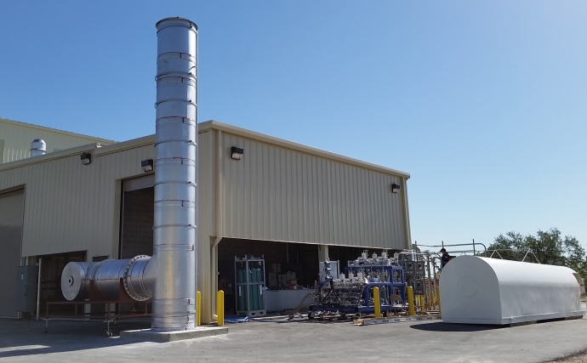
Modifications to Solar Titan-130 Combustion Systems for Efficient, High Turndown Operation DE-EE0008415 SwRI, Solar Turbines, EPRI, UC Irvine, Georgia Tech October 2019 – December 2021
PI: Jacob Delimont, Ph.D.
Southwest Research Institute
Email: Jacob.Delimont@swri.org
Phone: (210) 522-2726
U.S. DOE Advanced Manufacturing Office Program Review Meeting
Washington, D.C.
May 11, 2020
This presentation does not contain any proprietary, confidential, or otherwise restricted information.

Slide 2
Project Overview: Modifications to Solar Titan-130 Combustion Systems for Efficient, High Turndown Operation
Timeline:
Project Start (Contingent Award): 10/01/2018
Full Award: 1/18/2019
Budget Period End Date: 12/31/2019
Project End Date: 4/30/2021
AMO MYPP Connection:
Small to medium Combined Heat and Power (CHP) Systems operating in grid support can improve grid response to changes in non-dispatchable renewable energy sources.
Barriers and Challenges:
Current gas turbine combustors require reduced air flow to stably operate at part load
Air diversion or bleed creates inefficiencies in gas turbine operation
Goal of this project is to design combustion systems capable of operating in low NOx mode, at low part load, while maintaining high overall gas turbine efficiency
Project Budget and Costs:
Project Team and Roles:
Southwest Research Institute
Prime recipient, project management
Conceptual design of high turn down combustion system
Combustion testing
Solar Turbines
Conceptual design of high turn down combustion system
Supply of combustion hardware
EPRI
Grid integration, connectivity, and benefits study
UC – Irvine
Conceptual design of high turn down combustion system
Georgia Tech
Combustion dynamics
Budget | DOE Share | Cost Share | Total | Cost Share %
Overall Budget | $1,218,785 | $315,751 | $1,534,536 | 20.58%
BP 1 | $477,062 | $123,187 | $600,249 | 20.52%
BP 2 | $415,698 | $108,918 | $524,616 | 20.76%
BP 3 | $326,024 | $83,646 | $409,670 | 20.42%
Costs as of 5/1/19 | $37,220 | $0 | $37,220 | 0.00%

Slide 3
Project Objectives
Increase market penetration of small/medium sized CHP systems for grid support
Currently, to operate at very low loads current Solar Turbines combustion system must either:
Operate with high emissions (not allowed by regulation)
Sacrifice overall gas turbine efficiency
Current project seeks to develop a combustion system capable of allowing high gas turbine efficiency over a wide range of loads while maintaining emissions compliance

Slide 4
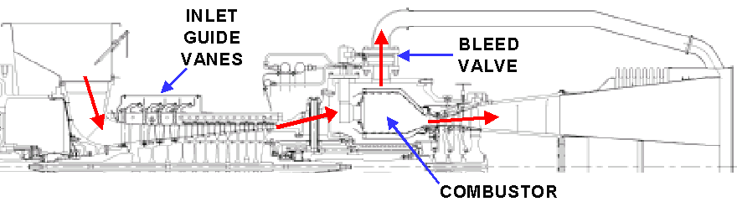
Current High Turn Down Operation
During high turn down operation (greater than 50%) the combustion becomes too lean and unstable
To combat this, air flow through the combustor is reduced by using inlet guide vanes or compressor bleed
Both of these solutions cause significant efficiency penalties
How can we increase lean operating range, while maintaining acceptable emissions?

Slide 5
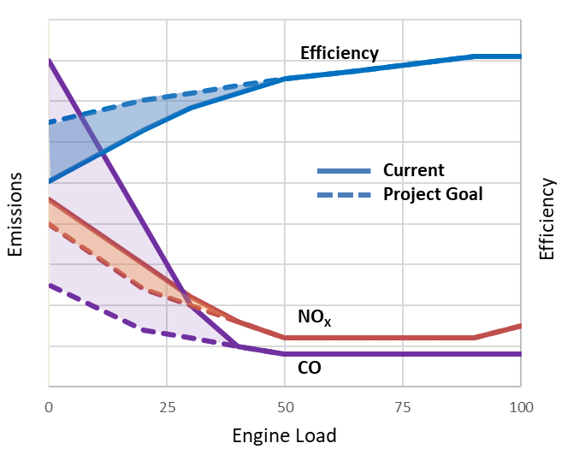
Project Goals
Improve overall gas turbine performance by increasing combustor performance at low loads
Decreasing compressor bleed and IGV use
Reduce CO and UHC emissions
The increased efficiency will decrease cost to operate small scale CHP gas turbines
Current
Project Goal
NO_{X}
CO

Slide 6
Management and Milestones
Project duration 39 months
Currently in BP2, which is scheduled to be completed in Dec. 2020
Written quarterly reports and monthly status update teleconference meetings
BP2 FY2020 Milestones
Completion of High Pressure Facility Rig Modifications | In progress, completion Aug. 2020
Commissioning of High Pressure Rig | On-track
Completion of High Pressure Rig Test Campaign | On-track
Completion of Design of New High Turndown Combustion System | In progress, completion Nov. 2020

Slide 7
Development of a Combustion System for Efficient Part Load Operation
Efficiency improvements to the gas turbine by improved combustor performance will pursue two lines in inquiry
What can be done to improve part load performance of the current system?
What level of performance can be achieved with a new combustion system?
Concept Selection (SwRI, Solar, UCI)
Detailed Design (Solar)
Validation testing (SwRI, Solar, GT)
Benefits study (EPRI, Solar, UCI)

Slide 8

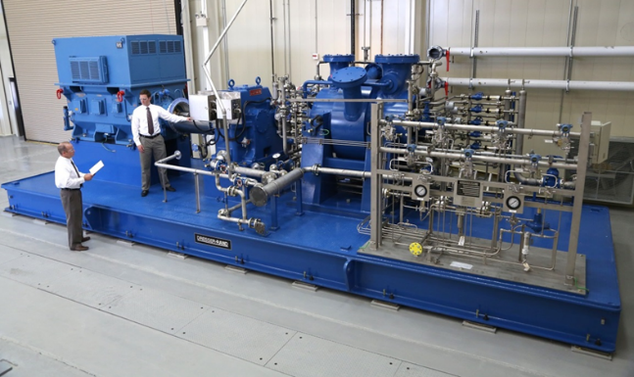
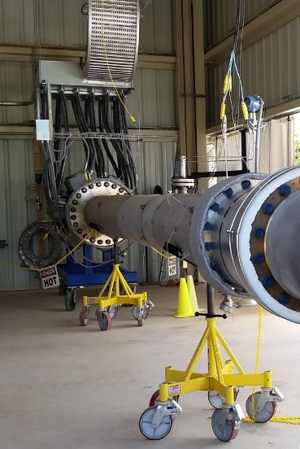
Combustion Testing at SwRI
Testing varied: load percent, hydrogen content, pilot flow, ambient temperature
Results showed up to ~30% improvement in lean blow off performance with the addition of hydrogen to the fuel mixture

Slide 9
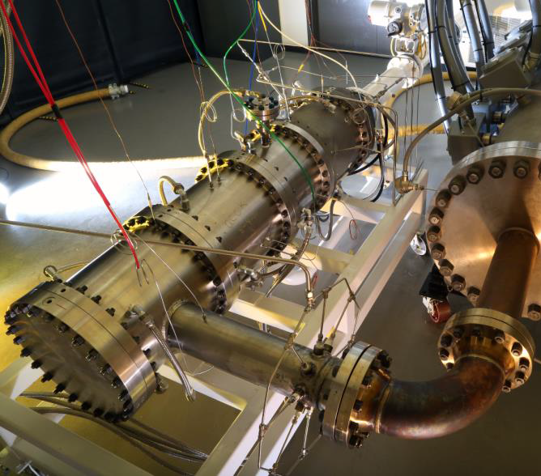
Current Project State
Atmospheric test campaign completed
Modifications to test facility at SwRI to support high pressure testing begun
2020 – Commissioning of high pressure rig, complete design of new combustion system
2021 – Testing of new combustor system in high pressure rig

Slide 10
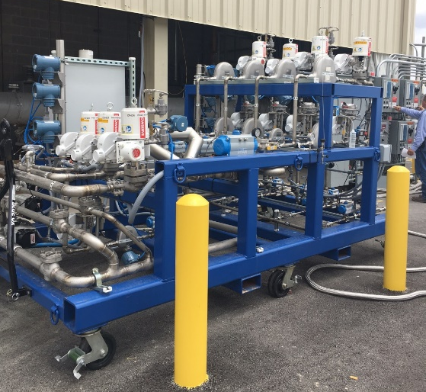
Questions?

