Slide 1
Simulation-Based Design and Optimization of Waste Heat Recovery Systems WBS 2.1.0.80 (NREL) and WBS 2.1.0.81 (LBNL) National Renewable Energy Laboratory Lawrence Berkeley National Laboratory 10/1/2018 – 9/30/2021
Nicholas Long – NREL Co-PI
Michael Wetter – LBNL Co-PI
U.S. DOE Advanced Manufacturing Office Virtual Program Review
June 2-3, 2020
This presentation does not contain any proprietary, confidential, or otherwise restricted information.

Slide 2
Overview
Project Title:
Simulation-Based Design and Optimization of Waste Heat Recovery Systems
Project Budget and Costs:
Budget | DOE Share | Cost Share | Total | Cost Share %
Overall Budget | $3,000,000 | $250,000 | $3,250,000 | 8%
Approved Budget (BP-1&2) | $3,000,000 | $250,000 | $3,250,000 | 8%
Costs as of 3/31/20 | $787,113 | $25,000 | $812,113 | 3%
Timeline:
Project Start Date: 01/01/2019
Budget Period End Date: 09/30/2021
Project End Date: 09/30/2021
Barriers and Challenges:
District energy systems are underutilized because integrated design tools do not exist to quantify their value proposition
Waste heat energy sources are not evaluated in connection to potential end users, namely buildings
Project Team and Roles:
Nicholas Long, NREL, Co-PI, Project Management, Software Architecture and Building Modeling
Amy Allen, NREL, District System Optimization Methods
Michael Wetter, LBNL, Co-PI, Dynamic Modeling and Simulation, 5th Generation DHC Systems
Antoine Gautier, LBNL, Technical Lead, 4th Generation DHC Systems
Wangda Zuo, University of Colorado – Boulder, 1st and 2nd Generation DHC Systems
Katy Hinkelman, University of Colorado – Boulder, Modelica Modeling
Valentin Gavan, ENGIE Lab CRIGEN, Industry Feedback
AMO MYPP Connection:
3.1.12 Waste Heat Recovery Systems
Lack of end use for waste heat
Low temperature waste heat
3.1.13 Combined Heat and Power (CHP) Systems

Slide 3
Project Objective(s)
Problem
Most unrecovered industrial waste heat (~60%) is at low temperatures (< 450°F / 232°C), with often no viable end use within the facility
Temperature of heat source and sink has a critical impact on
Efficiency of heat engines and heat pumps
Heat exchanger sizing and material requirements (corrosion with condensation)
Overall economics of the waste heat recovery process
Opportunities
Grow the demand for low temperature waste heat recovery by connecting industrial facilities with district heating systems
Leverage large-scale seasonal energy storage of low-quality heat at the district level
Objective: create a modular simulation tool for district energy systems, able to
Represent a variety of energy conversion processes, including combined heat and power systems
Represent the resulting cascading temperature levels
Support the design of fifth generation district heating and cooling systems with ambient water loop and geothermal energy storage
Run coupled simulation of the entire energy system: from the heat recovery processes, to the building loads
Quantify unrealized value for the waste heat producer (industrial process) and cost savings to the waste heat consumer (building in a district)

Slide 4
Technical Innovation
Conventional simulation frameworks
Are siloed between
Building energy modeling
District hydronic distribution modeling
Plant and energy conversion process modeling
Control sequence modeling
And cannot
Co-simulate buildings, district, and waste heat sources
Properly represent system controls, temperature, and pressure transients
Evaluate heat recovery potential both at the building and at the district level (energy quality is not considered consistently over the whole energy system)
Consequences
It takes several weeks of PhD labor to build a full-scale co-simulation model
Most developments are evaluated based on rules of thumb and spreadsheets
New simulation tool requirements
Unified modeling framework, from the plant to the load
Supporting simulation of fast pressure and control transients (hydronic analysis)
Open-source, open-standard and modular (seamless integration of new models)
With advanced templating for streamlined modeling of complex energy systems
And a comprehensive library of system models for waste heat recovery

Slide 5
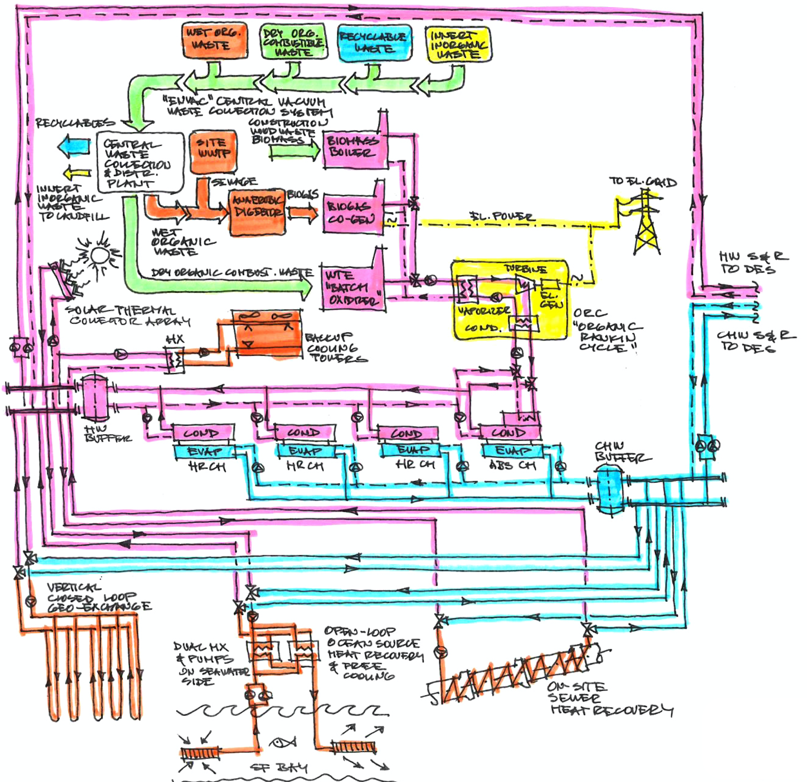
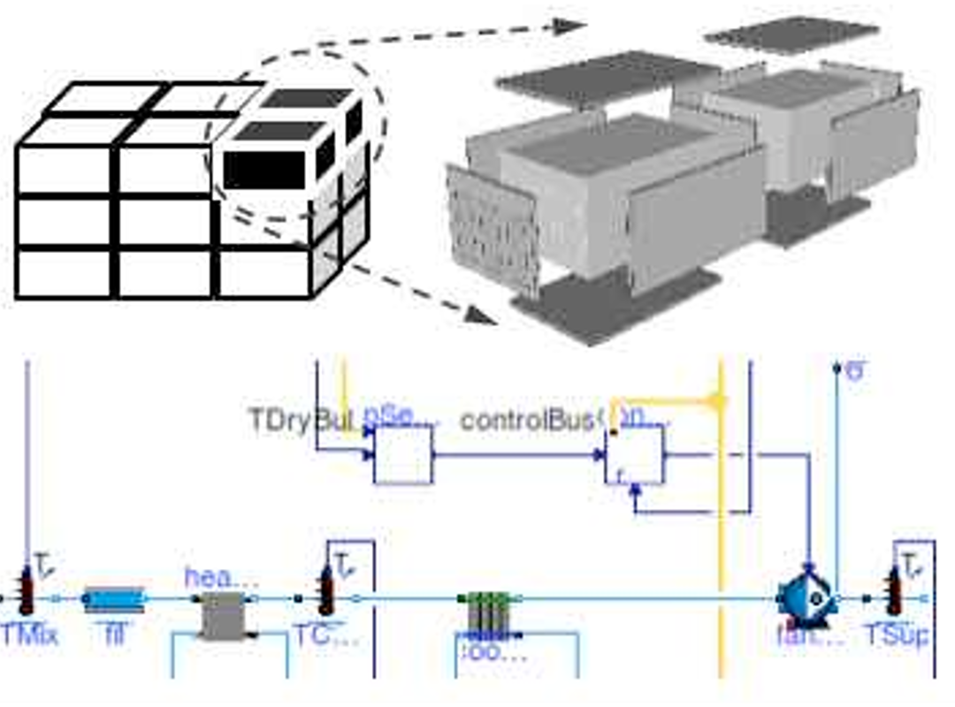
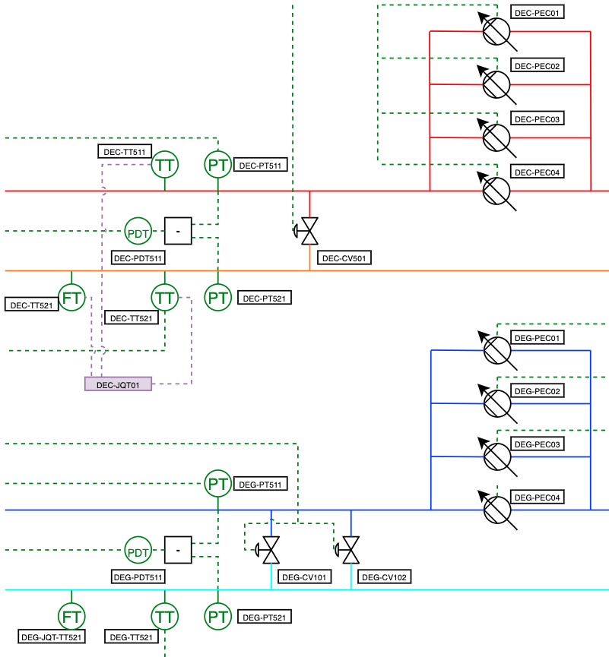
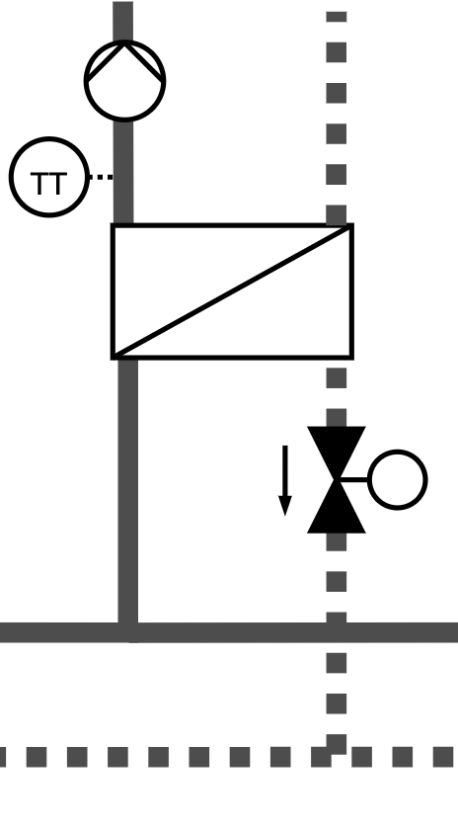
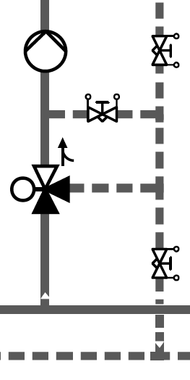
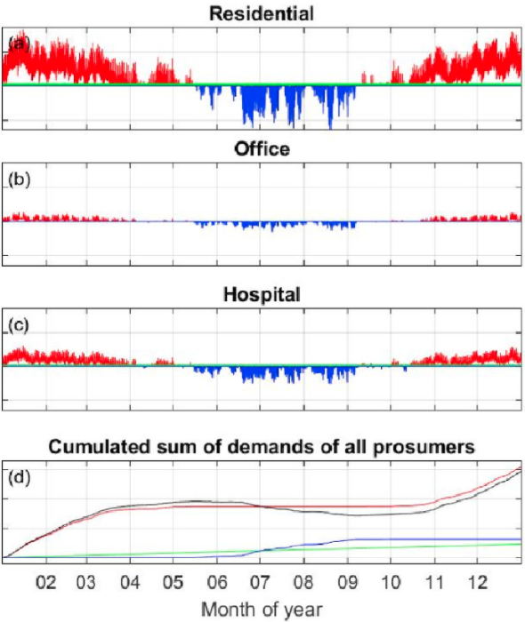
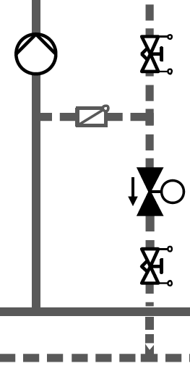
Technical Innovation
Courtesy of Integral Group – Hunters Point Eco-District
Courtesy of Engie – Thassalia DHC Distribution System
Plant / energy conversion process modeling
Waste heat recovery from high exergy manufacturing process
Through low exergy heating / chilled water production
To ultra-low exergy seasonal energy storage
Hydronic distribution modeling
Library of typical hydronic layouts and controls for central distribution and consumer interconnection
Precise representation of pressure, flow rate and temperature variation with the load
Building and HVAC modeling
Allow for reusing models authored by the design team, or authoring project specific models, or using time series from meter data or regression models
Realistic control sequence representation for all applications

Slide 6
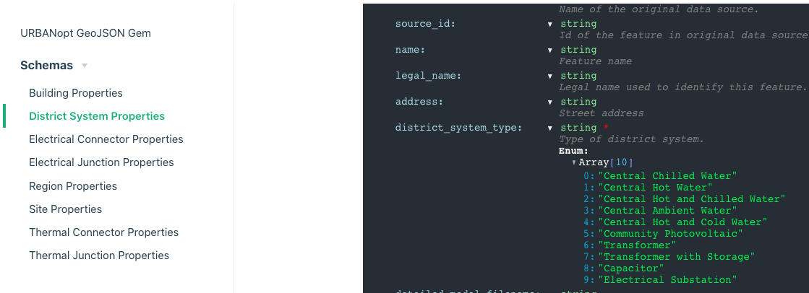
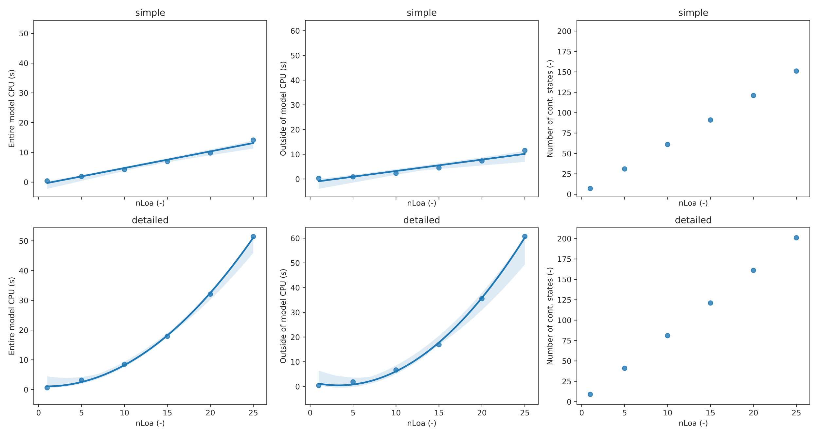
Technical Approach
Modelica as a foundational standard
Open, industry-driven standard for multi-physics & controls, equation-based modeling
Leverage key DOE investments
Spawn of EnergyPlus
Modelica Buildings Library
Existing URBANopt platform
Schema-based configuration files to interface with third-party graphical user interface
Challenges
Modularity
Reconfiguration of complex thermo-fluid models and control sequences, with a limited number of high-level parameters
Scalability
Number of iterations typically scales cubic in the number of state variables for implicit differential equation solvers, tailored modeling approaches are devised for linear scaling of CPU time

Slide 7
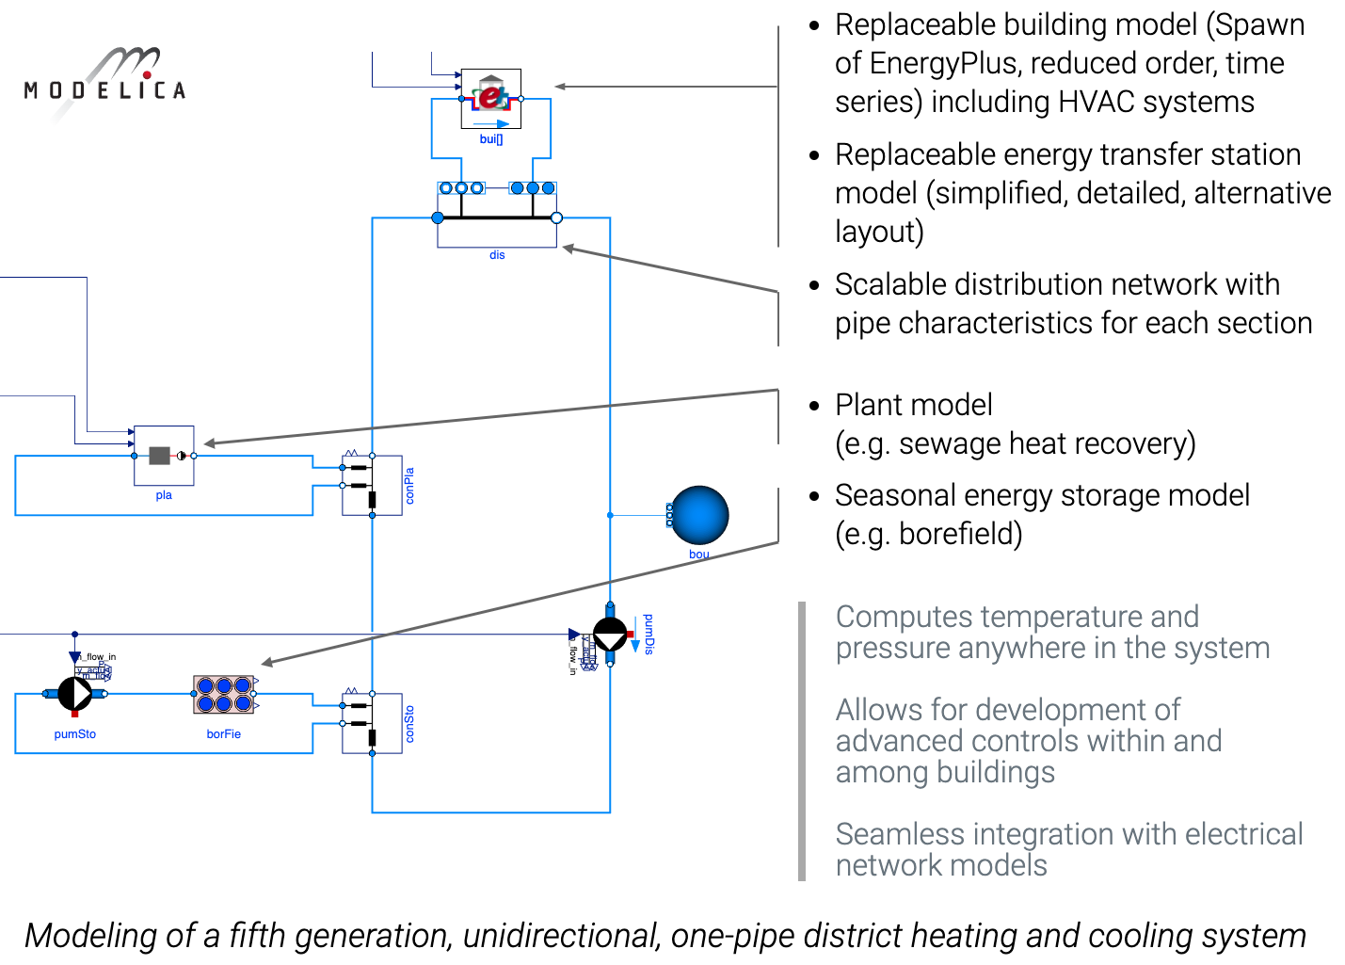
Technical Approach

Slide 8
Results and Accomplishments (1 slide max)
Milestone/Tasks | Status
Milestone Building Importer (6/30/19) – Designed Application Programming Interface (API) to export building models and to import them into Modelica. API designed, implemented and tested for 3 types of building models: time series, reduced order models (leverages TEASER development from IBPSA Project 1), Spawn of EnergyPlus models. | Achieved
Milestone Component Models (1/15/20) – Implemented at least three models models for waste heat utilization, and integrated them into continuous integration testing. Development of direct cooling energy transfer station (ETS) with in-building pumping, direct cooling without in-building pumping, and a cooling tower for district energy central plants. | Achieved
Milestone Component Models (1/31/20) – Implemented at least one model for waste heat utilization, and integrated them into continuous integration testing. Release of models for: combined heat and power systems based on internal combustion engines or Stirling engines (“topping cycles”), absorption chillers with steam as heat source, and water-source reversible heat pumps. We further planned the development of a model for combined heat and power systems based on Rankine cycle (“bottoming cycle”) for applications in low grade heat recovery. | Achieved
Milestone URBANopt with Modelica Engine and New Component Models (3/31/2020) – Integrate a Modelica simulation engine into URBANopt with ability to perform an analysis similar to the existing EnergyPlus workflow. Modelica component models for waste heat recovery devices have been committed to the Project’s GitHub repository. GeoJSON to Modelica Translator was released in alpha with basic ability to create building load models and ETS systems connected to an infinite source district system. Released new steam medium models for Modelica. | Achieved
Milestone Energy Transfer Station Models (3/31/20) - Implemented at least two template models for common Energy Transfer Stations (ETS) and integrated them into continuous integration testing. The development of a generic ETS model for fifth generation district systems is being finalized. The development of a generic ETS model for fourth generation district systems is planned next. | Partially achieved
Milestone Complete District System Model (6/30/20) – Components from previous milestones are assembled into a complete district system model. This should be considered a preparation step for upcoming case study, and the resulting be committed to a public or private GitHub repository. | In Progress
NREL Milestone Alpha version of URBANopt Modelica Edition is released (9/30/20) - All of the previous milestones are aggregated into an alpha version of URBANopt for Modelica. Software shall be made available on the project website and documentation will be published to carry out a basic workflow. | In Progress

Slide 9
Transition
Ladybug Tools

