Slide 1
Demonstration of Improved CHP Systems utilizing Improved Gas Turbine and sCO2 Cycles Using Additive Manufacturing (AM) DE-EE0008413 Siemens/Oak Ridge National Laboratory Oct 1st 2018 – Sept 30th 2021
Anand Kulkarni, Siemens Corporation
U.S. DOE Advanced Manufacturing Office Virtual Program Review
Washington, D.C.
June 2nd-3rd 2020
This presentation does not contain any proprietary, confidential, or otherwise restricted information.

Slide 2
Overview
Project Title: Demonstration of Improved CHP Systems utilizing Improved Gas Turbine and sCO2 Cycles Using Additive Manufacturing (AM)
Project Budget and Costs:
Timeline:
Project Start Date: 10/01/2018
Budget Period End Date: 4/30/2020
Project End Date: 09/30/2021
Budget | DOE Share | Cost Share | Total | Cost Share %
Overall Budget | $1,125,000 | $375,000 | $1,500,000 | 25.0%
Approved Budget | $1,125,000 | $375,000 | $1,500,000 | 25.0%
Costs as of 4/30/20 | $264,520 | $86,099 | $350,619 | 32.5%
Barriers and Challenges:
Integration of the different technologies so that operating conditions and system component sizing is optimized for waste heat recovery
Identification of cost-effective materials for the primary heat exchanger that do not degrade prematurely in high- moisture exhaust gas at 550°C
Design for a secondary heat exchanger that can tolerate sCO2 on one side and saturated steam on the other
Project Team and Roles:
AMO MYPP Connection:
A CHP system consisting of a high- efficiency gas turbine and sCO2 bottoming cycle will be suitable for many small and mid-size manufacturing facilities with both electrical and thermal loads. The increased gas turbine cycle efficiency will improve the business case for the installation of such CHP systems in the 5-10 MW size range.
Flexible CHP systems that can provide grid services are expected to be financially attractive investments in markets with high penetration of intermittent renewable resources, such as California, Texas, and several Midwestern states.

Slide 3
Project Objective(s)
Strongly support AMO’s initiative to conduct research and development activities to further the utilization of cost-effective, highly efficient combined heat and power (CHP).
Target - Electricity generation component of a 1‐20 MWe CHP system - Gas turbine based CHP system must be able to operate at a fuel to electricity generation efficiency of 25% and must demonstrate a total CHP efficiency of 85% at 50% rated electrical capacity.
A supercritical CO2 bottoming cycle will meet this requirement due to the size of its turbomachinery and demonstrated factory assembled design, however the cost of heat exchanger needs to be addressed.
The project seeks to enable a new type of a flexible CHP system by adding a supercritical carbon dioxide (sCO2) bottoming cycle and a steam injection system to an existing 5.3 megawatt (MW) gas turbine to increase its peak electrical efficiency to 50% and maintaining 30% electrical efficiency at 50% of load.

Slide 4
Technical Innovation
The new CHP system configuration will use an existing 5.3 MW aero-derivative gas turbine as its starting point. It is a proven turbine with capability for fast cold-starts, fast ramping up and down, and multiple starts and shutdowns per day.
The turbine currently has an electrical efficiency of 32% at rated power, but with additional steam injection this efficiency can be increased to approximately 37%. Incorporating a sCO2 bottoming cycle will increase total electrical efficiency to around 50%. Special emphasis will be placed on thermo-economic optimization of the cycle, to ensure commercial viability and marketability of the developed system.

Slide 5
Technical Innovation
To inject additional steam into the turbine, a new fuel nozzle and manifold variant will be designed, built, and tested. Additive manufacturing approaches, which allow intricate designs not feasible with conventional manufacturing technologies, will be utilized to build the modified nozzle.
A major focus of the project will be the development and demonstration of novel heat exchangers. To achieve project goals, a new heat exchanger design is needed for the primary cycle between the gas turbine and the sCO2 system as well as the secondary cycle between the sCO2 and process steam systems. The new advanced heat exchanger designs need to be optimized for low pressure drops, have the ability to withstand multiple cycles at high temperature and pressure, include integrated control systems, and be cost effective.

Slide 6
Technical Approach
Different combined GT, sCO2 and TAT system configurations possible
Goal is to maximize electrical output from waste heat with reasonable quality left for TAT
GT waste heat must also generate the steam injected into GT
Mass flow and temperature of waste heat required for GT efficiency improvement must balance with meaningful benefits from downstream devices
Siemens and Oak Ridge National laboratory (ORNL) have unique Infrastructure and Expertise for detailed thermodynamic simulation of cyber-physical
systems for optimization of cost/performance for desired targets

Slide 7
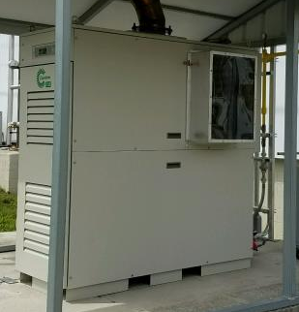
Technical Approach
ORNL/Capstone 65kw Microturbine Testing Facility
Steam Injection Planned at Pilot Manifold (after starting) for Potential Emissions Improvement
Microstructure and mechanical properties of the AM HX materials
Exposure in ORNL SCO2 rigs at 400°C-600°C and 200-300 bars for duration up to 2,000h to compare Determination of AM HX lifetime and ORNL lifetime model in SCO2
Hardware/Software Changes Needed:
Steam manifold
Valves for fuel shutoff and steam manifold switch
injected into combustion liner through pilot ports
Control system for fuel and steam valves
Integrated/Synergistic approach for technology advancements

Slide 8
Steam Injection from Pilot Manifold
Steam Injection Planned at Pilot Manifold (after starting) for Potential Emissions Improvement
Pilot Fuel/Steam Manifold
Main Fuel Manifold
Pilot Fuel/Steam Injection Ports
Main Fuel Injection (Nat. Gas)
Main Fuel/Air Premix Chamber

Slide 9
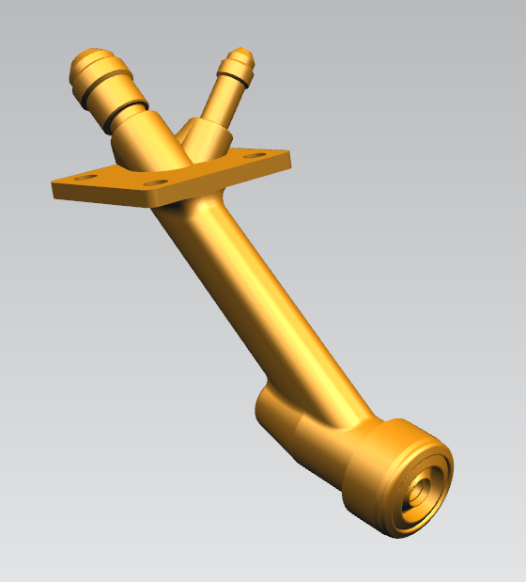
Original Proposal for Steam Manifold
Original Proposal – Inject steam through the DLE pilot fuel circuit
Challenges:
Maintain lean combustion without affecting flashback requires a dome redesign.
DLE fuel manifold is bulky and there is no room to accommodate a steam manifold and maintain emissions guarantee
Control system rework is required and a new fuel schedule has to be developed
Updated Proposal – Move to Gas/Water style combustion system.
Design challenges are greatly reduced
Steam manifold design exists and no DLE fuel manifold is required
Diffusion flame combustion system is more robust
Emissions at full load would be nearly unaffected

Slide 10
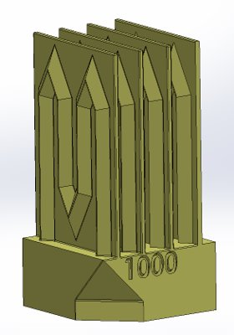
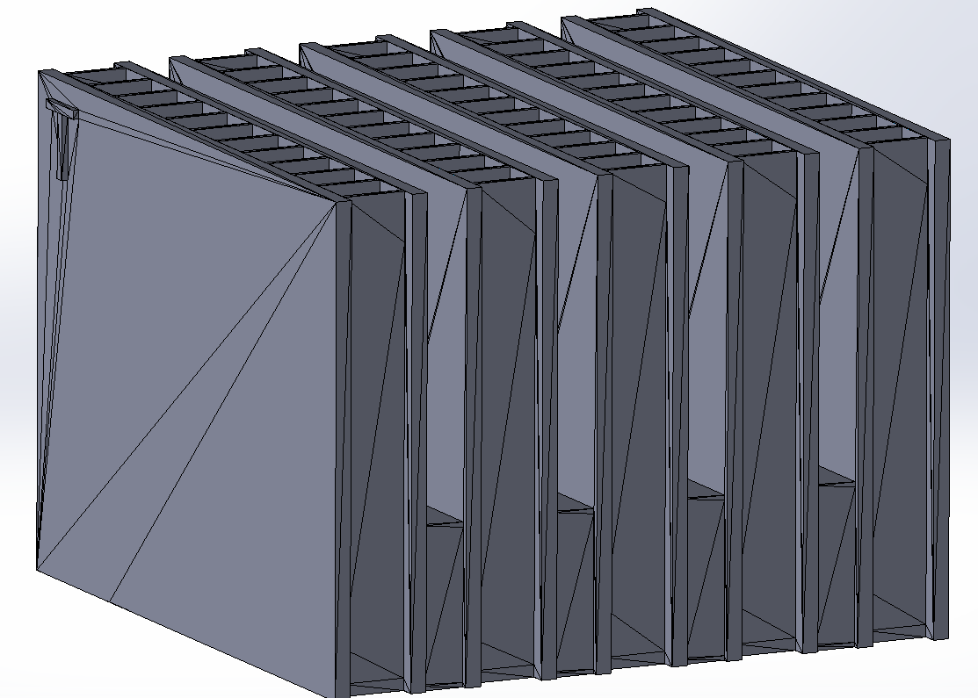
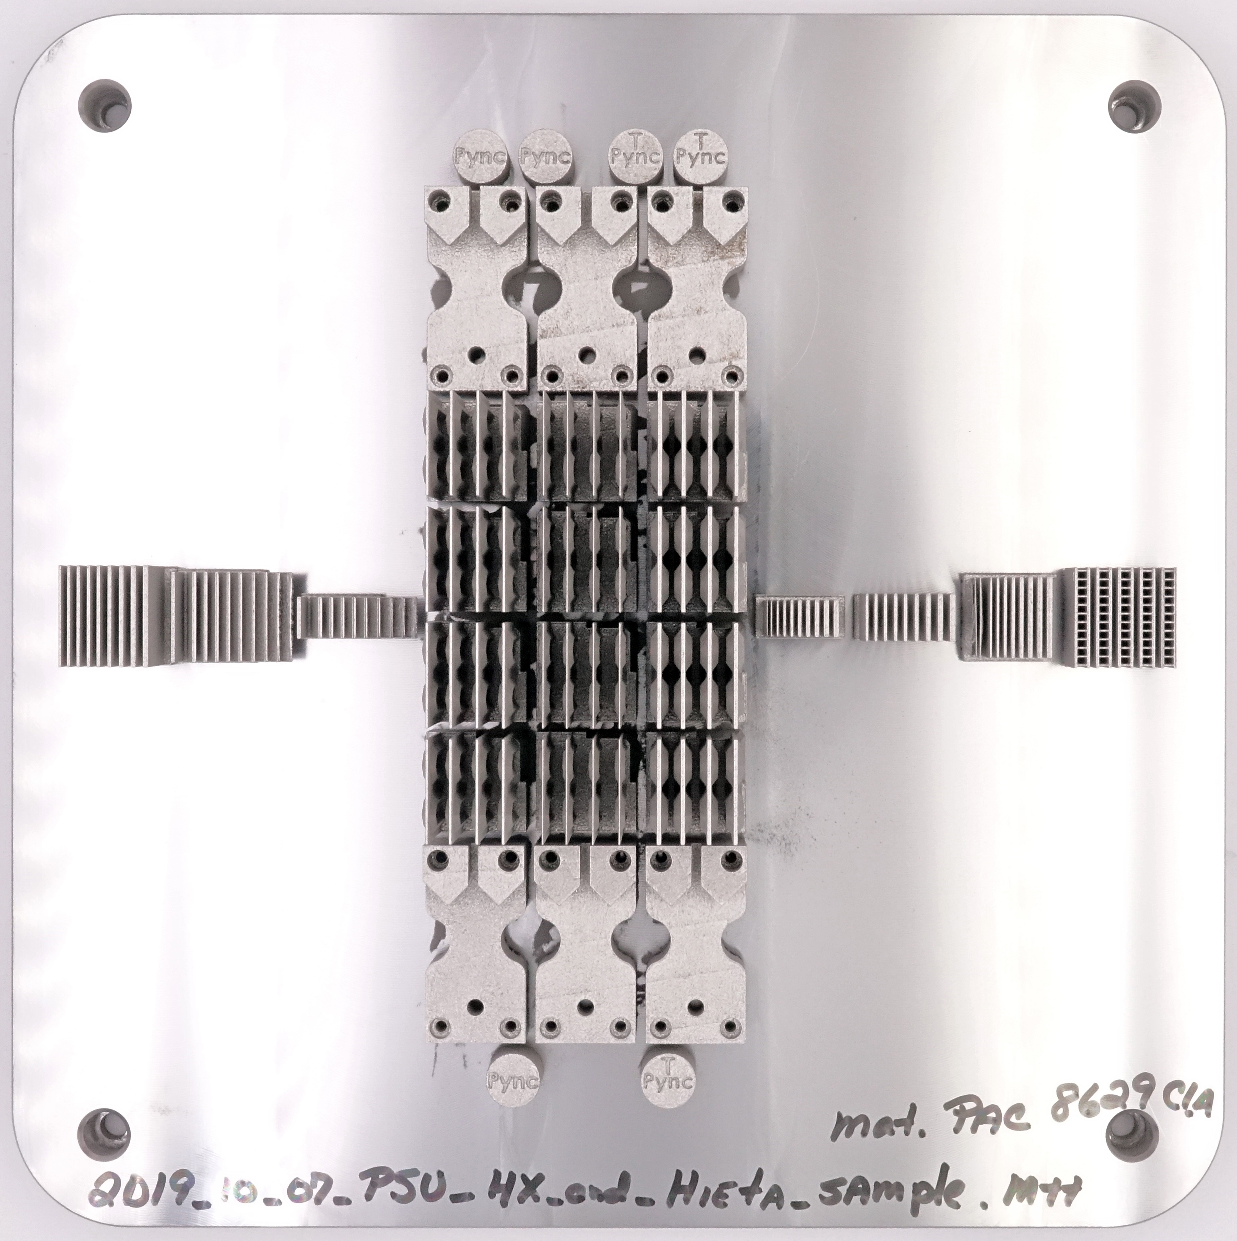
Results and Accomplishments
PSU Heat Exchanger
Label = tube wall thickness (400, 700, 1000 microns)
Hieta Heat Exchanger
20 x 20 x 15mm
Plates 0.5mm thick
Fins 0.2mm thick
Separation 2mm
AM artifacts being evaluated for existing/novel designs to find a good compromise between HX performance, printability and cost

Slide 11
Results and Accomplishments
Completed steady-state analysis of power system components and thermodynamic modeling to identify system designs meeting electrical efficiency goal at rated power and 50% rated power
3 sCO2 system architectures for bottoming cycle and a range of steam injection in the GT cycle have been studied
Rated Efficiency varies between 0.47 and 0.49 based on current technology but will increase beyond 0.5 with further optimization
Electrical efficiency at 50% turndown (total system power) will exceed 35%
Overall CHP efficiency varies between 0.87 to 0.90
Transient modeling framework for system start-up, turn-down and load-following is in progress
Materials/Coatings testing currently underway in sCO2/Combustion environments

Slide 12
Transition (beyond DOE assistance)
The developed CHP system will build on an existing 5.3 MW Siemens gas turbine that has a proven track record of service and more than 1,600 installed units worldwide. Marketing a new, advanced version of an existing gas turbine is expected to be easier than a completely new system design. Besides small and medium-size manufacturing facilities, likely host sites for the developed system include large hotels and apartment complexes, hospitals, and universities.
The Small Engine Business (SEB) division in Siemens Energy, located in Indianapolis, has expressed interest in developing and demonstrating new technologies for these advanced hybrid cycles in CHP mode. The whole engine design/engineering team is intricately involved in the project and are in discussions with a customer for on-site engine testing at the end of the project.

Slide 13
Questions?

