Slide 1
High Speed Medium Voltage CHP System with Advanced Grid Support
DE-EE0008409
Clemson University and TECO Westinghouse Motor Company
October 1, 2018 to March 31, 2022
J. Curtiss Fox, PhD – Clemson University
U.S. DOE Advanced Manufacturing Office Virtual Program Review Meeting
June 2-3, 2020
This presentation does not contain any proprietary, confidential, or otherwise restricted information.

Slide 2


Overview Slide
Timeline
Partners
Award issued: October 2018
Scheduled end date: June 2021
Projected end date: March 2022
Project Progress: 30%
Budget
 | FY 19-20 Costs | FY 21 Costs | FY 22 Costs | Total Planned Funding
DOE Funded | $627k | $422k | $449k | $1,499,368
Project Cost Share | $391k | $399k | $18k | $809,859
Barriers
Acceptance of wide bandgap semiconductors in medium-voltage utility class power electronics
Demonstration of megawatt scale medium voltage, power electronics coupled CHP system
Development of a control system able to meet grid connected and islanded operational standards
Achieving cost projections and market penetration
AMO MYPP Connection
Combined Heat and Power Systems
Wide Bandgap Semiconductors for Power Electronics
Advanced Manufacturing to Enable Modernization of Electric Power Systems

Slide 3
Project Objective(s)
The primary goal of this project is to be in a position to develop a medium voltage commercial grid-tied system with advanced grid support functions validated against UL 1741 SA
Enable a TR6 demonstration of the 1MW, 500Hz, 1500RPM high frequency CHP generator and electric machine system, utilizing advanced grid support functions required by IEEE Std. 1547-2018 and UL 1741SA .
The demonstration system developed during this project will:
  Validate the grid-tied SiC enabled high frequency CHP generator converter.
  Implement and validate the system replicating the gas turbine dynamics and high speed generator-tied converter.
  Demonstrate island mode transitions and resynchronization for reconnection with the power grid with the fully coupled system prototype setup.
Demonstration System Specifications
Generator Voltage | 4.16 kV
Power Rating | 1 MW
Operating Speed Range | 11,000 – 15,000 RPM
Grid Voltage | 480 V – 13.8 kV
Enabling Technology | WBG SiC MOSFET
Microgrid Controller | Compliant with IEEE Std. 2030.7
Interconnection and Interoperability | Compliant with IEEE Std. 1547
Installed Cost Target | < $1,800/KW rated power

Slide 4
Technical Innovation
Manufacturing plant microgrid solution for increased resiliency
  Scalable architecture for applications in the power range of 1 – 20 MW
  IEC 61850 GOOSE messaging for real-time communication in the plant
  Medium voltage, multi-megawatt power electronic converter certified for DER
  High speed dynamic control for medium voltage induction generators in direct gas turbine shaft coupled systems
Simplified block diagram of the
Control function enabled through high frequency variable speed drive
    The multi-level topology of the drive results in ultra-high effective power electronic switching frequencies
    High effective switching frequencies enables bandwidth to respond to fast dynamic events on the grid and generator
Schematic and actual system installation of a 1 – 2 MW SCHB archtecture

Slide 5
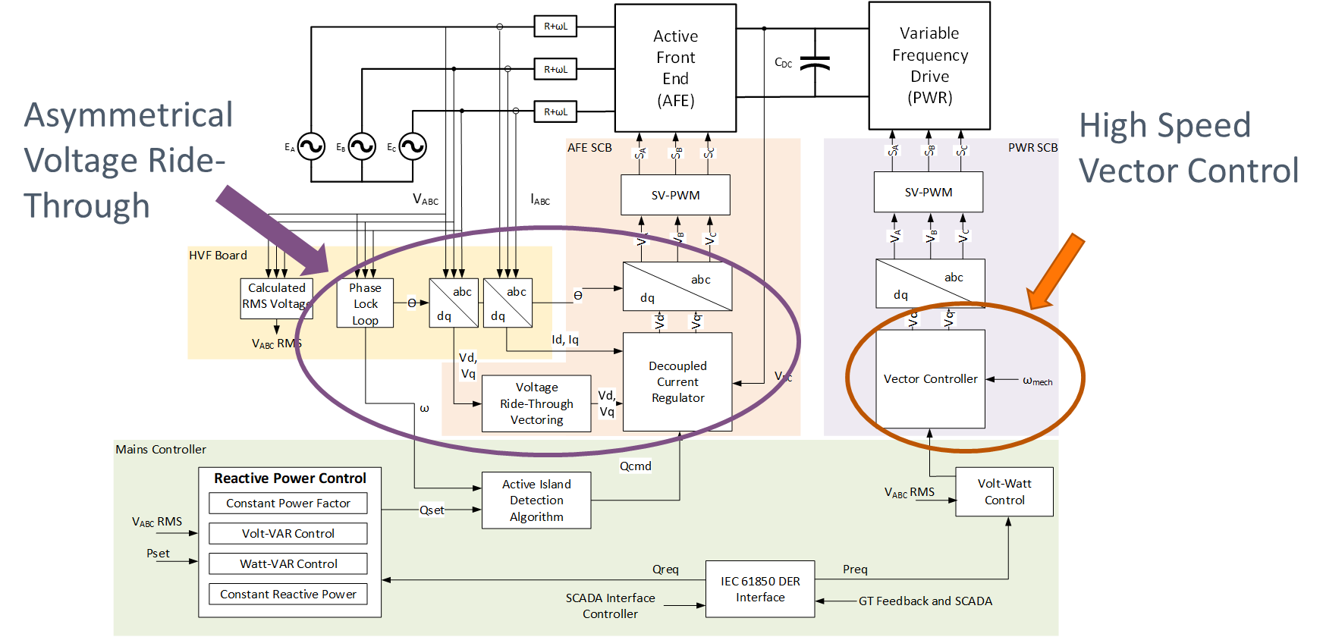
Technical Approach
SCADA Interface Controller – IEC 61850
  Utility interface and Microgrid EMS
System Grid Tied IEEE 1547 Classification
  Implemented system will follow Local EPS 3 configuration
  Classification of resource would be Category B with respect to clause 5 with abnormal operating voltage performance as per Category III
Machine Side Controller Dynamics
  High speed vector control to manage the safe operating area during load changes
Task | Description
1 | Integration of Power Electronics Coupled CHP in Advanced Manufacturing Plants
2 | Development of Advanced Grid Support Functions
3 | Hardware Validation of Advanced Grid Support Functions
4 | Development of Machine Controls for High Speed Gas Turbine Dynamics
5 | Hardware Validation of the Coupled Gas Turbine and High Speed Generator Dynamics
6 | Simulation and Controller Hardware-In-the-Loop Validation of the Fully Coupled System
7 | Power Hardware-In-the-Loop Testing of the Fully Coupled System
System Prototype Validation and Verification
  Real-time modeling of the Area EPS, plant, grid-side converter, machine-side converter, induction generator, and gas turbine
  Controller Hardware-In-the-Loop includes IEC 61850 IEDs, SCADA Interface Controller and representative grid-side control hardware
  Power Hardware-In-the-Loop includes full scale demonstration at the Clemson eGRID Center
Block diagram illustrating functions and capabilities to meet IEEE Std. 1547 and UL 1741

Slide 6
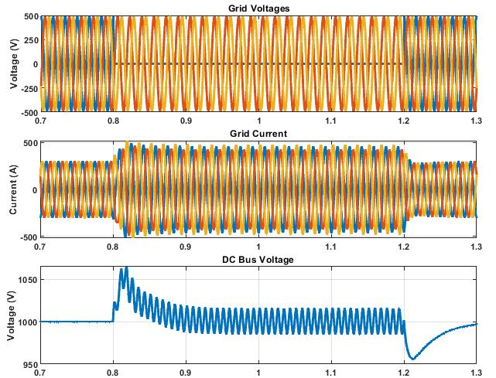
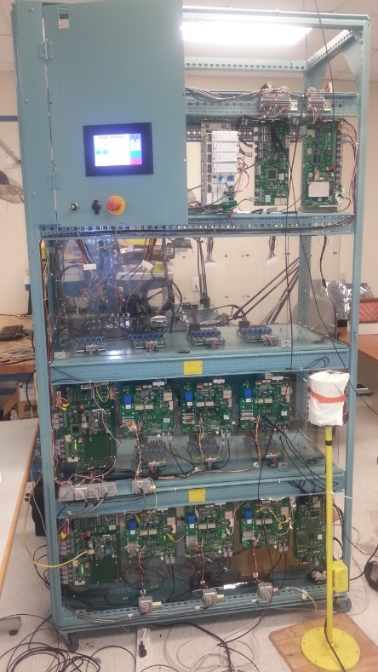
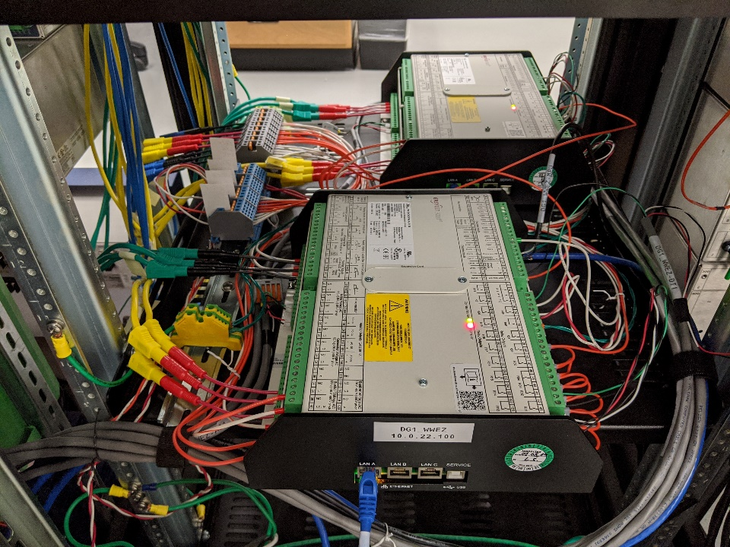
Results and Accomplishments
Results to date
  Integration of Power Electronics Coupled CHP in Advanced Manufacturing Plants
    Completed multi-resource integration in the microgrid IEC 61850 architecture
    Use cases developed for manufacturing plant islanded CHP operations
  Development of Advanced Grid Support Functions
    Integrated advanced phase-lock loop for frequency ride-through
    Developed advanced current regulators for asymmetrical voltage ride-through
  Development of Machine Controls for High Speed Gas Turbine
    Validation of high-speed vector control for generator power regulation
Performance of asymmetrical voltage PLL and Decoupled Current Regulators for IEEE 1547
Controller Hardware-In-the-Loop for microgrid development and high-speed generator control

Slide 7
Transition (beyond DOE assistance)
In discussions with stakeholders and potential customers
  Stakeholders include both end users and turbine OEMs
  Completing final technical proposals on two prototype systems for the technology
  Larger range of applications than initially anticipated: ORC heat recovery and compressed-air energy storage and generation
  Expanding microgrid controller capabilities to incorporate existing and future DER
Certification of the system
  Extending the UL certification of the motor drive for grid support requirements in distributed generation applications (IEEE 1547)
  Leveraging Clemson’s eGRID in development of a pre-certification test plan that will meet the requirements of UL 1741 and IEEE 1547

