Slide 1
Combined Heat and Power Technical Assistance Partnerships (CHP TAPs) Eight Contracts issued under DE-FOA-0001678 Center for Sustainable Energy, Houston Advanced Research Center, North Carolina State University, PACE University, Pennsylvania State University, University of Illinois/Chicago, University of Maine, Washington State University FY2018-FY2023
Dr. Robert Gemmer, Technology Manager, DOE AMO
Patti Garland, CHP TAP Coordinator, Contractor
U.S. DOE Advanced Manufacturing Office Program Review Meeting
Washington, D.C.
June 2-3, 2020
This presentation does not contain any proprietary, confidential, or otherwise restricted information.

Slide 2
Overview
Project Title: Combined Heat and Power Technical Assistance Partnerships (CHP TAPs)
Timeline:
Project Start Date: Q4FY2018
Budget Period End Date: 7/31/2019
Project End Date: 7/31/2023
Project Budget* and Costs:
Budget | DOE Share | Cost Share | Total | Cost Share %
Overall Budget | $24,998,700 | $2,235,196 | $27,233,896 | 9%
Approved Budget (BP1 + BP2)) | $9,917,685 | $880,883 | $10,798,568 | 9%
Costs as of 3/31/19 | $6,737,653 | $1,394,532 | $8,132,185 | 21%
Barriers and Challenges:
Delays in obligating project funds created disruptions in operations
Economic and Financial, Regulatory, and Informational barriers as outlined in Section 3.1.13 of the AMO MYPP and the DOE Barriers to Industrial Energy Efficiency Report.
*Awards made via competitive procurement DE-FOA-0001678
Project Team and Region:
University of Maine: New England
PACE University: New York-New Jersey
Pennsylvania State University: Mid-Atlantic
North Carolina State University: Southeast
University of Illinois/Chicago: Midwest & Central
Houston Advanced Research Center: Southcentral & Upper-West
Center for Sustainable Energy: Western
Washington State University: Northwest
AMO MYPP Connection:
Target 13.1 - Achieve a ten-fold cumulative increase in direct CHP technical support activities to potential commercial, institutional, and industrial end-users
Target 13.2 - Advance the development of cost-effective CHP systems that are responsive to site demands as well as grid requirements
Target 13.4 - Support a 20% reduction in installed cost of commercially available, packaged (<10 MW) CHP systems (while maintaining >75% system efficiency at HHV)

Slide 3
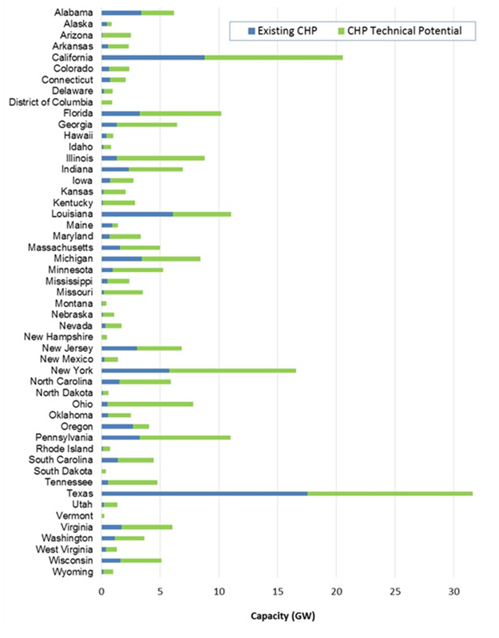
Project Objective(s)
Problem Statement: CHP remains an underutilized resource today due to economic and financial, regulatory, and informational barriers as outlined in the DOE Barriers to Industrial Energy Efficiency report.*
Project Objective: To maximize CHP exposure to potential end-users and key stakeholders, and to locally promote best practices in CHP technology policies and installation.
Support for AMO Goals:
If one quarter of CHP technical potential were met, the U.S. would save 1 quadrillion BTUs (Quad) of energy and would save energy users $10 Billion a year compared to current energy use.
CHP supports the transition to a strong, prosperous America powered by resilient, clean, domestic, affordable and secure energy.
CHP Technical Potential by State
Source: US DOE Technical Potential Report
*www.energy.gov/eere/amo/downloads/barriers-industrial-energy-efficiency-report-congress-june-2015

Slide 4
Technical Innovation
Current Practice and Limitations: Prior CHP TAP Program focused on one-on-one end-user technical assistance and feasibility analyses.
Innovation:
Transition focus of technical assistance from feasibility studies to screenings so that a larger number of end-users can be assisted
Building strategic long-term end-user partnerships to educate high-technical-potential market groups on CHP benefits for their application
Building strategic long-term stakeholder partnerships with cities, states, and utilities to encourage use of CHP
Develop resources to address growing markets for CHP such as hybrid CHP-renewable systems, critical infrastructure, and opportunity fuels.
Multipliers:
TAP TA though portfolio analysis and/or partnerships
Partnering with Better Plants Partners and IACs on CHP TAP TA
Policy changes that impact value proposition of CHP (standby rates, interconnection, inclusion of CHP in state/local energy plans)
TAP education efforts are multiplied when strategic partners carry the CHP message to their connections

Slide 5
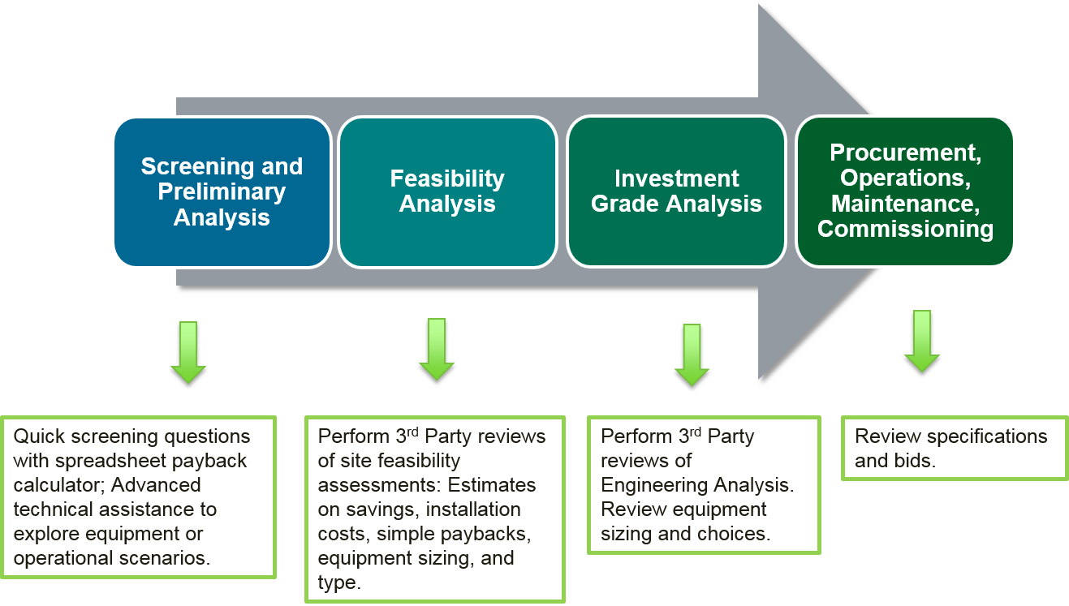
Approach
Ten CHP TAPs are comprised of regional CHP experts who provide fact based, unbiased information on CHP, including technologies, project development, project financing, local electric and natural gas utility interfaces, and related state/local best practice policies. They are vendor, fuel, and technology neutral.
CHP TAP Role for
Technical Assistance:
End-User & Stakeholder Engagements
Workshops
Webinars
One-on-one Meetings
Presentations
Booths at Conferences
Project or Policy/Program Profiles
Education – NOT Advocacy
Technical Services
Screening Technical Assistance
Advanced Technical Assistance
Portfolio Reviews

Slide 6
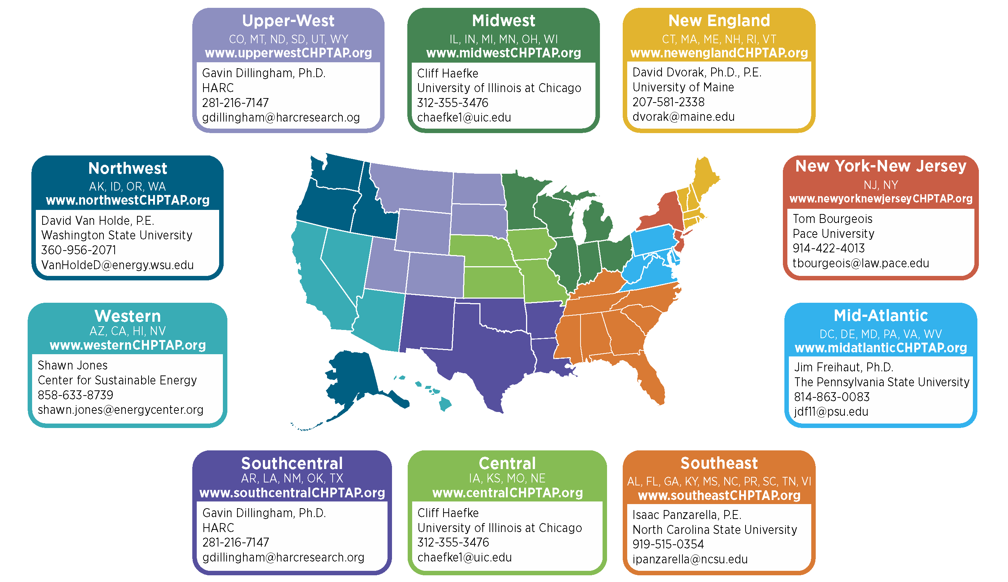
DOE CHP TAP Regions

Slide 7
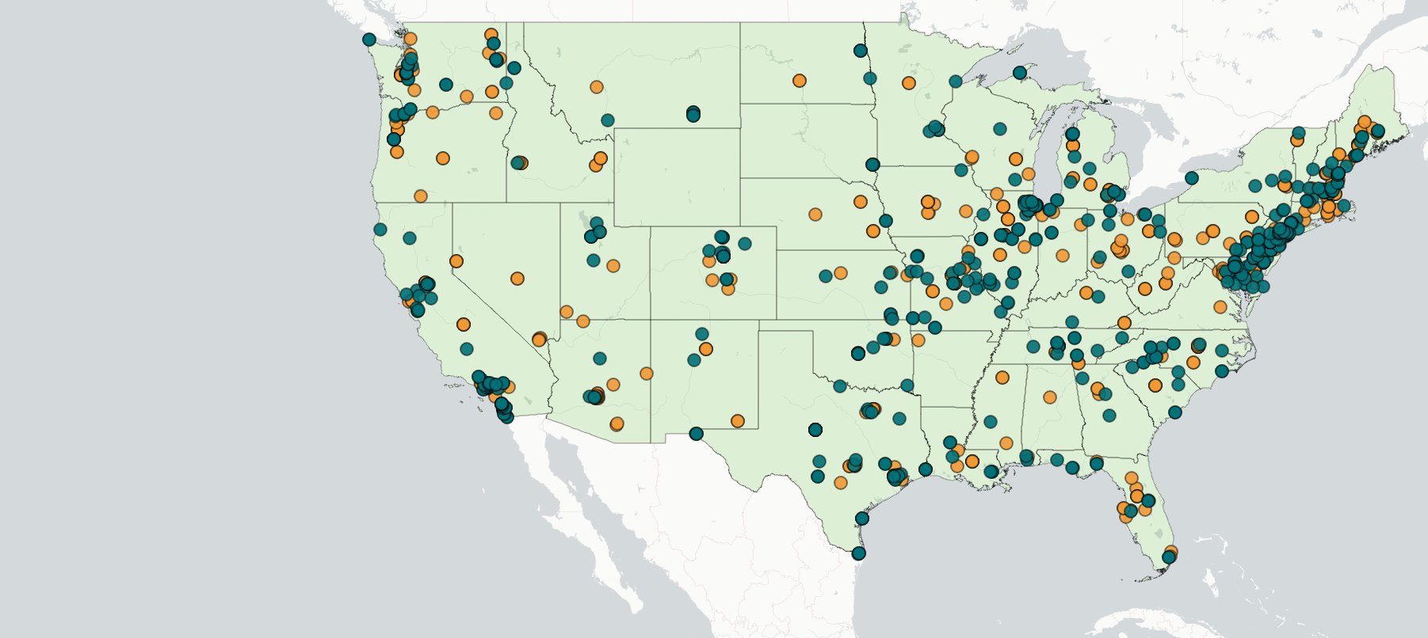

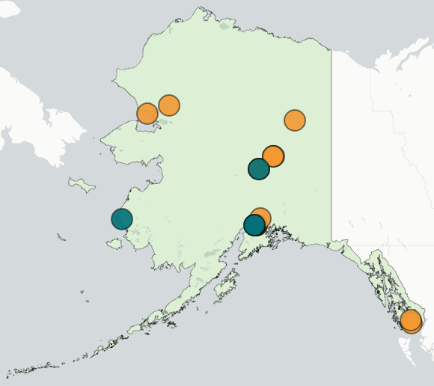
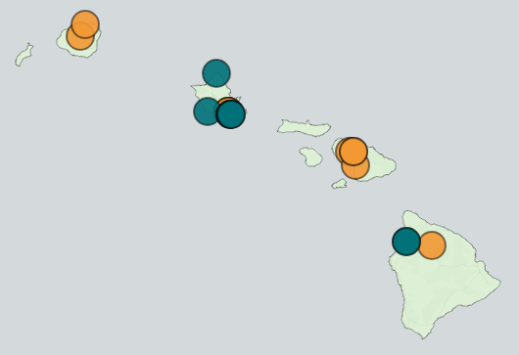
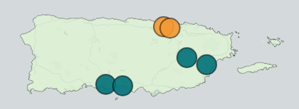
Results and Accomplishments
Through March 2020, at the National Level, the CHP TAPs:
Completed over 502 TA activities with an estimated capacity of ~800 MW
Identified 175 end-user partners and completed 247 engagements
Identified 120 stakeholder partners and completed 165 engagements
Some partner engagements physically occur in a single state and engage representatives from multiple states (e.g. at regional conferences, workshops, etc.). These engagements are reflected once in the map in the state where they occurred, even if they impacted other states. For example, multiple engagements occurred with representatives from Wyoming and South Dakota, although these are not reflected in the map because the engagements occurred outside their states.

Slide 8
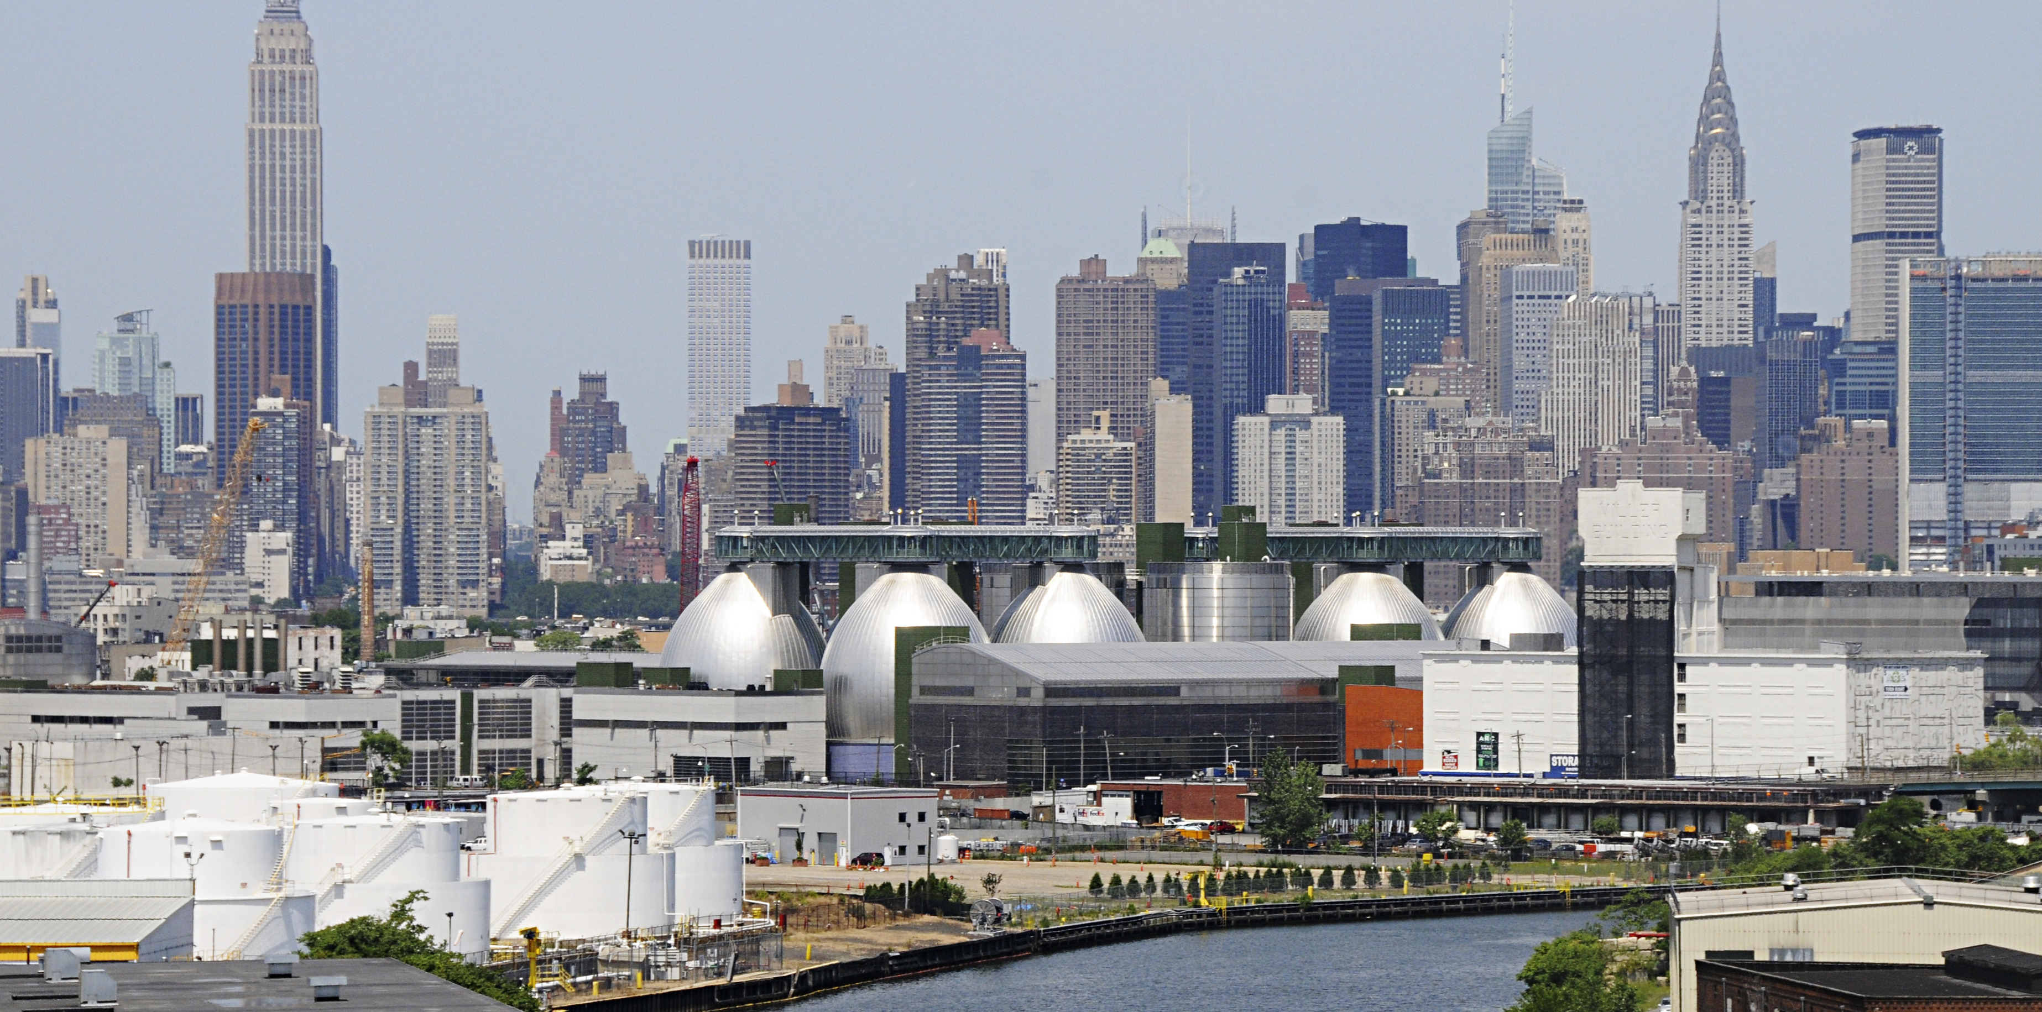


Example Regional Activities: New York-New Jersey CHP TAP Technical Assistance to New York City
NY-NJ CHP TAP completed screenings at 11 WWTPs in New York City
In consultation with NYC, the TAP down-selected to four sites and completed follow-on CHP analysis which yielded potential savings of:
$4,740,000 to $7,480,000 (16% to 26%)
16,449 to 21,216 ton in CO₂ emission reduction (24% to 33%)
New York City’s Wastewater Treatment Plants:
Treat 1.3 billion gallons of wastewater daily
Use over 500 million kWh of electricity, over 1 million MMBtu of fuel and generate over 1.6 million MMBtu of Anaerobic Digester Gas
The system consists of: over 6,000 miles of sewer pipes; 135,000 sewer catch basins; 95 wastewater pumping stations that transport water to 14 wastewater treatment plants located throughout the 5 boroughs.
Next Steps:
Meeting with New York City Mayor’s office of Resiliency & NYC Environmental Protection
Site visits to support CHP project development

Slide 9
Example Regional Activities: New York-New Jersey CHP TAP Partner Engagements and Communications Materials
With partner North East Combined Heat and Power Initiative (NECHPI), the TAP co-hosted several workshops and Webinars including May 5, 2020 webinar on the topic of C-PACE Financing for CHP, including expert panelists from the NY-NJ CHP TAP, CT Green Bank, NYC Energy Efficiency Corporation, and Greenworks Lending
The Webinar recording can be found at: https://pace.zoom.us/rec/share/4pVPNr-37kBLZ6Pm6k7eS4hiAqDCeaa8h3NP-6ZbnhoY5jRRGzDTcOqZg6kAoCjw?startTime=1588696068000
87 Attendees
NY-NJ TAP published 16 profiles to highlight successful CHP Systems and Programs, including:
A 2.4 MW CHP System at Essex and Union Counties WWTP designed for resiliency that operated through Super Storm Sandy and beyond for 5 days: https://chptap.lbl.gov/profile/111/JointMeeting-Project_Profile.pdf
Con Edison Brooklyn-Queens Demand Management (BQDM) Program (New York) - Demonstration of how utilities can use CHP to avoid traditional grid investments and alleviate congestion on the distribution system. https://chptap.lbl.gov/profile/49/ConEdisonBrooklyn-QueensDemandManagement%28BQDM%29Program-profile.pdf
New York CHP Catalog (NYSERDA PON 2568) -This profile describes NYSERDA’s successful catalog model and how it became the basis for the DOE’s national CHP eCatalog.
https://chptap.lbl.gov/profile/166/NewYorkCHPCatalog-profile.pdf

Slide 10
Transition (beyond DOE assistance)
Educate the marketplace to advance CHP adoption:
Advanced benefits of CHP for the grid: flexibility, resilience, distributed energy integration, and reduced environmental impact
Coordination with key Policymakers to:
Streamline interconnection and standby rates
Develop incentive and financing programs that support CHP
Educate key stakeholders on best practices on CHP adoption
Communicate CHP benefits and best practices through:
Project Profiles and snapshots
Policy/Program Profiles
Develop in-field CHP experts to advance CHP Regionally:
Educating regional staff to become CHP experts
Educating electric and gas utilities on how CHP and its benefits can be an advantage for them
Disseminate tools created by the deployment program [ex. eCatalog and Resiliency Guide] that are designed to transform the market and be sustained by partner organizations (ie. Accelerator partners) in the future

