Slide 1
Energy Efficiency and Renewable Energy (EERE)
Advanced Manufacturing Office (AMO)
Technical Partnerships (TP)
Combined Heat and Power Deployment Programs
FY 2019-2020
Robert Gemmer, Ph.D., CHP Technology Manager
U.S. DOE Advanced Manufacturing Office Program Review Meeting
Washington, D.C.
June 2-3, 2020
This presentation does not contain any proprietary, confidential, or otherwise restricted information.

Slide 2
Overview
Timeline:
Project Start Date: 10/01/2019
Budget Period End Date: 09/30/2020
Project End Date: 09/30/2020
Project Budget and Costs:
Budget | DOE Share
Prior-Year Carryover | $3,691,000
FY20 Approved Budget | $2,000,000
Costs as of 3/3/0/2020 | $1,862,000
AMO MYPP Connection:
Target 13.1 - Achieve a ten-fold cumulative increase in direct CHP technical support activities to potential commercial, institutional, and industrial end-users
Target 13.2 - Advance the development of cost-effective CHP systems that are responsive to site demands as well as grid requirements
Target 13.4 - Support a 20% reduction in installed cost of commercially available, packaged (<10 MW) CHP systems (while maintaining >75% system efficiency at HHV)
Project Team:
Lawrence Berkeley National Laboratory
Analytical Energy Solutions
Elberti Engineering
Energetics
Entropy Research
Exergy Partners
ICF International
Kestava Energy Management

Slide 3
Combined Heat & Power (CHP) Deployment Objectives
CHP Deployment Program Objectives
Support the development, validation, and verification of technologies and practices that increase the productivity and competitiveness of American manufacturers and large energy user facilities
  Explore CHP technologies and innovative processes through the wide range of sectors and industries
  Advance the installation of cost‐effective and efficient combined heat and power (CHP) that reduces line losses and strain on the grid infrastructure while also increasing site reliability and energy security
  Advance CHP technologies and deployment
    Accelerate the adoption of CHP through streamlined installation processes
    Increase operating efficiency
    Increased fuel flexibility
    Reduced costs
    Reduced GHG emissions

Slide 4
Combined Power & Heat (CHP) Deployment Barriers
Economic and Financial Regulatory Barriers
  Capital investments in a rapidly changing policy and economic environment
  Recognize the full energy and non-energy value of CHP in utility procurement and resource planning and incentives
Regulatory Barriers
  Inconsistent Interconnection requirements and standards
  Non-transparent standby rates
System Barriers
  Need for improved performance and verification for CHP systems
  Commercially proven and available hybrid CHP-renewable energy systems
  Need for higher-efficiency CHP systems in the 1-5 MW size range
  Expand use of local fuels, including renewable fuels
  Access to pre-packaged CHP solutions with verified performance and experienced vendors

Slide 5
Technical Approach & Accomplishments
CHP Technical Assistance Partnerships (TAPs)
  Deployed expertise assisting in the CHP Deployment Program in the growth of strategies to maximize CHP exposure to potential end‐users and key stakeholders, and to locally promote best practices in CHP technology policies and installation.
Packaged CHP eCatalog and Accelerator
  Objective - Develop web-based catalog (“eCatalog”) of pre-qualified DOE-recognized packaged systems that meet DOE technical specifications provided by vendors with demonstrated resources, warranties, and service capabilities to ensure performance to design; supported by robust state and utility market engagement programs to promote the eCatalog and provide technical assistance to users navigating the project development process.
  Basis - Based on the success of a New York State Research and Development Authority program, a properly designed and promoted national Packaged CHP system platform would reduce perceived risks by both users and vendors and accelerate market acceptance of emerging packaged CHP systems.
  Outcomes – Market based web platform technology to efficiently review CHP system design and performance information, and provide an easy end-user experience and a simple and efficient technical interface with CHP packagers.
Development of CHP Deployment Resources including: tools, analyses and technical materials to support CHP TAP mission; educate state and local policy makers, regulators, end users, trade associations, and CHP stakeholders; and inform DOE Deployment and R&D program planning

Slide 6








Technical Approach: CHP Technical Assistance Partnerships (CHP TAPs) Role: (CHP TAP program covered under separate presentation)
While there is considerable technical potential, CHP remains an underutilized resource today due to various knowledge, economic, and regulatory barriers as outlined in the DOE “Barriers to Industrial Energy Efficiency” June 2015 report.
Unlocking this potential and mitigating market and non-market barriers requires expertise in engineering, communications, and strategic market intelligence, as well as an understanding of federal, state and local regulation and policy diversity.
The regional CHP TAPs provide fact based, unbiased information on CHP, including technologies, project development, project financing, local electric and natural gas utility interfaces, and related state/local best practice policies. They are vendor, fuel, and technology neutral.
Locations of CHP TAPs
Notes:
There are still significant barriers to CHP in the market:
Financial uncertainty
Regulatory uncertainty
Utility uncertainty and attitudes
Utility goal is affordable and reliable power
Generally neutral to negative on CHP
CHP represents a loss of revenue to the utility and can result in the deferral of investment
This often results in unfavorable tariffs, drawn out interconnect and other utility roadblocks to CHP
Even technology uncertainty – not much familiarity with CHP in many of the new market segments
Right now the primary benefits to the user are cost savings and energy security
Difficult decision because of uncertainties – if you as an industrial or institutional manager want to install CHP – you need to become versed in new lines of businesses and skills – power plant operations, energy management – and it means new risks and requires additional management attention
So, what is happening, is that many elect not to proceed even with a strong financial case for CHP

Slide 7
Technical Approach: Packaged CHP System Markets are Growing
Large CHP potential in small/midsized industrials, commercial, institutional, government and military applications
Markets utilize smaller,
packaged CHP systems
(< 10 MW)
Markets have limited
CHP experience
Users have limited
technical resources
History of issues with
system performance
and with CHP sales
and service support
Many perceived risks by both users and suppliers
Non-traditional markets represented 35% of the capacity and 70% of the projects installed since 2008
Notes:
There are still significant barriers to CHP in the market:
Financial uncertainty
Regulatory uncertainty
Utility uncertainty and attitudes
Utility goal is affordable and reliable power
Generally neutral to negative on CHP
CHP represents a loss of revenue to the utility and can result in the deferral of investment
This often results in unfavorable tariffs, drawn out interconnect and other utility roadblocks to CHP
Even technology uncertainty – not much familiarity with CHP in many of the new market segments
Right now the primary benefits to the user are cost savings and energy security
Difficult decision because of uncertainties – if you as an industrial or institutional manager want to install CHP – you need to become versed in new lines of businesses and skills – power plant operations, energy management – and it means new risks and requires additional management attention
So, what is happening, is that many elect not to proceed even with a strong financial case for CHP

Slide 8
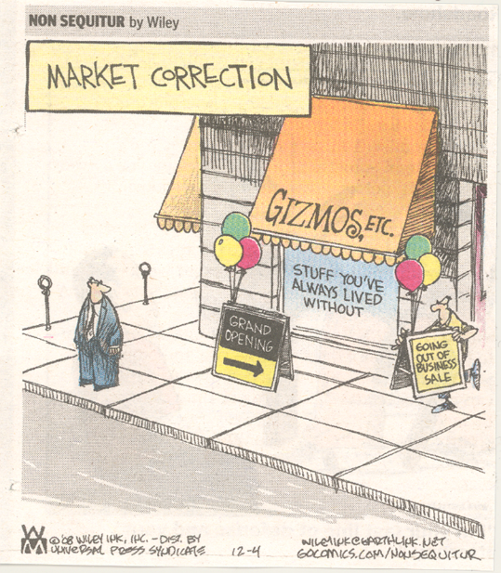
Packaged CHP Market Challenges
CHP viewed as a discretionary purchase
Lack of user awareness / understanding
Lack of technical expertise
Under-developed sales and service infrastructure
Every installation is considered unique
Uncertainty results in high soft costs
End-user bears bulk of responsibility
Notes:
There are a number of challenges in deploying CHP into this non-traditional market
CHP is viewed as a discretionary purchase – not part of the core business of these end-users, and not many existing systems that they can relate to
Potential users don’t really understand what CHP can do for them – overall benefits are unclear, costs can be high
Each installation is usually treated as unique – results in expensive systems - a lot of design work is required, few turnkey options
The uncertainty leads to high soft costs – costs of doing reengineering each installation, Interconnection costs, permitting costs, etc.
End-user end up bearing the bulk of responsibility – End-users typically hold a lot of the risk/uncertainty for project outcomes.

Slide 9
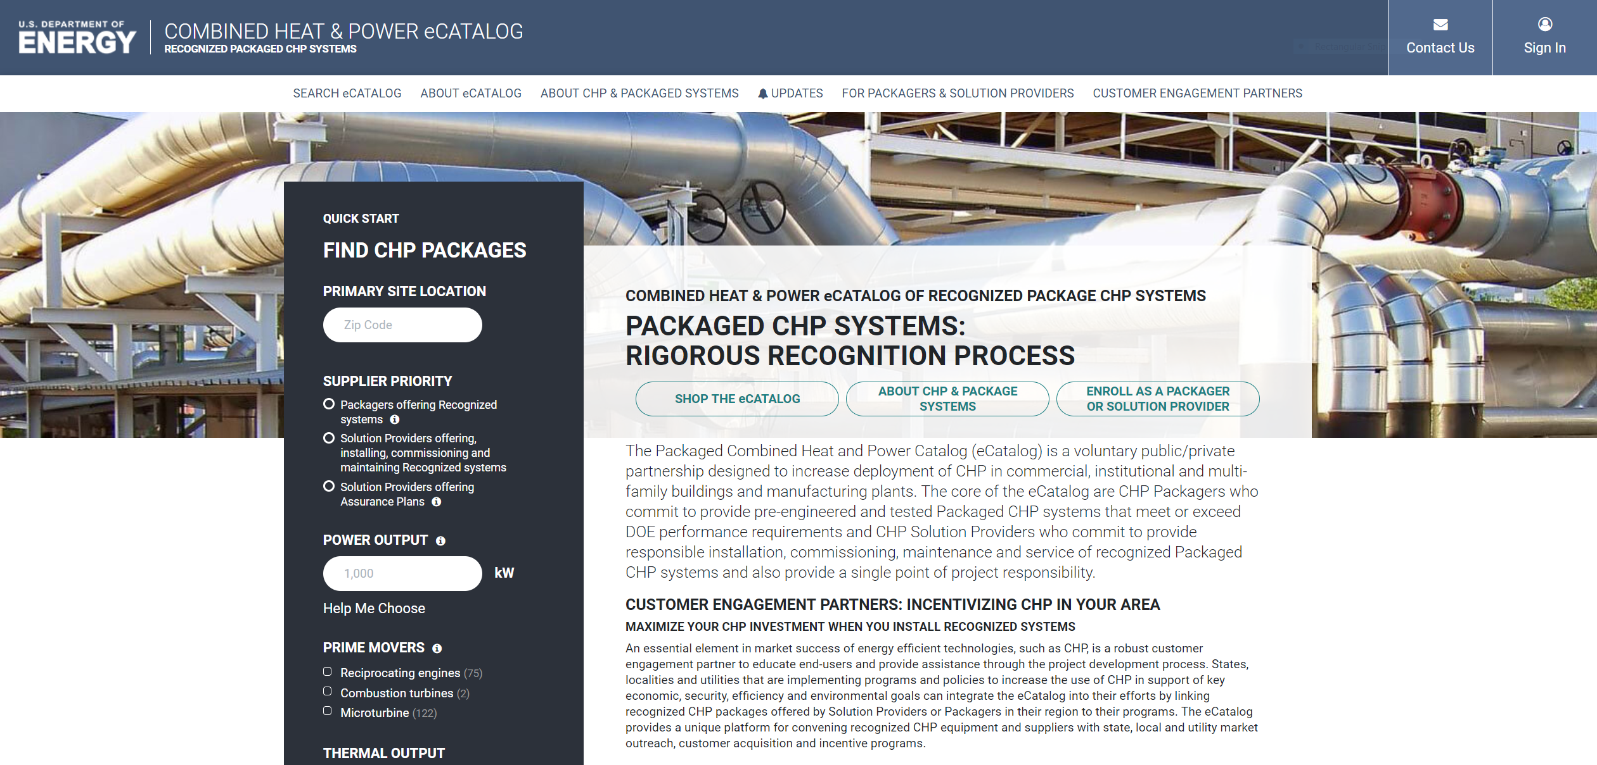
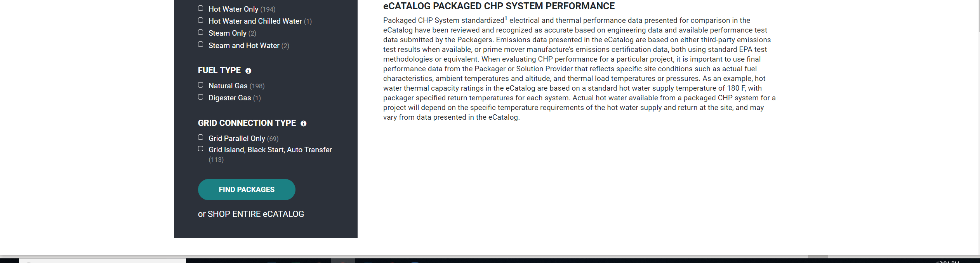
DOE Packaged CHP eCatalog
A national web-based searchable catalog (eCatalog) of DOE-recognized packaged CHP systems and suppliers with the goal to reduce risks for end-users and vendors through partnerships with:
  CHP Packagers and Solution
  Providers that assemble, install,
  commission and service packaged
  CHP systems
  CHP Customer Engagement
  partners that provide CHP market
  deployment programs at the state,
  local and utility level
Pre-engineered and tested packaged
CHP systems that meet DOE
performance requirements
End-users and design engineers
search for applicable CHP system
characteristics, and get connected
to packagers, installers and CHP
engagement programs
Allows users to compare technology
options on a common basis
https://chp.ecatalog.lbl.gov/
Notes:
DOE’s eCatalog program is designed to Reduce Risks for end-users and vendors in these markets through the combination of the web-based Catalog of DOE recognized packaged systems offered by recognized CHP suppliers, and state/utility partners with CHP market engagement programs
Built on a very successful state program in New York that started in 2013
Packaged System eCatalog - an open source, web-based system that hosts US DOE recognized packaged CHP systems that include select features designed to reduce economic and performance risk for the CHP user.
The core of the eCatalog are two groups of Partners:
CHP Suppliers - Packagers who commit to provide pre-engineered and tested Packaged CHP systems that meet or exceed DOE performance requirements and CHP Solution Providers who commit to provide responsible installation, commissioning, maintenance and service of recognized Packaged CHP systems and serve as the single point of responsibility for the product, and
CHP Engagement partners that provide CHP market deployment programs at the state, local and utility - these deployment programs could be utility or state energy efficiency incentive programs, but don’t have to include incentives – equally important are education, outreach and technical assistance programs designed to make end-users aware of the benefits of CHP, introduce them to the eCatalog, and help them work through the project development process
DOE experts review the CHP package applications to ensure they meet design and performance requirements,
eCatalog provides in-depth search capabilities that allows CHP users and consulting engineers to view the suite of available packaged CHP systems given a variety of site specifications and needs.

Slide 10
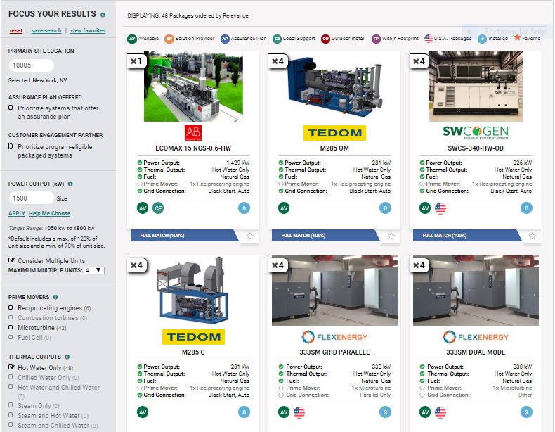
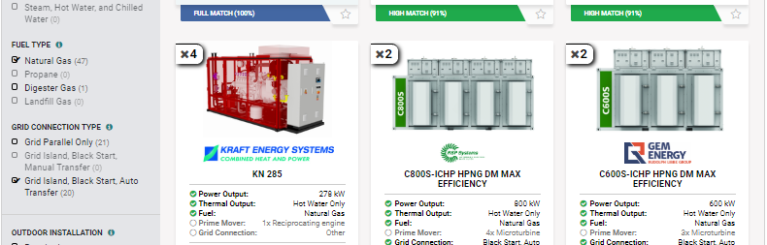
Packaged CHP eCatalog Status [May 2020]
30 recognized Packagers
19 recognized Solution Providers
187 Package Offerings
  104 recip engine
  82 microturbine
  1 gas turbine
  183 natural gas
  4 digester gas
  24 kW to 7.5 MW
  Multiple suppliers and packages in
  every zip code
10 Customer Engagement
Partners
https://chp.ecatalog.lbl.gov/
Notes:
DOE’s eCatalog program is designed to Reduce Risks for end-users and vendors in these markets through the combination of the web-based Catalog of DOE recognized packaged systems offered by recognized CHP suppliers, and state/utility partners with CHP market engagement programs
Built on a very successful state program in New York that started in 2013
Packaged System eCatalog - an open source, web-based system that hosts US DOE recognized packaged CHP systems that include select features designed to reduce economic and performance risk for the CHP user.
The core of the eCatalog are two groups of Partners:
CHP Suppliers - Packagers who commit to provide pre-engineered and tested Packaged CHP systems that meet or exceed DOE performance requirements and CHP Solution Providers who commit to provide responsible installation, commissioning, maintenance and service of recognized Packaged CHP systems and serve as the single point of responsibility for the product, and
CHP Engagement partners that provide CHP market deployment programs at the state, local and utility - these deployment programs could be utility or state energy efficiency incentive programs, but don’t have to include incentives – equally important are education, outreach and technical assistance programs designed to make end-users aware of the benefits of CHP, introduce them to the eCatalog, and help them work through the project development process
DOE experts review the CHP package applications to ensure they meet design and performance requirements,
eCatalog provides in-depth search capabilities that allows CHP users and consulting engineers to view the suite of available packaged CHP systems given a variety of site specifications and needs.

Slide 11
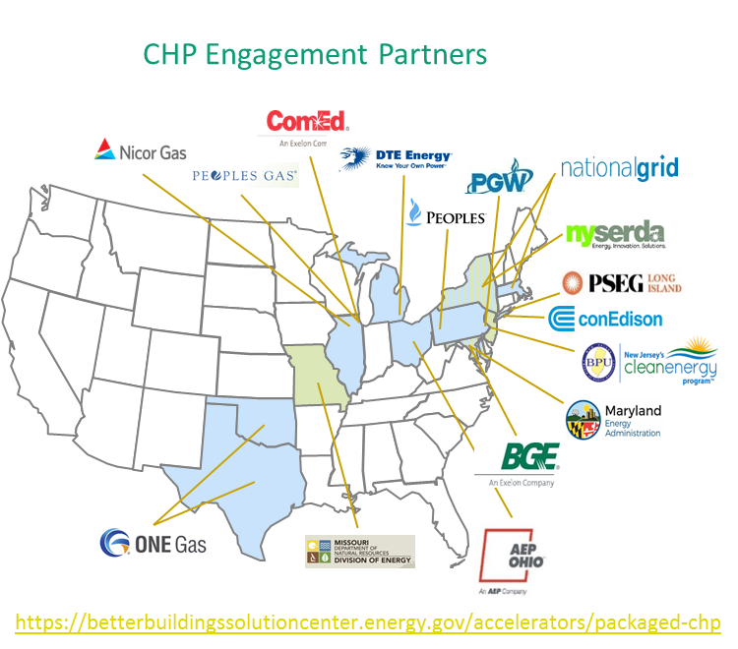
DOE Packaged CHP Accelerator [May 2020]
Better Buildings Accelerators demonstrate innovative policies and approaches designed to accelerate investment in energy efficiency
Objective:
Populate, launch and publicize the eCatalog
and promote efficient packaged CHP
Goals:
Verify packaged CHP system
performance in industrial,
commercial, institutional and
government markets
CHP Engagement Partners:
Utilities, states and federal agencies
committed to promoting packaged
CHP via CHP deployment and/or
incentive programs (16 Engagement Partners)
CHP Supplier Partners:
CHP packagers and solution providers
participating in the national eCatalog (18 Supplier Partners)
Notes:
DOE’s eCatalog program is designed to Reduce Risks for end-users and vendors in these markets through the combination of the web-based Catalog of DOE recognized packaged systems offered by recognized CHP suppliers, and state/utility partners with CHP market engagement programs
Built on a very successful state program in New York that started in 2013
Packaged System eCatalog - an open source, web-based system that hosts US DOE recognized packaged CHP systems that include select features designed to reduce economic and performance risk for the CHP user.
The core of the eCatalog are two groups of Partners:
CHP Suppliers - Packagers who commit to provide pre-engineered and tested Packaged CHP systems that meet or exceed DOE performance requirements and CHP Solution Providers who commit to provide responsible installation, commissioning, maintenance and service of recognized Packaged CHP systems and serve as the single point of responsibility for the product, and
CHP Engagement partners that provide CHP market deployment programs at the state, local and utility - these deployment programs could be utility or state energy efficiency incentive programs, but don’t have to include incentives – equally important are education, outreach and technical assistance programs designed to make end-users aware of the benefits of CHP, introduce them to the eCatalog, and help them work through the project development process
DOE experts review the CHP package applications to ensure they meet design and performance requirements,
eCatalog provides in-depth search capabilities that allows CHP users and consulting engineers to view the suite of available packaged CHP systems given a variety of site specifications and needs.

Slide 12
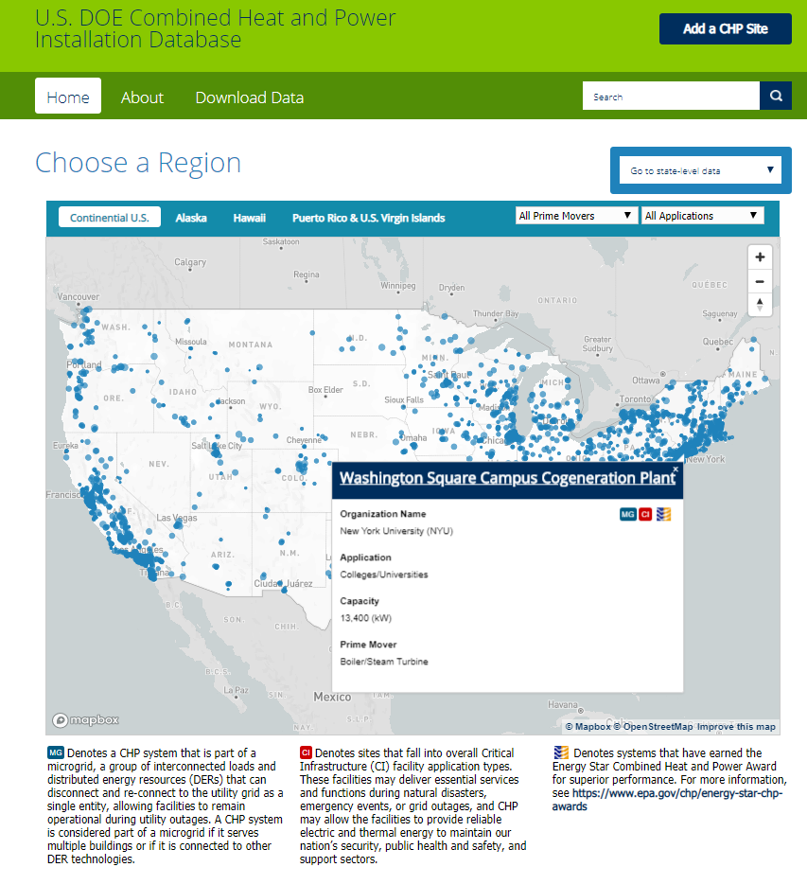
CHP Deployment Resources Accomplishment Example:
CHP Installation Database Website
Format: Interactive, searchable map of all CHP sites
  Dot size roughly corresponds with capacity
  Ability to filter map by prime mover technology and end-user application
Pop-up box for each site
  Includes basic site information
  Icons for when CHP is part of a microgrid, located at a critical infrastructure facility, and an EPA award winner
State pages show all CHP sites in each state/territory
Users can download data file and summary tables file
energy.gov/chp-installs

Slide 13

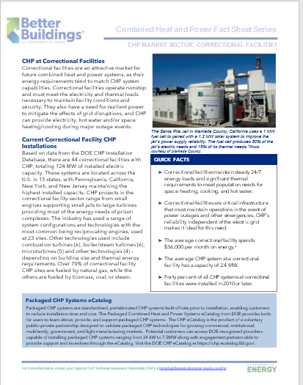
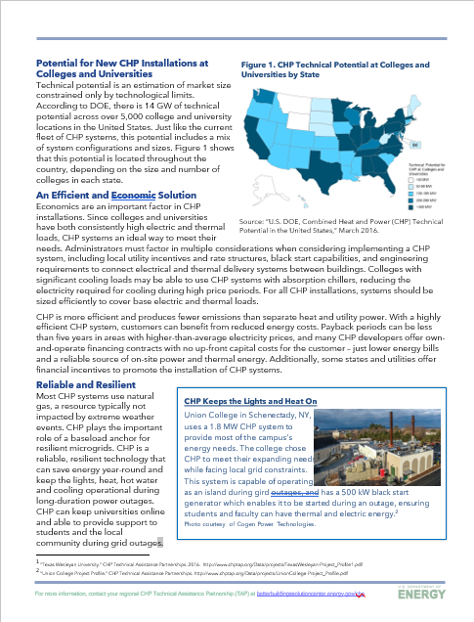
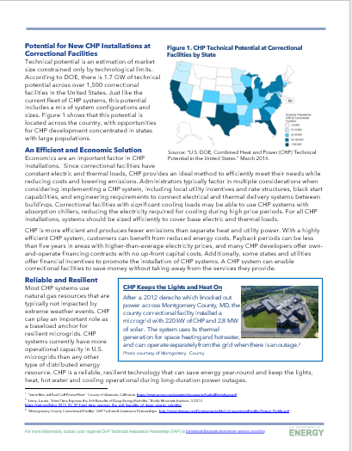
CHP Deployment Resources Accomplishment Example:
Issue Brief Series on CHP Policy Topics
Format: 8 new fact sheets highlighting the benefits and applications of CHP in major market sectors, including:
  Current installation data
  Applicable thermal loads
  Resiliency examples
  Case studies
Audience: Packaged CHP Accelerator Engagement Partners (utilities, federal agencies, states, cities, associations, etc.) promoting CHP (via the eCatalog) to their customers, affiliates or members.
Current Status: Drafts for all 8 sectors in progress internally
Market Sectors
Colleges/Universities | Hospitals
Nursing Homes | Hotels
Commercial Office Buildings | Government Buildings
Correctional Facilities | Multifamily Buildings

Slide 14
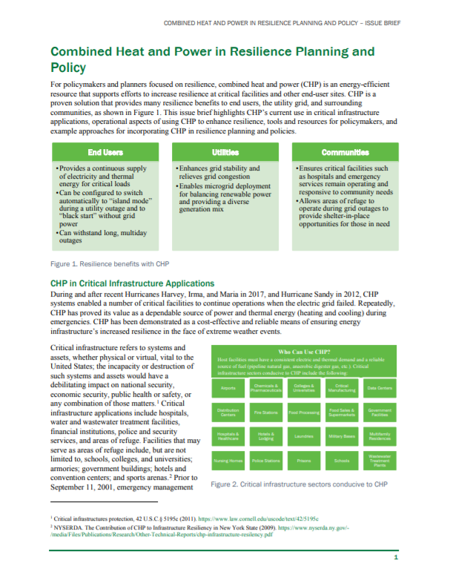
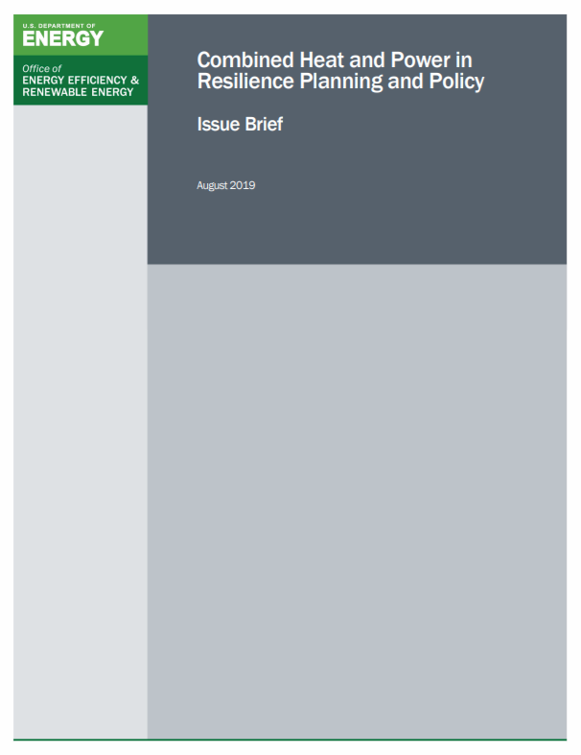
CHP Deployment Resources Accomplishment Example:
Market and Technology Fact Sheet Series
Format: 8 – 10 page documents discussing policy topics impacting CHP deployment
Audience: State utility regulators and other policy makers seeking actionable information to assist in implementing policies that address barriers and promote opportunities for CHP development.
Current Status:
Topic Area | Status
CHP in Resilience Planning and Policy | Published
State-Led Initiatives | Published
Utility CHP Programs | *Published
Interconnection Standards | *Published
Utility Ownership | Internal Review
Standby Rates | Research In Progress
CHP as a Non-Wires Solution | Research In Progress
CHP and Financing (PACE, Third-Party) | Research In Progress
CHP-based Microgrid Policy | Research In Progress
How CHP can Monetize Grid Services | Research In Progress
https://betterbuildingssolutioncenter.energy.gov/chp/resources-publications

Slide 15
CHP Deployment Resources Accomplishment Example:
CHP for Resiliency Accelerator* (completed)
Purpose: The DOE CHP for Resiliency Accelerator was a 2-year effort focused on bringing together resources for how states, local governments, and utilities could include CHP in their resilience planning efforts.
Available Now: Four key resources were created to assist local governments and utilities in their planning efforts.
Distributed Generation (DG) for Resilience Planning Guide: Helps decision makers determine how DG and CHP can help support resilience goals and assist in the resilience planning process, including information on DG technologies, examples of how DG is included in resilience planning, and examples of policies that support the use of DG/CHP.
CHP for Resilience Screening Tool: Allows users to screen and rank individual sites or portfolios of buildings based on a variety of resilience metrics and their suitability for CHP, and helps users prioritize which sites can best use CHP so that they can plan and implement resilience solutions. (Available in both web and excel versions)
Issue Brief on Performance of DERs in Disaster Events: Assists stakeholders/policy makers in assessing technology options best able to meet their resilience priorities; includes a qualitative assessment of the vulnerability of 6 DER technologies, including CHP, in 6 different disaster events, and highlights design strategies that could lower potential risks from events discussed.
Partner Profiles: Accelerator Partners completed short profiles that provide insights and real-world examples from state agencies, cities, utilities, nonprofit organizations, and CHP solution providers that other stakeholders can learn from and integrate into their own resilience initiatives.
*https://betterbuildingssolutioncenter.energy.gov/accelerators/combined-heat-and-power-resiliency

Slide 16
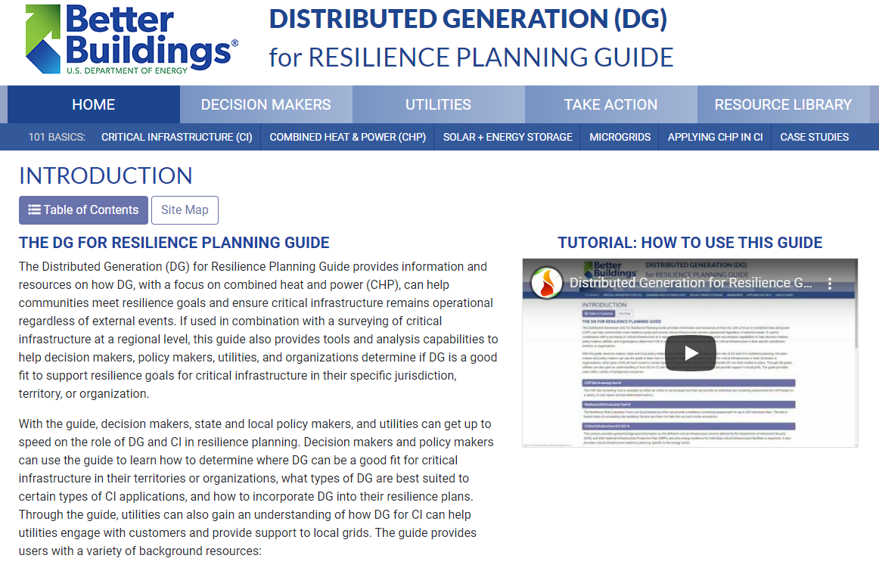
CHP Deployment Resources Accomplishment Example:
Just Released Video Tutorial for DG for Resilience Planning Guide
https://www.youtube.com/watch?v=otyG28ebpNY

