Slide 1
Organic Rankine Cycle (ORC) Integration and Optimization for High Efficiency CHP Genset Systems
DE‐FOA‐0001750
ElectraTherm
Oct. 2018-Dec. 2021
Principal Investigator/Tom Brokaw
Business Contact /Rob Emrich
U.S. DOE Advanced Manufacturing Office Program Review Meeting
Washington, D.C.
June 2nd, 2019
This presentation does not contain any proprietary, confidential, or otherwise restricted information.

Slide 2
Overview
Project Title: Organic Rankine Cycle Integration and Optimization for High Efficiency CHP Genset Systems
Timeline:
Project Start Date: 10/01/2018
Budget Period End Date: 06/30/2020
Approved No Cost Extension
Project End Date: 12/31/2021
Project Budget and Costs:
Budget | DOE Share | Cost Share | Total | Cost Share %
Overall Budget | $1,437,534 | $405,458 | $1,842,992 | 22%
Approved Budget (BP-1) | $647,951 | $182,756 | $830,707 | 22%
Costs as of 3/31/20 | $515,592 | $145,423 | $661,015 | 22%
Barriers and Challenges:
Beneficial thermal available after ORC power production
  Current capability ~120F/49C
  Goals of ~185F/85C
Cost Effective Engine Waste Heat Recovery
Project Team and Roles:
ElectraTherm – development of advanced ORC technology
Innio (Jenbacher) Application Engineering support to optimize ORC to Jenbacher engines
Susteon – Techno/Economic Analysis
OneCIS – Bureau Veritas – Pressure Equipment Certifications
AMO MYPP Connection:
CHP fuel to electricity generation efficiency >45% at rated capacity
  30% at 50% capacity
Total CHP (thermal mode) efficiency > 85%
Development of flexibility between CHP mode and prime power mode

Slide 3
Project Objective(s)
Traditional CHP Challenge – what to do with all that heat?
  Create 24/7 thermal demand via ORC
Advance engine based CHP offerings and enhance market acceptance
  Generate power from the CHP’s excess heat
    Increase prime power efficiency when heat is not required for the building
    Add flexibility via CHP mode
Provide “usable thermal energy” after ORC power production.
Target condensing side heat at 180F-190F range matching existing building hydronic infrastructure (today’s limit ~ 120F)
This will require new higher pressure expanders with new bearing schemes and lubrication methodology, new controls, new pressure ratings, certifications and potentially new working fluids.

Slide 4
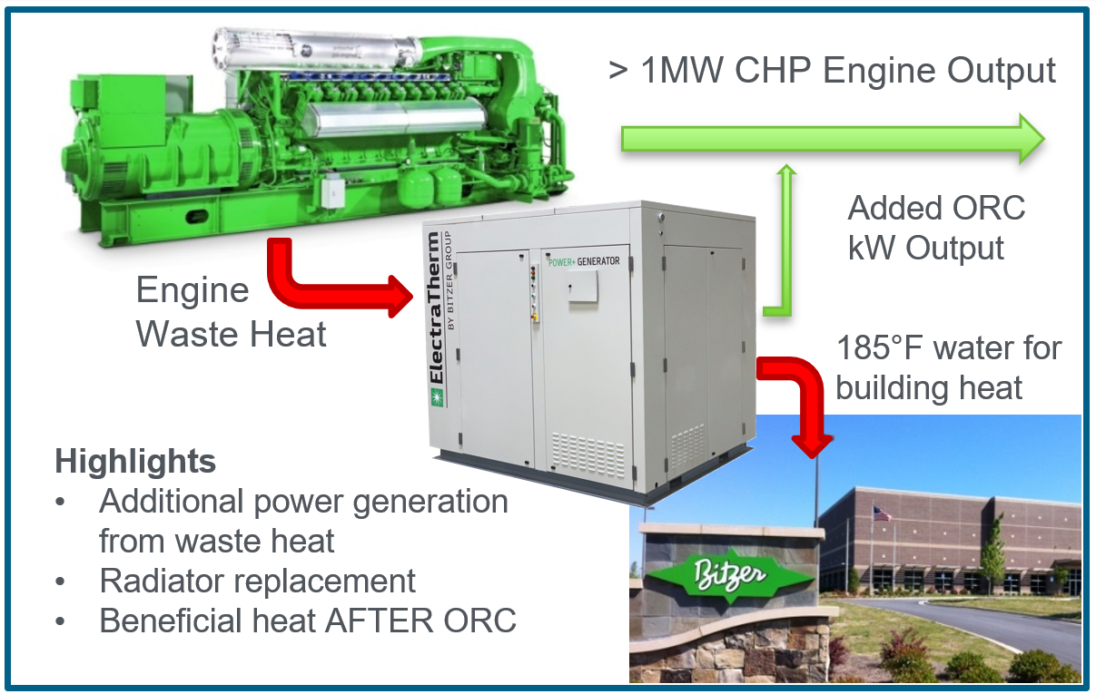
Technical Innovation
Traditional CHP Offerings consist of hot water, steam and absorption chilling
– this solution broadens those offerings and adds electrical efficiency and flexibility

Slide 5
Technical Innovation
Currently engine + ORC packages are not considered for CHP applications
Barriers are:
  COST - $/kW of ORC equipment
  No use for ORC condensing heat – too low value (~120F)
  Perceived complexity with “new” technology
Technical Advancements
  Raise input and exit temps of ORC so beneficial use of thermal energy after power production is possible
  New expander technology Including:
    Higher pressure castings
    New lubrication and bearing schemes
    New controls
  Extreme focus on market acceptance and $/kW – largest barrier
Adding 24/7 thermal demand, added power generation when in prime power mode and offering beneficial thermal in CHP mode at the right price point will enable further CHP market acceptance and benefit to the US manufacturing sector

Slide 6
Technical Approach
Utilize ElectraTherm’s 1,000,000 hours + of fleet operation and experience to elevate baseline production equipment and advance expander and ORC system capability to meet engine + ORC market requirements
Introduce and redesign BITZER semi-hermetic expanders to meet expander technical gaps
    Higher inlet temperature and pressures
    Establish a 24/7 expander fleet leader commercial site
    Raise condensing temperatures to match building thermal demands and designs
    Maintain acceptable system performance while driving for higher ORC condensing temperatures
      Investigate new low global warming potential refrigerants
    Address ORC shortfalls as expander weak link is addressed
Utilize baseline designs as platforms to learn as BITZER expander and new controls are integrated and new capabilities are developed
  Design/build and test LOW cost clean sheet of paper design to meet strict $/kW barrier to entry

Slide 7
Management Approach – BP1 Milestones
Type / Milestone | Milestone Description | Comments
Technical - New working fluid chemically compatible | New refrigerant and oil combinations have acceptable compatibility with all seals/o-rings and exposed materials in the entire ORC closed loop system | Complete Samples of new fluids on order
Technical - High temperature design complete for BHT ORC | All component selection and safety calculations in accordance with ASME B31.3 complete | Components reviewed and required changed identified. Will be complete by the end of BP1
Technical - 4400B prototype operational at commercial test site | Unit running and sending run data to ElectraTherm for performance/reliability analysis | Unit Operational at customer site
Go / No Go - Thermodynamic model validated at elevated operating conditions | Good agreement obtained between actual run data, and thermodynamic model for the elevated conditions necessary for CHP applications | Model will be validated with test cell data obtained with BHT Prototype - targeting initial data Q2 2020

Slide 8
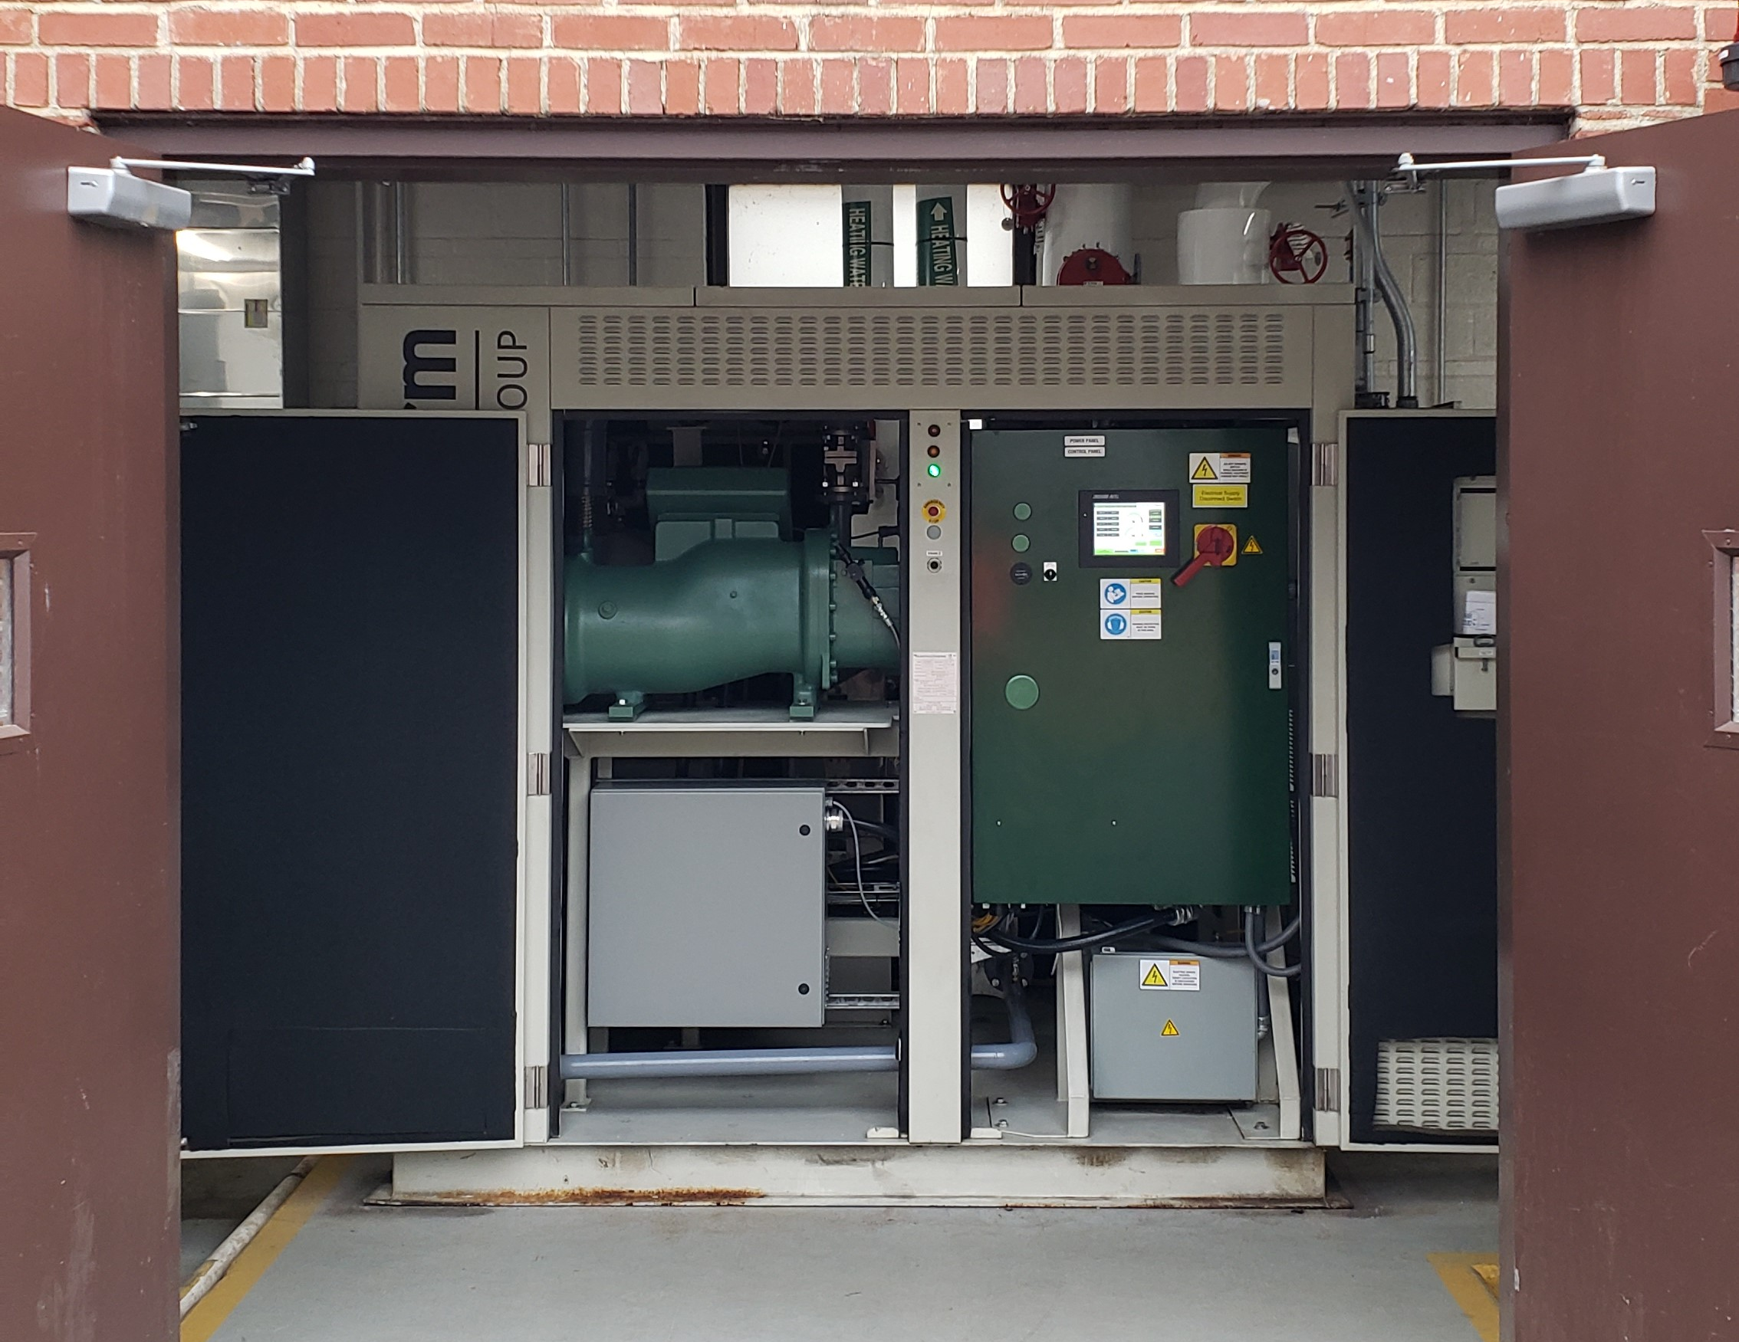
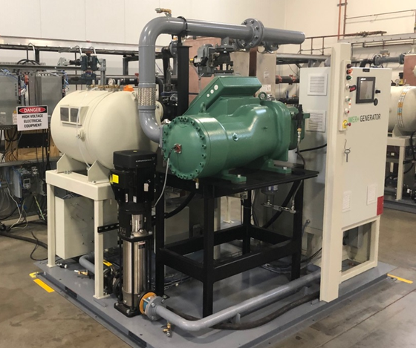
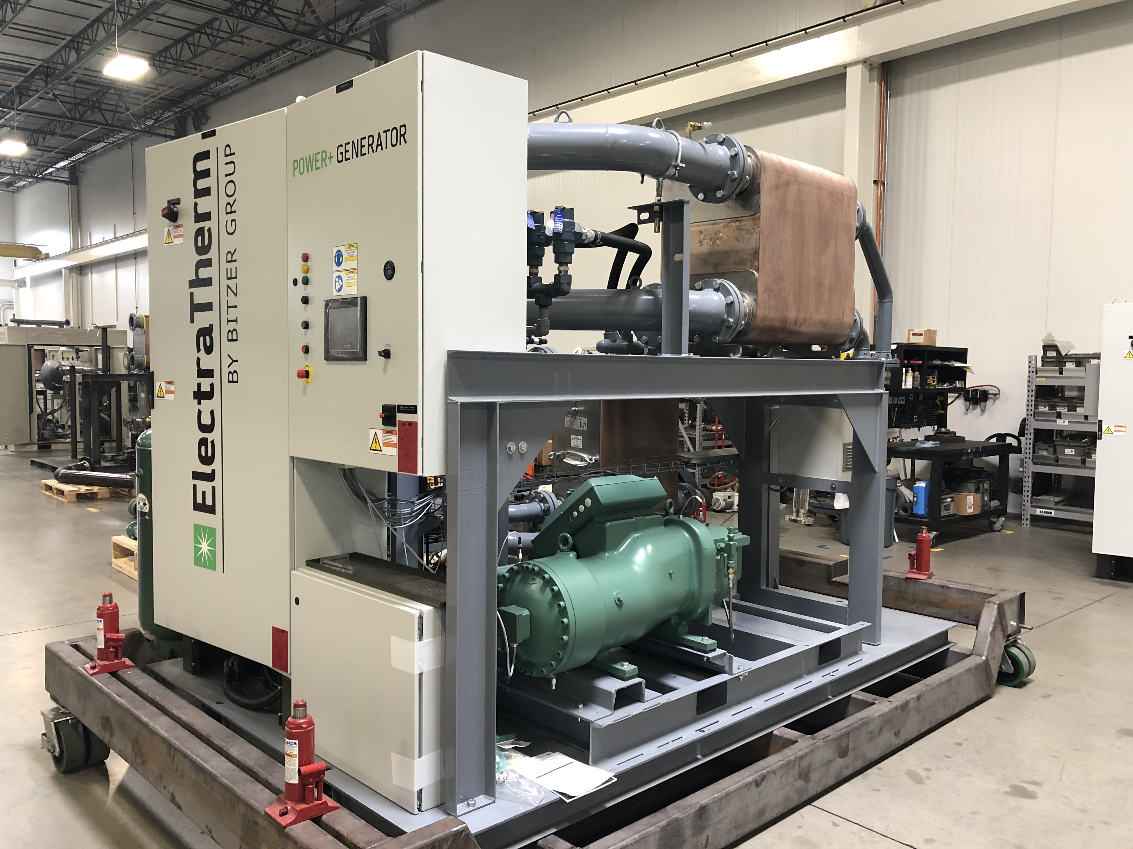
Results and Accomplishments
New HSE85 Expander designed into both 4400B and larger 6500B ORC’s
4400B retrofitted with HSE85 expander Installed and operational at customers site for endurance hours
New controls developed for operation with semi-hermetic expander / generator combination
New lubrication methods developed and validated

Slide 9
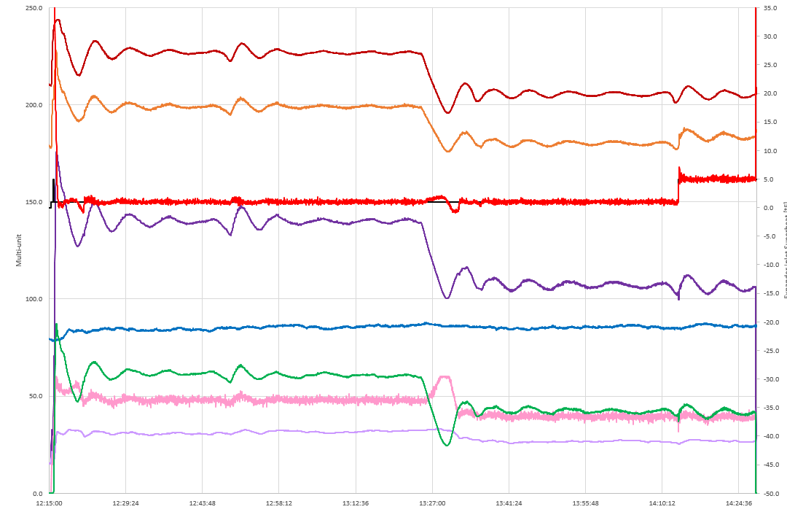
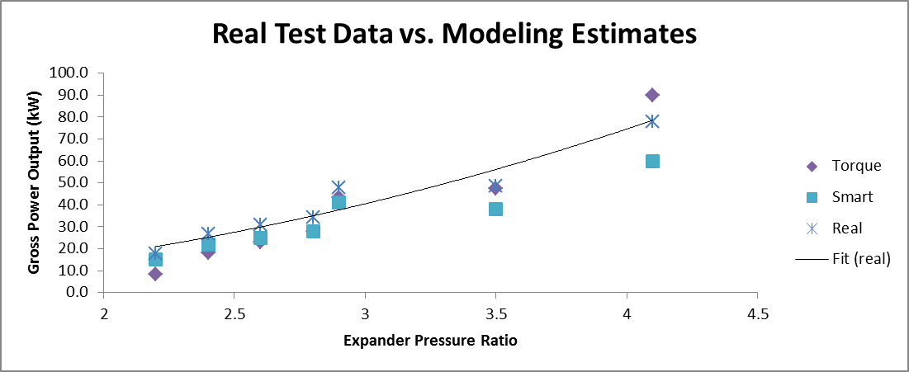
Results and Accomplishments
ORC modeling software (Torque) validated with new expander data
Modeling software will be updated for better fit at higher outputs
Modeling software will be used to estimate performance at expanded range
New estimates will be validated with data from the prototypes
ORC controls updated for operation with new expander
ORC output (green line) and heat consumption tracks very well with changes in input temperature (top red line)

Slide 10
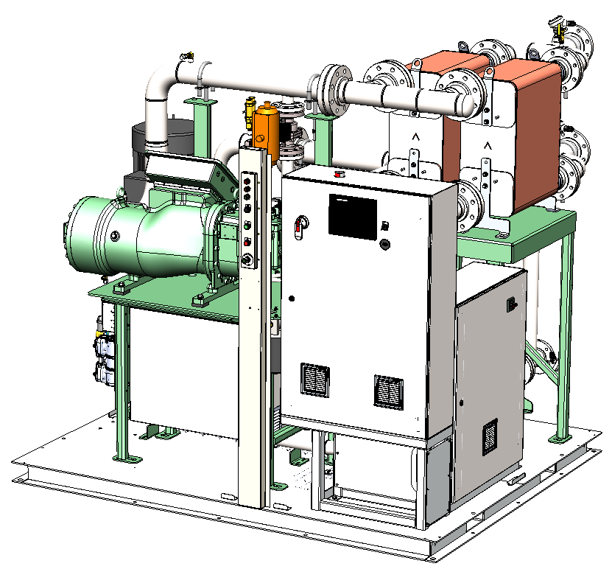
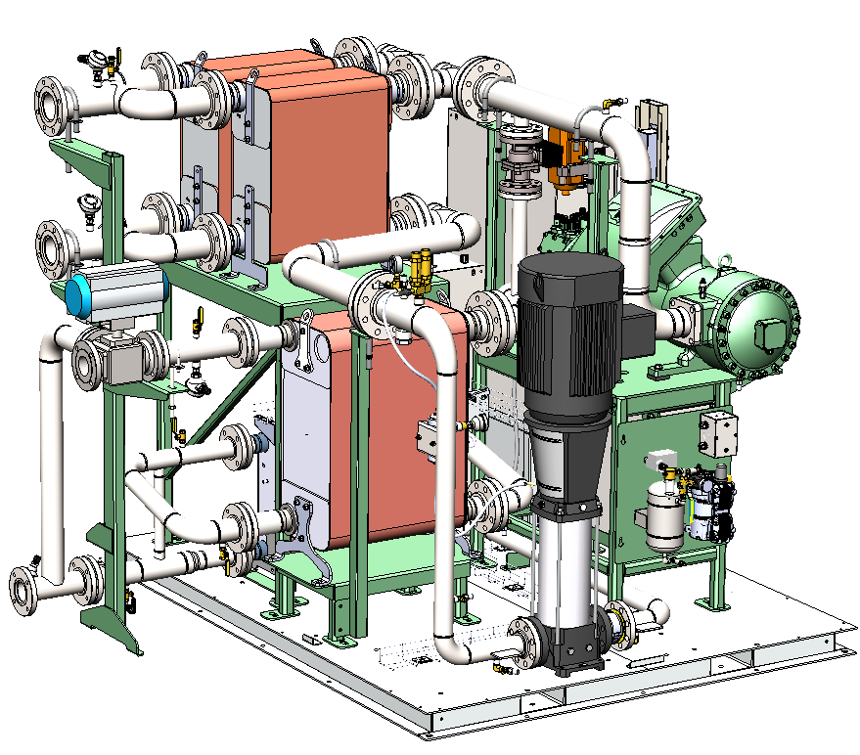
Results and Accomplishments
New ORC design for higher temperature and pressures complete
New Components will be capable of running at higher temperature and generating useful heat after the condensers – 185°F (85°C)

Slide 11
Transition (beyond DOE assistance)
Continue education and discussions with CHP developers, engine distributors, and OEM’s to the potential of engine + ORC optimization for CHP
Continue the search for first commercial application for engine + ORC at a CHP site
Continued focus on being lowest cost producer for ORC’s in this specific size range
Further understanding and optimization via the Innio/Jenbacher product families
Further developments to optimize the engine + ORC system as one package

Slide 12

Questions?
Thank You
Tom Brokaw
Engineering Manager
tbrokaw@electratherm.com

