Slide 1
Combined Heat and Power (CHP) Modeling in the REopt Lite Web Tool
CID Number GO28308
National Renewable Energy Laboratory, Colorado School of Mines, and Clean Energy Group
Fiscal Year 2019-2021
Kate Anderson, National Renewable Energy Laboratory (NREL)
Patti Garland, DOE Advanced Manufacturing Office
U.S. DOE Advanced Manufacturing Office Virtual Program Review
June 2-3, 2020
This presentation does not contain any proprietary, confidential, or otherwise restricted information.

Slide 2



Overview
Project Title: Combined Heat and Power (CHP) Modeling in the REopt Lite Web Tool
Timeline:
Project Start Date: 02/01/2019
Budget Period End Date: 09/30/2021
Project End Date: 09/30/2021
Project Budget and Costs:
Budget | DOE Share | Cost Share | Total | Cost Share %
Overall Budget | $3,015,000 | 0 | $3,015,000 | 0%
Approved Budget (BP-1&2) | $3,015,000 | 0 | $3,015,000 | 0%
Costs as of 3/31/19 | $1,423,675 | 0 | $1,423,675 | 0%
This project was awarded via a Lab Call Competitive Procurement
Barriers and Challenges:
  Hybrid CHP deployment is limited due to lack of understanding of the configuration options, economics and resilience benefits
Project Team and Roles:
  NREL: Team lead; user interface, API, and open source model development
  Colorado School of Mines (CSM): CHP model validation and optimization efficiency
  Clean Energy Group: Stakeholder engagement and outreach
AMO MYPP Connection:
MYPP Target 13.1

Slide 3
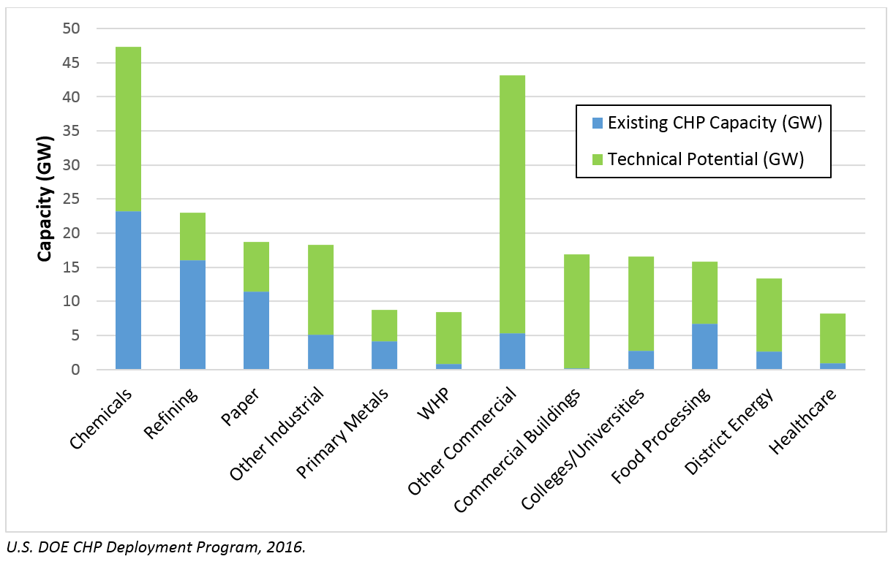
Project Objectives
Problem Statement:
  Hybrid CHP can reduce energy costs and emissions while providing more resilient electric power and thermal energy
  Lack of understanding of technology options and benefits limits current deployment
  There is a gap in the public space for a tool that integrates CHP with renewable technologies
Project Objectives:
  Increase deployment of hybrid CHP by providing a free online decision tool to:
    Assess hybrid CHP opportunities at a candidate site
    Quantify economic, environmental, and resilience benefits
  Increase accuracy of predicted CHP technology performance over current tools
  Optimize system configuration, size, and dispatch for lowest energy cost
  Educate customers and inform investment decisions
Support of AMO Goals:
  Hybrid CHP improves energy efficiency and reduces lifecycle energy of manufacturing sites
  Tool catalyzes adoption of CHP to drive economic competitiveness and energy productivity
  Tool provides online resources for site self-assessment of CHP potential and highlights opportunities for hybrid CHP-renewable systems (MYPP Target 13.1)
Hybrid CHP= Combined Heat and Power (CHP) with solar PV, small wind, and/or battery storage
CHP Technical Potential

Slide 4
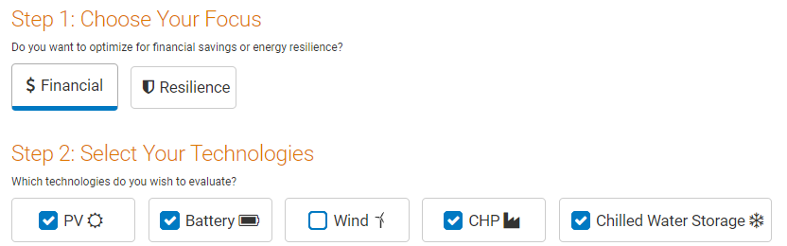

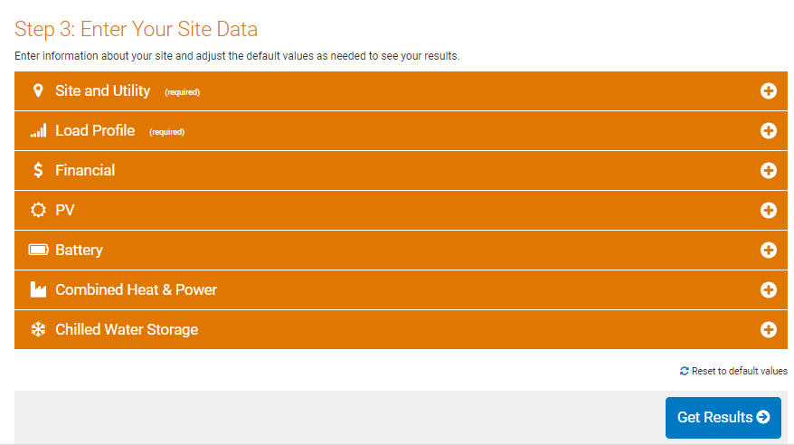
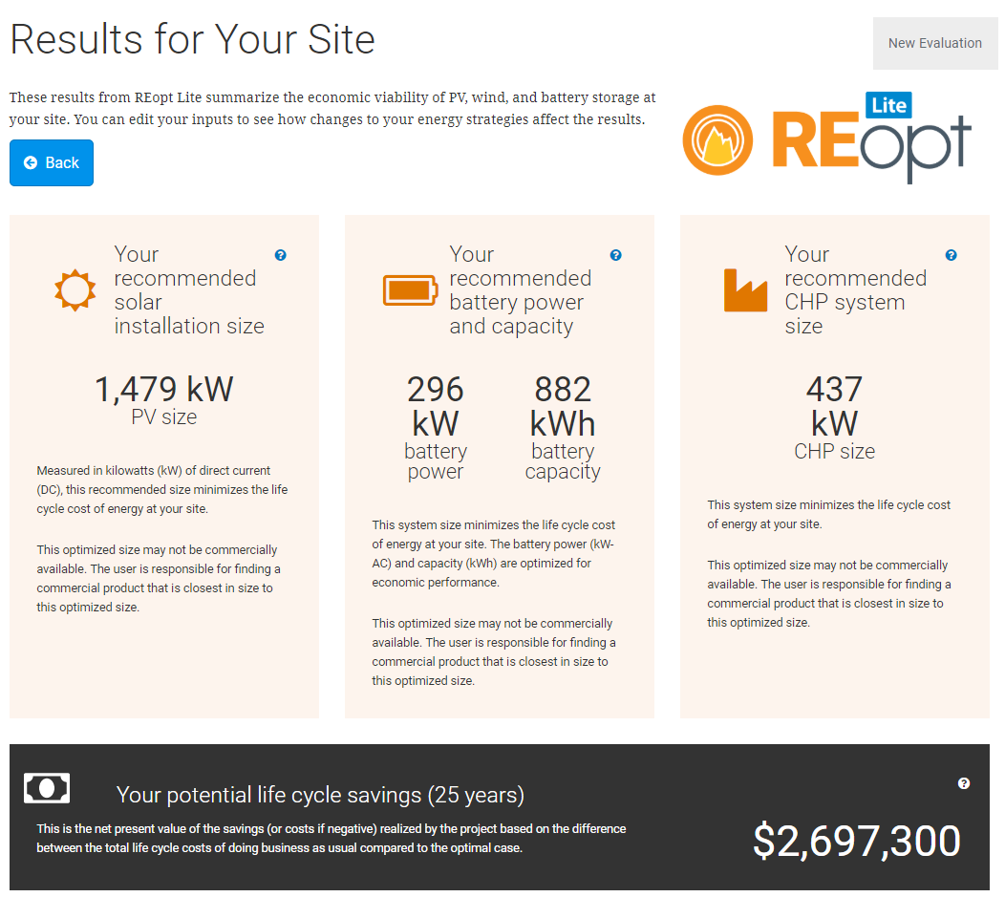
Technical Innovation
Current Practice and Limitations:
  Most current tools evaluate CHP alone and many rely on general rules of thumb
  Non-expert tools make many simplifications, while expert tools are too complex for some users
  Industry lacks standard, publicly available, trusted benchmark tools for hybrid CHP
Proposed approach
  Optimize integrated CHP-renewable energy systems to decrease energy costs and emissions and increase resilience
  Provide complex, expert-level analysis in an easy-to-use tool with actionable results
Innovations
  Apply advanced techniques to optimize system design and dispatch
  Make expert-level analysis widely accessible through web, API, and open-source options
  Provide pre-populated default datasets while allowing customization
  Modify performance for site conditions
Impact
  Identify opportunities and accelerate deployment of efficient, low-cost, resilient hybrid CHP systems
  Enable reduced costs through decision support on hybrid CHP procurement and dispatch

Slide 5
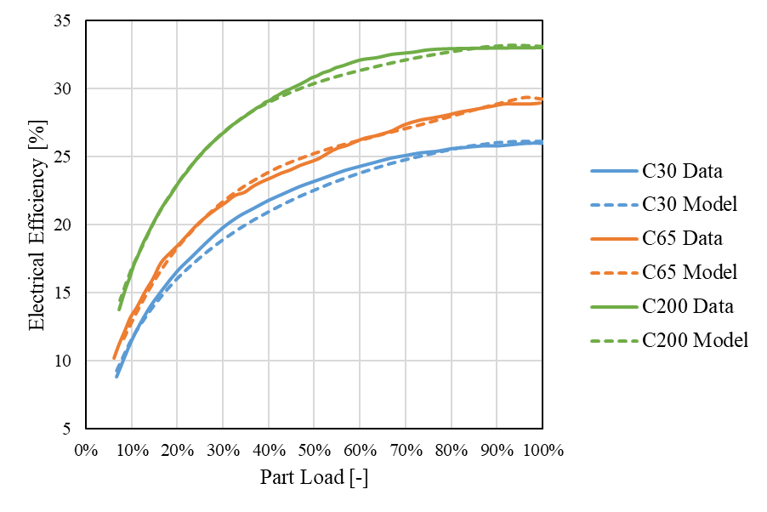
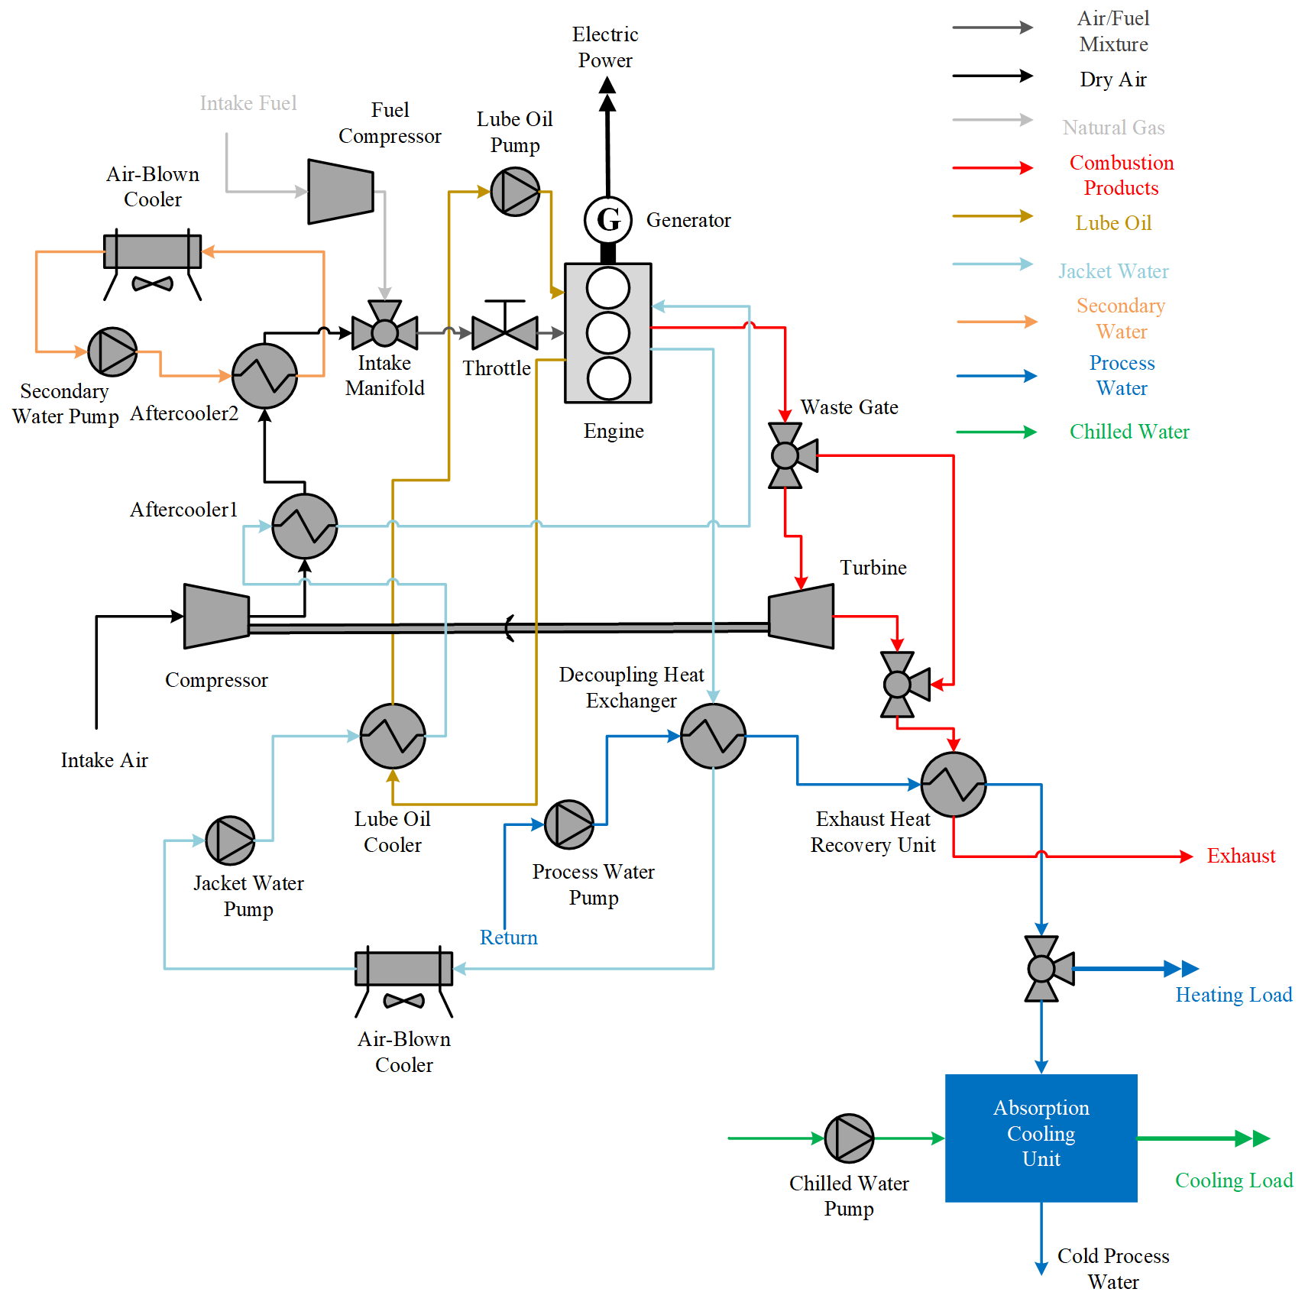
Technical Innovation
Increase accuracy of predicted CHP technology performance over current tools
  Validation against physics-based models improves performance predictions for part-load operation
  Capturing impact of ambient conditions and altitude on performance increases accuracy
  Both magnitude and quality of heat recovered are predicted as a function of generator electric load
Reduce model run times through advanced optimization techniques
  Existing model run times are at their limits for real-time use
  Adding new technologies and loads can increase complexity of model and solution times
  Reformulation decreases solution times without compromising output analysis
    Data structures have been simplified and/or eliminated
    Similar constructs, e.g., constraints, have been aggregated
    Numerical values causing instability and/or slow solve times have been excised
    The model has been tailored to more appropriately capture end-user scenarios
  Streamlining the formulation also simplifies model expansions and makes REopt more intuitive for the research and practitioner community
Modeling part-load performance of technologies increases accuracy
Model is fully validated against detailed physics-based models

Slide 6









Technical Approach
Drivers
Goals
Minimize Cost
Resilience
Economics
Technology Costs
Incentives
Financial Parameters
Utility Costs
Energy Charges
Demand Charges
Escalation Rate
Resources
Renewable Generation
Solar PV
Wind
Technologies
Technology Mix
Technology Size
Conventional Generation
Electric Grid
Diesel Generators
REopt Lite
Techno-economic
Integration & Optimization
Operations
Optimal Dispatch
Optimized Minimum
Cost Solution
Technology Options
Energy Storage
Batteries
Hot water TES
Chilled Water TES
Project Economics
CapEx, OpEx
Net Present Value
Combined Heat & Power
Internal combustion engine
Combustion turbine
Fuel cells
Microturbine
Backpressure steam turbine
Absorption chiller
*New additions in red
Electric Loads
Heating Loads
Cooling Loads
Technical Approach
Add CHP to REopt Lite mixed integer linear optimization model
Optimize size and dispatch of hybrid CHP system to minimize lifecycle cost of energy
Quantify economic and resilience benefits to guide users to cost-effective, resilient technologies
Provide options for simple screening and more detailed analysis
Roles
NREL: User interface, API, and open-source model development
CSM: Model validation and optimization speed up
Clean Energy Group: Stakeholder engagement and outreach
Notes:
Fuel inputs:
Natural gas
Propane
Biodigester and landfill gas
Optional thermal system: Absorption cooling & chilled water storage

Slide 7
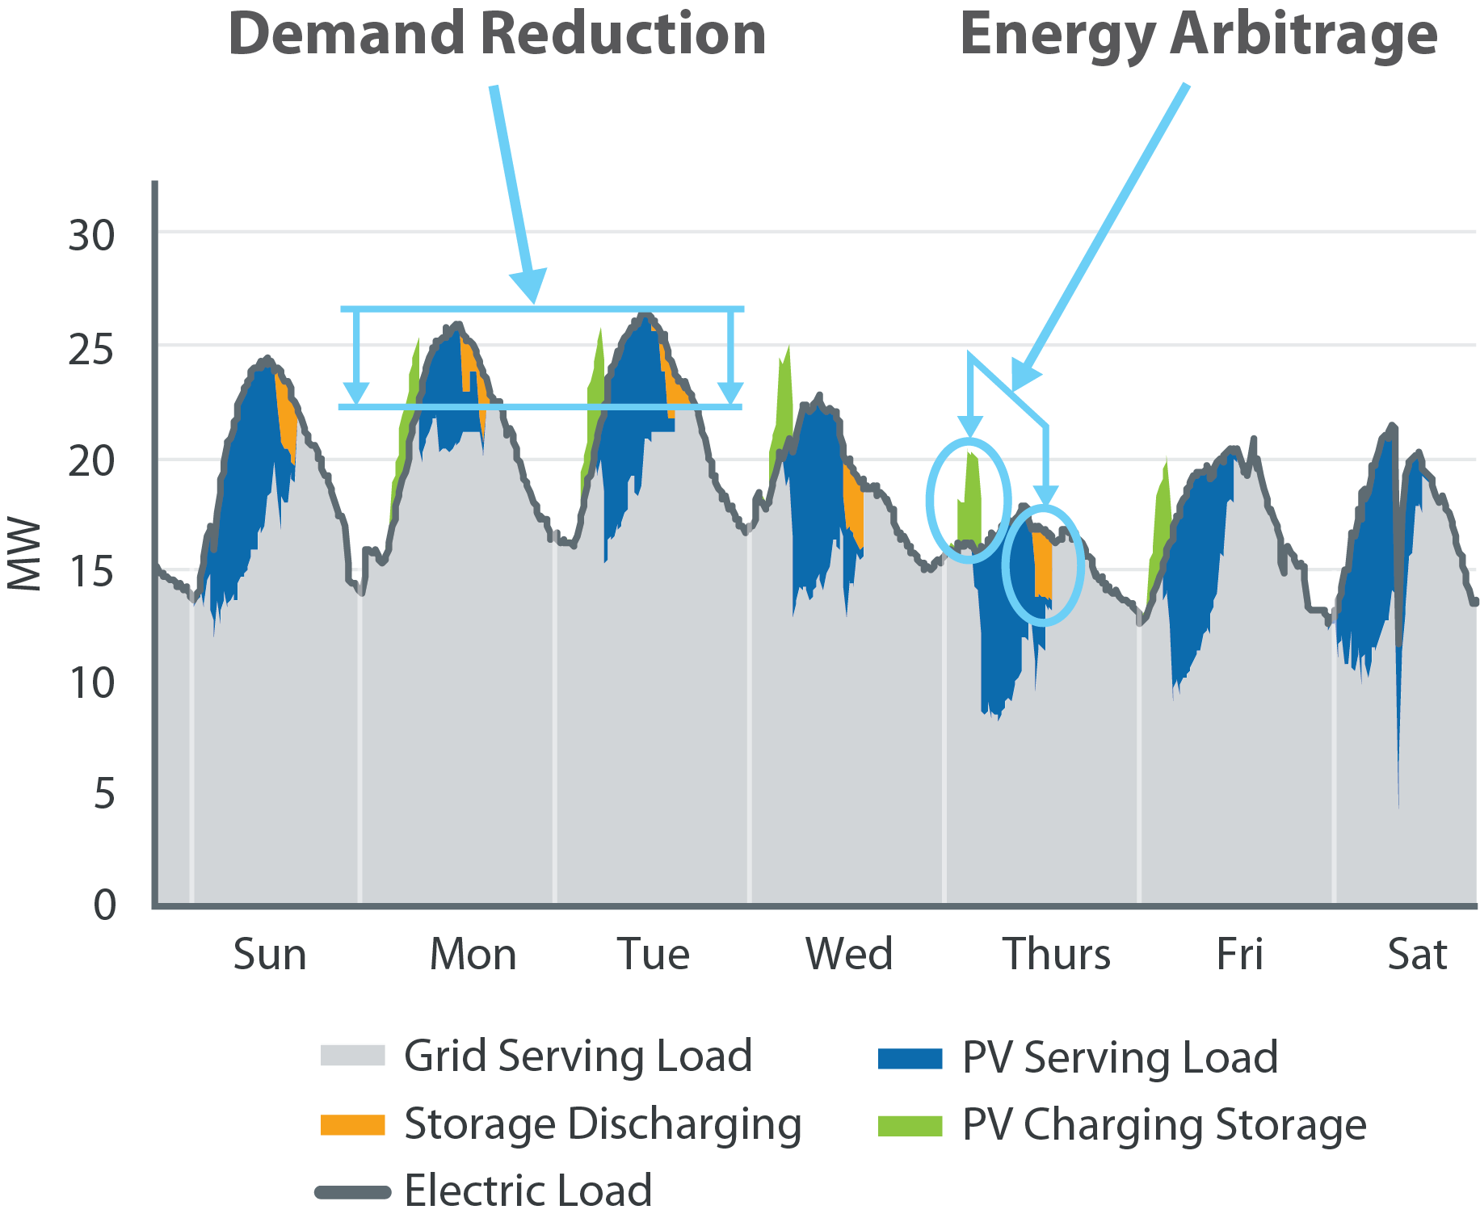
Technical Approach, cont.
REopt Lite Optimizes Size and Dispatch of Integrated Systems
REopt Lite:
Considers the integrated operation of multiple technologies
Analyzes hourly data across the project lifecycle
Evaluates the trade-off between capital costs, operating costs, and savings to find the most cost-effective mix
Provides outputs including recommended technology types and sizes, economics, emissions, and resilience

Slide 8
Results and Accomplishments
Held two workshops with TAPs for input on tool design requirements and demonstration of beta tool
Identified default datasets, costs, assumptions, and references
Releasing beta version of CHP model at the end of June
  Expanded capabilities will include heating and cooling loads, 4 combined heat and power prime movers (reciprocating engine, microturbine, combustion turbine, fuel cell), chilled water storage, hot water storage, and absorption chiller
  Efficiency improvements will reduce run time
 | FY19 | FY20 | FY21
Q1 Progress Measure |  | Data sets and references identified | CHP model finalized and user testing and validation complete
Q2 Progress Measure | Kickoff meeting held | Preliminary CHP model integrated in REopt Lite | Beta REopt Lite CHP model for a single site deployed
Q3 Progress Measure | Data requirements developed | User interface design requirements developed | Model scaled to larger systems and validated
Q4 Progress Measure | Design requirements developed | Preliminary user interface developed | Final REopt Lite CHP model deployed and publicized
Go/No-Go | Design requirements developed | Preliminary CHP model completed | Final REopt Lite CHP model deployed

Slide 9
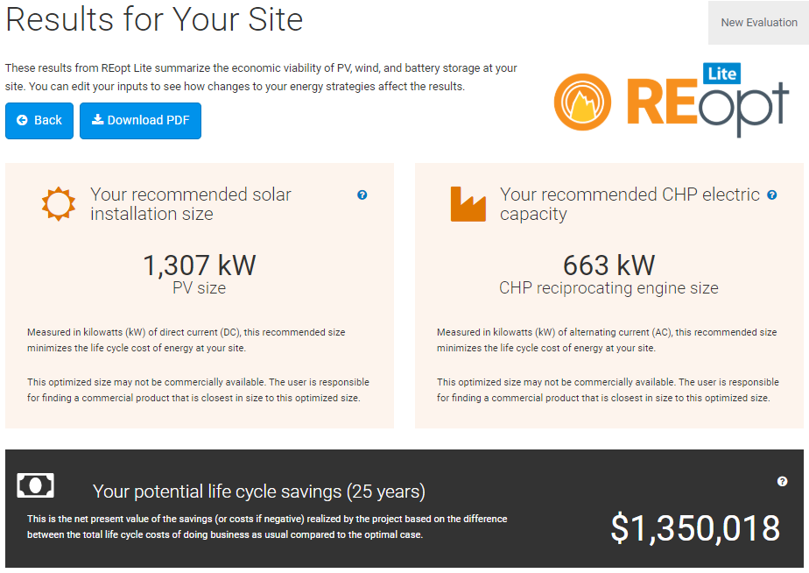
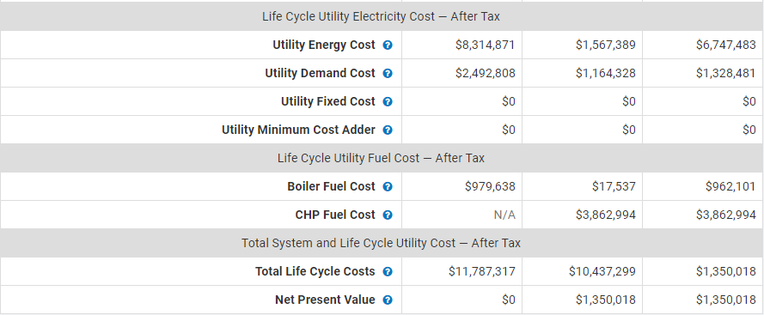
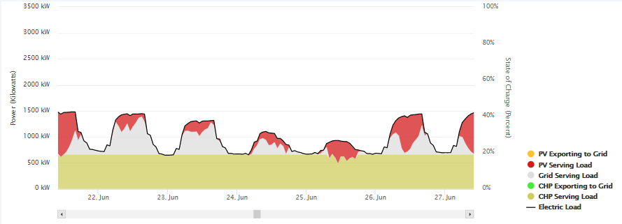
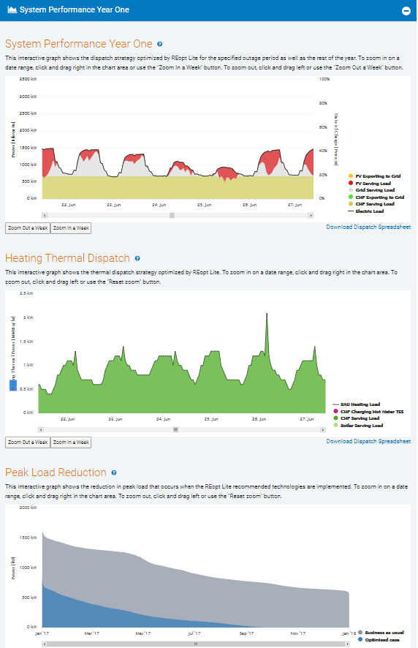
Results and Accomplishments
Tool demonstrates value of hybrid CHP systems
System Size and Net Present Value
Detailed Financial Outputs
Hourly Electrical Dispatch
Hourly Thermal Dispatch

Slide 10
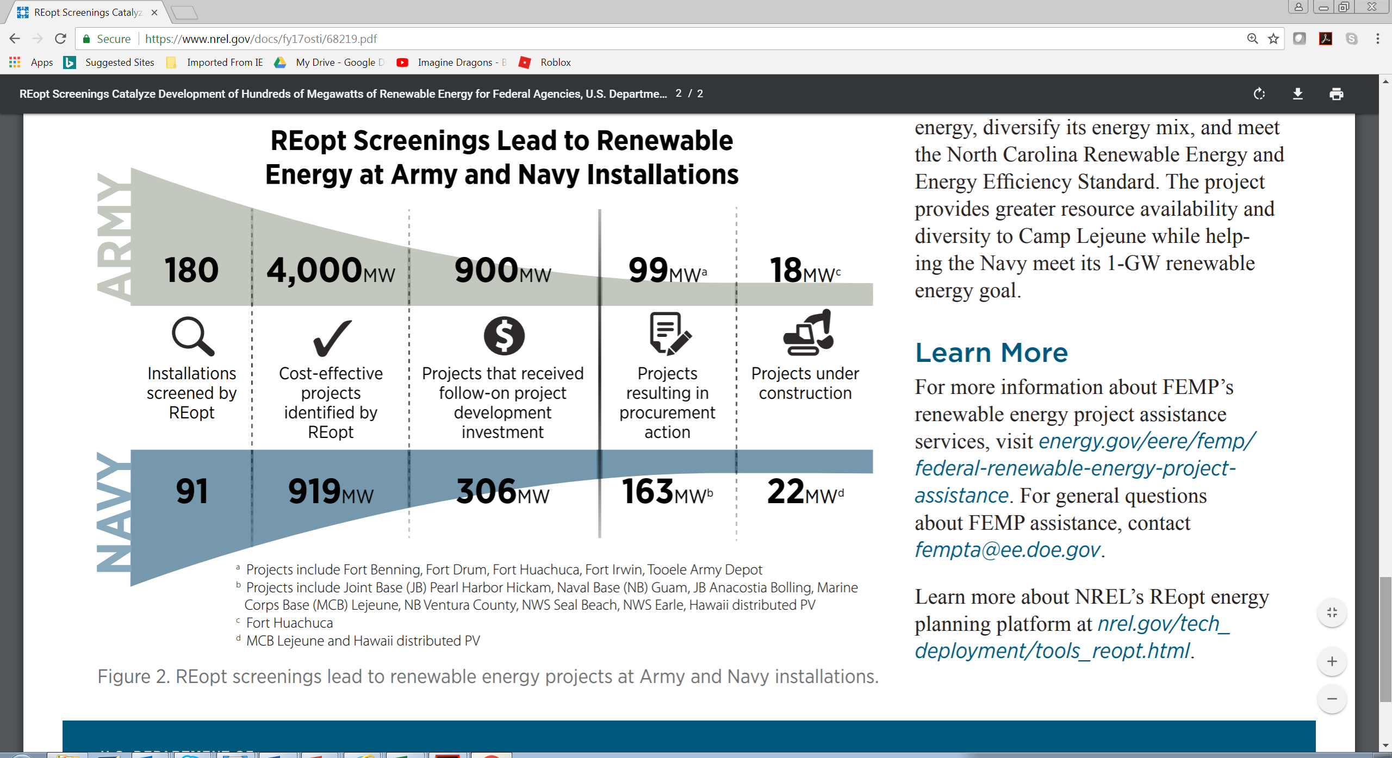
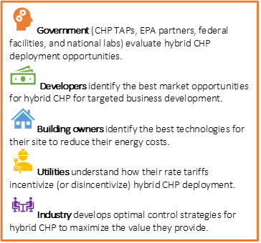
Transition (beyond DOE assistance)
Model will be a free, publicly available web tool hosted by NREL
API and open source version ensure industry can easily adopt and expand the tool
Advisory group including DOE, CHP Technical Assistance Partnerships (TAPs), Environmental Protection Agency (EPA), and industry are engaged to guide model development and provide stakeholder feedback
Outreach includes conferences, webinars, user manual, case studies, papers
Who will use this tool?
DOD renewable energy deployment resulting from REopt screening

